Slide 1


Everything Environmental Lawyers Wish Environmental Consultants Knew
Alessia Petricone-Westwood
Partner, Willms & Shier Environmental Lawyers LLP
Sydney Smith
Associate, Willms & Shier Environmental Lawyers LLP
This presentation provides general information and is not intended to provide legal advice.
Audience members should seek legal advice for specific situations.
RemTech East 2026
Ottawa, ON
April 9, 2026

Slide 2
Overview
Considerations for Environmental Pre-Purchase Due Diligence
Acting as an Environmental Litigation Expert
Common Consultant Blunders and How To Avoid Them

Slide 3
Considerations for Environmental pre-purchase due diligence

Slide 4
Environmental Pre-Purchase Due Diligence
Know your client’s objectives, including proposed use of the property
Highlight risks with the property and the client’s objectives, including:
  permits needed for development and/or proposed use
  contamination risks on-site and off-site
  if contamination is present, possible remedial options and costs

Slide 5
Environmental Pre-Purchase Due Diligence
Follow all applicable standards and procedures when conducting environmental investigations and preparing environmental reports
Contamination at a property may result in litigation
Pull in legal team when needed, who can:
  provide advice to the client about legal risks, including migration of contamination and dealing with regulators
  retain the consultant under privilege to keep reports and communications confidential, and
  negotiate terms that may offer some protections to the client as part of the transaction

Slide 6
Acting as an environmental litigation expert

Slide 7
Two Types of Environmental Liability
Regulatory
  Prosecutions
  Orders
  Authorizing Documents
Civil
  Lawsuits brought by third parties for injunctions and/or damages

Slide 8
Expert Role in Regulatory Litigation
Client may require:
  workplan under Order
  completion of work items and remediation
  if order is appealed, expert assistance with Tribunal proceeding
  prosecution defence and support
    pre-trial preparation and attendance
    trial support and attendance

Slide 9
Expert Role in Civil Litigation
Client may require:
  peer review and gap analysis
  investigations of environmental conditions on and off-site
  expert reports, including recommendations for mitigation and/or remediation, to assist with:
    mediation
    pre-trial preparation and attendance, and/or
    trial support and attendance

Slide 10
Expert Role in Litigation – General
Provincial and Federal Courts have rules about:
  who can be an expert
  the role of the expert
  the duties of an expert to the Court (duty of loyalty)
Independence of an expert is an element of the expert’s duty of loyalty
Advocacy on the part of an expert may affect the weight given to expert evidence
Any expert opinion and/or expert report must be within the expert’s area of expertise

Slide 11
Credibility and Preparation are Key
Credibility:
  Be honest and candid
  Don’t contradict yourself or take contrary positions from previous cases
  Flag issues with the case/position ahead of time
  Review and consider everything
  All opinions need to be supported by evidence
Preparation:
  Being a litigation expert takes significant time and dedication
  Make sure you understand the case and what you are being asked to do
  Work closely with the legal team to prepare for any testimony
  Put in the time to be knowledgeable and trustworthy

Slide 12
Seaspan ULC v. British Columbia (Director, Environmental Management Act) (2014, BCEAB)
Environmental Appeal Board found that a sophisticated appellant pursued an ill-founded appeal where that appellant’s expert professional engineer’s opinion was held to be “fundamentally and irredeemably flawed” because:
    the expert report was deceptive
    the expert adopted an artificially technical definition of contamination, and
    the expert contradicted conclusions of previous reports authored for Seaspan
Costs awarded against the appellant, who unexpectedly abandoned the appeal after their expert witness was completely discredited

Slide 13
Common consultant blunders and how to avoid them

Slide 14
Common Blunders
Failing to communicate
Not staying on top of legislative changes
Sharing findings with regulators
Performing work below the standard of care
Extending reliance in consultant contracts

Slide 15
Blunder #1: Failing to Communicate
Communication is key
  Client objectives – static or dynamic?
  Scope of work – what is in; importantly, what is not in?
  Timing and deadlines
    due diligence date in a deal
    anticipated first date of operations
    obtaining a permit or approval
  Findings and conclusions
    do they relate to the client’s objectives?
    does the client understand?
    are there limitations, caveats, carve-outs?
    does the executive summary match?
  Cost

Slide 16
Blunder #2: Not Staying Up-to-Date
Environmental legislation is in flux and constantly evolving
Consultants need to be up-to-date on the latest legislative changes and requirements
Recent legislative changes in Ontario include:
  Environmental Protection Act
  Environmental Assessment Act
  On-Site and Excess Soil Management Regulation
  Species Conservation Act, 2025

Slide 17
Blunder #3: Sharing Findings with Regulators
There are few circumstances when there is an obligation to notify an environmental regulator
The obligation is often on the client
Understand the regulatory framework in your jurisdiction
Seek legal advice
Get client instructions
Consider P.Eng. and P.Geo. professional reporting obligations where imminent harm (refer to applicable regulations)

Slide 18
Blunder #4: Performing Below Standard
There is a duty to meet the standard of care expected of a consultant within your area of practice and at the time the work is done
Includes:
  sampling and conducting testing, modelling
  reviewing and forming conclusions and opinions
  preparation of reports
  recommendations for next steps (or no next steps)
Need to ensure that all members of the team meet the appropriate standard
Ensure that the appropriate protocols, procedures, and methods are used and do not create a risk of damage to property/ exacerbate the existing problem

Slide 19
Blunder #5: Extending Reliance
Be aware who you are extending reliance to
Reliance on a consultant’s work products and reports provides a contractual right for the party receiving reliance to rely on the report
Where the report is erroneous, the party that is permitted to rely on the report can sue the consultant for damages
This can occur where the party depends on the report in making decisions (e.g. purchase transaction)
Reliance creates liability for consultants

Slide 20
Niagara Regional Housing v Trustees of Carleton United Church et al. (2022, ONSC)
The Housing Authority entered into an APS to purchase a property in St. Catharines
Vendor’s Consultant’s Report included a Disclaimer Clause that the Consultant’s Report was prepared for the sole benefit of the Vendor and expressly limited third parties’ reliance
Without the Consultant’s knowledge or consent, Vendor gave a copy of the Consultant’s Report to the Housing Authority during the sale transaction
The Housing Authority relied on the Consultant’s Report in the purchase transaction and claimed damages due to alleged negligent misstatement(s) in the report
The Court held that the Consultant’s Disclaimer Clause excluded imposition of a duty of care owed by the Consultant to the Housing Authority
A Disclaimer Clause can extinguish any duty of care and defeat a claim in negligence brought by a third-party even when the third-party plaintiff, who relied on the report absent the extension of reliance, establishes actual negligence by the Consultant

Slide 21
Questions?

Slide 22
Willms & Shier Environmental Lawyers
Established nearly 50 years ago
Environmental, Indigenous, and Energy law
16 lawyers
  six lawyers are certified by the Law Society of Ontario as Environmental Law Specialists
  lawyers called to the Bar in Alberta, British Columbia, Ontario, the Northwest Territories, Nunavut and the Yukon
  offices in Toronto, Ottawa, Calgary, and Yellowknife

Slide 23
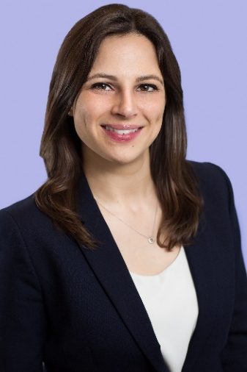
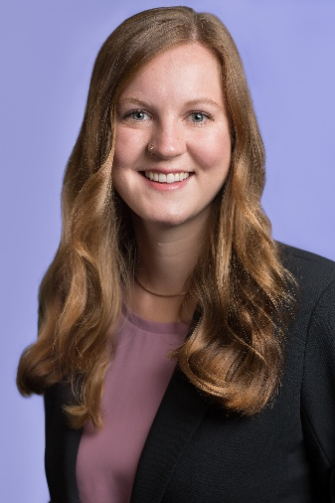
Alessia Petricone-Westwood
apetricone-westwood@willmsshier.com
(416) 642-4874
Sydney Smith
ssmith@willmsshier.com
(416) 642-4876

