Slide 1
Beyond Generic Standards:
Leveraging Screening-level Risk Assessments for Smarter Environmental Due Diligence
Presented by:
Andrea McNaughton, B.A.Sc., P.Eng.
Project Manager
April 10, 2026
Trace_SLRA RemTech Presentation_2026

Slide 2
Outline
What Do I Mean by SLRA?
Why Should You Care?
Increased Acceptance of SLRAs
Added Uses of SLRAs
Case Studies
SLRAs in Due Diligence

Slide 3
What Do I Mean by SLRA?
Screening-level Risk Assessment (SLRA)
  Looking into a generic criteria exceedance to find the driver
Components of all SLRAs:
  Identifying exposure pathways and relevant receptors for a site
  Identifying maximum measured concentrations of contaminants for a site
  Comparing maximum concentrations only to exposure values for relevant exposure pathways
Identifies exposure scenarios that are NOT a concern
Identifies exposure scenarios that remain POTENTIAL concern
Notes:
-To get started, I want to define what I mean by SLRA.
-An SLRA is a relatively high-level risk assessment that considers each of the exposure scenarios used in generic regulatory criteria.
-In other words, an SLRA allows you to look into the details of regulatory criteria and find what’s driving it
- then, can question if the drivers are applicable to your site
All SLRAs will include following steps at a minimum:
-identify relevant exposure scenarios at a site
-Identifying COCs and max concentrations at the site
-comparing max concentrations of COCs only to exposure values for relevant exposure pathways
-These steps mean than an SLRA will always allow you to at least:
1. identify exposure scenarios that a NOT a concern for the site
2. identify exposure scenarios that remain a POTENTIAL concern for the site

Slide 4
Why Should You Care?
Focus investigations on what matters
  Exposure scenarios of potential concern on a site
Regulator-published guidelines are conservative
  Developed considering many exposure scenarios
  Not all exposure scenarios are applicable to all sites
  Non-mandatory for due diligence – results in unnecessary costs for interventions
Risk Assessments (RAs) are used often within the regulatory setting
  Consider increased use of SLRAs in due diligence
Notes:
-SLRAs allow both the investigator and the reader of a report to focus on WHAT MATTERS
-Which are exposure scenarios which pose potential risk at a site
-No need to spend time examining exposure scenarios where we have found no levels of unacceptable risk
-In enviro. due diligence work, people often default to regulator-published guidelines
-but these are often CONSERVATIVE
-THAT’S BECAUSE, regulatory guidelines are developed considering many exposure scenarios -– some of which may not apply at your site
-Using regulatory guidelines is not mandatory in due diligence work
-so applying these guidelines in due diligence work can result in unnecessary costs for interventions without proportional risk reduction
-RAs often used within regulatory setting - Why not apply a similar approach for due diligence-level work?

Slide 5
Increased Acceptance of SLRAs
Trace Associates Inc. has had success implementing SLRA approaches in multiple provinces within the due diligence framework
SLRAs enable site-specific, defensible, cost-effective decisions
Increasing acceptance by:
  Financial lenders
  Real estate brokers
  Insurers
  Corporate risk managers
Notes:
-At Trace, we’ve had success using the SLRA approach in due diligence work conducted across many provinces
-SLRAs enable SITE-SPECIFIC, defensible, cost-effective decisions
-Most importantly, Trace has found increasing acceptance of the use of SLRAs in due diligence from many stakeholders, including financial lenders and insurers

Slide 6
Additional Uses of SLRAs
Allows for identification of Risk Management Measures (RMMs)
  Hard or fill capping
  Administrative RMMs
    Health and safety plans
    Prohibitions (i.e., potable wells)
Establish property-specific standards (PSS)
  Site-specific criteria protective of relevant exposure scenarios
Notes:
-In addition to the minimum components of SLRAs I noted at the beginning, SLRAs can include other beneficial components, which can be complementary to the assessment, especially if the SLRA has identified potential risk
-Many SLRAs will include a QUALITATIVE DISCUSSION of Risk Management Measures (RMMs) to reduce exposure for a given pathway
-Examples are capping (hard or fill caps)
-Can also include administrative RMMs, such as health and safety plans or prohibition of use of groundwater as potable water
-An SLRA can also include the development of property specific standards (PSS)
-Site-specific criteria protective of relevant exposure scenarios identified for the site
-PSS can be used as target concentrations for remediation, or in regular monitoring as triggers for the implementation of an RMM or further assessment

Slide 7
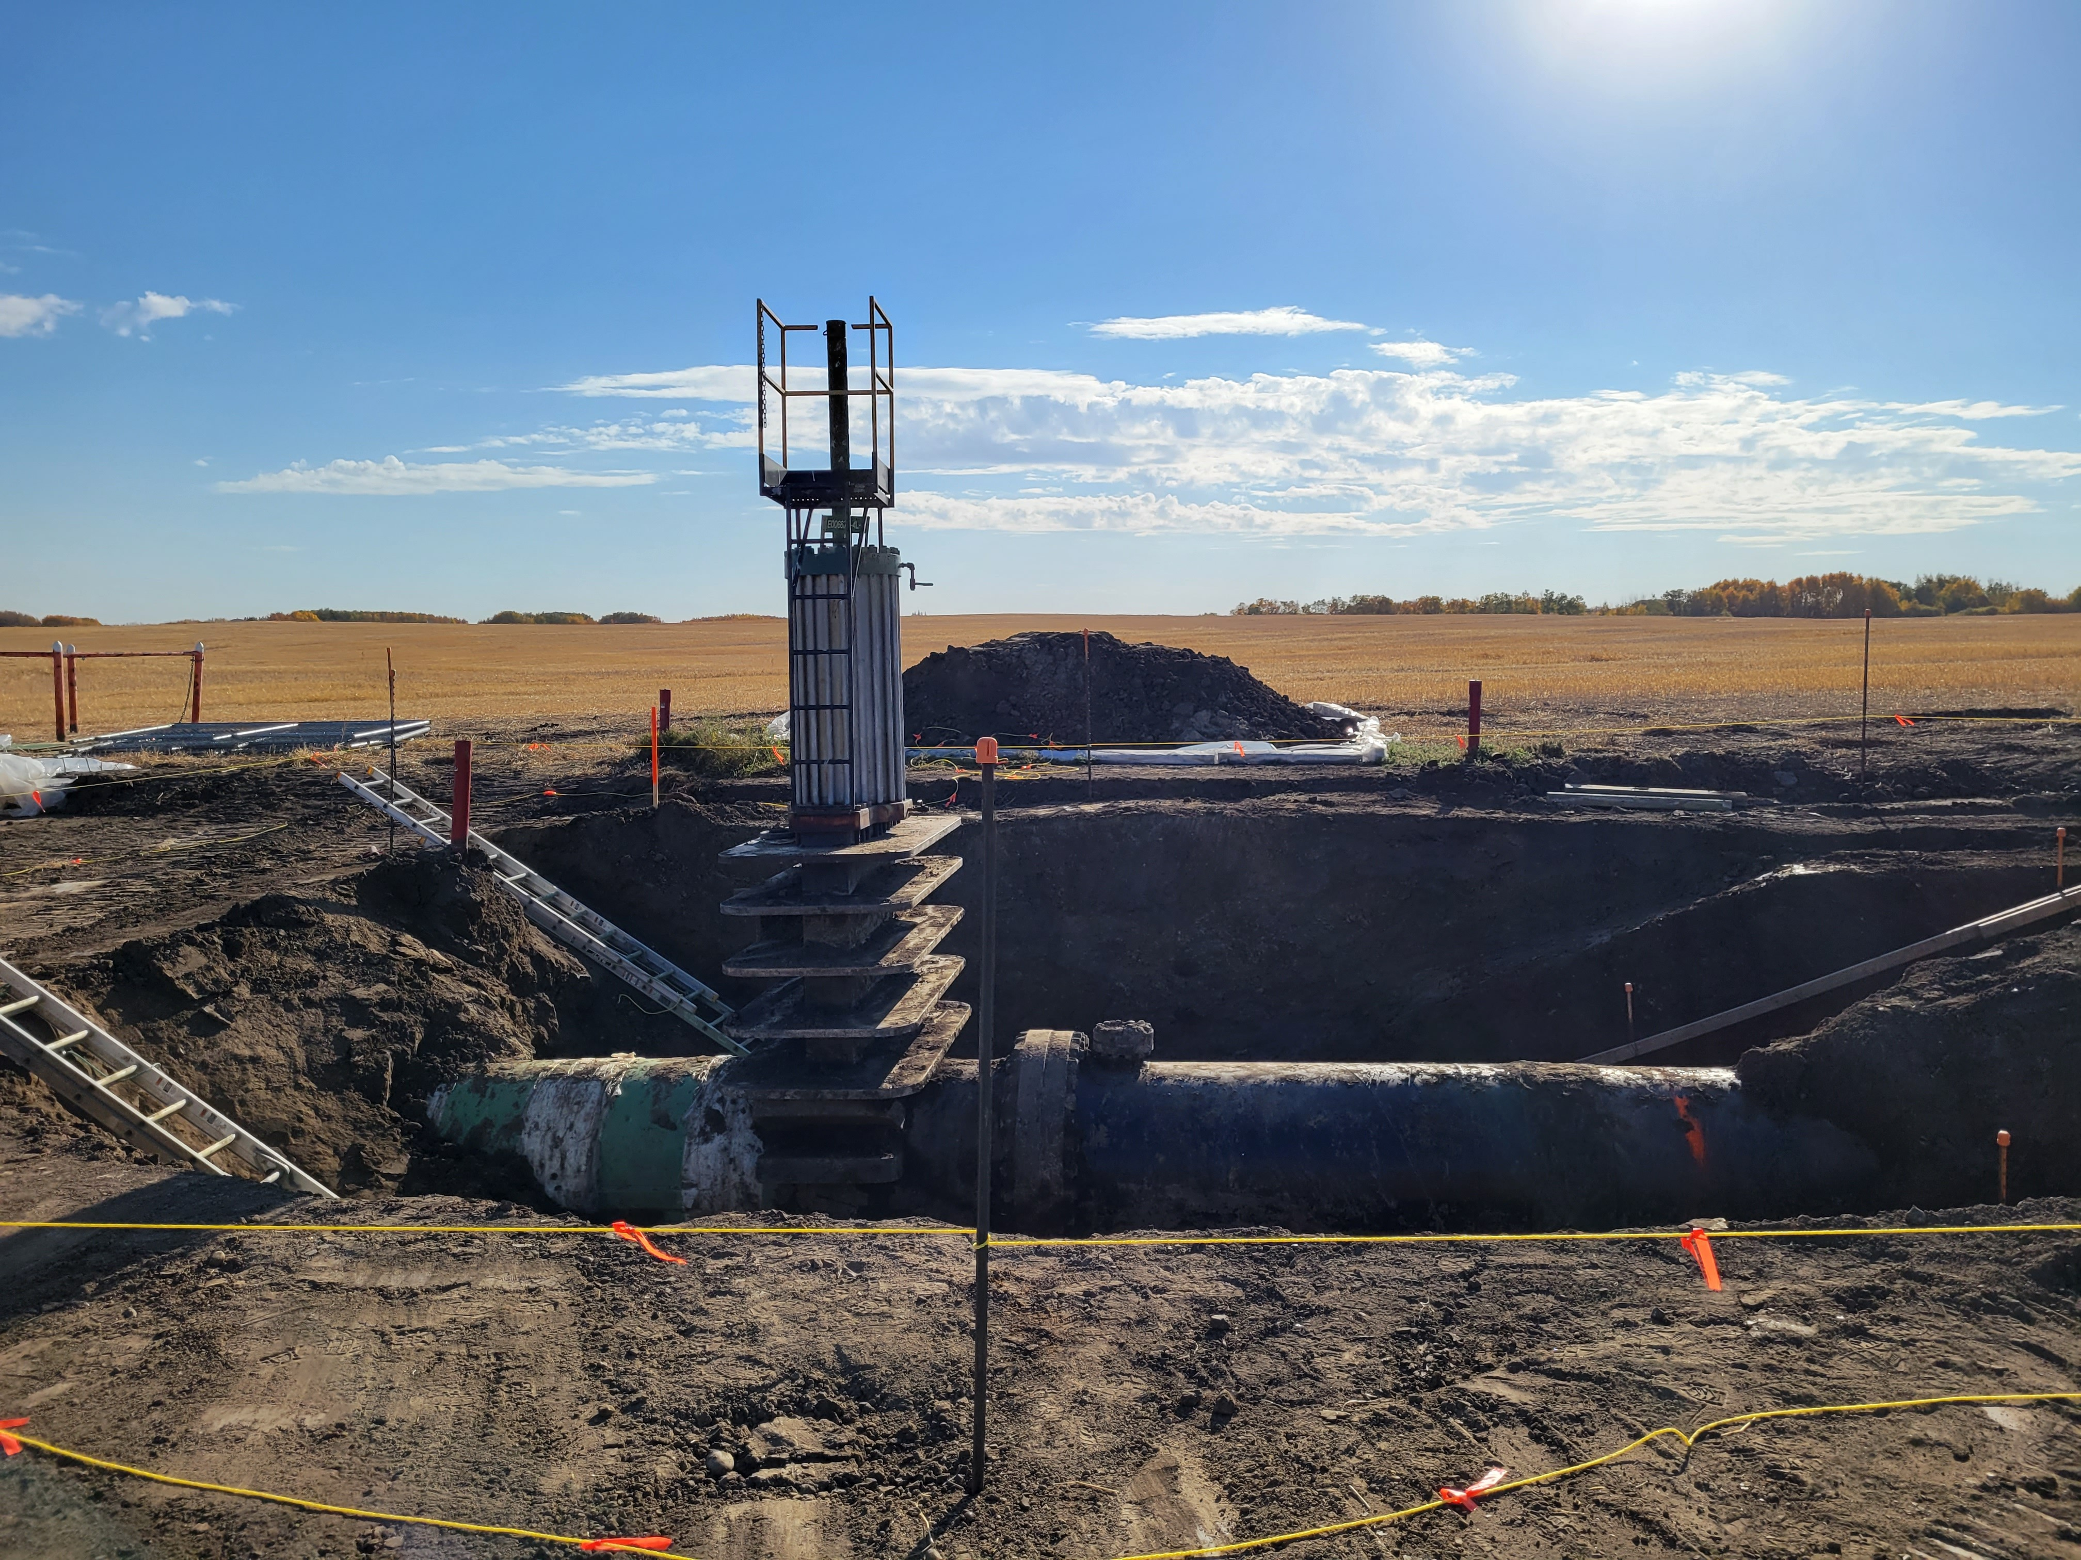
Case Study No. 1 – Federal Pipeline
Petroleum hydrocarbon (PHC) impacts identified in soil during pipeline construction
Concentrations post-remediation above guidelines in soil (PHCs and polycyclic aromatic hydrocarbons) and groundwater (benzene and PHC fraction [F]2)
Lateral and vertical delineation achieved in soil and groundwater
Stable or decreasing trends
in groundwater
Photo from SLR 2015
Notes:
Here’s a case study of a stand-alone SLRA report conducted for a federal site (in Saskatchewan)
P:\Secretary\0400 - Regina\Projects\400-1601\Final

Slide 8
Case Study No. 1 – Conceptual Site Model
RECEPTORS
Residents / Agricultural Workers
Terrestrial Plants Soil Invertebrates Soil Microbes
Freshwater Aquatic Life
Wildlife and Livestock
SOURCE
MIGRATION PATHWAY
EXPOSURE PATHWAY
Upward Migration of Volatile Contaminants through Unsaturated Soils
Indoor Vapour Inhalation
Pipeline Release
Vapour Inhalation in Trenches, Fire and Explosive Hazards
Soil
Direct Contact, Dust Inhalation, Soil Ingestion
Discharge to Surface Water
Migration Through Unsaturated Soils (Surface Water Infiltration and Groundwater Transport)
Dugout
Irrigation
Drinking Water
Notes:
-As with any investigation, we started with the CSM
-CSMs are the foundation of an SLRA. If your CSM is not robust, you cannot expect to have an accurate assessment of risk from your SLRA
-The CSM flowchart I’m showing here identifies the potential exposure scenarios for the site
-Discuss flow of flowchart
- Circle = potentially complete pathway
- x = incomplete exposure pathway based on site conditions
-Did want to note that:
-We’ve included an assessment of both on-site property use and property use in the vicinity of the site
-Also, there were no buildings in the vicinity of the site during this assessment, but we considered vapour intrusion in potential future buildings nearby as part of the assessment
-As you can see, for this site there were a few exposure pathways that were found to be incomplete:
- There are seasonal waterbodies, but no permanent water bodies that would sustain aquatic life within 500 m of the Site.
-So, discharge of groundwater to surface water considered incomplete
-Due to the low hydraulic conductivity, shallow groundwater on-site did not meet definition of potable water aquifer .
-Use of groundwater as potable water also considered incomplete pathway

Slide 9
Case Study No. 1 – Evaluation Process
Pathway | Benz(a)anthracene | Benzo(b+j)fluoranthene | Benzo(k)fluoranthene | Benzo(a)pyrene | Chrysene | Dibenz(a,h)anthracene | Indeno(1,2,3-c,d)pyrene | B(a)P TPEª | Index of Additive Cancer Risk (CCME) | Anthracene | Fluoranthene | Fluorene | Naphthalene | Phenanthrene | Pyrene
Maximum Concentrations (mg/kg) | 10.7 | 12 | 4.07 | 9.14 | 9.2 | 0.84 | 3.31 | 13.1 | 167 | 8.43 | 29.5 | 7.31 | 19.8 | 38 | 24.7
Human Direct Contact | - | - | - | - | - | - | - | 5.3 | - | - | - | - | - | - | -
Protection of Domestic Use Aquifer | - | - | - | - | - | - | - | - | 1 | - | - | - | - | - | -
Ecological Soil Contact | - | - | - | 20 | - | - | - | - | - | 2.5 | 50 | - | - | - | -
Soil and Food Ingestion | 6.2 | 6.2 | 6.2 | 0.6 | 6.2 | - | - | - | - | 61.5 | 15.4 | 15.4 | 8.8 | 43 | 7.7
Protection of Freshwater Life | - | - | - | 8,800 | - | - | - | - | - | - | - | 0.25 | 0.013 | 0.046 | -
Interim/Provisional | 0.1 | 0.1 | 0.1 | 0.7 | - | 0.1 | 0.1 | - | - | - | - | - | 0.6 | 0.1 | 0.1
Notes:
-The next step was to compare the max concentrations of each of the COCs to the acceptable exposure values for each of the pathways identified for the site.
-The exposure values for pathway are published by the regulator in support of the generic criteria
-In Ontario the exposure values for pathway is also referred to as a component value – and they are published in the 2011 Rationale Document supporting the development of the O. Reg 153 standards
-Here we’ve shown the comparison of the maximum concentrations of PAHs in soil to the EXPOSURE VALUE for each pathway
-Incomplete pathways shown as strikeouts for clarity
-Conduct same process for all media on-site and all COCs
-From this assessment, you can determine which exposure pathways represent potential risk at the site
-In this example, as there’s at least one exceedance for all pathways identified for the site, all noted pathways represent potential risk

Slide 10
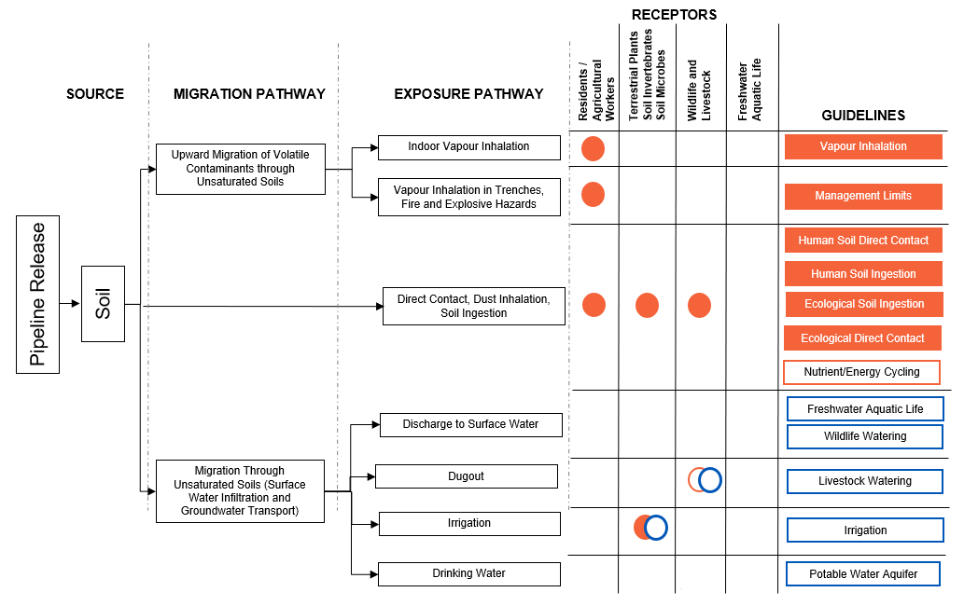
Case Study No. 1 – Conceptual Exposure Model
Based on soil data
Based on groundwater data
Exposure Scenario of potential concern (max > guideline)
Exposure Scenario of potential concern (max < guideline)
Notes:
-Here is a visual representation of the potential exposure scenarios on-site
-Used the previously shown CSM and applied the results of the exposure pathway comparison we just conducted
-different colours for different media types (orange for soil, blue for GW)
-filled circle means potential risk identified
-outline means pathway not a concern
-As you can see, in this case study, POTENTIAL risk identified for all soil vapour and direct soil contact exposure pathways.
-No concern identified for the exposure of livestock watering from a dugout.
-Then there’s the irrigation pathway. Here, the soil criteria indicated that there was a potential risk, but the groundwater results found that there was no concern for the site.
-In cases like this, it’s the END media that we want to consider – so in this case, the groundwater. If no actual leaching from soil to groundwater is occurring on-site, then there is no potential risk for this exposure pathway (provided conditions are stable – which was established for this case study)
-For this case study, each of the potentially complete exposure scaenarios was discussed qualitatively and RMMs were proposed as necessary

Slide 11
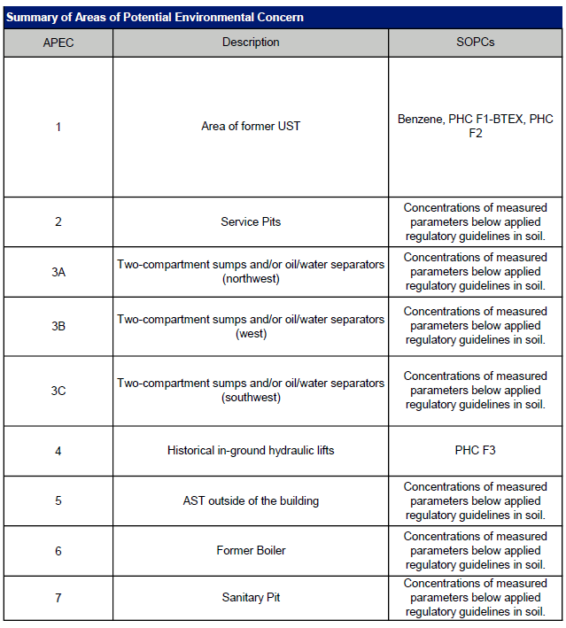
Case Study No. 2 – Saskatchewan Industrial Site
Large industrial site within
Regina city limits
Following subsurface investigations, concentrations of select parameters identified above generic criteria
  In soil only
  Lateral and vertical delineation
  Impacts isolated to select areas of potential environmental concern (APECs)
Notes:
-Large industrial site within Regina city limits
- Following subsurface investigations, concentrations of select parameters identified above generic regulatory criteria
-In soil only
-Lateral and vertical delineation
-Impacts isolated to TWO areas of potential environmental concern (APECs)
-This case study is representative of many sites, where max concentrations may not be representative of concentrations across the entire site.
P:\Secretary\0400 - Regina\Projects\400-1559\400-1559-02\Rev 0

Slide 12
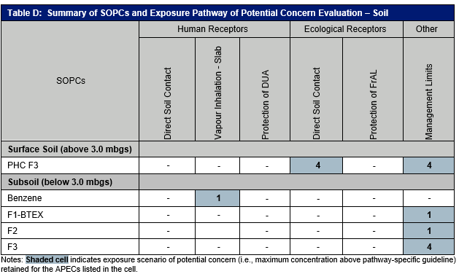
Case Study No. 2 – Classification of Pathways by Area
Notes:
-The SLRA for this next case study was conducted with a similar approach as discussed for the last case study, so I won’t go over that in detail again, but I wanted to highlight a different way of illustrating the potential exposure pathways of concern on-site.
-Showed potential risk as incomplete or potentially complete FOR EACH APEC, not the overall site
-This allows us to refine our risk assessment, consider the use and characteristics of each area of the property, and ONLY implement appropriate RMMs only where necessary,
-Remember, when using this approach, it’s especially important to consider any potential preferential pathways and confirm that the areas under consideration are truly distinct

Slide 13
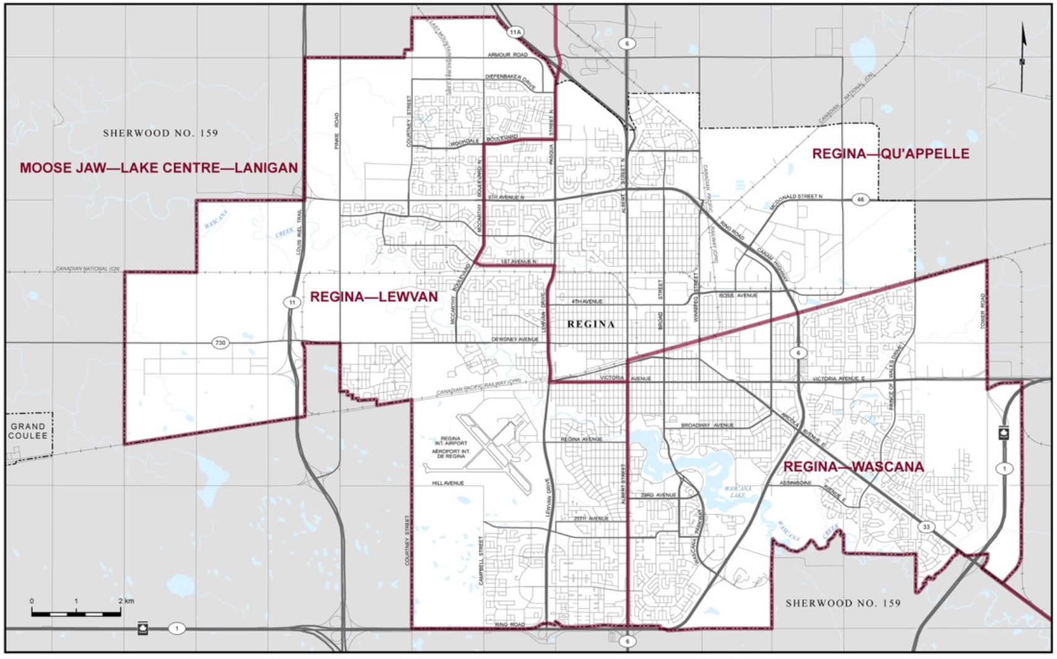
Case Study No. 2 – Existing Administrative Controls
The Regina Water Bylaw, No. 8942
  Potable groundwater wells are prohibited for domestic use within the City of Regina
Use of groundwater as potable water not complete exposure pathway at the site
Check bylaws for existing administrative RMMs
Notes:
-Another thing I wanted to note from this case study was a specific By-Law for the City of Regina
- Which prohibits the use of groundwater for domestic use within city limits
-This is an example of an existing administrative RMM,
-Check by-laws for your site. They can be a source of RMMs that are already applicable for the site
Photo from Elections Canada - https://www.elections.ca/map_02.aspx?p=08_SK&t=/3Cit/Regina&d=Regina&lang=e

Slide 14
Different Methods of Implementing SLRA Approach
Standalone SLRA report
Discussion of site-specific pathways within other report
  Phase II environmental site assessment
  Soil and/or Groundwater Quality Investigation
Modification of input parameters
  Use of Ontario Modified Generic Risk Assessment (MGRA) model or Alberta Tier 2 Soil and Groundwater Remediation Guidelines
  Edits to site-specific inputs
  Site-specific acceptable values for each exposure pathway
Notes:
Now that we’ve looked at a couple SLRA examples, I wanted to discuss the different ways an SLRA can be implemented.
-SLRAs can be prepared as stand-alone reports
-But did want to add that Trace has also had success using an SLRA approach within the discussion of subsurface investigation reports (i.e, Phase II ESA)
-So far, I’ve discussed using the SLRA approach to break down the generic criteria into values for each exposure pathway – but there have been no changes to these regulatory values for each pathway that are published by the regulator
-Another step that can be taken within the SLRA approach is to MODIFY INPUT PARAMETERs for the regulatory model
-This generates site-specific acceptable values for each exposure pathway
-Trace has done this with the: -Ontario MGRA model -Alberta Tier 2 Guidelines

Slide 15
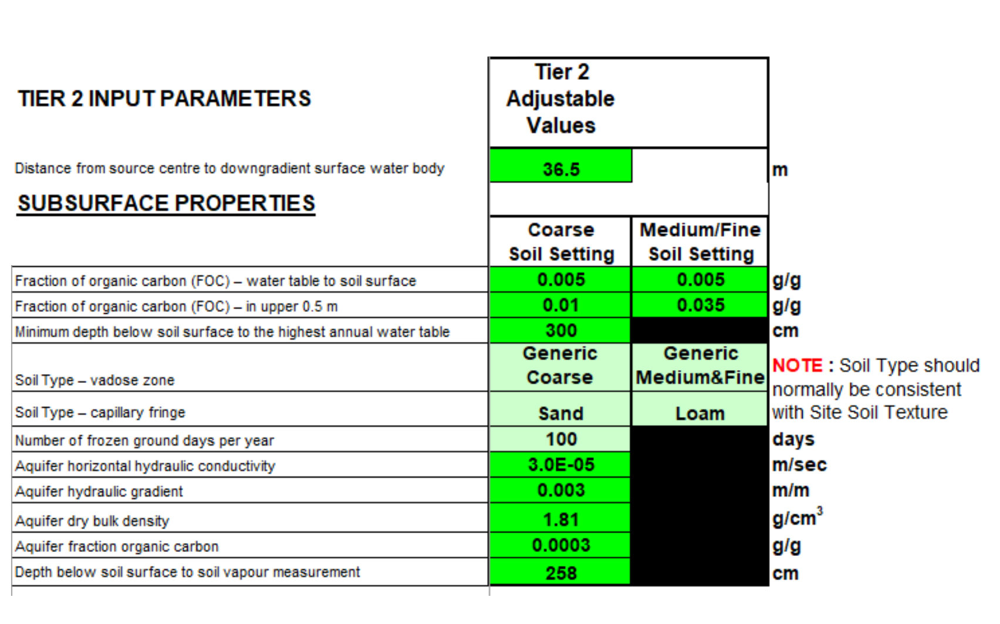
Modification of Input Parameters – Tier 2
Site-specific
geophysical parameters
  Distance to downgradient
  water body
  Minimum depth of groundwater
  Soil type
  Horizontal hydraulic conductivity
  Horizontal hydraulic gradient
  Fraction organic on
Notes:
-When using this approach, the input parameter that are modified are certain site-specific geophysical parameters.
-Here, I’ve included a screenshot and a list of some of the parameters which can be changed in the Ontario MGRA model
-Can update similar site parameters for the Alberta Tier 2 process

Slide 16
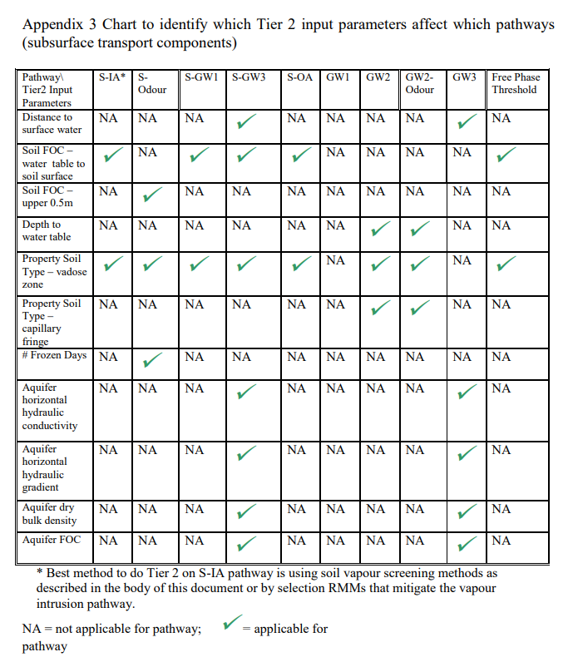
Assumptions for Each Pathway
Understand the regulatory guidance’s generic assumptions
  Rationale for the Development of Soil and Ground Water Standards for Use at Contaminated Sites in Ontario
Understand how each input parameter affects each pathway
  MGRA User Guide
Notes:
-Screenshot from MGRA User Guide, showing which input parameters affect each pathway
-When you are modifying input parameters, it’s especially important to understand the assumptions used in the development in the regulatory criteria
-Wanted to note that, even though changing some inputs, still NO changes to most of the assumptions, such as:
-source area/volume
-high permeability zone/preferential pathways
-receptor details such as -- exposure frequency/duration
MGRA User Guide - https://files.ontario.ca/mgra_user_guide_tier_2_final_aoda.pdf
Rationale - https://dr6j45jk9xcmk.cloudfront.net/documents/999/3-6-4-rationale-for-the-development-of-soil-and.pdf

Slide 17
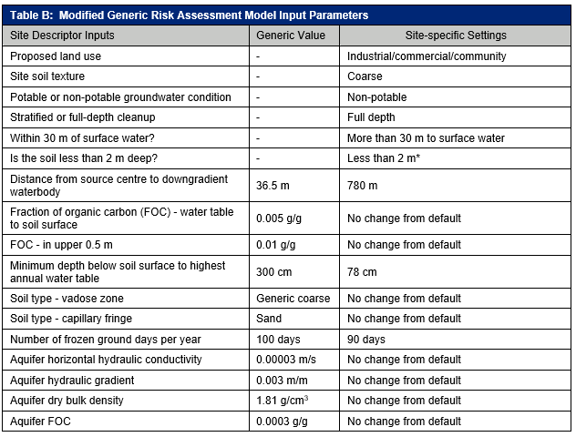
Case Study No. 3 – Ontario Commercial Plaza
Large commercial plaza
Historical dry cleaning in one unit
  Volatile organic compounds
  in groundwater
Preparation for potential remediation activities
Main differences from generic:
  Shallow groundwater conditions
  Distance to downgradient water body compared to generic
Notes:
-This brings us to our third and final case study, where we used the modified input parameter approach.
-Large commercial plaza in Ontario
-Dry cleaning historically in one unit --- VOCs impacts in groundwater
-Purpose of this SLRA --Preparation for potential remediation activities
-Included a table here of the inputs used.
-Main differences from default generic values:
Shallow groundwater conditions
Greater distance to downgradient water body compared to generic
**Also wanted to note that for this case study, due to the shallow groundwater we used component values from the shallow soil tables (Table 7) to be protective of potential vapour intrusion

Slide 18
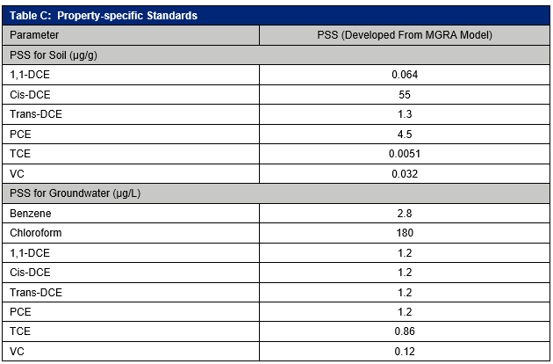
Case Study No. 3 – Property-specific Standards
Notes:
-A similar approach as described for the other case studies was used to evaluate the potential risk based on current property use.
-ADDITIONALLY, Because this assessment was conducted in preparation for remediation activities, PSS were developed as part of the SLRA.
-The PSS were set at the lowest component values for the relevant exposure pathways at the site
-This means that these PSS are protective of unacceptable risk for the identified site-specific exposure scenarios, without the use of any RMMs.
-Will be used as target concentrations for the remedial activities

Slide 19
SLRAs in Due Diligence
SLRAs are a useful tool that can be implemented at any point following the establishment of a robust CSM
SLRAs enable site-specific, defensible, cost-effective decisions
Tailor approach depending on complexity
Increasing acceptance by:
  Financial lenders
  Real estate brokers
  Insurers
  Corporate risk managers
Notes:
-Through this presentation, I hope that I’ve made a good case that SLRAs are a USEFUL TOOL that can be implemented at any point following the establishment of a robust CSM for a site
-SLRAs enable site-specific, defensible, cost-effective decisions
-The SLRA approach can be tailored to a project, depending on project complexity and objectives
-And, most importantly, as I noted before Trace has seen increasing acceptance using SLRAs in due diligence from many different types of stakeholders

