Slide 1
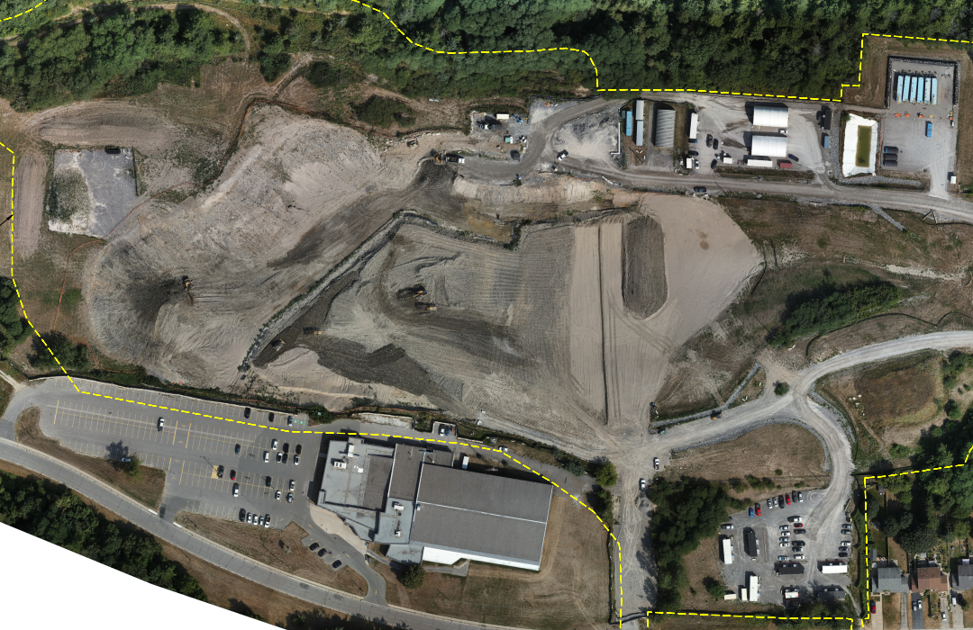
Port Hope Area Initiative –Highland Drive Remediation
REMTECH EAST 2026
April 9, 2026

Slide 2
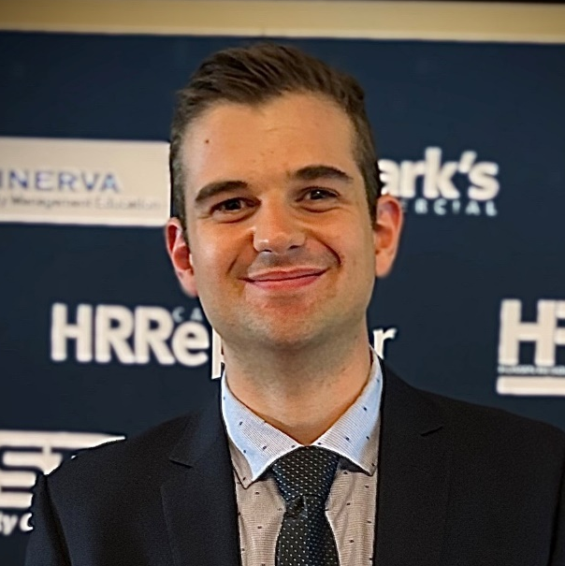
Introduction
Experience
Over 8 years of experience managing environmental remediation projects across Canada
Expertise executing complex, multi-disciplinary projects
Management of multiple 8 figure remediation and restoration projects.
Role and Responsibilities
ECC’s Project Manager
Onsite single point of contact for CNL
Full authority on all decisions and resource allocations
Ensures execution and compliance with all contract documents and specifications
Maintains overall budget and schedule
Ryan Tennant
Project Manager, PMP
rtennant@ecc.net
www.ECC.net

Slide 3
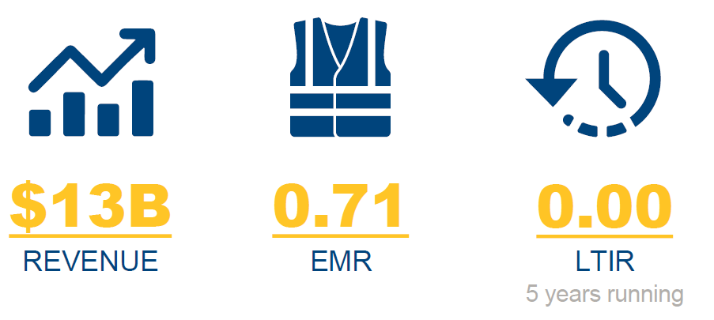




ECC – building a better world
$16B
Environmental
Munitions Response
Construction
Disaster Response
Notes:
Briefly on ECC, we're a US based company who's employee owned since 1985.
We manage some of the largest remediation, UXO, Construction and Disaster Response Projects around the globe.
We've been operating in Canada since 2008 managing some of Canada's most challenging remediation projects like the Sydney Tar Ponds, Goose Bay Remediation and now P

Slide 4
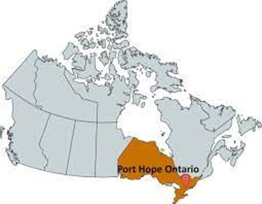
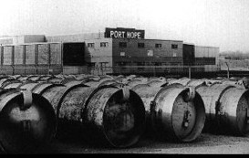
Port Hope Area Initiative (P.H.A.I)
Program is located in Port Hope Ontario, Canada
1.5 hours E of Toronto / 3 hours SW of Ottawa
ECC currently manages 8 projects
    3 Design Projects
    5 Remediation Projects
Port Hope Area Initiative (PHAI) was created to clean up historical LLRW with $2.6 billion in Federal funding
LLRW was deposited in various sites in Port Hope from historic waste generated from El Dorado Nuclear (Uranium Refinery) between 1932 and 1988

Slide 5



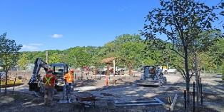
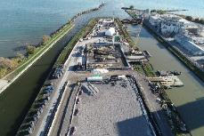
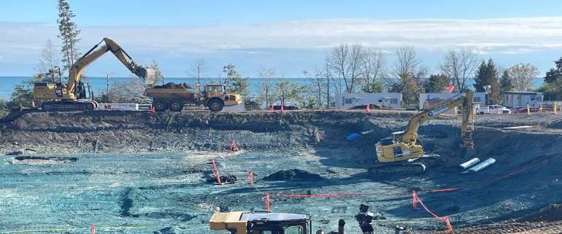
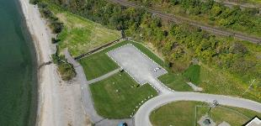
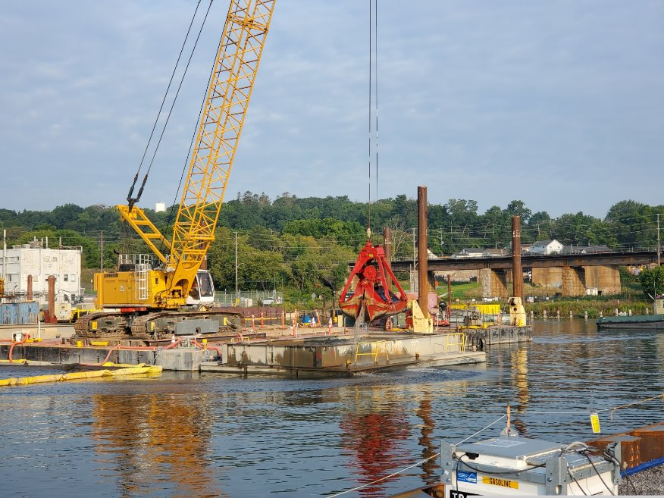
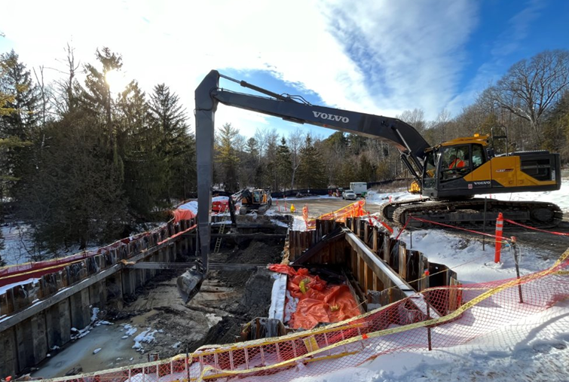
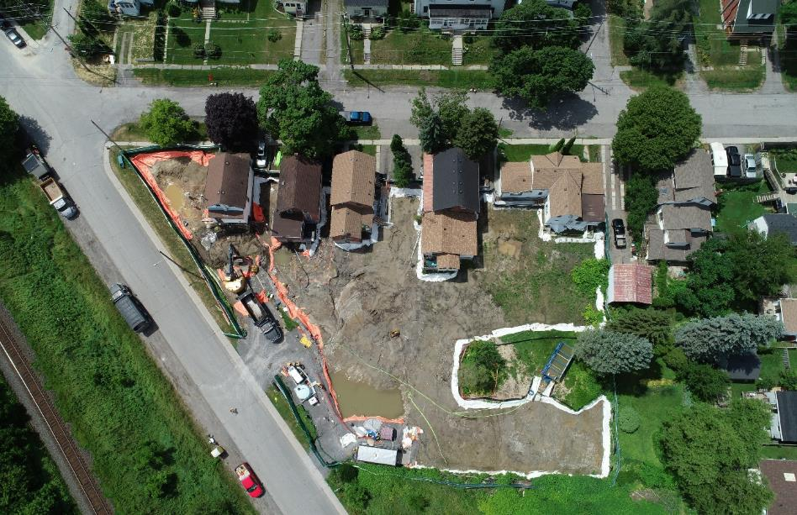
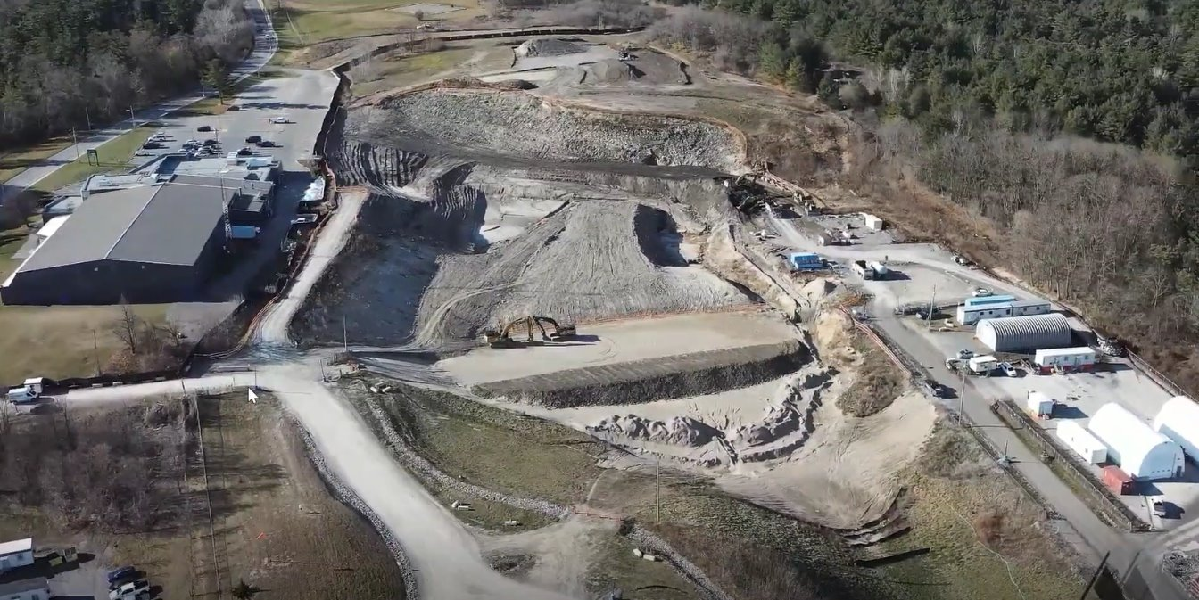
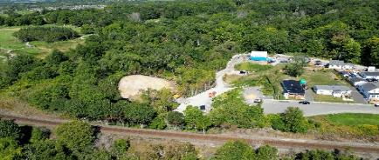
Lions Park
Centre Pier
Chemetron Lagoon
West Beach
Port Hope Harbour
Highland Drive South Ravine
Property Remediation & Restoration
Highland Dr. Landfill
Alexander St. Ravine
Notes:
VILIJA

Slide 6






TEAM engagement
Project Client
Project management
Project execution
Environmental services
Engineering Support
Radiation Protection

Slide 7
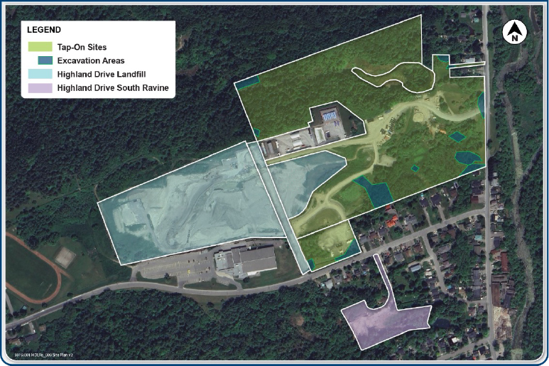
Port hope Highland Drive Sites
3 Separate Highland Drive Projects
Landfill
(2022 - Ongoing)
South Ravine (2024 – 2026)
Tap-On Sites (2025 – 2026)

Slide 8
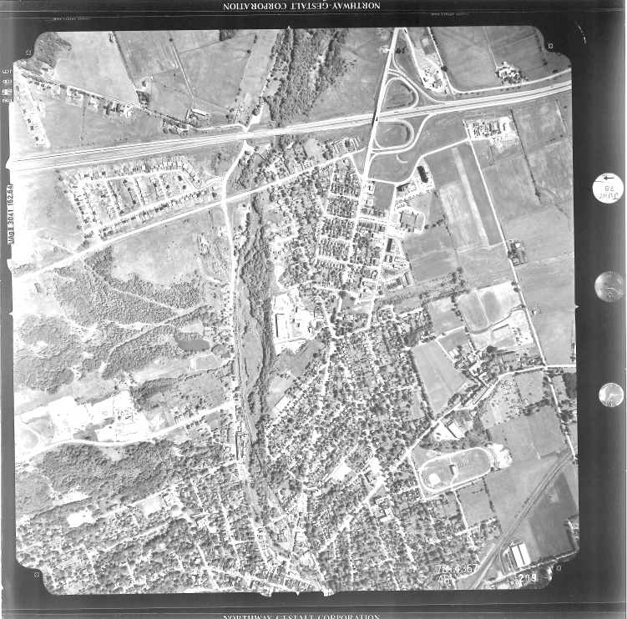
Site History
Landfill operated from the 1940s – 1990s accepting municipal solid waste.
LLRW source material was placed within the landfill and used as daily cover.
Groundwater encounters the impacted material and transports contaminants to the adjacent ravine.

Slide 9
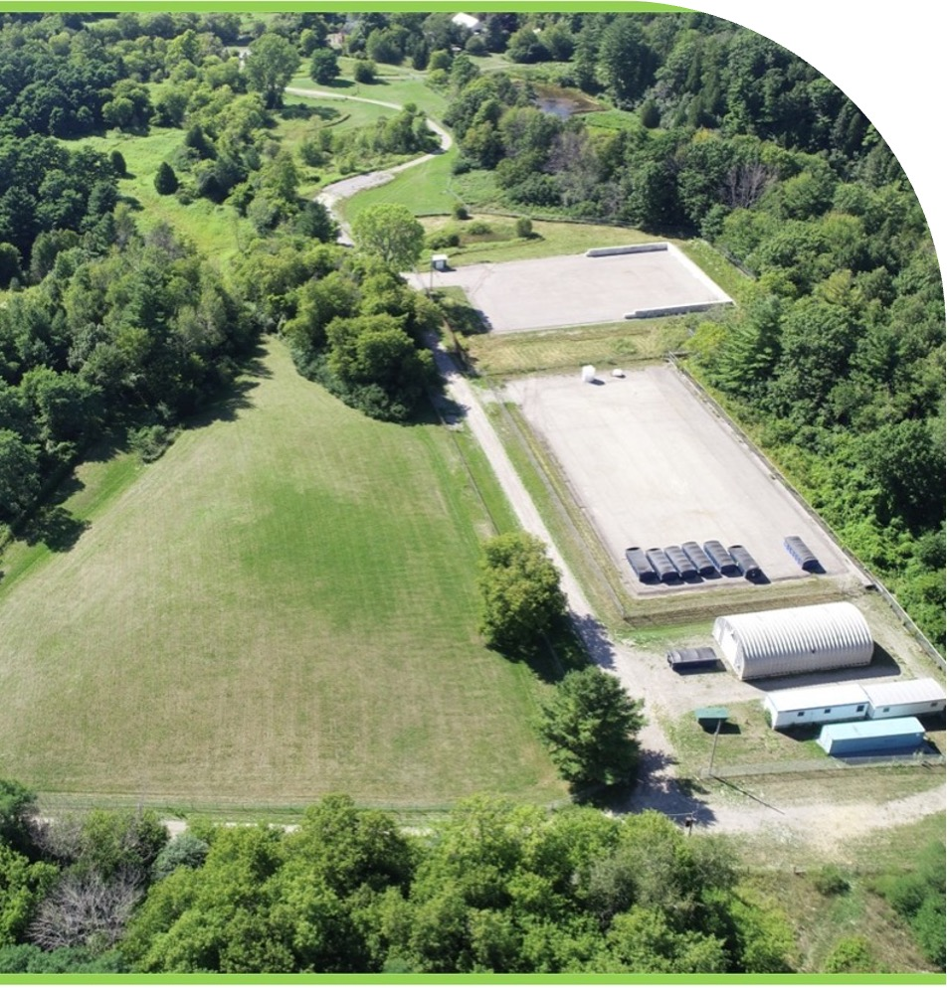
Project Scope
Mobilization & site preparation
Excavation, sorting, and scanning of Municipal Solid Waste (MSW) & Low-Level Radioactive Waste (LLRW)
    Off-site disposal of LLRW
    Re-placement of MSW as backfill
  Remedial verification of excavation extents
  Backfill & clay cap historic landfill
  Site restoration and maintenance
Notes:
RYAN
The project’s goal was ultimately to Remove all historic LLRW and bring the Site to a final end use of Residential / Parkland. To-Do this it was broken up into multiple phases.
The short-term objectives started in the Summer of 2023 with the 95% Project Remedial Design Completion and the project planning for mobilization.
In the Fall of 2023, we began remediation of the John St properties to allow for installation of a Portable Water Treatment System and effective remediation of the Coal Gas property.
Starting with remediation of Arsenic Driven LLRW on the Coal Gas property
Then installing waterloo barrier type shoring and excavating the deep NAPL material and excavating and backfilling within
Finally implementing a 1.5 m Risk Management Measure layer (RMM) across the site to allow for approval of a Record of Site Condition change of the property with the Ministry of Environment and Final site restoration
For some subtle foreshadowing, of course that’s exactly how the project ended up going…

Slide 10
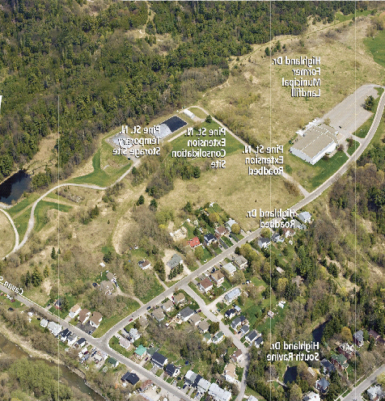
Pre-Mobilization and Concerns
Areas of Major Concern
Proximity to High Traffic Public Areas
Exposing municipal solid waste
Radiological Impacts
    Segregation
    On-site Management

Slide 11
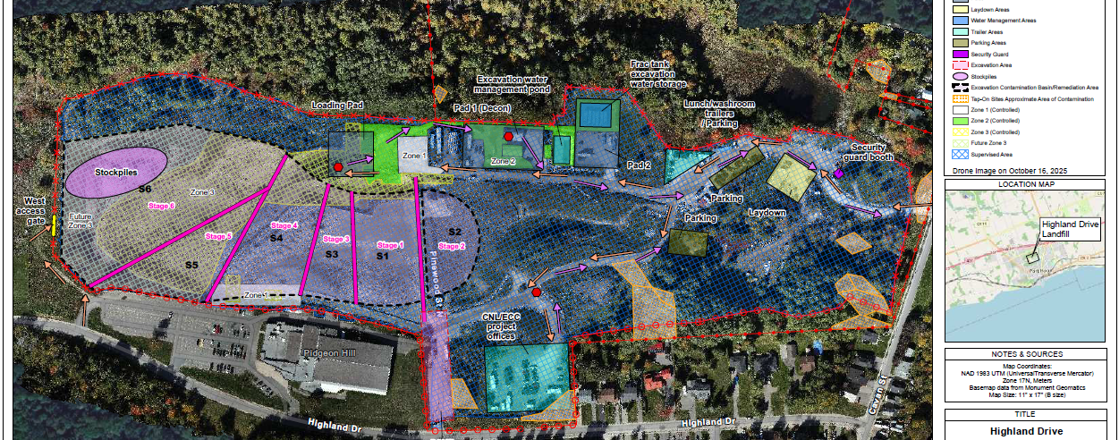
Highland Drive Landfill Stages
Highland Drive Landfill Stages 1 - 6

Slide 12
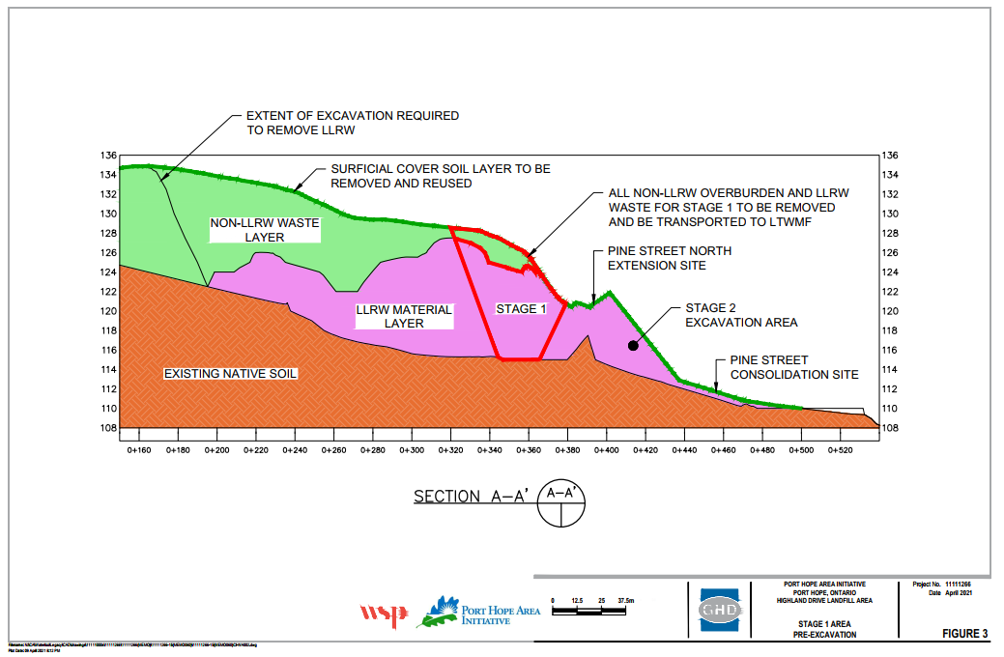
Remedial Concept – Stage 1

Slide 13
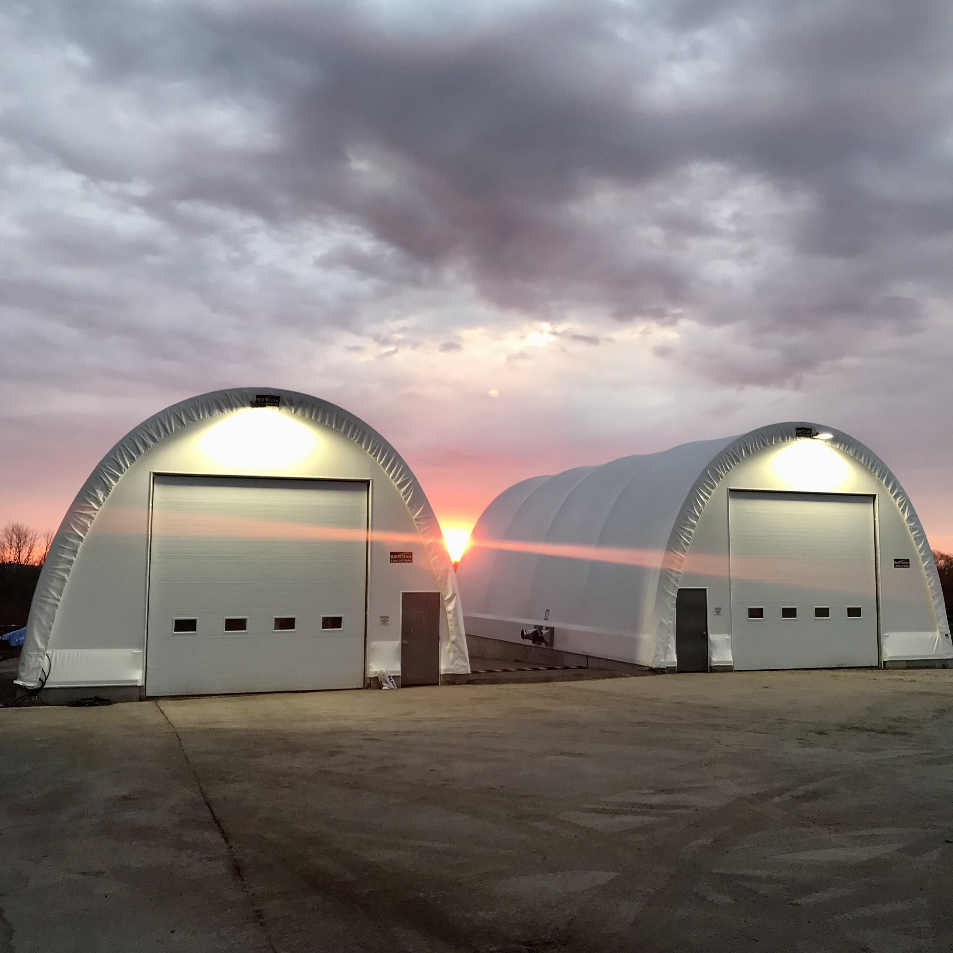
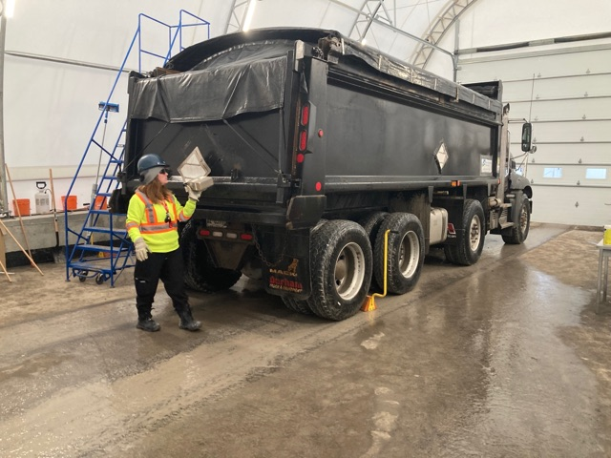
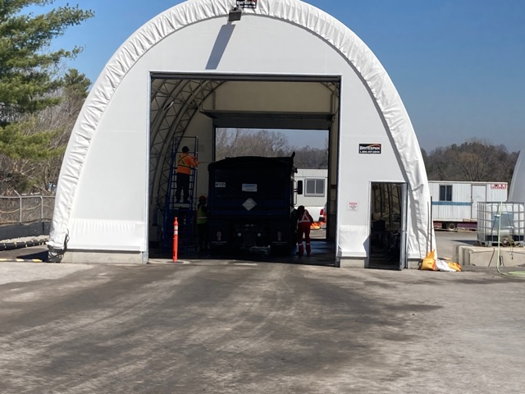
Contamination Control

Slide 14
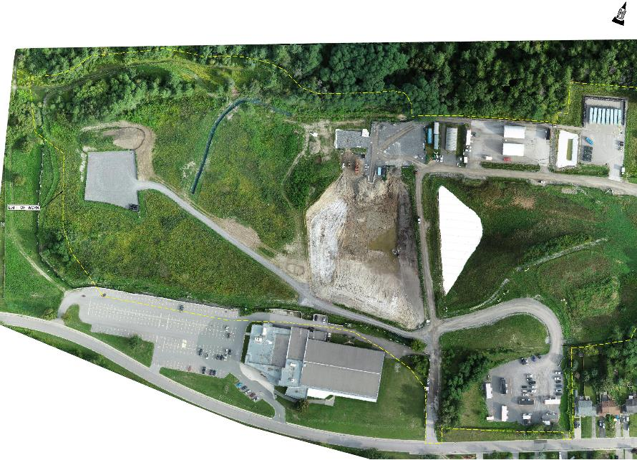
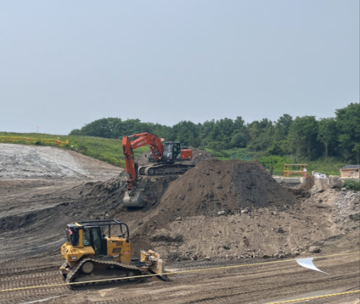
Stage 1 Remediation (August 2023)

Slide 15
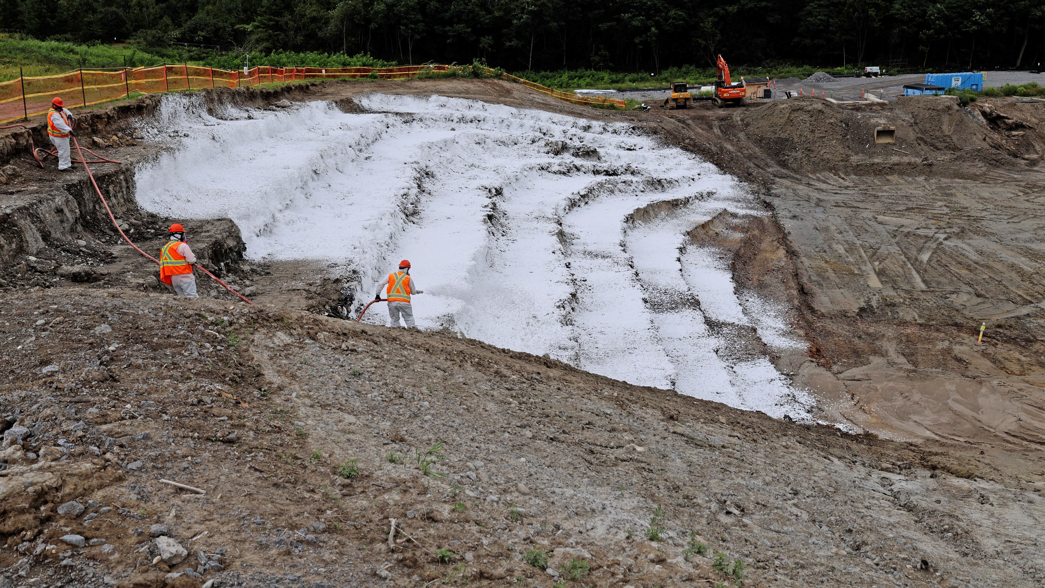
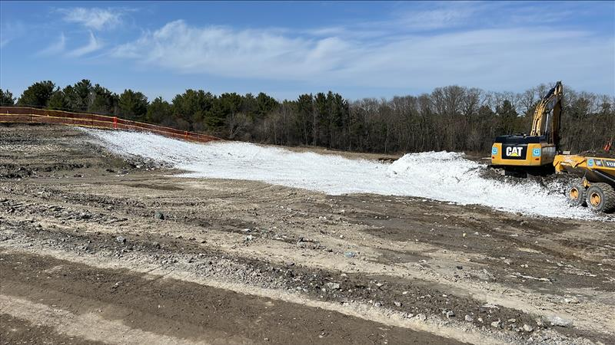
Odour Management
Foam Placement
Odour Control Foam Cover

Slide 16
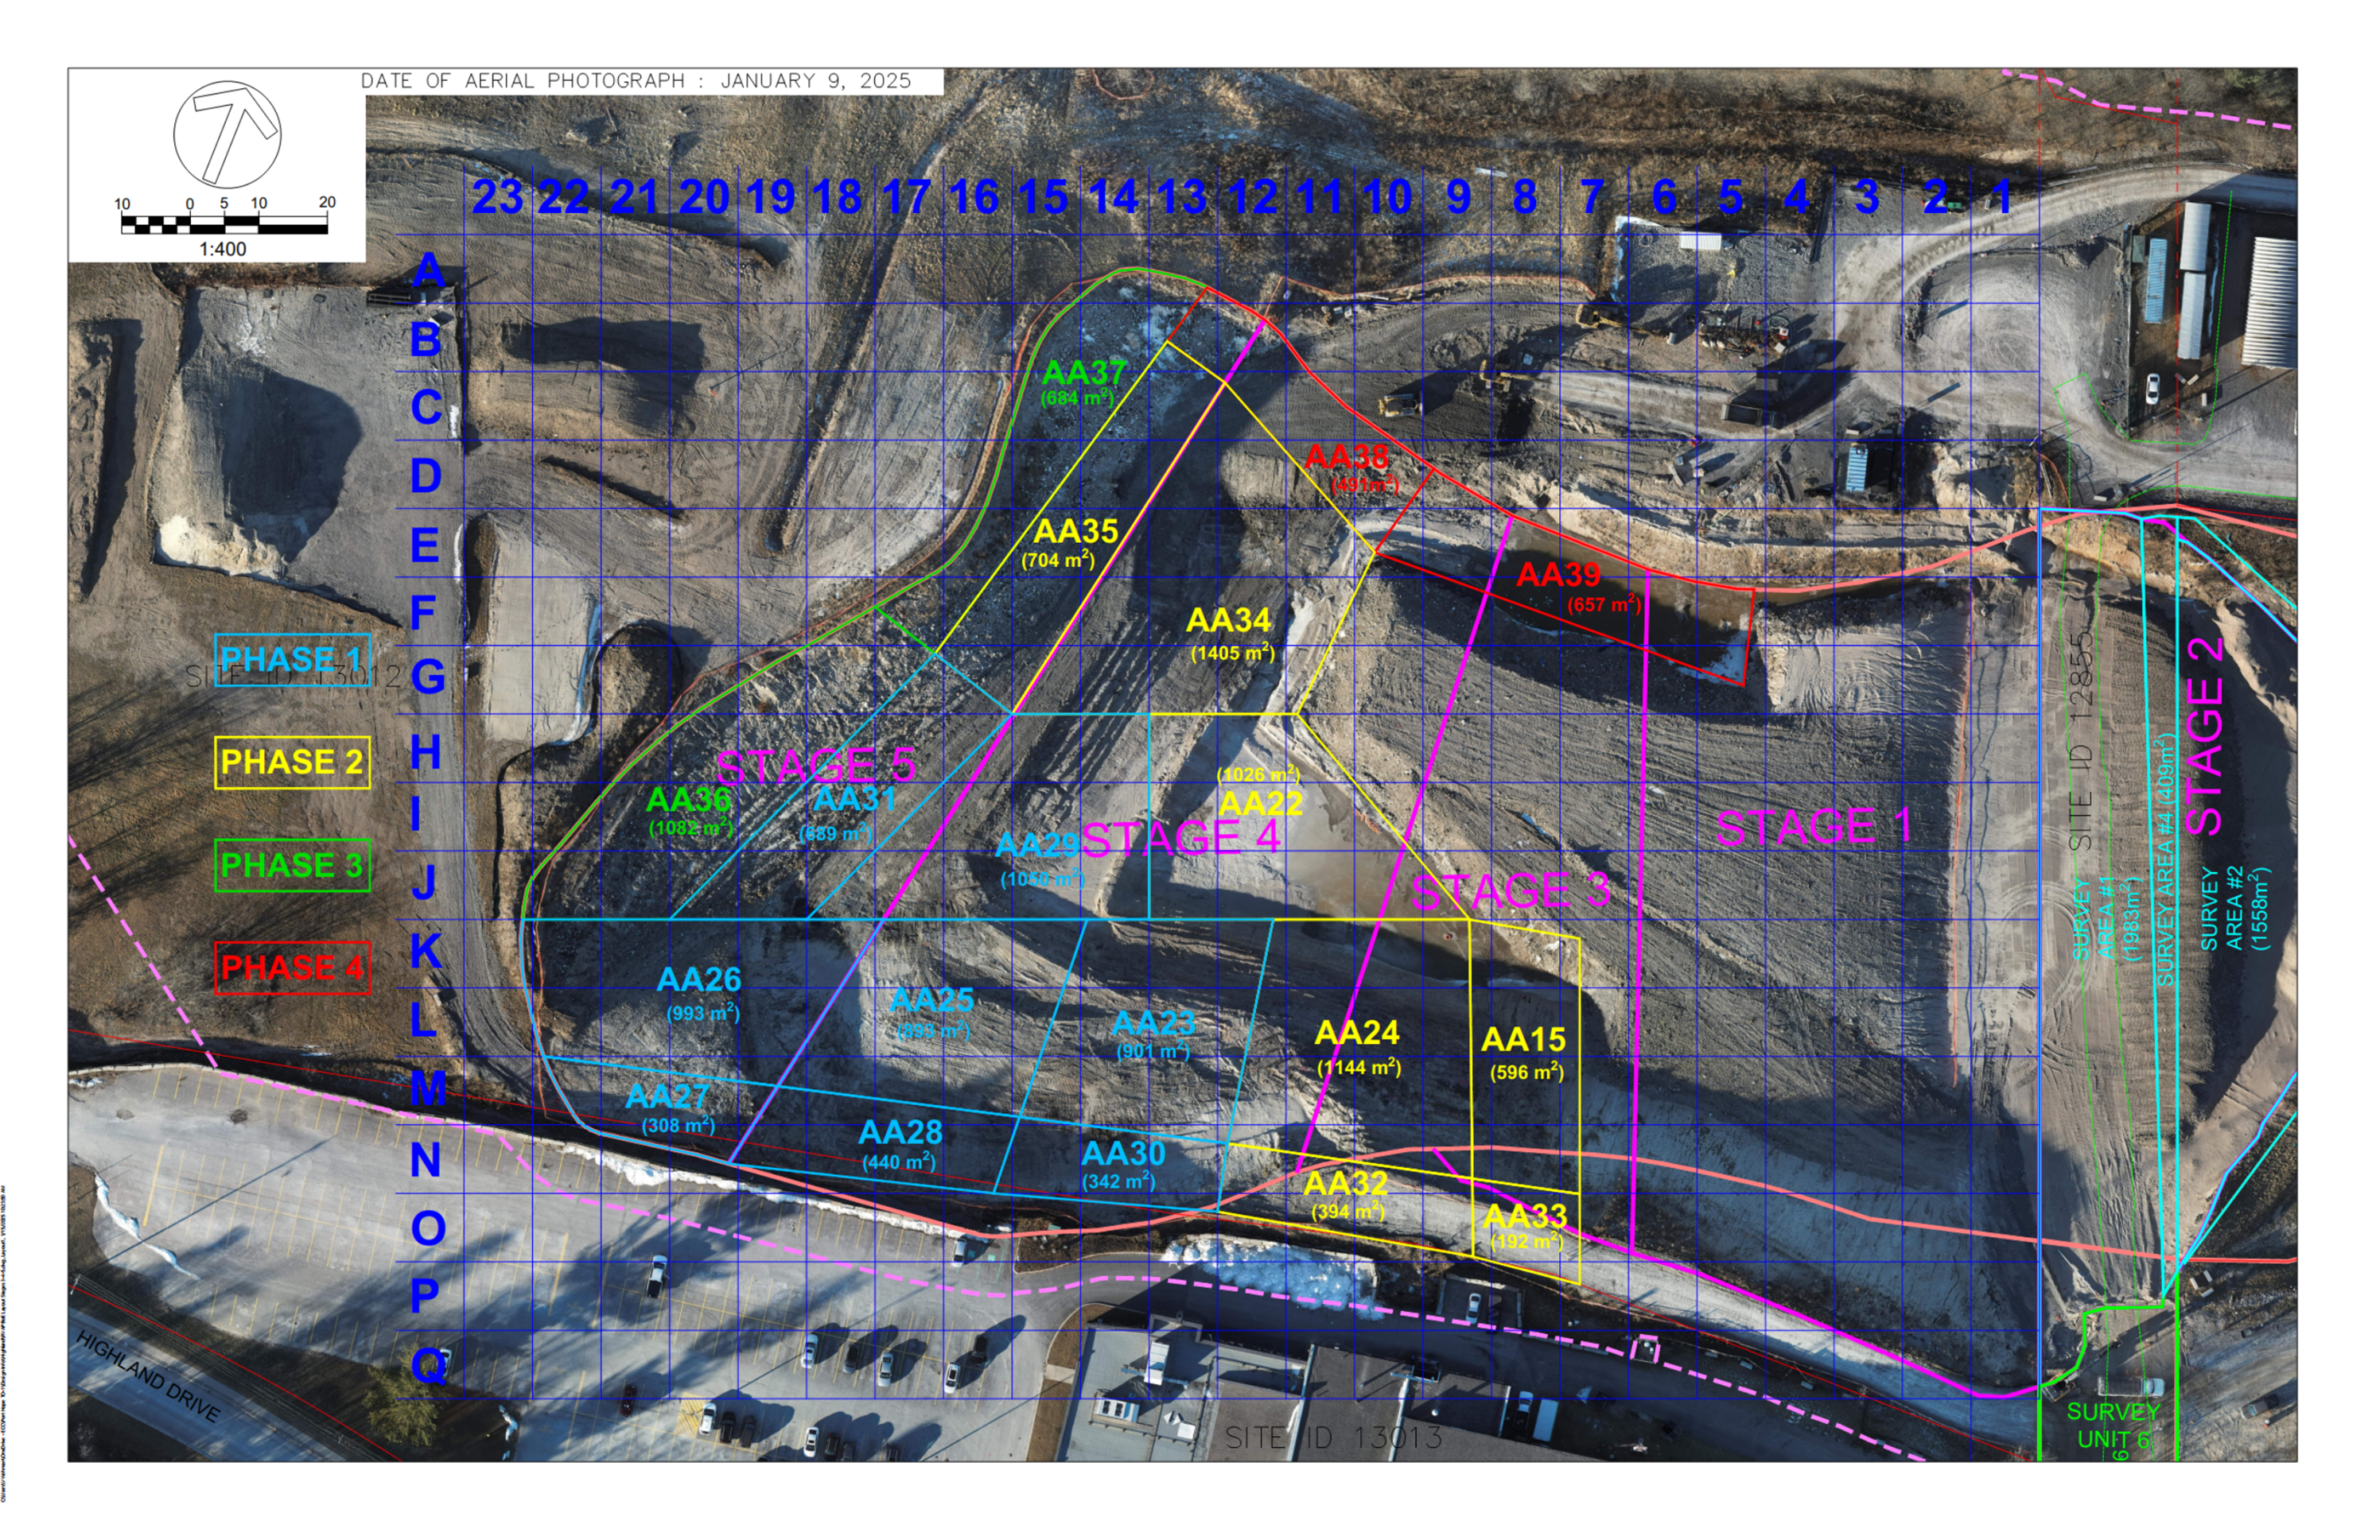
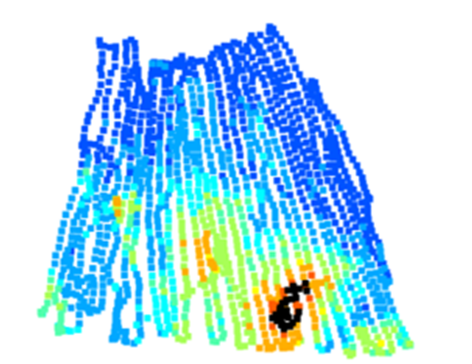
Remedial Verification

Slide 17
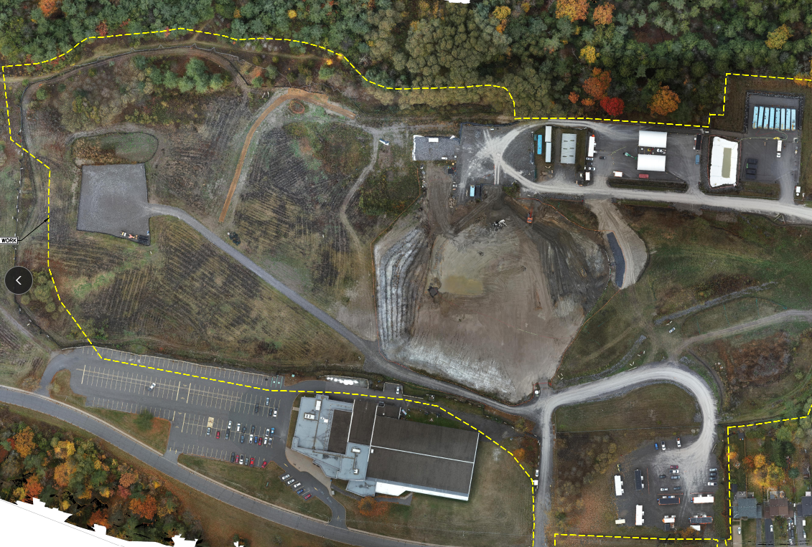
Stage 2 Remediation (October 2023)

Slide 18
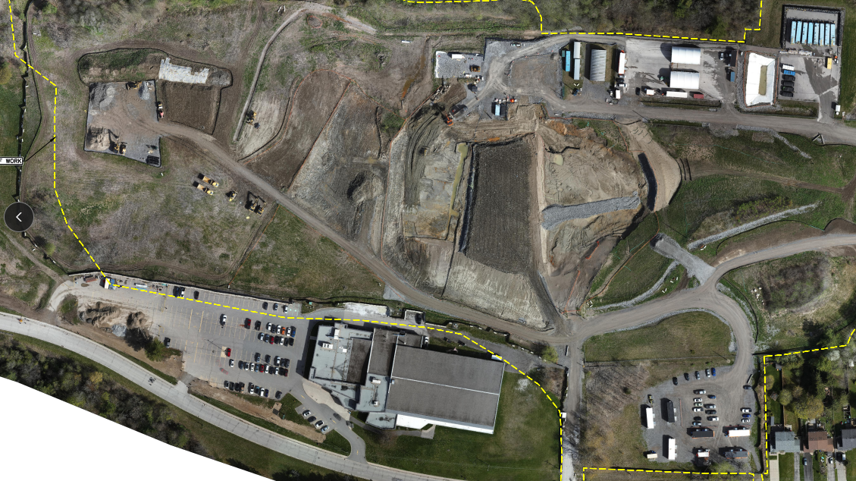
Stage 3 Remediation (March 2024)
Excavation, sorting, and scanning of MSW and LLRW in Stage 3
MSW placement in Stage 1 of landfill

Slide 19
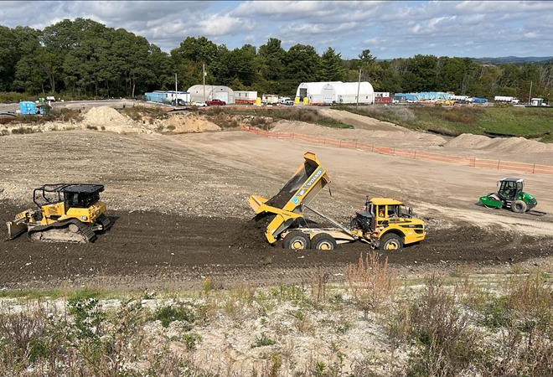
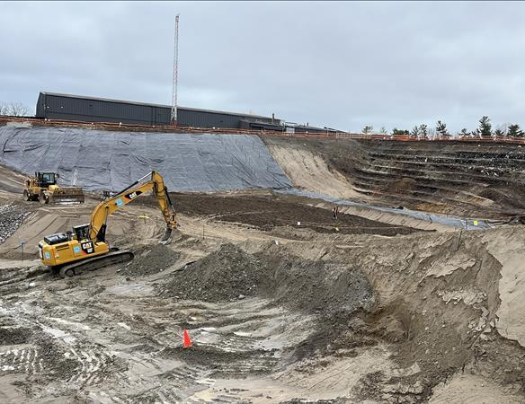
MSW Backfill
Placement and Compaction
Layers Placed in 30 cm intervals

Slide 20
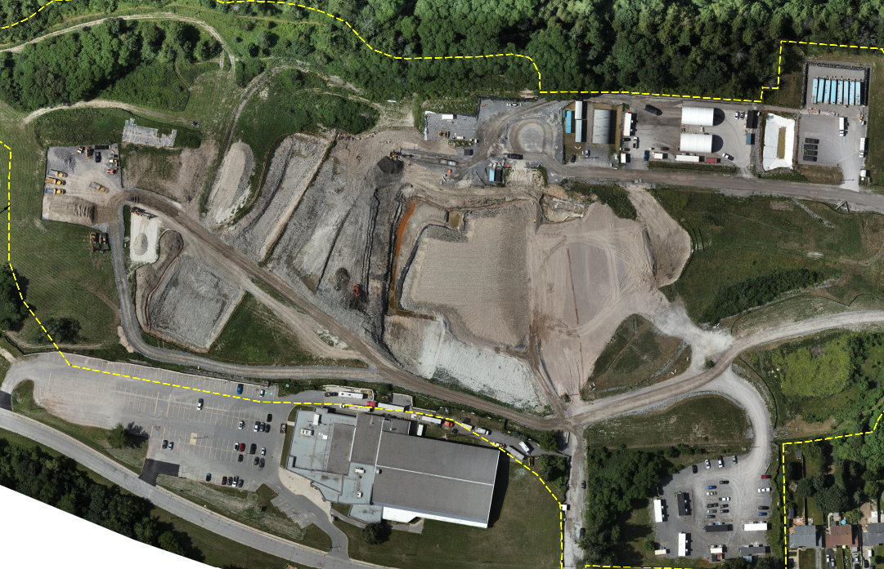
Stage 4 Remediation (July 2024)

Slide 21
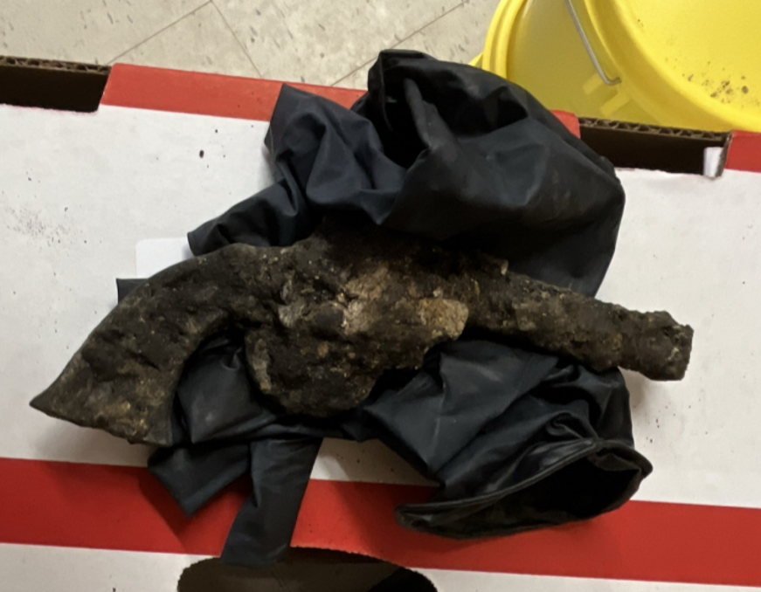
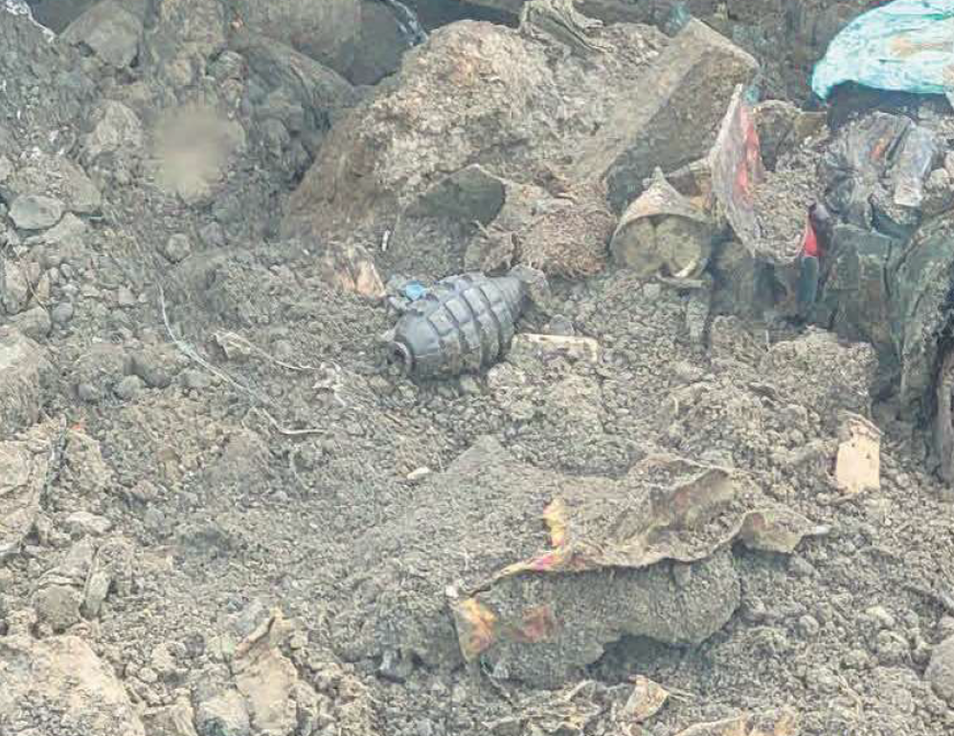
Landfill Findings
Historic Handgun
Replica Hand Grenade

Slide 22
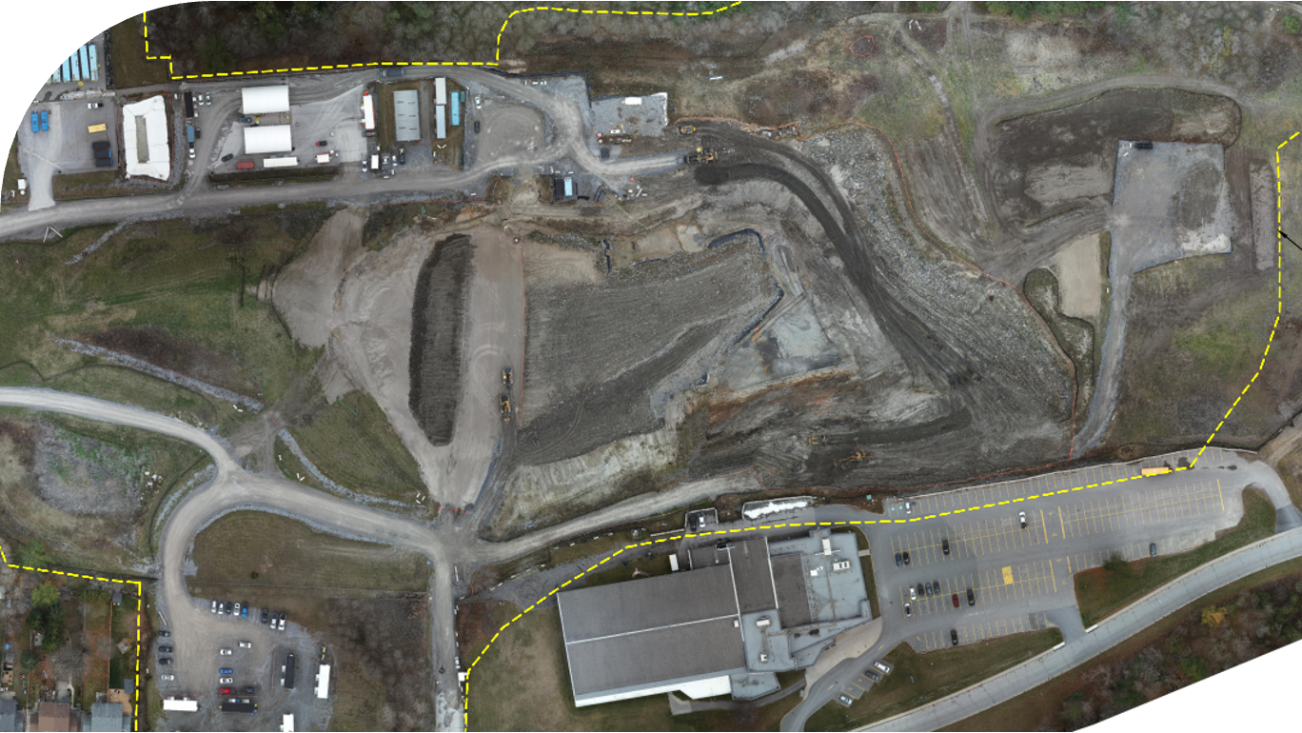
Stage 5 Floor Remediation (December 2024)
Bulk excavation and loadout
Shipment of up to 120 loads a day!
90% of total volume to LTWMF across all Port Hope Sites

Slide 23
Stage 5 West Wall Remediation (July 2025)
Excavation on 20m high 2:1 slope!
MSW placement in Stage 3 & 4
Continued excavation into west wall

Slide 24
Results To Date
Contract Volumes (m3) Compared to Actual Volumes (m3)
Stage | Contract Volume (LLRW) | Contract Volume (MSW) | Total Contract Volume | Actual Volume (LLRW) | Actual Volume (MSW) | Actual Volume (LLRW & MSW) | Percent Volume Change (LLRW & MSW) | Percent Volume Change (LLRW) | Percent Volume Change (MSW)
Stage 1 | 36,000 | 0 | 36,000 | 282,265 | 18,272 | 56,640 | 57.33% | 281.10% | -84.75%
Stage 2 | 14,216 | 0 | 14,216 |  |  | 24,344 | 71.24%
Stage 3 | 8,900 | 28,600 | 37,500 |  |  | 37,664 | 0.44%
Stage 4 | 9,000 | 33,000 | 42,000 |  |  | 37,262 | -11.28%
Stage 5 & 6 | 5,950 | 58,200 | 64,150 |  |  | 144,627 | 125.45%
Total | 74,066 | 119,800 | 193,866 | 282,265 | 18,272 | 300,537 | 55.02% | 281.10% | -84.75%

Slide 25
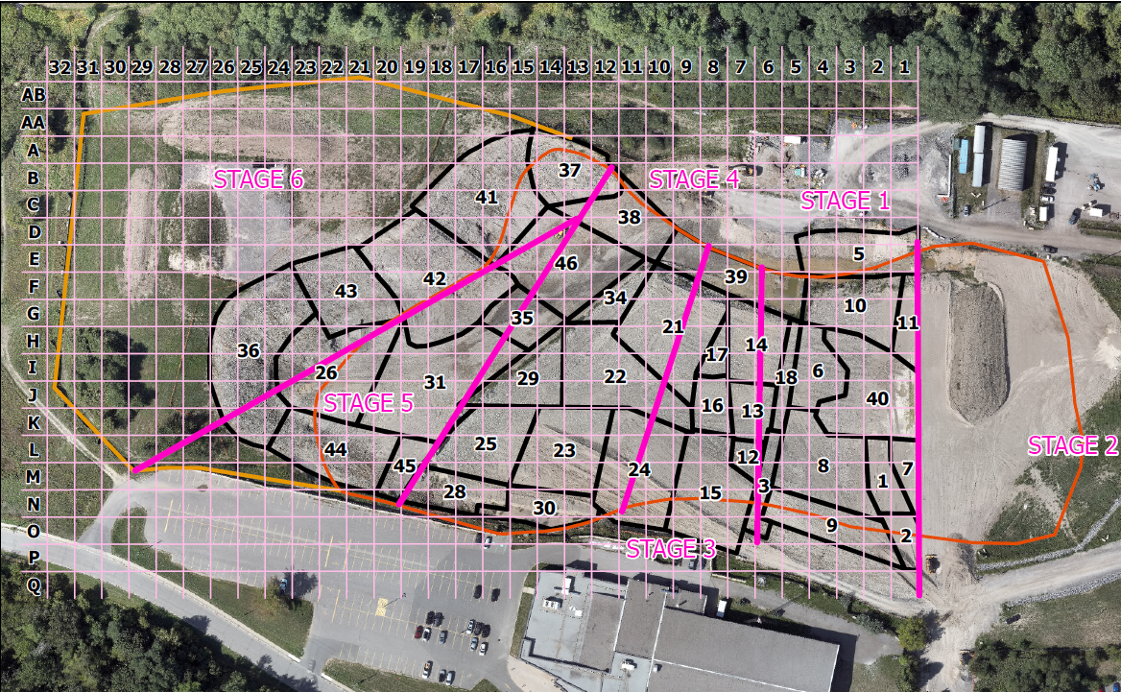
Current & Future Works
Further remediation of Stage 6
Diligent excavation, sorting, scanning and segregating material
Clay capping of entire landfill
Restoration

Slide 26
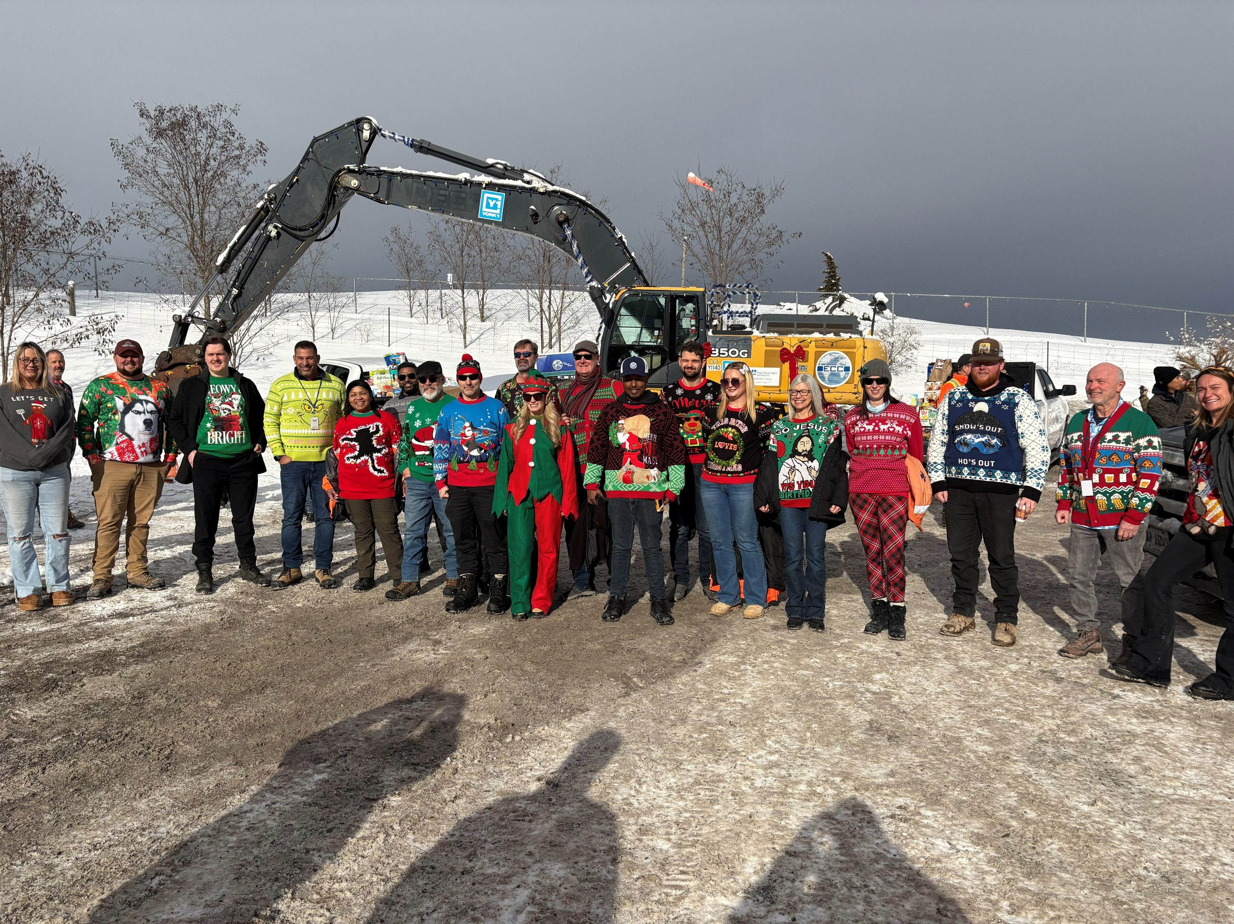
Challenges & Lessons Learned
Key Success Factors
Material Segregation with Comingled LLRW/MSW
Site Characterization/ Contamination Placement ​
Proximity to high use Community infrastructure
Strong Client–Contractor Collaboration Key to Navigating Project Challenges Proactive and Transparent Change Management Timely and Informed Decision-Making

Slide 27
Ryan Tennant
Project manager, PMP
Email: rtennant@ecc.net
www.ECC.net

