Slide 1

Determining the effectiveness of frequency domain electromagnetic and ground penetrating radar surveying techniques in delineating the extents of buried waste in small trench-and-fill style waste disposal sites
By Gregory McKay, P.Geo
gmckay@blumetric.ca

Slide 2
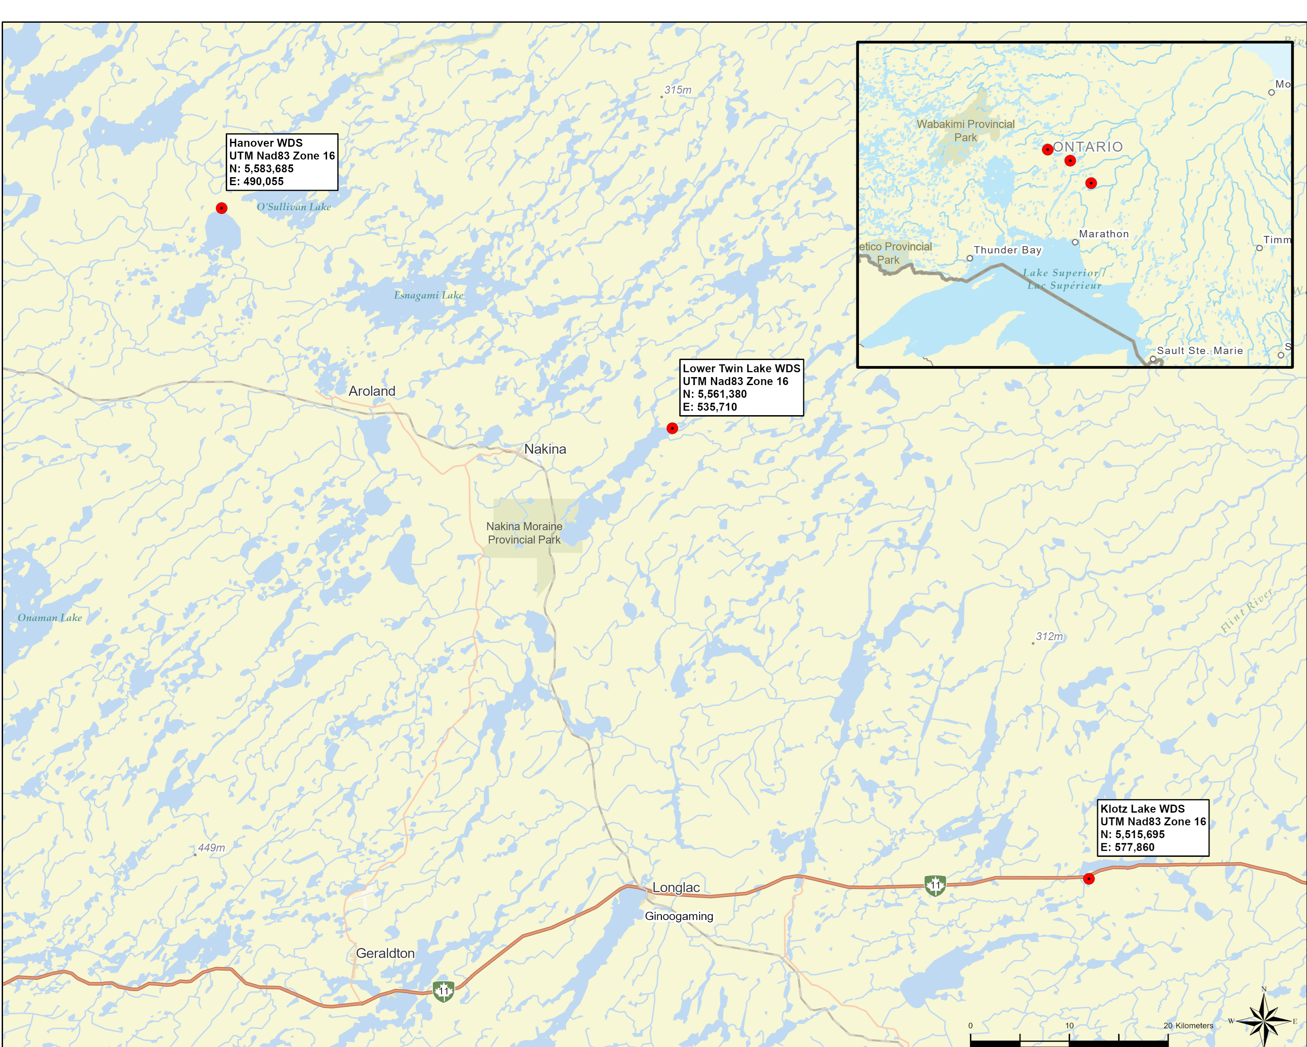
Objective
Completed by BluMetric Environmental in collaboration with MNR
Look for a better way to determine the extent of waste
Help with capacity assessments, operation plans, and closure plans.

Slide 3
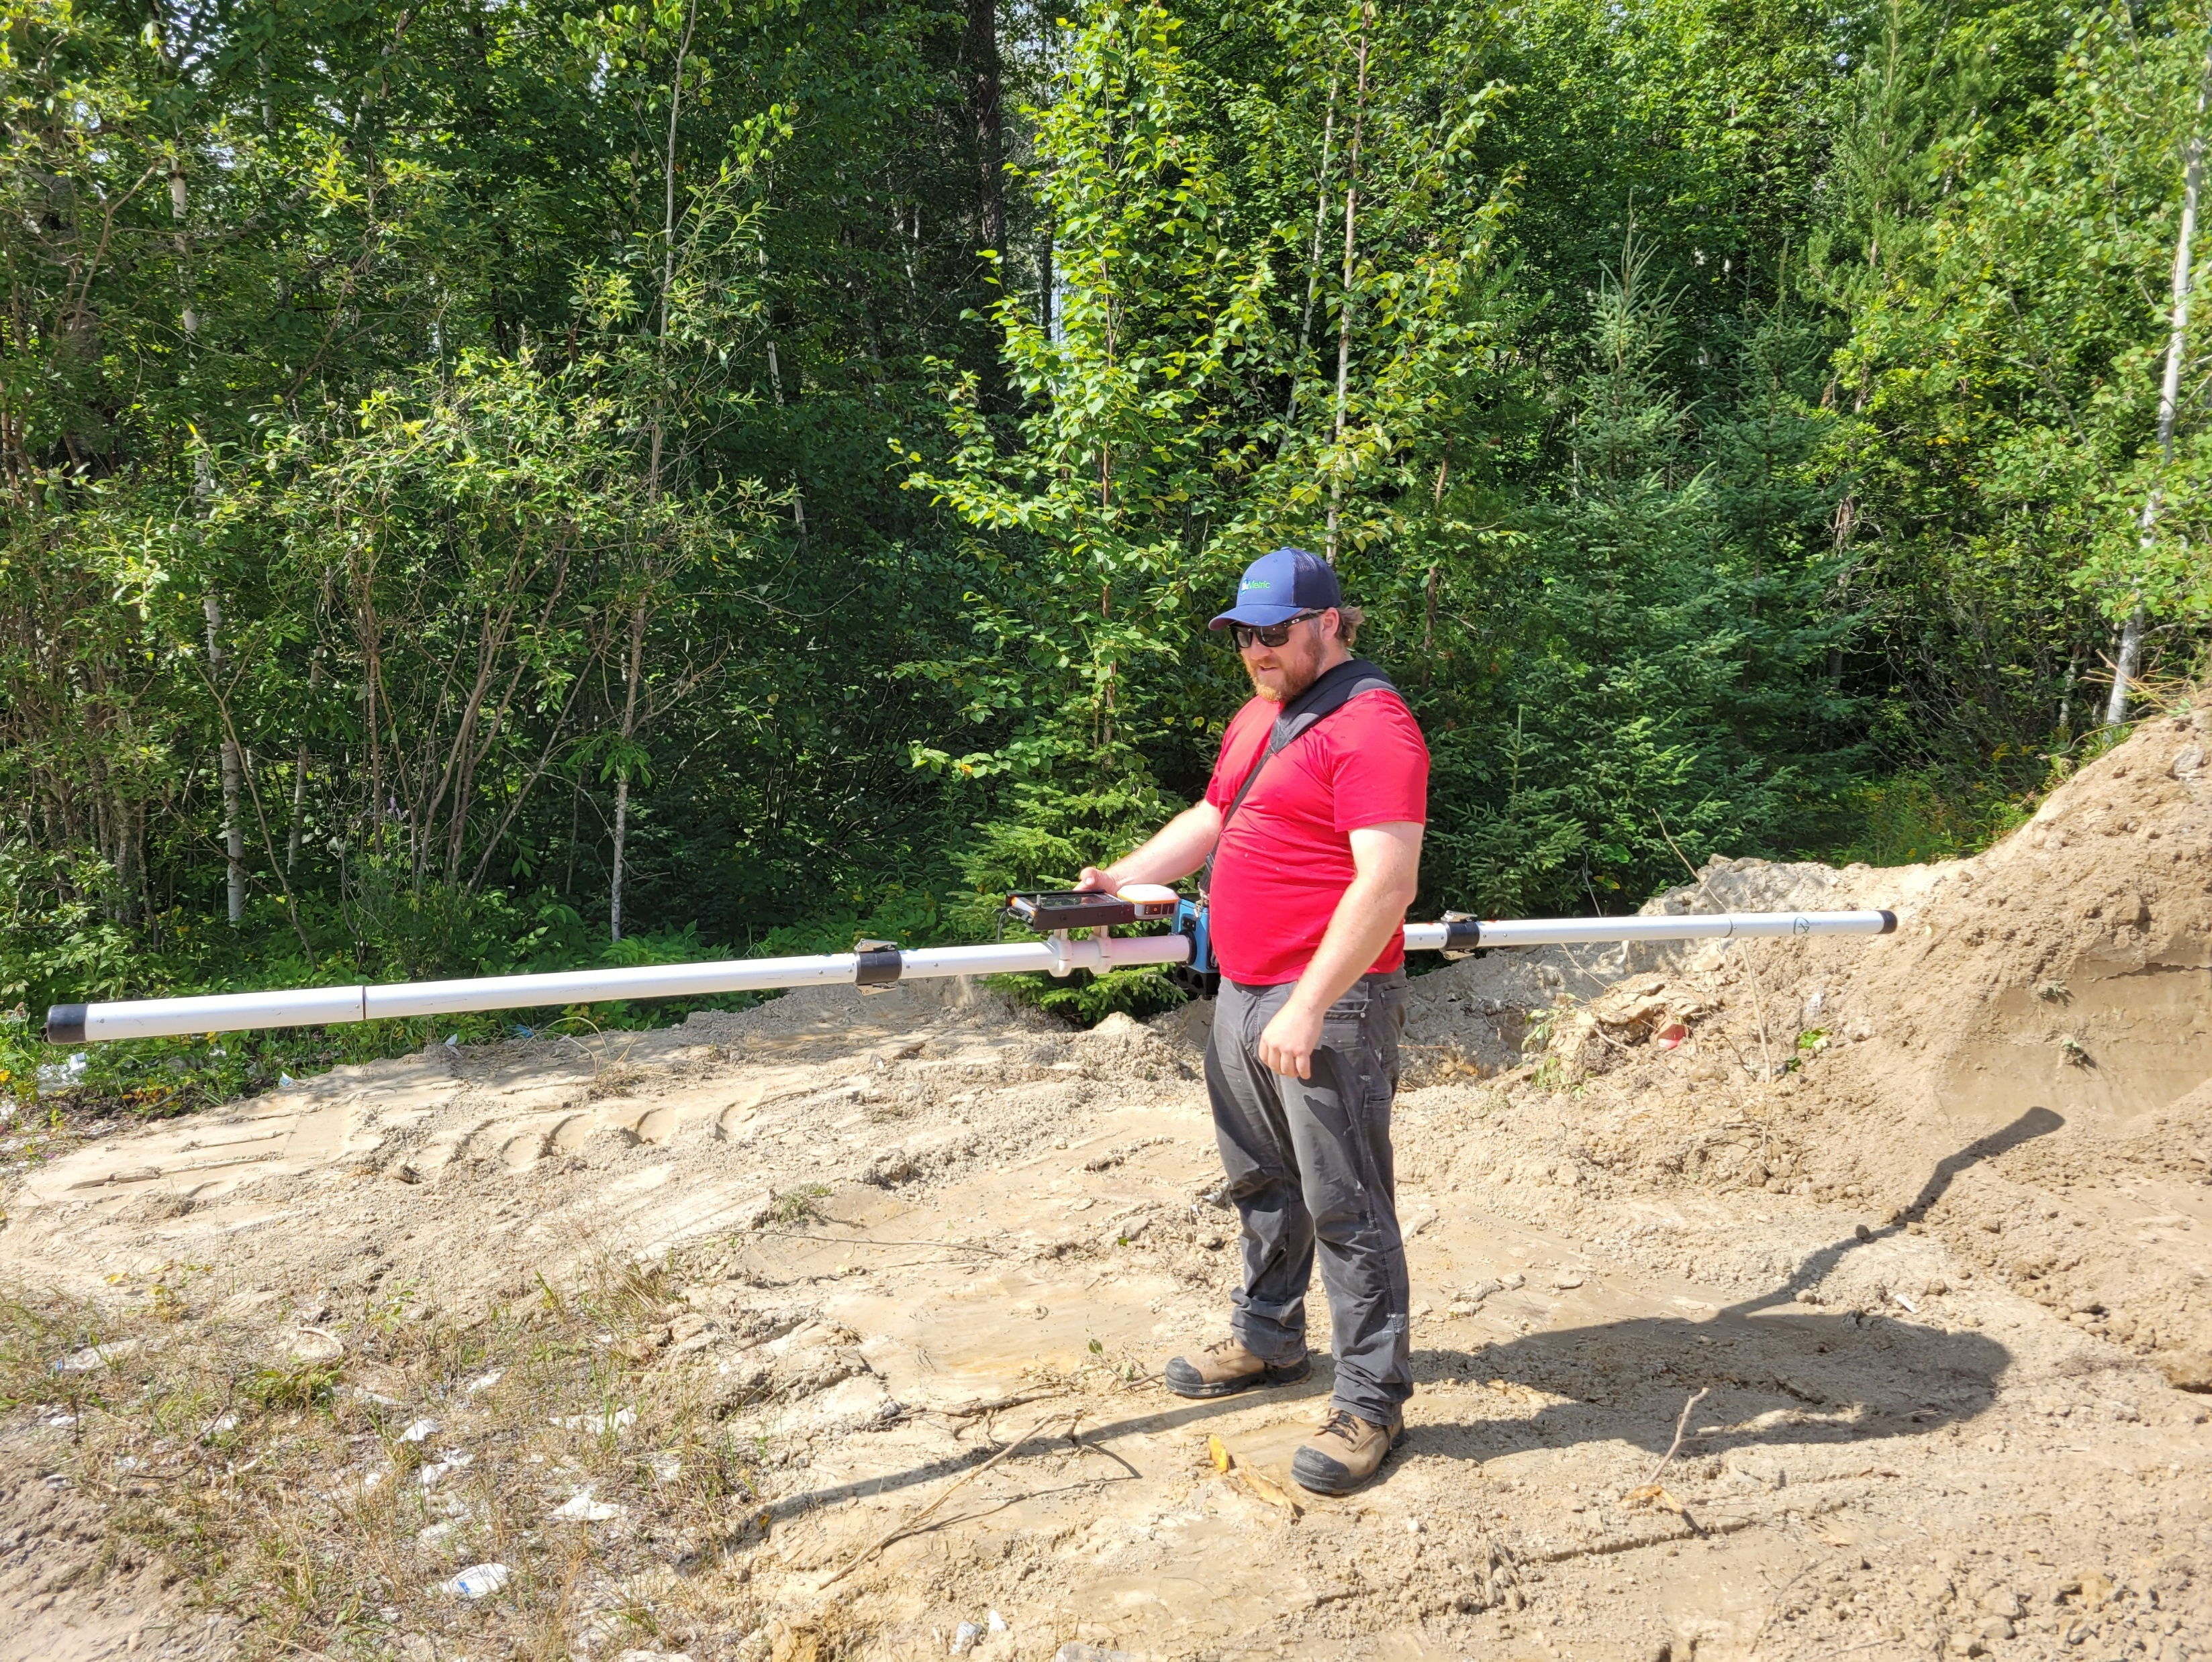
Objective
To determine if the use of electromagnetic (EM) or ground-penetrating radar can be used to effectively determine the extents of buried waste within small trench-and-fill style landfills.

Slide 4
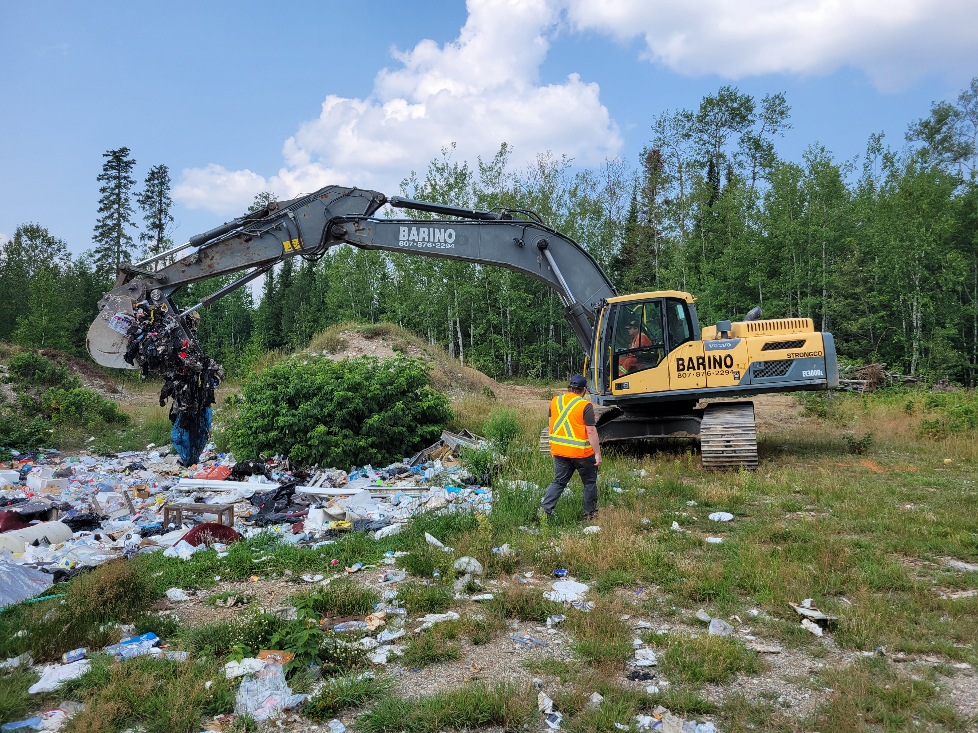
Objective
Advantages
Non-Destructive
Cleaner
Quick
Cheaper
Easier Access
More Accurate?

Slide 5
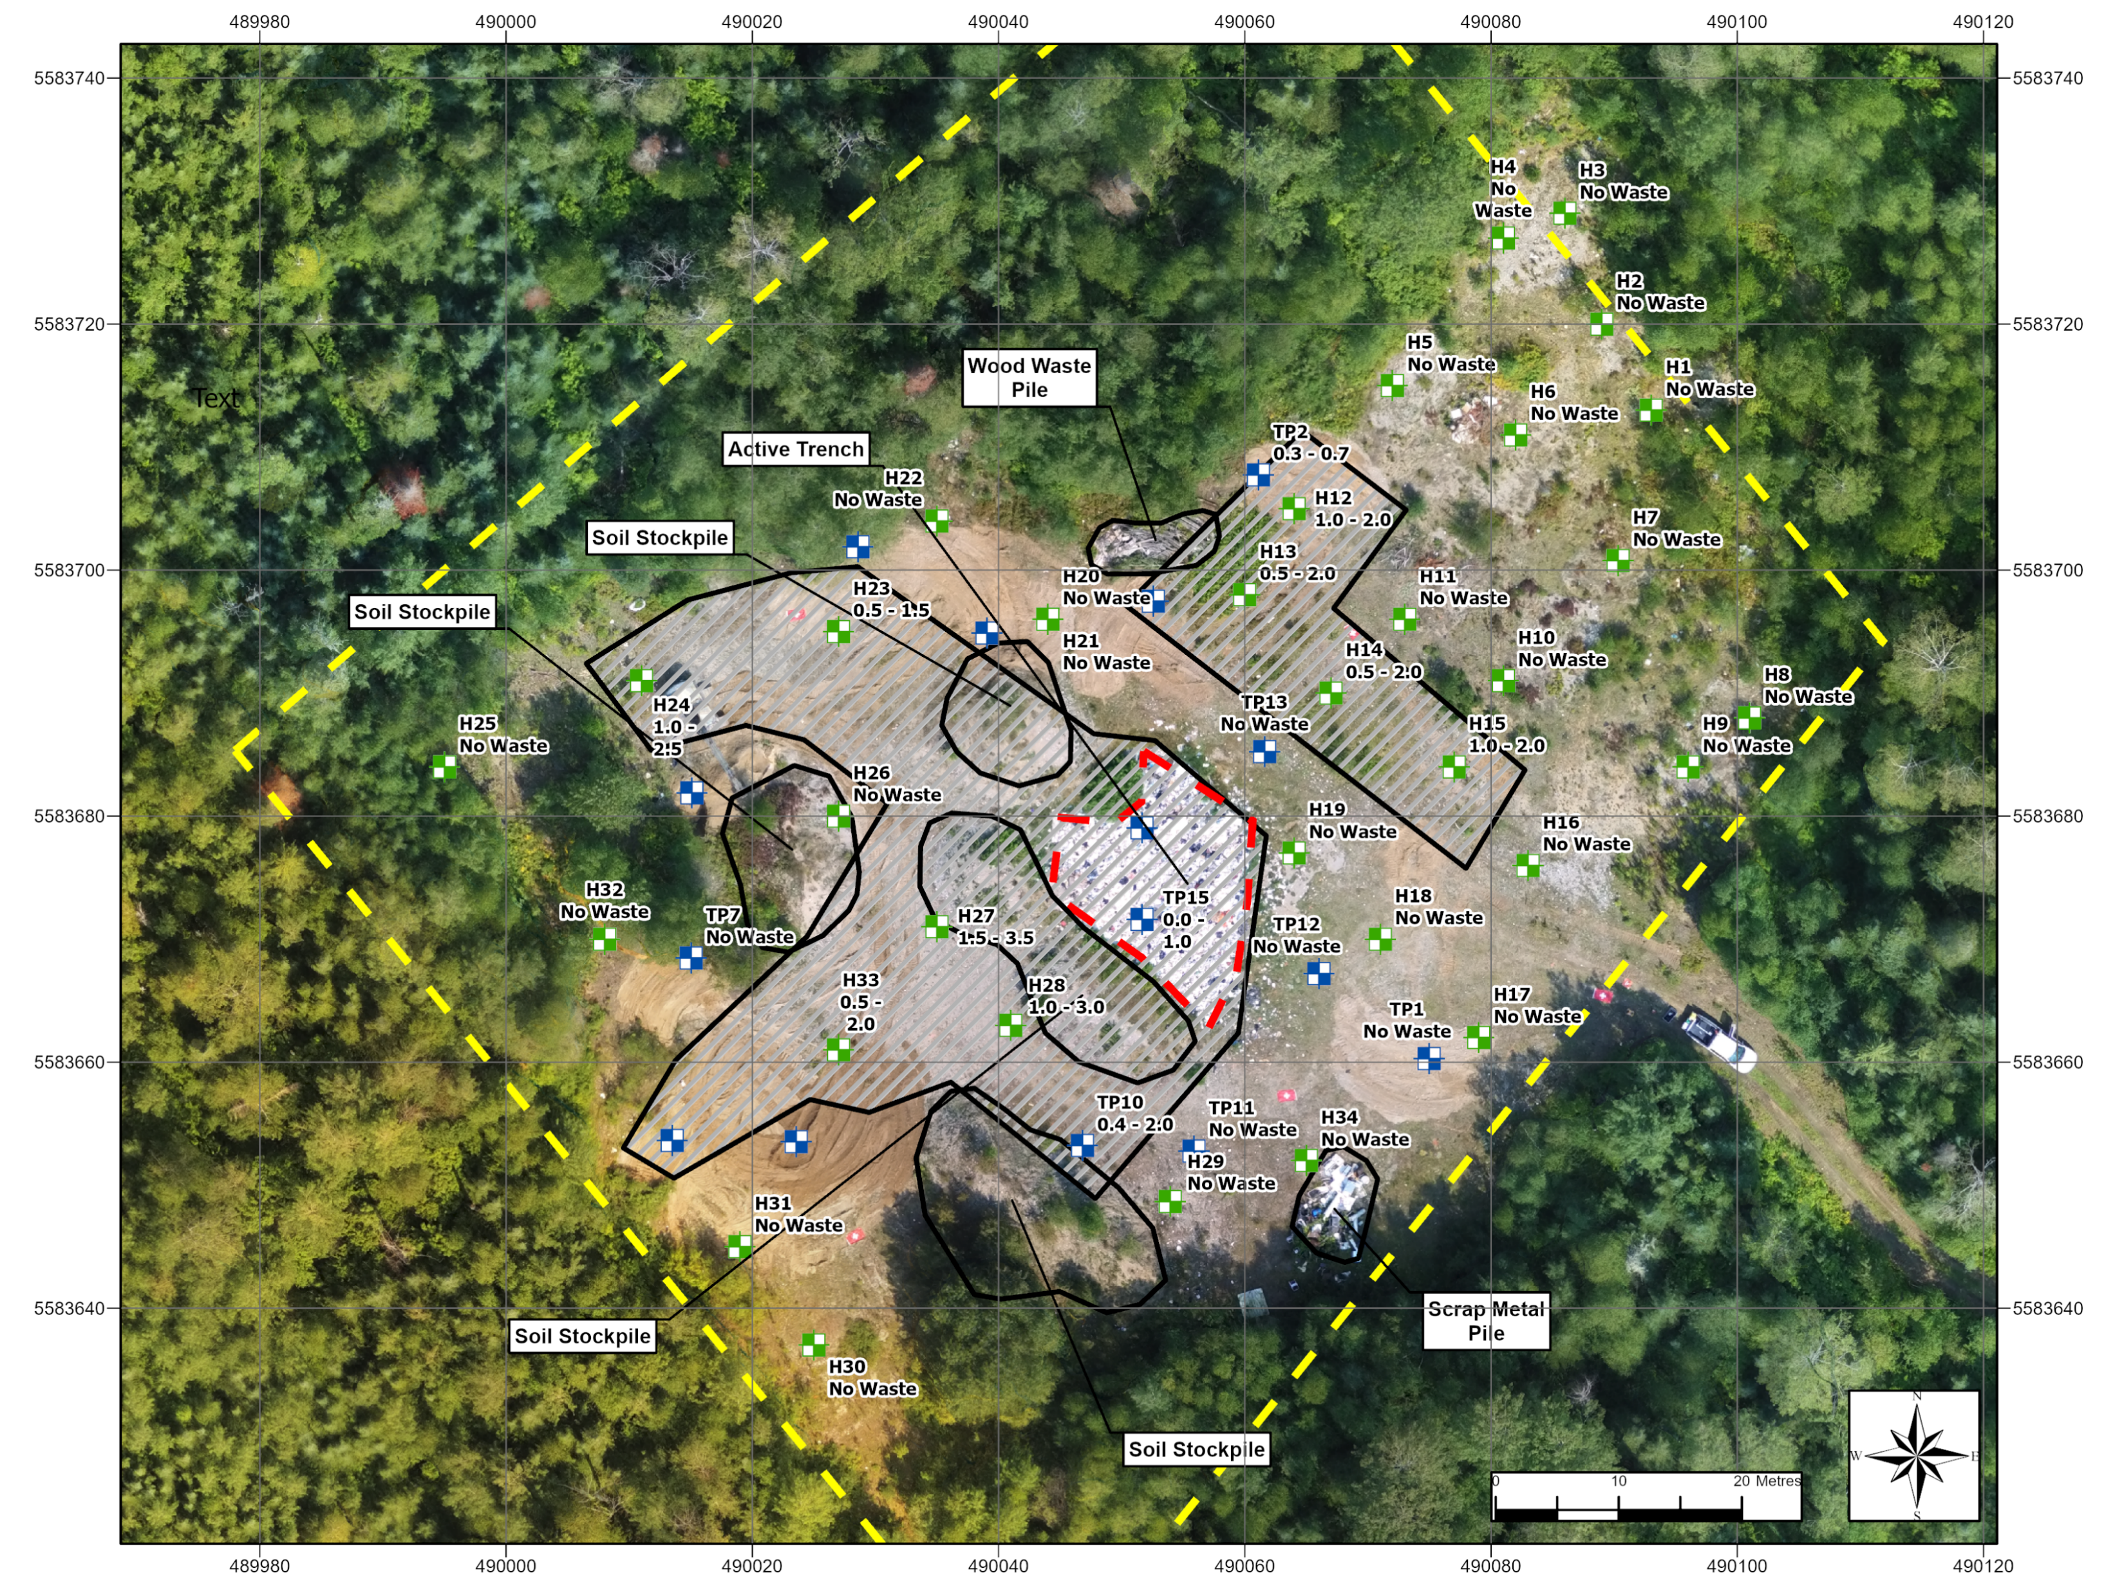
Methodology
Use a traditional test-pitting method to determine the extent of buried waste

Slide 6
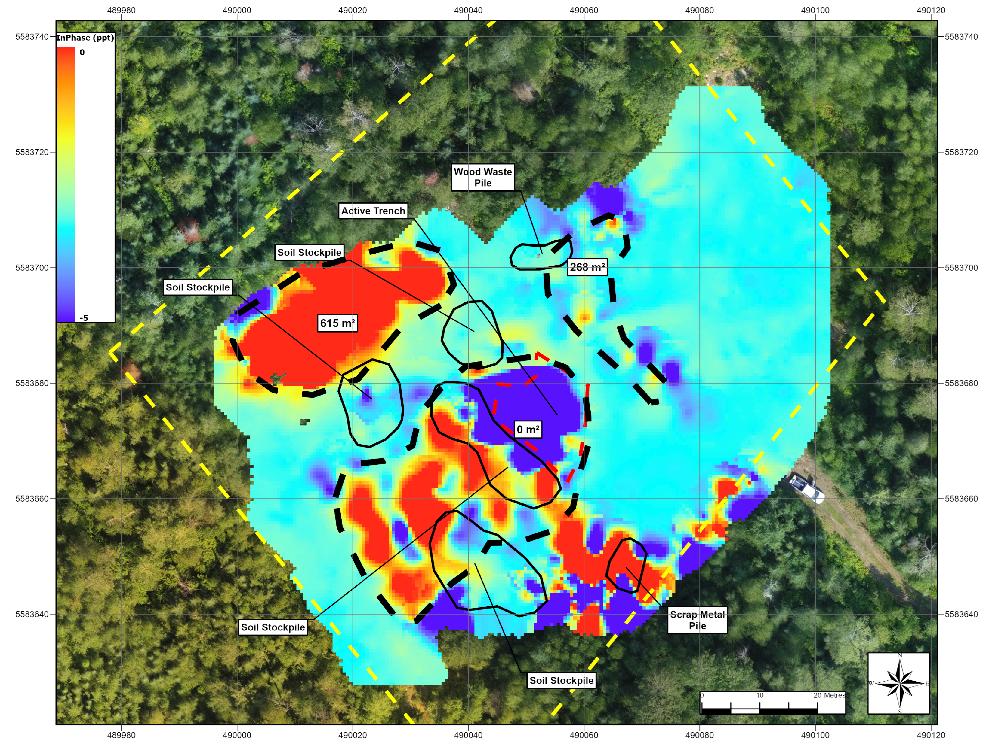
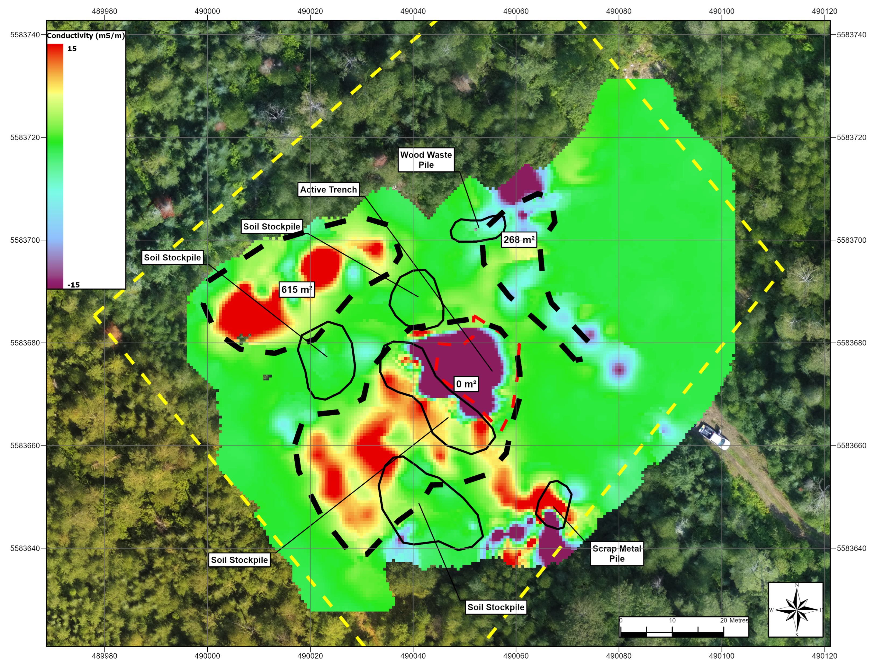
Methodology
Use an EM31-MK2 to determine both the in-phase (magnetic susceptibility) and quad-phase (apparent conductivity) response across each site.
In-Phase Response
Quad-Phase Response

Slide 7
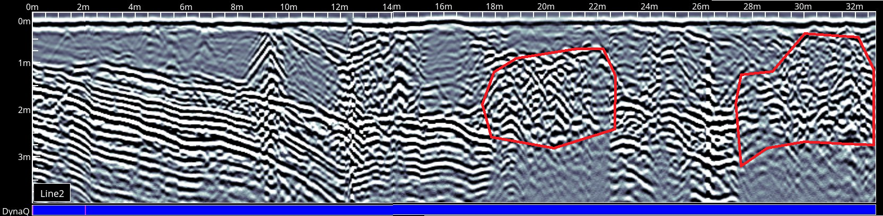
Methodology
Use a Noggin 250 with a SmartCart system to map the reflective response to a ground-penetrating radar (GPR) signal in transects across the site.

Slide 8
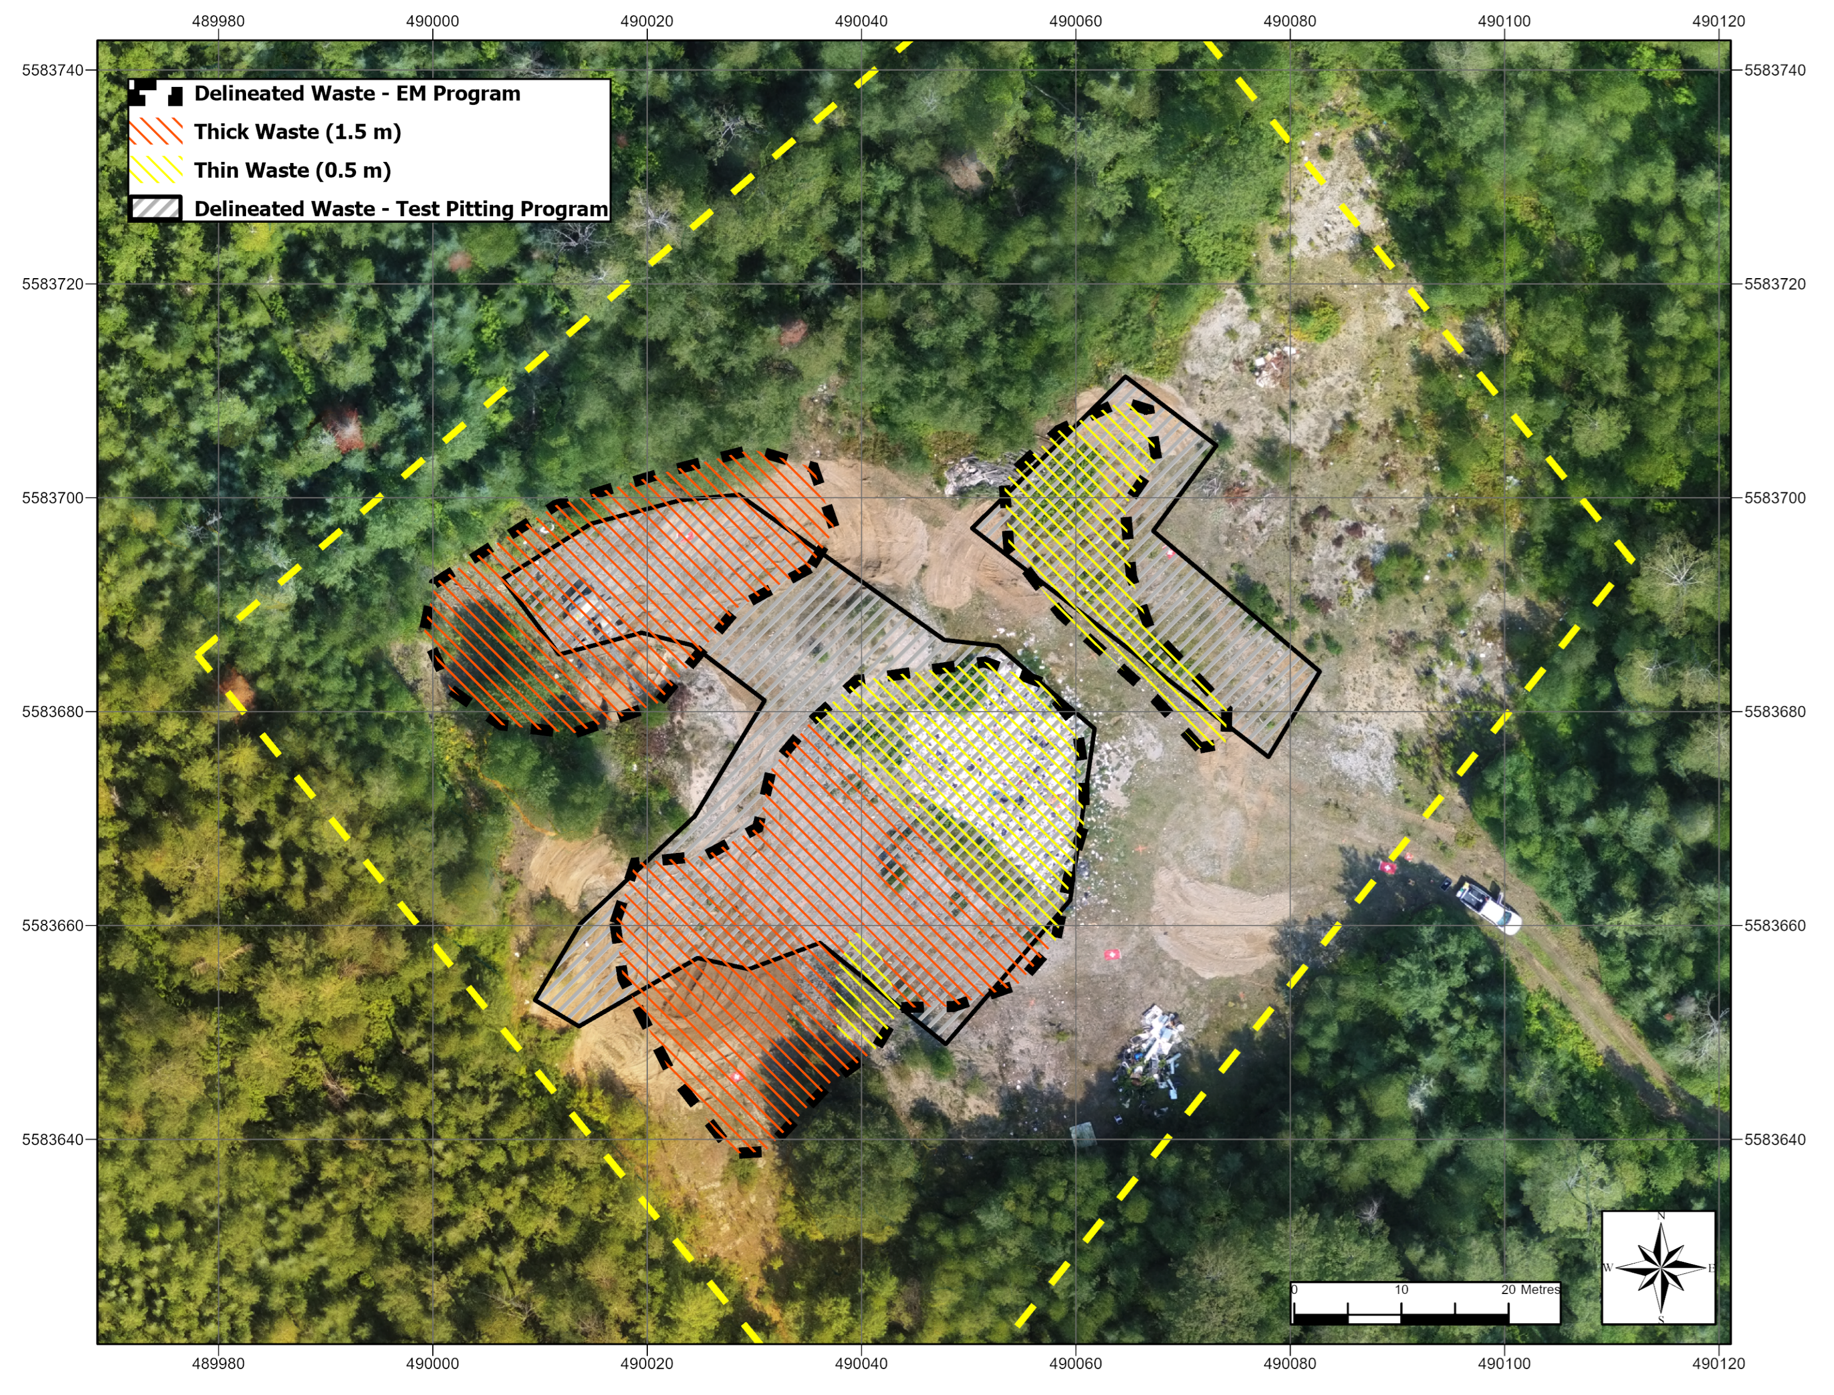
Methodology
Compare the results of each method to determine the accuracy of the non-invasive methods.

Slide 9
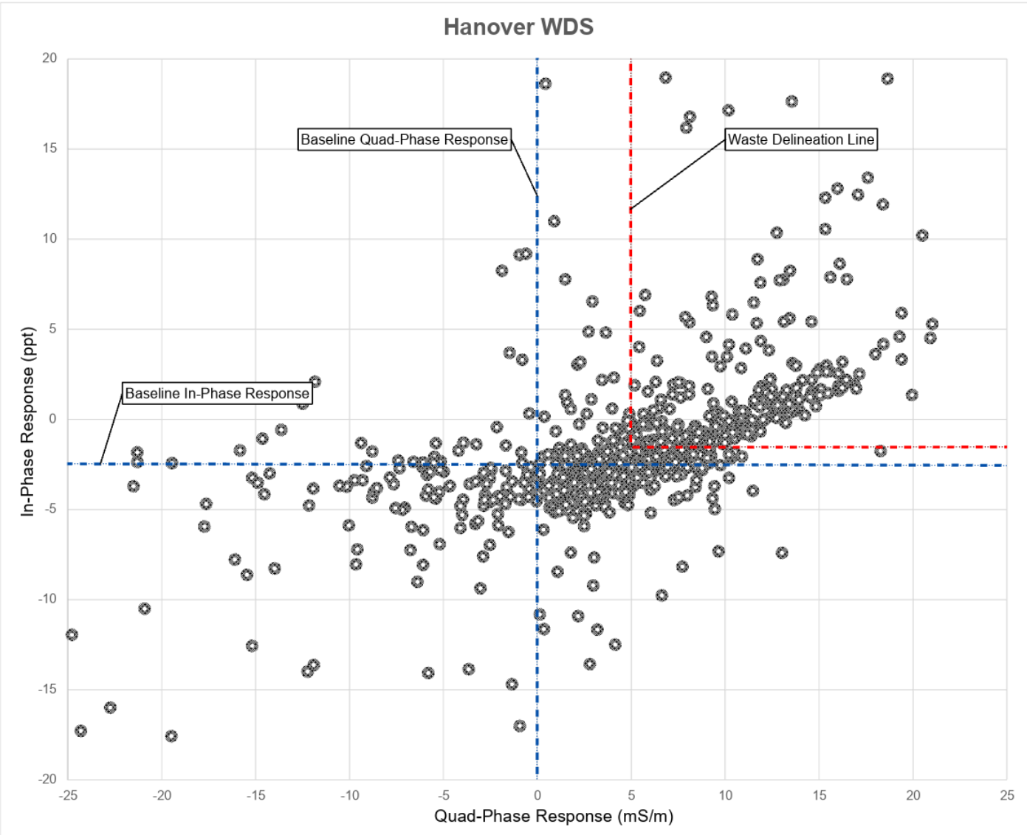
Results - EM
The EM31-MK2 was successful in accurately determining the extents of buried waste
The EM survey may be more accurate than a traditional test-pitting method (Hanover WDS)
The EM survey did not clearly detect thin layers or scattered waste (Klotz Lake WDS)
 | Test Pitting Program |  | EM Program |  | Difference (%) |  | Overlap
Site | Lateral Area of Buried Waste (m²) | Volume of Buried Waste (m³) | Lateral Area of Buried Waste (m²) | Volume of Buried Waste (m³) | Lateral Area of Buried Waste | Volume of Buried Waste | Area of Buried Waste (%)
Hanover WDS | 1.992 | 2,304 | 2,097 | 2,444 | 5.3% | 6.1% | 70.3
Lower Twin Lake WDS | 691 | 771 | 704 | 797 | 1.9% | 3.4% | 81.6
Klotz Lake WDS | 4,426 | 4,120 | 3,220 | 3,820 | 27.2% | 7.3% | 72.8

Slide 10
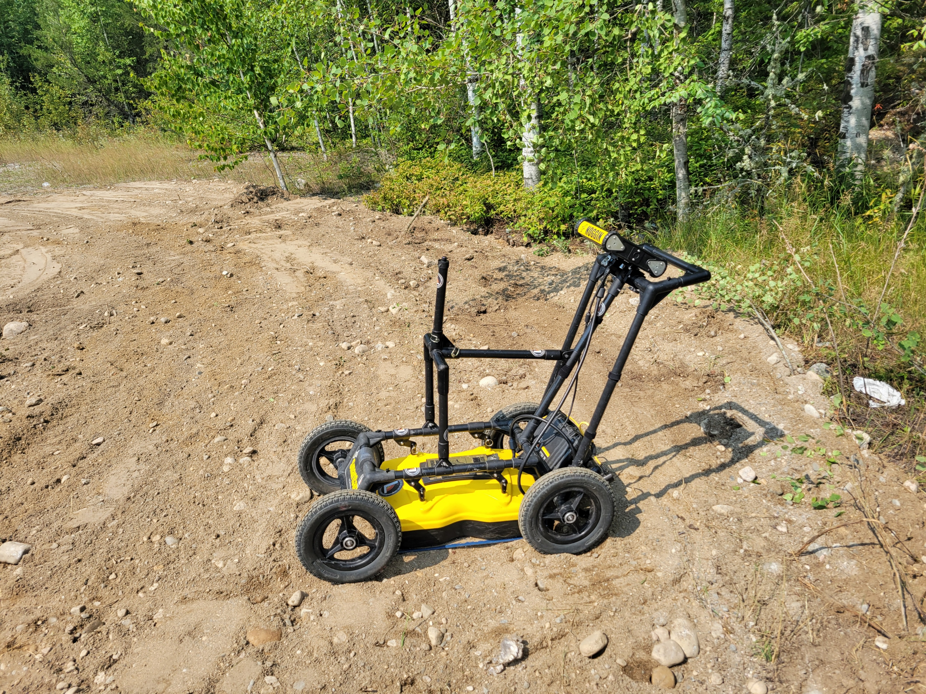
Results - GPR
The Noggin 250 was able to accurately determine the lateral extents of buried waste along transects
The vertical thickness of buried waste was not determined.

Slide 11
Discussion - EM
Advantages
Clean
Easy to traverse
Easy to use
Small and portable
Accurate delineation of historic waste trenches
Rough calculation of waste volume
Disadvantages
Vertical extents not determined
Thin waste layers not detected
Affected by nearby metal

Slide 12
Discussion - GPR
Advantages
Clean
Small and portable
Accurate delineation of waste along a transect
Disadvantages
Vertical extents not determined
Not maneuverable on a waste disposal site
Did not penetrate hard-packed gravel
Grids did not delineate any body of waste

Slide 13
Questions?
Gregory McKay P.Geo
gmckay@blumetric.ca

