Slide 1

A New Science Risk Assessment: Addressing Sediment Contamination in a Creek Using Multiple Lines of Evidence and Long-Term Monitoring
Reese McMillan, M.Sc., LEL, QP_{RA}, Head of Risk Assessment
DS Consultants Ltd.

Slide 2
Outline
Site History
Site Investigations
Risk Assessment Process
Risk Management Measures
Ongoing Monitoring
Lessons Learned

Slide 3
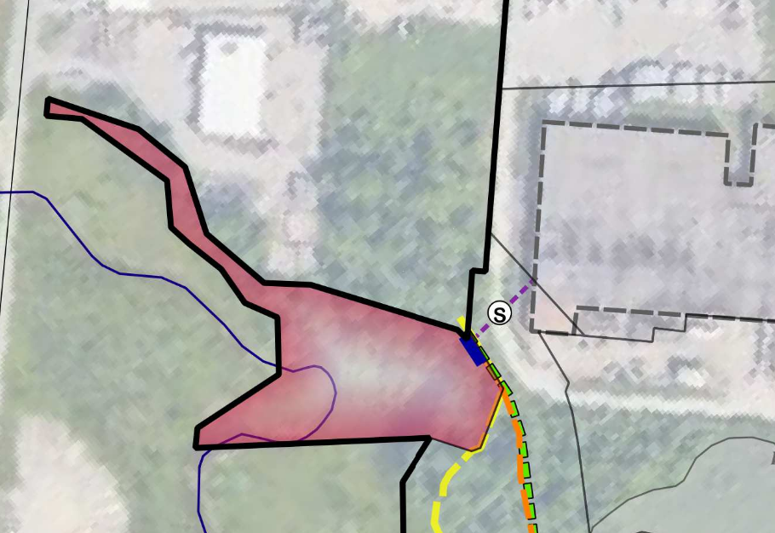
Site History
Part of larger property with industrial processes
Storm sewer outfall into creek from factory
Record of Site Condition required by seller
Intent to give land to Town or place in trust

Slide 4
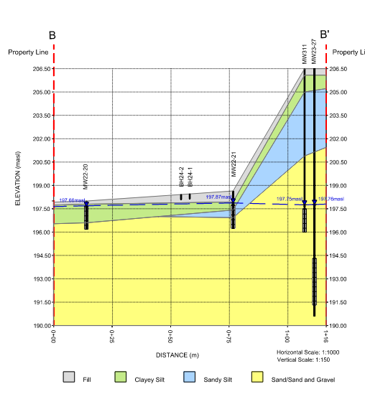
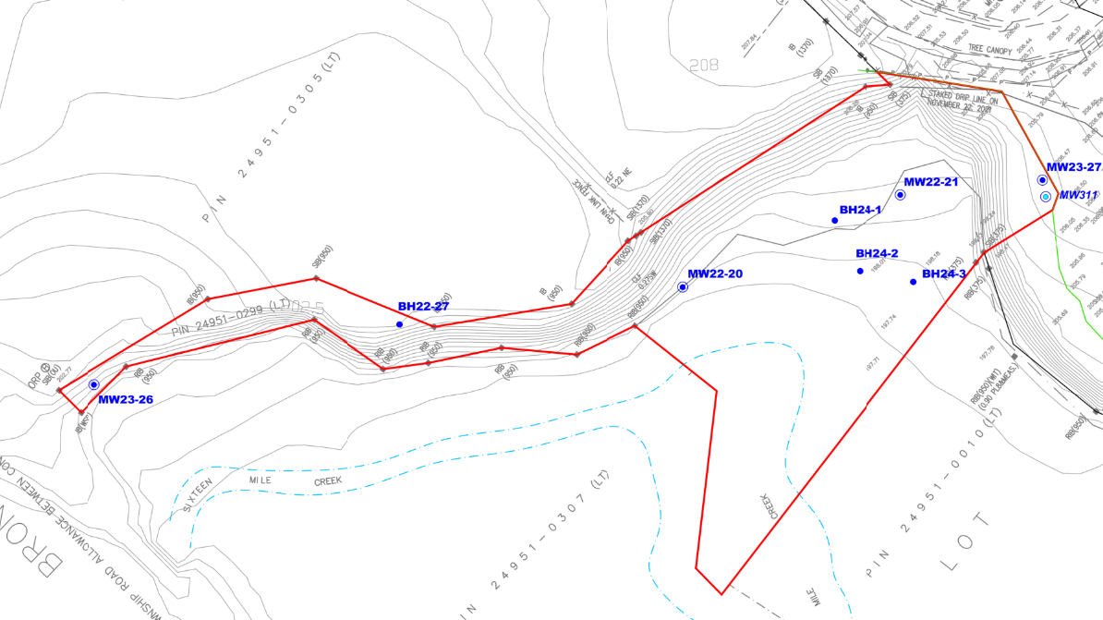
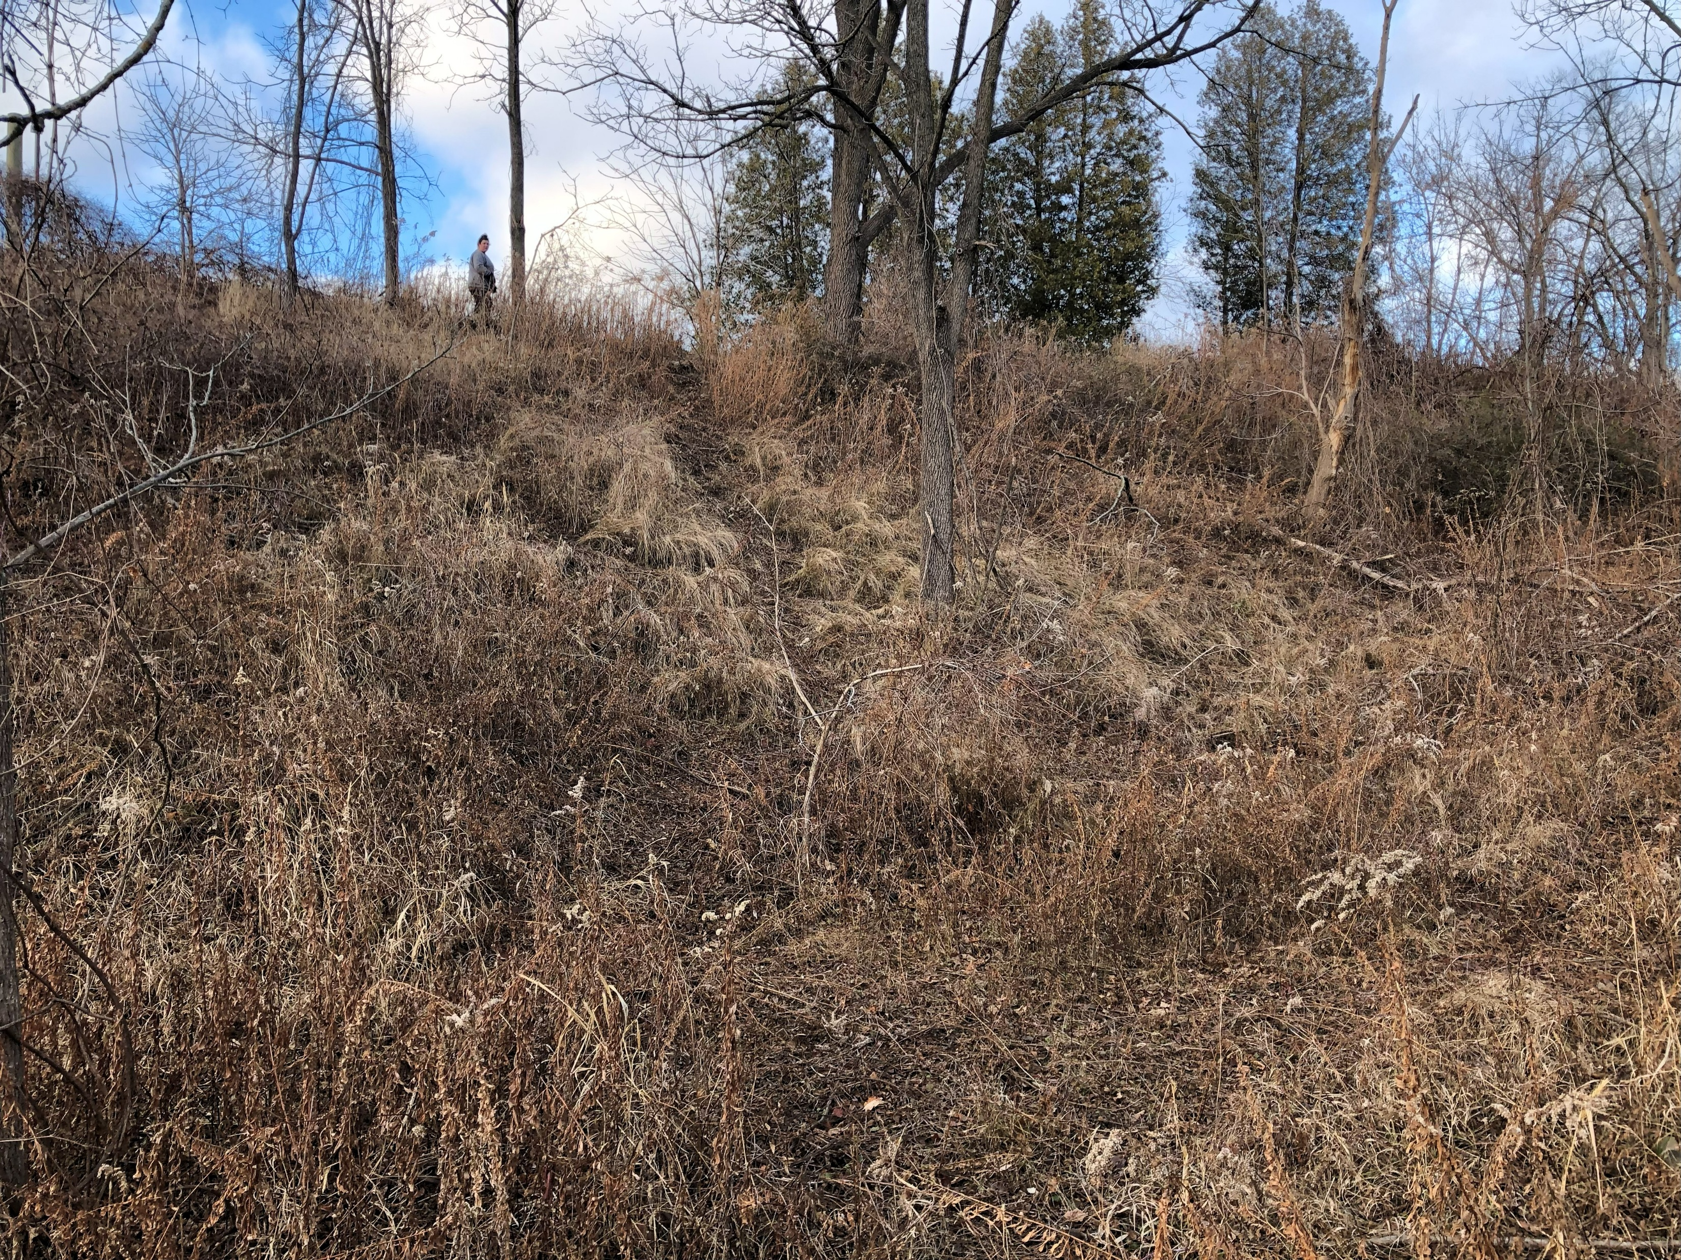

Slide 5
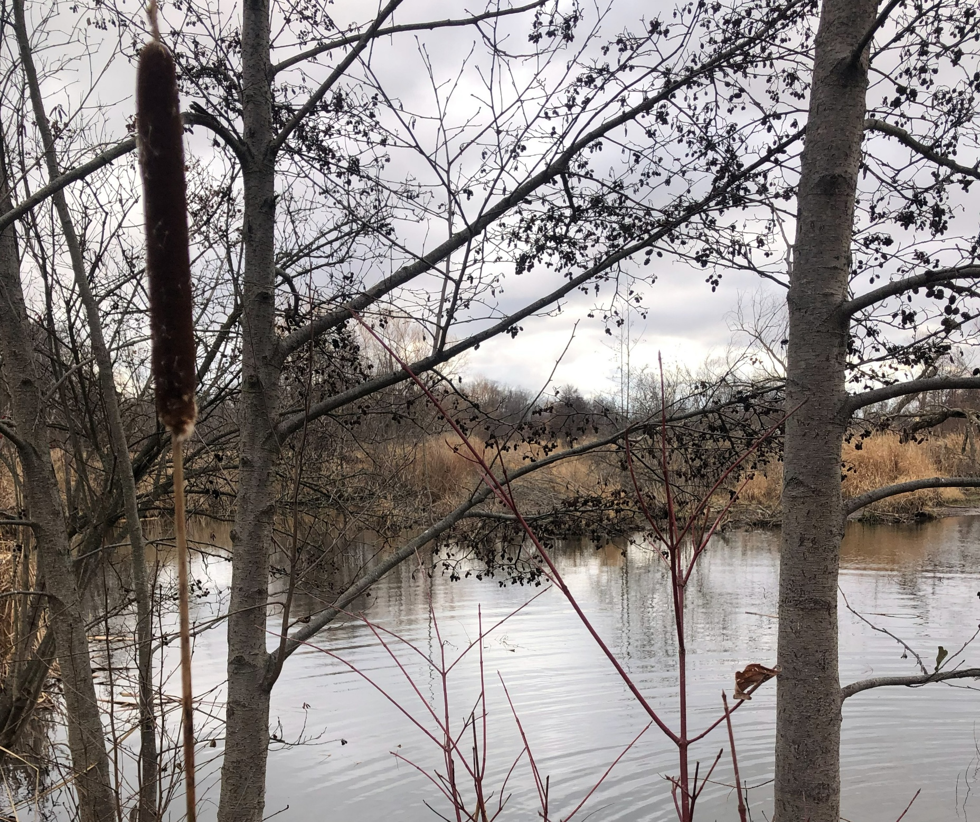
Site Investigations
Previous sampling in creek (30 cm) for PHCs and metals required replacement
Site characterization required for soil and groundwater
Additional sampling required for delineation

Slide 6
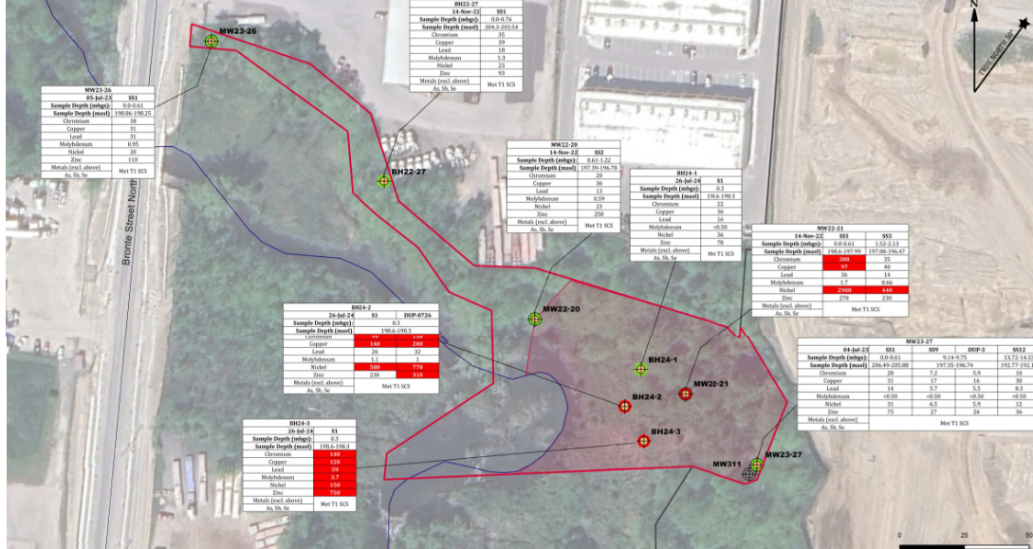

Slide 7
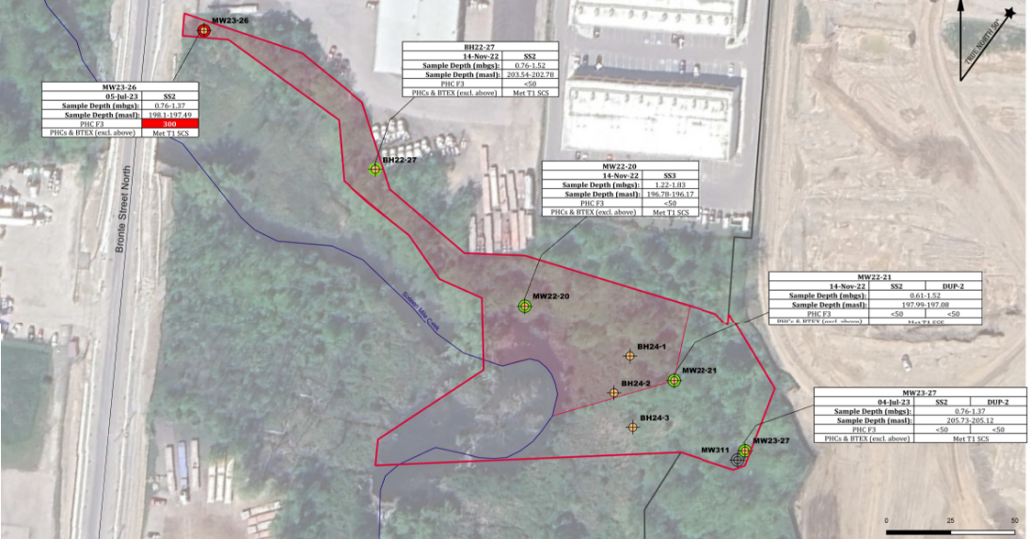
Non-Standard Delineation used for PHC F3 hit

Slide 8
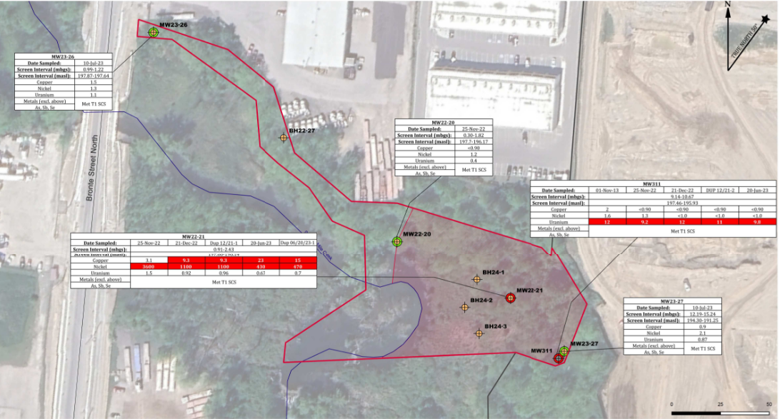

Slide 9
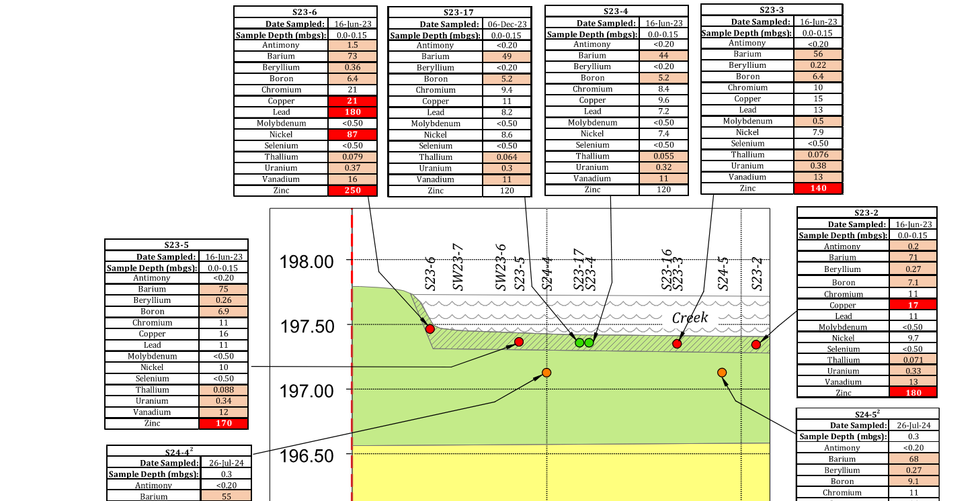
Retained COCs from creek:
Actual exceedances
Detected concentrations without standards
Raised MDLs
Soil exceedances
Soil→sediment exceedances

Slide 10
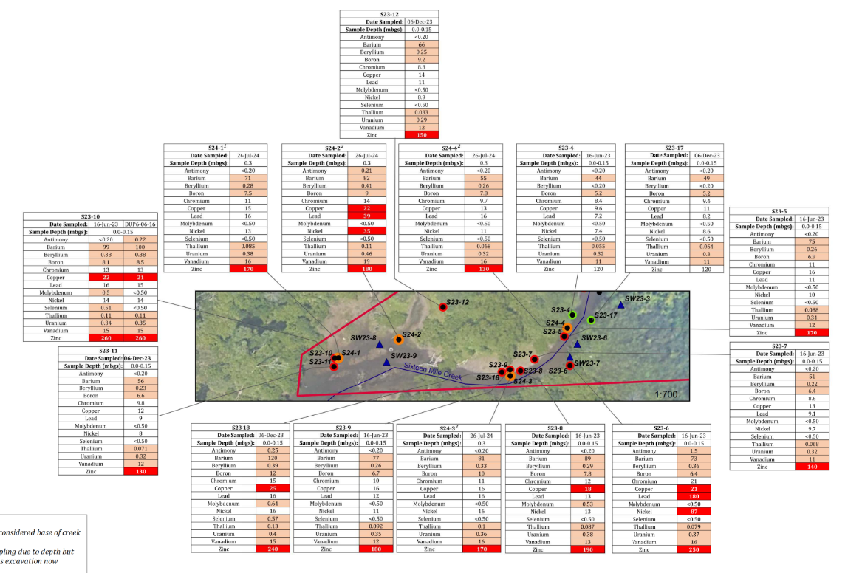

Slide 11
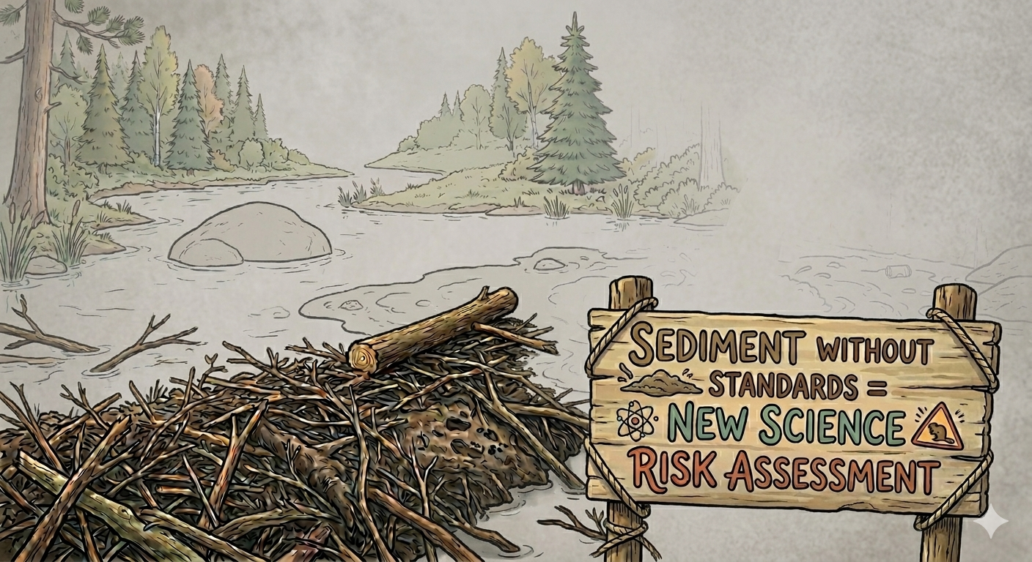
Risk Assessment Process
Iterative sampling process
New Science Risk Assessment due to sediment COCs without standards
Table 1 “Other Use” under O. Reg. 153/04
Goal to limit invasive remediation

Slide 12






























Plants and Soil Invertebrates
Carnivorous Mammals and Birds
Industrial Storm Sewer
Redside Dace
Recreationalist
Mammals and birds
Outdoor Worker
Semi-Aquatic Species
Benthic Invertebrates
Overburden
Silty Clay
Sand
Bedrock
eSolutionsGroup Ltd. 2015. Conceptual Site Model Builder Tool. Contractor report prepared for the Contaminated Sites Division, Safe Environments Directorate, Health Canada, Ottawa.

Slide 13

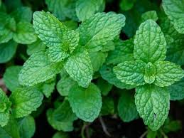
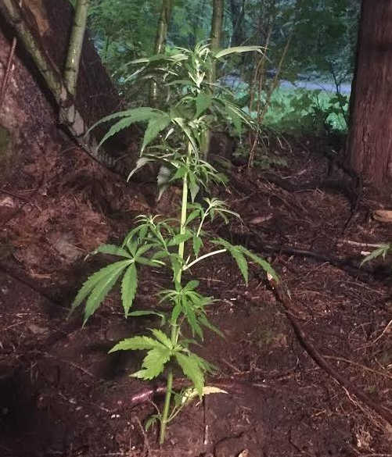
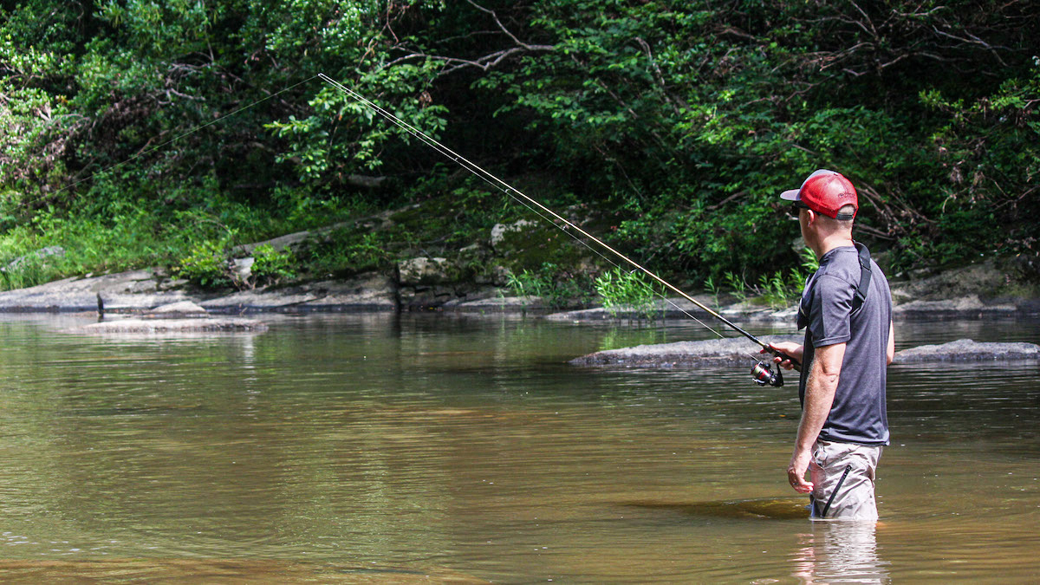
Additional Pathways

Slide 14
Human Health Risks
Risk Management Measure | Pathways | Receptors
Site Use Restriction- no RPI or ICC | Soil and Groundwater Contact Produce Ingestion | Residents and Indoor Workers
Site Access Restriction- Signage and Fencing | Soil, Groundwater and Sediment Contact Pathways | Recreationalists
Drinking Water Restriction | Groundwater Ingestion | Residents and Indoor Workers
Health and Safety Plan | Soil, Groundwater, Sediment and Surface Water Contact | Outdoor Workers, Trench Workers, Creek Workers (Including CPU Monitoring staff)
Soil, Groundwater, Sediment and Surface Water Management Plan

Slide 15
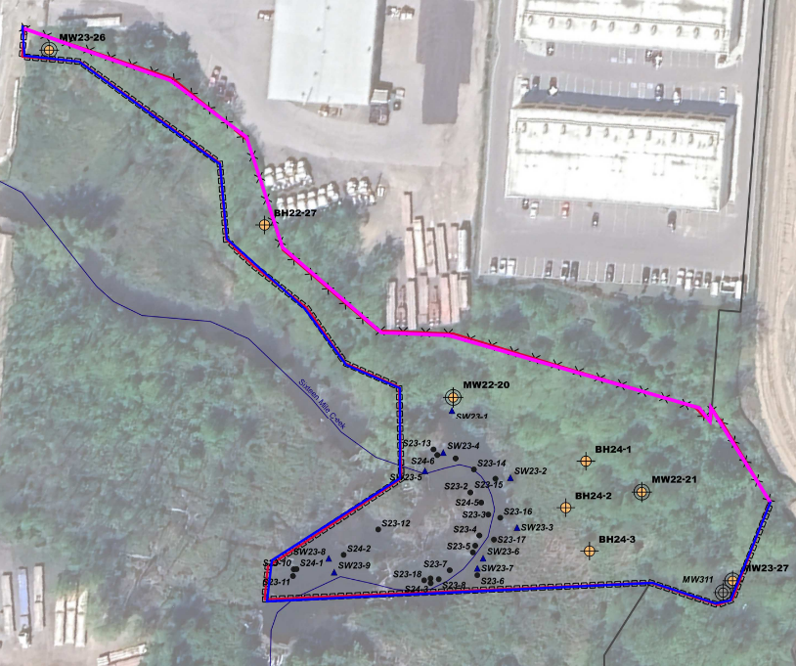
Risk Management Measures

Slide 16

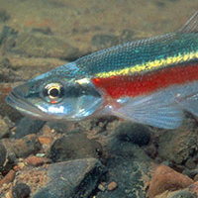
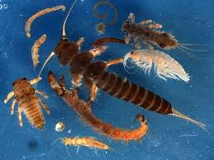

Ecological Receptors

Slide 17
Toxicity Reference Values
Various agencies and TRVs were considered
NEL: No Effect Level
LEL: Lowest Effect Level
SEL: Severe Effect Level
TEL: Threshold Effect Level
PEL: Probable Effect Level
MET: Minimal Effect Threshold
NA: Negligible Addition
MPA: Maximum Permissible Addition
SRA: Serious Risk Addition
Provincial Sediment Quality Guidelines
Canadian Council of Ministers of the Environment (CCME)
Ontario Background
MacDonald et al. 2000
Atlantic Risk Based Corrective Action
RIVM (Netherlands)
US Environmental Protection Agency (US EPA)
National Oceanic and Atmospheric Administration (NOAA)

Slide 18
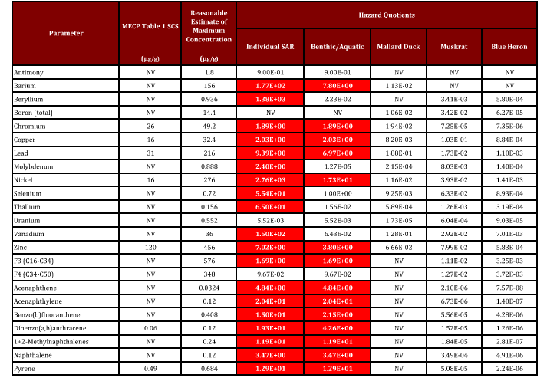
Unacceptable risks….now what?

Slide 19
Multiple Lines of Evidence
Sediment Toxicity
Benthic Survey
Regional Data
Surface Water Sampling
Additional soil and sediment sampling

Slide 20
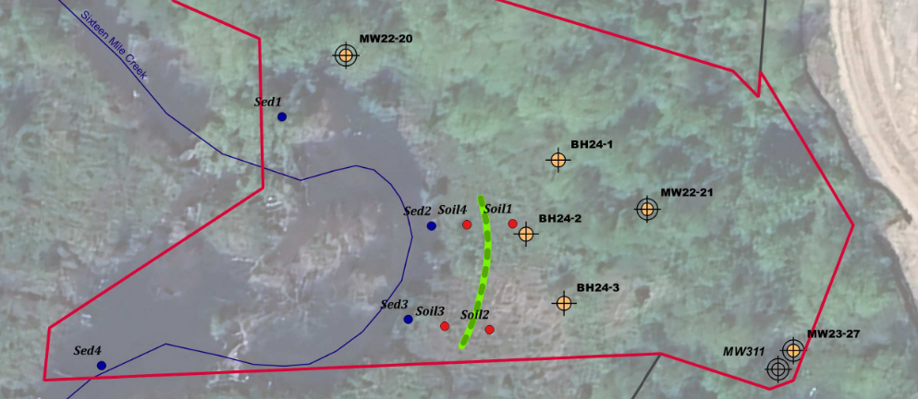
Silt Fencing

Slide 21
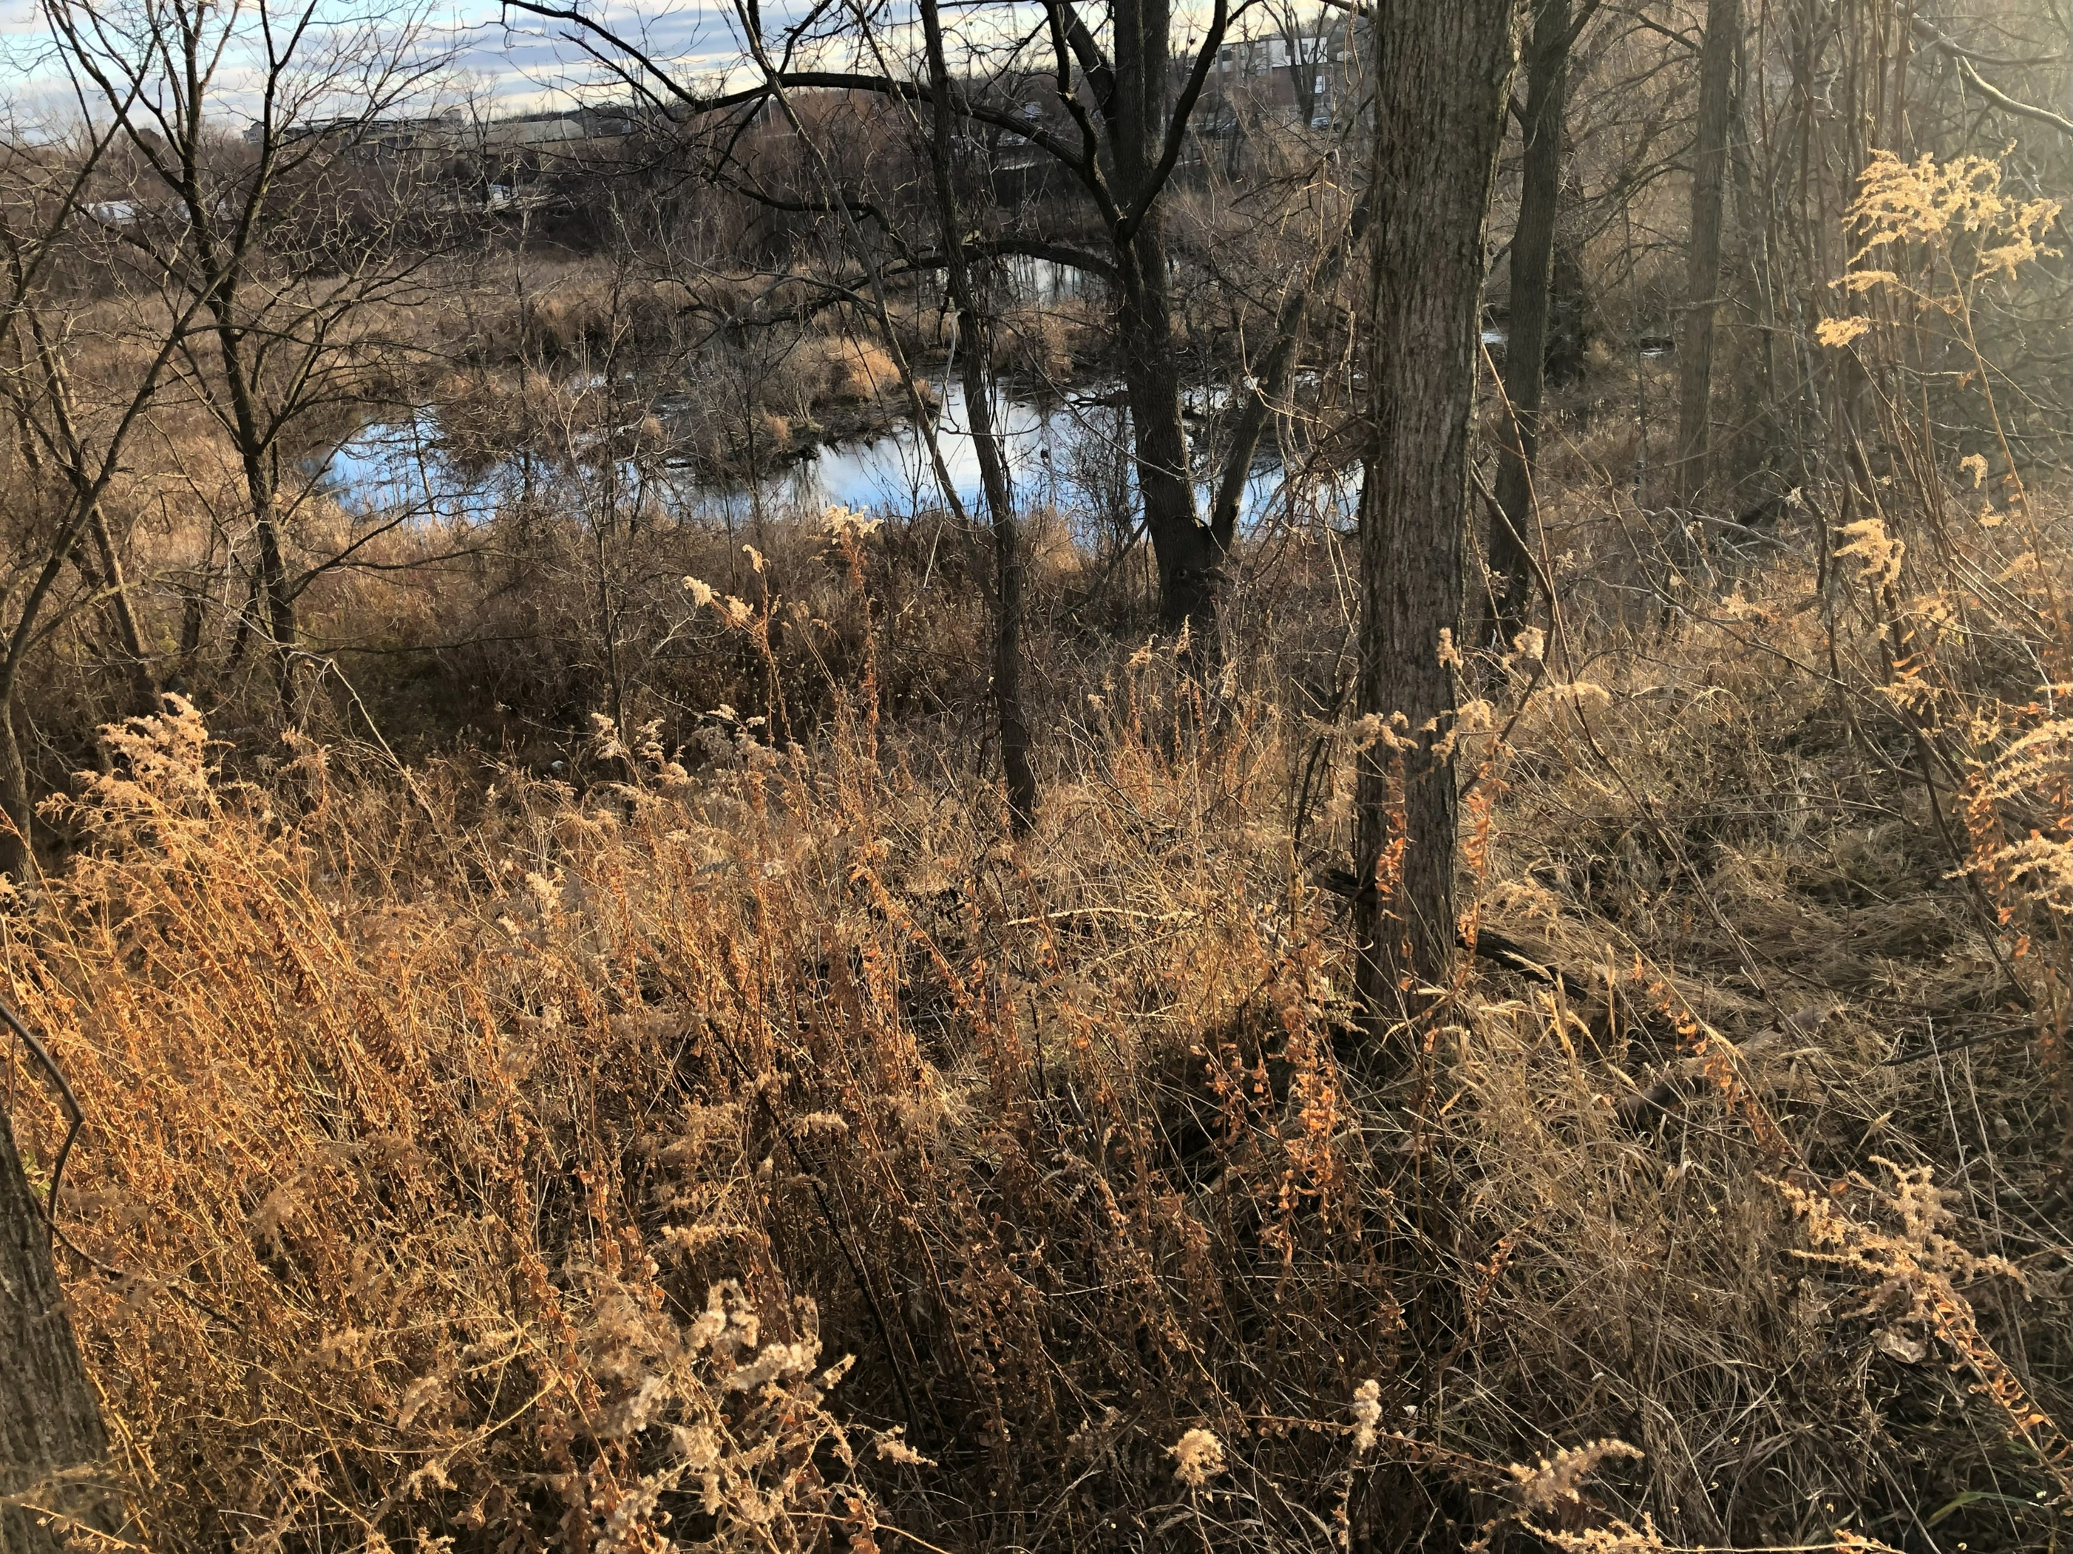
Creek Monitoring Program
Quarterly site visits for terrestrial health monitoring
Biannual soil and sediment sampling
Annual benthic survey sampling
Extensive contingency plans

Slide 22
Lessons Learned
Clear understanding of outcomes and pitfalls when dealing with sediment
Stakeholder engagement is key
Multiple lines of evidence is required when defending unique approaches
Monitoring programs require extensive contingency plans
Ongoing conversations with MECP early and often

Slide 23

Questions?
rmcmillan@dsconsultants.ca
No beavers were harmed in the making of this presentation.

