Slide 1
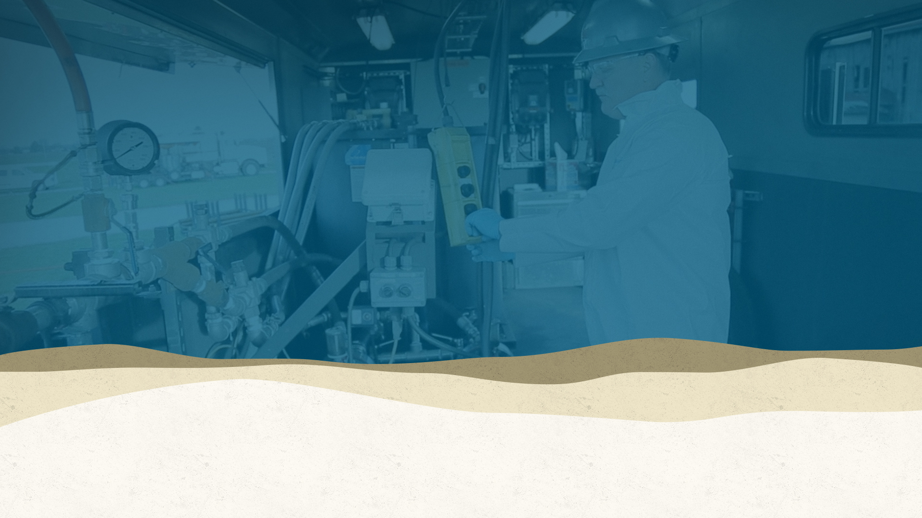

Design Considerations and Implementation Techniques for In Situ applications of Modified Clay for pfas sequestration
Mike Mazzarese
Senior Remediation Engineer
Denver, CO, USA

Slide 2
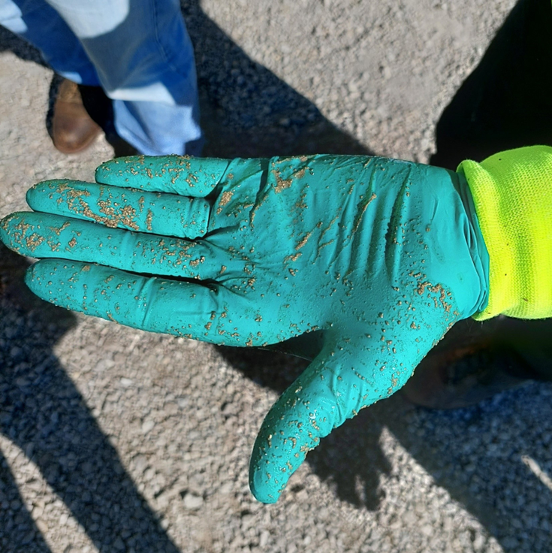
Presentation Outline
Review of Modified Clay (MC) Technology
  Comparison to other adsorbents
  Impact of co-contaminants
Application Techniques
  Injection
  Soil mixing
Review of In-Situ Application Data

Slide 3
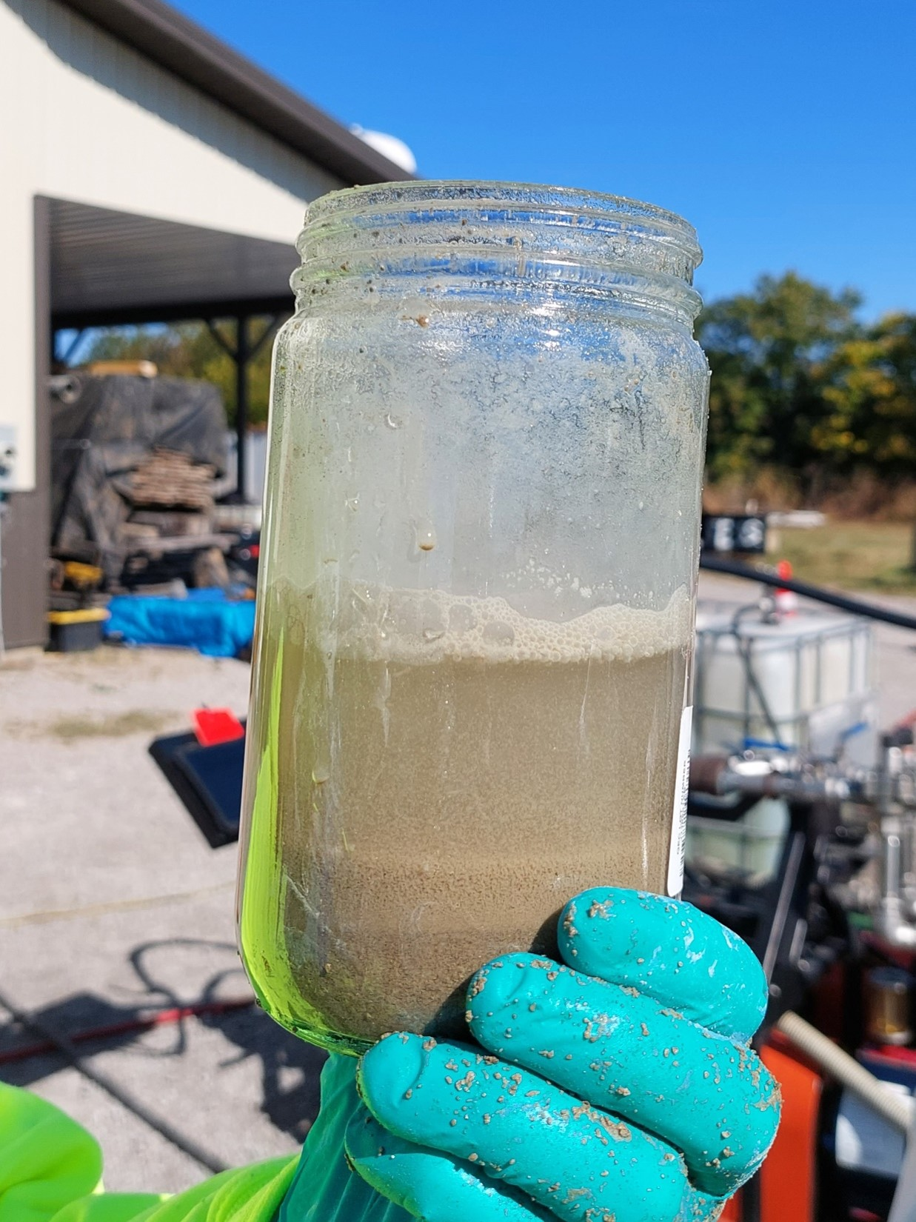
What is a Modified Clay?
Bentonite clay, modified by installing quaternary ammonium surfactants into the interlayer space via cation exchange
Does not swell
High sorption capacity, not significantly affected by co-contaminants
Established for PFAS sequestration ex-situ (e.g. P&T)
In-situ mixing applications started 2019
  Multiple large-scale mixing projects completed in Canada, US, Australia, and Europe
  But can we inject it?

Slide 4
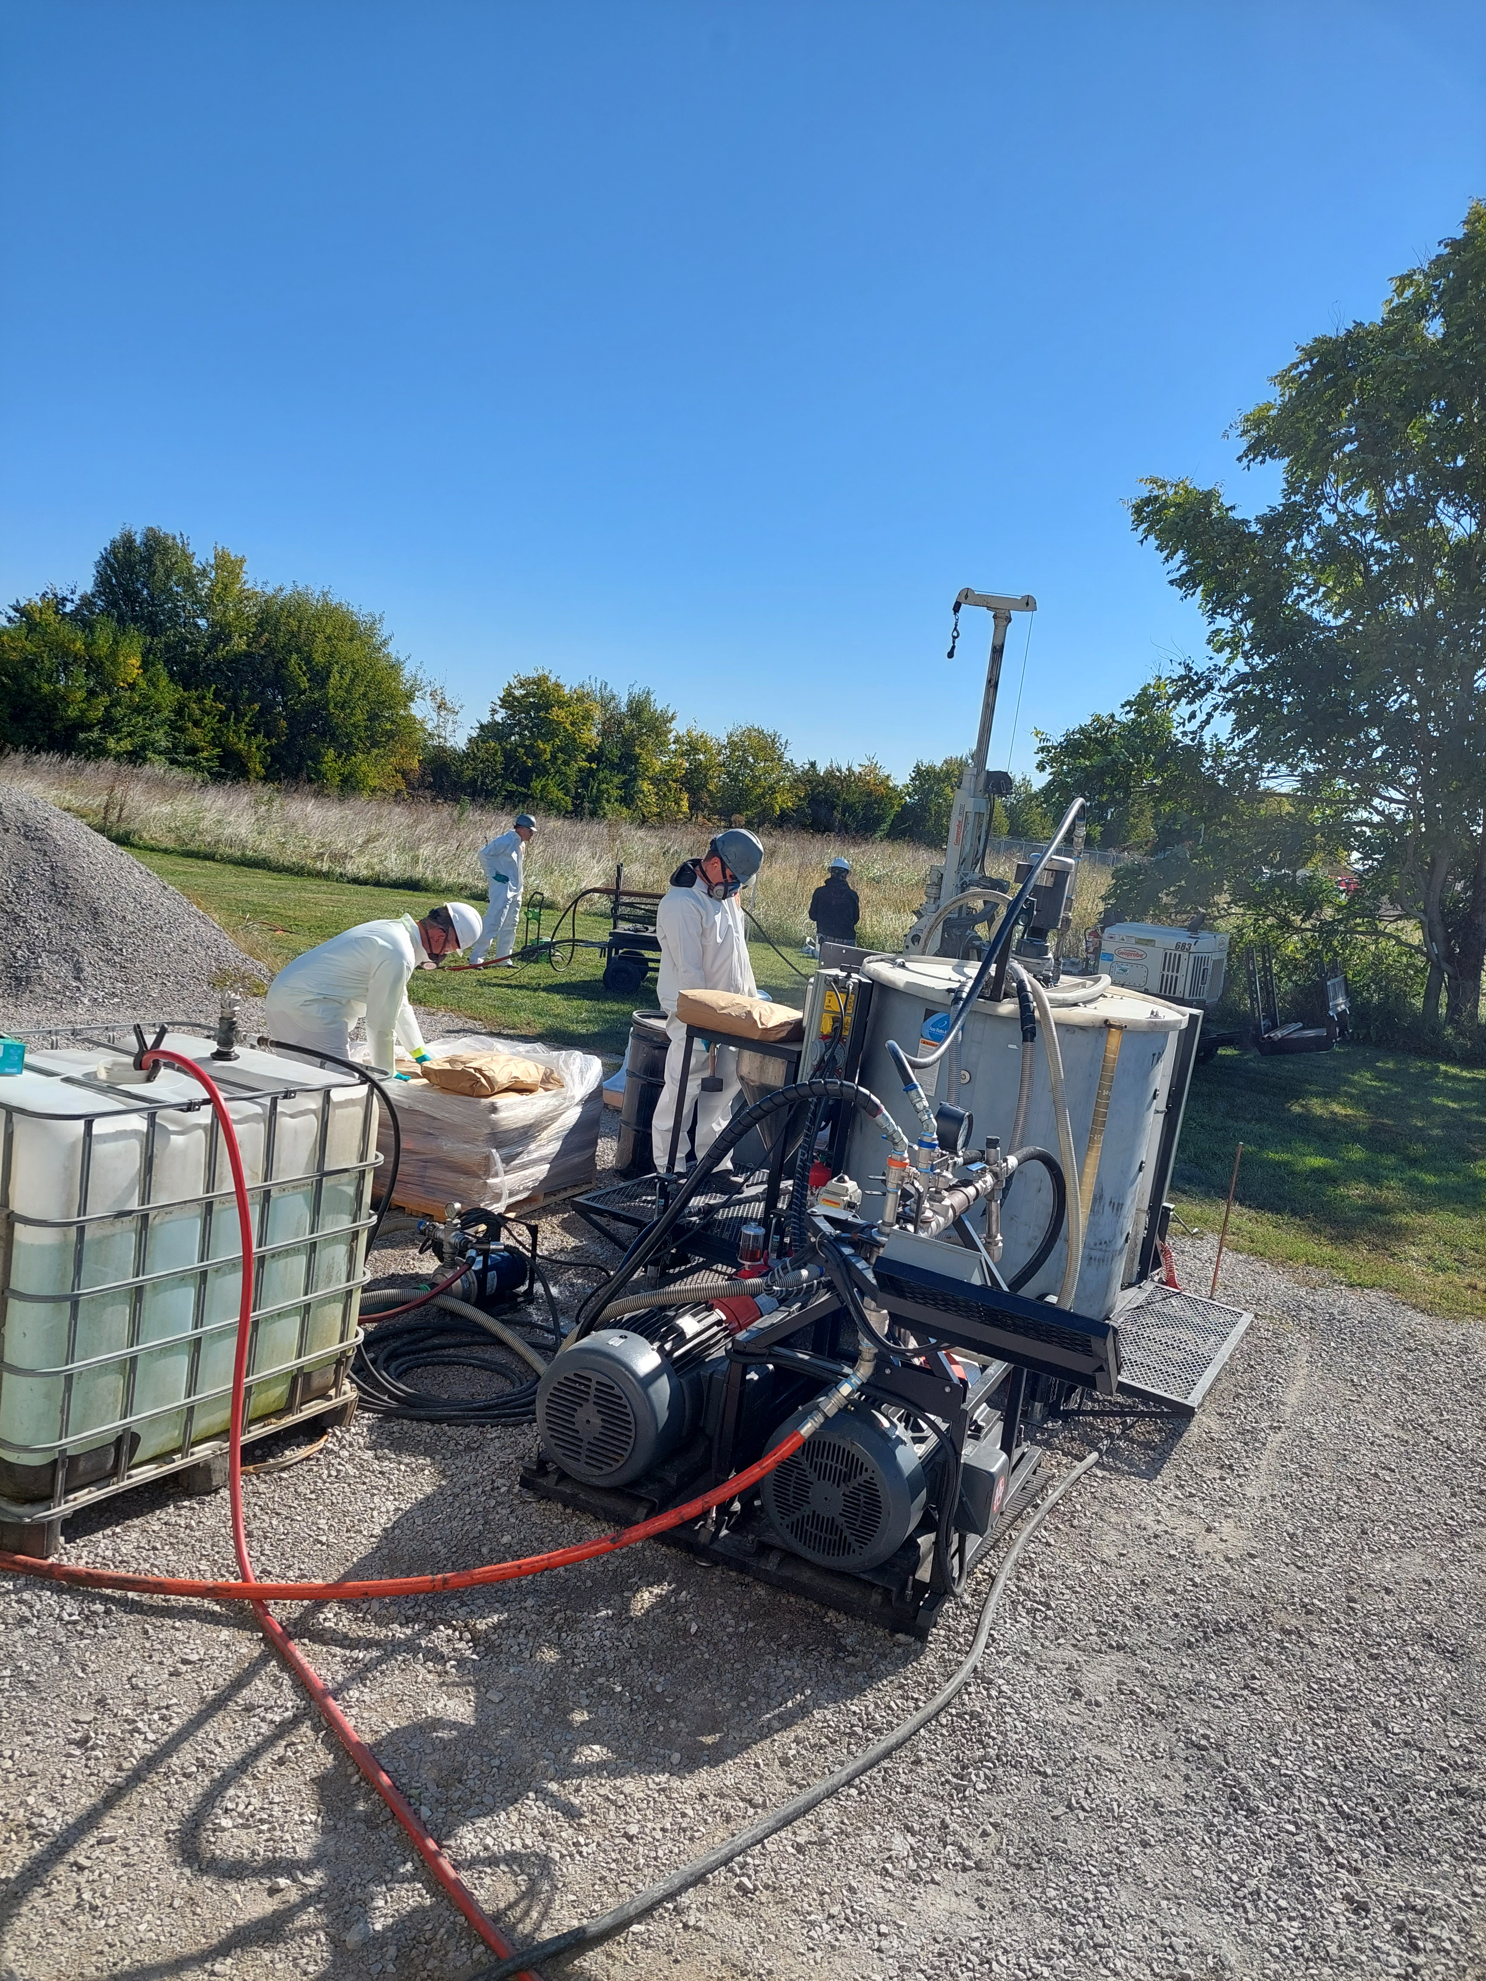
In-situ Applications of MC
September 2022 field testing trials began
  Multiple grain sizes tested for injectability and distribution
    FS-P 97% finer 250 µm
    FS-100 92% finer 850 µm
  Important for matching grain size to geology/mass flux
  Injection system design/selection critical due to high settling velocity
October 2023 first injection application at impacted site (Canada)
Field applications completed in USA, Canada, and Europe to date

Slide 5
Comparative Assessment
40 mg adsorbent + 500 mL AFB groundwater;
7-day equilibrium
Total PFAS: IER > MC > GAC > Biochar
Long Chains: IER ≈ MC > GAC > Biochar
Reference: Yan, B., Munoz, G., Sauvé, S., and Liu, J. (2020) “Molecular mechanisms of per- and polyfluoroalkyl substances on a modified
clay: a combined experimental and molecular simulation”, Water Research, 184, 116166.

Slide 6
Impact of co-contaminants
Not significantly impacted by presence of other contaminants
May be able to be combined with other technologies
Reference: Yan, B., Munoz, G., Sauvé, S., and Liu, J. (2020) “Molecular mechanisms of per- and polyfluoroalkyl substances on a modified
clay: a combined experimental and molecular simulation”, Water Research, 184, 116166.

Slide 7
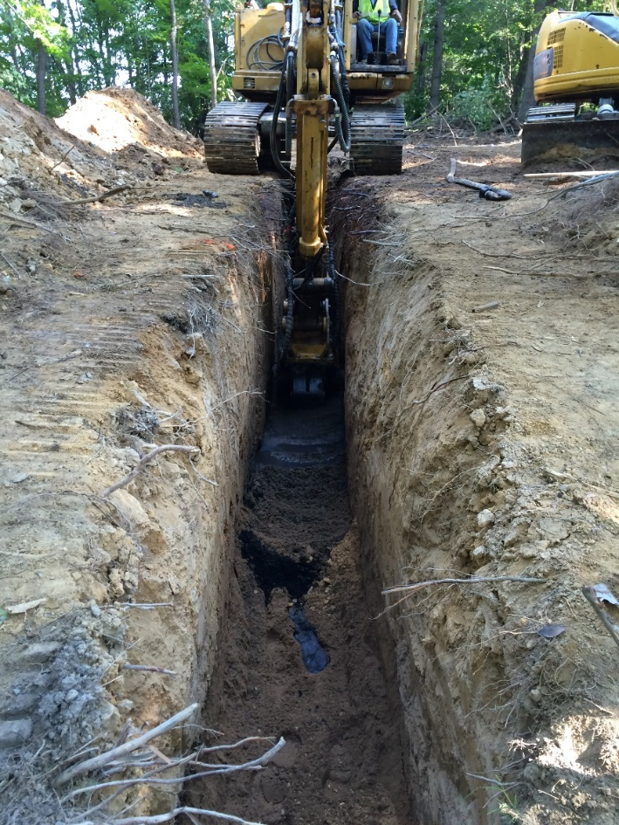
Permeable Adsorptive Barrier (PAB) Design
Most common application
  Due to plume size and product immobility
Trench approach
  Ideal for shallow applications, blend of MC + sand at typ. 1-5% w/w
Injection approach
  Multiple, tightly spaced rows
    Sorption zone width determined by mass flux and slurry density considerations
  Injection point spacing typ. 1.5-3 m

Slide 8
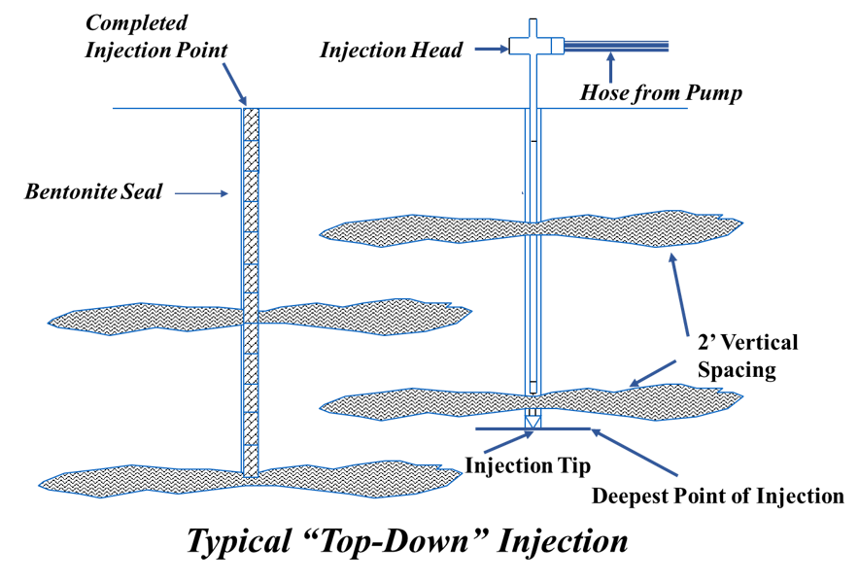
Overburden Slurry Injection
Slurry injection best practices
  High flow rate (e.g. 130 Lpm) and port exit velocity
  Relatively small injection volumes per interval (e.g. 40-100 L)
  Interlocking pattern
  Top-down progression
Traditional direct push for overburden applications
Pre-drill an option for DPT refusal
  Demonstrated on numerous sites in Canada (non-PFAS sites)
Notes:
We’re trying to install small pulses of material into a small area over very short T
Other products and methodologies may use this same technique to some degree, but typically target high k zones only

Slide 9
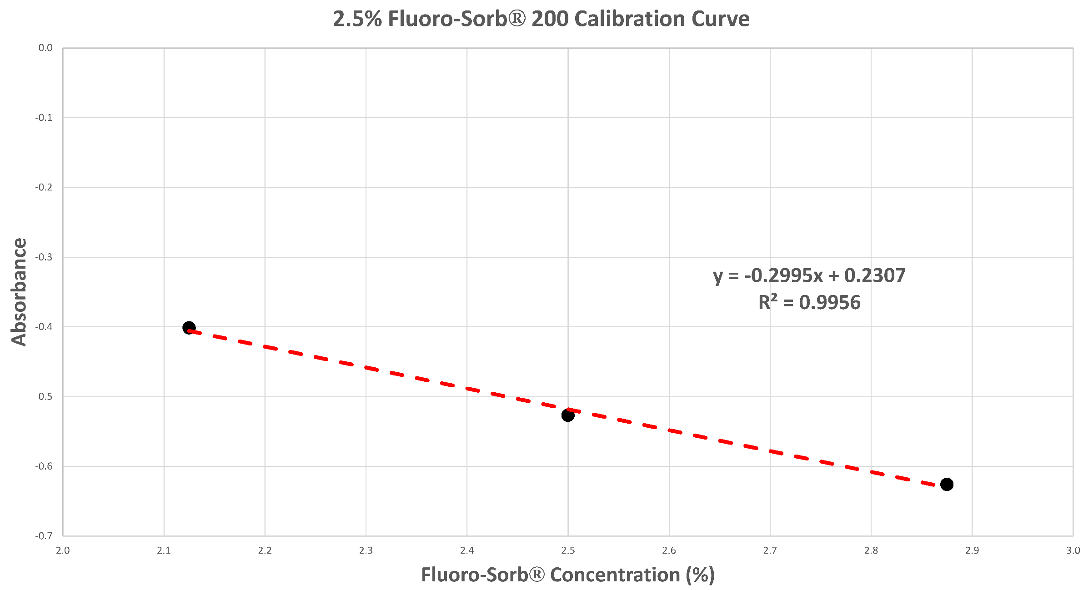
QA/QC Distribution Assessment
Amenable to semi-quantitative dye adsorption testing (developed by VEI)

Slide 10
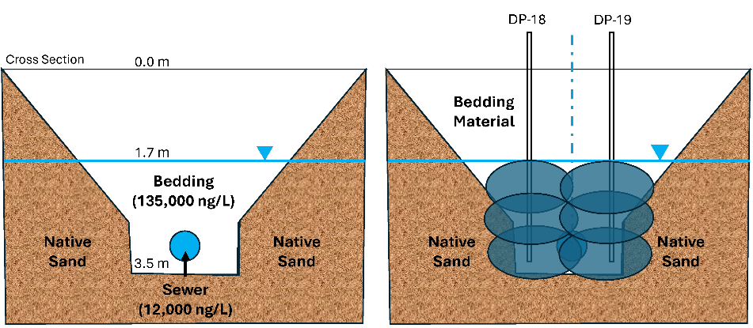
Examples of Projects Completed
Military Site, Canada
  Downgradient of FFTA
  Impacted sewer bedding material, PFAS discharging to wetlands
  122,000 to 135,000 ng/L PFAS
  K value 100x native sand
  Pre/post hydraulic conductivity testing
  Dye testing performed to verify distribution
DPT injection
36% w/w slurry
1.5 m injection spacing
1.7-4 m injection horizon

Slide 11
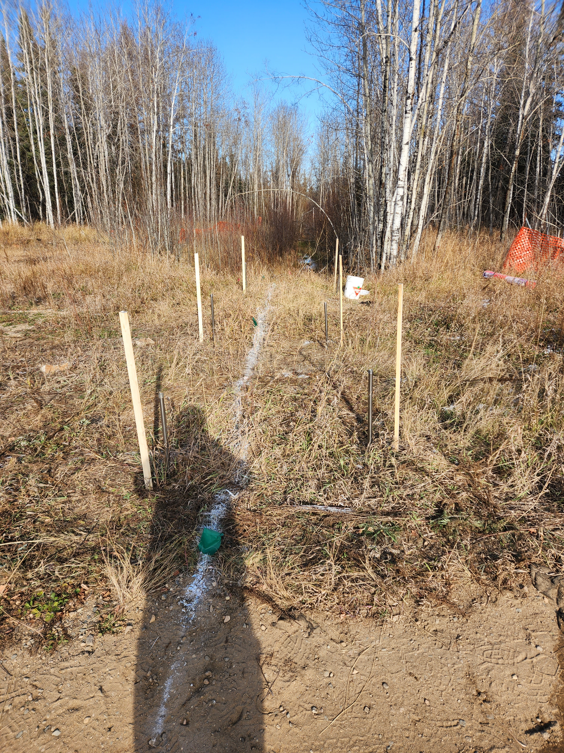
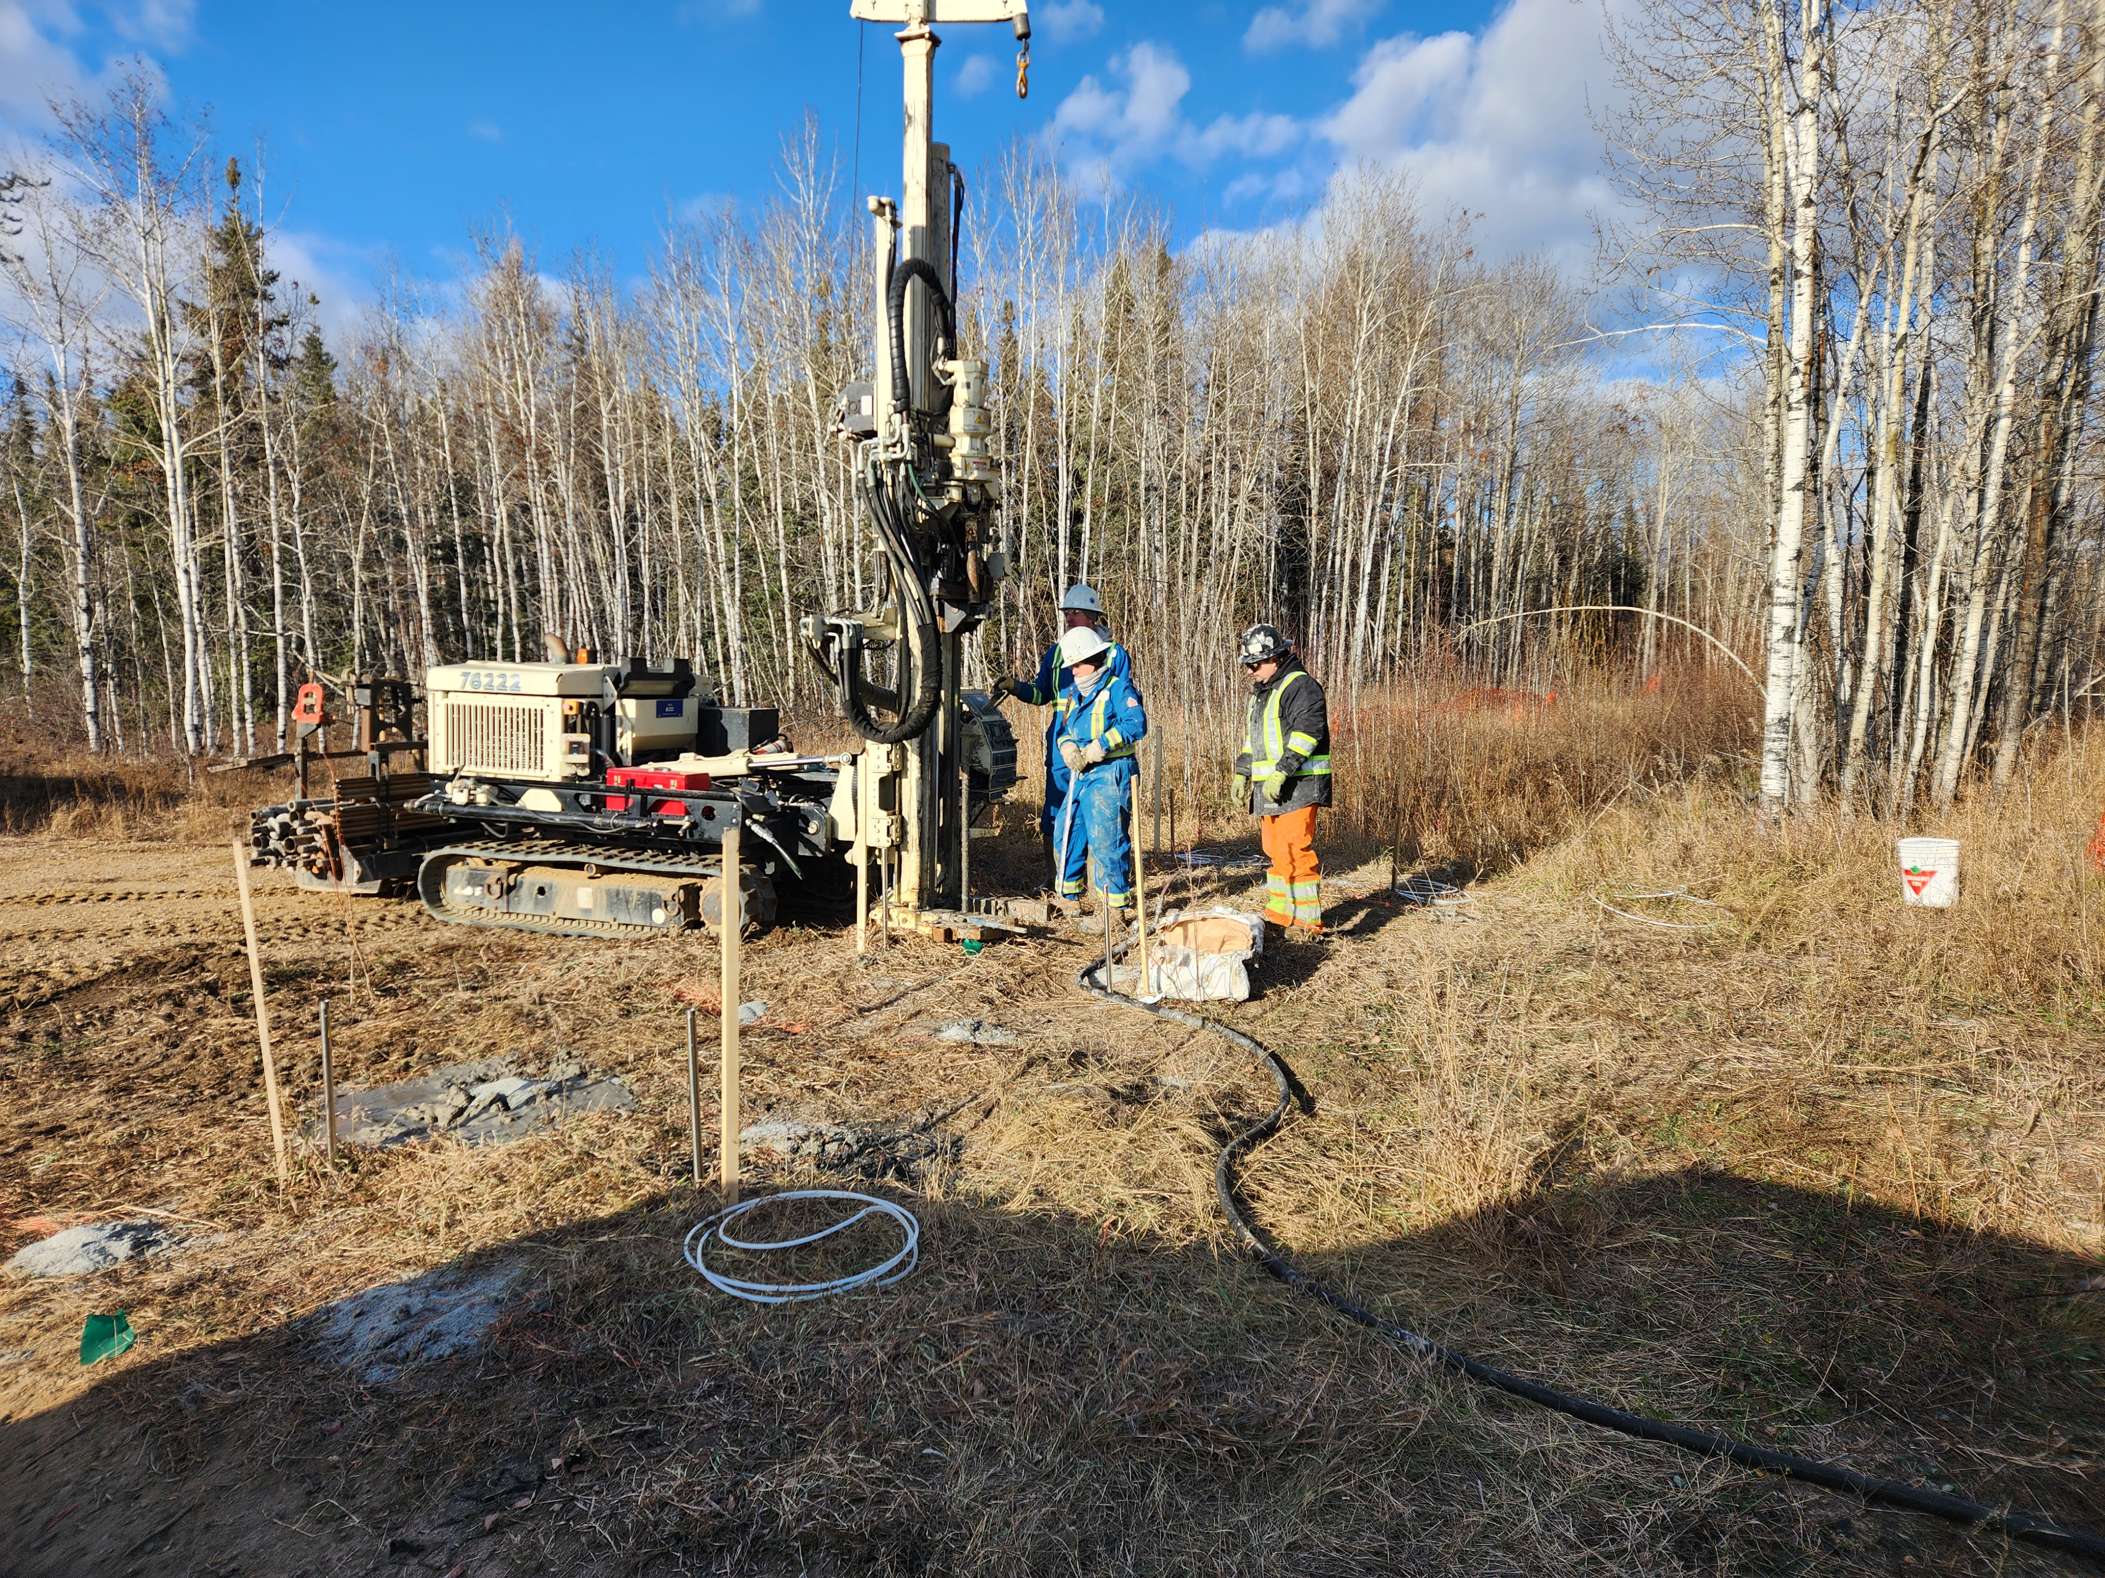
Pilot Test Photographs

Slide 12
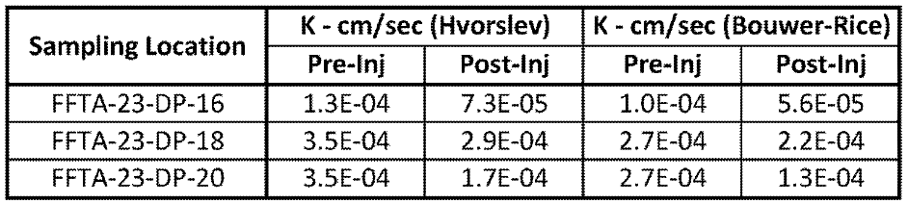
Maintaining Hydraulic Integrity
Slug tests before and after the injection event
  Approximately 0.2 orders of magnitude (OOM)
  Change falls within the testing margin of error
Confirmed that MC would not hinder natural groundwater movement

Slide 13
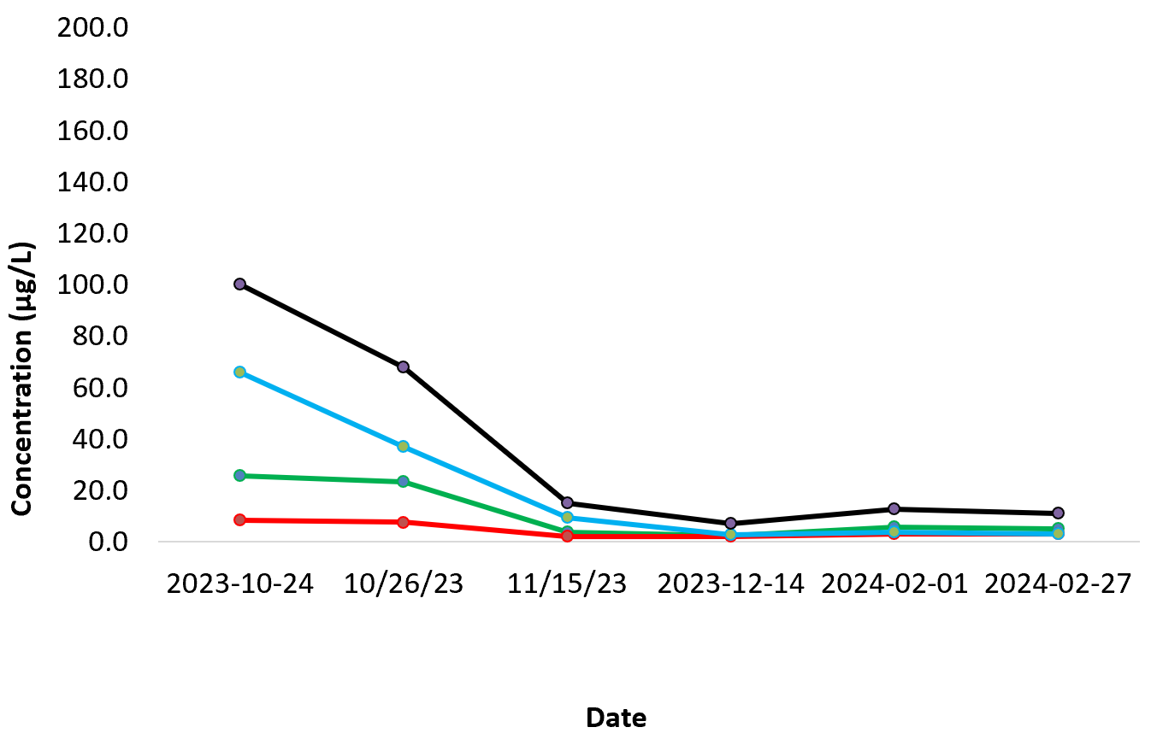
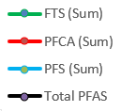
Reductions
Total PFAS: 89% (avg.) at 4 months
  80% for fluorotelomer sulfonic acids
  63% for perfluoroalkyl carboxylic acids
  96% for perfluoroalkyl sulfonates.
Total PFAS: 93% (avg.) at 9 months
  91% for fluorotelomer sulfonic acids
  66% for perfluoroalkyl carboxylic acids
  97% for perfluoroalkyl sulfonates.
High flux event from rapid snowmelt
PAB maintained its efficacy

Slide 14
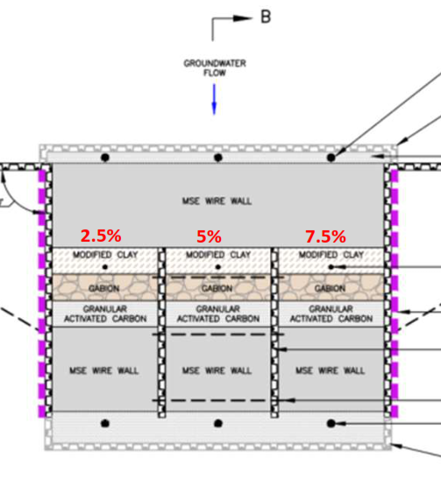
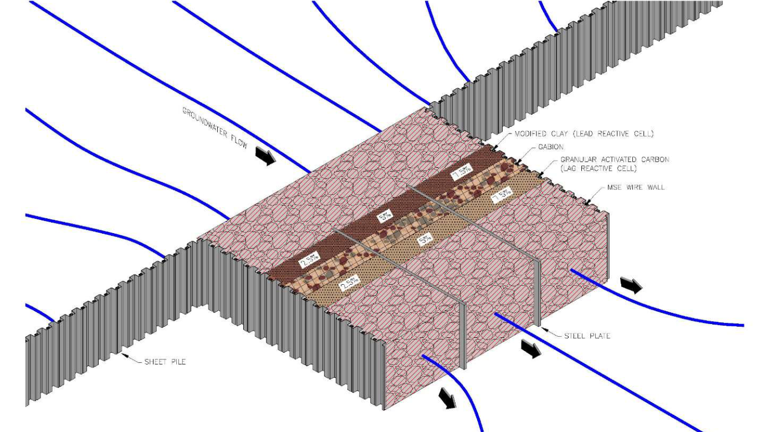

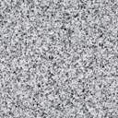

Funnel & Gate PRB Example
Funnel
Gabion
Gate
Granular Activated Carbon
Mechanically Stabilized Earth
Courtesy of AtkinsRéalis

Slide 15
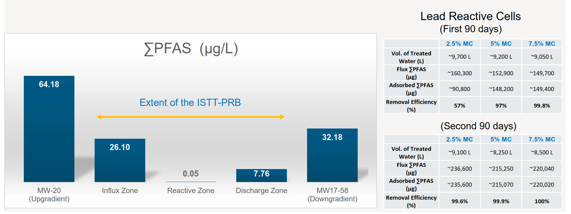
Funnel & Gate PRB Data
Downstream, no
treatment material
Courtesy of AtkinsRéalis

Slide 16
Examples of Projects Completed
Chrome Plating Facility
  Mixture of PFAS and hexavalent chromium
  Colloidal carbon and MC bench tested with calcium polysulfide (CPS)
  MC co-injected with CPS in PAB and source area configurations in large-scale (60 IPs) pilot test
  Baseline concentrations
    PFBS max = 5,300 ng/L
    PFOS max = 600,000 ng/L
  Current downgradient concentrations (~3m downgradient of PAB)
    PFBS = 150-310 ng/L (94-97% reduction)
    PFOS = 2.9-490 ng/L (99.9+% reduction)

Slide 17
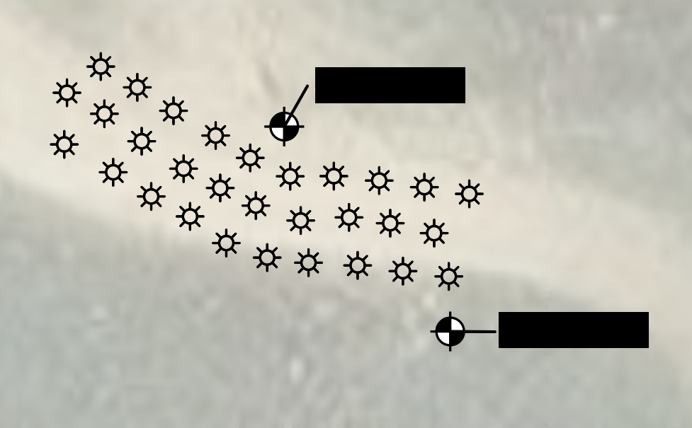
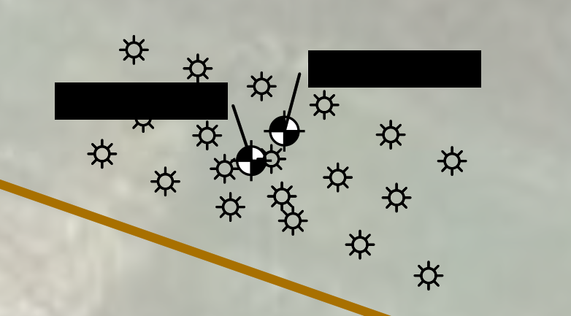
Examples of Projects Completed
Two pilot tests performed in Fall 2025 at active refinery
  PAB and plume/grid configurations
  Presence of PHC (F2/F3)
  PAB results > 3 mo
    PFOA max = 80 ng/L, current = 13 ng/L (83% red)
    PFOS max = 530 ng/L, current = 77 mg/L (85% red)
  Grid results > 3 mo
    PFOA max = 160 ng/L, current = 19 ng/L (88% red)
    PFOS max = 4,800 ng/L, current = 1,200 mg/L (75% red)
  Short chain % reductions (e.g. PFBS) are similar
PAB Layout
Grid Layout

Slide 18
Next Steps
SERDP (US DOD) grant to compare MC to existing colloidal carbon PAB (Fall 2026)
Fractured bedrock application using straddle packers (2026)
CVOC + PFAS combined remedy pilot testing (completed 2026)

Slide 19
Summary
Modified clay (MC) is a viable and sustainable technology for in-situ sequestration of PFAS
Presence of co-contaminants does not significantly impact performance, very important for sites with co-contaminants or high TOC
MC can be injected into the subsurface using established slurry injection techniques and equipment

Slide 20
Thank you for your time. Questions? mmazzarese@astenv.com
+1 303-880-4714

