Slide 1
PFAS in Air – Analysis and Monitoring for Thermal Products of Incomplete Destruction
RemTech East - April 2026
Presented by: Tammy Chartrand

Slide 2
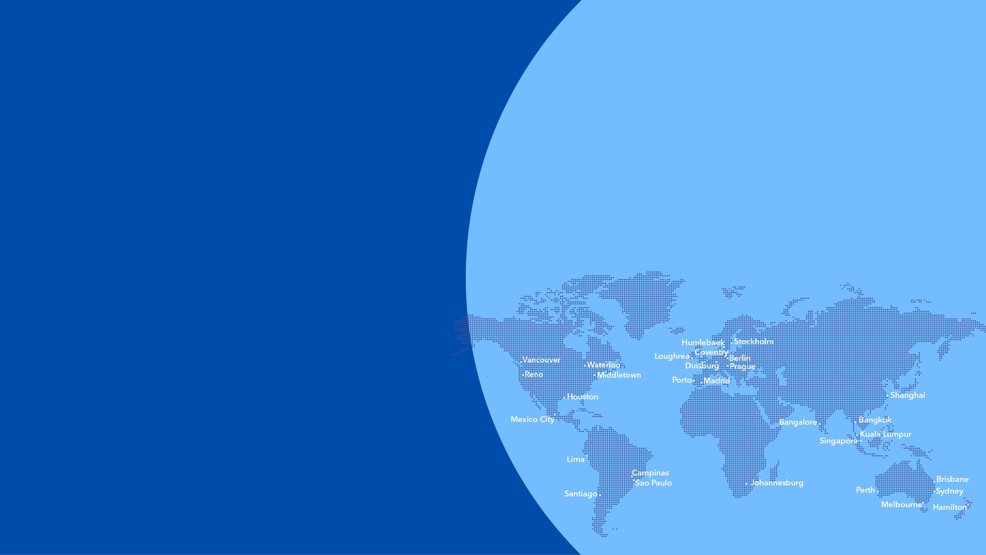
Who we are
Countries
Locations
A global leader in testing
70+
450+
ALS provides comprehensive testing solutions to clients in a wide range of industries around the world.
Staff worldwide
Revenue (AUD)
22k+
2.9b+
Our values
SAFE
RESILIENT
CURIOUS
COMMITTED
CARING
HONEST
Our brand promise
right solutions. right partner.
Our vision
To be the global leader in the discipline of scientific analysis in pursuit of a better world for all.
Our mission
To help our clients leverage the power of testing and data-driven insights for a safer and healthier world.
Our purpose
To help make the world a better place through science, assurance, and sustainability.

Slide 3
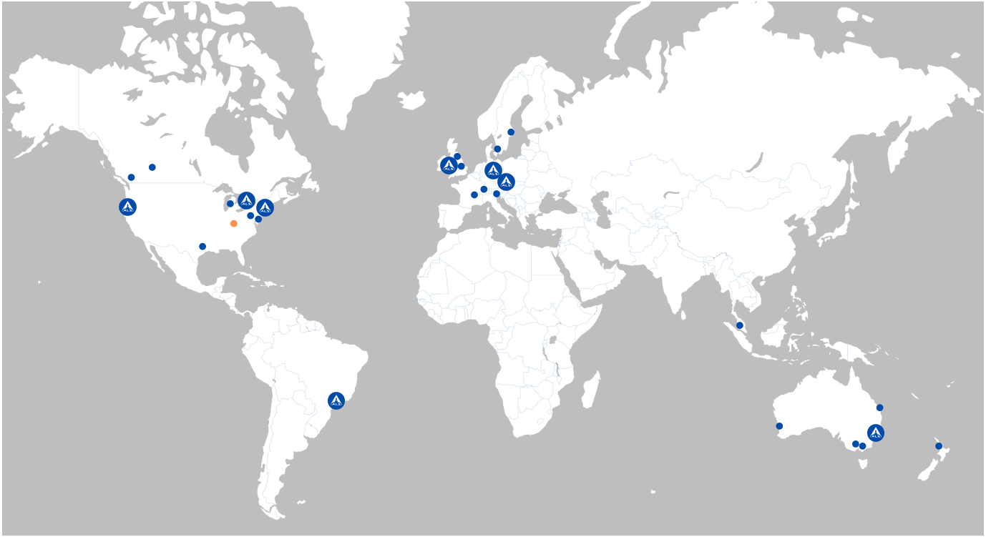
27 PFAS Testing Labs
Across Asia Pacific, Europe and Americas

Slide 4
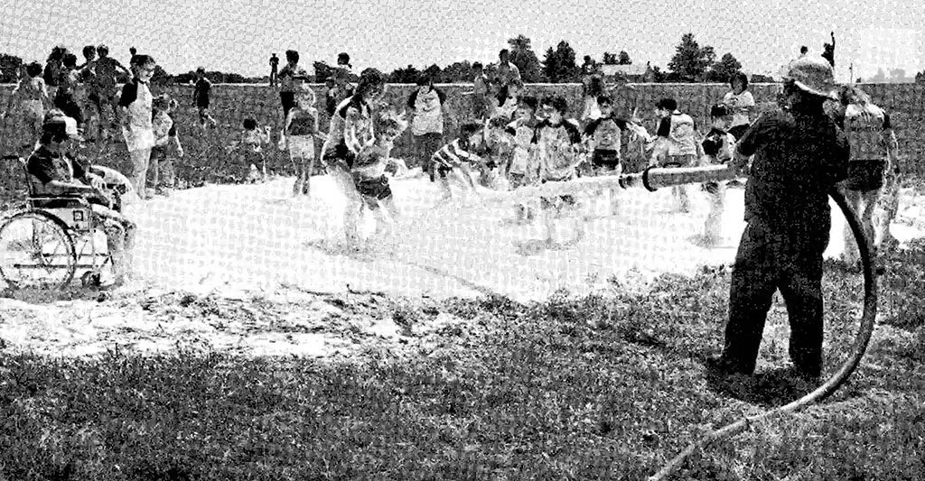
Outline
Where are PFAS Compounds in Air?
Why are we concerned about them?
What PFAS can be analyzed in air?
How do we sample and analyze for them?
What's Next?
https://earthjustice.org/feature/breaking-down-toxic-pfas
4

Slide 5
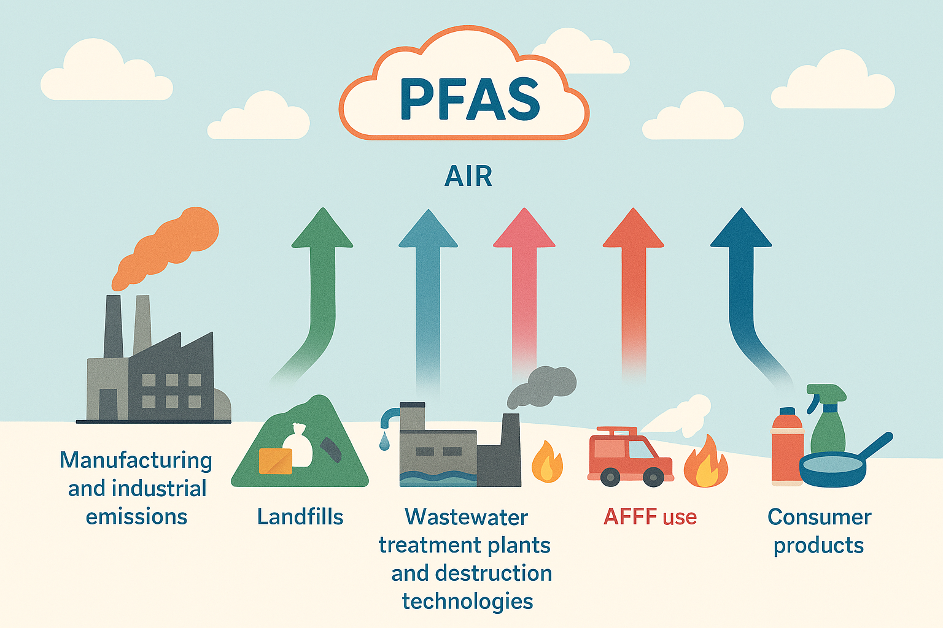
Where: The Sources
Notes:
PFAS contains such a broad range of compounds their volatility also varies based on their structure and chemical properties. Compounds like PFOS and PFOA have low vapor pressures and high water solubility, their ability to partition from water into the air is restricted, but still can be dispersed bound to water droplets or airborne particulate. Conversely other PFAS, such as Fluorotelomer alcohols have properties that enhance their volatility, enabling them to more readily transition into the atmosphere.
When it comes to sources of PFAS in air, they are not all that different from the sources of typical soil and groundwater contamination, however it might not be as clear as to which are the main contributors of contamination since this pathway is not as well understood. There are emissions from manufacturing and industrial facilities, from landfills as biogas, from wastewater treatments plants and waste facilities, AFFF release, and even off-gasing from everyday consumer products. This can include volatile PFAS in the gas phase, and/or PFAS that have sorbed onto particulate or water and are expelled into the air.

Slide 6
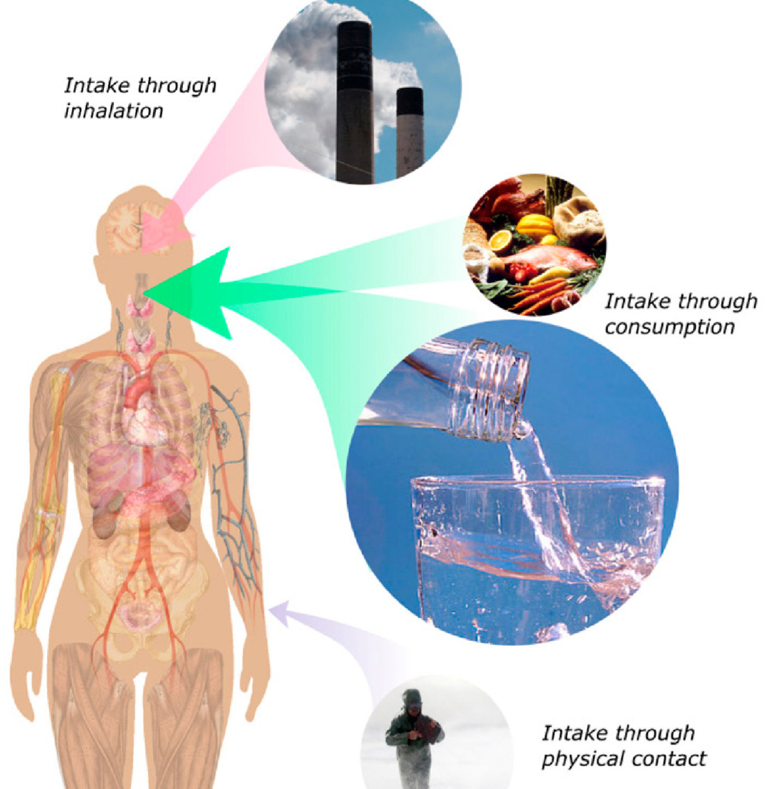
Why : Environmental and Health Implications
PFAS Release
Short / long range dispersion
Atmospheric deposition (wet or dry)
Sea Spray
Further Environmental Contamination
Notes:
For Human Health concerns, of course once in the air, PFAS can be inhaled, contributing to health concerns that have been linked to PFAS exposure affecting the liver and kidneys, immune systems, fat metabolism and developmental or reproductive concerns. While inhalation exposure is likely less relevant than ingestion through food and water, or dermal exposure, it is another pathway for PFAS to enter the body. A compounding issue is that it enables atmospheric transport of PFAS, which can result in a wider area of exposures through these other routes.
In the environment, any volatile or airborne PFAS can be dispersed and deposited in the surrounding area, either by dry or wet deposition that can then contaminate the surrounding soil, surface water and beyond.
It also enables long range transport, with PFAS being found in remote northern regions, far from any potential sources. These are believed to be enabled by both from atmospheric transport of volatile precursors and subsequent transformation, as well as ocean current transport which can then be released to the atmosphere via sea spray.

Slide 7
What: PFAS Analysis in Air
Stack/source sampling
Canister collection
GC-MS/MS
30 compounds (mostly PID)
Not many known compounds in this category
Ambient sampling
ASTM D8591 - TD tubes
OTM-55 - PUF/XAD traps solvent elution
GC-MS/MS or LC-MS/MS
FTOH, sulfonamides and others
Stack/source sampling
Sampling train collection
LC-MS/MS
49 compounds (typical water analytes)
Source: US EPA
Notes:
There are different approaches that can be used to target the different types of PFAS found in air, based on their structure and properties, This is a great visual from the US EPA showing method suitability based on volatility and polarity. The first standardized air method developed by the US EPA is OTM-45, targeting polar, semi-volatile and particulate bound PFAS which includes many of the known compounds of concern typically included in standard methods for water (EPA methods 1633, 533, and 537.1) with some additional compounds for a total of 49. OTM-50 focuses on non-polar volatile PFAS, primarily products of incomplete combustion with a target list of 30 compounds distinct from OTM-45, relying on canister sampling and analysis by GC-MS.
Then there is the non-polar semi volatile compounds, such as fluorotelomer alcohols. An EPA method OTM-55 was under development for that group although with the recent demise of the US EPA. Office of Research and Development (ORD), it is looking less likely that the EPA will be driving that development.
All this to say that as with most PFAS testing, this is not a one size fits all, but rather a series of approaches to create a more complete picture of PFAS dispersion, and provide a level of evidence to monitor and track PFAS in air.

Slide 8
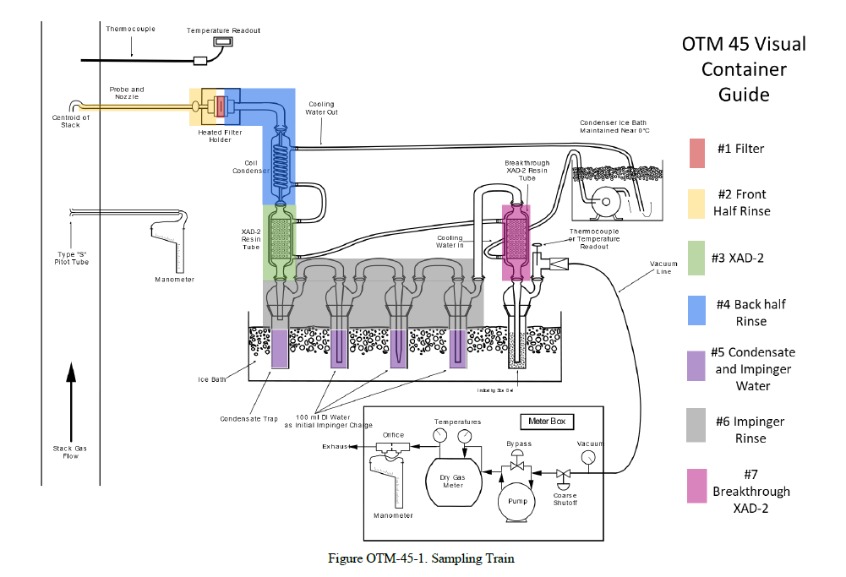
How: OTM-45 (Polar Semi-Volatile)
Stack sampling
Analysis by LC-MS/MS
49 compounds (typical water analytes)
Notes:
Method targeting Polar-semi volatile PFAS in air from stationary sources. This method was developed for stack emissions from stationary sources, relying on filter, XAD sorbent tubes, and a series of impingers for sample collection, with 4 final extracts analyzed by LC-MS/MS. Targets are mostly the same analytes we would see for water methods such as EPA 1633.

Slide 9
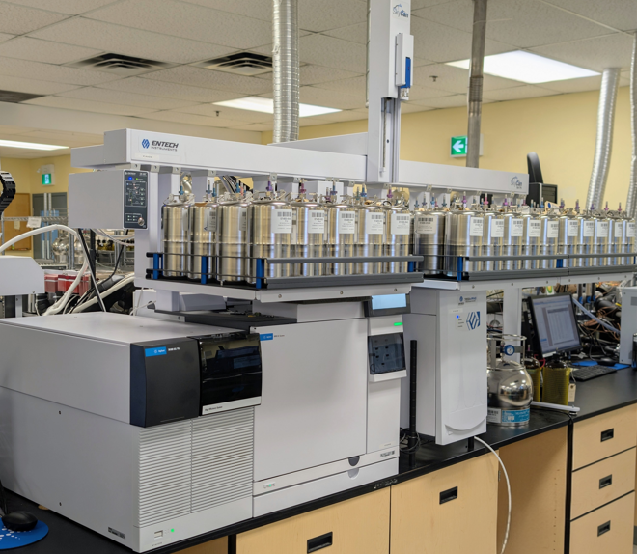
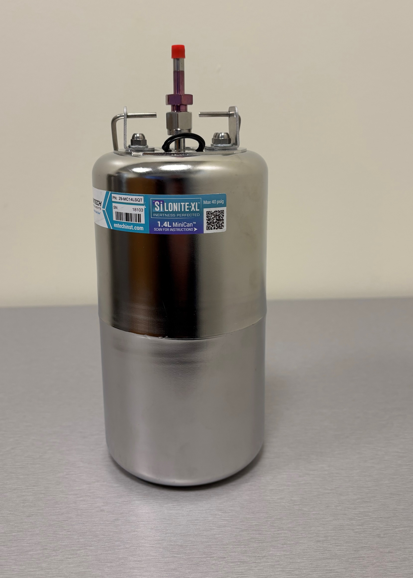
How? OTM-50 Evacuated Canisters, GC-MS/MS
Sampling Times : 4,10, 20 or 60 minutes
1.4L Silonite canister
Dedicated PFAS canisters
Agilent 7010D GC-MS/MS
Entech 7200-PFAS pre-concentrator and SK-75 autosampler
Passivated silicon ceramic lined stainless-steel
Notes:
The sample is collected in a 1.4 L silonite canister, that is exclusively dedicated to PFAS. And you can see here the GC-MS/MS here that is used for analysis.
Tie canister selection to OTM-50 specification: Section 6.1.10. Passivated silicon ceramic lined stainless-steel canisters are specified. "The suitability of electropolished (SUMMA) canisters has not been evaluated for this method.“The silicon ceramic coating is more prevalent and more inert than the traditional SUMMA passivation

Slide 10
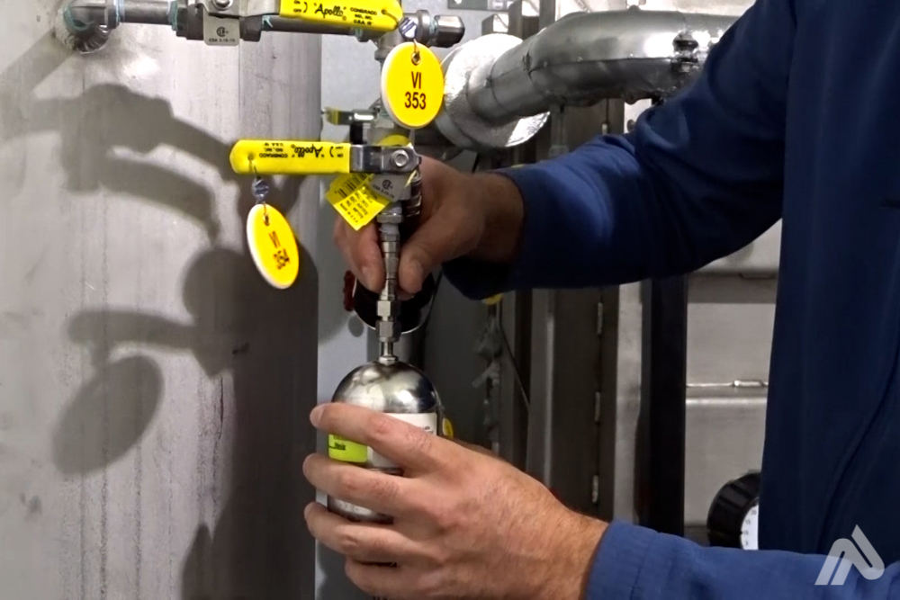
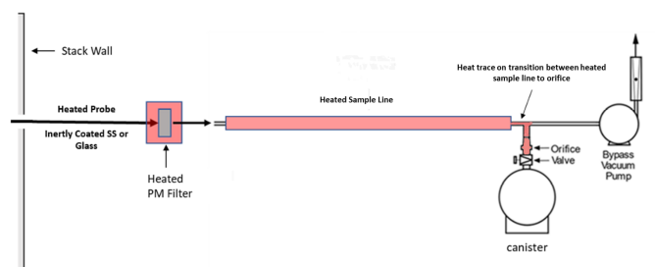
Quality Control – Field
Considerations
Sampling Configuration: moisture and acid gases – configuration varies. duplicate samples – precision or varied volumes? Check system background before & after Pre-heat / flush sampling lines – 2hrs!
Good to know
Based on TO-15A
Particulate matter filter required upstream
Bypass vacuum pump required downstream
OTM-50 FAQ sheet available from US EPA website: Google it or ask us!
10
Notes:
Does OTM-50 specify duplicates - optional
What field QA/QC does OTM-50 specify: Sampling system background before & after testing campaign
Samples may be collected directly from the non-combustion stacks or vents when the moisture is relatively low (<3% volume/volume (v/v)), when sample gas temperatures are <250 °F, and when acid gases are not present.
To collect samples outside these criteria, sample conditioning including moisture, acid gas, and temperature management, as described in this method, is required. extracting representative gas samples from an emission vent or stack, conditioning the gas if necessary to manage moisture and acid gases.
The method allows for collection of multiple canisters concurrently by connecting them in series between the heated sample line and the bypass pump. Why do this?​
Collection of paired samples determining precision.​
Collection of different volumes of the same sample where high VFC concentrations may be present. The smaller sample will help avoid a large dilution to bring concentrations into analysis calibration range.

Slide 11
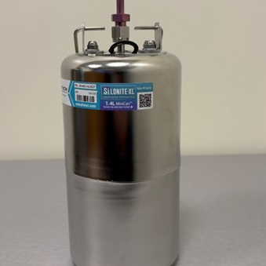
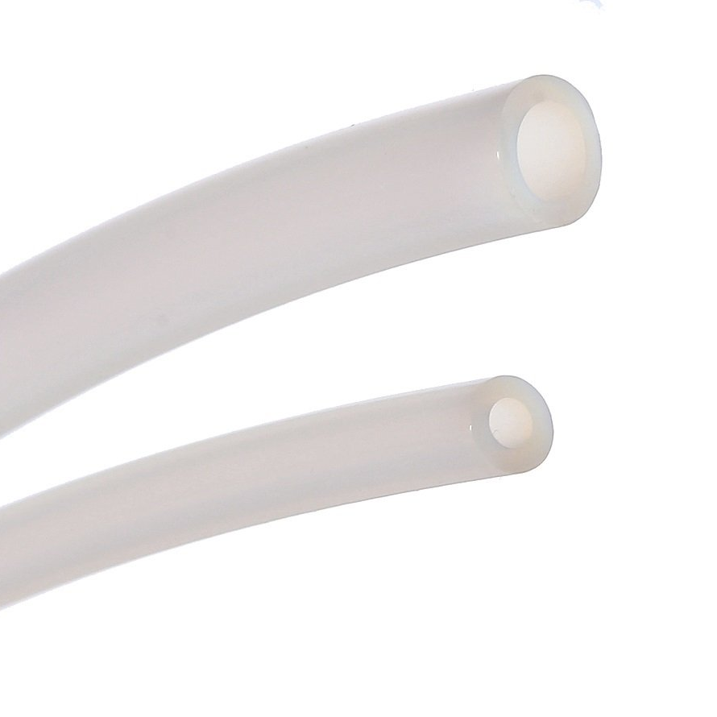
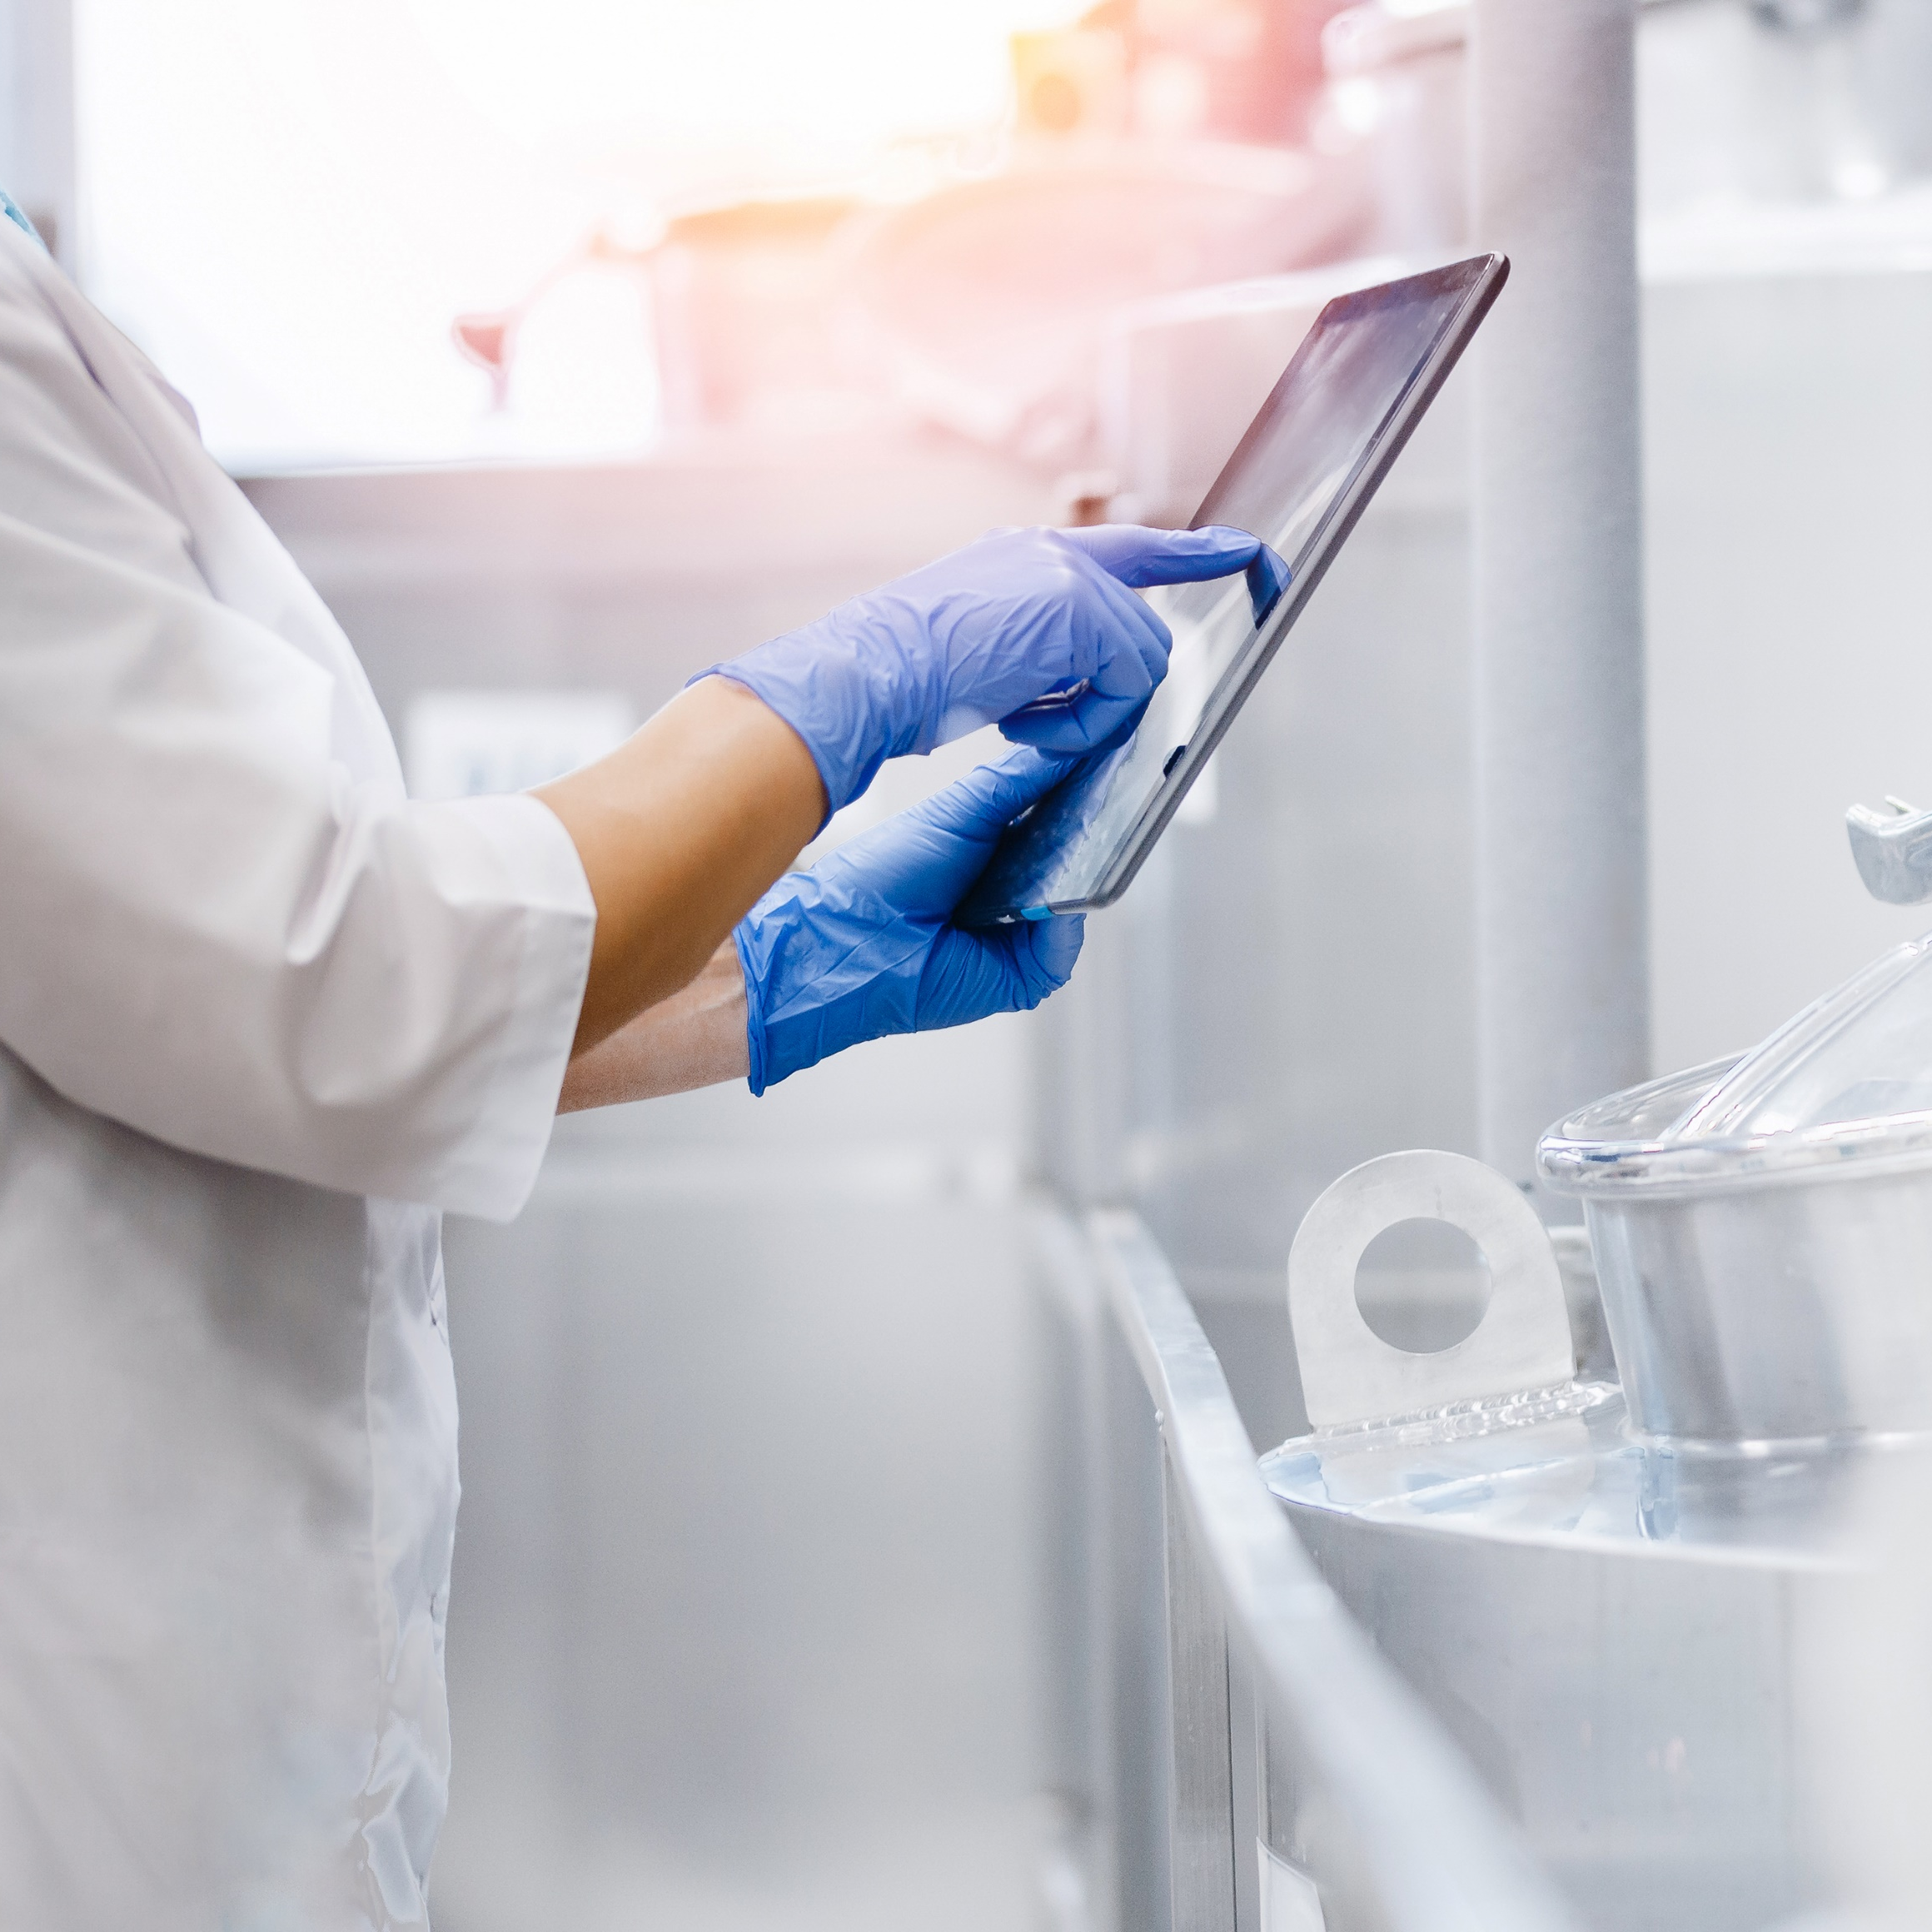
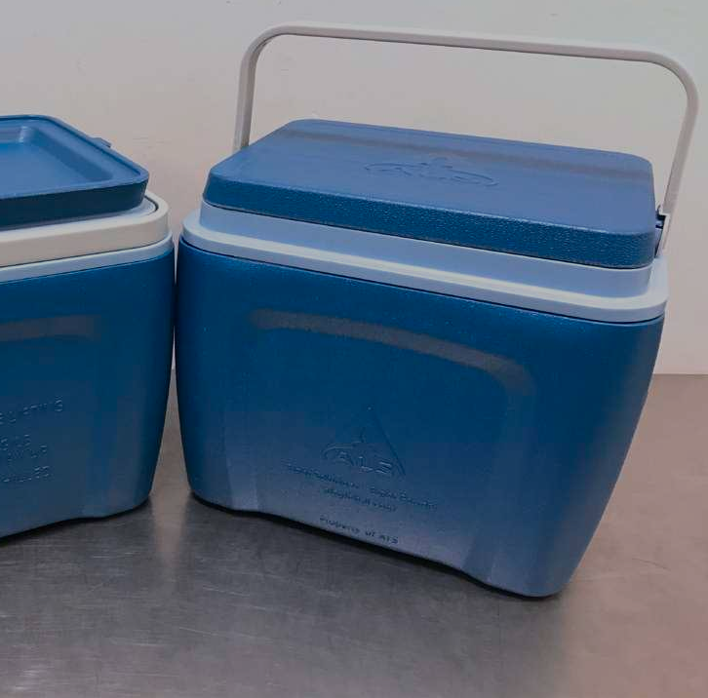
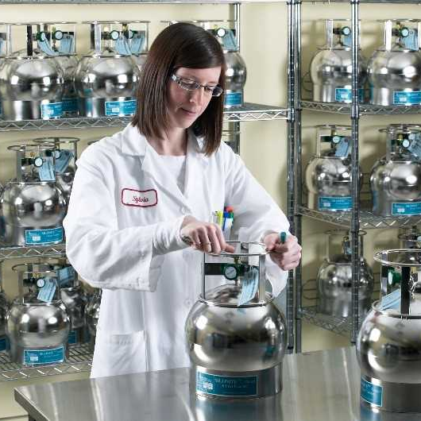
Quality Control – Laboratory
Segregation of PFAS Canisters
PFA Tubing?
fluoropolymer!
Cleaning & Proofing
Shipping
Handling in the lab
Notes:
PFAS Canisters are segregated from other canisters and are cleaned by the PFAS-specific cleaning protocol described in OTM-50
OTM-50 prescribes the use of PFA tubing to collect from stack ports into the canister. They also specify a rigorous pre-treatment for it as it is itself a fluoropolymer
Our cleaning and proofing protocols for all sampling equipment meets or exceeds the requirements of OTM-50
PFAS canisters are shipped to and from site in coolers that do not transport other samples.
Canisters are stored and processed in a dedicated section of the lab to avoid cross-contamination from other canister testing.

Slide 12
What else? We are Clean Freaks!
Canister Cleaning Procedure - Specific to PFAS
1.4 L Silonite canisters are cleaned for 1 week:
  Heated and purged with clean humidified air, evacuated to 0.0067 kPa.
Quick Connects cleaned for one week:
  Rinsed in methanol and water, then heated (100 °C max) under vacuum.
Flow controllers cleaned, conditioned & checked (digital flow meter) to confirm accuracy
All canisters are individually proofed; however, we only report 1 per batch on C of As.
  meets batch proofing requirements, but we actually proof all cans
  By individually proofing each canister, you are able to request individual proof certificates ($100) after analysis based on data received.
  This saves $$ as you can pick which, if any, individual canister proofs you want.
Notes:
Darlene: It is $100 per certificate

Slide 13
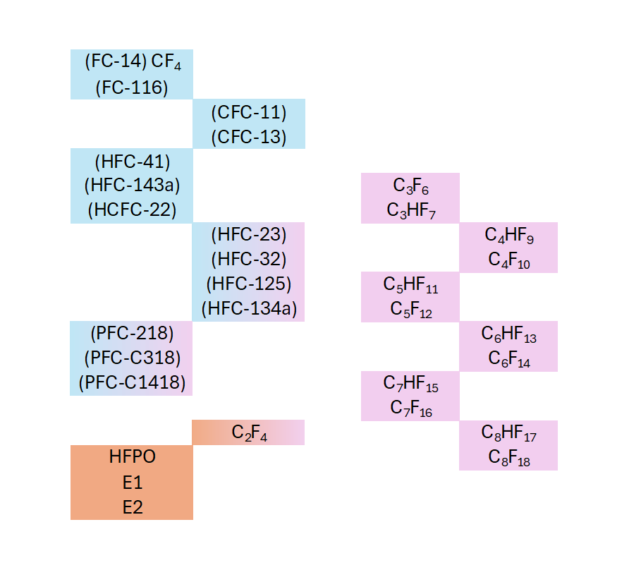
What: OTM-50 (Non-polar Volatile)
Refrigerants
Canister sample collection
Analysis by GC-MS/MS
30 compounds (mostly PIC/PID)
PIC/PID
fluorinated alkanes and alkenes
Volatile fluorinated compounds (VFCs)
Products of incomplete combustion / destruction (PICs/PIDs)
Fluorinated refrigerants
Industrial compounds of interest
Some refrigerants and industrial chemicals are formed from PFAS during destruction.
Industrial Chemicals
Shields et al. ACS EST Eng. 2023, 3, 1308−1317.
Notes:
When looking at destruction technologies, including but not limited to incinerators, kilns, combustors, spent carbon reactivators and other emerging technologies it is important to ensure the PFAS have been completed destroyed, or mineralized, to prevent the release of fluorinated products of incomplete combustion being released into the environment. That is where OTM-50 comes in.
Temperatures and residence time need to be sufficient to completely degrade the compounds. Carbon Tetrafluoride, which is the most difficult fluorinated compounds to breakdown has been shown to degrade only at temperatures above 1400 degrees celsius in certain conditions. Some research shows that 1000 degrees might be sufficient to mineralize many fluorinated compounds, but this is still not fully understood.
The presence of carbon–carbon or carbon–hydrogen bonds provides a weak point in the structure and thus significantly lowers temperatures needed for decomposition. Due to their thermal stabilities, short-chain fluorinated carbons may be good indicators of broader PFAS defluorination.
The US EPA studied PFAS incineration to determine appropriate operating conditions for full mineralization, and the intermediates and byproducts of the process. The results were published by Shields and colleagues in 2023 in the article cited here. The thirty compounds in the OTM-50 target list were largely derived from their study. These compounds are shown here as either their chemical formula, their refrigerant code or their common acronym. Some of the refrigerants on the list are produced as intermediates and others are included due to their likelihood of being found in ambient air. The industrial chemicals on the list are commonly used in fluorchemical production. Over half of the PIDs on the list are fluorinated alkanes and alkenes. These have high greenhouse gas potential and largely unknown environmental risks. Compounds that are both PIDs and either refrigerants or an industrial chemical are shown in two tone colour boxes where the right half is pink.

Slide 14
OTM-50 – Tubing Investigation
Estimated: over calibration
LOR = 2 pptv
Sampling Tube NOT pre-conditioned!
Notes:
Once we got the method up and running, our VOC lab manager took a couple of canisters with her on her drive home through the usual slow rush hour traffic along Highway 85 that snakes through the middle of the urban area of Waterloo Region. One tube had the standard fluoropolymer sampling tube attached and she removed it from the other. You can see the immense background that the fluoropolymer tube contributed to the sample. This is why OTM-50 specifies that the sampling tube needs to be conditioned for two hours prior to sampling.
We have been working to identify an alternative tubing that won't impart background, in order to reduce this pre-conditioning time. We have identified 2 alternative tubing that has no detectible levels of the OTM-50 compounds. We need to do a bit more work to ensure it is fit for purpose but we will be making it available once we are confident with it.

Slide 15
OTM-50 Ambient Air Sampling – Lab & Rush Hour Traffic Air
LOR = 2 pptv
Notes:
Refrigerants are known to be present at higher levels in proximity to major roadways. We wanted to see how the highway sample compared to our lab air. While the highway air sample was from a very urbanized area, our lab is in the north end of Waterloo region, a stone's throw from vast acreages of farmland.
We found that three of the refrigerants we measured were elevated in the highway sample. HFC-32, HFC-125 and HFC 134a.
HFC-134a is the dominant refrigerant in current use for vehicle AC so that makes sense here.
A refrigerant called R-410A is a 50:50 mixture of HFC-32 and HFC-125 and it is the dominant refrigerant used in residential and commercial AC and heat pump units. It also makes sense that we saw these two refrigerants in equal proportions, and with equal elevations in the more urbanized area of the Region.

Slide 16
OTM-50 Ambient Air Sampling – Source Identification
Refrigerant
Industrial Chemical
PIC (PID)
CF₄
LOR = 2 pptv
Shields et al. ACS EST Eng. 2023, 3, 1308−1317.
Notes:
This chart is the same as the previous one, but shows which of the compounds are in each of the classes and which were produced during the EPA combustion trials. Shields et al. did not identify CF4 as a PIC, although others have. They did note however that their detection limit for CF4 was unusually high. Since 2023, some of the same PIDs have been found to be produced in other destruction processes such as UV and Electrochemical Oxidation.

Slide 17
OTM-50 Results vs Global Monitoring
NM: Not Monitored
NH: Northern Hemisphere
CF₄
NM
NM
Global data reference: Cong et al. 2024 Science of the Total Environment, 956, 177348.​
Notes:
The global monitoring data shown here is from this 2024 paper: Cong et al. 2024 Science of the Total Environment.
The Advanced Global Atmospheric Gases Experiment (AGAGE) is an international network of atmospheric observing stations and associated laboratory, calibration, and atmospheric modeling infrastructure. It has been measuring the composition of the global atmosphere continuously since 1978. Cong and colleagues reported the average refrigerants concentrations from Northern Hemisphere monitoring stations in 2022. They also reported on a separate 2022 study of refrigerants at the Mount Everest Base Camp. I was surprised to see HFC-134a so elevated there. I guess they need portable refrigerant compressors there too!
Some of you may have noted that PFC-218 looks odd too. We dug into this a bit. PFC-218 is a perfluorocarbon (PFC), and is a potent greenhouse gas regulated under climate policies. It has become more highly regulated since 2022 and its use is now allowed only in niche applications (semiconductor manufacturing and ophthalmic surgery), and venting is prohibited under EPA Section 608 rules.

Slide 18
OTM-50 Ambient Air Comparison
NM: Not Monitored
NH: Northern Hemisphere
CF₄
NM
NM
NM
NM
Notes:
Finally, we were interested to see how our lab air compared to some places in Ontario that are far away from urban centres and major highways.
The AGAGE and Mount Everest data are here again in the dark and light blue bars and the lab air is the gold bar. Our lab team also collected air from a couple of cottages, both near the eastern shore of Lake Huron and having some of the best air in Ontario. Bayfield, which is the middle magenta bar, is about 100km from Sarnia but Oliphant, the pink bar here, is pretty much in the middle of nowhere. It was interesting to see that there's very little difference in the ambient refrigerant levels between our lab and these more remote locations.

Slide 19
GC-MS/MS Method Reporting Limits
 |  | OTM50 QRL (3xMDL) | ALS LOR
Parameter | Synonym | --- --- --- ppbv --- --- ---
Tetrafluoromethane | (FC-14) | 0.090 | 0.002
Hexafluoroethane | (FC-116) | 0.037 | 0.002
Chlorotrifluoromethane | (CFC-13) | 0.037 | 0.002
Tetrafluoroethene | C2F4 | 0.033 | 0.002
Trifluoromethane | (HFC-23) | 0.150 | 0.002
Difluoromethane | (HFC-32) | 0.048 | 0.002
Octafluoropropane | (PFC-218) | 0.037 | 0.002
Fluoromethane | (HFC-41) | 0.057 | 0.002
1,1,1,2,2-Pentafluoroethane | (HFC-125) | 0.037 | 0.002
1,1,1-Trifluoroethane | (HFC-143a) | 0.096 | 0.002
Hexafluoropropene | C3F6 | 0.037 | 0.002
Chlorodifluoromethane | (HCFC-22) | 0.033 | 0.002
Hexafluoropropylene oxide | HFPO | 0.063 | 0.002
1,1,1,2-Tetrafluoroethane | (HFC-134a) | 0.048 | 0.002
Octafluorocyclobutane | (PFC-C318) | 0.037 | 0.002
Decafluorobutane | C4F10 | 0.037 | 0.002
 |  | OTM50 QRL (3xMDL) | ALS LOR
Parameter | Synonym | --- --- --- ppbv --- --- ---
1H-Heptafluoropropane | C3HF7 | 0.042 | 0.002
Trichlorofluoromethane | (CFC-11) | 0.042 | 0.002
Dodecafluoropentane | C5F12 | 0.069 | 0.002
Octafluorocyclopentene | (PFC-C1418) | 0.037 | 0.002
1H-Nonafluorobutane | C4HF9 | 0.033 | 0.002
Tetradecafluorohexane | C6F14 | 0.048 | 0.002
1H-Perfluoropentane | C5HF11 | 0.048 | 0.002
Heptafluoropropyl-1,1,1,2-tetrafluoroethyl ether | E1 | 0.042 | 0.002
Hexadecafluoroheptane | C7F16 | 0.037 | 0.002
1H-Perfluorohexane | C6HF13 | 0.048 | 0.002
Octadecafluorooctane | C8F18 | 0.037 | 0.002
1H-Perfluoroheptane | C7HF15 | 0.033 | 0.002
2H-Perfluoro-5methyl-3-6,dioxanonane | E2 | 0.037 | 0.002
1H-Perfluorooctane | C8HF17 | 0.037 | 0.002
ALS Limits of Reporting (LOR) are higher than our statistically derived LOQ for each compound.
Notes:
The QRLs reported in OTM-50 were not statistically derived. They are simply the MDL multiplied by three. You can see here that our LORs are at least 20x lower and the EPA QRL for CF4 is one of the highest on their list. We attribute the difference to both the use of a triple quadrupole instrument instead of the single quadrupole system on which OTM-50 was based, and the improvements in the equipment achieved by Agilent and Entech in recent years.

Slide 20
Looking to the future…PFAS in Air – What is next?
EPA OTM-50 is up and running in Waterloo (Accreditation received February 2026)
EPA OTM-45 roll out in Australia is nearing completion.
Next: Moving on to the next quadrant!
  Method development for non-polar PFAS in ambient air and soil vapour by canister and/or thermal desorption tube.
  OTM-55 / ASTM D8591-24
8:2 FTOH
Aerobic Biotransformation of 8:2 FTOH in Soil
https://commons.wikimedia.org/wiki/File:Aerobic_biotransformation_8-2_FTOH_soil_labeled.svg.
Notes:
In parallel with the OTM-50 method development in Canada, our colleagues in Australia have also set up OTM-45 during these past few months. We are now working on swapping methods with them so we can have both methods up and running in both countries.
We are looking forward to partnering with destruction technology vendors who are interested in monitoring their destruction processes. In addition to incineration, some of the newer destruction technologies are known to produce similar PIDs. [UV and ECO].
Also on our radar is to move on to the next quadrant and work on a reliable air method for things like the fluortelomer alcohols and sulfonamides that aren't covered well by either OTM-45 or OTM-50. Major category of polyfluorinated PFAS
High concentrations in indoor air and landfill gas.
Commonly used in manufacturing and AFFF
Pending regulation for 6:2 and 8:2 FTOH in Europe
Testing in air via ASTM D8591-24 and OTM-55 ("under development")
Testing in soil and water available for select compounds.

Slide 21


Questions?
Tammy Chartrand
National PFAS Program Lead, Environmental Canada
Tammy.chartrand@alsglobal.com
Special Thanks To:
Andrea Armstrong, Air Quality Manager
Sylvia Fisher, Air Quality Technical Specialist
Darlene Hoogenes-Stastny, National Air Quality Specialist
Heather Lord, Global PFAS Practice Lead

