Slide 1
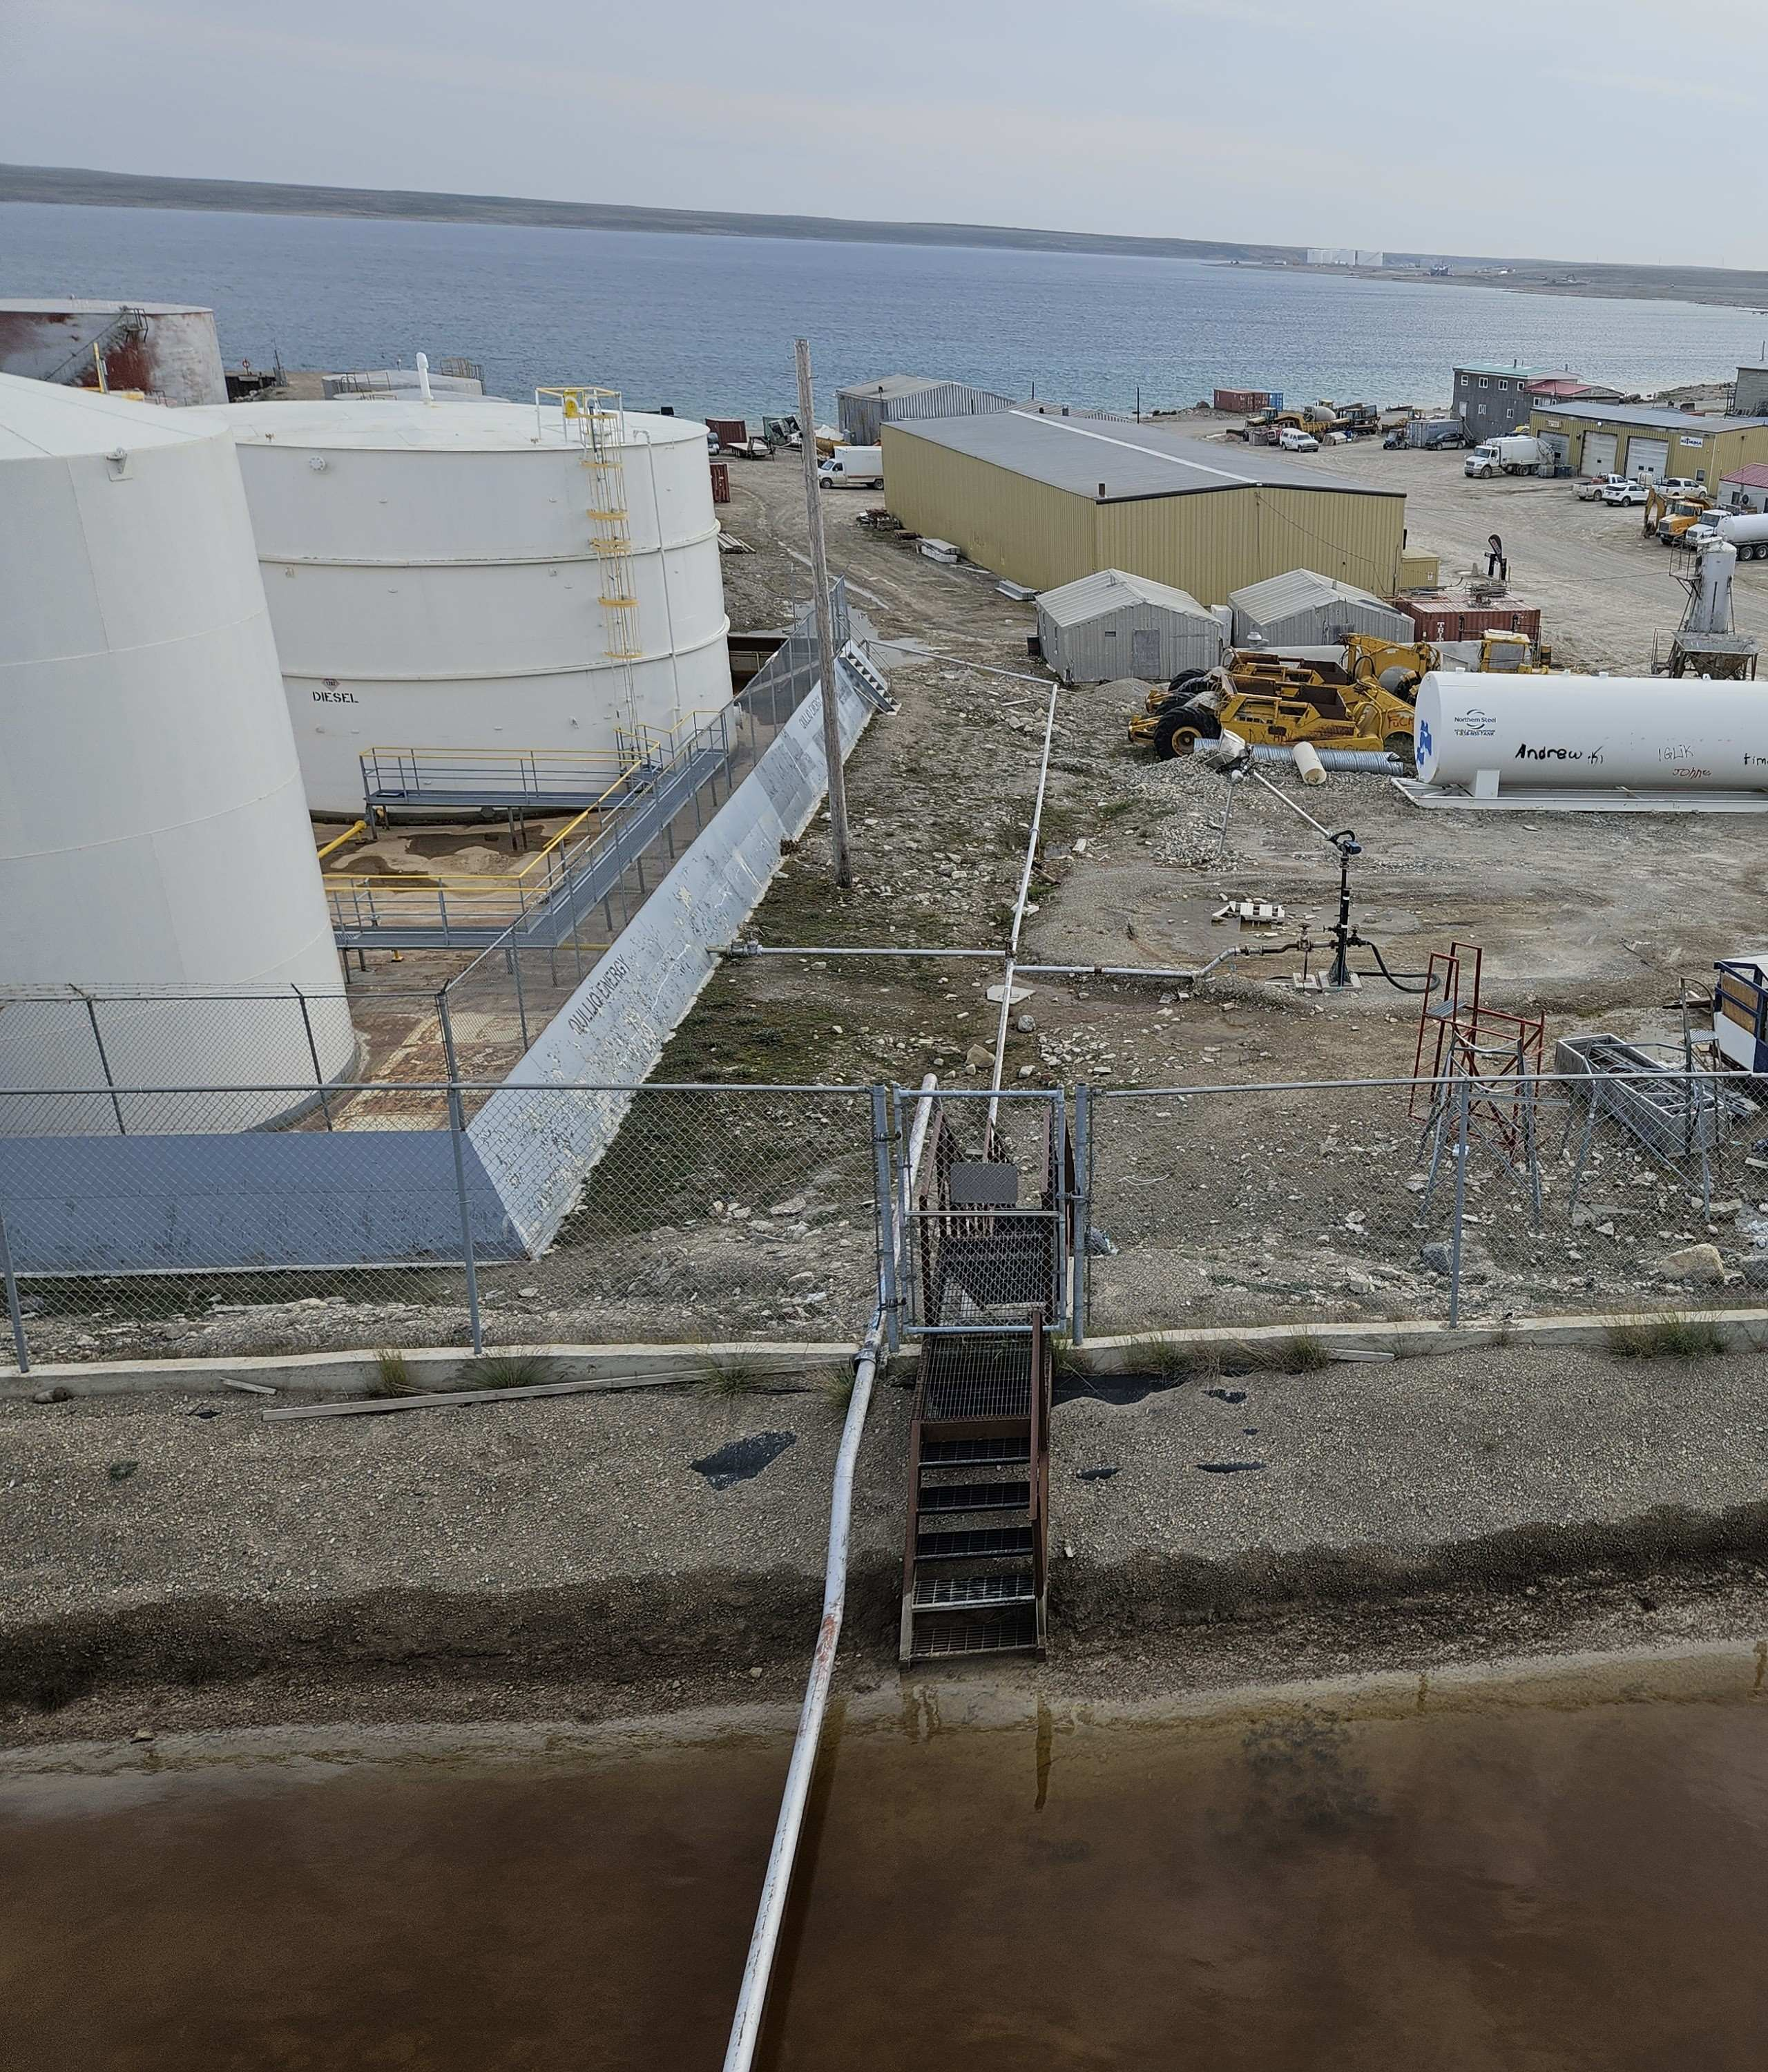
RemTech 2026
The Remediation
Reckoning
[ PHOTO — northern/remote site ]
Canada's remaining contaminated sites are
bigger, more remote, and harder to solve.
Shawn Samborsky | President, CORE Environmental
core-canada.com

Slide 2
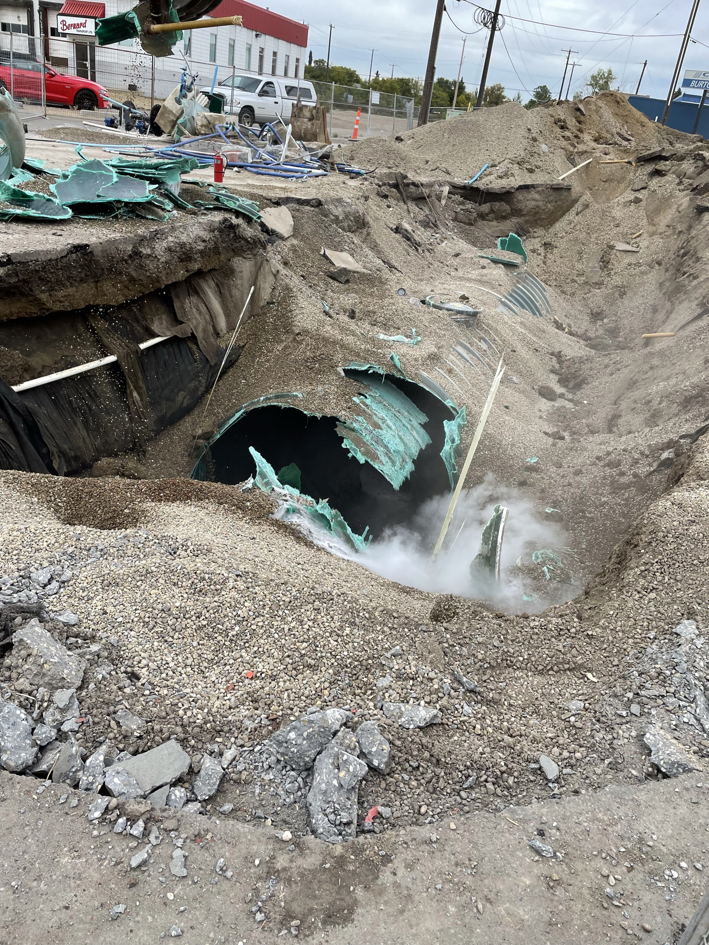
The Easy Sites Are Gone
2000–2015: urban gas stations, dry cleaners, brownfields.
High land values. Small volumes. Clear closure criteria.
Dig to clean. Backfill. Close.
That model worked because the economics worked.
[ PHOTO — urban gas station remediation
or brownfield excavation ]
24,000+
Federal contaminated
sites listed – 6000 remain
$10B+
Estimated federal
liability (OAG 2024)
Most
Require solutions beyond
conventional disposal
Source: ECCC Federal Contaminated Sites Inventory
Notes:
Since 2005, remediation has been completed at only about 3,000 sites and assessment at about 11,000 — out of that 24,229 total. Canada.ca That means a significant portion haven't even been fully assessed yet.

Slide 3

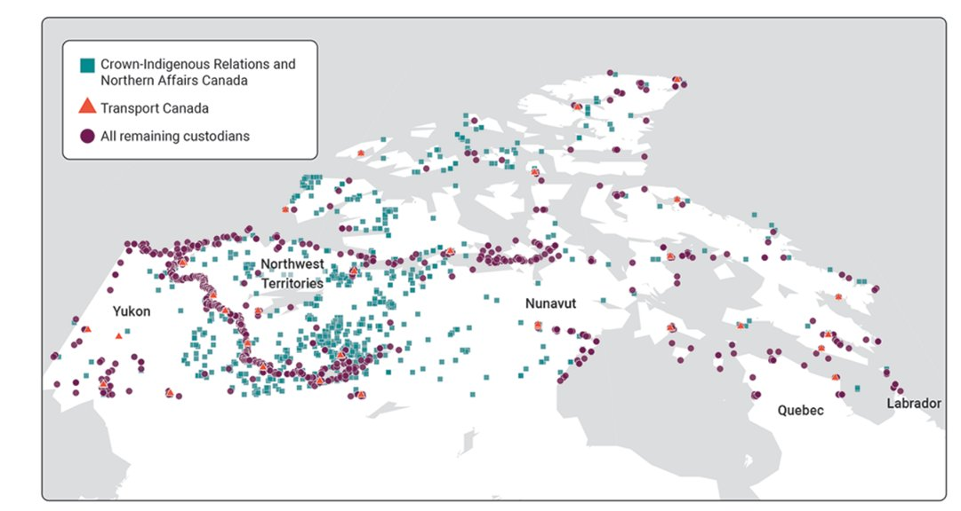



What's Left Is Different
Source: OAG — Report 1, Contaminated Sites in the North, 2024
Remote & Northern
2,600
contaminated sites
in northern Canada alone
Massive volumes
390Mt
waste at Faro Mine —
26,000 football fields 1m deep
Sensitive territories
60%
of all federal remediation
costs are for northern sites
Up to $4.38B per site
+95%
cost increase since 2019
for the 8 largest northern mines

Slide 4
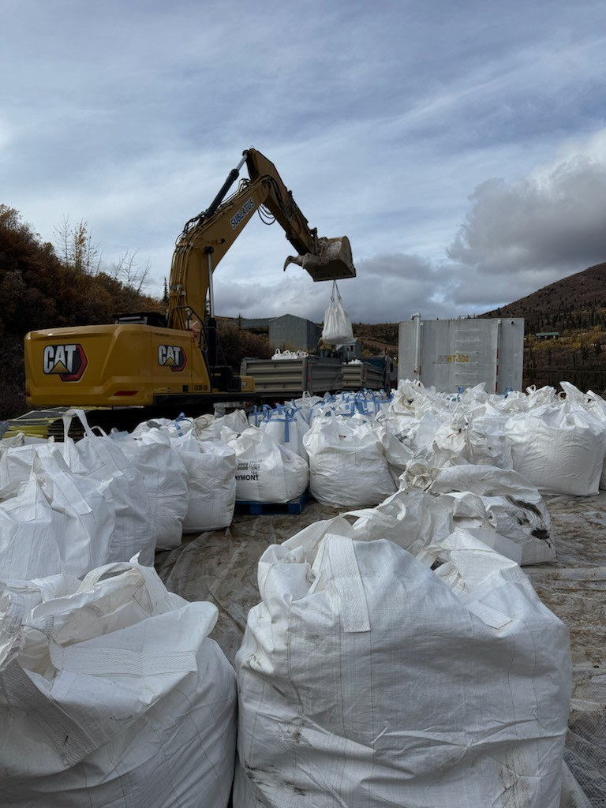
Why Dig-and-Dump Fails Here
$100-$800/t
Transport cost before a shovel hits the ground
No capacity
No local landfill — backfill must also be imported
Secondary risk
Dust, runoff, wildlife exposure from mass disturbance
Carbon
Trucking, barges hundreds or thousands of km
Net result
Sites are left in perpetual monitoring, remediations occurs slowly or never

Slide 5
Soil Stabilization as a Tool
Duraflex Mineral Admixture
7+ MPa
Chloride-free mineral supplement that enhances cement-based stabilization of contaminated soils — hydrocarbons, heavy metals, and salts.
Compressive Strength Achieved
The Formula
10-25%
Contaminated Soil + 10% Cement (by soil weight) + 2% Duraflex (by cement weight) = Inert, High-Strength Engineered Material
Strength Increase vs Cement-Only
How It Works
>50%
Enhanced hydration kinetics form interlocking crystalline structures that physically and chemically encapsulate contaminants — blocking migration into soil and water permanently.
Reduction in Freeze thaw loss
The Outcome
Zero
Hazardous soils reclassified as non haz. No excavation to landfill. Engineered fill material reused on-site in risk managed settings.
Landfill Disposal Required

Slide 6
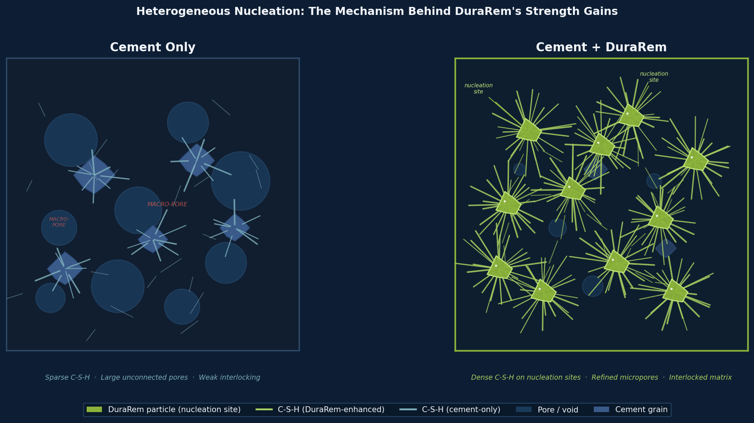
Why Duraflex Works: Heterogeneous Nucleation of C-S-H
01
Pozzolanic Reaction
Duraflex reacts with Ca(OH)₂ released during cement hydration, producing additional C-S-H gel and consuming free lime
02
Heterogeneous Nucleation
Angular Duraflex surfaces provide low-energy nucleation sites producing a finer, denser crystal network with far fewer macropores between grains.
03
Pore Refinement & Matrix Bridging
The resulting C-S-H network fills and bridges macropores, 10–25% higher UCS and measurably lower permeability.
The physical reality: In cement-only mixes, C-S-H precipitates sparsely in bulk pore solution, leaving macropores and weak grain bridges. Duraflex surfaces lower the nucleation energy barrier — more crystals form, faster, and at grain boundaries and void walls where they deliver maximum structural benefit.
Yaworski et al. (2026, accepted). University of Calgary, Schulich School of Engineering. World Mining Congress. SEM imaging and BET N₂ analysis confirm microstructural mechanism. SGS North America validation data on file.
Notes:
Makes better use of the lime to create Calcium Silicate Hydrate crystals, more crystals means less pore space

Slide 7

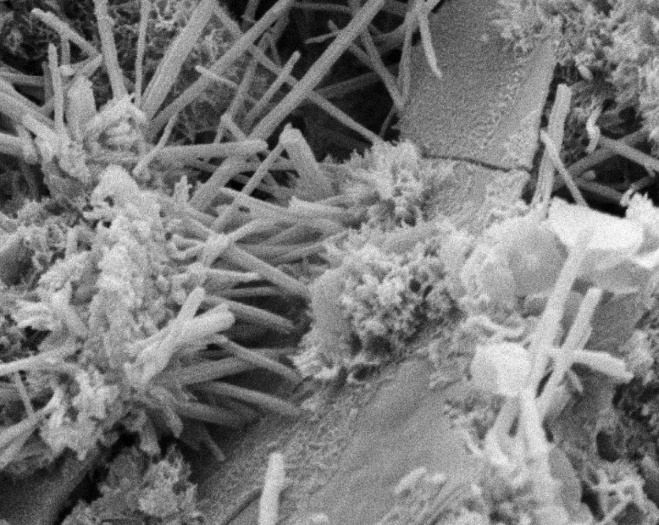
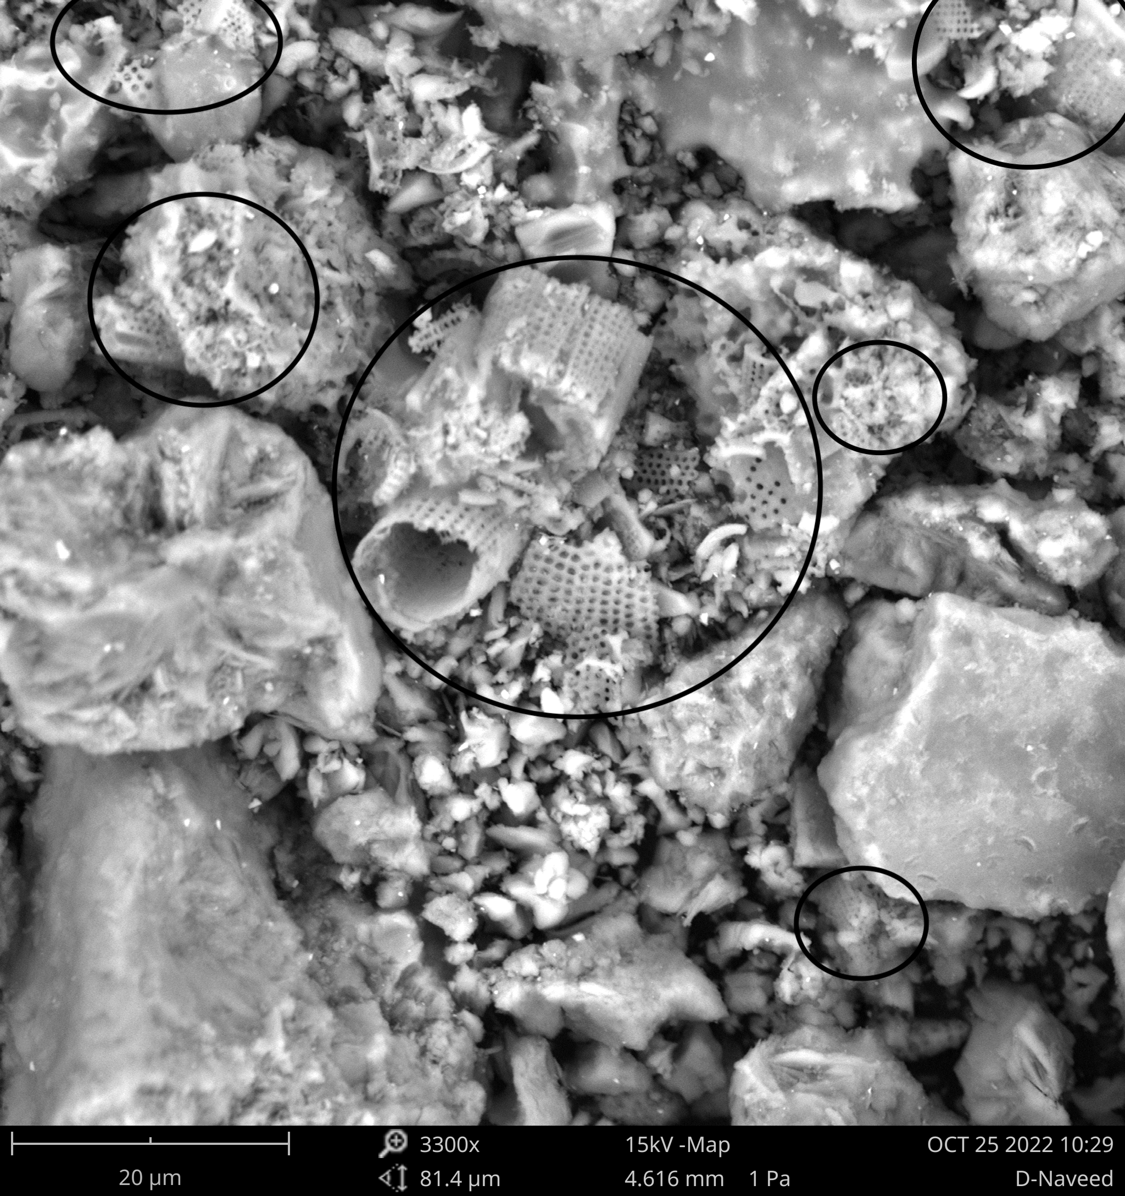
The Mechanism, Confirmed: SEM + Q-XRD Analysis
University of Calgary SEM imaging confirms the microstructural changes behind Duraflex's 10–25% strength gains and superior freeze-thaw durability presented in this study.
What the Images Confirm
↑
Increased C-S-H gel
Denser, interlocking crystalline matrix beyond cement-only
↓
Reduced pore connectivity
BET N₂ confirms micropore volume decrease in SCD specimens
↓
Lower permeability
Contaminants have no viable migration pathway
↓
Frost heave risk
Critical for northern and Arctic applications
SEM: C-S-H Crystal Formation Cement + Duraflex
SEM 3,300x: Pore Structure Circled = refined pore zones · 20 µm scale
↑
Service life
Superior wet-dry and freeze-thaw cycling resistance (ASTM D559/560)
Why this matters: The SGS encapsulation results and UCalgary strength gains aren't coincidental this is the physical reason they happen. Denser matrix. Fewer pores. Nowhere for contaminants to go.

Slide 8
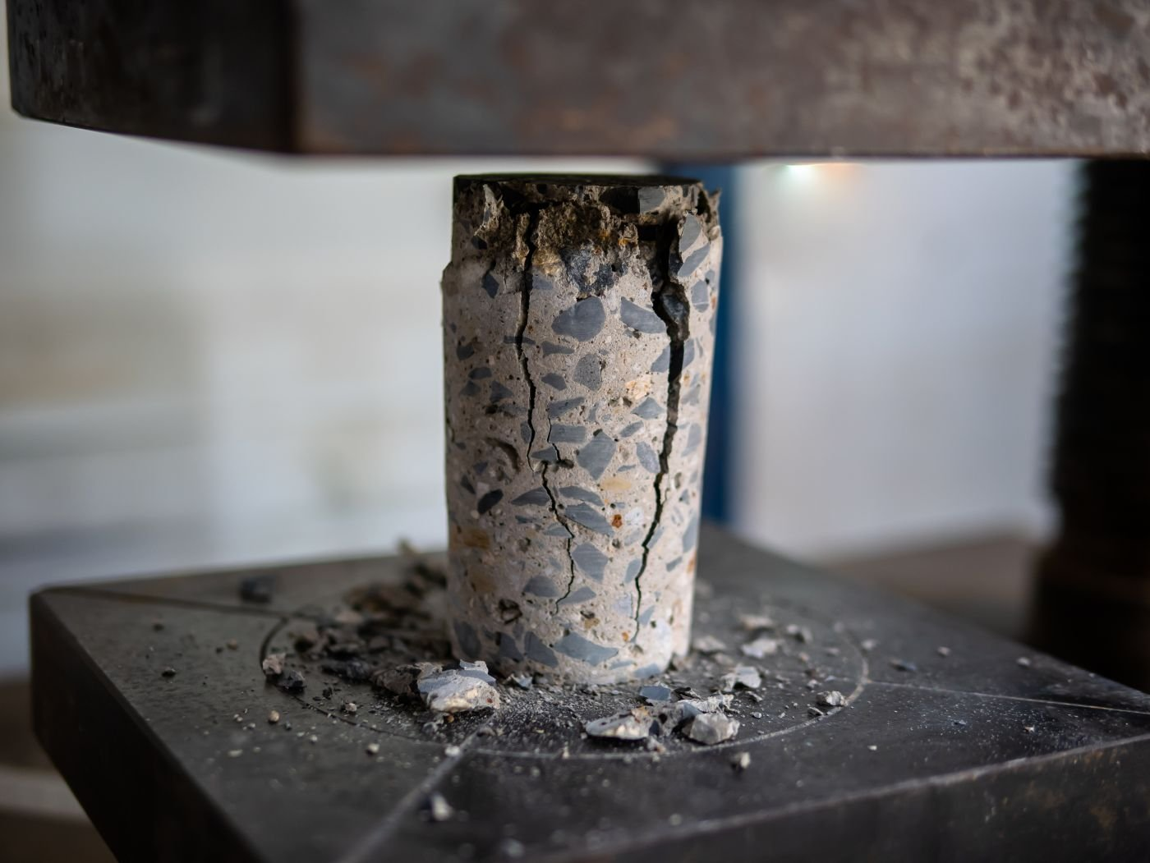
Laboratory Verification Methods
Performance criteria validated against two independent ASTM standards
Laboratory Verification Methods
Performance criteria validated against two independent ASTM standards
Performance criteria validated against two independent ASTM standards
Unconfined Compressive Strength
Freeze-Thaw Durability
ASTM D2166 / D2166M-24
ASTM D4842 — Solidified Waste Resistance to Freezing and Thawing
Cycle 1
Cycle 2
Cycle 3
FREEZE
FREEZE
FREEZE
-23°C / 24 hrs
-23°C / 24 hrs
-23°C / 24 hrs
↕
↕
↕
THAW
THAW
THAW
+23°C / 24 hrs
+23°C / 24 hrs
+23°C / 24 hrs
Axial cracking pattern at failure — characteristic of compressive shear
× 12 cycles total | Mass loss and dimensional change measured after each cycle
Purpose
Specimen & Rate
Purpose
Protocol
Measures peak axial load a stabilized soil cylinder can sustain before failure —the primary structural performance criterion for ISS/E
Cylindrical specimen, h/d ratio 2–2.5; constant strain rate 0.5%–2% per minute
Evaluates long-term structural integrity of stabilized waste exposed to freeze-thaw cycling — critical for northern Canadian site conditions
12 cycles of freezing at -23°C (24 hrs) followed by thawing at +23°C (24 hrs). Mass and dimensions recorded each cycle
Failure Criterion
Limitation
Pass Criterion
Why It Matters
qu = maximum axial stress, or stress at 15% axial strain — whichever occurs first
Cohesive soils only — not applicable to dry, sandy, or fissured materials
Mass loss ≤ 10–14% after 12 cycles (EPA SW-846 guidance); permeability and UCS re-tested post-cycling
Confirms Duraflex monolith survives Arctic/subarctic conditions without fracture, swelling, or contaminant release
ASTM D2166/D2166M-24 — Unconfined Compressive Strength of Cohesive Soil | ASTM D4842 — Resistance of Solidified Waste to Freezing and Thawing | EPA SW-846 Method 9090A

Slide 9
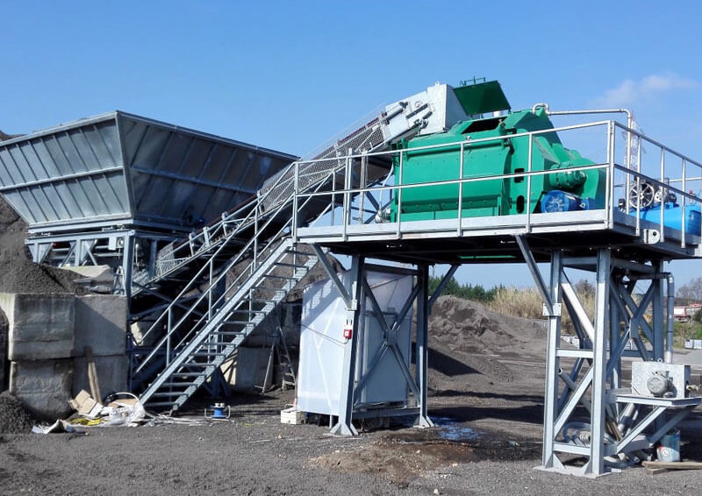
Stabilization / Solidification
Contaminants stay in place.
Encapsulated in a stabilized matrix. Mobility reduced. Leaching controlled.
Risk reduction, not destruction.
The goal is stopping exposure pathways — not eliminating the contaminant.
[ PHOTO — pug mill treatment,
stabilization equipment in field ]
Makes remediation possible.
Sites that will never get cleaned under conventional economics
become viable under S/S. That's a better outcome than perpetual monitoring.

Slide 10
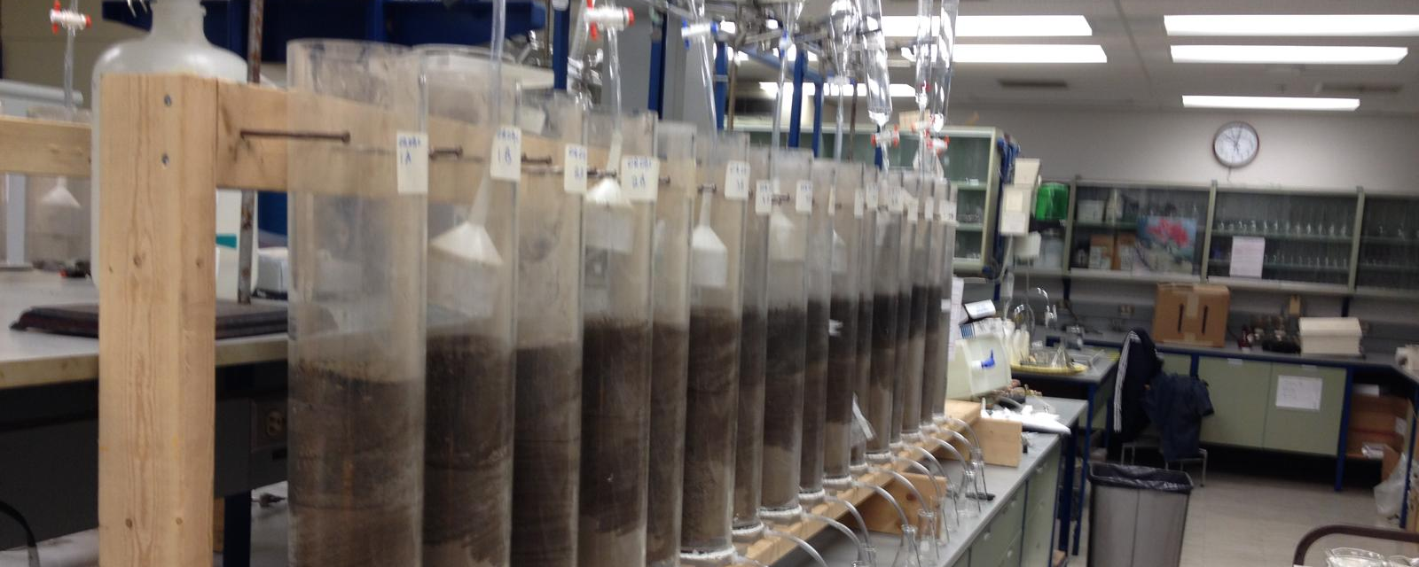
Duraflex Admixture — Independent Validation
+25%
INDEPENDENT PEER-REVIEWED RESEARCH
Higher UCS vs. OPC alone
at equivalent cure time
Mechanical and Microstructural Behaviour of
DuraFlex-Stabilized Contaminated Soil
Khan & Shrive
Schulish School of Engineering
University of Calgary
↓ Pore
Reduced mesopore connectivity
less leaching pathway
Accepted — World Mining Congress 2026
Fe ↓98%
Iron leaching: 80.7 mg/L untreated
to <0.49 mg/L after treatment
[ PHOTO — lab specimens / U of C research ]

Slide 11
Lab Performance: Strength & Freeze-Thaw Durability
DuraFlex admixture tested in contaminated soil — relevant to northern ISS where freeze-thaw is a long-term durability concern.
Unconfined Compressive Strength — 28 days
Freeze-Thaw Durability — Mass Loss %
SCD vs SC: +31% UCS | 58% less mass loss at 12 F-T cycles | Source: Khan & Shrive, Schulich School of Engineering, U of C — WMC 2026

Slide 12
The Numbers: S/S vs. Conventional Disposal
Representative project — 80,000 m³ contaminated soil. Remote site. Excavation costs equal under both scenarios.
Cost Item | Conventional (Dig & Dump) | ISS / Duraflex
Off-site transport | $3,888,000 | —
Landfill tipping fees | $9,360,000 | —
Clean backfill supply & placement | $3,200,000 | Not required
Field operations, pug mill, equipment | — | $4,446,870
Portland cement (supplied & delivered) | — | $4,032,000
Duraflex admixture | — | $1,440,000
Risk management & consulting | — | $300,000
Contingency (7%) | $1,151,360 | $745,071
TOTAL | $17,599,360 $122/t | $10,963,941 $76/t
Estimated saving: ~$6,635,000 (38% lower cost)

Slide 13
We’ve Already Worked
Where It Matters
Remote northern sites. No road access. Indigenous partnerships.
CORE delivers in exactly the conditions Duraflex is designed for.

Slide 14
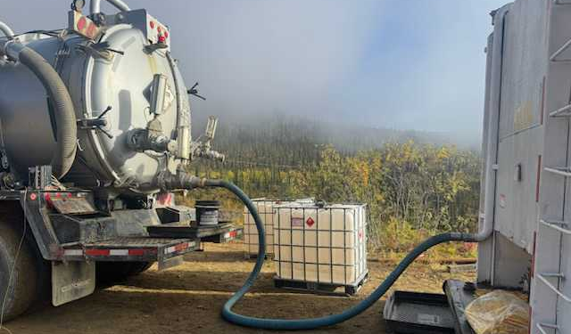
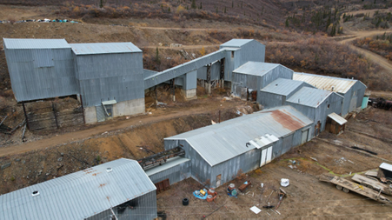
CASE STUDY
Mount Nansen Mine— Yukon
LOCATION
Central Yukon
SCOPE
Abandoned mine decommissioning, waste stabilization/removal
SCHEDULE
Summer / Fall 2025
OUTCOME
Majority of waste rendered non-hazardous on site.
Reduced volume requiring hazardous disposal.
On schedule. Under budget.
Next step: ISS treating contaminated soils on site to reduce disposal costs.

Slide 15
Mount Nansen — On-Site Treatment Approach
01
Characterize
~$300K
TCLP + metals/cyanide sampling
of every stream before treatment
Estimated savings
02
Oxidize cyanide
On-site treatment vs. shipping
hazardous sludge to disposal
KMnO4 treatment, pH > 7.0
Prevents HCN gas formation
Majority
03
Stabilize slurries
Perlite + lime solidification
Passes paint filter test — non-hazardous solid
of waste streams
Rendered non-hazardous
through treatment on site
04
Package & classify
TDG-compliant containers
Hazardous vs. non-hazardous routed separately
0
HCN incidents
05
Dispose optimally
Controlled pH chemistry
Prevented gas formation throughout
Class II landfill for treated solids
Aevitas for residual hazardous only
CORE already treats contaminated material on site. Duraflex extends this capability to heavy-metal and hydrocarbon-impacted soils.

Slide 16
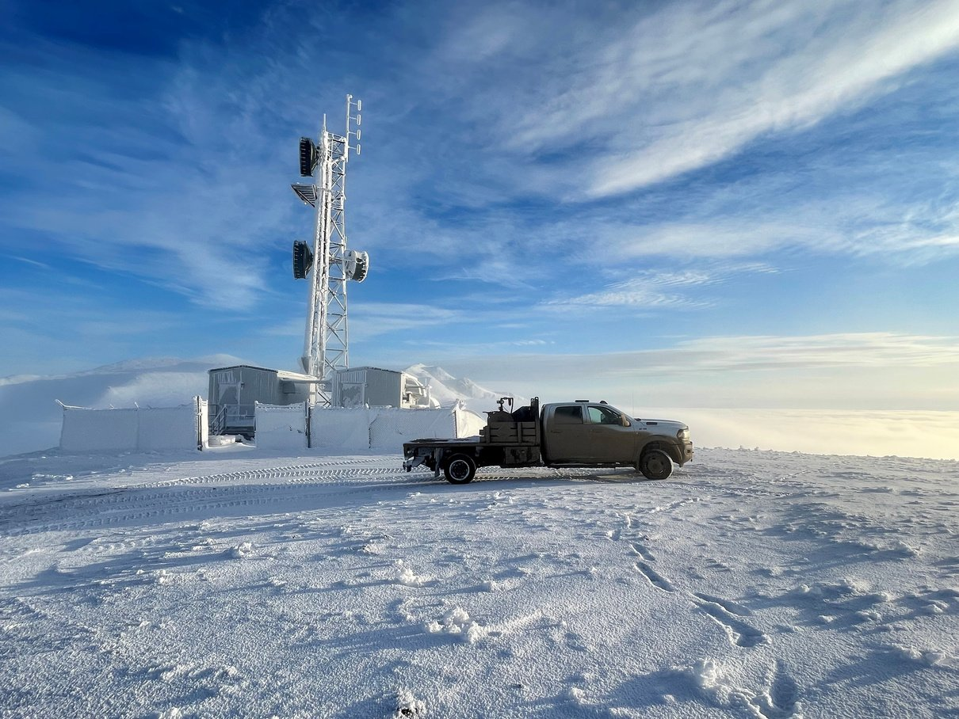
CASE STUDY
NorthwesTel — YT / NT / BC
ACCESS
Helicopter-accessed remote sites — YT, NT, BC
PARTNERS
Castle Rock Enterprises (Indigenous-owned)
SCHEDULE
September – October 2025
METHODOLOGY
Each site received a site-specific Material Classification Plan developed on arrival. Walk-through assessments documented every waste stream prior to any material movement. Wastes were categorized by regulatory classification — TDG dangerous goods, BC Special Waste, Yukon Special Waste — and assigned a disposition pathway based on character, not default assumptions.
WASTE STREAMS IDENTIFIED
Lead-acid batteries — Class 8 corrosive, UN2794
Diesel fuel & used motor oil — Class 3 flammable liquid
Hydrocarbon-contaminated materials — assessed by TCLP
Uncharacterized industrial waste — profiled on site before movement
The same discipline — characterize first, then treat — is the foundation of every CORE deployment.

Slide 17
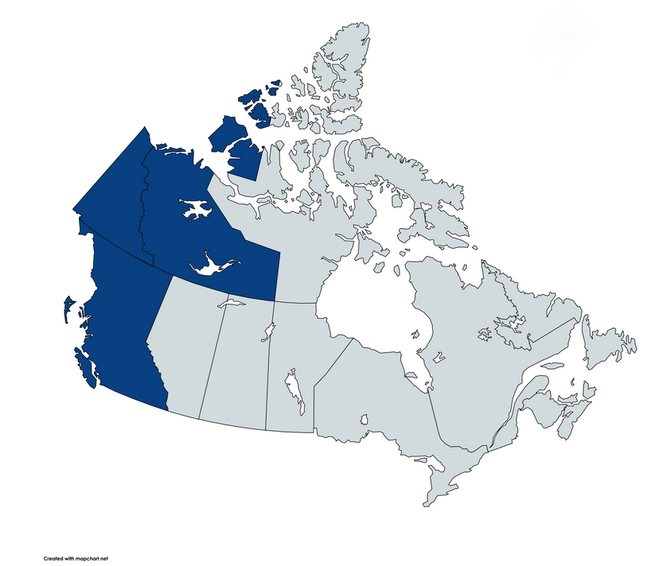
CASE STUDY — NorthwesTel
What happened to each waste stream
FUEL & OIL
Valorized not disposed
Diesel fuel and used motor oil were assessed as recoverable product, not waste. Transferred to local Indigenous-owned partners for energy reuse. Zero disposal cost..
LEAD-ACID BATTERIES
Recycled under TDG not landfilled
Classified UN2794, Class 8. Packaged, manifested, and transported by licensed carrier to approved battery recycling facility. Material recovery maximized; hazardous disposal avoided entirely.
The default would have been to ship everything.
Characterize first. Every material gets a destination based on what it is. That discipline is what turns a compliance exercise into a cost advantage and it's the same foundation CORE is built on.
SITES
Secured for future decommissioning
Building penetrations sealed, access points restricted. Wildlife intrusion prevented. Sites documented and handed back in a stable, controlled condition — liability reduced, future scope defined.
Treatment on site cost less. Every time. Across three jurisdictions.

Slide 18
The Path Forward
01
Canada’s environmental liabilities are not going away.
Not under the current model. Monitoring is not remediation.
02
S/S changes what's economically possible.
Sites that can't be cleaned conventionally become viable.
That matters at the scale Canada is facing.
03
Regulatory acceptance is growing. Technology is ready.
CCME framework exists. Academic validation is building.
Operators with northern capability exist. The question is adoption and acceptance of risk management strategies.

Slide 19

Let's Talk.
CORE Environmental
[ CORE logo
or team photo ]
Shawn Samborsky, President
core-canada.com
Edmonton, AB | Whitehorse, YT | St. John's, NL
NO AI WAS HARMED DURING THE DEVELOPMENT OF THIS PRESENTATION

