Slide 1

Bedrock Injections – A Success Story Built on Chapters of Failure
Samuel Lingwood – Environmental Due Diligence and Remediation
RemTech East 2026

Slide 2

Who I am:
Samuel Lingwood
Senior Technical Manager – Contaminant Management and Remediation
647.825.1101 – slingwood@pinchin.com

Slide 4
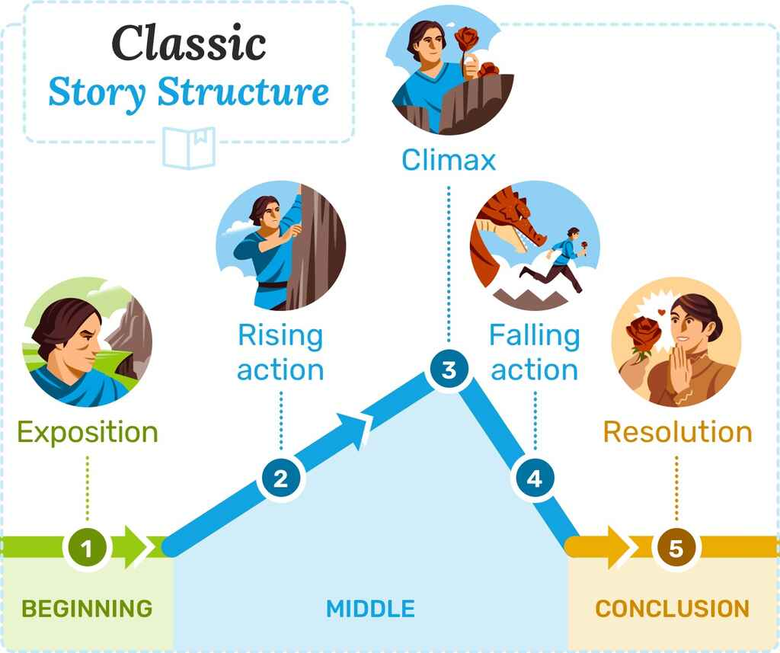
Let’s take a moment to
Let’s take a moment to talk about literature theory…
BEGINNING
MIDDLE
END
Notes:
Let’s just take a moment to do what I have no doubt you all came here to do and are eagerly awaiting - let’s discuss literature theory deliberately titled my presentation “Bedrock Injection – A Success Story Built on Chapters of Failure” because it really is a story and a good one. And as we know, every story has a beginning middle and end. But that’s a little reductive and boring. If we dive deeper into the theory of story telling, people smarter than me note that there actually 5 parts to the narrative structure of the Classic Story Arc – Exposition, Rising Action, Climax!, Falling, Action and Resolution. Freytag’s Pyramid – but even this is a little basic – there are archetypes within this structure – ones that we all know and love: Icarus – Rise and Fall, Cinderella – Rise, Fall, Rise; Rags to Riches – Fall,

Slide 5

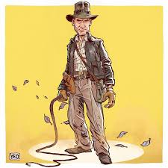



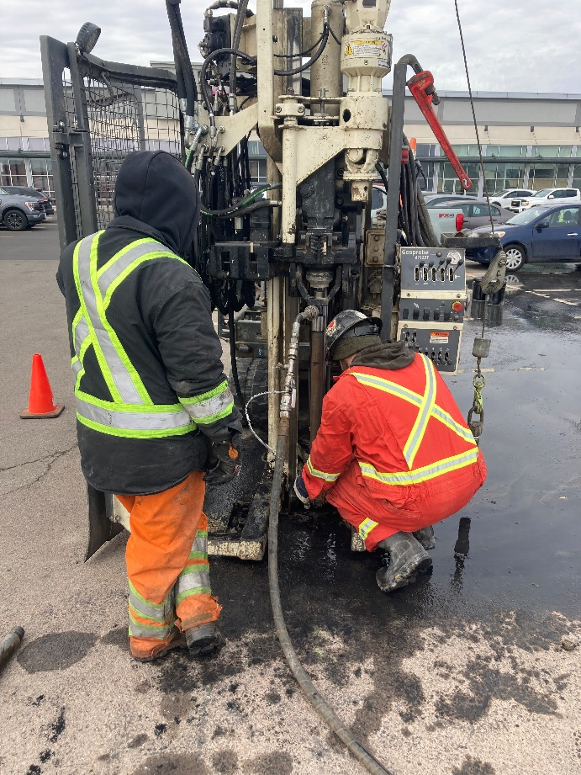




Let’s take a moment to
Let’s take a moment to talk about literature theory…
Notes:
But what do all these famous characters’ have in common? The HERO’s Journey (also sometimes referred to as man in a hole)

Slide 6
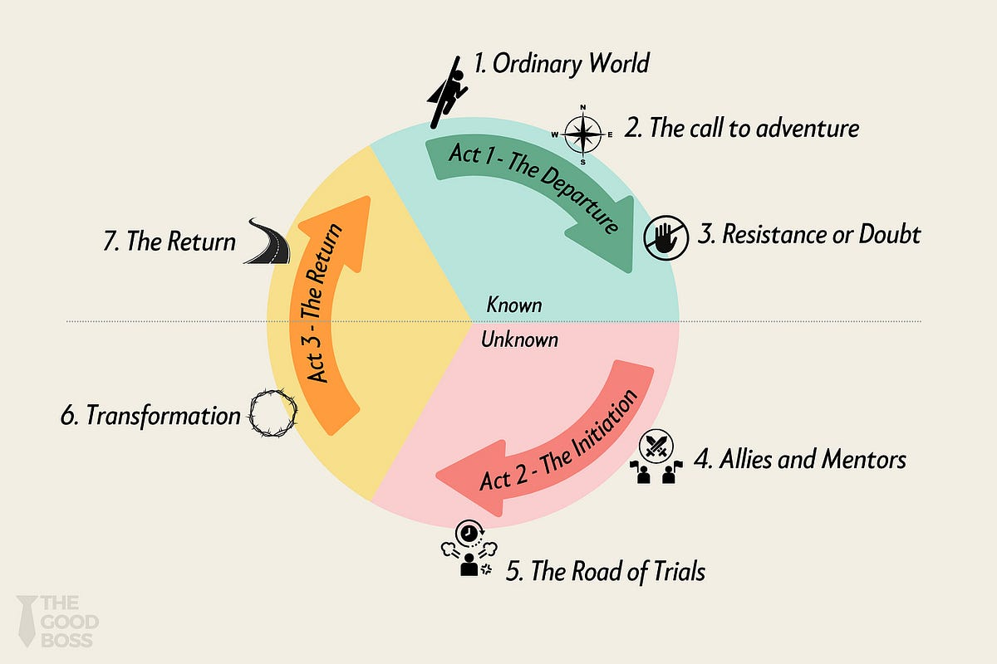
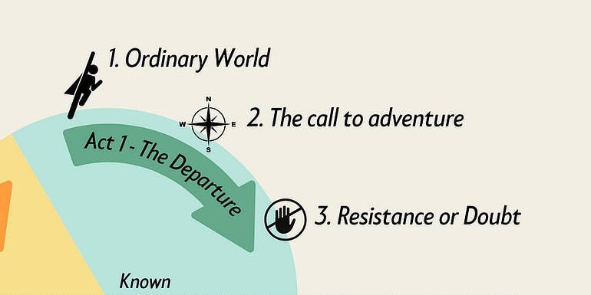

Let’s take a moment to talk about literature theory…
The Hero’s Journey
ACT 1
Notes:
Now the hero’s journey is that archetypal one of discovery, failure and trials, learning and flection (with not a little doubt and stress) followed by ultimate success or redemption through change and adaptation. But it all starts with the un extraordinary being called to adventure.

Slide 7
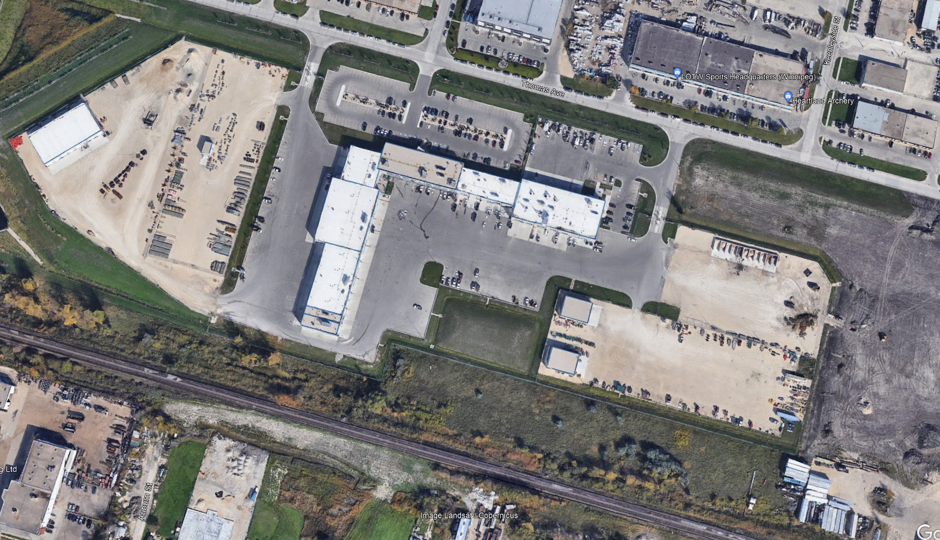
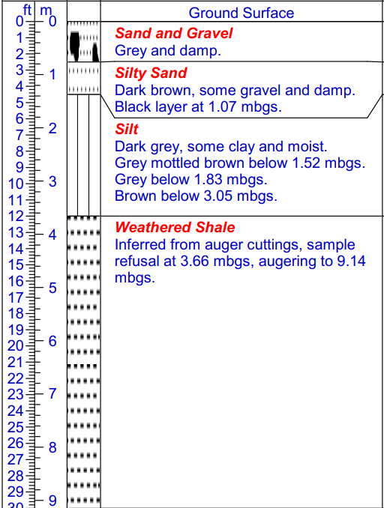


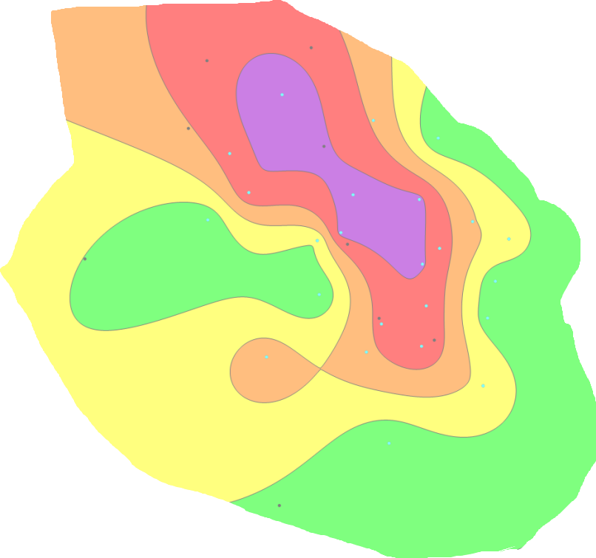
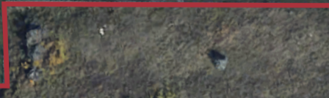
Background
The Call to Adventure – Identifying a Source Zone
PCE (µg/L)
>10,000
10,000 – 1,000
1,000 – std
Std - Non-detect
Non-detect
Notes:
Every hero’s journey begins in standard world that appears stable – until a hidden problem is revealed.
So here we have a fairly standard commercial site but there are unseen threats below - a storied past that included amongst many different operations – at least 2 different dry cleaners with decades of operation
The site has undergone a fairly rigorous drilling and investigation program and chlorinated plume has been identified that approximately follows this heat map. More importantly though and more to the main conflict or antagonist of our story is that these impacts are found penetrating into the weathered shale. Groundwater flow is to the south but we can also see other influences at play likely associated with bedrock layering and potentially the influence of fractures.
Now to manage offsite migration, we previously installed a PRB along the a section of the southern property line – now that’s a story for another time – but suffice it to say, this source zone plume’s elevated source concentrations increase the mass loading to the existing PRB, potentially shortening its effective lifespan. They also posed a long-term risk to planned site redevelopment, particularly with respect to soil vapour intrusion and the need for future vapour mitigation systems. We need to manage this source zone – What better hero’s call can there be than this? And from here we start our journey that would challenge assumptions, test conventional methods, and ultimately require adaptation and innovation to succeed.

Slide 8
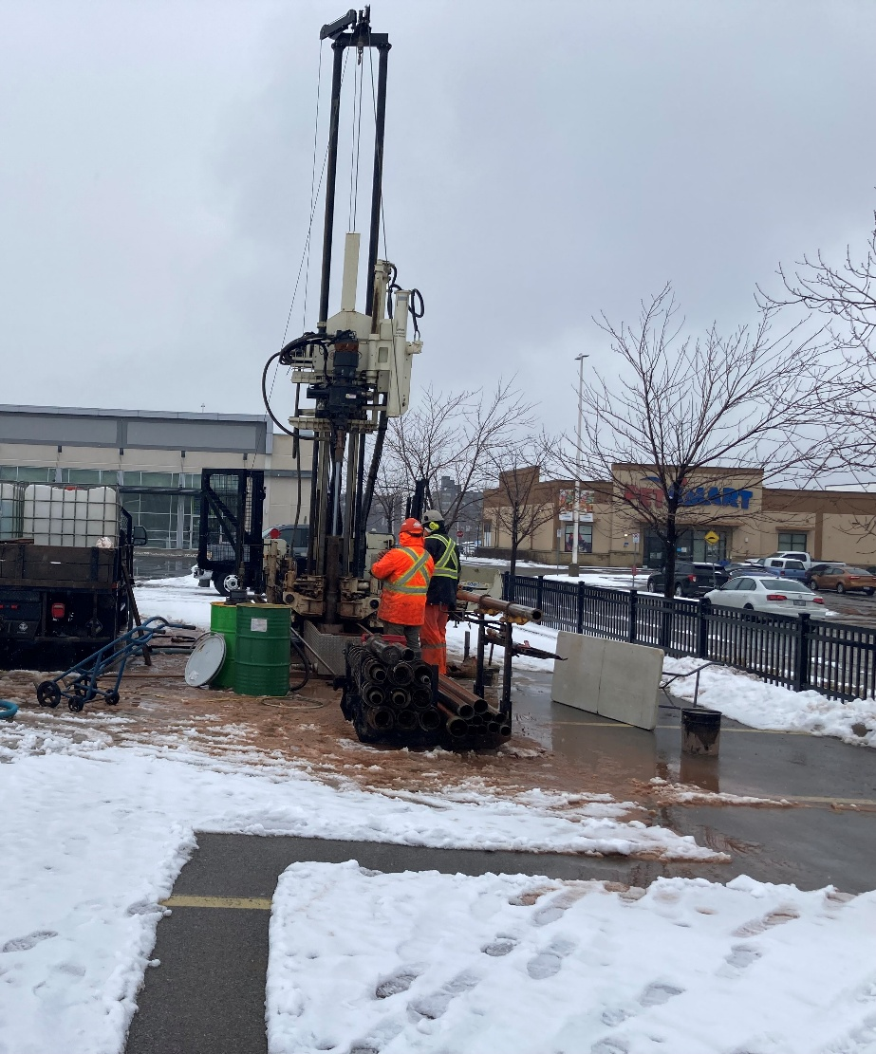
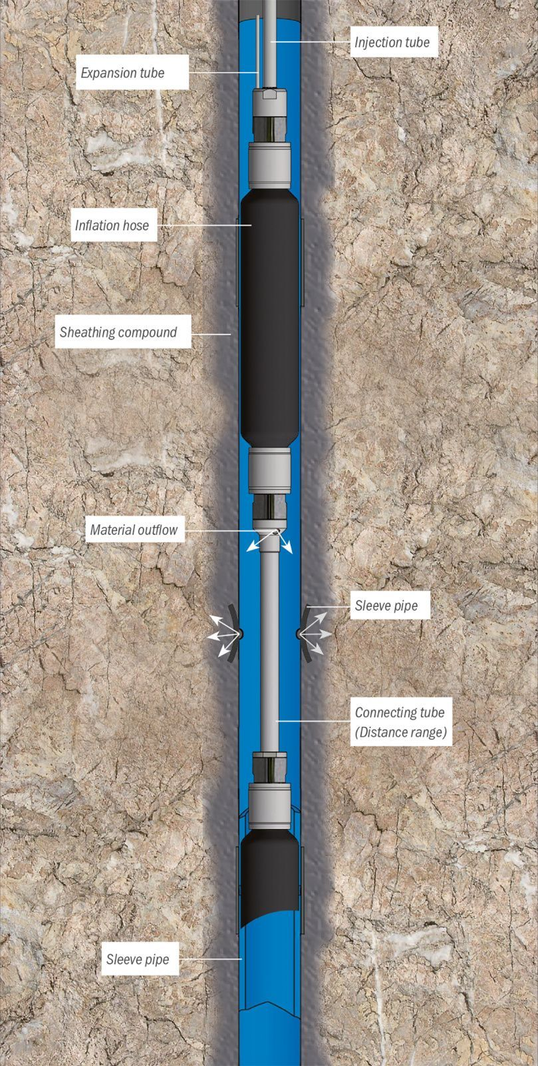
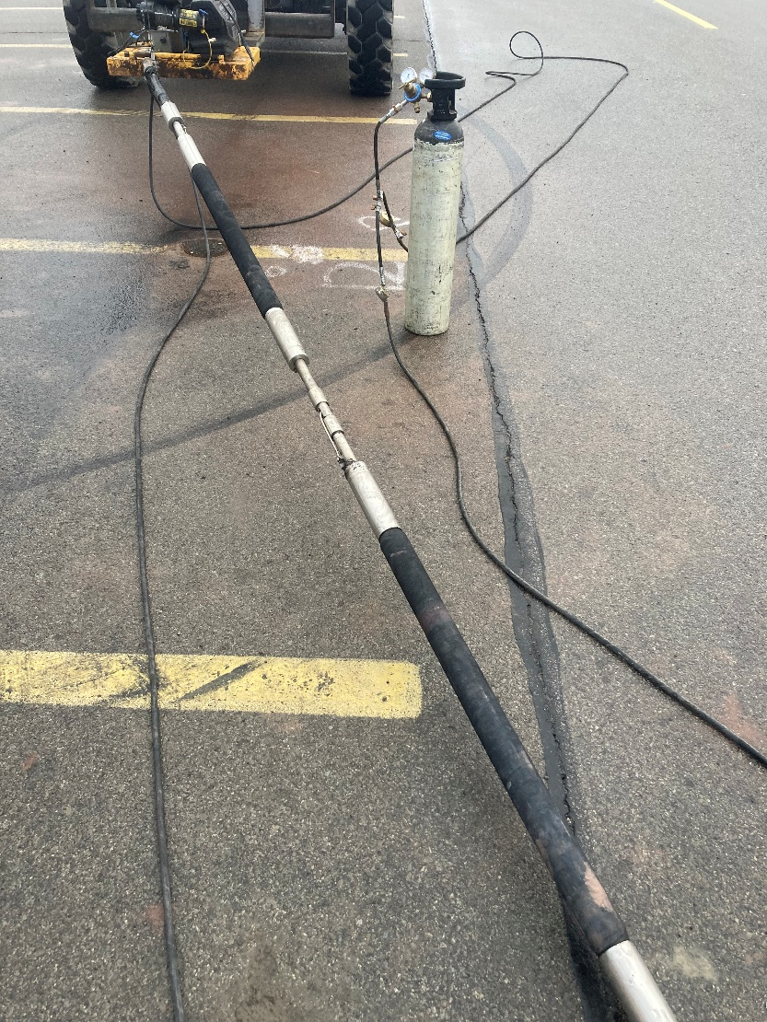
Refusal of the Call
Notes:
This is more of the reluctance to change, reluctance to adopt something new. So we go with some thing safe, predictable - a proven history in the same formation - packer injection. And the plan looked solid on paper.
The approach requires the advancement of a open borehole at first with the upper non-impacted overburden cased off. The double packer is then deployed, sealing off sections as required and injection of the amendment – in this case an engineered activated carbon substrate impregnated with ZVI and augmented with KB1 - at high pressure. Target was 3-10 mbgs

Slide 9
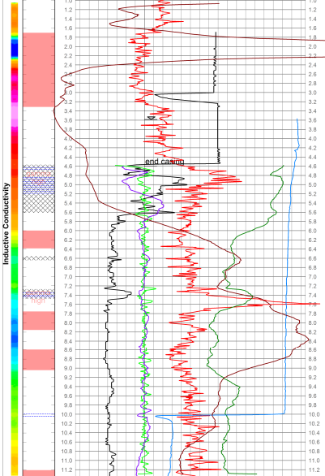
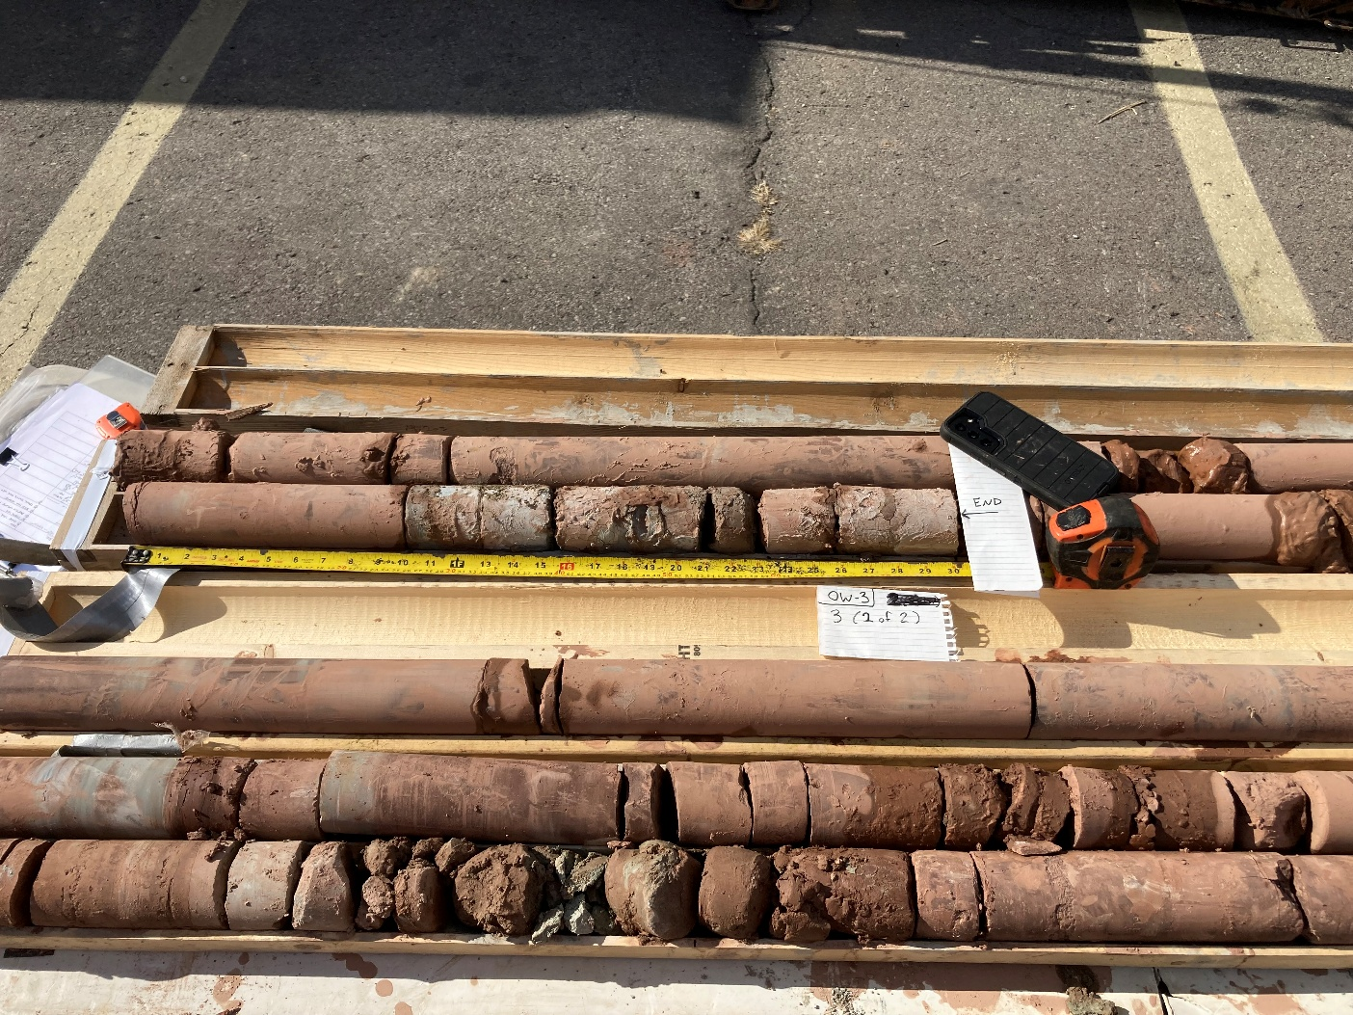
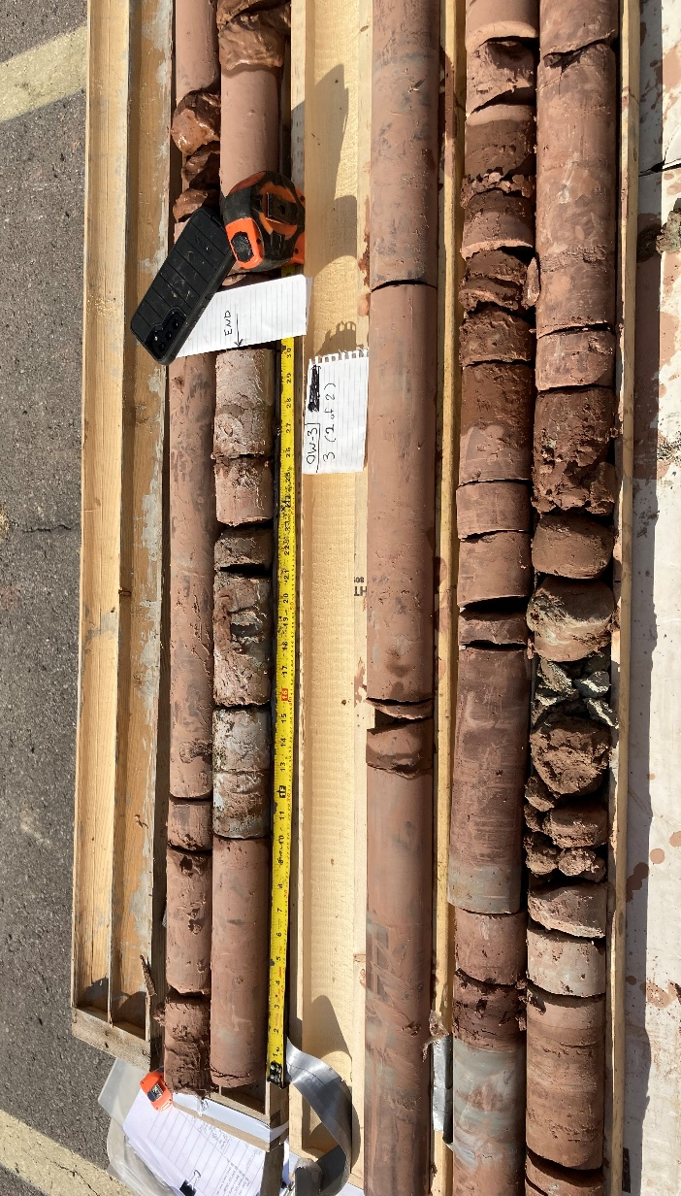
Geophysics
Tests completed:
  Spontaneous Potential
  Fluid Conductivity
  Single Point Resistance
  Fluid Temperature
  TC Gamma
  Caliper

Slide 10
The Plan – safe, standard, predictable…
Central Injection
PRZ#1 Injection
PRZ#2 Injection
Notes:
And the plan looked solid on paper –
41 permanent injection points with a target depth of 3 to 10 mbgs.
3 treatment zones: central injection area, and two PRZs
But once the drilling begins, theory meets the geology.

Slide 11
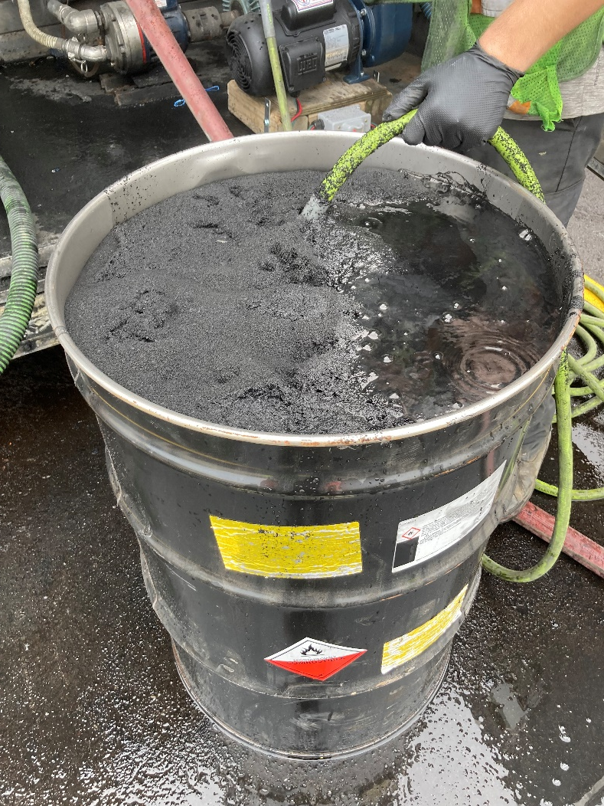

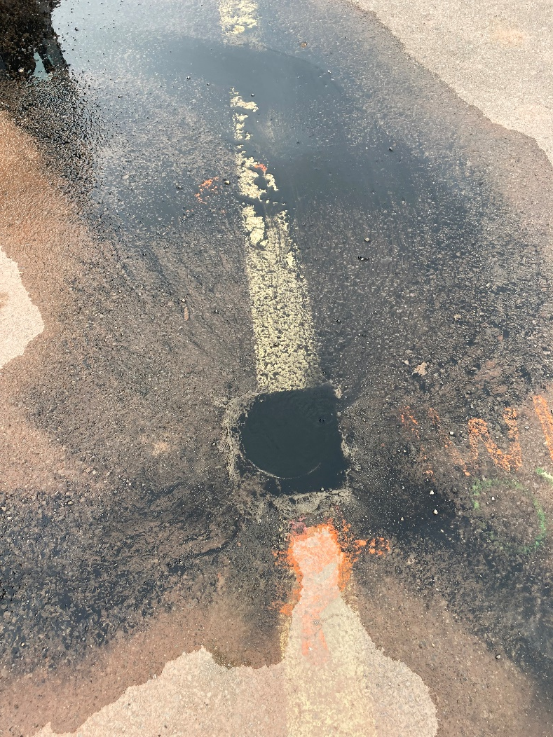
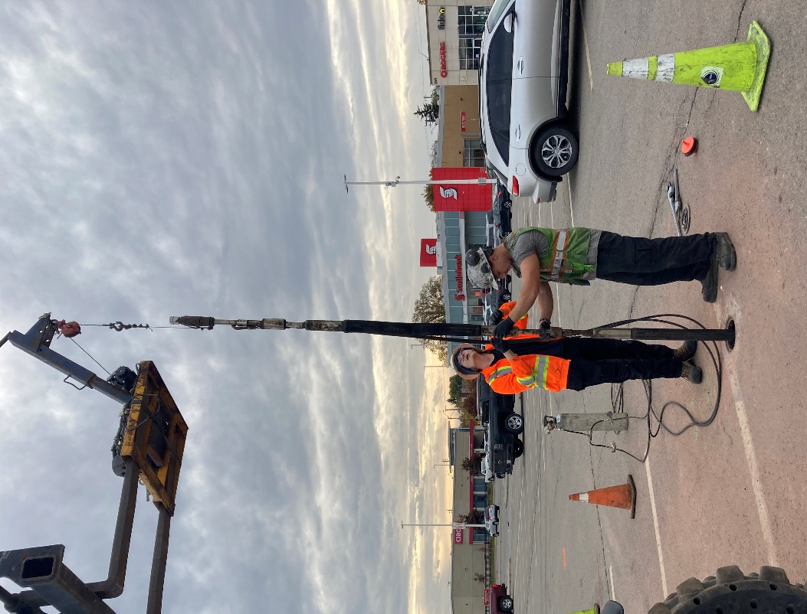
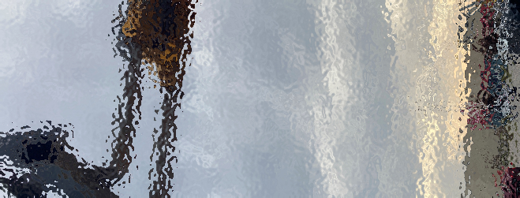
PILOT INJECTION
PREP
INJECT WITH PACKERS
TRACK THE RESULTS
Notes:
A pilot was completed – safe, easy, successful – and it was believed that this would translate to the rest of the site without issue

Slide 12
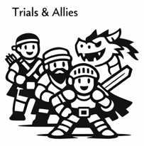
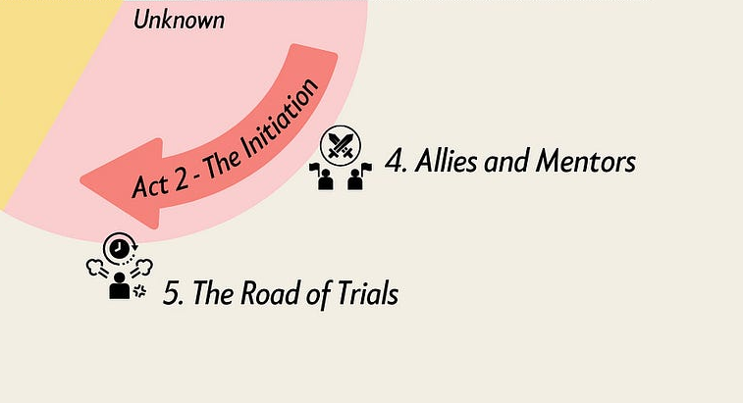
Refusal of the Call
The Hero’s Journey
ACT 2
Notes:
This brings us into Act 2- The initiation where the hero enters into the unknown – where we test the meddle of our hero, push his limits, force him to face failure. And failure is what we had.

Slide 13
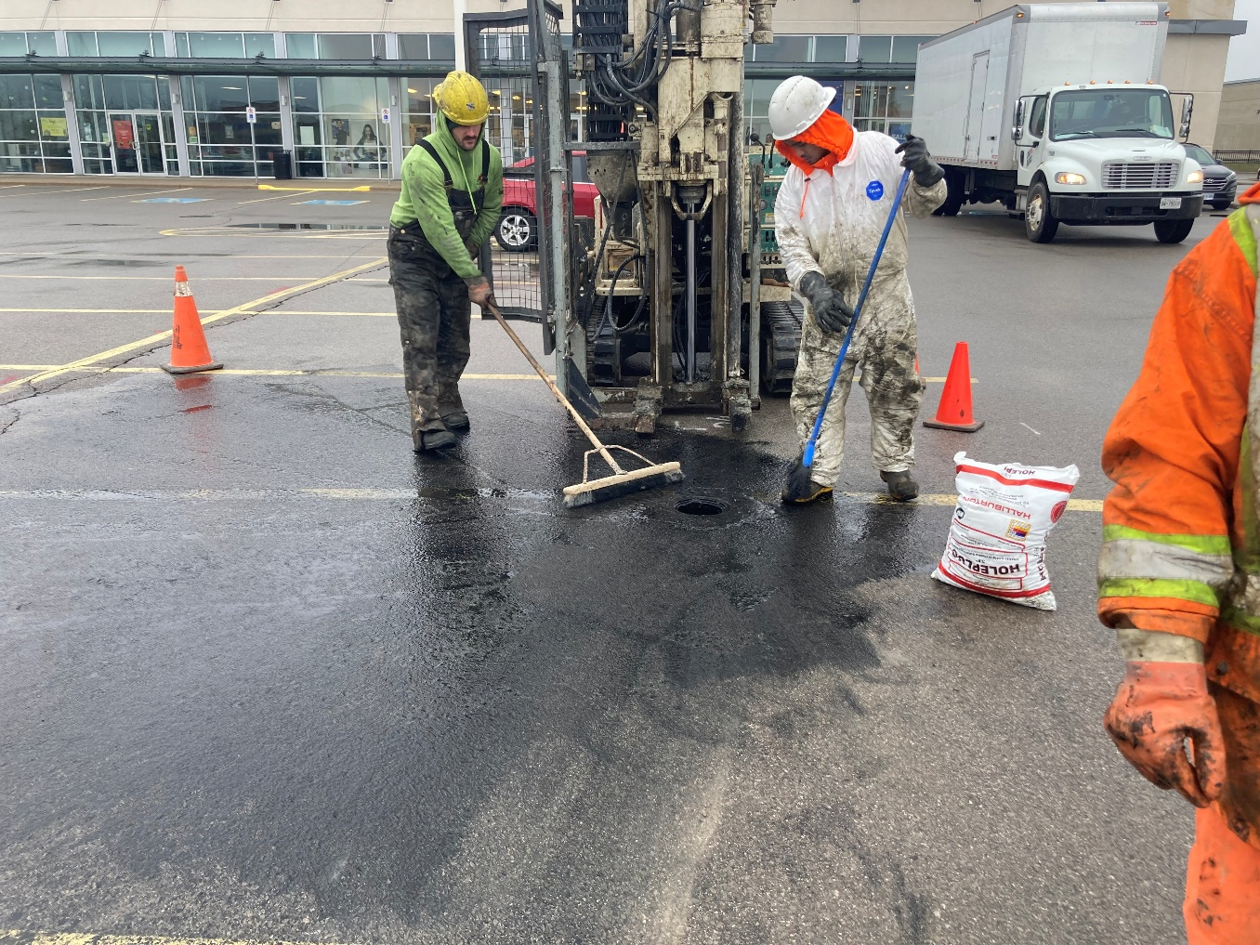
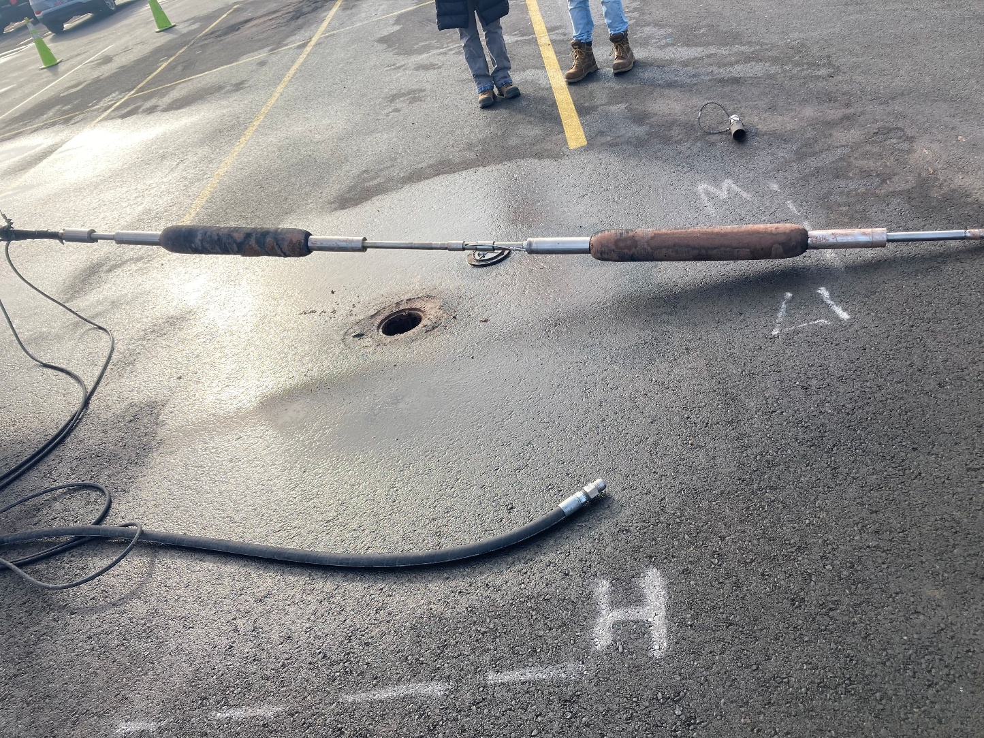
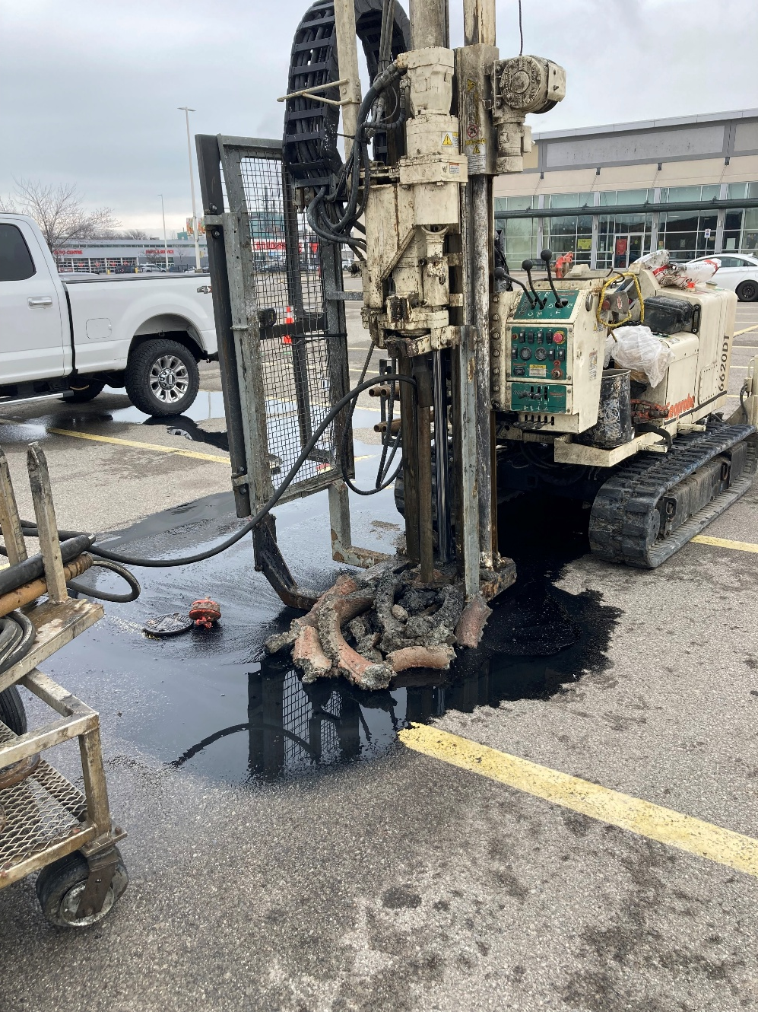
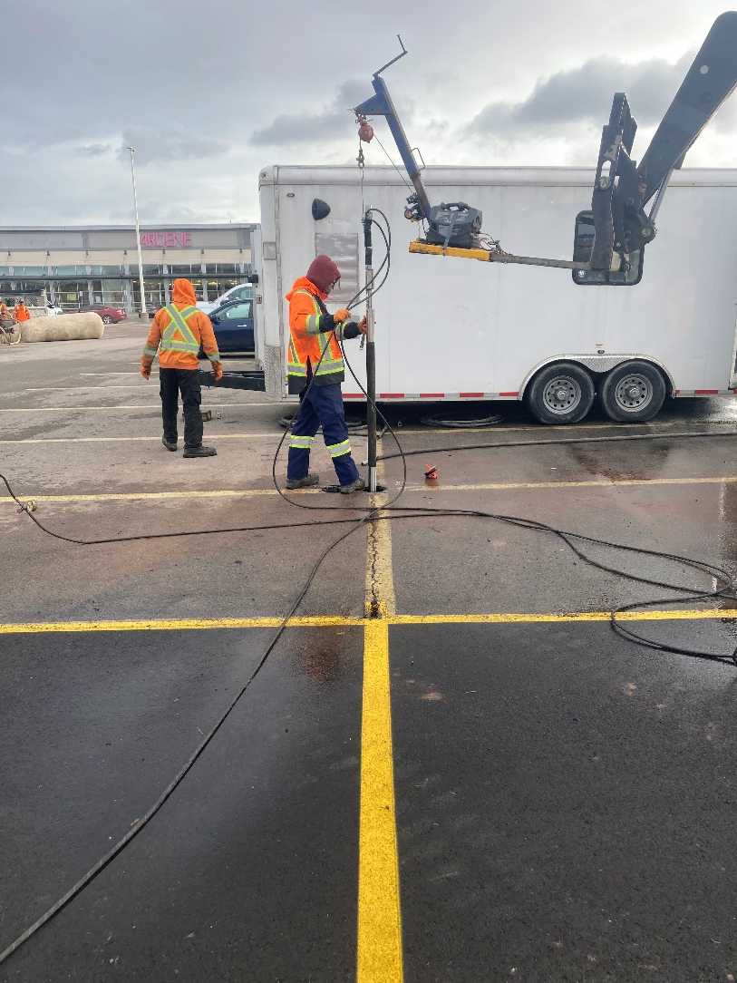
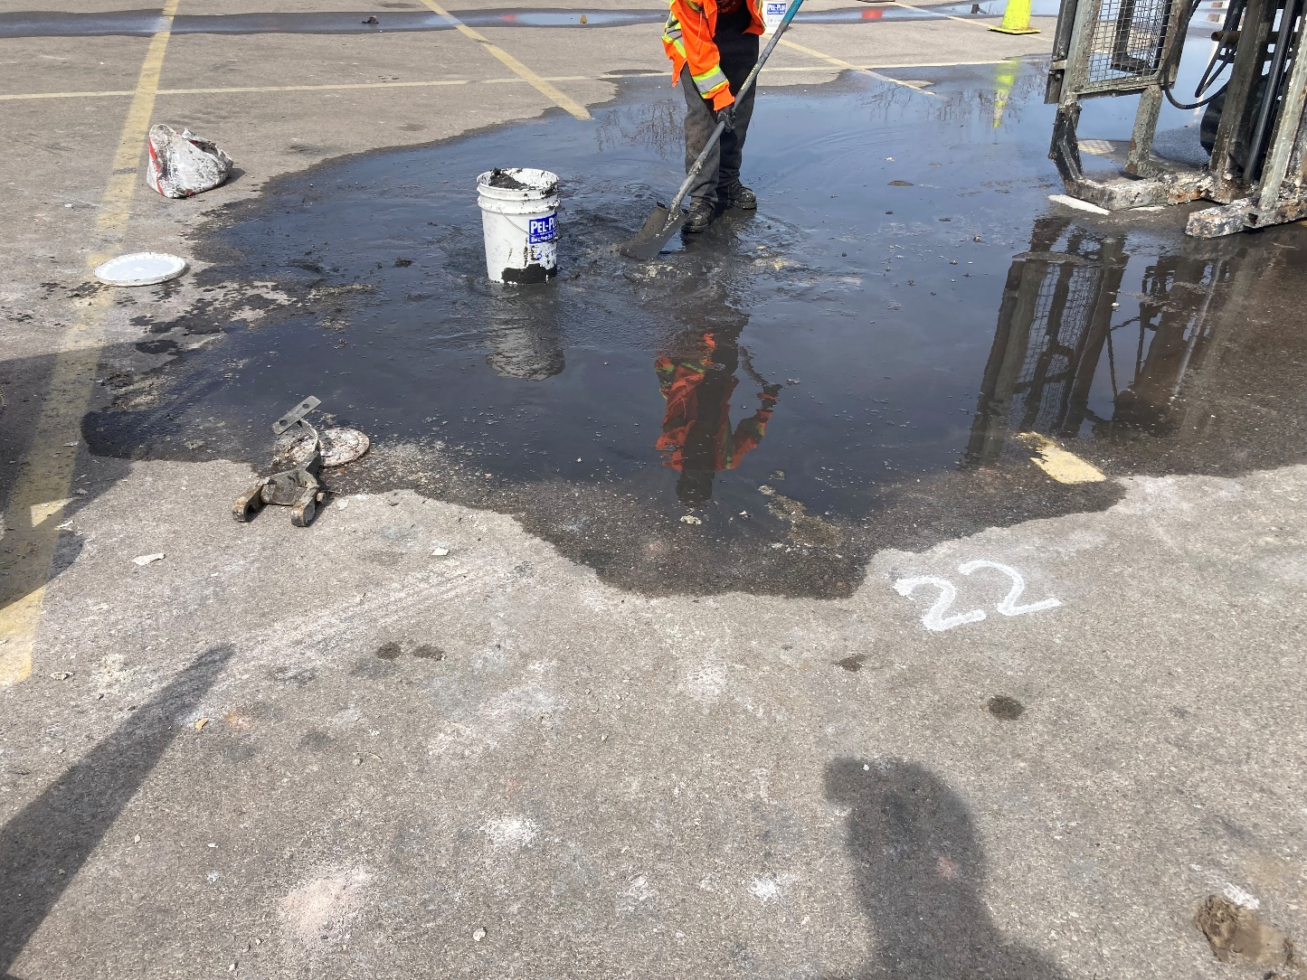
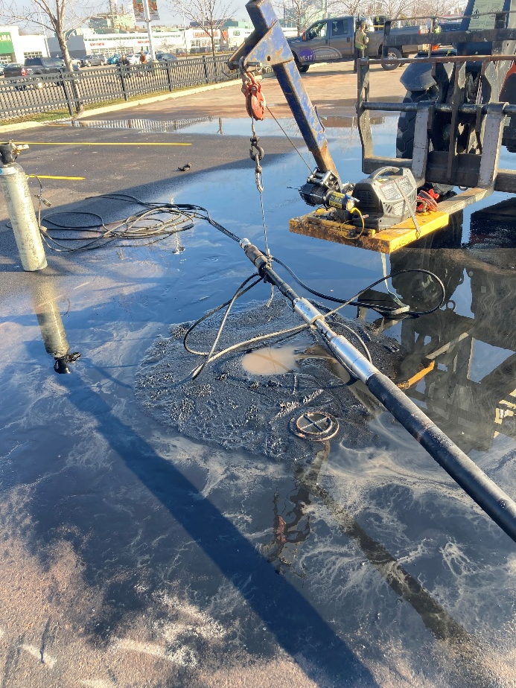
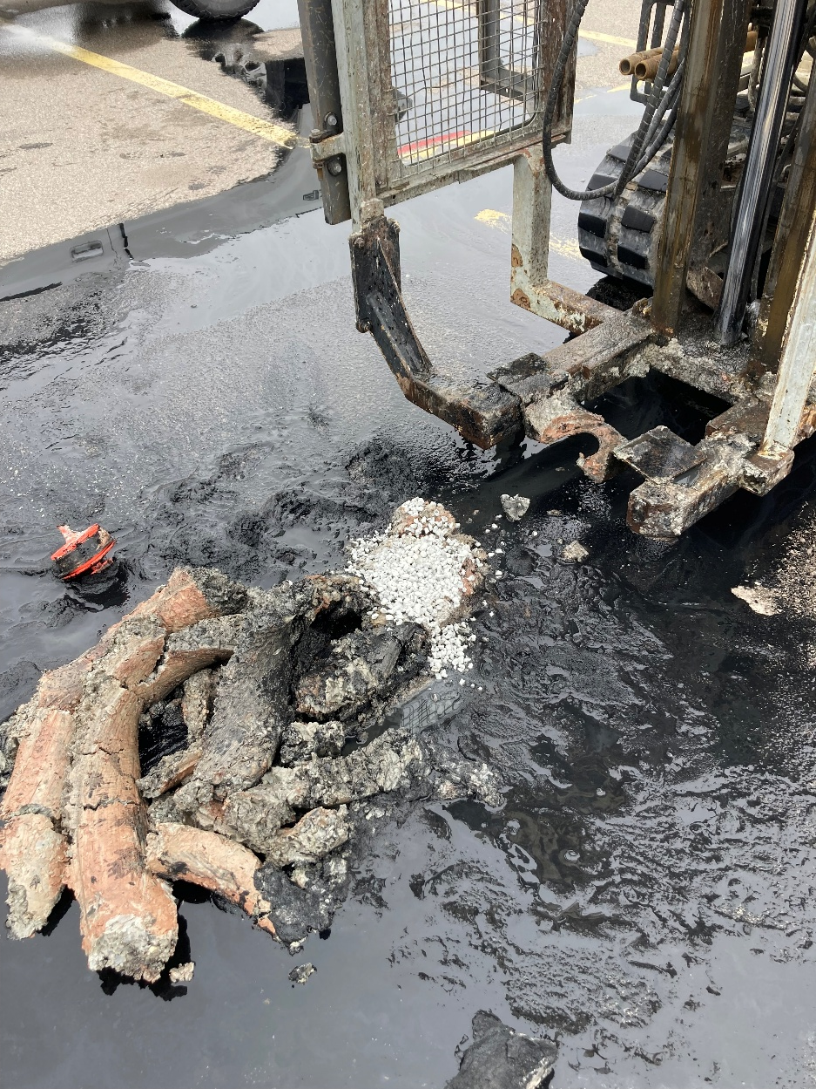
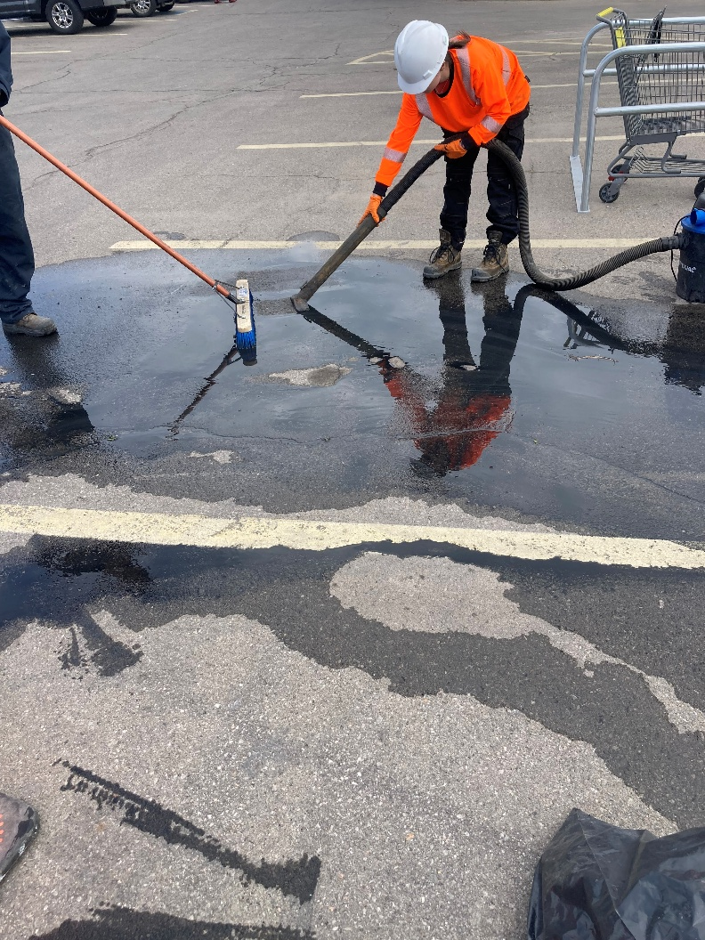
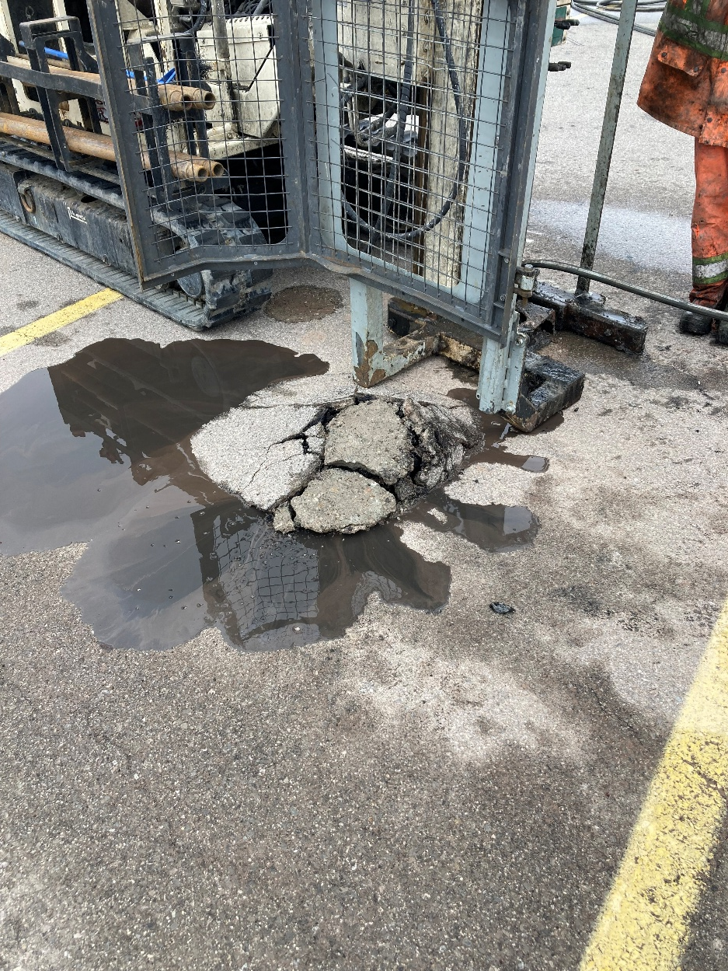
Trials and Setbacks
Notes:
We begin with our standard plan – but the formation fights back. Highly weathered and stratified bedrock creates unsuitable conditions for the nitrogen packers to create a seal and clay seams cause unpredictable sloughing.
Pressure packer challenger
Blockages below 6 m
Packer slippage
Injection refusal at high pressures.
The tried and true is a failure.
Additional flaw – like the brash young hero of story, we are overconfident, eager to please, and become over committed. Due to some cost savings measures and a desire to show progress based on shallow success that is not indicative of depth, we advance all the boreholes! Our hotheaded pride is going to get us in hot water

Slide 14
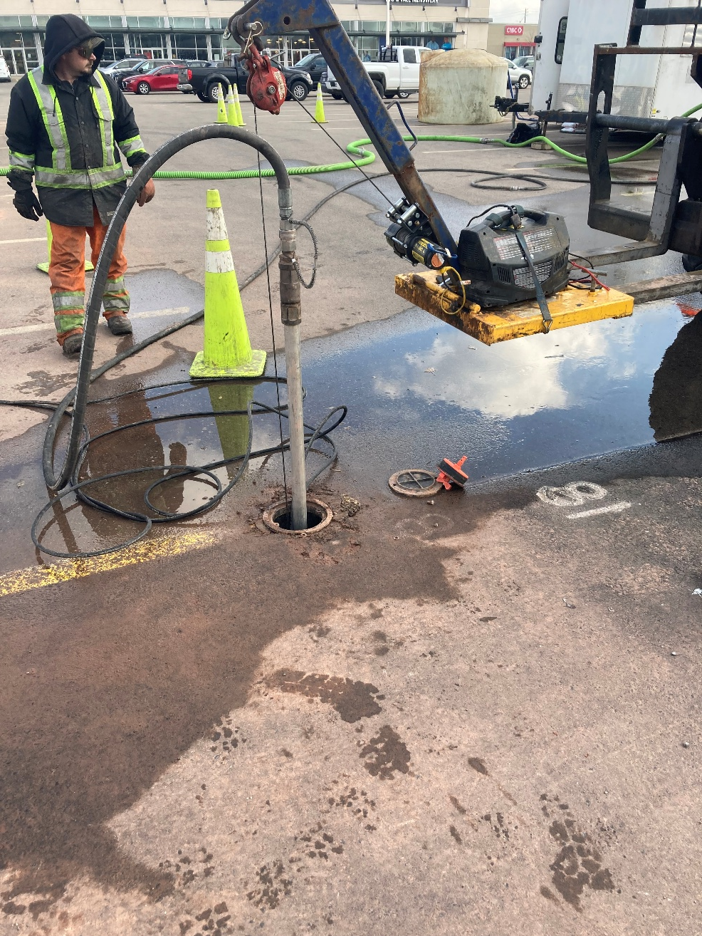
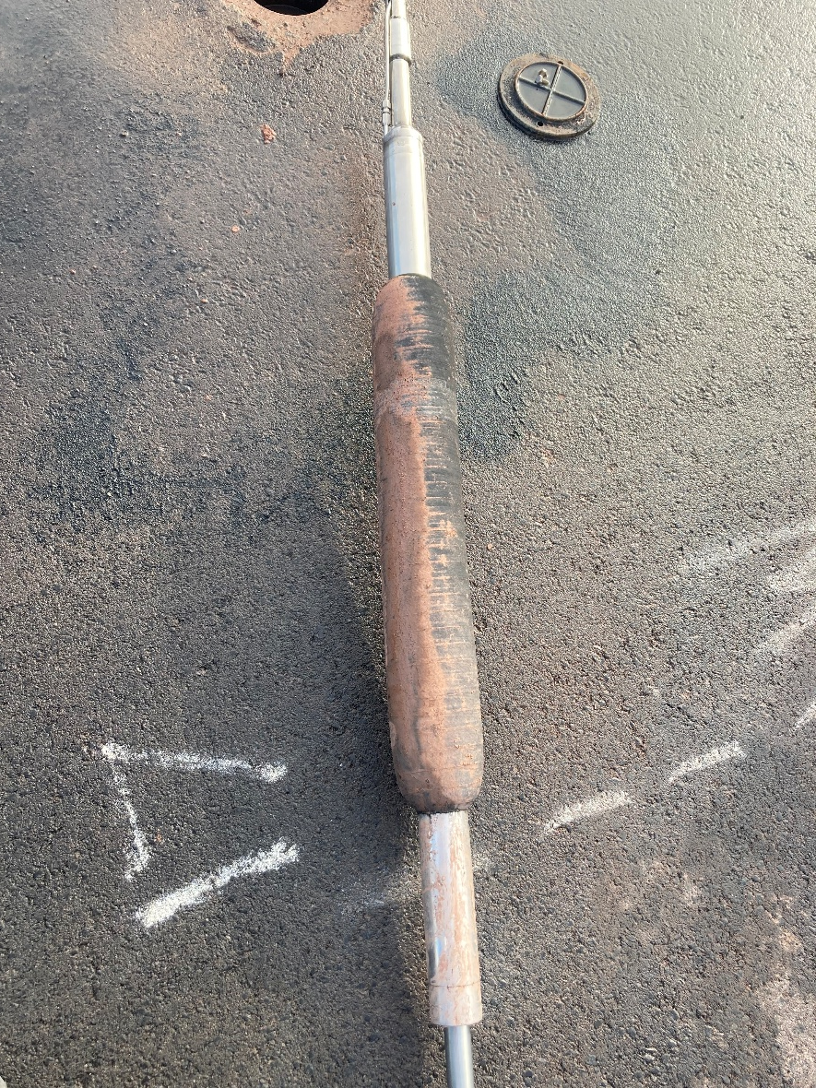
The Abyss (and allies)
Notes:
Nitrogen packers have failed at depth and now we run the risk of incomplete treatment, shallow only injections, loss of confident in the client, inability to delivery on a our promise and ultimately potentially fail to do what we set out to do. Like tightening your grip on water flowing through your fingers, In an effort to salvage the situation we double down on the approach and modify the system to inflate with water, increasing out pressure capacity – alas no solution, pushes the rig out and tooling out of the ground – need to adapt, change, and effectively start over with new assumptions

Slide 15
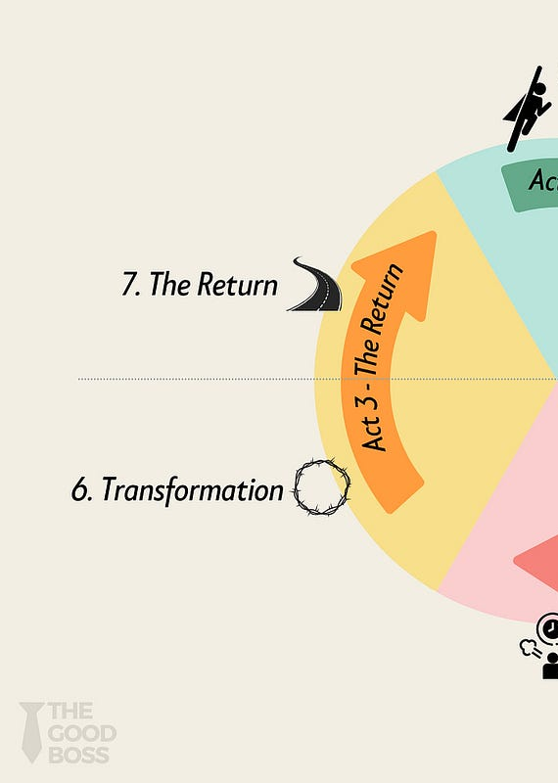
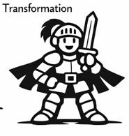
The Return
The Hero’s Journey
ACT 3
Notes:
Transform – the begging of Act 3 and the Resurrection – the Return with the Elixir

Slide 16
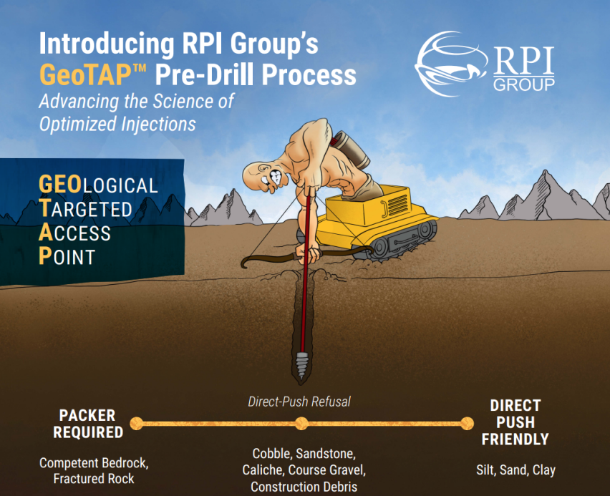
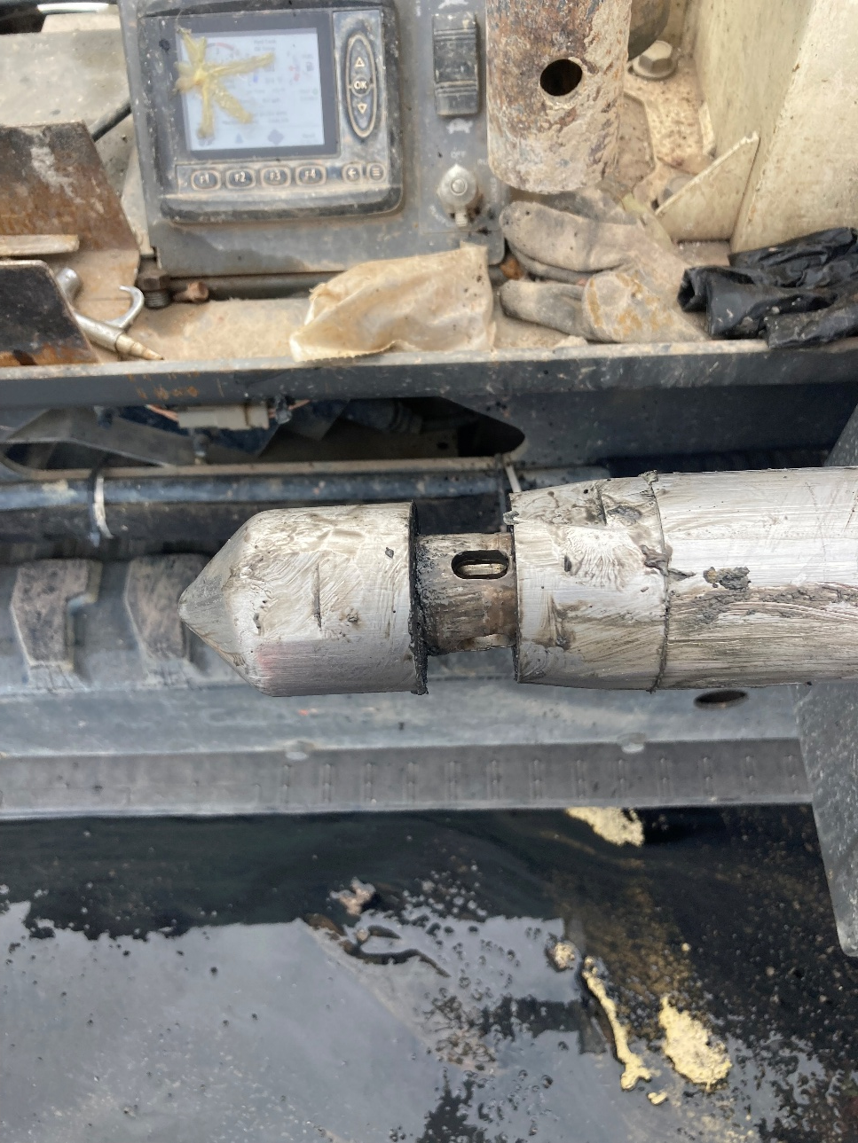
The Elixir
Notes:
This elixir came in the form of GeoTAP drilling.

Slide 17
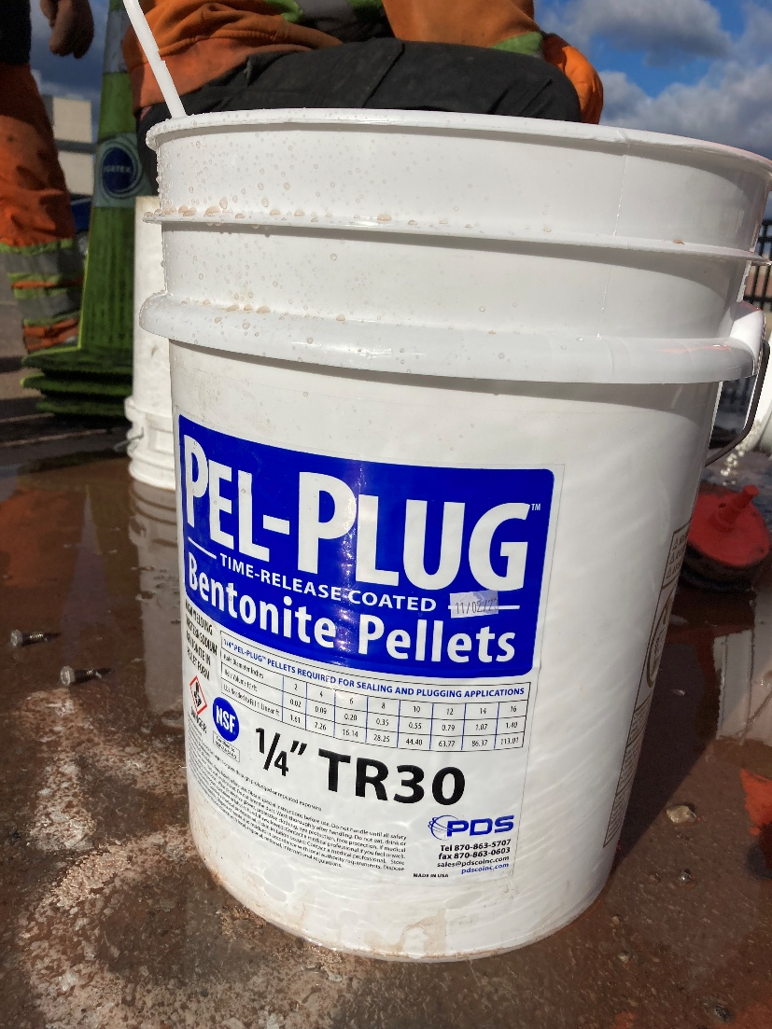
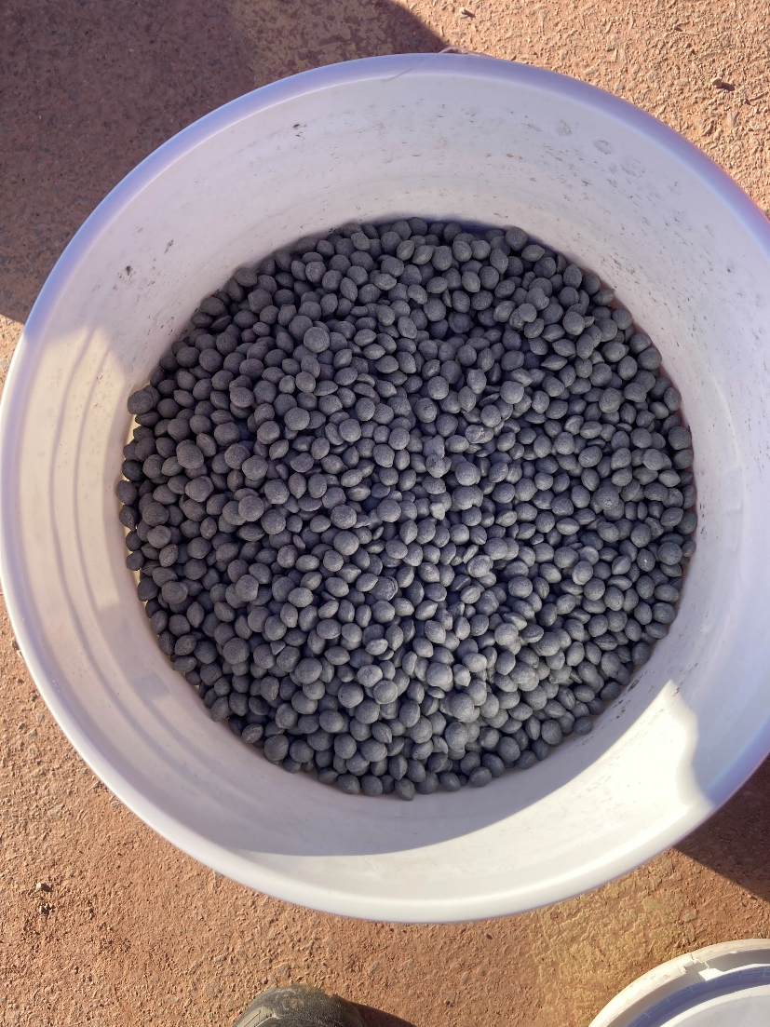
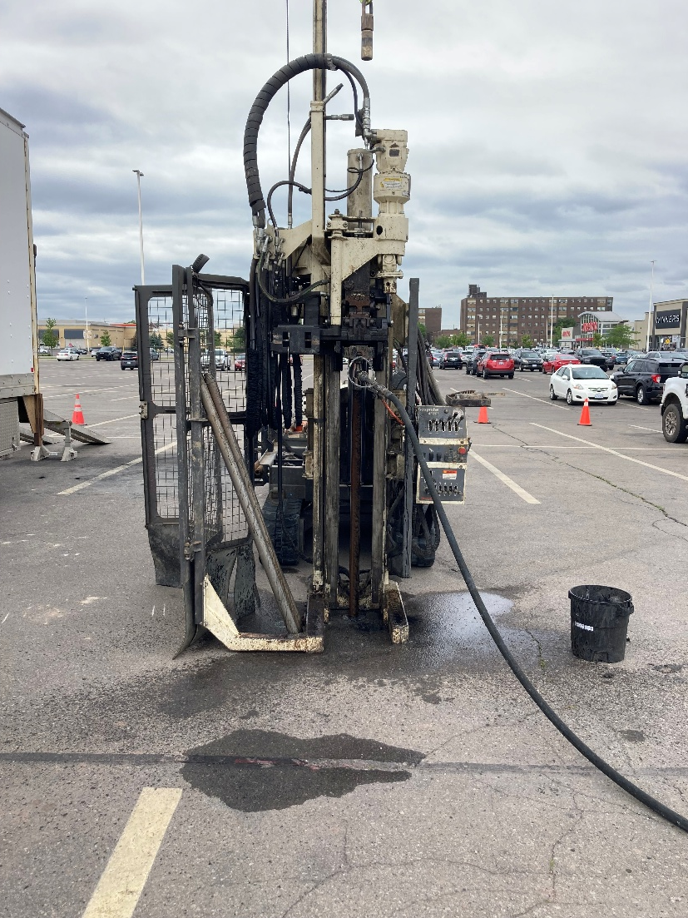
GeoTAP
Notes:
Locations were over drilled to remove surface casing and backfilled with pel plug
Pilot GeoTAP™ injections demonstrated immediate success. Amendments were successfully delivered at depths of 7 to 10 metres below ground surface, with injection pressures reaching up to approximately 1,000 psi. Hydraulic responses observed in nearby monitoring wells confirmed connectivity within the fracture network, and subsequent bedrock coring verified that injection intervals aligned with natural fracture zones. With proof of concept established, GeoTAP™ was deployed across all remaining injection points.
The system finally behaves. And through this hard won lesson/ 25,400 lbs of BOS100 were injected along with a KB1 insurance policy

Slide 18
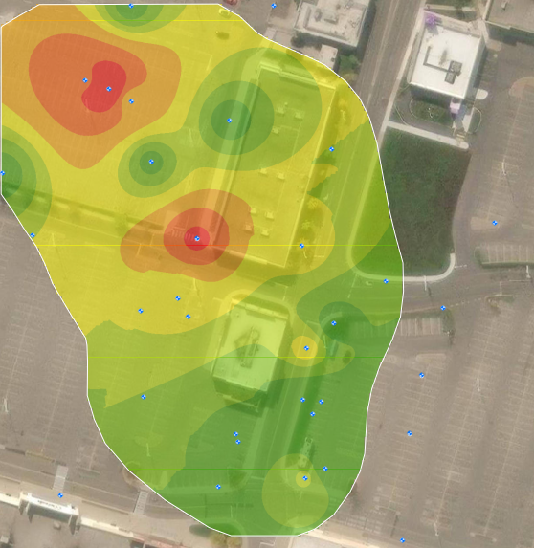
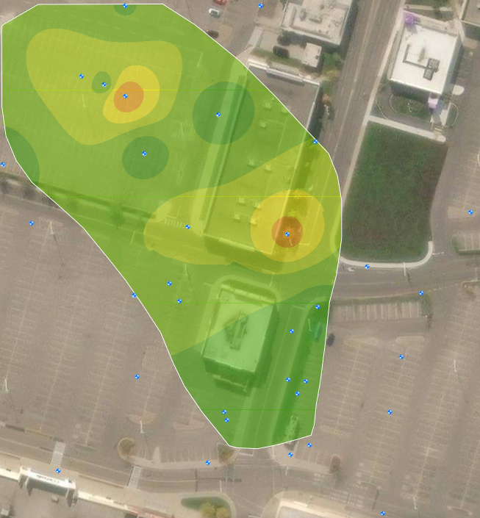
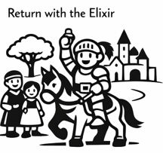
The Reward
1 YEAR
Notes:
PCE and TCE decrease in most wells, daughter products are evident and proof of reductive dechlorination
Geochemistry is shifted with a drop in DO and more reducing conditions, increased methane production
Results
in reduced loading on PRB and increase life
Lower vapour mitigation demand
Treatment achieved without disruptive ex-situ approach
Bedrock fractures successfully used and remedial pathways

Slide 19
Changed and Appreciative
The Hero’s Journey
Bedrock injection is a difficult game and not a one-size fits all arena
Flexibility in methodology is crucial
Geotap is a power approach in fractured and unstable bedrock where inconsistencies in strata can be managed
Pilot works and their interpretation must be taken with limitations and not broadly applied without context.
Notes:
Our trials have transformed our hero – not the plucky doe eyed myopic self proclaimed champion who first set out on this journey. They have been humbled, forced to revaluate assumptions and adapt and learn. But our hero emerged from the journey changed, having overcome adversity through adaptation, and returned with an effective, resilient remediation outcome.
These lessons include”
Bedrock injection is a difficult game and not a one-size fits all arena
Flexibility in methodology is crucial
Geotap is a power approach in fractured and unstable bedrock where inconsistencies in strata can be managed
Pilot works and their interpretation must be taken with limitations and not broadly applied without context.

Slide 20

