Slide 1
Introduction to 6PPD and
6PPD-quinone
The Race to Find Alternatives
RemTech East, Ottawa
April 9, 2026

Slide 2
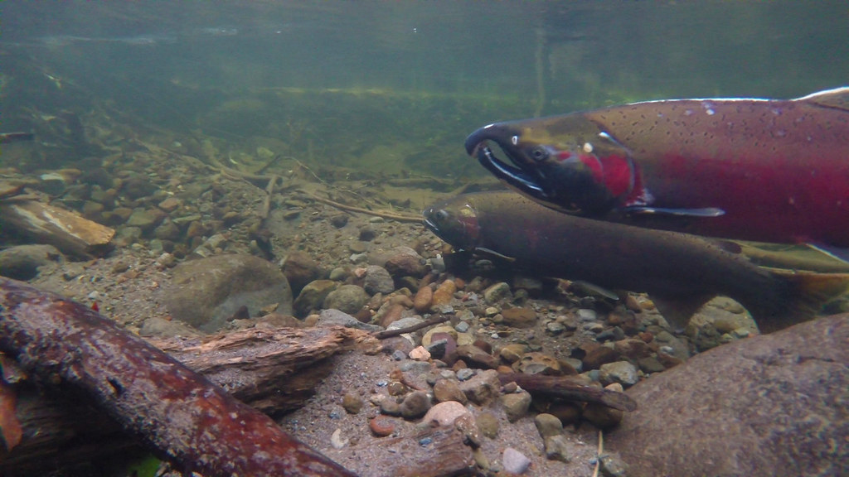




Coho Salmon, Oncorhynchus kisutch
Lifecycle is spent in both freshwater and ocean (anadromous)
Important commercial, recreational, and traditional Indigenous fishery
Pacific Coast – CA to AK, Russia
Introduced to Great Lakes
Spend the first half of their lives in freshwater
3-year life span
50-70 cm, 2-5 kg
Return to freshwater to spawn
All Coho die after spawning
This Photo by Unknown Author is licensed under CC BY

Slide 3
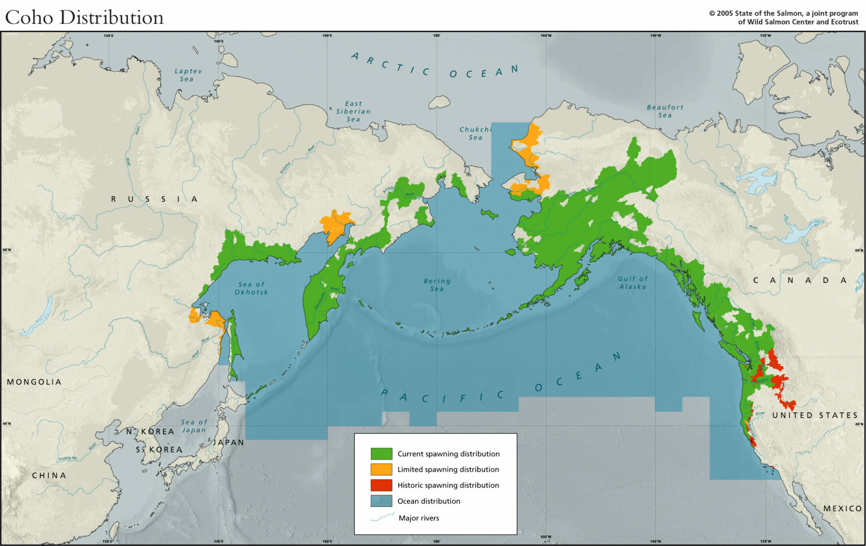
Spend the first half of their lives in freshwater
3-year life span
50-70 cm, 2-5 kg
Return to freshwater to spawn
All Coho die after spawning
This Photo by Unknown Author is licensed under CC BY

Slide 4
Coho Salmon Life Cycle
Spend the first half of their lives in freshwater
3-year life span
50-70 cm, 2-5 kg
Return to freshwater to spawn
All Coho die after spawning
This Photo by Unknown Author is licensed under CC BY

Slide 5
The Mystery of
Pre-Spawn Fish Kills

Slide 6
1980s
Coho Salmon fish kill events and decreasing populations observed in Pacific Northwest
2011
Urban road runoff suspected as the cause of pre-spawn fish kills
2018
Research into chemicals identified in tire wear particle leachate
2020
A previously unknown chemical determined to be the cause of acute pre-spawn mortality

Slide 7
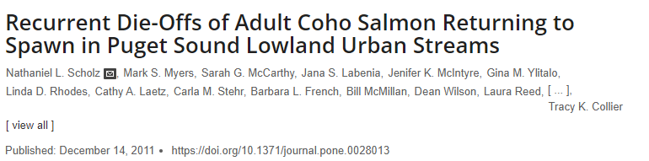
1980s
Coho Salmon fish kill events and decreasing populations observed in Pacific Northwest
2011
Urban road runoff suspected as the cause of pre-spawn fish kills
2018
Research into chemicals identified in tire wear particle leachate
2020
A previously unknown chemical determined to be the cause of acute pre-spawn mortality

Slide 8
1980s
Coho Salmon fish kill events and decreasing populations observed in Pacific Northwest
2011
Urban road runoff suspected as the cause of pre-spawn fish kills
2018
Research into chemicals identified in tire wear particle leachate
2020
A previously unknown chemical determined to be the cause of acute pre-spawn mortality

Slide 9
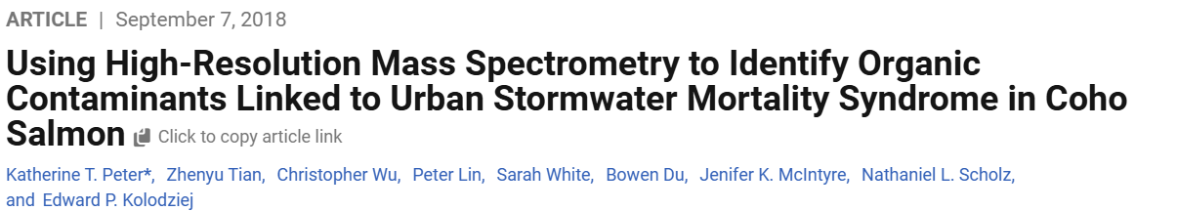
1980s
Coho Salmon fish kill events and decreasing populations observed in Pacific Northwest
2011
Urban road runoff suspected as the cause of pre-spawn fish kills
2018
Research into chemicals identified in tire wear particle leachate
2020
A previously unknown chemical determined to be the cause of acute pre-spawn mortality

Slide 10
1980s
Coho Salmon* fish kill events and decreasing populations observed in Pacific Northwest
2011
Urban road runoff suspected as the cause of pre-spawn fish kills
2018
Research into chemicals identified in tire wear particle leachate
2020
A previously unknown chemical determined to be the cause of acute pre-spawn mortality

Slide 11
The weight of evidence suggests that freshwater-transitional coho are particularly vulnerable to an as-yet unidentified toxic contaminant
(or contaminant mixture) in urban runoff.
Scholz et al. 2011

Slide 12
1980s
Coho Salmon* fish kill events and decreasing populations observed in Pacific Northwest
2011
Urban road runoff suspected as the cause of pre-spawn fish kills
2018
Research into chemicals identified in tire wear particle leachate
2020
A previously unknown chemical determined to be the cause of acute pre-spawn mortality

Slide 13
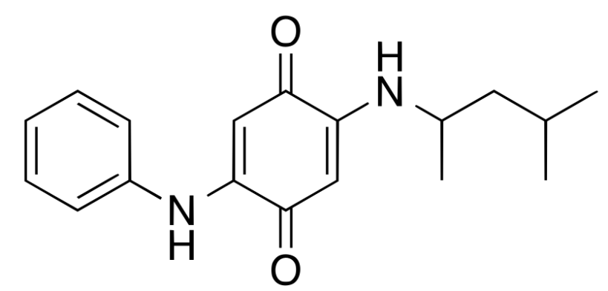
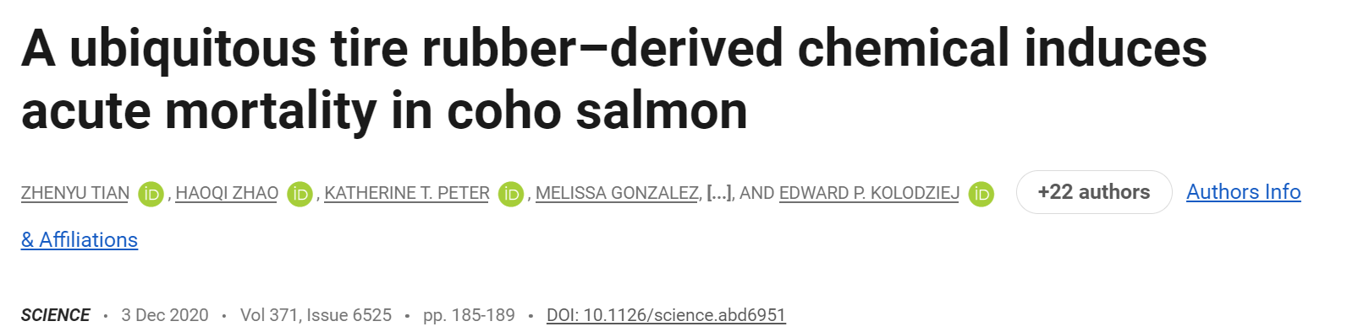
1980s
Coho Salmon* fish kill events and decreasing populations observed in Pacific Northwest
2011
Urban road runoff suspected as the cause of pre-spawn fish kills
2018
Research into chemicals identified in tire wear particle leachate
2020
A previously unknown chemical determined to be the cause of acute pre-spawn mortality

Slide 14
Coho Salmon 24-hr LC₅₀: 0.8 µg/L (median)

Slide 15
About EnVision

Slide 20
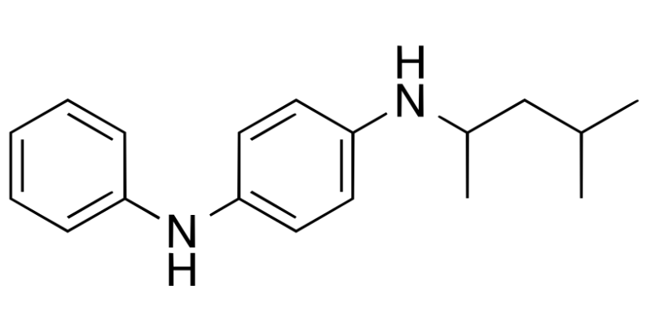
What is this mystery chemical?

Slide 21
6PPD
N-(1,3-dimethylbutyl)-N′-phenyl-
p-phenylenediamine

Slide 22
What is 6PPD?

Slide 23
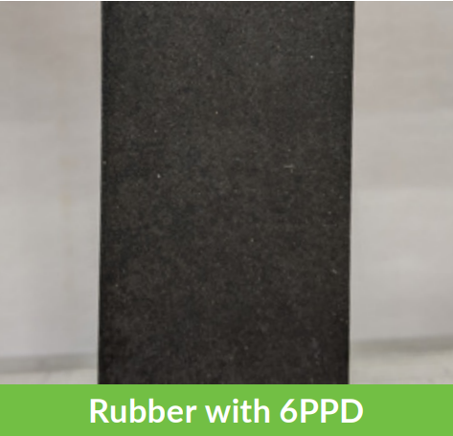
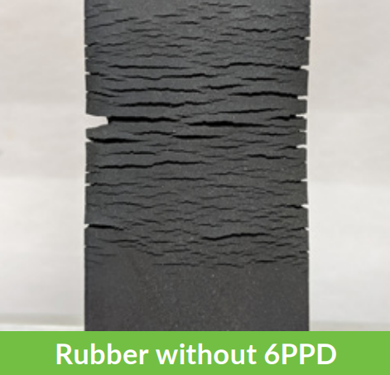
Part of the p-phenylenediamine (PPD) group of anti-oxidants
Allows rubber to resist cracking and degradation due to ozone
Used in rubber products since 1960s
Most widely consumed rubber anti-oxidant
U.S. Tire Manufacturers Association

Slide 24
6PPD is a highly reactive
anti-oxidant and anti-ozonant
6PPD
Numerous compounds can be formed following oxidation/ozonation
O₃
6PPD-quinone represents between 1% to 19% of 6PPD transformation products
6PPD-quinone

Slide 25
6PPD in Tires
0.5% to 2% of tire rubber by weight
Tire Wear Particles
TWPs generated by acceleration, turning, and braking
Urban Road Runoff
6PPD and 6PPD-q introduced to aquatic environment
Canadian Production
Potentially 100,000 to 190,000 tonnes of TWPs per year

Slide 26
6PPD in Tires
0.5% to 2% of tire rubber by weight
Tire Wear Particles
TWPs generated by acceleration, turning, and braking
Urban Road Runoff
6PPD and 6PPD-q introduced to aquatic environment
Canadian Production
Potentially 100,000 to 190,000 tonnes of TWPs per year

Slide 27
6PPD in Tires
0.5% to 2% of tire rubber by weight
Tire Wear Particles
TWPs generated by acceleration, turning, and braking
Urban Road Runoff
6PPD and 6PPD-q introduced to aquatic environment
Canadian Production
Potentially 100,000 to 190,000 tonnes of TWPs per year*
* U.S. per capita generation of 2.5 to 4.7 kg/y
(DTSC, 2022)

Slide 28
6PPD in Tires
0.5% to 2% of tire rubber by weight
Tire Wear Particles
TWPs generated by acceleration, turning, and braking
Urban Road Runoff
6PPD and 6PPD-q introduced to aquatic environment
Canadian Production
Potentially 100,000 to 190,000 tonnes of TWPs per year*

Slide 29
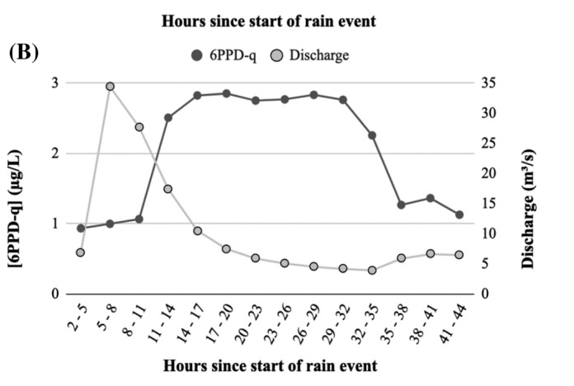
6PPD-quinone in Surface Water
Concentrations of 6PPD-quinone spike following rainfall events
Concentrations of 6PPD-quinone are highest in stormwater and urban watersheds
Preferentially sorbs to soil/sediment
6PPD-quinone has a half-life in river water of 13-16 days
Johannessen et al. (2022), Arch. Environ. Contam. Toxicol

Slide 30
6PPD-quinone in Surface Water
Sample type​ | 6PPD-quinone ​ (µg/L)​ | References​
Surface water, Toronto, ON​ | 0.93 – 2.85 ​ | Johannessen et al., 2022​
Surface water, Nanaimo, BC | 0.096 – 0.112 | Monaghan et al., 2021
Surface water, Toronto, ON | 0.54 – 0.72 (grab) 0.11 – 0.21 (comp.) | Johannessen, Helm and Metcalf, 2021
Runoff, Various Cities, USA | 0.020 – 0.30​ | Tian et al., 2022
Surface water, Various Cities, USA | 0.002 – 0.15 | Lane et al., 2024

Slide 31
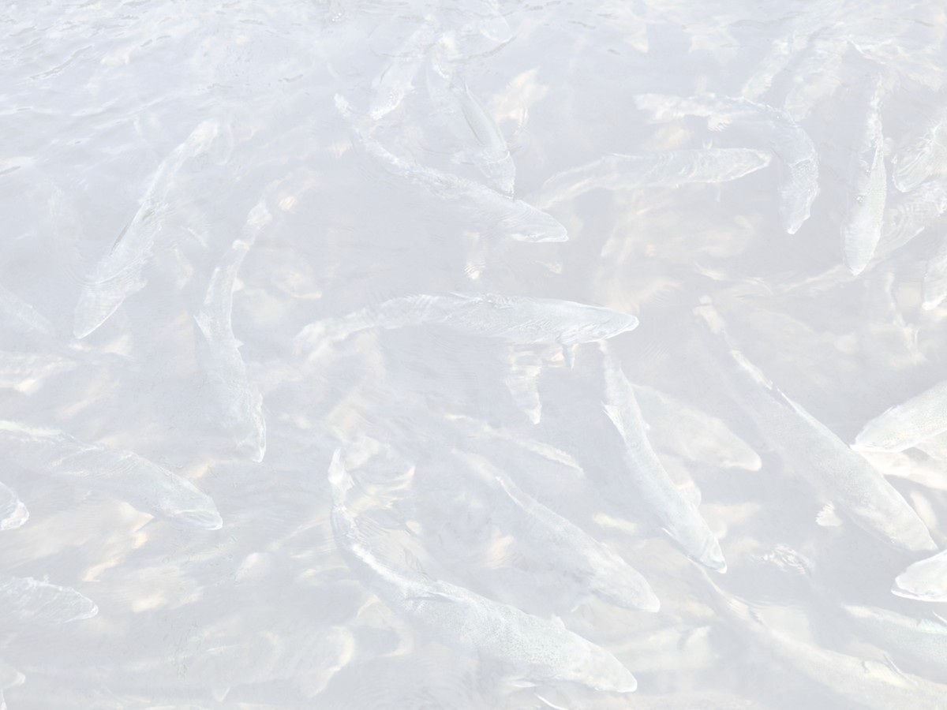
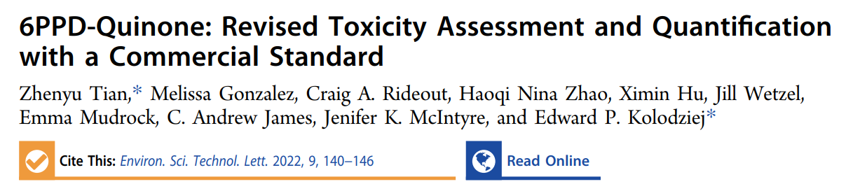
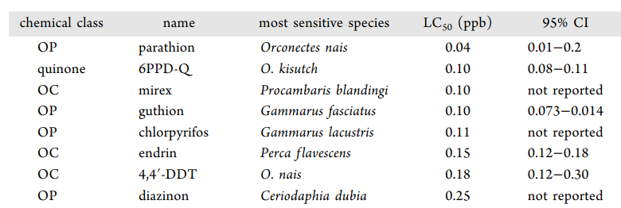

Slide 32
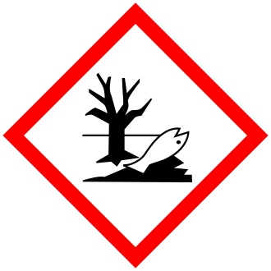
Adult Coho Salmon 24-hr LC₅₀: 0.095 µg/L
Juvenile Coho Salmon 24-hr LC₅₀: 0.041 µg/L
Acute Toxicity Category 1
LC₅₀ or EC₅₀≤ 1000 µg/L
Globally Harmonized System of classification and labeling (UN, 2023)
Toxicity goes beyond Coho Salmon but with mixed sensitivity

Slide 33
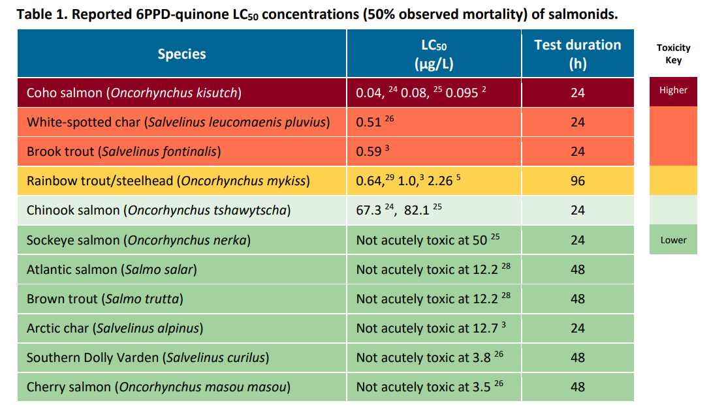
ITRC (2023), 6PPD and 6PPD-q Focus Sheet

Slide 34
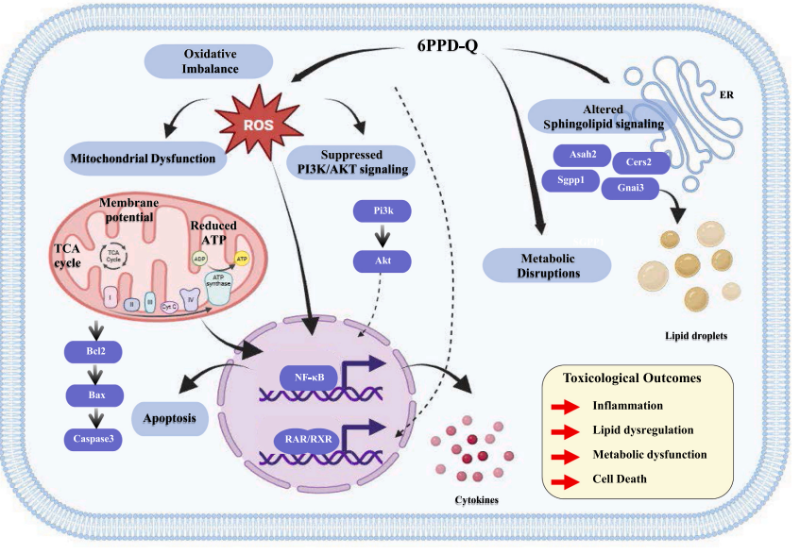
Potential Risks to Humans from 6PPD-quinone
Already identified in humans
Potential routes of human exposure include:
  inhalation, oral and dermal exposure to dusts (TWPs)
  dermal exposure to rubber
  Ingestion of contaminated water
Evidence of multi-organ toxicity in mammals
Data gap in real-world environmentally relevant doses
Yang et al. (2026), Ecotoxicol. Environ. Saf.

Slide 35
Regulator Action

Slide 36

Washington, USA
Identified 6PPD as a “Priority Toxic Chemical”
Persistence, Bioaccumulative, Toxicity
Includes PFAS, PCBs, Phthalates, Flame Retardants
Three key efforts underway
Understand the problem
Reduce stormwater pollution
Reduce sources of 6PPD

Slide 37

California, USA
Tires containing 6PPD are a “Priority Product”
Safer Consumer Products Regulations (Oct 2023)
Onus placed on manufacturers
Manufacturers obliged to declare intent to replace or significantly reduce use of 6PPD in tires (March 2024)

Slide 38
Canada
British Columbia set Water Quality Guideline Protective of Freshwater Aquatic Life (0.01 µg/L)
6PPD (and transformation products) identified as priority for assessment under CEPA, 1999 in June 2025
Research under DSL (CEPA, 1999) scheduled to start Winter 2025

Slide 39

US Tire Manufacturers Association
Declared intent to replace 6PPD in Tires
California Stage 1
Alternatives Analysis
(July 2024)
Detailed review of alternatives
California Stage 2 Alternatives Analysis (August 2026)

Slide 40
What makes a good alternative to 6PPD?

Slide 41
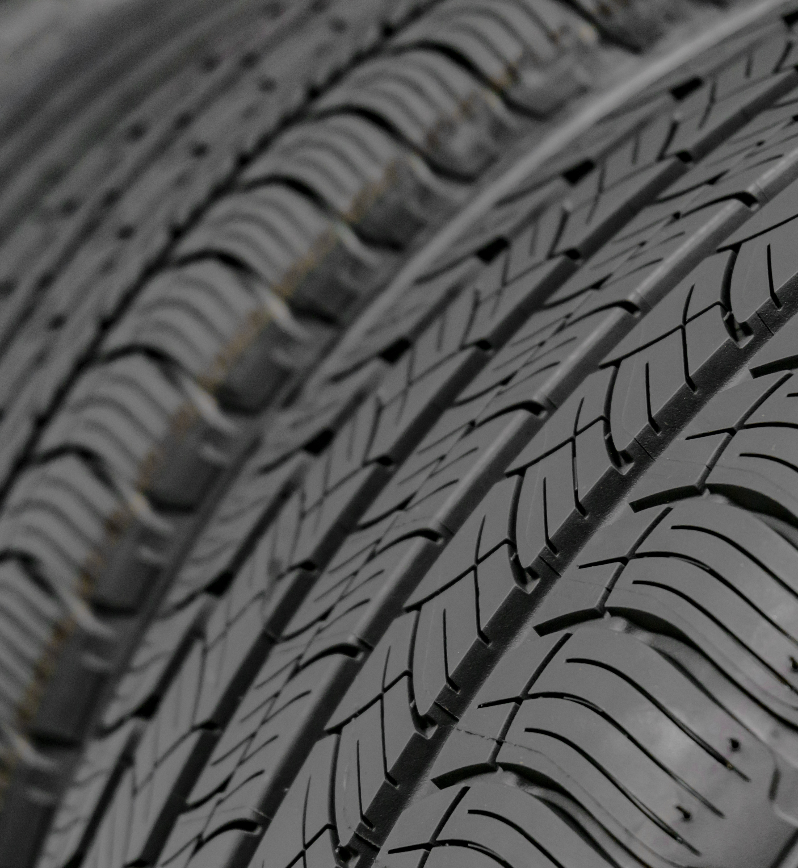
6PPD Alternatives
Ideal alternatives (U.S. Tire Manufacturers):
Maintain anti-ozonant and anti-oxidant performance
Maintain product safety and performance
Compatible with existing manufacturing processes

Slide 42
6PPD Alternatives
Ideal alternatives (Washington):
Known toxicity of parent to salmon and other trophic levels
Known transformation compounds
Reduced toxicity

Slide 43
California Stage 1 Alternatives Analysis
70+ Initial Candidate Compounds
43 Candidate Compounds extensively reviewed
7 Candidate Compounds advanced to next stage as potential alternatives (July 2024)
Cost not considered in Stage 1

Slide 44
Stage 2 AA Candidates to Replace 6PPD
IPPD
7PPD
CCPD
Graphene
Octyl gallate
Irganox 1520
77PD

Slide 45
California Stage 2 Alternatives Analysis
Stage 2 AA due August 2026
Detailed exposure assessment of potential transformation products – formation and migration potential
Candidate Compounds have similar or lower hazard relative to 6PPD
Outcome of Stage 2AA is to find a replacement for 6PPD in tires subject to performance testing

Slide 46
Once a new candidate antidegradant is identified, an additional 4 years (minimum) of limited-scale field testing would be required to ensure performance as a tire ages.
U.S. Tire Manufacturers Association, 2024
Notes:
Stage 2 report due to The California Department of Toxic Substance Control (DTSC) on August 19, 2026
To described findings of the testing to determine a suitable alternative (subject to further safety and performance testing)

Slide 47
What’s Next?

Slide 48
Before 6PPD is Replaced
Research on 6PPD, 6PPD‑q, and TWP chemistry is still emerging
Growing interest from regulators, industry, and the public
Increasing focus on mitigation strategies
The Case for Green Infrastructure
Key research gaps remain in toxicity, occurrence, and measurement

Slide 49
The Case for Green Infrastructure

Slide 50
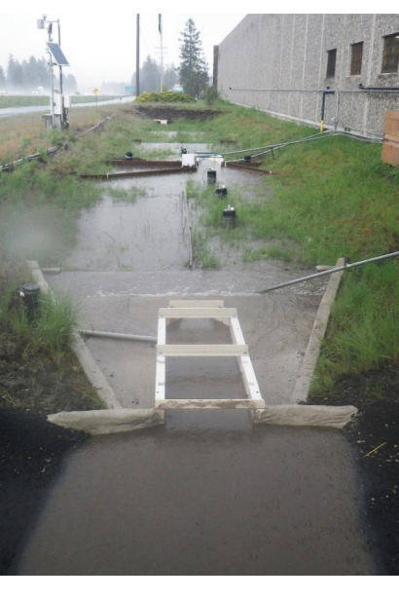
Evidence that bioretention prevents sensitive species mortality
Potential that Green Street Infrastructure can reduce contaminant load in surface water
The design of urban stormwater treatment systems should consider these emerging contaminants
ITRC (2023), 6PPD Factsheet

Slide 51
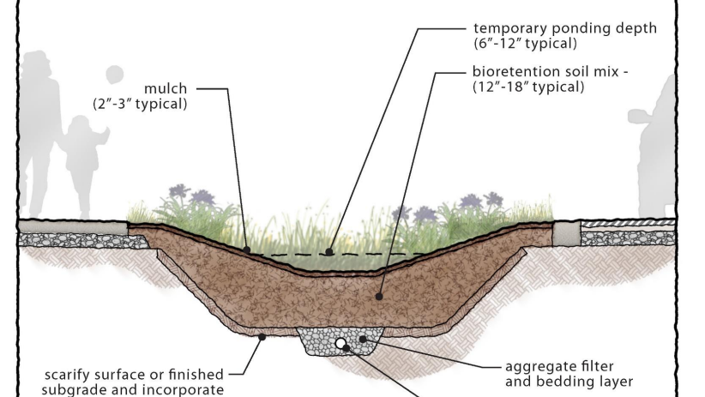
ITRC 6PPD Factsheet, 2023

Slide 52
What’s Next?
Research on 6PPD, 6PPD‑q, and TWP chemistry is still emerging
Growing interest from regulators, industry, and the public
Increasing focus on mitigation strategies
The Case for Green Infrastructure
Key research gaps remain in toxicity, occurrence, and measurement

Slide 53


Questions?
Paul H Cheung
Tiffany Waters
Senior Risk Assessor
pcheung@envisionconsultants.ca
Ecologist and Risk Assessor

Slide 54
Questions?
Paul H Cheung
Tiffany Waters
Senior Risk Assessor
pcheung@envisionconsultants.ca
Ecologist and Risk Assessor

