Slide 1
Welcome
The Rise of PFAS Drinking Water Class Actions in Canada: Insights for Environmental Professionals
Presentation by:
Michael S. Hebert
Nathan Adams
RemTech East Conference
April 9, 2026

Slide 2
OVERVIEW
Rising Public Awareness
Media coverage of PFAS contamination fueling public concern about environmental and health risks
PFAS Hotspot Maps
Government Action on PFAS in Canada is Accelerating
July 2024: Updated Draft State of PFAS Report recommendation to add PFAS to Part 2 of Schedule 1 of CEPA
August 2024: Health Canada Drinking Water Objective of 30 ng/L for sum of 25 PFAS
March 2025: Federal Final State of PFAS Report and PFAS Risk Management Approach
Evolving PFAS Class Action Litigation in Canada
Certified Mississippi Mills PFAS Stigma Class Action (Egan et al. v. National Research Council of Canada)
Proposed CFB North Bay and Jack Garland Airport PFAS Stigma Class Action (Sway & Currie v. the Attorney General of Canada and the Corporation of the City of North Bay)
Notes:
Focus on:
Risks of exposure to PFAS contamination in private residential water wells surrounding federal military bases and airports nationwide
Notoriety exacerbated by national media coverage, evolving science, HC and ECCC reporting and the resulting class action claims
Michael Hebert and I are co-counsel on two such class actions in Ontario, which focus on the diminution in property value due to the stigma of PFAS drinking water contamination

Slide 3
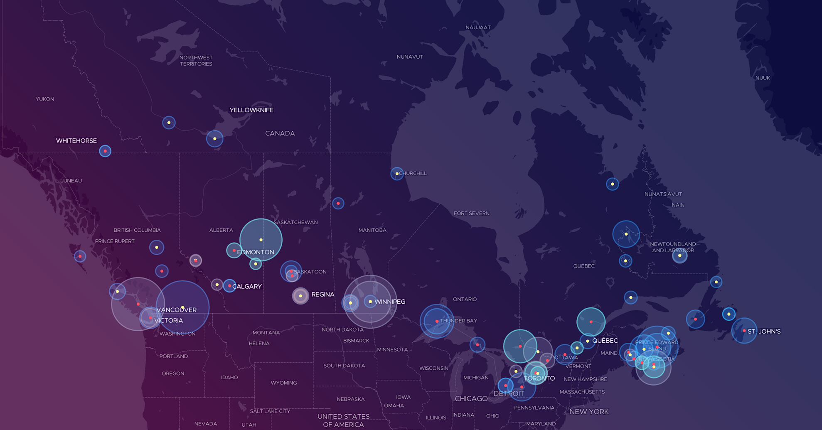
CBC PFAS Hotspots Map
Notes:
Based on Federal Contaminated Sites Inventory data on PFAS contamination at federal facilities nationwide
Red circles show residents with drinking water wells within 1 km radius
Circle size represents population size within 1 km
About 100 sites with confirmed or suspected PFAS contamination nationwide
Several engineers in this room involved in remediating these sites and I commend you for that. It is a serious issue
Maps invoking public national interest and concern concerning potential exposure

Slide 4
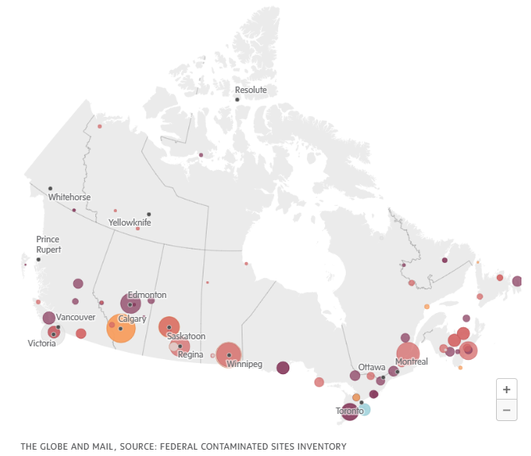
The Globe and Mail PFAS Hotspots Map

Slide 5
Government Action on PFAS in Canada is Accelerating

Slide 6
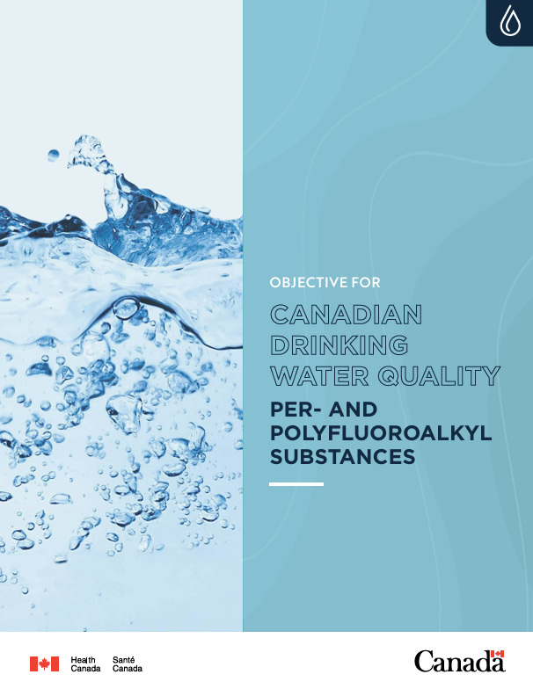
Revised Health Canada PFAS
Drinking Water Objective
August 9, 2024: Health Canada Updated Drinking Water Quality Objective for PFAS
Accelerated Release
  Driven by growing concerns and new health data on PFAS risks
  Traditional health-based approach was not adopted due to rapidly evolving science
  Based on performance of treatment technologies, not health-based criteria
New Interim Objective
  Sets a 30 ng/L threshold for the sum of 25 PFAS, replacing previous guidelines for 9 individual PFAS
Precautionary Approach
  Aims to reduce PFAS exposure
  No scientific consensus regarding the most sensitive health effects
Guidance
  Encourages jurisdictions to maintain PFAS levels “as low as reasonably achievable”
Unenforceable Benchmark
  Non-mandatory but strongly recommended for all jurisdictions
Notes:
Our position is that government reliance on these or similar guidelines is somewhat misplaced, particularly concerning decision-making concerning the pro-active provision of bottled water and PFAS filtration systems to potentially impacted communities
We agree with ALARA

Slide 7
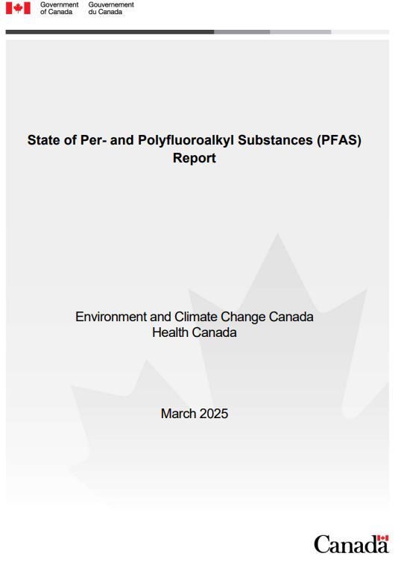
Canada’s Final State of PFAS Report:
Recommendation
Released: March 5, 2025
Key Recommendation:
  Designate PFAS (excluding fluoropolymers) as “toxic” under CEPA Part 2, Schedule 1
  Not an outright ban, but enables federal implementation of risk management measures
PFAS Risk Management Approach – Phased Strategy:
  Phase 1: Ban PFAS not currently regulated in firefighting foams (high exposure risk)
  Phase 2: Ban PFAS uses unnecessary for health, safety, or environment, including consumer products (cosmetics, food packaging)
  Phase 3: Potential ban on PFAS without feasible alternatives (prescription drugs, medical devices)

Slide 8
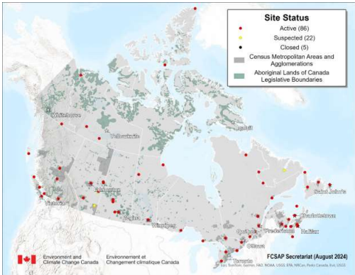
Canda’s Final State of PFAS Report:
PFAS “Hot Spots”
Released: March 5, 2025
PFAS “Hot Spots”
  Elevated PFAS levels at sites with historical AFFF use (firefighting training areas, equipment maintenance)
  PFAS contamination can migrate offsite via groundwater and surface water – several kilometers possible
  100+ federal sites across all provinces & territories with confirmed/suspected PFAS contamination
  Many sites near communities relying on private groundwater wells
  Highest concentrations typically near original release points
  PFAS are persistent in the environment; difficult to remediate completely
Notes:
- Show of hands if you would consider purchasing a home relying on well water in these highlighted areas. Would you, even at a discount?

Slide 9
Canada’s Final State of PFAS Report:
PFAS Exposure & Health Concerns
Released: March 5, 2025
PFAS Exposure Risks:
  People living near PFAS-contaminated sites (e.g., AFFF use areas) may experience higher exposure levels
  Highest concentrations typically near known contamination sources
Key Health Concerns:
  Widespread Health Impacts: affects liver, kidneys, immune system, reproductive health, thyroid, nervous system, and metabolism
  Health Effects at Lower Levels: PFAS (e.g., PFOA, PFOS) can cause harm even at lower concentrations than previously recognized
  Bioaccumulation PFAS persist in the body for years, accumulating over time and associated with long-term negative health effects
Notes:
- After seeing this, show of hands if you would consider purchasing a home relying on well water in these highlighted areas. Would you, even at a discount?

Slide 10
Emerging PFAS Class Action Litigation in Canada

Slide 11
Stigma Case Law Review Tridan Developments Ltd. v.
Shell Canada Products Ltd., 2002
Case Overview
Tridan car dealership property was contaminated by a gasoline leak from Shell Canada, with a claim of reduced property value and associated financing issues due to lingering contamination stigma
Stigma
Court recognized stigma as a new head of damage due to negative market perception that persists after remediation, even to Ministry of the Environment standards (i.e., not to “pristine” conditions pre-contamination)
Damages Awarded
Tridan’s compensation for stigma damage assessed at $350,000 for the drop in property value if only remediated to Ministry standards (i.e., not remediated to “pristine” conditions pre-contamination)
Legal Precedent
Although reversed on appeal, this was the first time a Canadian court acknowledged that stigma causing diminution in property value alone could justify financial loss, even if remediated to Ministry standards
Notes:
-Appeal decision re $250,000 rather than $350,000 because evidence on stigma damages only given on remediation to Ministry standards, not pristine conditions

Slide 12
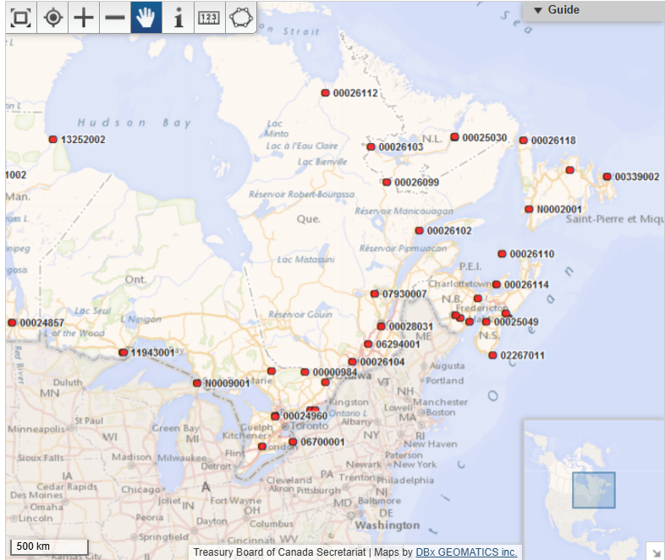
PFAS Contamination Stigma Class Actions 2025
Filed 2024; Remains Uncertified
Filed 2016; Certified

Slide 13
PFAS Contamination Stigma Class Actions 2026
Filed 2024; Remains Uncertified
Filed 2025; Uncertified
Filed 2016; Certified
Filed 2025; Uncertified
Notes:
-Four class actions by my count, but let me know if there are more

Slide 14
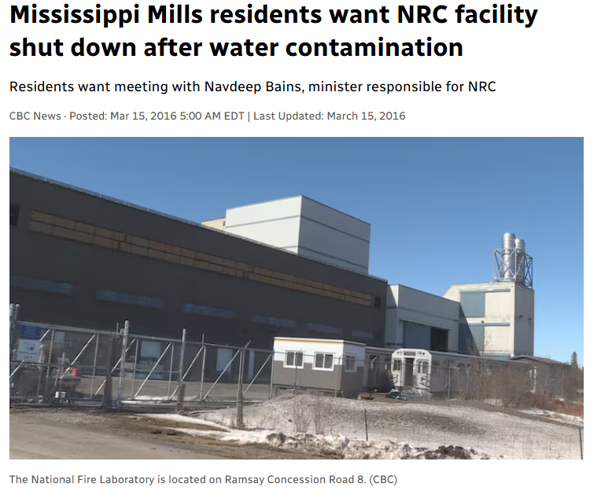
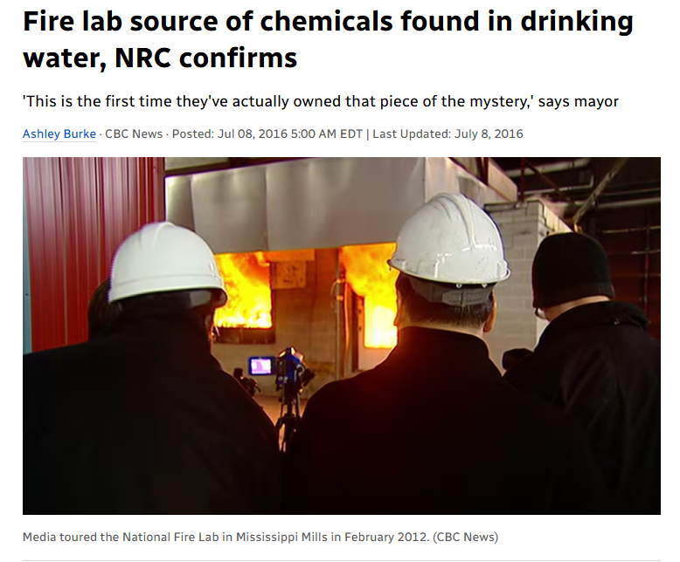
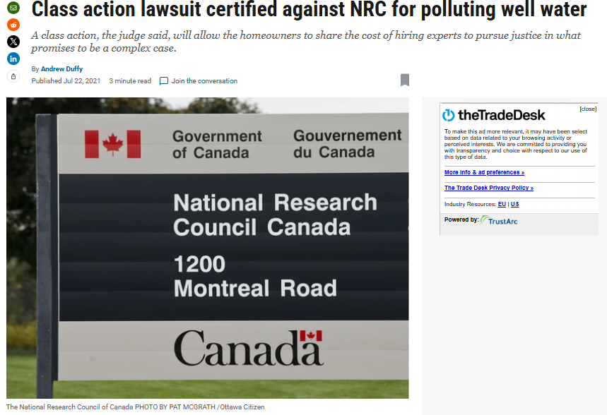
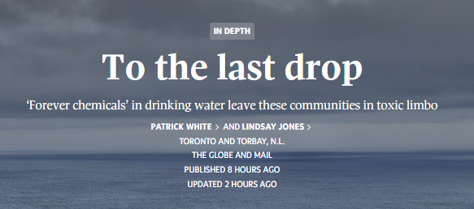
PFAS Class Action Lawsuit Egan et al. v. National Research Council of Canada
Notes:
-First certified PFAS-related class action in Canada
-Since 1981 conducted various experiments including the use of freighting foams containing PFAS
-Alleges that this PFAS migrated offsite via the surface water and groundwater at the NFL
-Class action certified in 2021
-Alleges that neighboring landowners’ residential drinking water contaminated by PFAS from these activities
-Alleges diminution in property value due to stigma

Slide 15
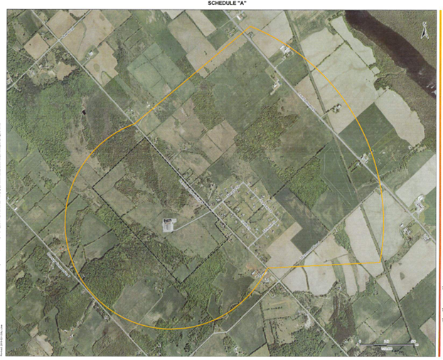
PFAS Class Action Area: 69 Properties Egan et al. v. National Research Council of Canada

Slide 16
PFAS Class Action Lawsuit Egan et al. v. National Research Council of Canada
Class certification motion contested and upheld on appeal
$40 million certified class action against the National Research Council of Canada concerning the alleged PFAS contamination of properties’ drinking water surrounding the National Fire Laboratory in Mississippi Mills, Ontario
Claims damages for:
Diminution in property value due to stigma associated with potential drinking water contamination
Remediation costs
Engineering and other professional costs
Mortgage financing costs
Notes:
-First certified PFAS-related class action in Canada
-Since 1981 conducted various experiments including the use of freighting foams containing PFAS
-Alleges that this PFAS migrated offsite via the surface water and groundwater at the NFL
-Class action certified in 2021
-Alleges that neighboring landowners’ residential drinking water contaminated by PFAS from these activities
-Alleges diminution in property value due to stigma

Slide 17
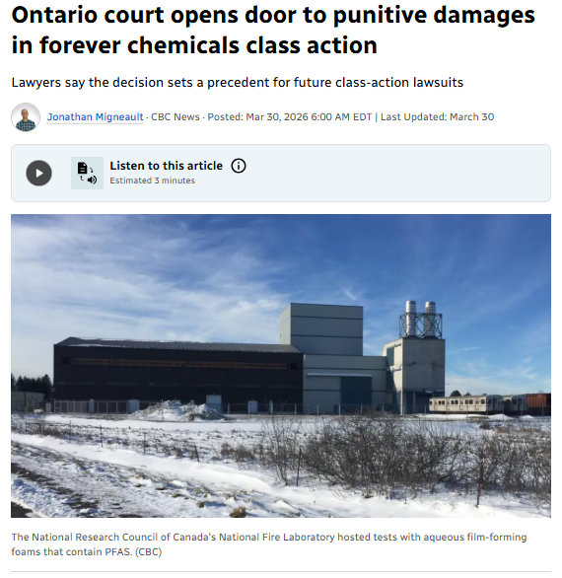
Notes:
-First certified PFAS-related class action in Canada
-Since 1981 conducted various experiments including the use of freighting foams containing PFAS
-Alleges that this PFAS migrated offsite via the surface water and groundwater at the NFL
-Class action certified in 2021
-Alleges that neighboring landowners’ residential drinking water contaminated by PFAS from these activities
-Alleges diminution in property value due to stigma

Slide 18
PFAS Class Action Lawsuit Egan et al. v. National Research Council of Canada
$2 million Additional Punitive Damages Claim Certified (March, 2026)
  ON Superior Court of Justice Decision: 2026 ONSC 1429
  PFAS Class Action Legal First in Canada
  Certified due to evidence of 2 to 3-year delay in NRC’s informing the community of potential PFAS contamination in their drinking water
  Signals increasing scrutiny of public bodies that fail to act promptly when drinking water PFAS contamination ought to be known — setting a precedent for other environmental class actions, including potential additional punitive damages available as remedy for affected communities.
Notes:
-First certified PFAS-related class action in Canada
-Since 1981 conducted various experiments including the use of freighting foams containing PFAS
-Alleges that this PFAS migrated offsite via the surface water and groundwater at the NFL
-Class action certified in 2021
-Alleges that neighboring landowners’ residential drinking water contaminated by PFAS from these activities
-Alleges diminution in property value due to stigma

Slide 19
PFAS Class Action Lawsuit Egan et al. v. National Research Council of Canada
Decision of Justice R. Smith in 2026 ONSC 1429
  Para 20: “NRC submits that a claim for punitive damages has no reasonable prospect of success even if the evidence shows that NRC ought to have known that the Class Members drinking water was contaminated by PFAS chemicals and failed to advise the Class Members of possible contamination of their drinking water or to test for contamination to ensure that the drinking water was not dangerous to drink”
  Para 21: “The failure to warn the neighbouring residents that their drinking water was or may be contaminated by PFAS chemicals may be found to “offend the court’s sense of decency”. For this reason, the amendment to the pleadings regarding punitive damages is granted”
Notes:
-First certified PFAS-related class action in Canada
-Since 1981 conducted various experiments including the use of freighting foams containing PFAS
-Alleges that this PFAS migrated offsite via the surface water and groundwater at the NFL
-Class action certified in 2021
-Alleges that neighboring landowners’ residential drinking water contaminated by PFAS from these activities
-Alleges diminution in property value due to stigma

Slide 20
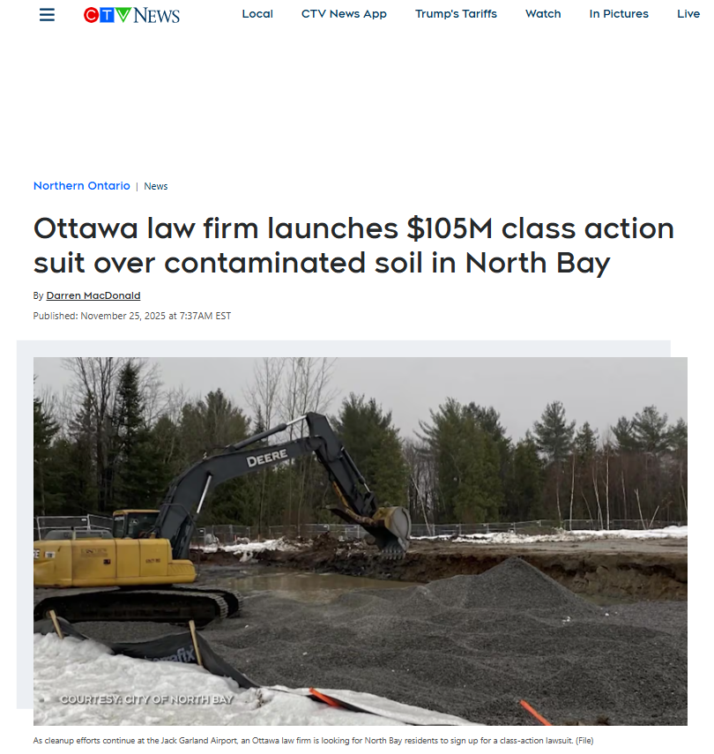
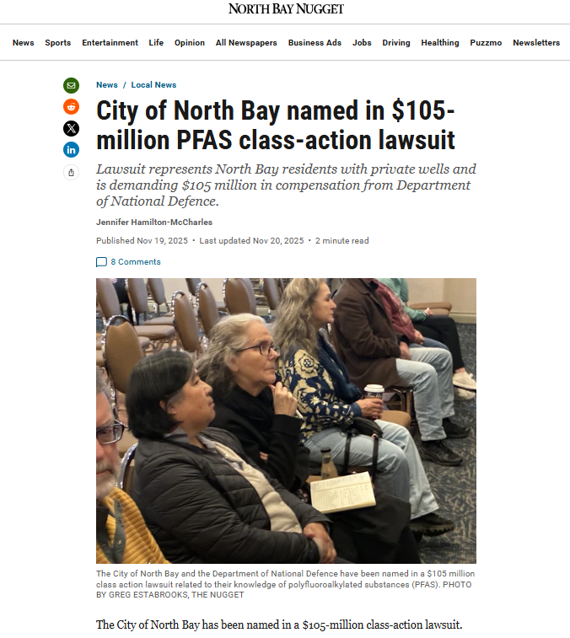
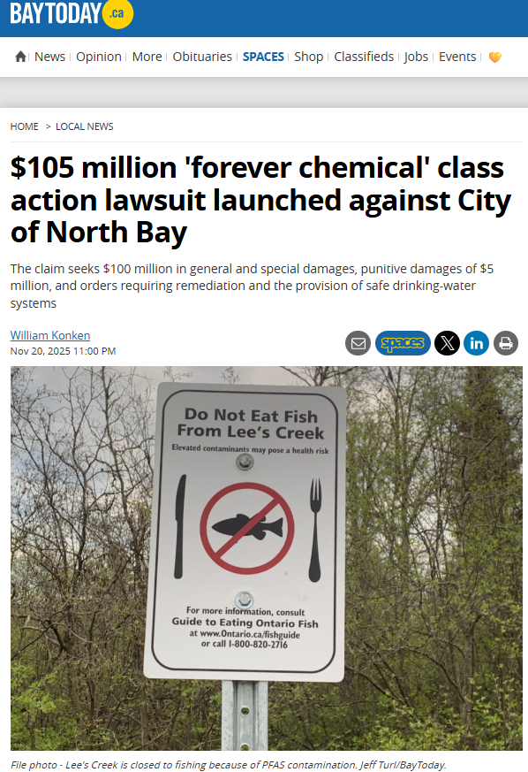
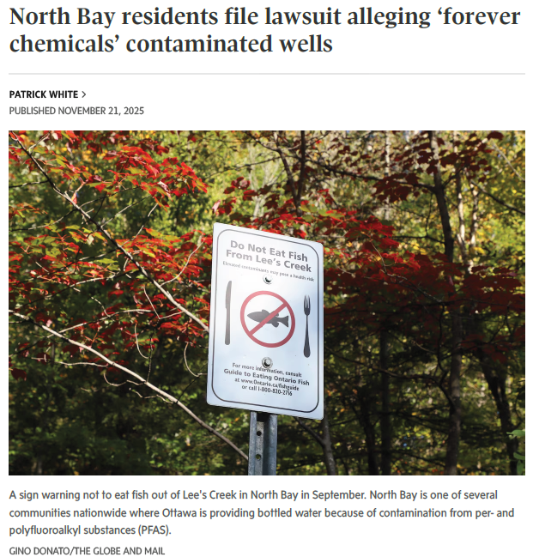
North Bay Proposed PFAS Class Action Lawsuit
Notes:
-recently filed in October 2025
-agreements in place and active on site remediation on site ongoing
-serious problem with PFAS contamination in residential drinking water wells, as alleged in our claim

Slide 21
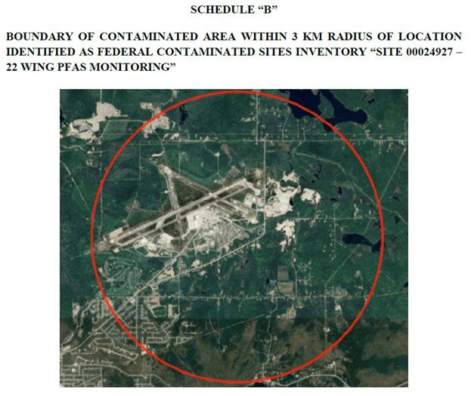
North Bay Proposed PFAS Class Action Lawsuit – at least 160 Residential Properties

Slide 22
Sway and Currie v. The Attorney General of Canada and Corporation of the City of North Bay
$105 million Proposed Class Action against the Attorney General of Canada (Department of National Defence (DND)) and the City of North Bay concerning alleged PFAS contamination of drinking well water of residential properties surrounding CFB North Bay and the Jack Garland Airport
Alleged Liability:
1. Nuisance
2. Strict Liability
3. Negligence
4. Trespass
5. Environmental Statuary Liability
Relief Sought:
1. Safe Water Provision: Seeks PFAS drinking water filtration systems and bottled water for properties with wells
2. Damages totaling $100 million: Alleges diminution in property value, remediation, engineering and professional costs
3. Punitive Damages totaling $5 million: Alleges that DND was aware of PFAS exceeding drinking water guidelines in groundwater as early as 2011 and that Defendants failed to inform the community of potential drinking water contamination promptly. Further alleges inappropriate reliance on less stringent MECP guidelines
Proposed Class Criteria:
1. Owned real property on or after January 1, 2017
2. Property must have a private drinking-water well; and
3. Property must be located within 3 km boundary of CFB North Bay and Jack Garland Airport.

Slide 23
Final thoughts
Importance of testing for PFAS in groundwater and drinking water, particularly as standards and guidelines become more stringent
Fast-changing regulatory and public perception landscape worldwide compared to only a few years ago
Health Canada establishing final PFAS drinking water guidelines. Ontario has its own interim drinking water advice limiting combined level of 11 specific PFAS compounds in drinking water to 70 ng/L
While some provinces, including British Columbia, Alberta and Nova Scotia already have PFAS-specific standards, more stringent PFAS regulation nationwide is likely
Increased public scrutiny of PFAS leading to further contamination stigma and property value diminution litigation
NRC and North Bay Class Actions do not accept reliance on Drinking Water Guidelines to justify acceptable levels of PFAS in drinking water
Notes:
-Serious issue of national concern
-Science is much more clear for impacts on health
-A lot of work being done and a lot more to be done by engineers in this room

Slide 24
Disclaimer
This presentation provides general information and is not legal advice. Attendees should consult a legal professional for guidance on specific situations.

Slide 25
Thank you!
Michael S. Hebert
Nathan Adams
Mann Lawyers
11 Holland Avenue, Suite 300
Ottawa, ON K1Y 4S1
T: 613.369.1500
F: 613.722.7677
michael.hebert@manlawyers.com
nathan.adams@mannlawyers.com

