Slide 1
Intercepting Salinity Impacted Groundwater from a Former Salt Storage Site via Extraction Wells Prior to Reaching a Highly Valued Community Recreational Surface Waterbody
Presented by: John Forbes, B.Sc., P.Biol.
April 9, 2026
0300-011 RemTech East 2026 Intercepting Salinity Impacted Groundwater

Slide 2
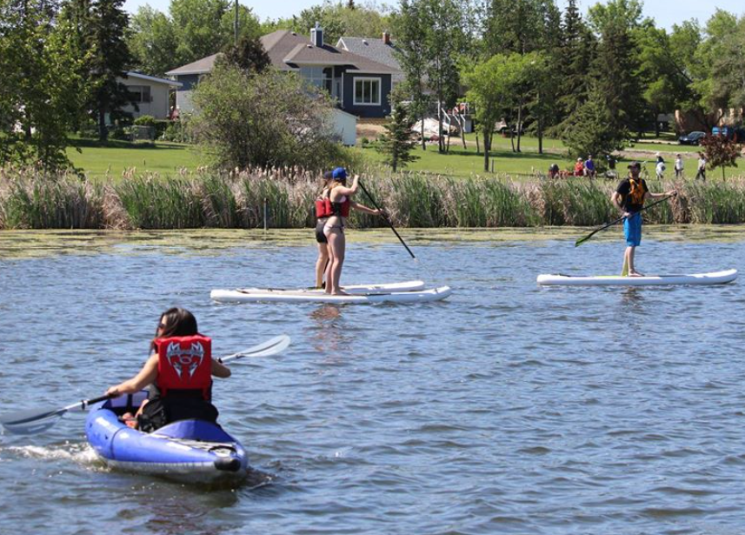
Outline
Site Background
Environmental Site Assessments,
Risk Assessment,
Remedial Options Analysis
Groundwater Modelling,
and Extraction Well Installation
On-going Plume Modelling
and Monitoring
Conclusions
Image from ToDoCanada.ca

Slide 3
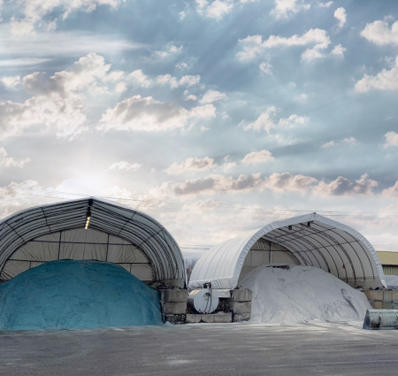
Site Background
The Site was a former municipality-owned Main Yard and Shop.
The municipality historically stored its road salt on the Site.
Over time, the storage of salt at this Site leached into the soil and eventually into the shallow groundwater table and began migrating off-site towards a highly valued community waterbody.
Image from Legends Landscape Supply Inc.

Slide 4
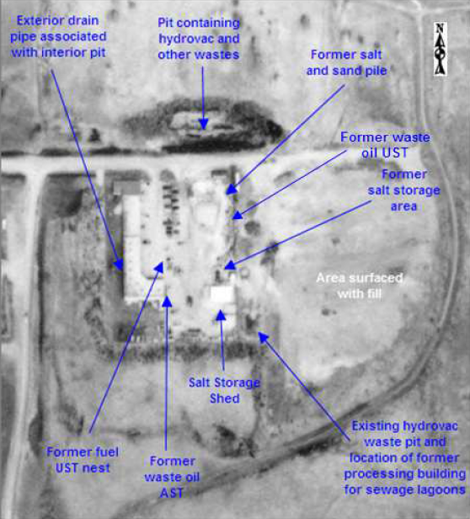
Environmental Site Assessments
The initial Phase I ESA was conducted in 2011 and identified several APECs for the site:
Two hydrovac waste pits
Former waste oil UST
Former waste oil AST
Former fuel UST nest
Former salt/sand pile
Former salt storage area
Salt storage shed
Image from AMEC Limited Phase 1 and Phase 2

Slide 5
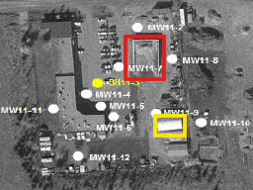
Environmental Site Assessments
The first Phase II ESA was conducted in 2011 and identified salinity impacts were present in the soil on-site from surface to approximately 7.5 mbgs.
Chloride concentrations in soil ranged from 148 to 15,200 mg/kg.
Chloride concentrations in groundwater ranged from 542 to 21,400 mg/L.
Sources were the historical salt storage shed (yellow) and the salt/sand piles (red).
Image from AMEC Limited Phase 1 and Phase 2

Slide 6
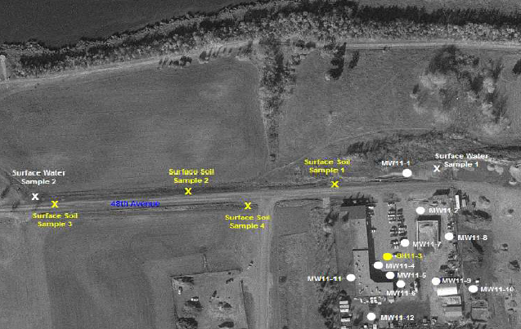
Environmental Site Assessments
Surface soil samples were also collected along the ditches north and west of the Site in the flow direction of the lake.
Chloride concentrations in the surface soil samples ranged from 282 to 28,800 mg/kg (highest value sample #1).
Image from AMEC Limited Phase 1 and Phase 2
Notes:
Mention Nitrate parameters

Slide 7
Environmental Site Assessments
Two surface water samples were also collected.
The chloride concentration in the surface water sample directly north of the site was 21,400 mg/L.
The chloride concentration in the surface water sample downgradient of the site was 6.4 mg/L.
Image from AMEC Limited Phase 1 and Phase 2

Slide 8
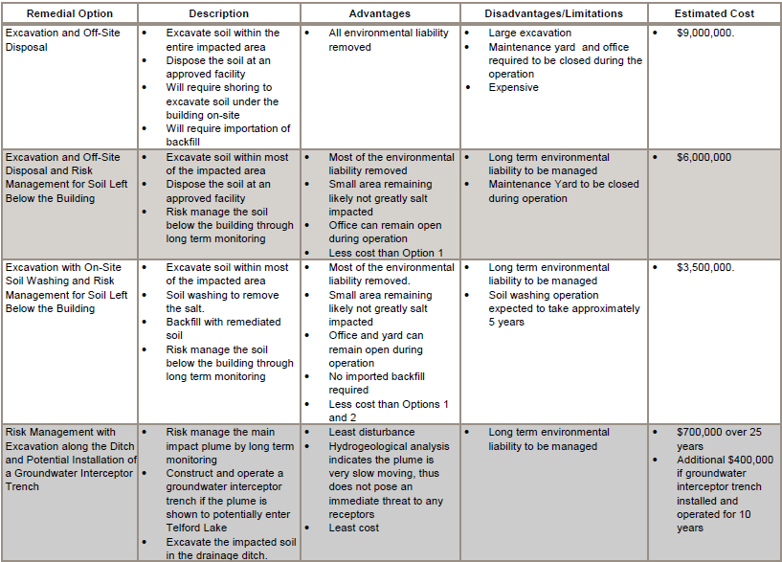
Remedial Action Plan
In 2014, a Remedial Action Plan (RAP) was developed for the site to evaluate remedial options for the identified impacted areas.
Four options were proposed:
Excavation and Disposal
Excavation and Risk Management
Excavation and On-Site Washing and Risk Management
Risk Management, Excavation, and Installation of Groundwater Interceptor Trench
Image from AECOM RAP

Slide 9
Risk Management and Exposure Control Plan
In 2016, a draft Risk Management and Exposure Control Plan (RMECP) was developed for the site. The short-term control plan proposed consisted of three elements:
Annual groundwater monitoring to evaluate groundwater quality
Additional vertical and horizontal delineation of soil and groundwater chloride to the north and west.
Additional assessment to determine the feasibility of different/more practical remedial options.

Slide 10
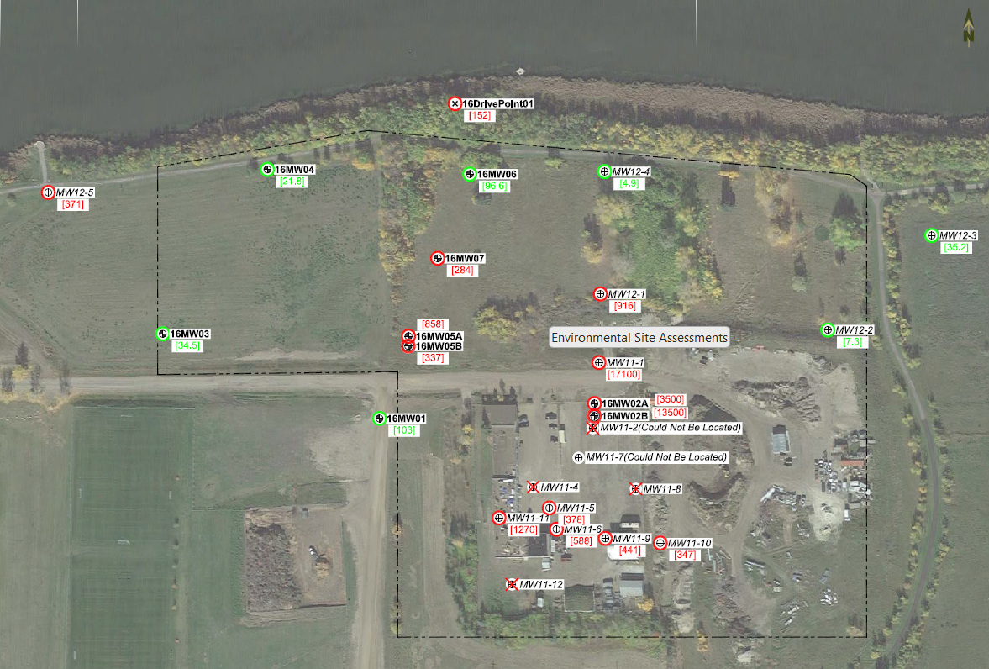
Environmental Site Assessments
In 2016, a Supplemental
Phase 2 ESA was conducted
to fully delineate the soil and groundwater salinity impacts.
Impacts were identified in soil off-site to the north, and groundwater off-site to the north and northwest.
This figure illustrates the chloride concentrations
in groundwater.
Image from Trace Phase 2

Slide 11
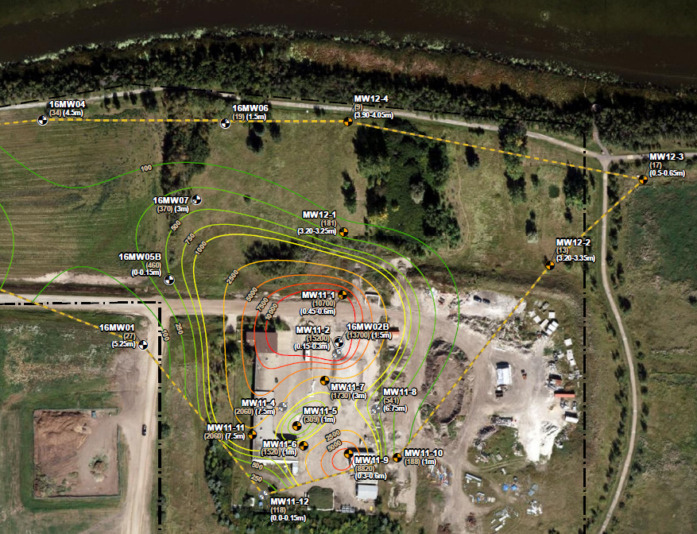
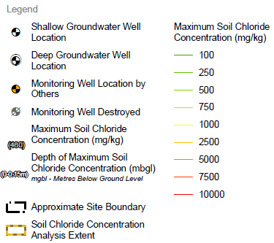
Risk Assessment
A Subsoil Salinity Tool (SST) assessment was conducted to calculate preliminary Tier 2 subsoil and groundwater chloride guidelines and assess risks to applicable pathways.
Soil chloride concentrations above 100 mg/kg extended off-site to the north, east and west.
The highest concentrations were in the southeast and north portions of the site.
Image from Trace SST Assessment

Slide 12
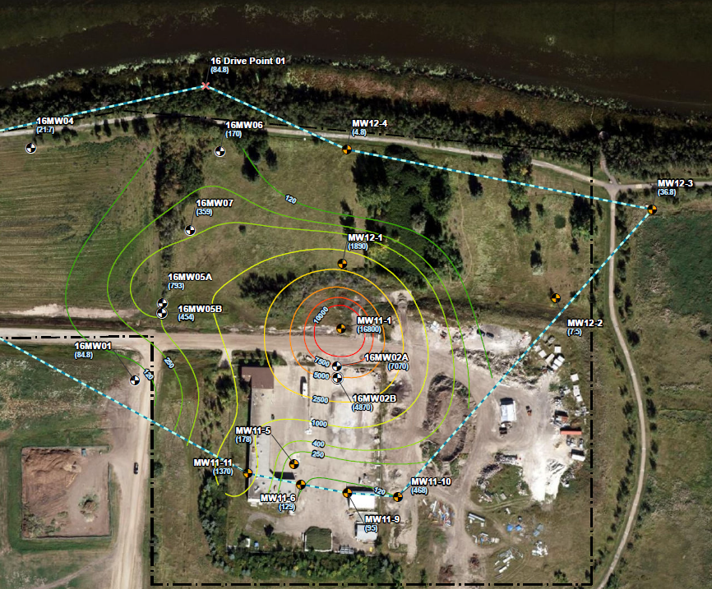
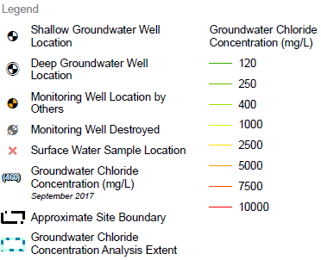
Risk Assessment
Groundwater chloride concentrations above 120 mg/L extended off-site to the north, east and west.
The highest concentrations were just off-site to the north.
Image from Trace SST Assessment

Slide 13
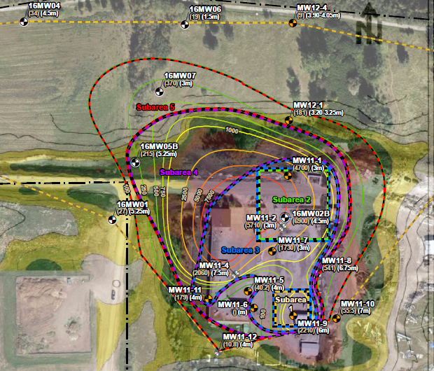
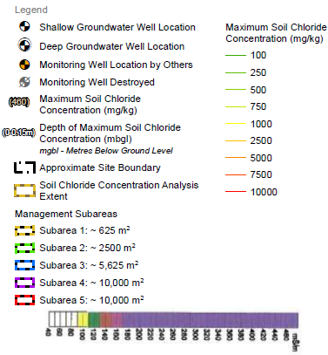
Risk Assessment
Five subareas were selected for the SST assessment:
Subarea 1 = Historical salt storage shed (southeast)
Subarea 2 = Historical salt/sand piles (northeast)
Subareas 3 through 5 = Based on soil chloride concentration isolines
Image from Trace SST Assessment

Slide 14
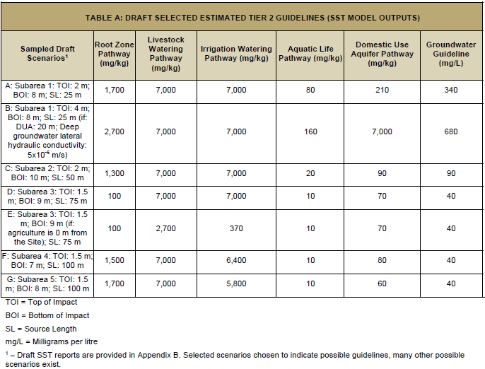
Risk Assessment
Results of the SST assessment were not favorable given the close proximity to the lake.
As a result, further assessment and remediation and/or risk management activities were required to protect the affected receptor.
Image from Trace SST Assessment

Slide 15
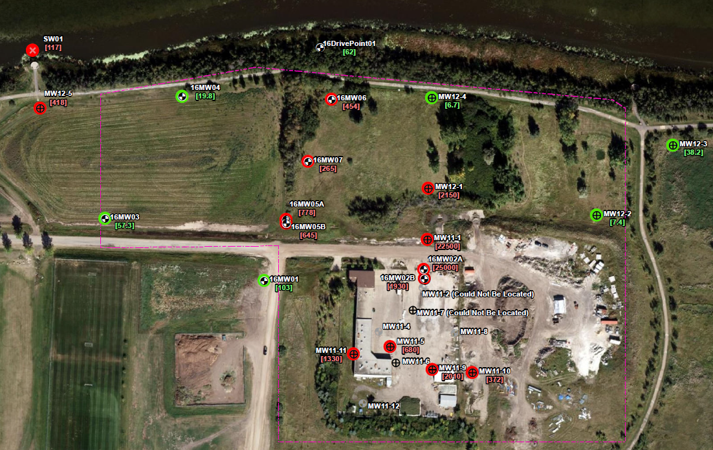
Environmental Site Assessments
In 2018, annual groundwater monitoring results indicated the chloride plume was migrating north closer to the lake.
Hydraulic conductivity tests were conducted on 6 wells to understand the groundwater gradient at the Site.
The average conductivity was 1.21 x 10⁻⁶ m/s, the average hydraulic gradient was 0.019 m/m, and the estimated linear velocity was 15.3 m/year.
Image from Trace Groundwater Report

Slide 16
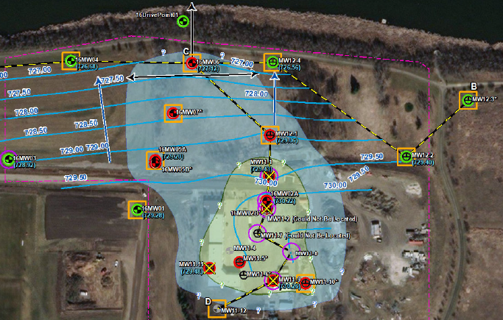
Environmental Site Assessments
Based on the estimated distance of the plume to the lake, and the calculations from 2018 and 2019 gradients, the plume was estimated to reach the lake in ~ 4 to 9 years.
As a result, recommendations were:
Install 4 monitoring wells to close gaps to the northeast, northwest and vertical at the northern most impacted well (16MW06).
Conduct a feasibility
analysis of the installation of
an interceptor system.
Image from Trace Remedial Options Analysis Report

Slide 17
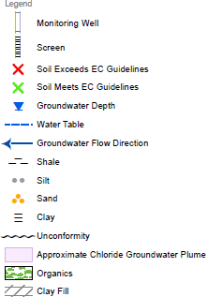
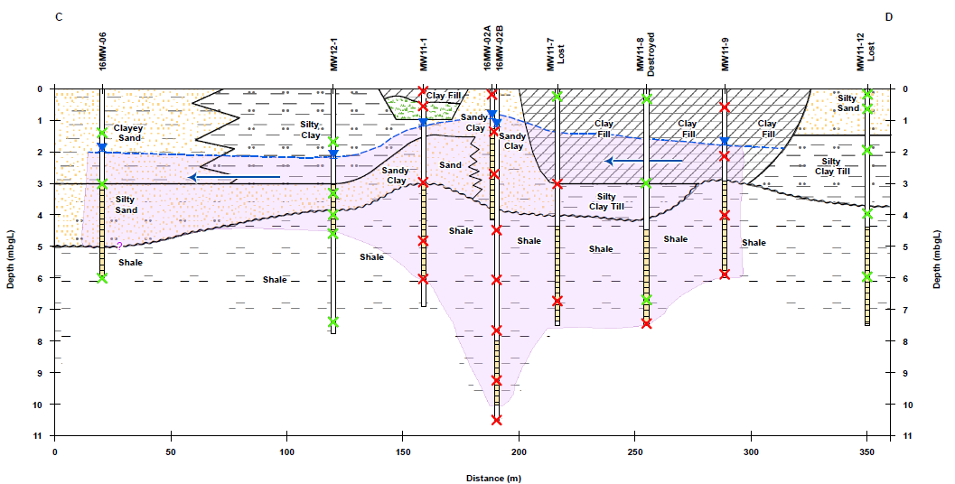
Environmental Site Assessments
Image from Trace Remedial Options Analysis Report
Notes:
Right is south, left is north

Slide 18
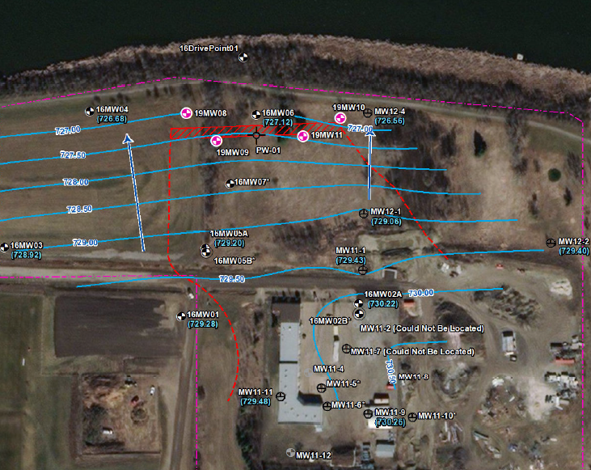
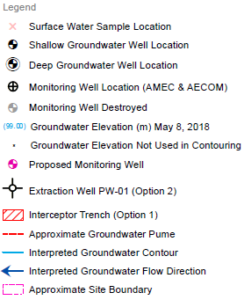
Remedial Options Analysis
In 2019, a remedial options cost analysis was completed.
The most effective and financially viable options were evaluated.
The two options proposed were:
Interceptor Trench System
Extraction Well System
Image from Trace Remedial Options Analysis Report

Slide 19
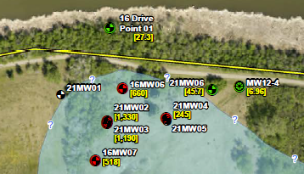
Environmental Site Assessments
In 2021, 6 monitoring wells were installed along the plume leading edge to better understand the vertical and lateral extents of groundwater impacts.
Two nested pairs and two shallow wells were installed.
Image from Trace Groundwater Report

Slide 20
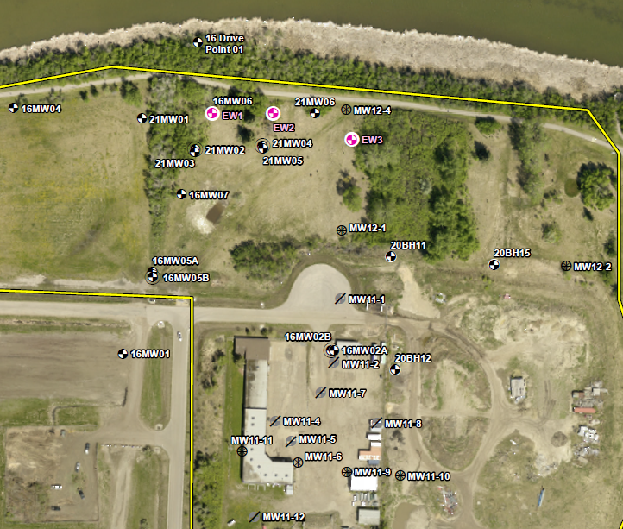
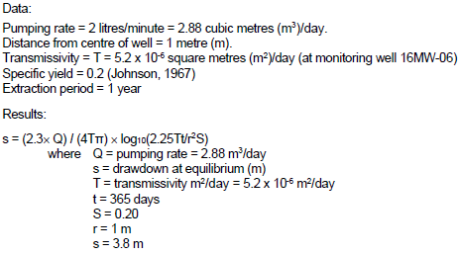
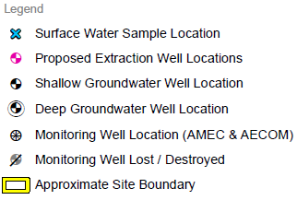
Groundwater Modelling and Extraction Well Installation
Using the data from the new and existing wells, the groundwater system was modelled to determine the best locations for the extraction wells.
Image from Trace Remedial Options Analysis Report
Image from Trace Extraction Well Report

Slide 21
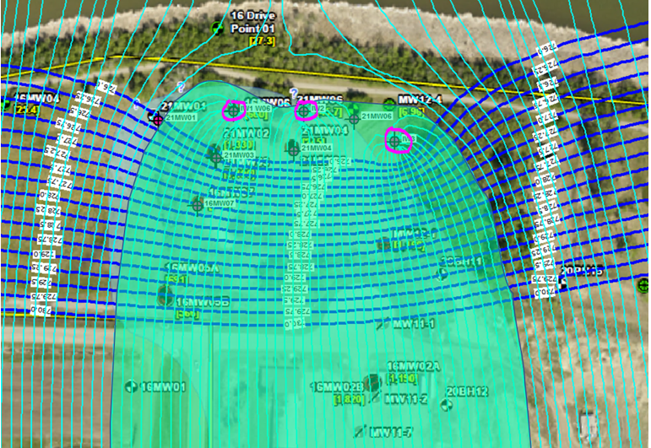
Groundwater Modelling and Extraction Well Installation
A low volume, constant rate (1L/min) pumping test was completed on 16MW06 to observe the drawdown on the adjacent wells.
The results from the pumping test indicated a transmissivity of 7.5 x 10⁻⁶ m²/s.
Using the data collected, the groundwater system was modelled to determine the best locations for the extraction wells.
Image from Trace Extraction Well Report

Slide 22
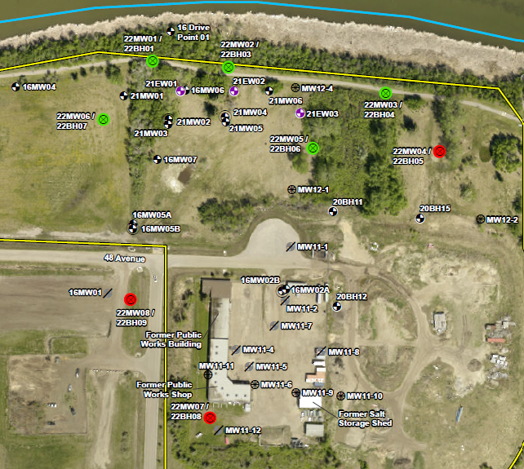
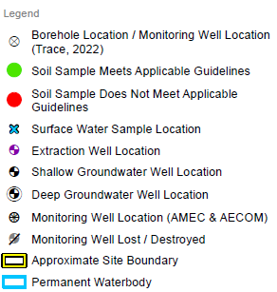
Groundwater Modelling and Extraction Well Installation
In 2022, 8 additional monitoring wells were installed to fill data gaps at the Site.
The 3 extraction wells
were also installed and
brought online after the
spring sampling event.
Image from Trace Groundwater Report

Slide 23
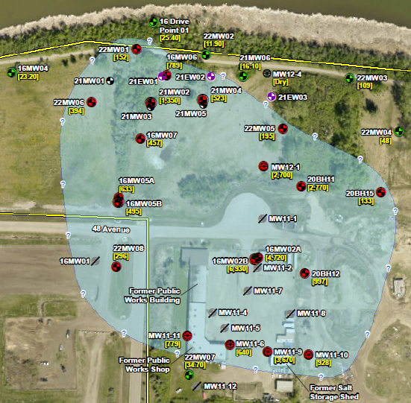
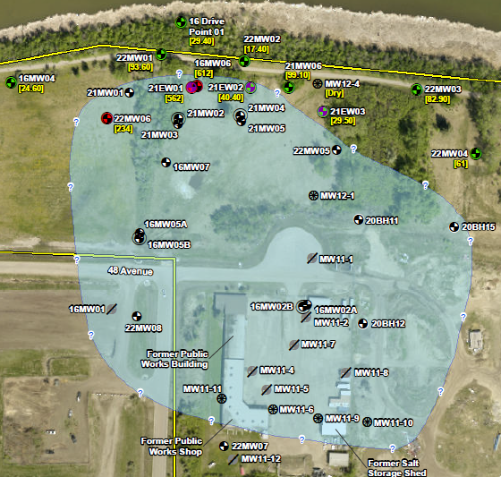
Groundwater Modelling and Extraction Well Installation
Pre:
Post:
Images from Trace Groundwater Report

Slide 24
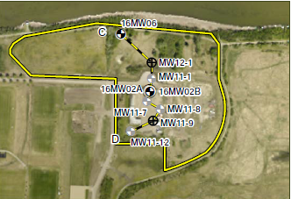
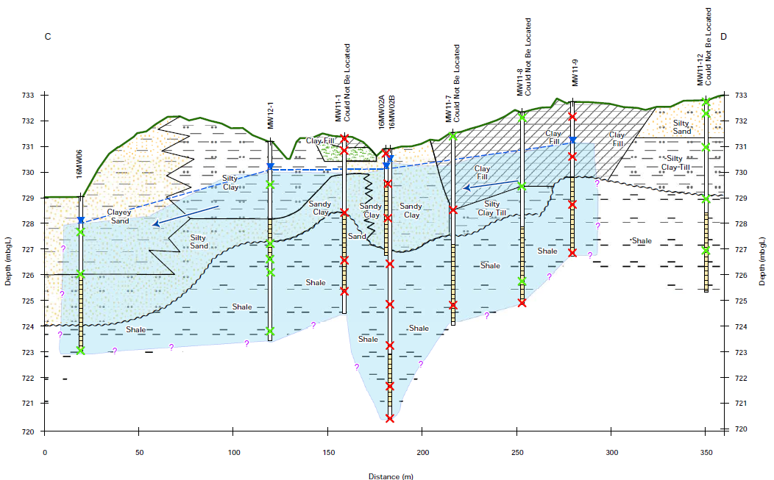
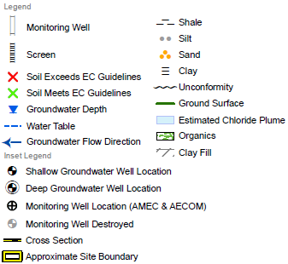
Groundwater Modelling and Extraction Well Installation
Pre:
Images from Trace Groundwater Report

Slide 25
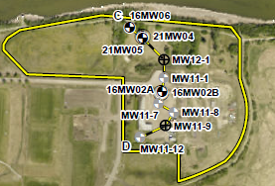
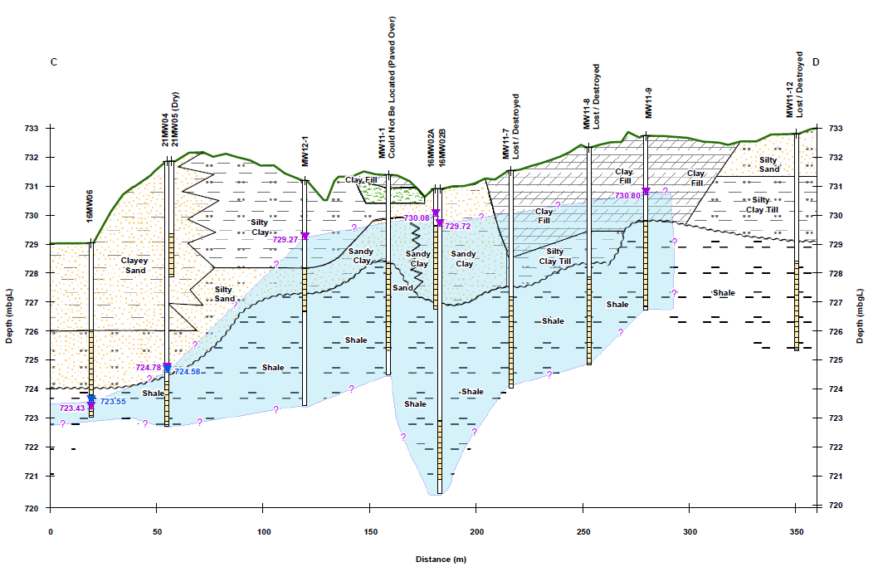
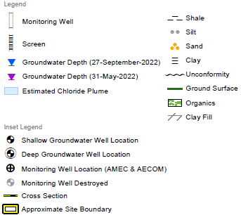
Groundwater Modelling and Extraction Well Installation
Post:
Images from Trace Groundwater Report

Slide 26
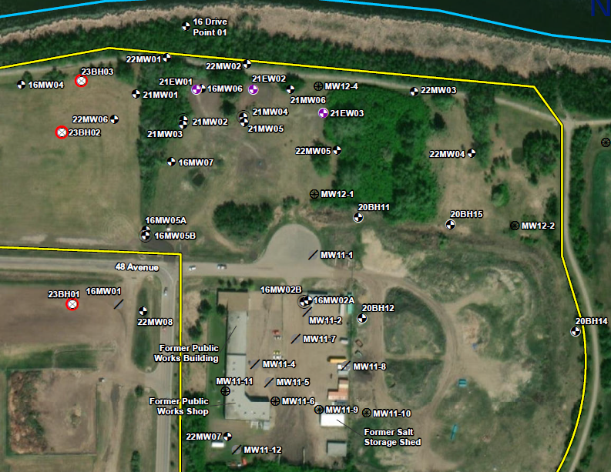
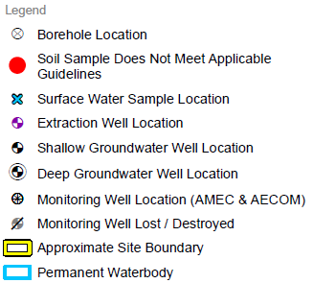
Groundwater
Monitoring
In 2023, 3 additional monitoring wells were installed to fill data gaps on the west side of the plume.
Image from Trace Groundwater Report

Slide 27
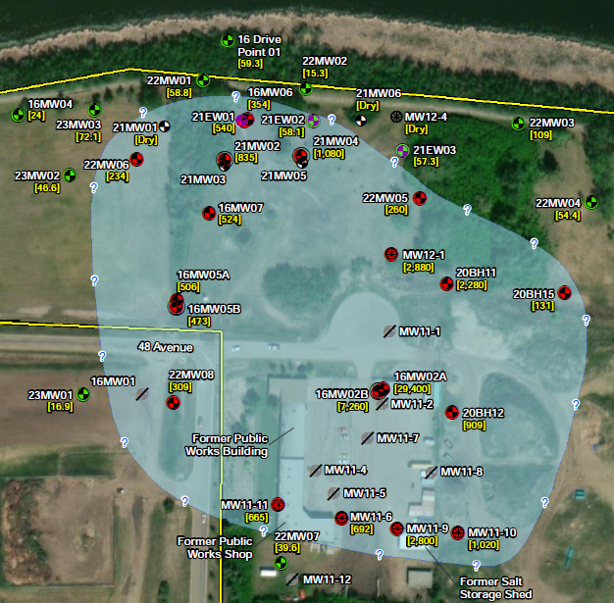
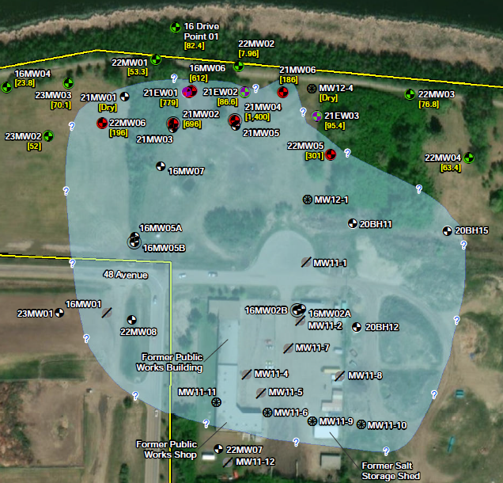
Groundwater Monitoring
Spring:
Fall:
Images from Trace Groundwater Report

Slide 28
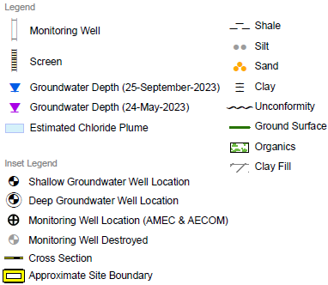
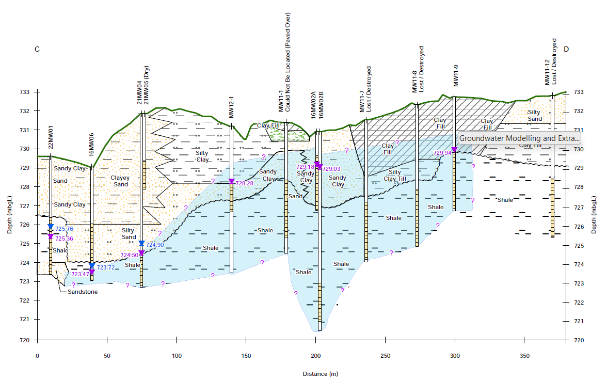
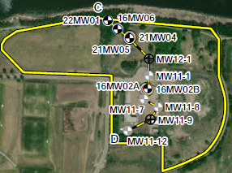
Groundwater Monitoring
2023:
Images from Trace Groundwater Report

Slide 29
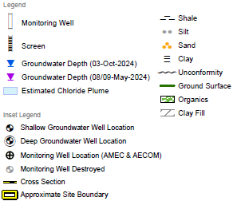
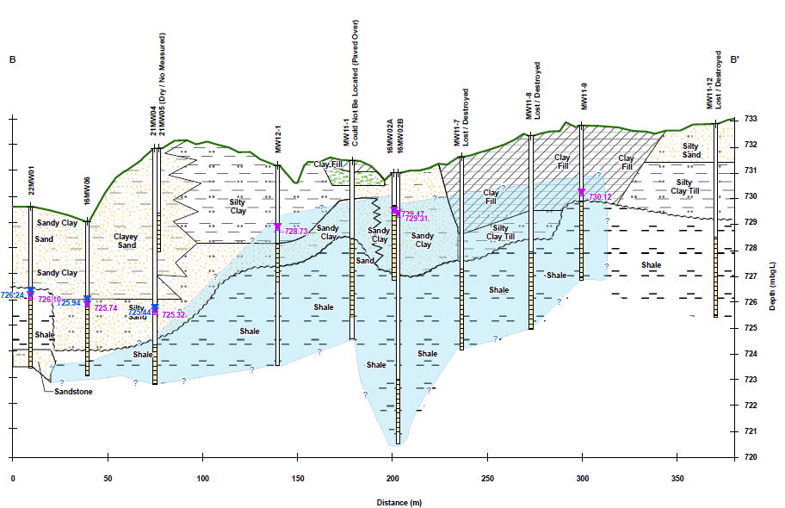
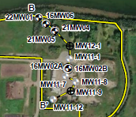
Groundwater Monitoring
2024:
Images from Trace Groundwater Report

Slide 30
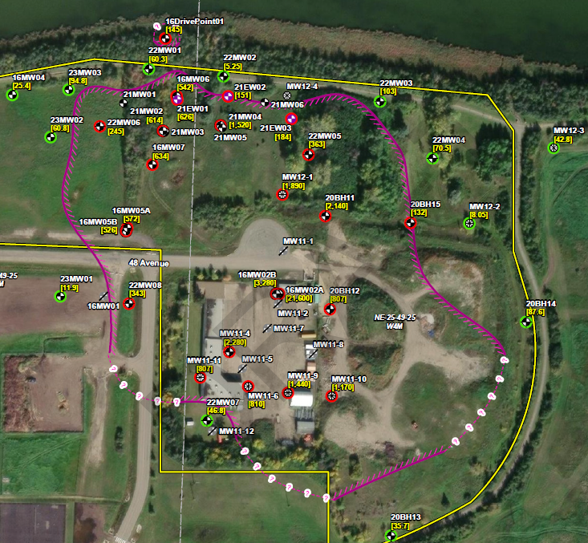
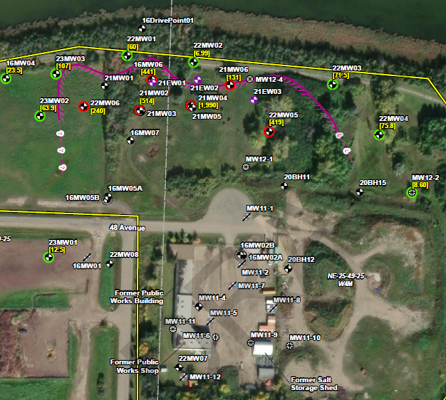
Groundwater Monitoring
Spring 2024:
Fall 2024:
Images from Trace Groundwater Report

Slide 31
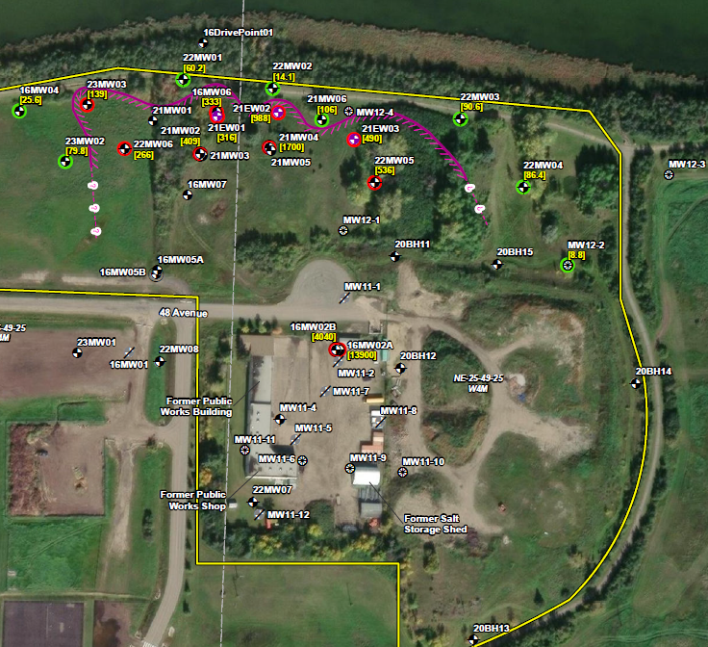
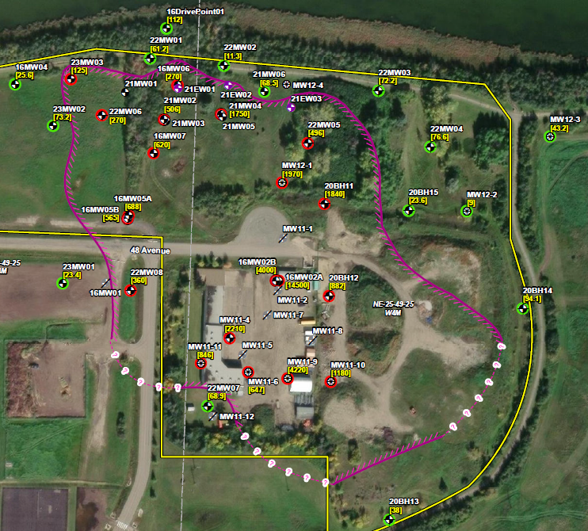
Groundwater Monitoring
Spring 2025:
Fall 2025:
Images from Trace Groundwater Report

Slide 32
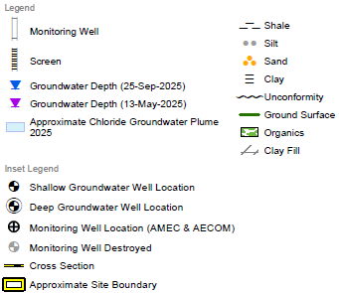

Groundwater Monitoring
2025:
Images from Trace Groundwater Report

Slide 33

Groundwater Modelling and Extraction Well Installation
Modelling was completed using the most recent data from the groundwater monitoring program.
Modelling identified that some of the western portion of the chloride plume wasn’t being captured with the zone of influence of the current extraction well system.
As a result, an additional extraction well has been recommended for installation in 2026 to capture the west portion of the chloride plume.
Image from Trace Presentation

Slide 34
Conclusions
A focused, step-wise approach was taken to delineate soil and groundwater impacts, assess risk to receptors through SST modeling, evaluate remedial options to find a cost-effective method, and groundwater modelling to effectively install a successful extraction well system.
Annual groundwater monitoring at the Site was used to confirm the efficacy of the interception and extraction of the salinity impacted groundwater from reaching the highly valued community waterbody.
On-going groundwater monitoring also confirmed the plume extending beyond the zone of capture and the requirement for adding a 4th extraction well to the west.

Slide 35
Conclusions
Overall, the client was very happy with finding a cost-effective remedial option to address the issue of the salinity impacted groundwater at this Site and protect the highly valued community waterbody.

Slide 36

Questions?
We’re Here to Help.
John Forbes, B.Sc., P.Biol.
Environmental Scientist
jforbes@traceassociates.ca
Environmental Science, Engineering, and Management Consulting

