Slide 1
Regional PFAS Estimation and
Explainable AI (XIA)
Landfill, Refinery/terminal, Chrome plating, Airport sites and Remediation Sites
RemTech, April 2026
Paul Hurst, M.Sc., QP(ESA), P.Eng. Environmental Engineer
Skyler Sorsby , MS, Senior Hydrogeologist – Data Science Specialist
Usha Vedagiri, Ph.D., Senior Vice-President – PFAS Support Services Leader
Dean Lay, MS, Senior Consultant – Data Evaluation

Slide 2
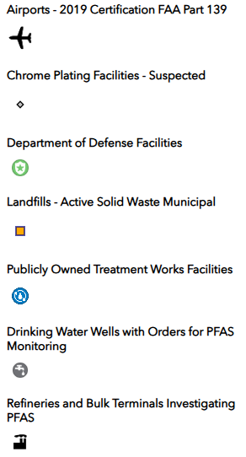
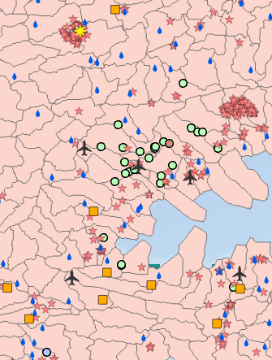
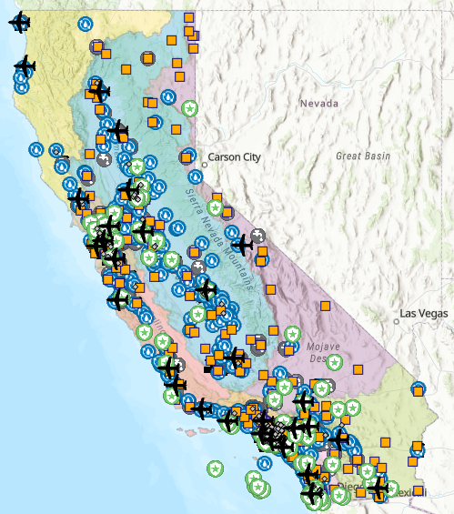
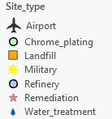
High Level Summary
California (CA) PFAS Prediction Model
  Trained with non PFAS data to predict PFAS in drinking water
  Result: PFAS in drinking water wells correlated strongly with site types & hydroclimate info
XIA -> Used to highlight feature importance
Using Equivalent Layers in Ontario (ON), deployed CA model
  Initial results show correlations between model and known PFAS sites

Slide 3




Overview of Machine Learning
We specify the response
Regression
Classification
Continuous response
Categorical response
Response
Predictors
Response
Predictors
Dimensionality Reduction
Clustering
?
?
?
?
Unmeasured response
Modified from Greenacre and Primicerio, 2013, Multivariate analysis of ecological data: Fundacion BBVA, Plaza de San Nicolas, 4. 48005 Bilbao, 333 p. [Available at www.fbbva.es]
Notes:
Classification is supervised learning where labeled data has known categories (e.g., spam vs. not spam), and the model is trained on many examples to learn patterns (such as word frequencies, specific terms, and sender reputation and more) in order to assign a class label to new data.
Clustering: unsupervised learning , data is unlabeled, no predefined categories. Algorithm groups based on similarity in their features
Dimensionality Reduction: unsupervised learning that reduces the number of input features while preserving the most important structures (e.g., signals or fingerprints) making analysis easier
Regression is supervised learning where labeled data has a continuous numeric outcome, and the model learns relationships between features and that outcome in order to predict a numeric value for new data.

Slide 4




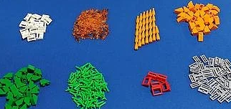
Using Lego to Explain Machine Learning
Takeaway: Four kinds of AI / machine learning
1
2
We provide the answers
Trend
Group
AI finds patterns
4
3
http://www.r2d3.us/visual-intro-to-machine-learning-part-1/
Notes:
When approaching AI, there are four general questions that can be asked –
Trends we want to predict (given existing instructions/answers) – like a Lego set with instructions for one cohesive picture. (regression)
Groups we want to predict (given existing instructions/answers) – like a Lego set with instructions for multiple models. (classification)
Groups we want to understand (without existing answers) – like sorting your Legos by shared characteristics. (clustering)
Trends we want to understand (without existing answers) – like a free-form Lego set that you find unique opportunities in. (
Classification: predict a category Clustering: discover groups Dimensionality reduction: simplify features Regression: predict a number

Slide 5
How can Machine Learning
Support Site Management
Neighboring site
“Reference” site
10 miles away
Potential for sources on neighboring sites? [inform sampling plan]
Site-specific characteristic levels? [fine-tune cleanup goals]
Differentiate onsite and offsite sources vs. fate & transport and precursor transformation patterns?
Perform data-driven site partitioning? [optimize monitoring and remedial action]
What are the spatiotemporal trends? [demonstrate attenuation, well optimization].
Site
Neighbor’s
Plume
Other
Site
X
?
AFFF
Plume
Main
Onsite
Plume
Site wells w/
Low / regional
levels

Slide 6
California Model
Site owners worldwide are receiving PFAS investigation requests from regulators
  Source differentiation / identifying offsite sources (forensics) answers some questions
  Time and $ spent on developing site-specific sampling strategies
Goal: Leverage California’s Geotracker data to provide initial estimates for site management questions. Focus on groundwater [sites, drinking water wells] only for this presentation
Notes:
Geotracker data: California database maintained by CA reg agencies to track contaminated sites. Requires landowners to conduct sampling and monitoring, data publicly available

Slide 7
California’s PFAS Data Collection Program
Source Category | Order Date | Number of Facilities | Number Completed | Analytical Methods | # of PFAS
Airports | 03/20/2019 | 28 | 27 | DoD QSM | 39
Landfills | 03/20/2019 | 203 | 195 | DoD QSM | 39
Chrome Platers | 10/25/2019 | 271 | 71 | DoD QSM | 38
WWTP | 07/09/2020 | 260 | 213 | DoD QSM | 31
Refineries/ Terminals | 03/12/2021 | 160 | 73 | DoD QSM | 31
Drinking Water Wells | 03/04/2024 (newest) | 1,207 PWS 3,819 Wells | 965 PWS 4,308 Wells | EPA 533 | 25
Notes:
- For the non-drinking water sources, analytical methods were required to comply with the DoD QSM, with no specific method required
- The number of PFAS listed for each source category is based on the recommended list, with facilities able to analyze for more or fewer in some cases
- There have been four investigative orders for drinking water wells, and the required facilities of each one is neither fully inclusive or exclusive of the others
- Number completed field is based on the data set analyzed; not current at date of presentation
Notes:
Order date: when group was ordered to collect data; Number completed – how many have reported; # of PFAS = # of PFAS analytes reported

Slide 8




Supplemental Data Used
Geographic, hydrologic, and climate data were incorporated to identify potential controls on PFAS distribution:
  HydroSheds – global hydroclimate data (temperature, land cover, topography, water-balance) present at catchment-scale.
  Community Water Center GIS database of potential PFAS sites, including airports, chrome plating facilities, refineries/terminals, landfills, military installations, and water treatment plants.
Notes:
Geotracker and El Centro Comunitario – CA Only

Slide 9
Overall Approach
Can we identify…
1… characteristic environmental PFAS levels?
2… regional influences on PFAS distribution?
3… rules of thumb for common offsite sources?
4… prevalent source type signatures?
5… site characteristics, rapidly? (STEP)

Slide 10
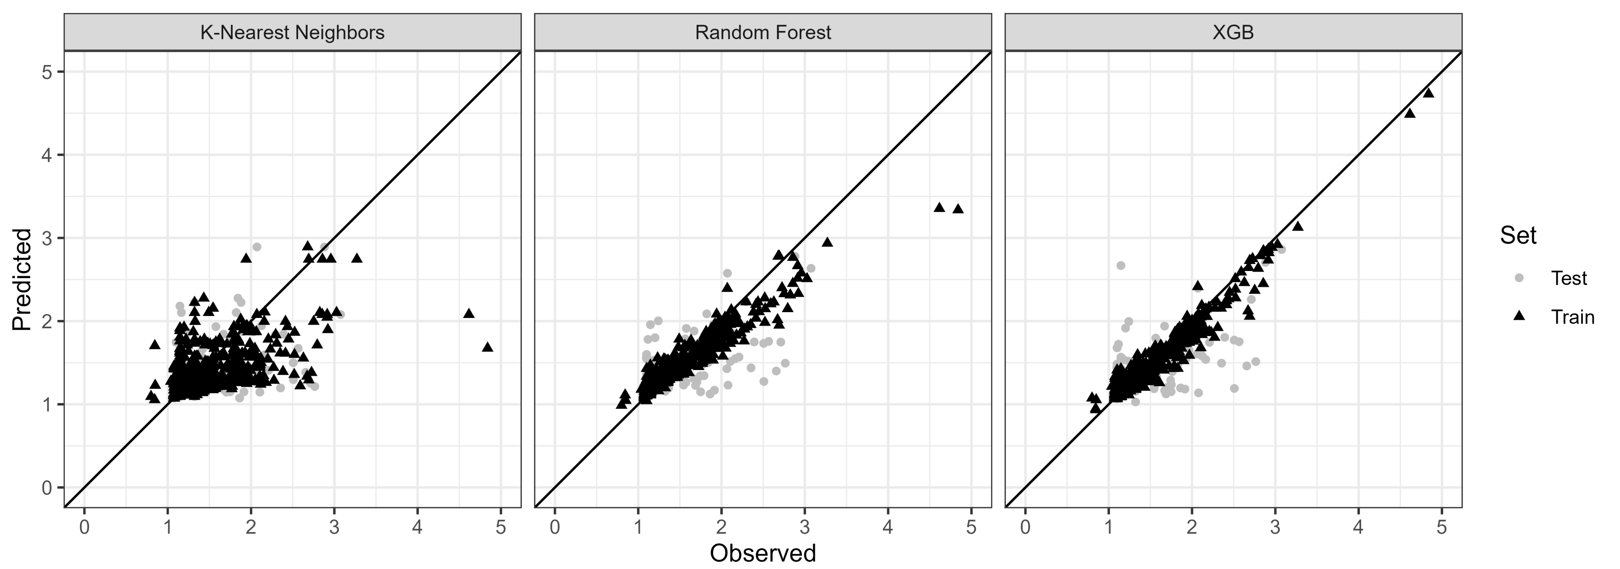
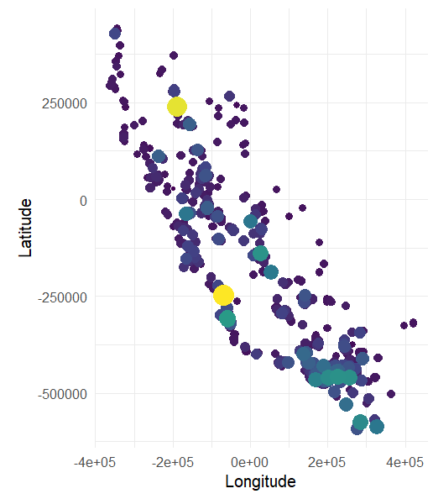
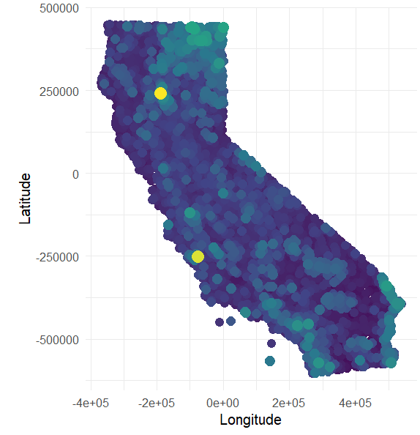
Estimated PFAS Levels
Takeaway
PFAS in drinking water wells correlates strongly with sites & hydroclimate info – predictive map shows spatial distribution.
As seen by drinking-water wells
Fit multiple machine learning models to predict the sum of PFAS drinking water well data.
Select best-fitting model based on traditional assessment of training & test sets
Predict spatial distribution of PFAS impacts at drinking water wells – advance knowledge of what could be present onsite.
Need to explain predictions / extract rules-of-thumb.
Sum of PFAS
(log10 ng/L)
1
2
3
4
RMSE | R2 | MAE | Set | Model
0.11 | 0.93 | 0.05 | Training | Random Forest
0.08 | 0.94 | 0.05 | Training | XGBoost
0.25 | 0.45 | 0.12 | Training | K-nearest neighbors
0.24 | 0.48 | 0.12 | Testing | Random Forest
0.24 | 0.49 | 0.12 | Testing | XGBoost
0.30 | 0.26 | 0.16 | Testing | K-nearest neighbors
Notes:
Left panel – Geotracker sites – places with known PFAS sites. Model: Right panel hydroclimate info – land cover, urban density, climate, topographic, distance to difference source sites. Rights on right site correlated to known pfas site. Reverse look, top right left panel with no yellow dot but top right panel suggests could be something.

Slide 11
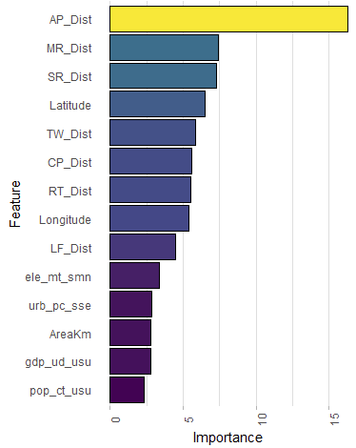
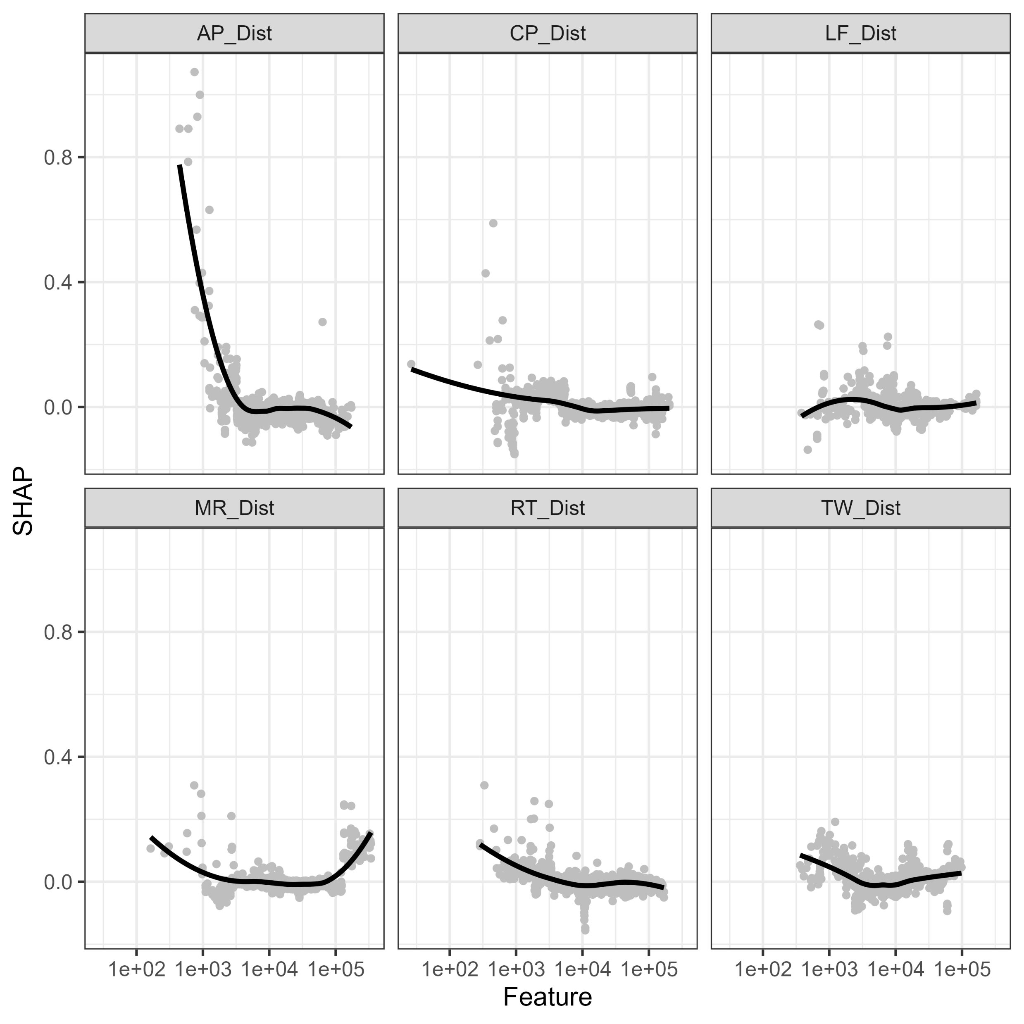
Regional Influences
Takeaway
Importance to predicting PFAS levels: Airports > military sites > remediation sites > WWTP > chrome plating > refineries > landfills.
Advanced correlation: hydro-geo-climate characteristics & Explainable AI (XAI)
Interpret the previously fitted model using Permutation Feature Importance (PFI) and Shapley Additive exPlanations (SHAP).
PFI: How important are the predictors to PFAS concentrations?
SHAP: How does proximity to different site types influence PFAS concentrations (proxy for plume magnitude and transport distance)?
Airport breakpoint: ~ < 975 m
Terminals/refineries breakpoint: < 1025 m
Landfills breakpoint: ~ no clear breakpoint
Chrome Platers breakpoint: ~ < 250 m
WWTP breakpoint: ~ < 375 m
Military sites breakpoint: ~ < 1,100 m
Notes:
PFI measures importance by calculating the increase in model loss (error) when a feature's values are randomly shuffled. It tells you how much the model depends on a feature for its overall accuracy. E.g., permute a future, does model
SHAP: “For this one prediction, how much did this feature move the answer compared to average – simulates the model , pretends model only knows parts, sees how the parts and order matters
In a situation with industrial land uses and multiple types of sources present, this type of analysis can help to understand potential for contributions from other sources and what sites to watch out for.
Can assess whether additional non-target analysis would be useful and worth the cost.
It is possible for regional levels to exceed regulatory criteria. Characterizing these levels is important to understand recontamination potential and remediation effectiveness.
Explainable AI can assist with identifying potential drivers for PFAS levels or characterizing environmental pathways.
Together, the above can inform sampling configurations, density, and analytical suites.

Slide 12
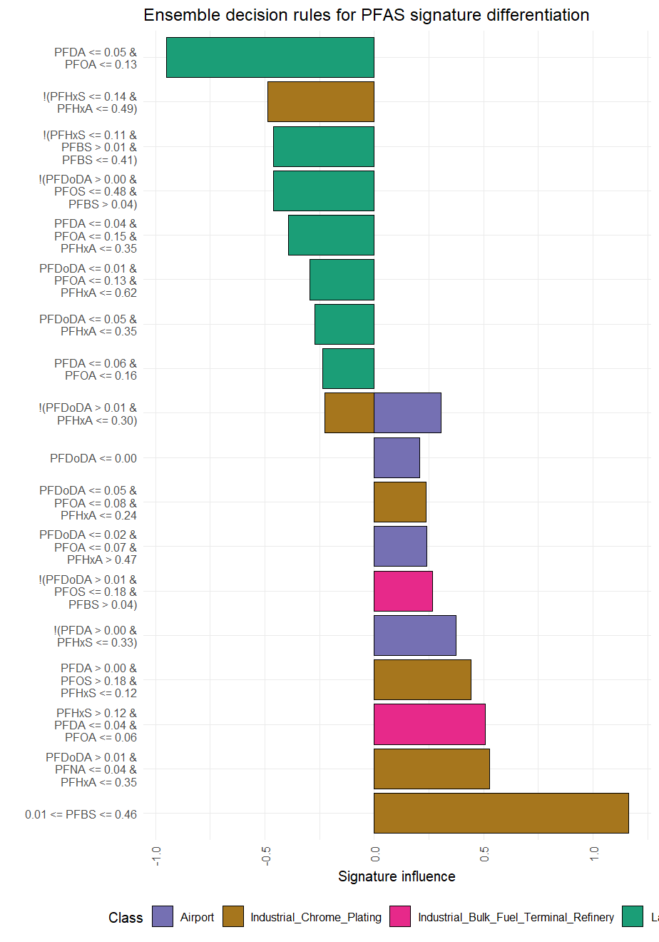
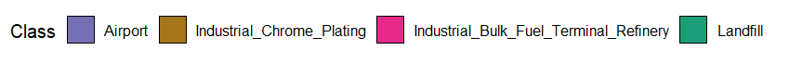
Site Signatures (RuleFit)
Takeaway
Site/source type classifier – Not a silver bullet, some uncertainty
Negative rules
Positive rules
Site | Accuracy
Airport | 60%
Fuel Terminal / refinery | 77%
Chrome Plating | 87%
Landfill | 86%
Notes:
Knowing top influencers, conducted small test – can we train a classifier to distinguish these 4 types of sites (A, Fuel Terminal/Refinery, CP, LF)
Took most source-like samples (highest / most unique) from each site. Trained classifier to distinguish these 4 types of sites. Biggest differentiator for CP was PFBS (0.01 <= PFBS < 0.046) – up to 46% PFBS Differentiates CP.
Accuracy – 60% of time is correctly classified airports; i.e., has to fit a signal into a bucket, if you provide it a AFFF source from a fire, still needs to fit into the classification scheme .

Slide 13
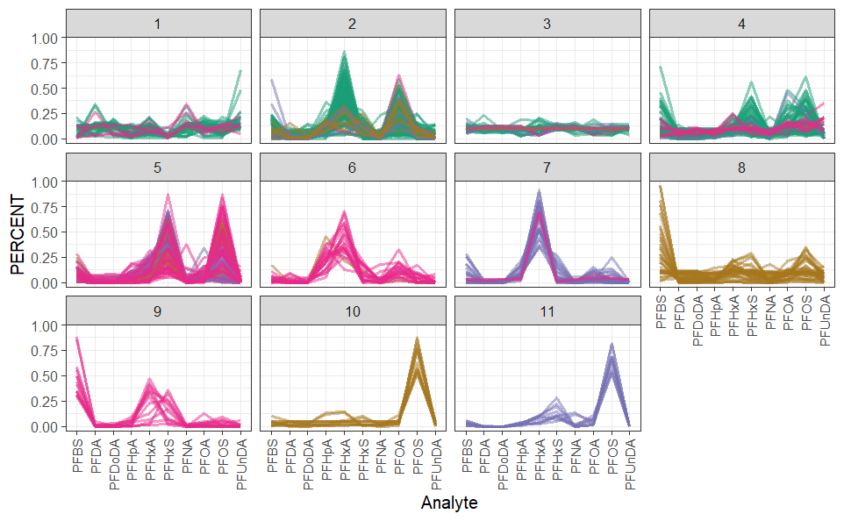
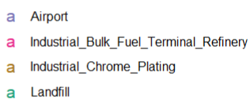
Prevalent source-type signature combinations
Takeaway
Multiple signatures per site – not just one source to classify!
Source types (panels) sometimes occur on more than one site type (colors). i.e., PFAS-containing products, including multiple generations of AFFF (i.e., ECF C8, FT C8, FT C6)
Classification based on site data is difficult, due to product mixing, dilution, transport-related fractionation, and biogeochemical precursor transformation.
Data-mining source-type signature groups
Mass fraction
Notes:
Perhaps more interesting, if we move to reviewing these site vists general chemical patterns (parallel coordinate plots)
Data processed to retain the three highest-concentration, most dissimilar samples for each site and normalized to total concentration.
Uniform Manifold Approximation and Projection (UMAP) used to identify 11 signature sub-groups.
Potential for multiple onsite signatures (and shared signatures between sites based on similar activities).
Airports: PFHXA, PFOS + some PFHxS
Chrome platers: PFBS, PFOS
Landfills: range of mixtures, including PFOA + PFOS + PFHxS & PFOA + PFHxA
Refineries & Terminals: PFOS + PFHxS, PFBS + PFHxA + PFHxS, and PFHxA

Slide 14
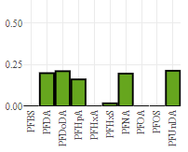
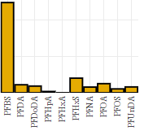
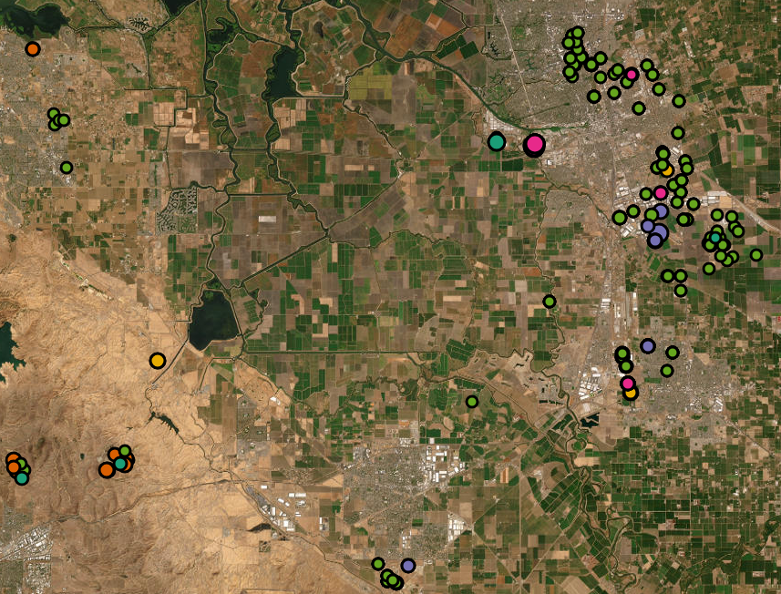
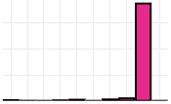
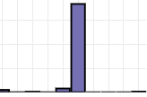
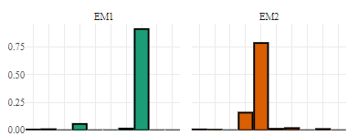
Site Characteristics: Local fingerprints
Low-concentration signature at DWW
Shorter-chain signature @ private residence
Takeaway
Rule-of-thumb fingerprint inferences hold at a local scale. Factor analysis promotes knowledge discovery.
Stockton, CA
PFOS-dominated signatures at refinery
WSP’s PFAS tool automates the identification fingerprint extraction. Unlike classifiers, matrix factorization discovers unique site-specific fingerprints.
General rule-of-thumb signatures still discernible at a local scale.
PFOS dominates at the terminal.
PFHxS dominates at the airport, with some presence at the terminal as well.
PFHxA and PFOA dominate landfill signatures.
PFHxS-dominated signature at airport
Two landfill signatures
Notes:
Last step – can use NMF , this is an output from a WSP visualizer tool, identifies LFs, same signatures identified in classifier

Slide 15
How about Ontario?
Question: Can we gain any insights deploying a model trained with California data?
Ontario Feature Layers:
  Ontario Chrome Platers
  Military Bases
  Federal Investigation and Remediation Sites (FCSI)
  Ontario Airports
  Ontario WWTP
  Ontario refineries
  Ontario Landfills
  Hydroclimate Data

Slide 16
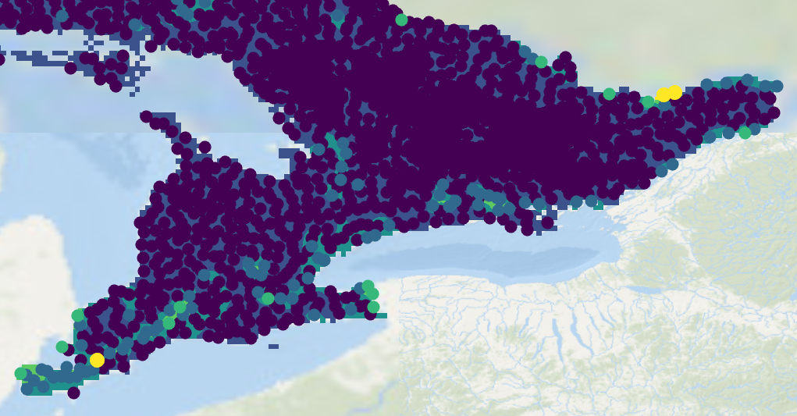
Estimated PFAS Levels (Ontario)
Some interesting correlations!
Predictions tend to follow remediation sites and WWTP
Many hot spots are beside WWTP or have one nearby, however WWTP alone does not equal PFAS prediction
Interestingly, airport alone does not always predict PFAS
Further refinement worthwhile
Sum of PFAS (log10 ng/L)
1.5
1.75
2
Notes:
Some interesting correlations!

Slide 17
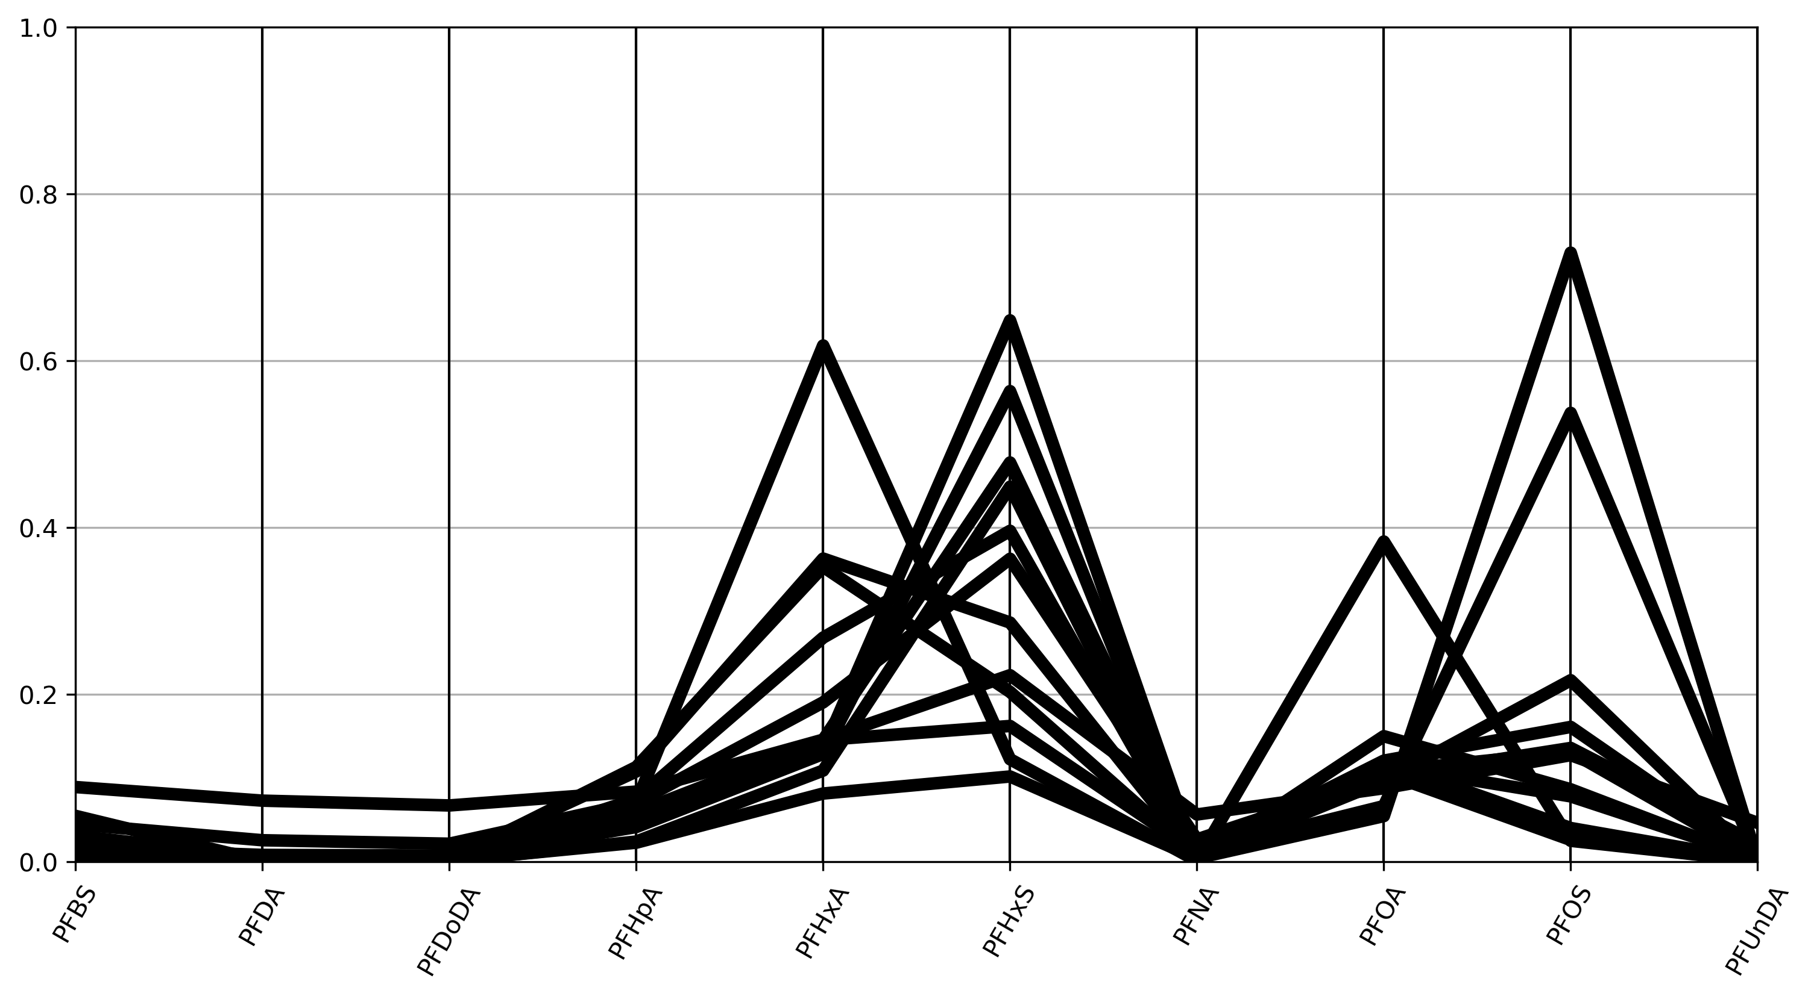
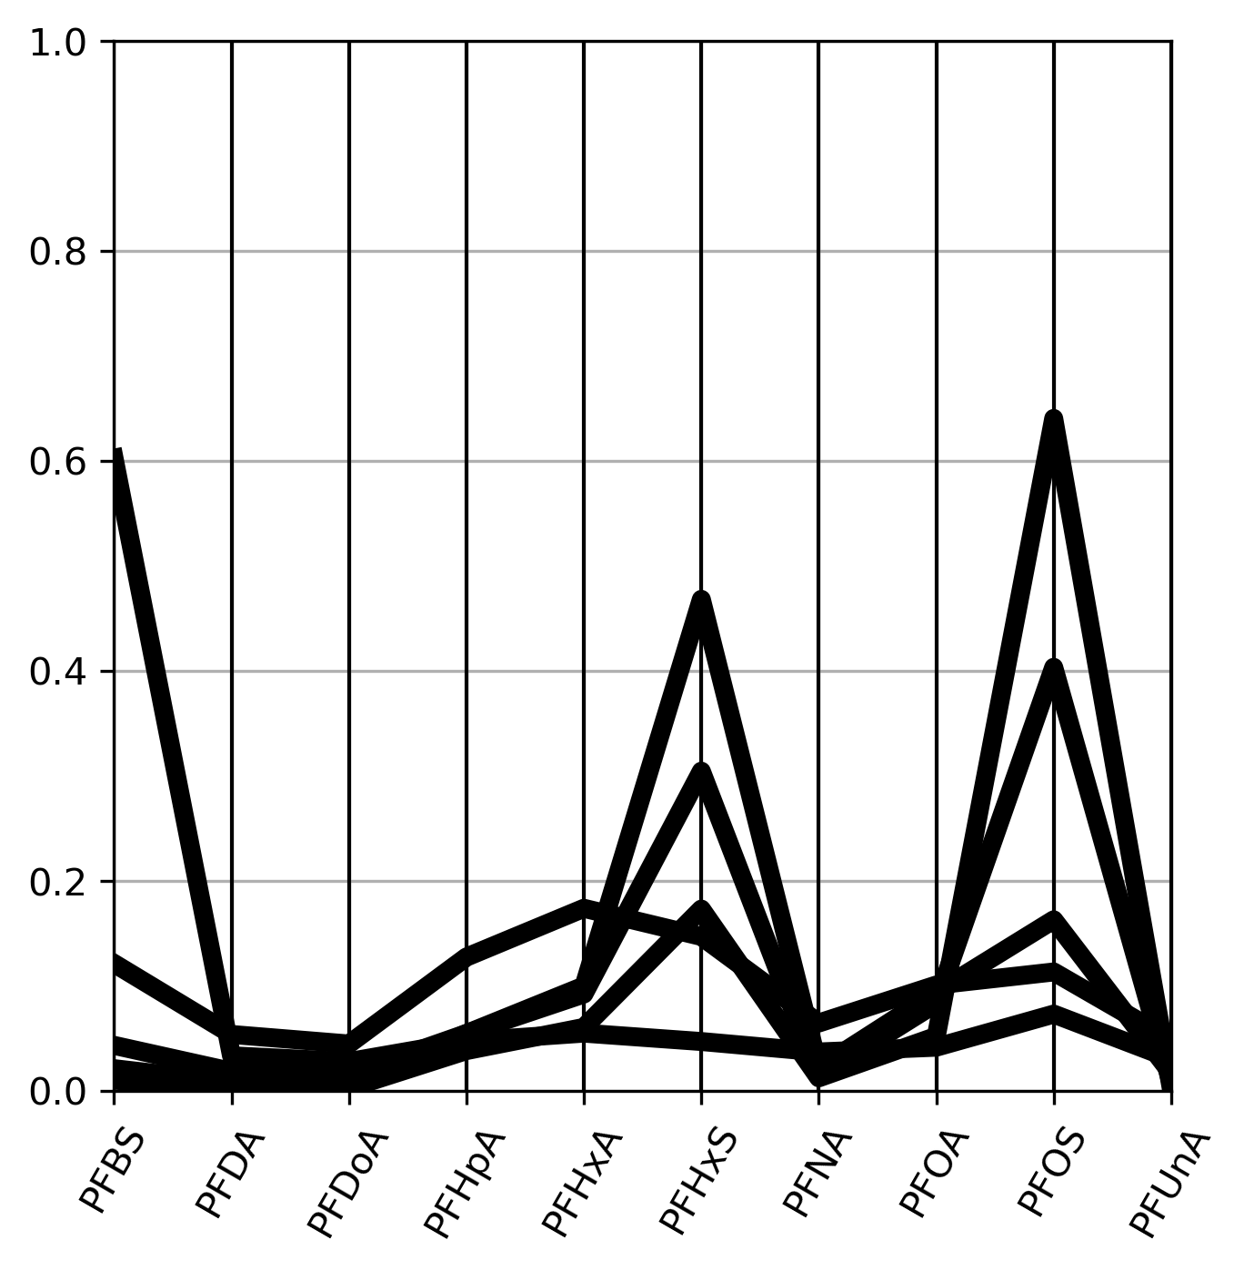
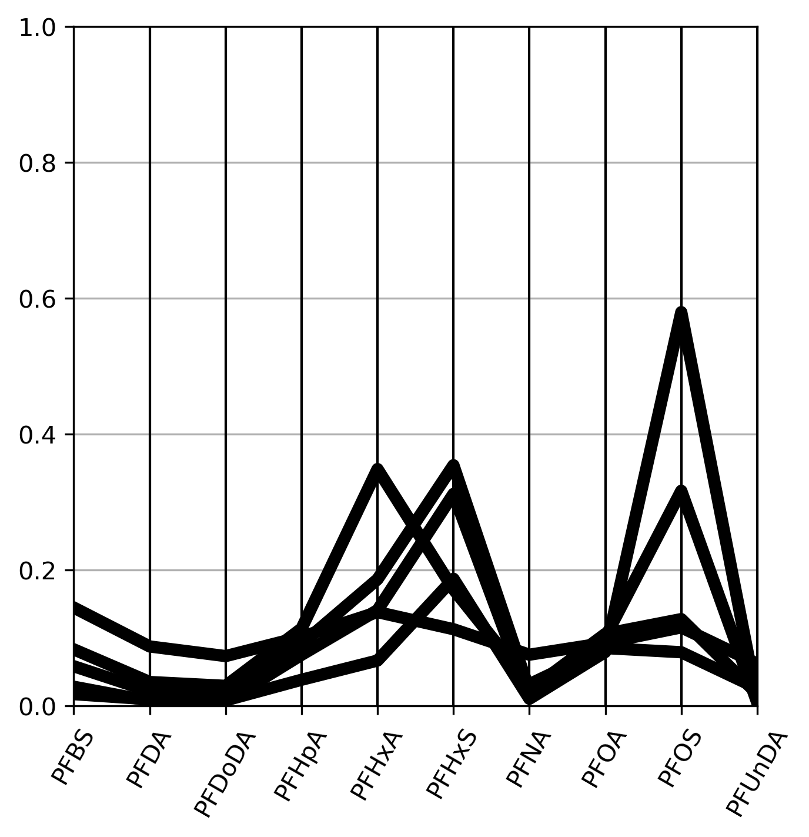

Comparison of California Prevalent Signatures To 3 Canadian Sites
For interest – reviewed three Canadian sites (two Ontario, one Atlantic Canada)
Each site: military bases/airports, presence of Fire Fighting Training Areas (FFTA) and Airstrips.
Significant source of PFAS from emergency response / AFFF
Overall fairly similar overall site signatures
Notes:
Takeaway – 3 military bases/airports fairly similar overall site signatures
All three -> PFHxS and PFOS dominant.
WSP experience is that AFFF related sites drive PFAS conc in GW much more than WWTPs since the latter discharge to SW . What drives the model to find a different trend for ON?
PFAS generally driven by FFTA, fire fighting – >

Slide 18
Comparison of California Prevalent Signatures To 3 Canadian Sites
Data-mining source-type signature groups
Site 1
Site 2
Mass fraction
Site 3
Notes:
Takeaway – 3 military bases/airports fairly similar overall site signatures
All three -> PFHxS and PFOS dominant.
WSP experience is that AFFF related sites drive PFAS conc in GW much more than WWTPs since the latter discharge to SW . What drives the model to find a different trend for ON?
PFAS generally driven by FFTA, fire fighting – >

Slide 19
Comparison of California Prevalent Signatures To 3 Canadian Sites
Data-mining source-type signature groups
Site 1
Site 2
Mass fraction
Site 3
Notes:
Takeaway – 3 military bases/airports fairly similar overall site signatures
All three -> PFHxS and PFOS dominant.
Difference: Some PFHxA, PFOA only at 1 site, PFDA only at 1 site
Site 1 and 3 – close match to 1 / 4 landfills, 1 / 4 industrial bulk fuel terminals/refinery, 1 / 2 airports (partial), 0 / 2 chrome plating
Site 2 – close match to 1 / 4 landfills, 2*/ 4 industrial bulk fuel terminals/refinery, 1 / 2 airports, 1 / 2 chrome plating
* = partial match

Slide 20
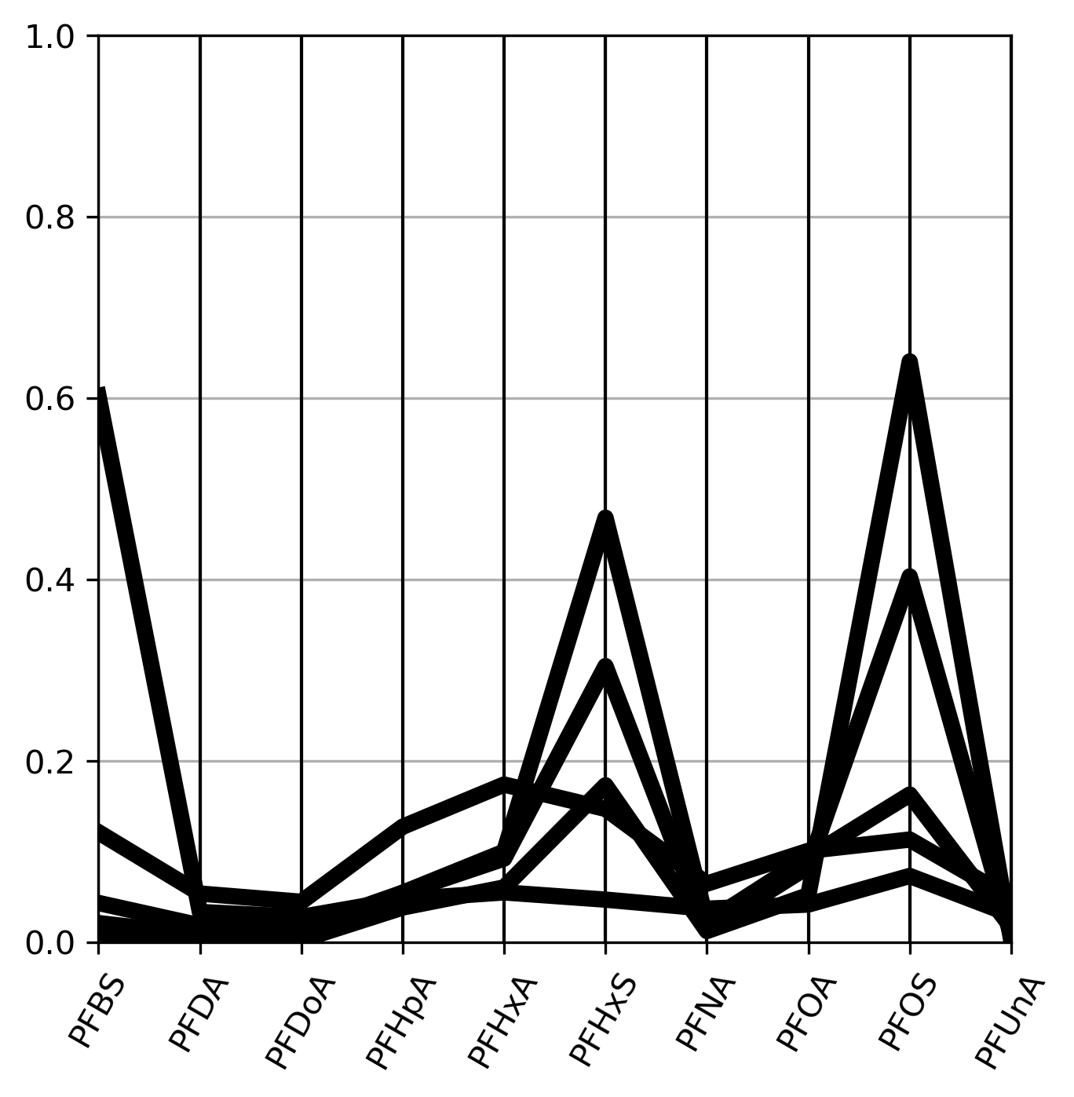
Comparison of California Prevalent Signatures To 3 Canadian Sites
Data-mining source-type signature groups
Site 1
Site 2
Mass fraction
Site 3
Notes:
Takeaway – 3 military bases/airports fairly similar overall site signatures
All three -> PFHxS and PFOS dominant.
Difference: Some PFHxA, PFOA only at 1 site, PFDA only at 1 site
Site 1 and 3 – close match to 1 / 4 landfills, 1 / 4 industrial bulk fuel terminals/refinery, 1 / 2 airports (partial), 0 / 2 chrome plating
Site 2 – close match to 1 / 4 landfills, 2*/ 4 industrial bulk fuel terminals/refinery, 1 / 2 airports, 1 / 2 chrome plating
* = partial match

Slide 21
Summary of Findings
California databases is a valuable resource to begin to understand regional PFAS trends and apply to individual site assessment
Source-related trends in concentration bands and chemical profiles are apparent.
Empirical ranking of site types influence on PFAS levels:
  Airports > military sites > remediation sites > WWTP > chrome plating > refineries > landfills.
Potential for multiple onsite signatures (and shared signatures between sites based on similar activities).
Three Canadian Sites matched a variety of site type signatures – AFFF usage creates PFAS regardless of site type
Deploying the CA Model in Ontario provided initial insights, further refinement worthwhile
Notes:
Pfas prospecting ☺
Shared patterns:
Airports: PFHXA, PFOS + some PFHxS
Chrome platers: PFBS, PFOS
Landfills: range of mixtures, including PFOA + PFOS + PFHxS & PFOA + PFHxA
Refineries & Terminals: PFOS + PFHxS, PFBS + PFHxA + PFHxS, and PFHxA

Slide 22

Questions?
Paul.Hurst@WSP.com
wsp.com

