Slide 1
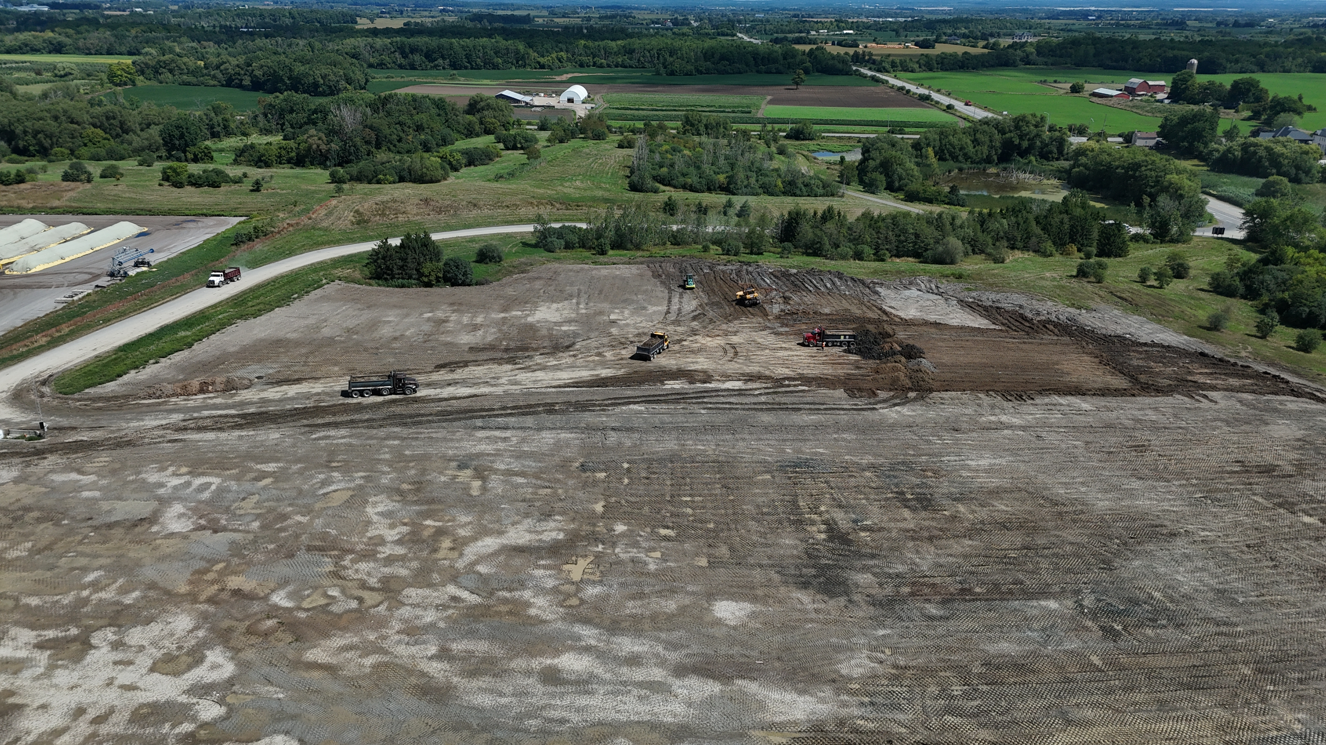

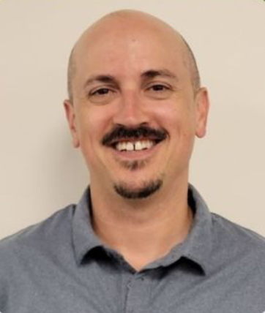

Chinguacousy Beneficial Soil Reuse Site (CBSRS)
How the Region of Peel Revolutionized Soils Management by Leveraging a Closed Landfill to Make a Clean Soil Reuse Site.
April 8, 2026

Slide 2
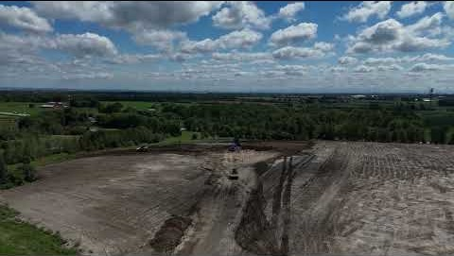
New Beginnings

Slide 3
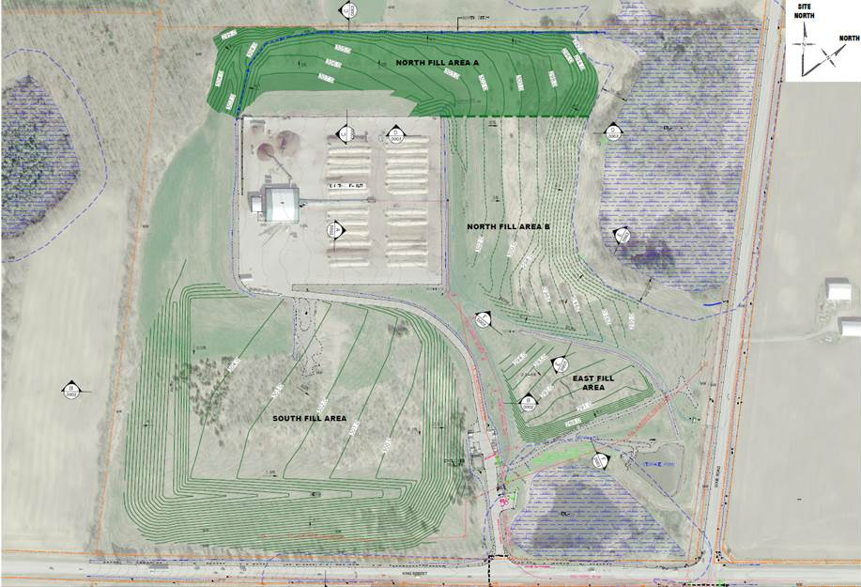
CBSRS - South Fill Area
Notes:
Located at 4400 King Street, Caledon, using the CBSRS for receiving clean fill has allowed for:
The beneficial reuse of excess soil generated by Peel capital works projects, including W/W/roads/RPAM
Reduced project costs related to soil transport,
Improved landfill final cover as a proactive measure to reduce water infiltration and onsite and offsite environmental impacts.

Slide 4

Planning and Preparation
Engage Region of Peel Stakeholders
  Launched an interdisciplinary stakeholder committee and working group to align on strategic objectives
  Liaise with Waste Management Division, Public Works to determine possible site locations and program needs including the following:
    CBSRS was best suited (owned by ROP, dedicated turning lanes, asphalted driveway access, located at two Regional Roads (Dixie and King), already established as truck access facility.
    Aligned long-term planning with Peel’s composting operations, creating operational synergy.
  Connect with Office of Climate Change and Energy Management, Stormwater Management and Hydrogeology Teams
  Ensure Regulatory Compliance- MECP
Project would be exempt from the reuse planning requirements outlined in sections 8 to 16 of the regulation if both of the following conditions met:
The excess soil is excavated as part of an undertaking related to infrastructure.
The project leader for the undertaking related to infrastructure intends, after removing the excess soil from the project area, to finally place it at a reuse site that is owned by the project leader or a public body and that is part of another undertaking related to infrastructure.
Soil meets Table 3.1 ICC ESQS

Slide 5
Planning & Preparation
Engage External Stakeholders
  Town of Caledon- potential permit requirements, traffic concerns
  Toronto and Region Conservation Authority (TRCA)- potential species at risk and wetland boundary identification
  Local Liaison Committee- Local Ward Councillor discussion, resident concerns and input, communications letter distribution
  Vendor Procurement
  Atkins Realis- Development of Fill Management Plan, Contour Plans Design, Stormwater Management Plans, Traffic Impact Assessment
  Pacific Paving- Tree clearing, grubbing and site preparation, daily onsite soil management and operations
  SoilFlo- Truck tracking software
  Daily staffing requirements- Load inspection, verification

Slide 6
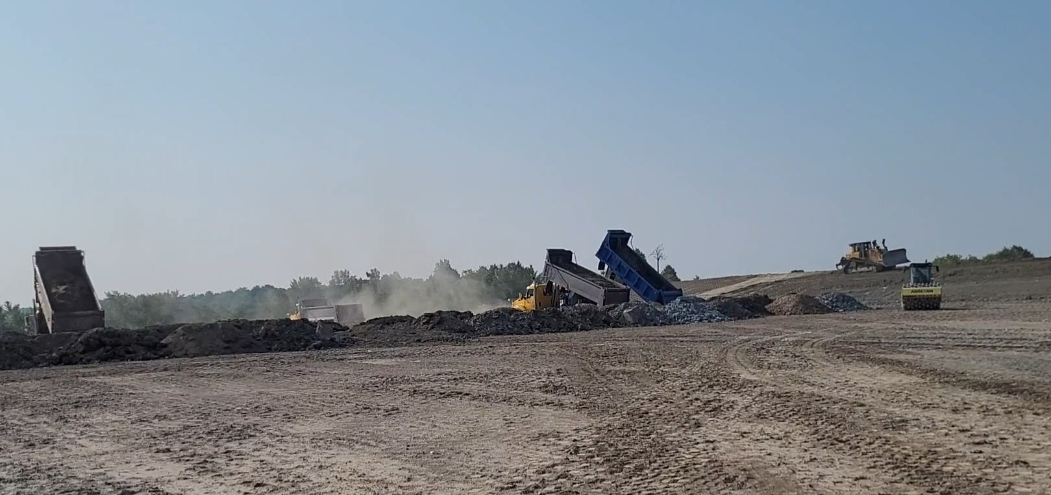
Phased Implementation for Execution
Pilot Program Launch: Initiated operations with select capital works projects featuring smaller truck volumes to ensure precise tracking and management.
Strategic Site Utilization: Directed initial soil placement to the South Fill Area, leveraging its 550,000 m³ capacity for optimal staging and management.
  Jim Tovey Conservation Area project received approximately 24,600 loads (246,000 m³), averaging 100 trucks daily.

Slide 7
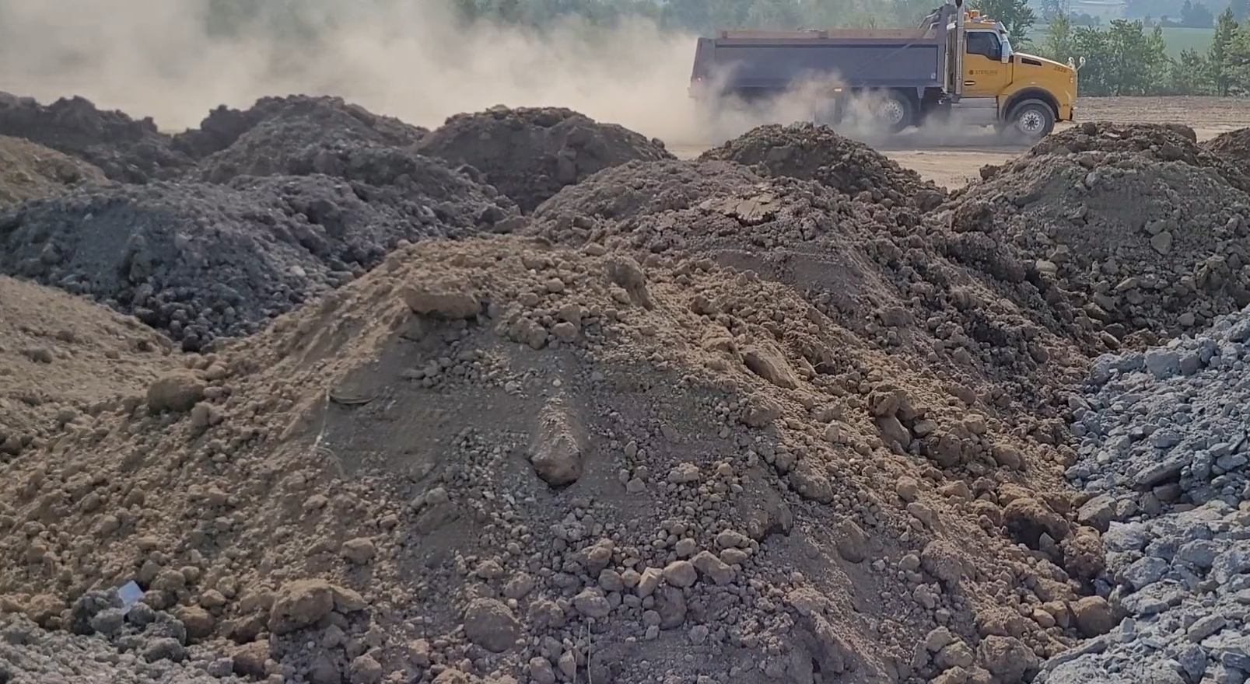
The Site in Action- Results
Project Totals- August 2024 to March 2026 the CBSRS has received just over 298,510 m³; 228,868 in 2025 alone.
Winter total of 4,280 loads (Dec to Mar) in 2026
  1,426 loads average per month and 90 loads average per day.
Spring total of 4,326 loads (Mar to June) in 2025
  1,442 loads average per month and 72 loads average per day.
Summer total of 8,280 loads (June to Sept) in 2025
  2,760 loads average per month and 133 loads average per day.
Fall total of 9,280 loads (Sept to Dec) in 2025
  2,268 loads average per month and 122 loads average per day.

Slide 8
What’s Forecasted
550,000 m3
Legend
298,510 m3
527,000 m3
Total Site Capacity
Projected Fill Volume- End of 2026
Current Fill Volume- March 2026

Slide 9
Cost Savings and Environmental Benefits
Direct Cost Savings: Achieved approximately $2.7 M in operational and disposal cost avoidance.
  Significant cost savings regarding avoided soil importation costs for expansion of Peel Curing Facility.
Significant Emissions Reduction: Prevented an estimated 2,981 tCO2e in greenhouse gas emissions.
Major Logistics Efficiency: Saved 2.8 M km in total travel distance through localized soil reuse.
Reduced leachate in groundwater: Leachate collection system onsite
Assumptions
Based on $150 per load tipping fee, not a lot is known of sites receiving Table 3.1 ICC ESQS
Savings calcs include staffing salaries and project development and operations costs.
65 km average distance per load value taken from MECP news release and OSPE report
Downtown locations within each municipality were chosen as a fixed point for the starting point of the soil transport.
Soil journey per load consists of 2 trips; there and back, with no other deviations.
All soil loads were transported using a dual axle, non-trailer, dump truck
Sources
Diesel GHG factor - Sourced from Environment and Climate Change Canada’s National Inventory Report 2019
Ontario Society of Professional Engineers Report 2016-excess-soil-management.pdf (rccao.com) - “Most of the projects, at 67% (8 out of 12) using dual-axle vehicles for soil disposal made more than 100 trips for this function. Of those, half (4 out of 8) travelled between 50 and 100 kilometres one way to dispose soil. “
MECP News Release Ontario Making it Easier and Safer to Reuse Local Excess Soil | Ontario Newsroom - “Soils travel long distances to either a landfill or reuse site. On average, a load of excess soil travels 65 km or more”

Slide 10
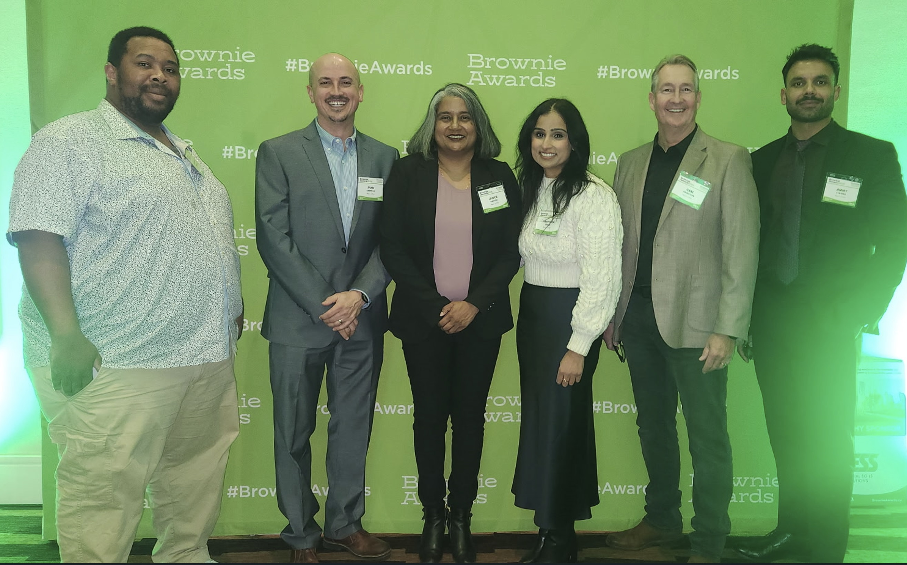
Strategic Framework- Keys to Success
Proactive Planning for Regulations
  Aligned Region of Peel procedures with MECP requirements
  Implemented robust documentation, soil tracking and approvals
  Established clear criteria for reuse sites
2. Collaboration at Every Level
  Team diversity and effective collaboration across Regional departments including Steering Committee and Working Group
  Partnership with consultants, contractors and regulators
  QP’s who worked collaboratively and took a solution-focused approach

Slide 11
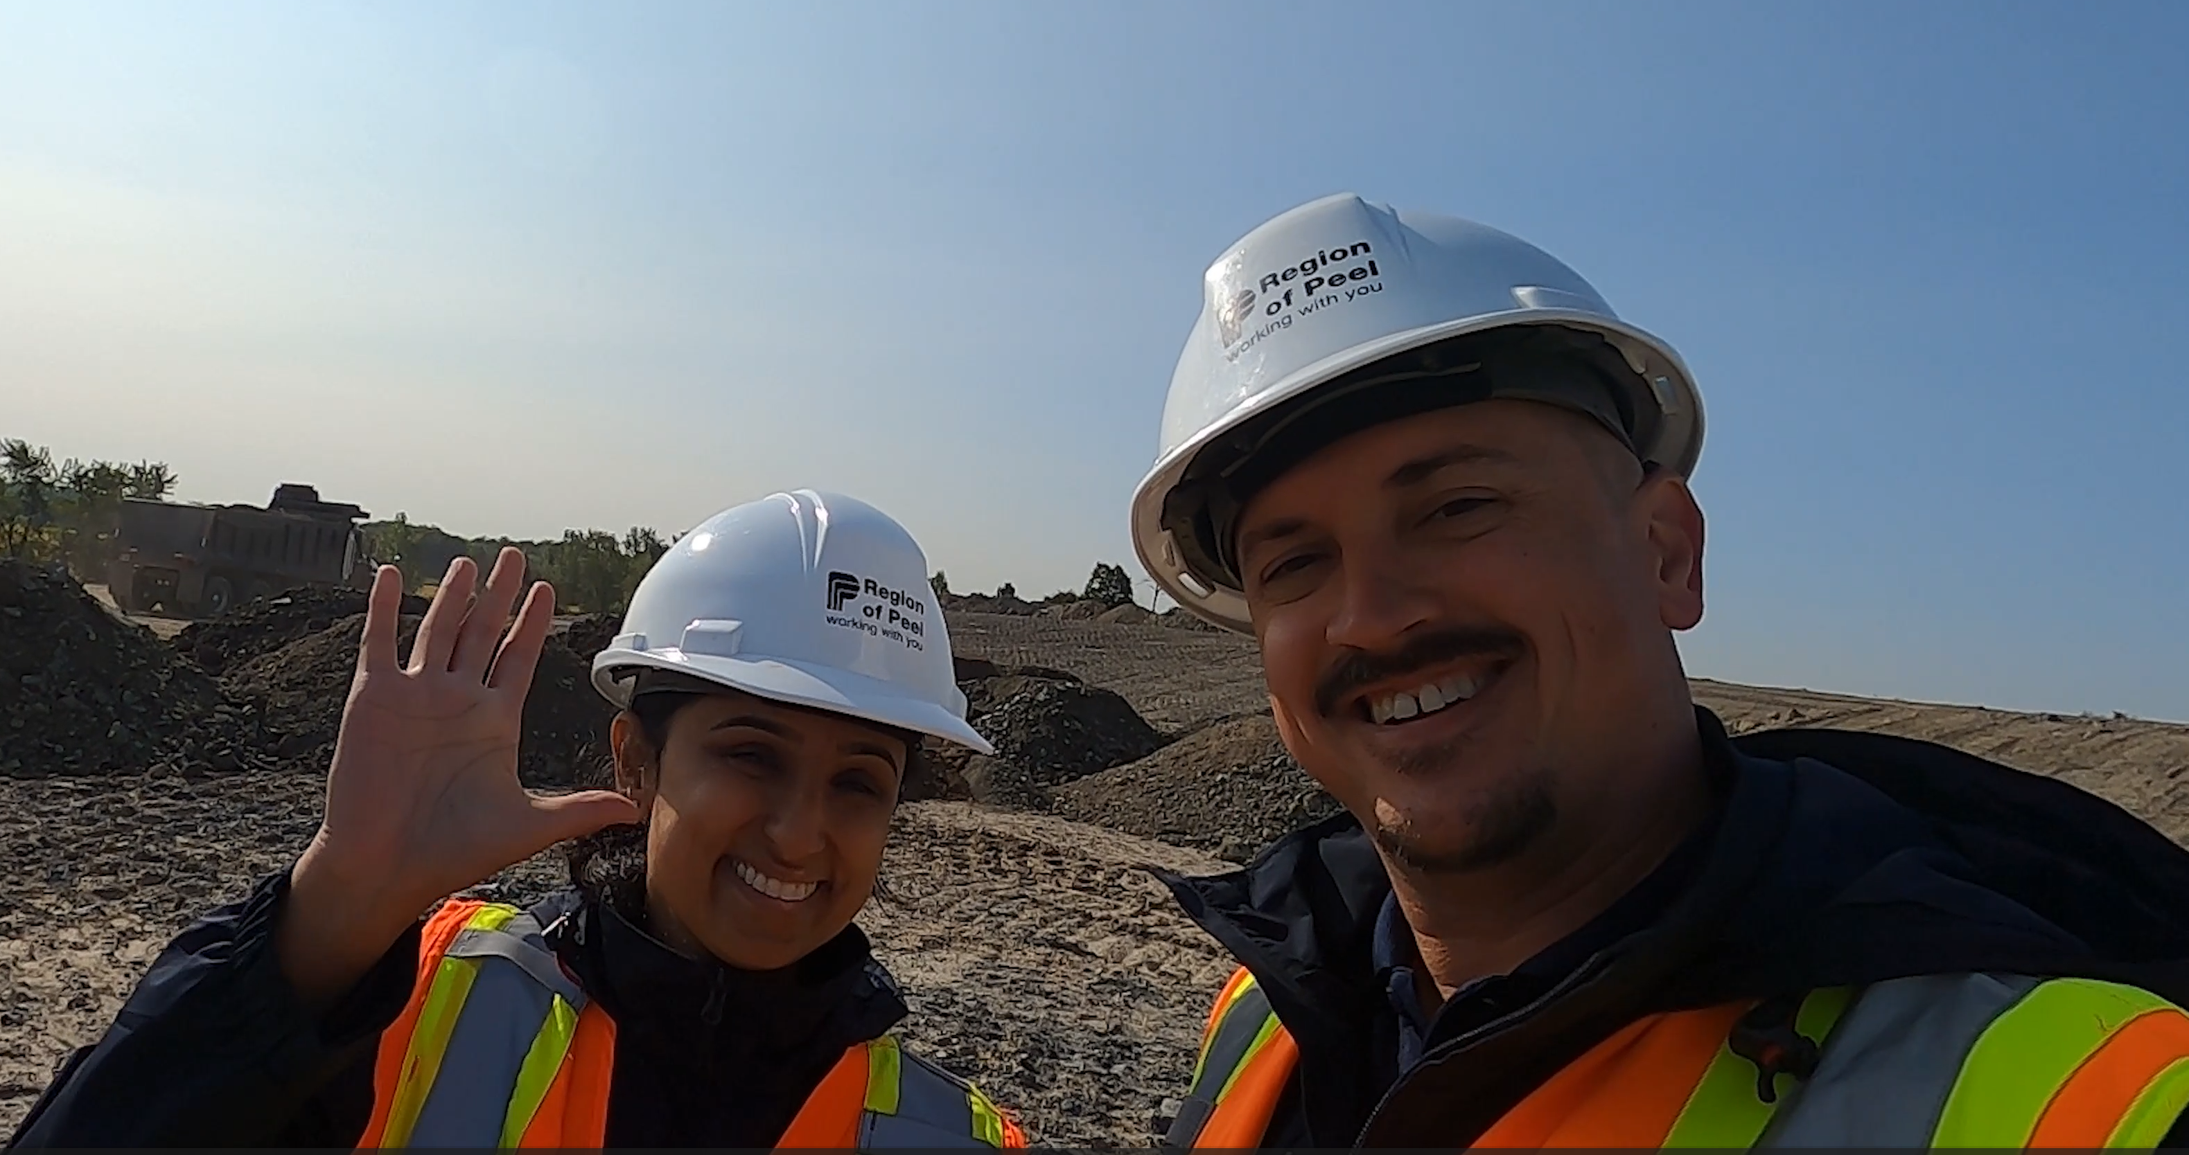
Strategic Framework- Concept to Completion
Strategic Site Repurposing
  Leveraged a former landfill into an efficient soil receiving facility
  Created integrated value by supporting future Peel composting capacity expansion
  Reduced dependency on external commercial disposal sites
Efficient Soil Management
  Achieved significant transportation cost reductions and environmental benefits
  Maximized beneficial reuse of clean excess soils through circular management
Rigorous Project Oversight
  Implemented strong governance frameworks ensuring full accountability
  Maintained comprehensive risk mitigation throughout project execution
Template for Future Success
  Established a replicable template for future excess soil management projects
  Created standardized protocols for regional soil reuse initiatives

Slide 12
Lessons Learned
  Enhanced Site Maintenance Protocols
  Implemented frequent road sweeping and driveway maintenance to control dust and mud accumulation
  Performed asphalt paving repairs to address surface wear and ensure access reliability
  Rigorous Quality Assurance Measures
  Conducted due diligence, weekly on-site soil sampling to maintain quality standards
  Performed regular slump testing to monitor soil consistency and moisture content
  Proactive Stakeholder Engagement
  Maintained quarterly liaison committee meetings for community updates and concern resolution
  Established continuous driver communication protocols to minimize operational disruptions

Slide 13
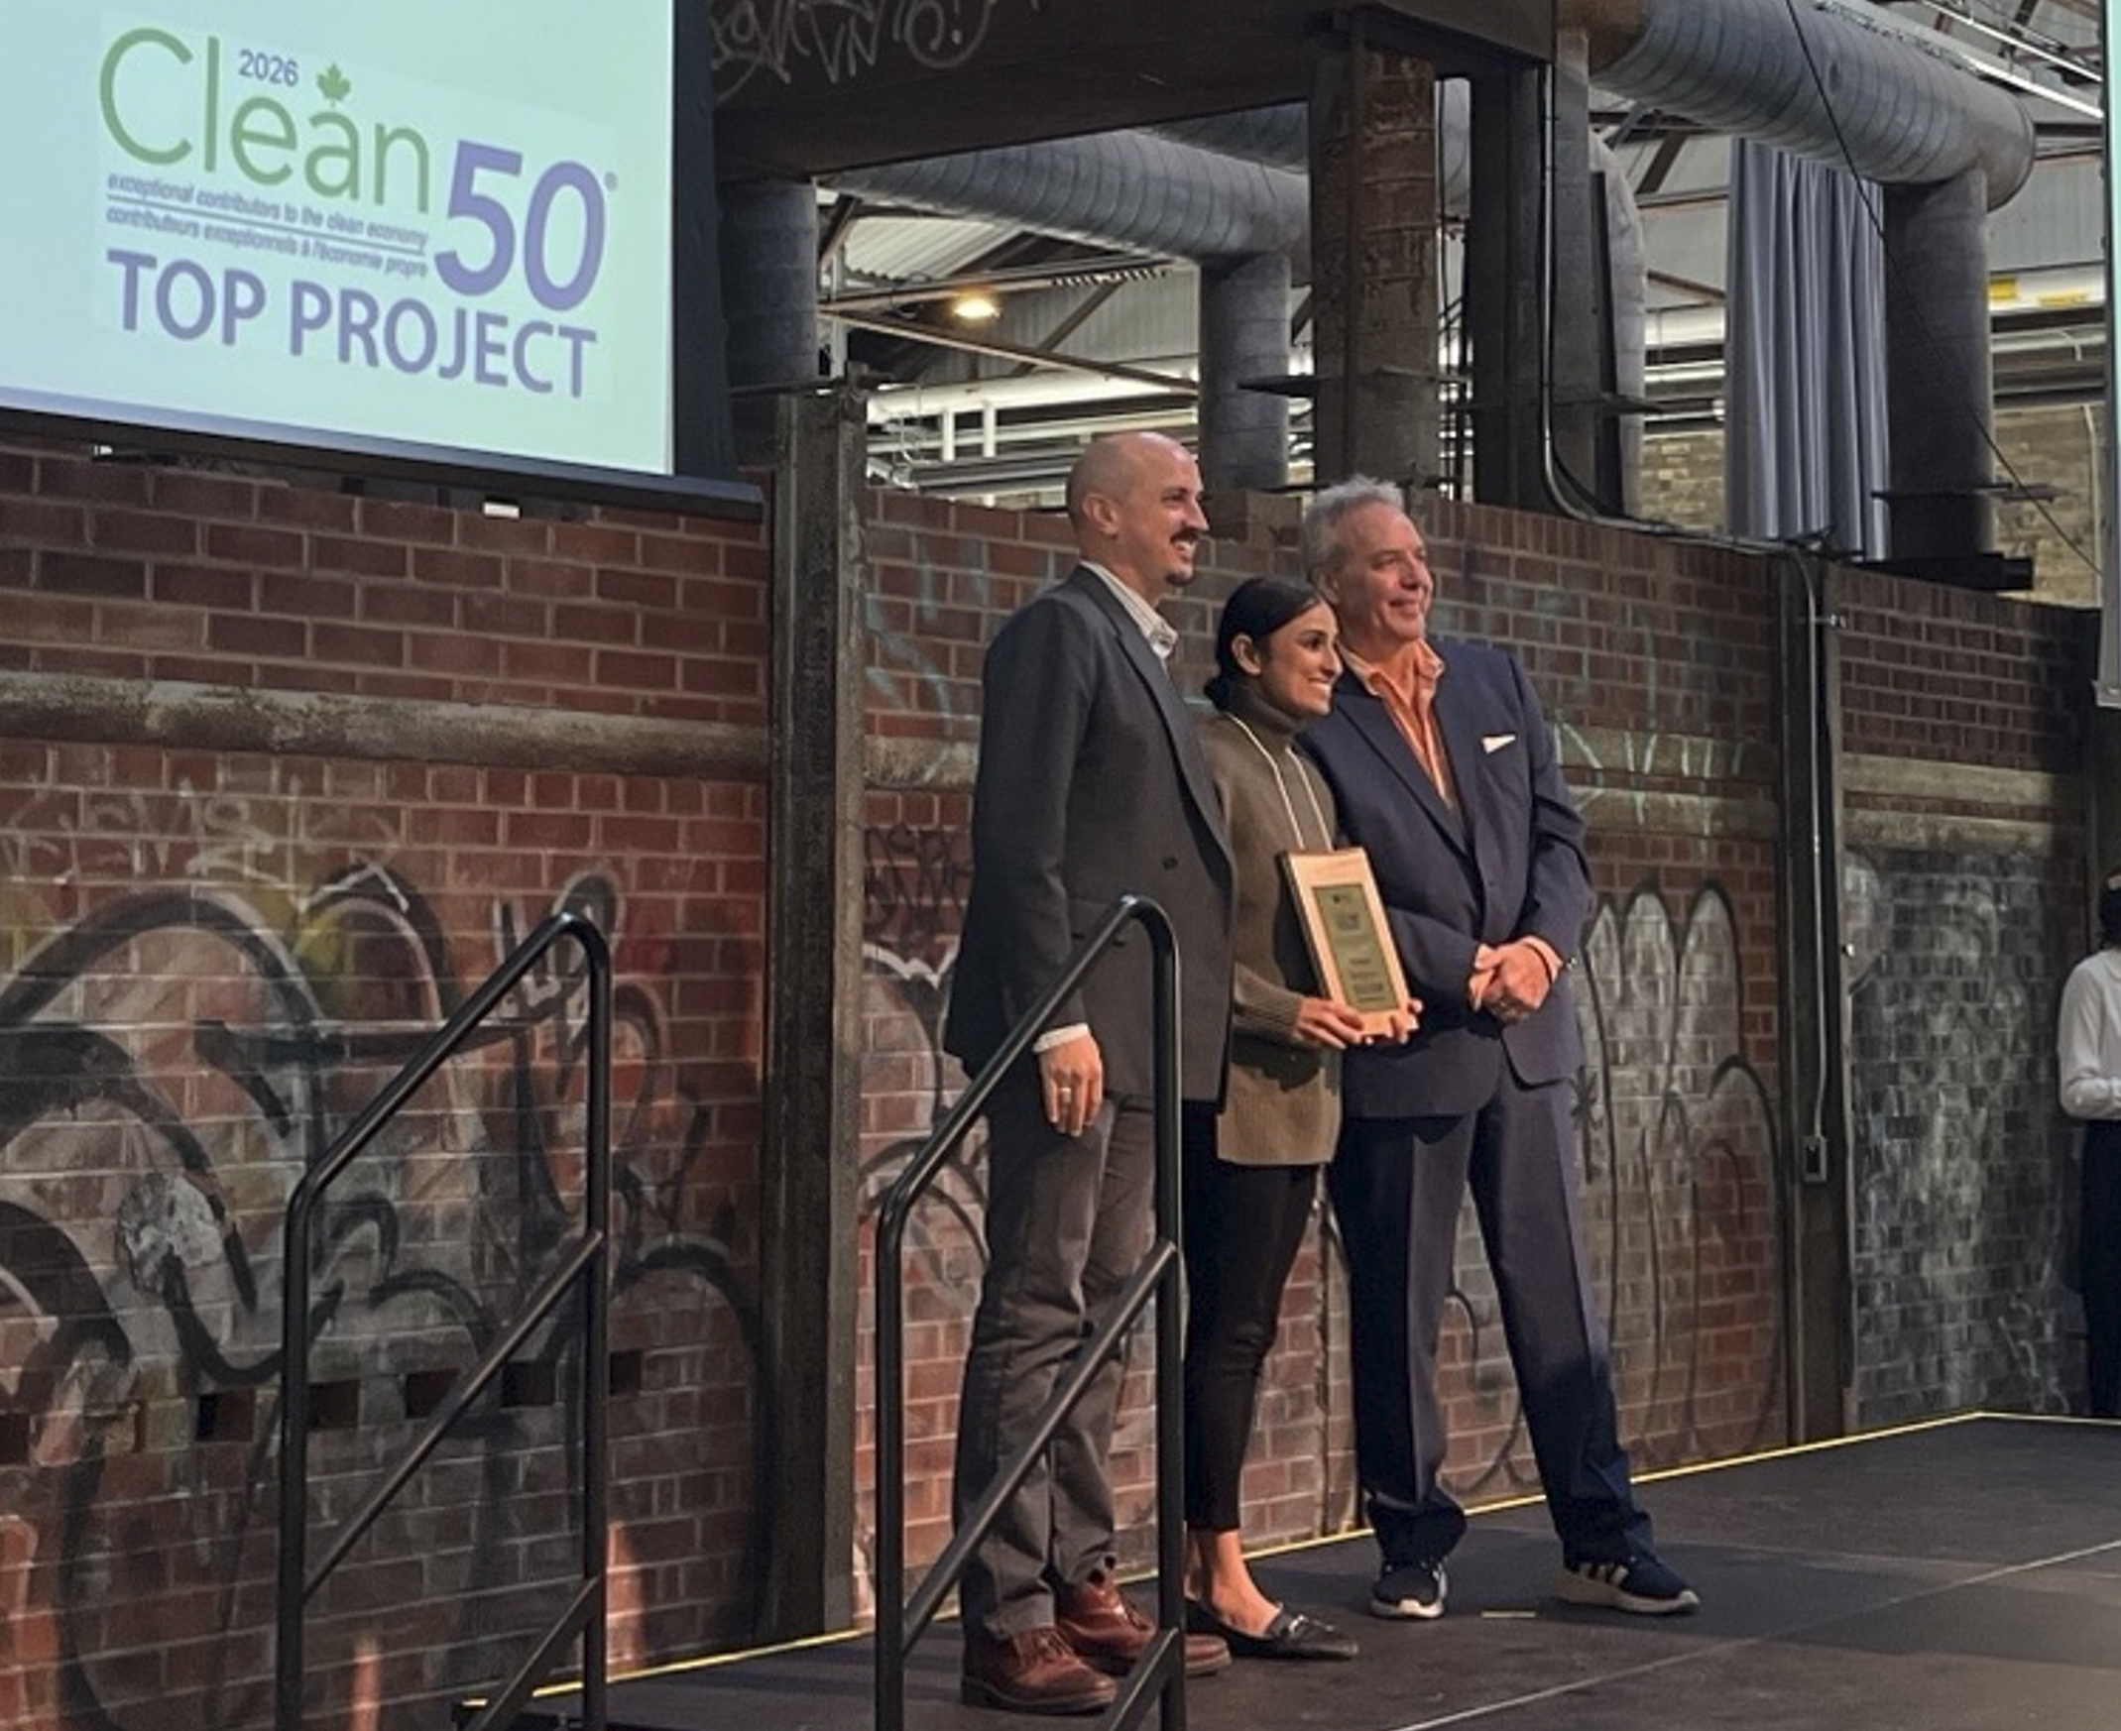
Strategic Framework- Awards & Recognition
Peel Celebrates – Climate Action Innovation Award
Clean 50 – 2025 award winner
Environmental Journal – Brownie Award Nominee 2025

Slide 14
Thank you!
Questions?
Harinder Singh, P.Eng., QP_{ESA}
Environmental Advisor, Engineering Technical Services
Operations Support Division, Public Works
Region of Peel
Harinder.Singh@peelregion.ca
Ryan Grzesiak, B.A.
Environmental Advisor, Engineering Technical Services
Operations Support Division, Public Works
Region of Peel
ryan.grzesiak@peelregion.ca

