Slide 1

PFAS Projects: Where to Start?
A consultant's journey when starting a PFAS project
Thomas Honey MEB, P.Eng.
RemTech East - April 9, 2026

Slide 2
Objective & Agenda
Objective
Using a real-world case study, an active military base in Nova Scotia, we will discuss the initial steps a consultant takes to begin a base-wide PFAS assessment to manage risk.
Who is this for?
Asset managers/property owners
Contractors
We Will Cover
Project Background
The Players
First Steps
The Investigations
Painting the Picture
Looking Ahead
Conclusion

Slide 3

Project Background
Active military base in Nova Scotia
  Asset Manager: DND
PFAS sources include: FFTA and various records for fire training activities, aircraft and firefighting equipment maintenance, burn pits, landfills – AFFF use from ~1970’s to ~1990’s
PFAS []’s first detected in 2017
Following isolated PFAS sampling from 2017-2020, DND decided to implement a site-wide approach in 2021

Slide 4
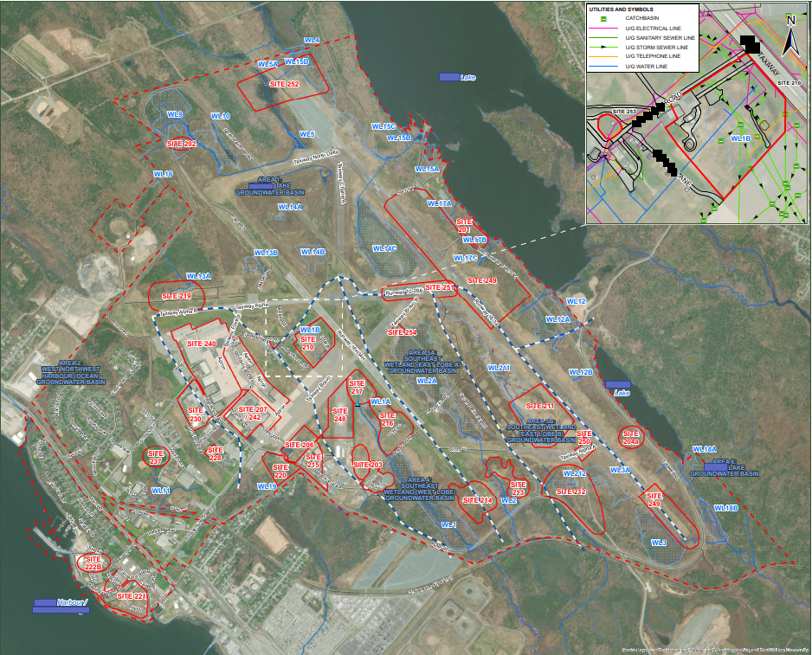
Project Background

Slide 5



The Players
ESA Engineers & Scientists
Hydrogeologists & Hydrologists
Risk Assessors
The Solutions People
The Problem Solvers
The Water People
Primary Responsibilities
Field Work and Delineation
Database creation
Remedial Strategies and Design
Primary Responsibilities
CSM development
Establishment of ‘Catchment Areas’
Contaminant Flow model
Water Balance and volumes
Primary Responsibilities
HHERA and Problem Formulation
Receptor identification and Risk CSM development
Site-specific target levels

Slide 6
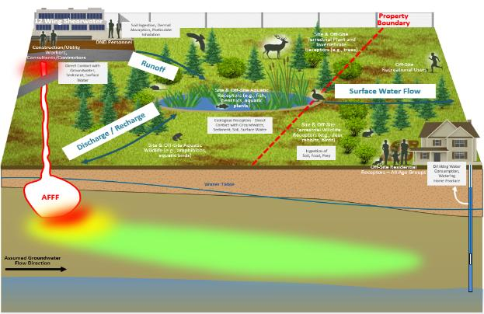
First Steps
Long-term Workplan Development
What is the scale of the problem?
What are potential solutions and tools?
Roadmap and schedule for navigating FCSAP 10-Steps
  Projections for ~4 years
Well Database Creation
What PFAS data do we even have?

Slide 7
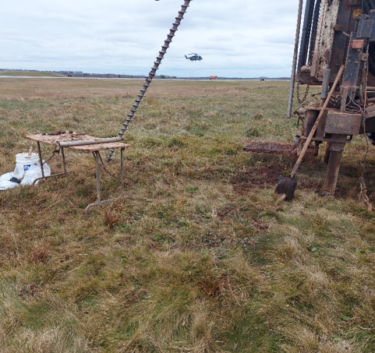
The Investigations
Detailed Testing Programs
6 field investigations over 2 years
~40 MWs and 10 MPs installed; over 700 MWs monitored; over 350 soil, GW, SW and Sed samples collected and analyzed for PFAS
  Includes 9 ‘Golden Spike’ MWs installed
Surface and stormwater outfall assessment
K-testing and datalogger installations
Storm system, utilities and dewatering system assessments
LIDAR survey for surface water runoff

Slide 8
Painting the Picture
Hydrological/Hydrogeological CSM
Risk-Based CSM
Where is the water going?
  Creation of 6 ‘Water Basins’
  Primary PFAS movement through surface water/runoff movement and storm system
What/how much is moving?
  Water Balance for each basin (GW & SW)
  PFAS Trend Analysis – plume stability (PFPeA, PFHxS, ƩPFAS)
  PFAS Profiles – determining sources of PFAS contamination
Who/what may be affected?
  Surface water/runoff for human and eco receptors
Max PFAS concentrations
  FFTA (no surprise)

Slide 9
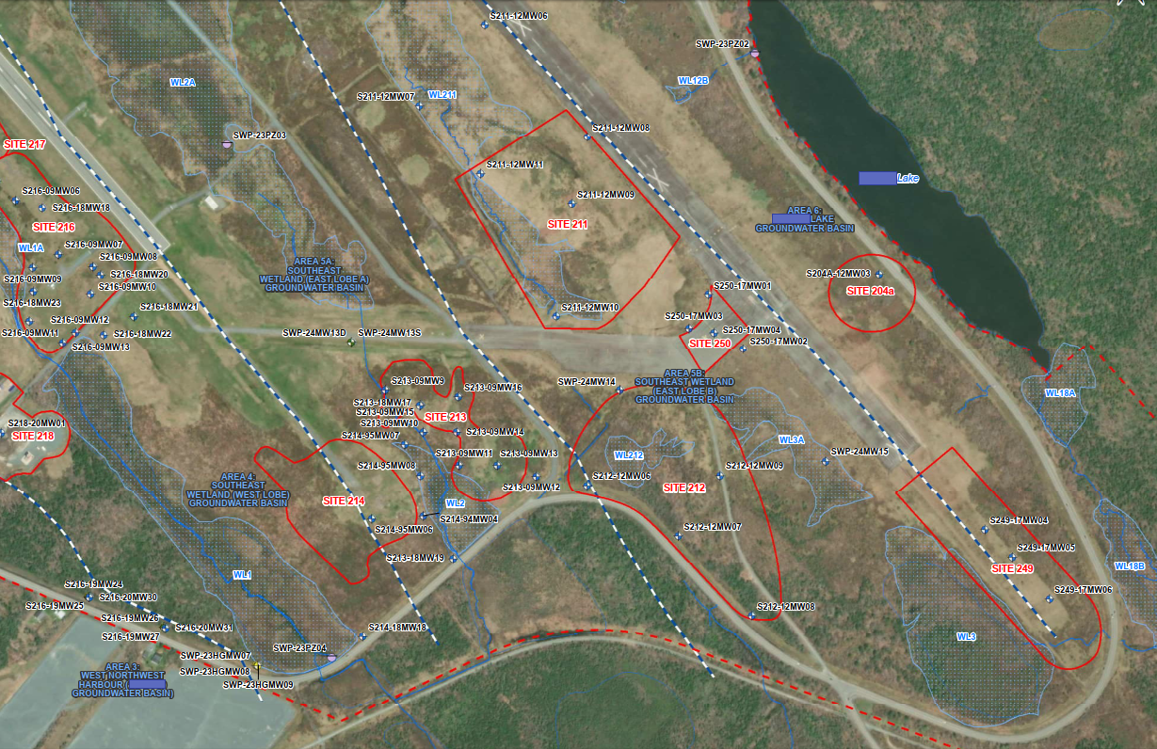
Painting the Picture – Water Basins

Slide 10
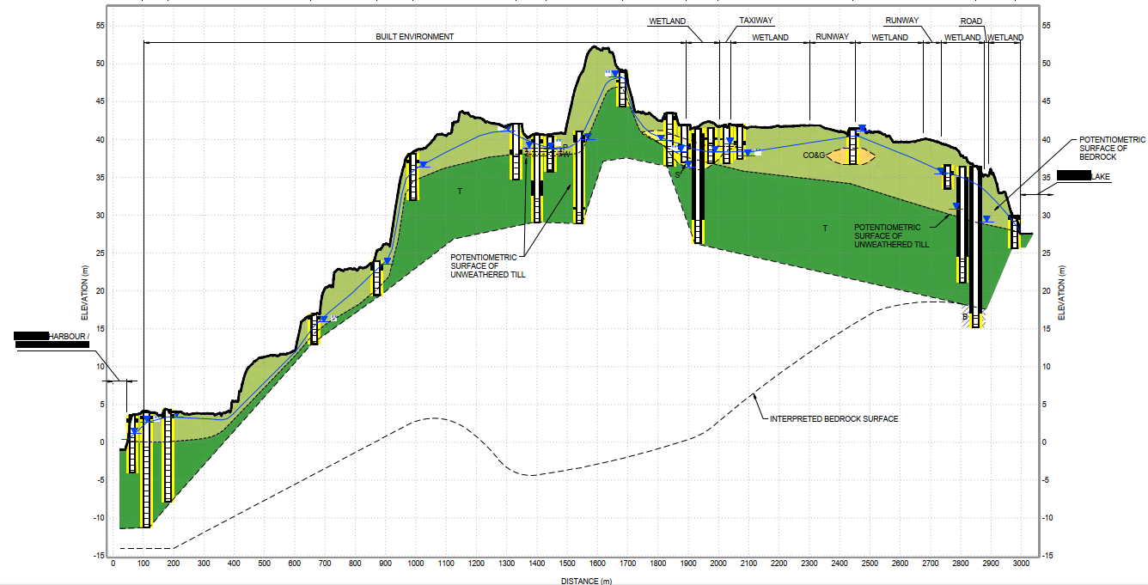
Painting the Picture – Site Cross Section

Slide 11
Painting the Picture – Hydro-G CSM

Slide 12
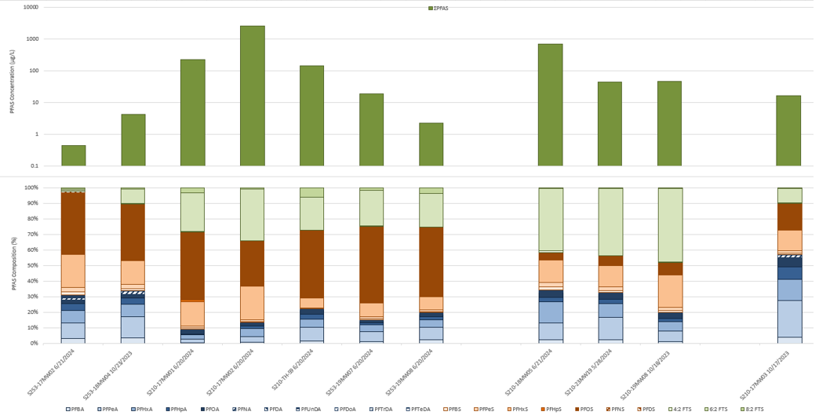
Painting the Picture – FFTA PFAS Profile

Slide 13
Looking Ahead – High-Level Action Items
Complete the Contaminant Flow Model
  Complete surface/stormwater drainage review
  Complete GW/stormwater to surface water connectivity investigations
Additional Detailed Testing Programs
  Complete necessary delineations/off-site work following CFM
Problem Formulation and HHERA
ROA and Remedial Design
  Execute targeted remediations, as needed (e.g. risk from []’s in FFTA)

Slide 14
Conclusion
Make a Plan
  Develop a roadmap before diving in
  PFAS projects will go nowhere without a quality CSM!
Assemble the right experts
No ‘quick’ solutions
  Work outlined here took ~4 years (continuous)
  Recommended additional work BEFORE potential remediation, ~1-3 years
Budget Considerations
  High six-figures per year ($$$$)

Slide 15
Do you have any questions?

Slide 16

Thomas Honey
Sr. Environmental Engineer & Project Manager
M 1-416-668-4305
E thoney@slrconsulting.com

