Slide 1
Occurrence of 6PPD-quinone in Environmental Waters
Egemen Aydin, Ph.D.

Slide 2
Outline
Introduction
  Background information
  Sources, fate and transport of 6PPD and 6PPD-quinone
  Exposure routes
  Environmental Impact of 6PPD-quinone
Analytical method
Occurrence in environmental waters
AGAT monitoring study
Regulatory landscape
What’s next?
Occurrence of 6PPD-quinone in Environmental Waters
Notes:
A quick overview of what we will be discussing:
Background information
Sources, fate and transport of 6PPD and 6PPD quinone
Exposure routes
Environmental impacts of 6ppd-quinone
Analytical measurement technique used
Occurrence in environmental waters
Regulatory landscape
What’s next?

Slide 3
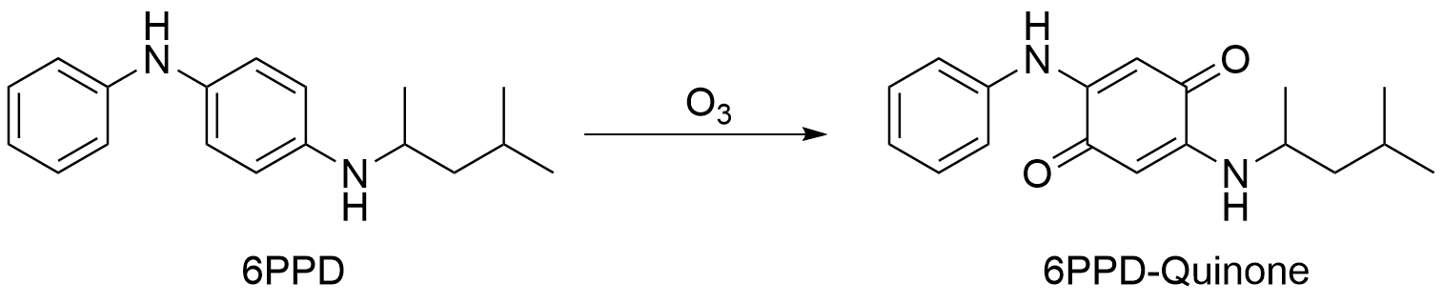
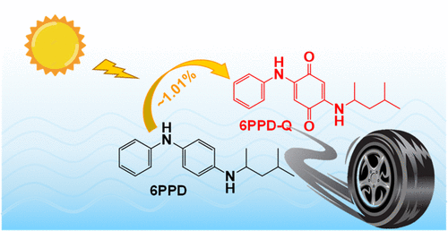
What’s 6PPD-quinone?
6PPD-quinone
  Transformation product of 6PPD
6PPD
  Used for stronger and more reliable tires
Source: US Tire Manufacturers Association
Source: Zhou et al., 2023
Occurrence of 6PPD-quinone in Environmental Waters
Notes:
What is 6ppd Quinone? 6PPD-q is not an intentionally produced compound but a byproduct of commonly used chemical called 6PPD (N-(1,3-dimethylbutyl)-N’-phenyl-p-phenylenediamine).
6PPD is a stabilizing additive used to make stronger more reliable tires, it’s found a levels of 0.4-2% in tires which is actually quite high. The main pathway to produce 6PPD-quinone is the reaction of 6PPD with ozone in the air. Another formation route is exposure to Sunlight, this type of induced transformation produces a 1% yield of 6PPD Quinone.
6PPD has a low water solubility but short half life (couple hours when in neutral water). 6PPD-Q has a high solubility making it highly mobile, it is also more toxic and more stable than just 6PPD.

Slide 4
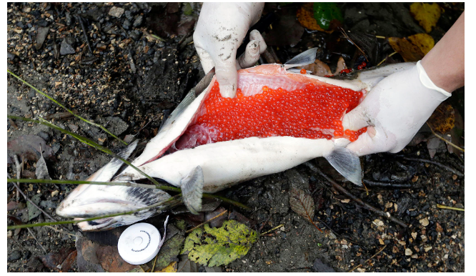
Background information
Symptoms associated to “urban runoff mortality syndrome” as far back as 1999
Mysterious high mortality rates of salmon before spawning eggs
Symptoms like:
  Disorientation
  Gasping at surface
  Death within hours of entering urban streams
  Retaining ocean color
No disease or pathogens
Source: AP Photo/Elaine Thompson
Occurrence of 6PPD-quinone in Environmental Waters
Notes:
A little bit of background, it started with the unexplained salmon deaths before spawning eggs. These symptoms were associated to urban runoff mortality syndrome and dated back to 1999.

Slide 5
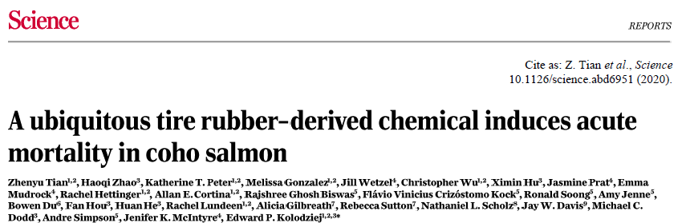
Discovery of 6PPD-quinone
6PPD-quinone
Occurrence of 6PPD-quinone in Environmental Waters
Notes:
A group of scientists were tasked to solve these mysterious salmon deaths and in doing so they discovered 6PPD-quinone and that it can be very toxic to coho salmon.

Slide 6
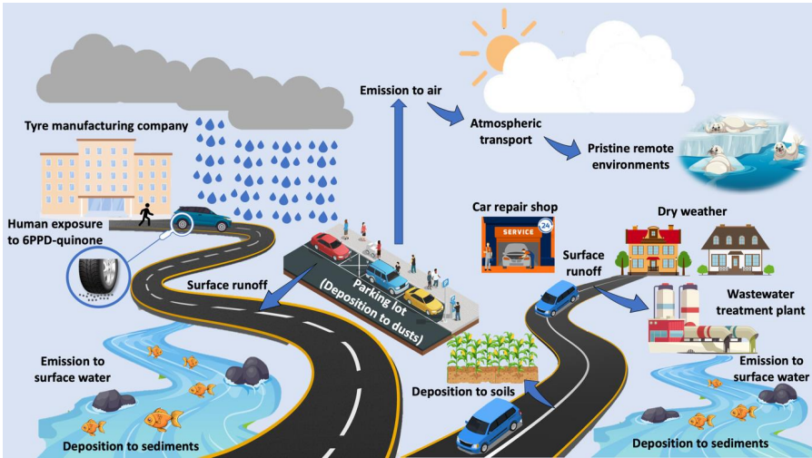
Fate, transport and exposure routes
Source: Nicomel and Li, 2023
Occurrence of 6PPD-quinone in Environmental Waters
Notes:
6PPD is heavily used in the tire industry to extend the useful life of tires as well as improve their performance. 6ppd-quinone is unfortunately highly soluble in water so when it is released into the environment via surface runoff from highways and roads if can easily dissolve and travel throughout our ecosystem. Thus the monitoring of environmental waters is an emerging concern. We can quantify 6PPD quinone at trace levels in surface water, surface runoff, groundwater, drinking water and waste water samples.

Slide 7
Environmental impact
First findings in 2020
Revised toxicity in 2022 with pure chemical
NOEC = 34 ng/L
Occurrence of 6PPD-quinone in Environmental Waters
Notes:
Initial findings in 2020 with in-house standards indicated 0.8-1.5 ug/L LC50. (LC 50 is short for Lethal concentration 50, used to quantify exposure concentration of toxic substance lethal to half of test animals.
Toxicity studies done with commercial standards in 2022 this yielded an LC50 value of = 95 ng/L and NOEC = 34 ng/L. The NOEC is the no observed effect concentration.

Slide 8
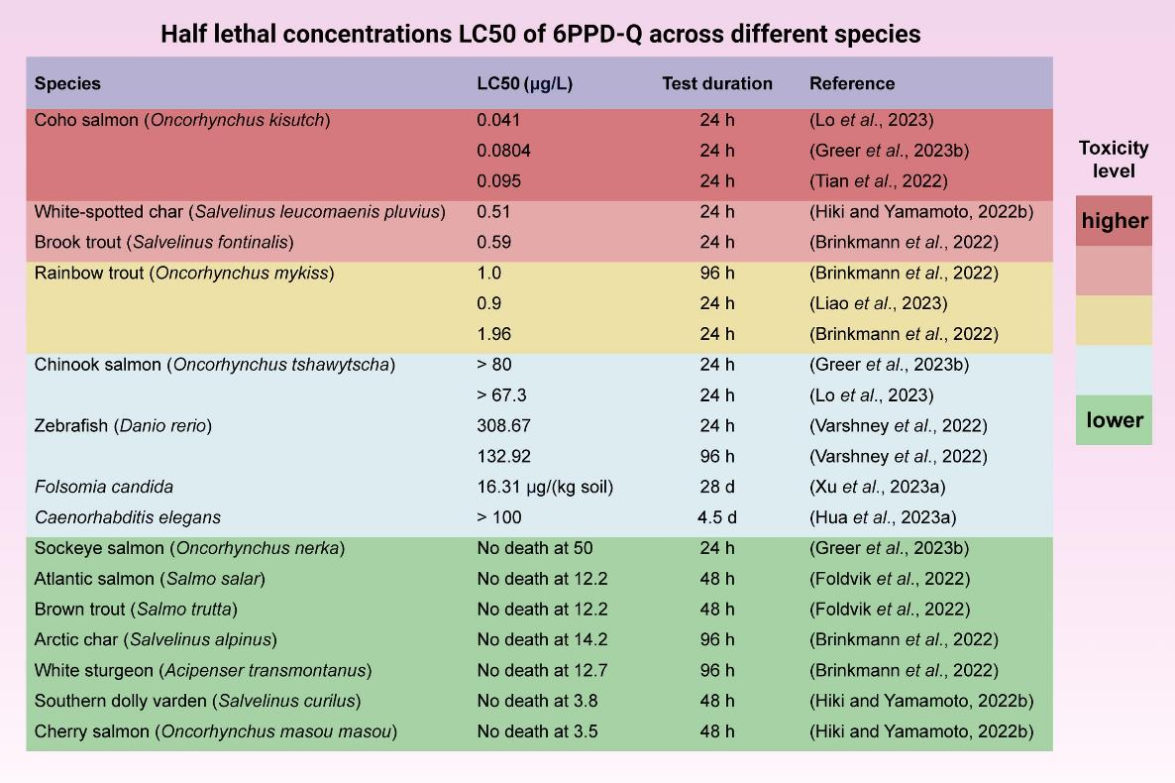
Environmental impact
Source: Jiang et al., 2024
Occurrence of 6PPD-quinone in Environmental Waters
Notes:
Research continued and different responses for different fish species were observed. As you can see the toxicity level was still quite high for Coho salmon.

Slide 9
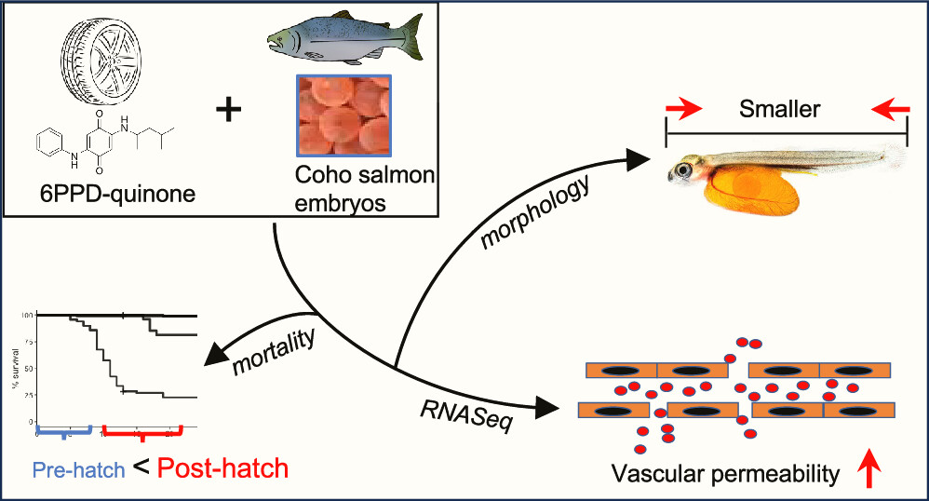
Environmental impact
Source: Greer et al., 2023
Occurrence of 6PPD-quinone in Environmental Waters
Notes:
From the research that was completed it was apparent that 6PPD-Quinone induces mortality, morphological changes and transcriptionally disrupts vascular permeability.

Slide 10
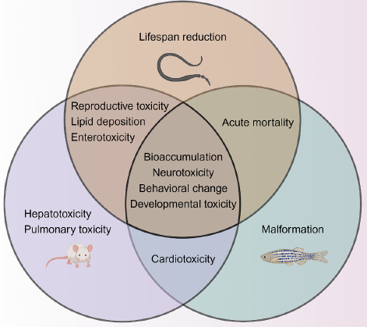
Environmental impact
Source: Jiang et al., 2024
Occurrence of 6PPD-quinone in Environmental Waters
Notes:
This image outlines that different responses may be observed for different organisms. These results can range from: bioaccumulation, neurotoxicity, behavioral changes, malformation, lifespan reduction, acute mortality, etc.

Slide 11
Method Development & Validation
We have extensive quality assurance and quality control criteria that are followed when a method is developed.
Performance parameters such as:
    Method detection limits
    Accuracy
    Precision and recovery values
  Are calculated to determine if validation results meet our performance limits.
The EPA draft method was not available when our development started so internal corporate criteria were used during setup.
Validated EPA 1634 Draft and started to use it after publication.
Occurrence of 6PPD-quinone in Environmental Waters
Notes:
With the environmental impacts and growing need for this analysis we decided to proceed with the development and validation of the method.
We have extensive quality assurance and quality control criteria that are followed when a method is developed.
Performance parameters such as: method detection limits, accuracy and precision and recovery values are all calculated to determine if the validation results meet our performance limits. When our method was being developed the draft method was not available at that time so our internal corporate criteria (which is often times more stringent than EPA guidelines) was used during the setup. We go through multiple sets of spikes at varying levels to verify our analysis range. These results are tabulated and levels of detection are established.

Slide 12
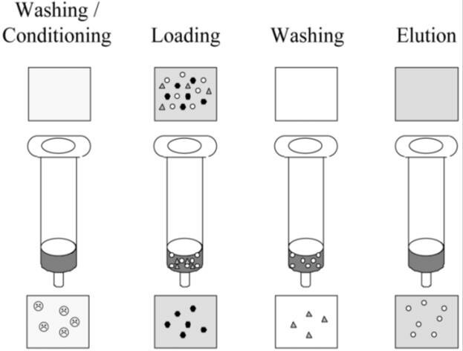
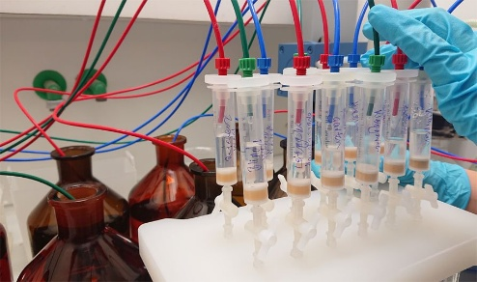
Analytical method
Developed in 2021 by AGAT with custom synthesized standards
Currently complies with EPA 1634 draft with commercially available standards
Sample:
250 mL in glass bottles
Hold time: 14 days
Spike surrogate
Solid phase extraction
Spike ISTD
Analysis by LC-MS/MS
Occurrence of 6PPD-quinone in Environmental Waters
Notes:
The method was developed back in 2021 back then with custom synthesized standards as that was all that was available at the time.
Now all the standards are commercially available. This test requests a 250 mL sample volume in a glass container and has a hold time is 28 days. Samples are to be sent cold with no preservative required. We offer 11 – 15 day regular TAT with 7 – 10 day and 5- 6 day rush options.
Solid phase extraction is done using mixed mode cation exchange cartridges (MCX cartridges). Analytes are eluted with an ammonium hydroxide solution and run by LCMSMS.

Slide 13
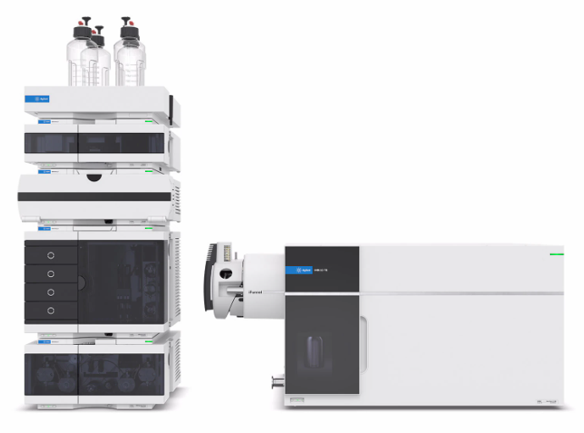
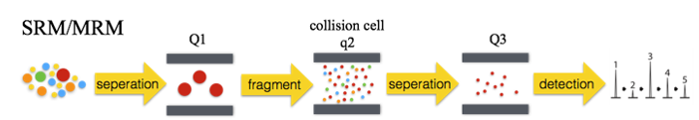
Analytical Method
Tandem quadrupole liquid chromatography mass spectrometry (LC-QQQ, LC-MS/MS, LC-TQ)
Multiple Reaction Monitoring
Enhanced selectivity and sensitivity
Source: Agilent Technologies
Occurrence of 6PPD-quinone in Environmental Waters
Notes:
This brings us to instrumentation, we used LCMSMS instrumentation for this analysis which is also known as tandem quadrupole liquid chromatography mass spectrometry. There are several different acronyms that users use for this: LC-QQQ, etc.
This technique uses Multiple Reaction Monitoring (MRM) transitions. So what happens is selected ions (which are the precursor ions) make it through the first quadrupole and then into the collision cell. They are then fragmented and directed into the second quadrupole which result in product ions which we obtain results for. The two quadrupoles act as mass filters which make this instrumentation highly selective and very sensitive.

Slide 14
Analytical method
Isotope dilution quantification
  Ultimate accuracy with surrogate recovery correction.
  Mitigation of matrix effects and sample preparation inefficiencies.
2 different Isotopically labeled 6PPD-quinone for surrogate and internal standard.
Wide linear range (1 - 500 ng/L)
6PPD-quinone
d₅-6PPD-quinone
299.2 -> 241.1
, 299.2 -> 215.1
…
a
x10
2
Ratio = 93.8 (93.9 %)
d
n
u
1
b
¹³C₆-6PPD-quinone
A
0.75
e
v
i
0.5
t
a
l
e
0.25
R
0
4.4
4.6
4.8
5
5.2
5.4
5.6
5.8
6
6.2
Acquisition Time (min)
Occurrence of 6PPD-quinone in Environmental Waters
Notes:
Isotope dilution is used for the quantification of results.
Why is this important for analysis? In analytical chemistry we use these isotopically labeled standards as surrogates or internal standards to correct for variations in sample preparation and instrument conditions. They can correct for matrix effects and ion suppression/enhancement in mass spectrometry. This better enables us to provide enhanced reliability since these isotopically labeled standards mimic the behavior of the target compounds during analysis. Resulting in higher accuracy and reproducibility of our results making it a suitable choice for complex matrices.
We use two different isotopically labelled 6PPD-quinone standards for our surrogate and internal standard. We have a wide linear range for our analysis which is from 1 – 500 ng/L (ppt).

Slide 15
Analytical method
Parameter | Value
MDL | 0.3 ng/L
Reporting Limit | 1.0 ng/L
Accuracy (n=10) | 97%
Uncertainty (n=10) | 6%
Reporting limit: 30x lower than NOEC
High accuracy and precision
Fast and environmentally friendly sample preparation
Experience with many samples
Occurrence of 6PPD-quinone in Environmental Waters
Notes:
The multiple spikes used in the validation of the method are tabulated and for this analysis we have a method detection limit of 0.3 ng/L (ppt)
We use a low sample size (50 mL) and have short run times allowing results to be available to clients quicker so they can make decisions sooner.
The AGAT developed method uses low solvent consumption which is more environmentally friendly when compared to other methods that are currently available. There is now draft EPA method 1634 that is available.
We have experience with many storm and surface water samples throughout the years since we have had this method available since 2021. We are one of the first labs to offer this analysis as part of a special project for a large consulting firm.

Slide 16
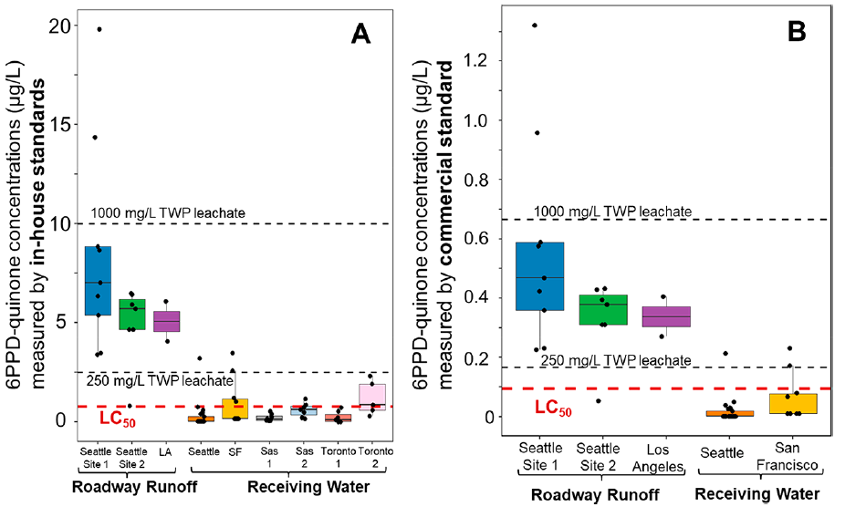
Occurrence
Source: Tian et al., 2022
Occurrence of 6PPD-quinone in Environmental Waters
Notes:
A quick look at the occurrences of 6PPD-quinone in different locations using in house standards versus commercial standard. Please note the units are ug/L which are ppb. Our method units are in ng/L (ppt)
As you can see the surface runoff has very high concentrations of 6PPD-quinone.
Whereas the receiving water concentrations are lower likely due to being diluted but it is possible to observe concentrations over LC50.

Slide 17
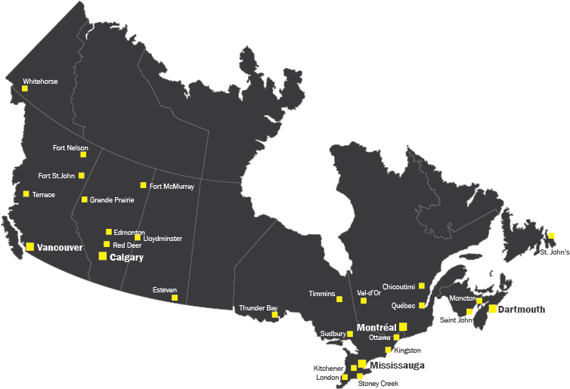
AGAT monitoring study
Snow melt
Surface runoff
River water
River water
Surface runoff
Snow melt
Snow melt
Surface runoff
Occurrence of 6PPD-quinone in Environmental Waters

Slide 18
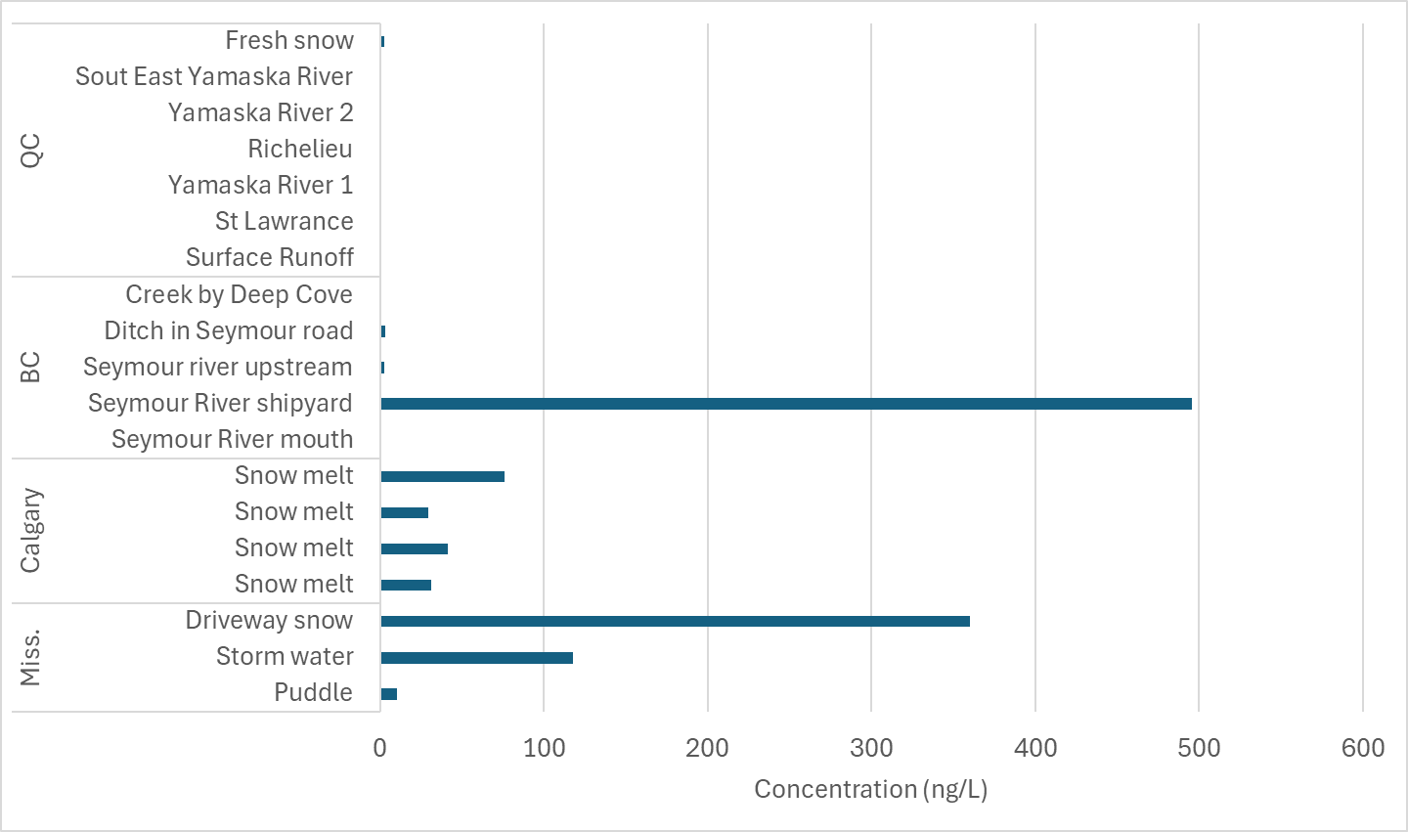
AGAT monitoring study
Occurrence of 6PPD-quinone in Environmental Waters

Slide 19
Regulatory landscape
EPA 1634 draft method
  Similar to AGAT in-house method
  SPE sample prep with LC-MS/MS detection
  Isotope dilution
EPA screening value: 11 ng/L
  1h average
  Exceedance of once in three years
WA aquatic life criteria: 12 ng/L
BC short term acute water quality guideline: 10 ng/L
Occurrence of 6PPD-quinone in Environmental Waters
Notes:
US EPA now has a draft Method 1634 for stormwater and surface waters. It is a performance based method which means the analyst can make changes to the method to improved performance as long as everything is documented and still meets or exceeds the specified limits within the 1634 method.
The draft method is very similar to the AGAT in-house method. It also uses SPE sample prep with LCMSMS detection and isotope dilution.
The EPA is working on developing screening values and a draft guideline of this is expected in 2024.
There are currently no regulations or guidelines in Canada. The US has a screening value for acute exposures of 6PPD-Q in freshwater as 11 ng/L that is generally meant to be protective of 95% of freshwater species potentially exposed to 6PPD-Q for short durations (1 hour or less).
Efforts to be made to understand the situation in Canada: UBC, USask, BC Env have been looking into this.

Slide 20
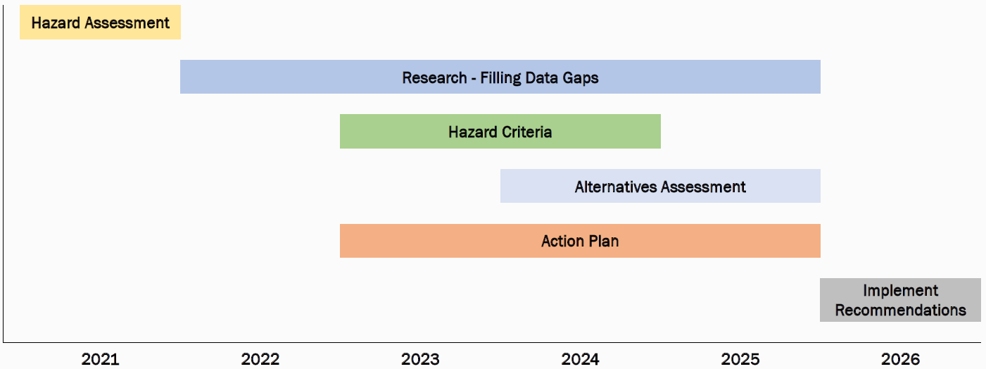
Regulatory landscape
Source: State of Washington, Dept. Ecology
Occurrence of 6PPD-quinone in Environmental Waters
Notes:
This is the State of Washington’s action plan for 6PPD-quinone. The blue area is where most of the focus is now so next steps can be taken.

Slide 21
What’s next?
Research is still at an early stage
Broader Canadian monitoring
Better understanding of atmospheric deposition
More data on environmental impact and exposure
  Different organisms
  Human health effects
  Risk assessment
Mitigation efforts
Source reduction
Remediation possibilities
Other transformation products of 6PPD
Occurrence of 6PPD-quinone in Environmental Waters
Notes:
What’s next:
Research is still at an early stage.
More data on environmental impact and exposure is needed.
Looking more in depth at the effects on different organisms
What human health effects are observed
Risk assessment
What mitigation efforts or options are available
Source reduction
Remediation possibilities
Other transformation products of 6PPD

Slide 22
Questions?
Egemen Aydin, Ph.D.
Senior Scientific Advisor
aydin@agatlabs.com
Occurrence of 6PPD-quinone in Environmental Waters

