Slide 1
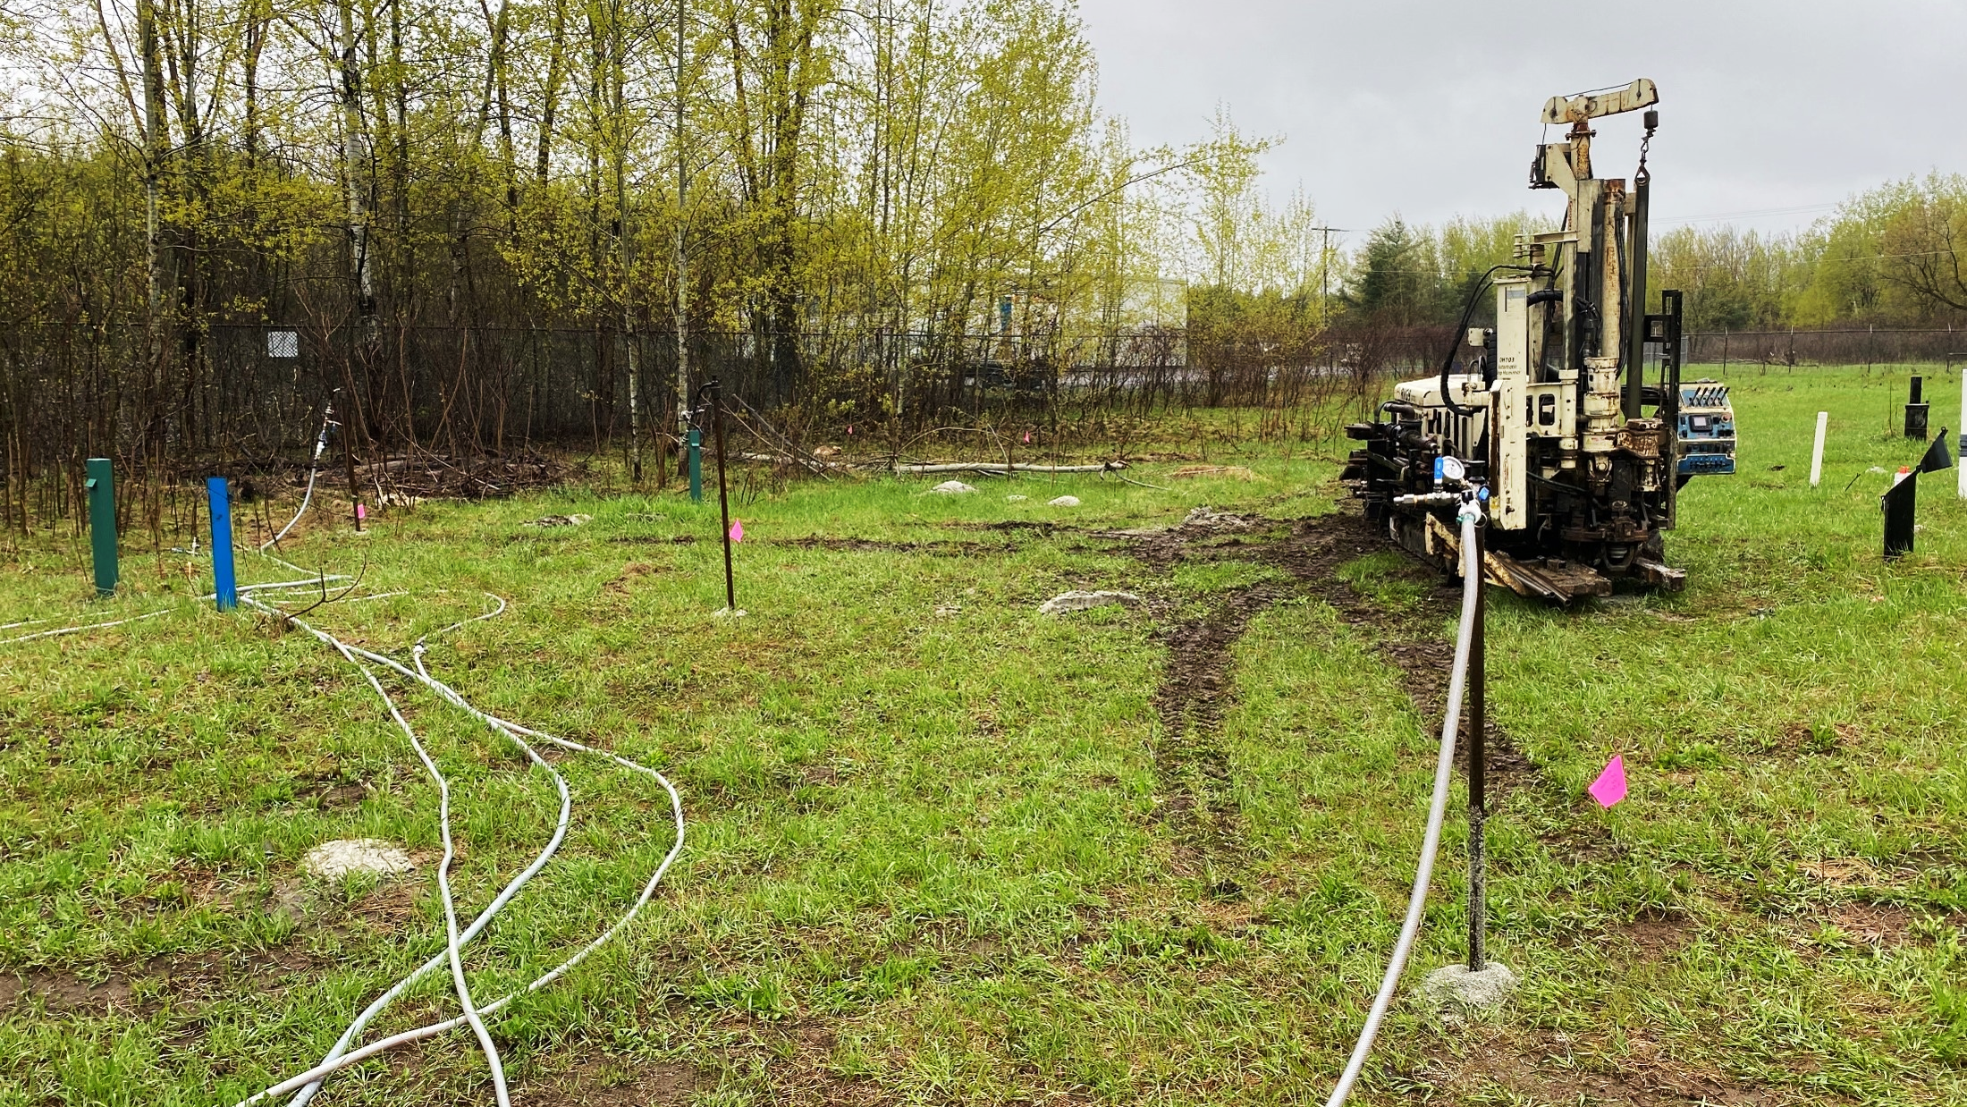

Case Study
The Use of Chemical and Biological Techniques to Remediate a cVOC Plume at a Former Landfill
Mitchell A. Davidson, M.A.Sc., P.Geo.
Notes:
Good morning, my name is Mitchell Davidson, I am an Environmental Scientist with Stantec Consulting, and today I will be presenting to you A Case Study:
The Use of Chemical and Biological Techniques to Remediate a cVOC Plume at a Former Landfill

Slide 2
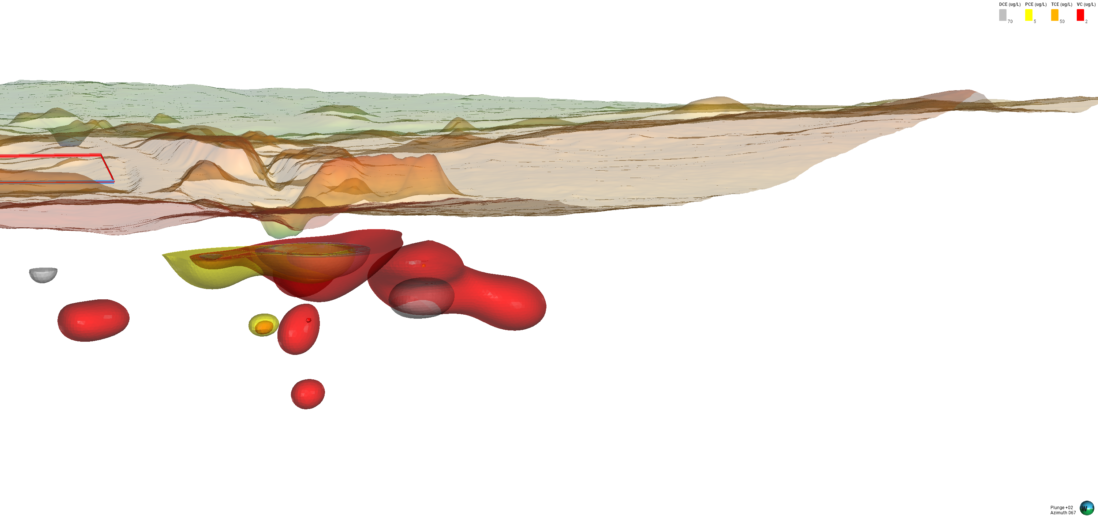
Agenda
Hydrogeological Background
Previous Remediation Efforts
Current Remediation Efforts
November 2025 GW Monitoring Results
Concentration vs. Time Plots
Approximate Plume Volume Reduction
Lessons Learned
Notes:
Say outline.

Slide 3
Hydrogeological Background
1

Slide 4
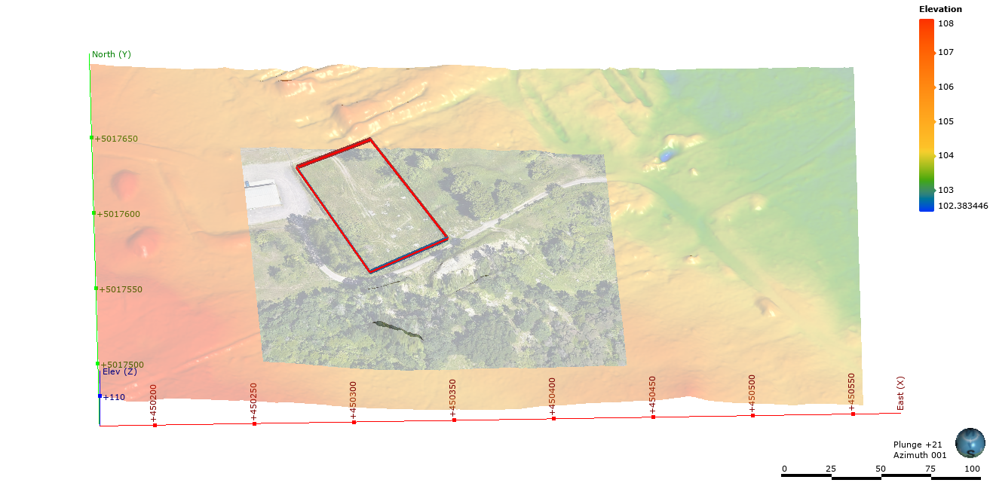
Notes:
For context, the former landfill encompassed a large area and accepted hazardous waste throughout much of its life. The hazardous waste was deposited in the fenced area outlined here in red referred to as the special waste compound. The focus of this presentation will be on the special waste compound and the plume connected to it.

Slide 5

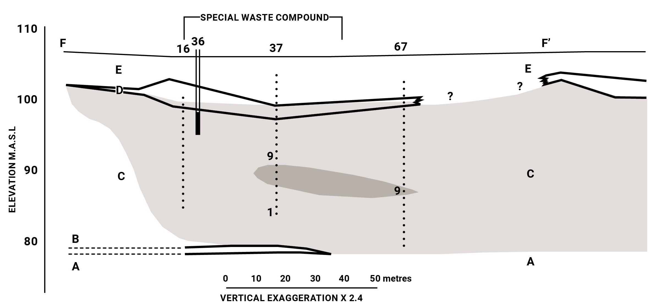
D
D
Limestone
Till Layer
Subaqueous Outwash
Stratified Clayey Silt & Silt
Regressional Sands & Gravels
Highly Reducing Zone
Anoxic Zone
Modified from Jackson et al., 1985
Notes:
For reference, I have a cross section, which slices through the southwestern corner of the special waste compound and is from the original Hydrogeological Research program, published by Jackson et al., in 1985. Five hydrostratigraphic units have been documented: Unit A is limestone; Unit B is a till layer; Unit C consists of poorly sorted gravels, sands, and silts interpreted as sub aqueous outwash; Unit D consists of discontinuous stratified clayey silts and silts; and Unit E consists of regressional sands and gravels. Of note is Unit D, which we have considered as a discontinuous leaky confining layer.

Slide 6
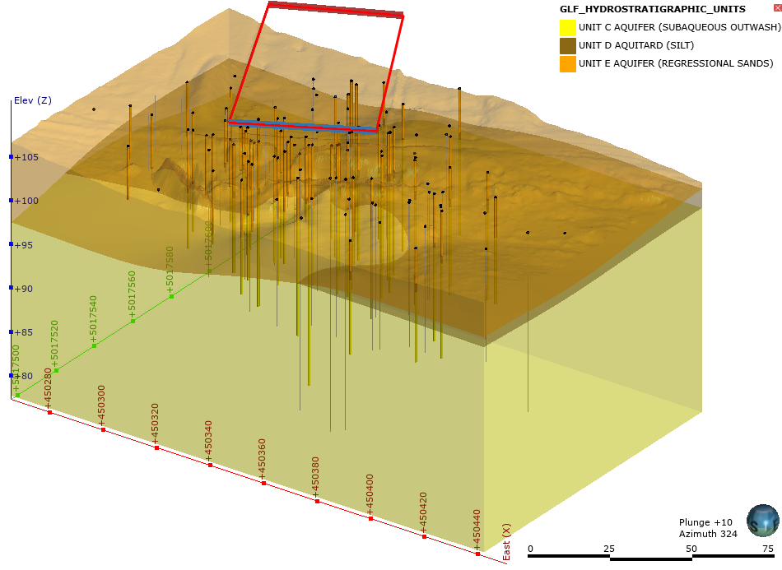
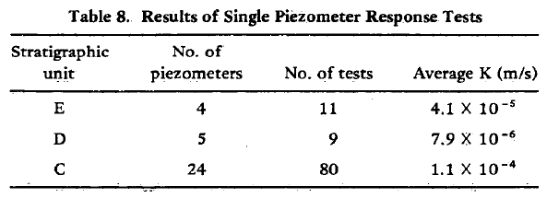
Overburden stratigraphy was characterized from past and current investigations
Focus on the lateral continuity and thickness of the confining layer (Unit D)
3D model updated with new information from each drilling program
Unit E
Unit D
Unit C
From Jackson et al., 1985
Notes:
Shown here, is our current geological interpretation in three dimensions. The geological interpretation is rooted in the original interpretation provided by Jackson et al.
The model has focused on the lateral continuity and thickness of the Unit D confining layer, as it can have a large influence over DNAPL migration. Of note are the hydraulic conductivities of Units C, D, and E, documented by Jackson et al., in 1985 identified in the table in the bottom left of this slide. Unit D has a hydraulic conductivity that is 1 to 2 orders of magnitude lower than the hydraulic conductivities of Units C and E.

Slide 7
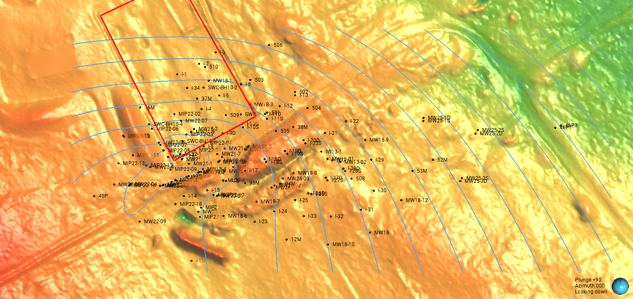
Notes:
The prevailing groundwater flow direction is predominately towards the east.

Slide 8
Previous Remediation Efforts
2

Slide 9
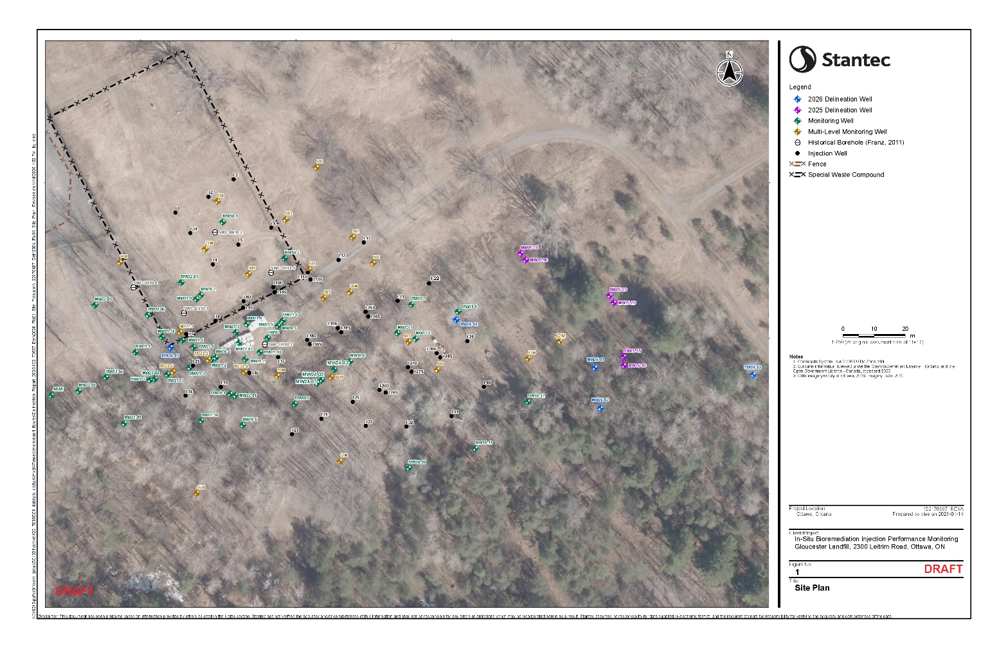
Risk Based Target Criteria (RBTC) & Bioremediation Pilot Study
Pilot Study Area
Chlorinated Ethene | Groundwater RBTC (µg/L)
Tetrachloroethene (PCE) | 5
Trichloroethene (TCE) | 50
cis 1,2 Dichloroethene (cis 1,2 DCE) | 70
Vinyl Chloride (VC) | 2
2003 RBTC values were established
2005/2007 RBTC values were updated
2013 pump and treat system was shut down
2014 pilot study for bioremediation was conducted
Previous consultant installed the injection wells in 2017
Previous consultant injected events 1 and 2 in 2019
Notes:
From the early 1990s until 2013, a pump and treat system was operated at the Site.
In 2007, the previous consultant finalized the Risk Based Target Criteria (RBTC) shown here for chlorinated ethenes. These values will be referenced throughout the remainder of the presentation, as they are what our cleanup efforts are aimed to achieve.
In 2013, the pump and treat system was shut down. Following the pump and treat system, a pilot study was conducted by the previous consultant in 2014, in which one injection well and two monitoring wells were installed in what was understood to be an area with relatively high PCE concentrations, downgradient of the source zone. The pilot study focused on establishing a microbial population of Dehaloccoccoides bacteria through the injection of an engineered mixture of the bacteria called a KB1 culture, which is produced by SiREM laboratories, and the co-injection of a substrate called EHC-L.

Slide 10

Notes:
Following the pilot study, the previous consultant installed the permanent injection wells intended to support the bioremediation efforts for the life of the project in 2017 and completed injection events 1 and 2 using a substrate of molasses into the injection wells in 2019. The understood radius of influence for injections was determined to be 3 – 5 meters at that time.

Slide 11
Current Remediation Efforts & Progress
3

Slide 12
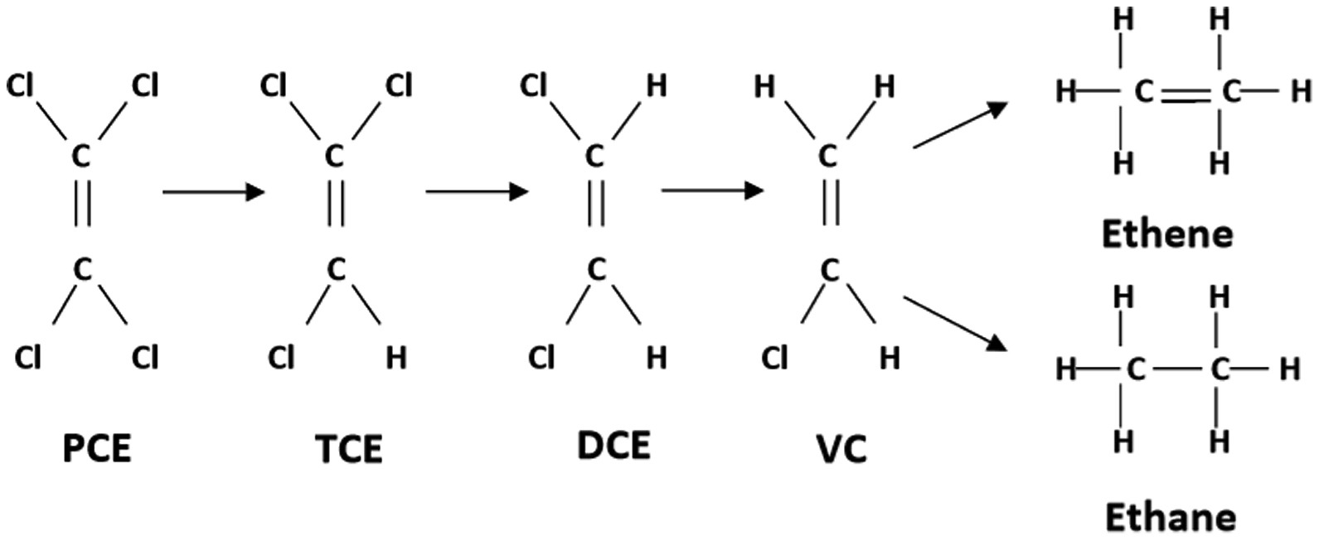
From Saiyari et al., 2018 (https://doi.org/10.1016/j.serj.2018.01.006)
Notes:
Shown here is the simplified degradation pathway. As many of you may know, with the bioremediation techniques applied, PCE will sequentially degrade to TCE, followed by DCE and VC, then finally to ethene, a non-toxic end product.

Slide 13
Year | Injection Events (MSSIE/LSSIE) | Consultant | Injection Substrate(s) | Key Changes
1 (2019 – 2020) | 1 and 2 | Previous consultant | Molasses
2 (2020 - 2021) | 3, 4, and 5 | Stantec | Molasses | Introduction to the use of Leapfrog modelling software Better delineation in the Deep (Unit C) aquifer to the west (September 2020)
3 (2021 - 2022) | 6, 7, and 8 | Stantec | Molasses (Event 6 and Event 7) Lactate (Event 8) | Better delineation in the shallow (Unit E) aquifer to the west (May 2021) Lactate had a more favorable viscosity for injections.
4 (2022 - 2023) | 9, 10, and 11 | Stantec | Lactate | Further delineation in the shallow (Unit E) aquifer to the west (June and December 2022) Implementation of direct push injection techniques
5 (2023 - 2024) | 12, 13, and 14 | Stantec | Lactate and Plumestop/SmZVI | Coupled Plumestop/SmZVI injections to target PCE hot spots
6 (2024 – 2025) | 15, 16, and 17 | Stantec | Lactate and Plumestop/SmZVI | Further delineation near well 94M
7 (2025 – 2026) | 18, 19, and 20 | Stantec | Lactate and Plumestop/SmZVI | Further delineation on eastern side of Site
Notes:
Here, I have outlined some important changes that were made in the methodology throughout the years.
As shown here, Stantec continued with injections of molasses in 2020 through the injection wells put in place by the previous consultant.
At this time, we started generating a 3D model of the plume using Leapfrog to assist with communication and interpretation
Throughout the years, we have added a number of monitoring wells (MW20 series, MW21 series, MW22 series, MW24 series, and MW25 series), which have each provided better delineation across the site.
In year 3 we switched from using Molasses as the source of carbon for the Dehaloccoccoides to using a lactate solution
In year 4, we moved away from using the injection wells and began injecting using direct push injection techniques to more accurately target hot-spot areas.
In year 5, we coupled the bioremediation program with a chemical reduction technique, which involved the injection of a combination of Plumetop and sulfidated zero valent iron, a proven effective remediation treatment that chemically reduces PCE to ethene.
In years 6 and 7 we supported additional chemical reduction and bioremediation. As well, we installed wells near to a legacy well from the early 1980s to investigate potentially anomalous results in the vicinity of this legacy well and we installed wells in the eastern portion of the Site to provide further delineation.

Slide 14
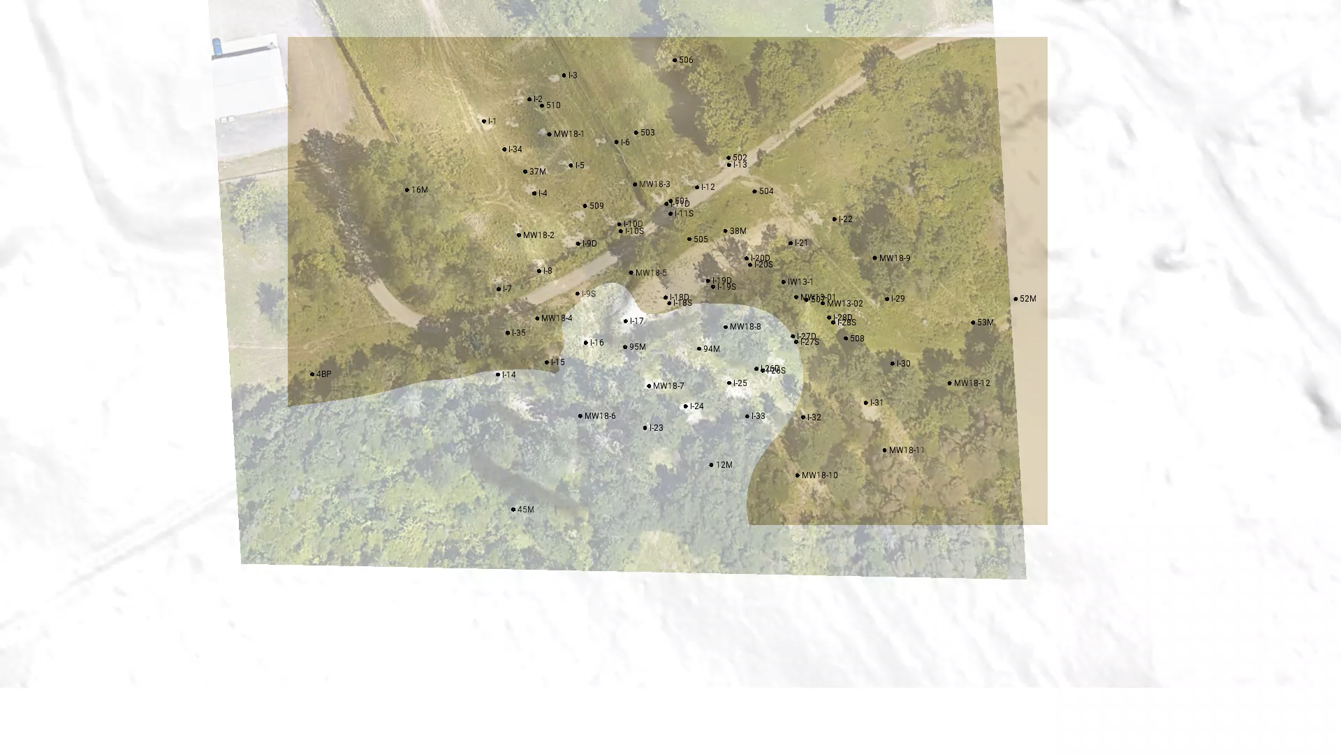
Notes:
Before starting the video:
To keep this presentation on time, we are going to focus on the evolution of only PCE and Dehaloccoccoides at the site through time. The video I am about to play will show the measured and modelled concentrations of PCE and Dehaloccoccoides for one monitoring event in each year, starting in 2020. As well, in this perspective, north is directly up, and relevant concentration data will be located in the top right hand corner as the video plays.
In July 2020, we had limited data and the PCE concentrations appeared to be delineated to the east. However, to the west we did not have delineation. Remember this for the lessons learned portion.
The Dehaloccoccoides population at this time had not been established, with each well sampled showing an enumeration per litre less than the ideal value dictated by SiREM Labs of 1 x 10^7
By November of 2021, the MW20 series wells and MW21 series wells were installed. This provided some better delineation to the west in both the deep Unit C and Shallow Unit E Aquifers. Of particular note is the hot spot discovered in the shallow Unit E Aquifer residing in a swale of the discontinuous leaky confining layer.
The Dehaloccoccoides population began to grow, with minimal overlap in the areas where PCE concentrations were above the RBTC value
By August of 2022, the MW22 and ML22 series wells had been partially installed. This provided a better understanding of what is now thought to be the source zone for the remainder of the PCE plume located in the shallow Unit E aquifer in that swale above the Unit D confining layer I mentioned earlier. Direct push injection techniques began to be implemented, targeting areas that were not covered by the radius of influence of the injection wells, and where PCE concentrations were persistent. This included a large focus on the western portion of the shallow Unit E aquifer due to the highest concentrations persisting within this area.
The Dehaloccoccoides population remains relatively stagnant with minor establishment from the first injections into the shallow Unit E aquifer.
By October of 2023, the PCE plume was well delineated with the final three MW22-series wells providing delineation west and south of the shallow plume hot spot. Plumestop/SmZVI had begun to be used in the area where the highest concentrations had been observed, which resulted in a substantial decrease in the maximum concentrations measured in the western portion of the shallow Unit E Aquifer.
As well, we can see the Dehaloccoccoides coverage growing in the central area of the Deep Unit C aquifer and in the shallow Unit E Aquifer.
In July 2024, we can see another large decrease in the total volume of the PCE plume, with only discontinuous point sources remaining in the shallow Unit E Aquifer. Much of this change in PCE concentrations is attributed to additional injections of Plumestop/SmZVI.
Additionally, we can see a large increase in the dehaloccoccoides population, with much better coverage in the west-central area, both in the shallow Unit E Aquifer and in the Deep Unit C Aquifer.
In the last event being shown in this video, July 2025, we can see another large decrease in the total volume of the PCE plume, with only discontinuous point sources remaining in the shallow Unit E Aquifer and in the Deep Unit C Aquifer. Much of this change in PCE concentrations is attributed to the Dehaloccoccoides working to decrease concentrations.
Additionally, we can see a large increase in the dehaloccoccoides population, with much better coverage in the west-central, both in the shallow Unit E Aquifer and in the Deep Unit C Aquifer, and in the eastern-central area in the Deep Unit C Aquifer.

Slide 15
November 2025 Groundwater Monitoring Results
3A

Slide 16
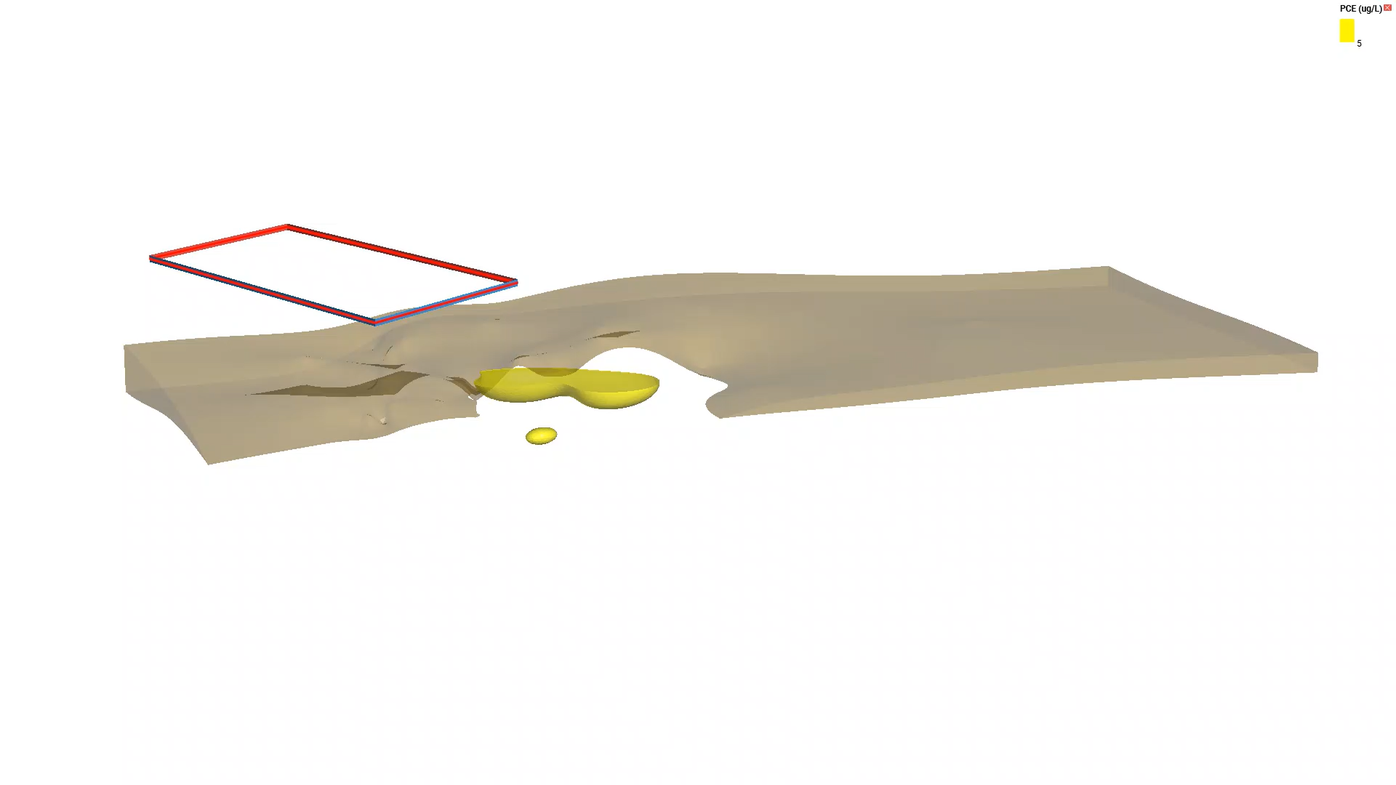
Notes:
Here we have added in the PCE plume, followed by the TCE plume, then the DCE plume, and finally the VC plume relative to their respective RBTC values. We then, have added in the Total organic carbon greater than 75 mg/L, which is the food source for the Dehaloccoccoides, and finally the Dehaloccoccoides population. This is to set the scene for the concentration vs. time plots to follow. Highlighted are the three wells we will look at, MW21-1, MW21-12, and ML22-4-7. Note that MW21-1 and MW21-12 are within the radius of influence of Plumestop/SmZVI injections, while ML22-4-7 is not.

Slide 17
Concentration vs. Time Plots
3B

Slide 18
MW21-1
Notes:
PCE in MW21-1 fell below the RBTC in July of 2023

Slide 19
MW21-1
Plumestop/SmZVI injection
Notes:
This was following the first Plumestop/SmZVI injections near to this well in May of 2023. The concentrations have remained below the RBTC since then.
The TCE, and DCE concentrations also fell in July of 2023. The VC concentrations, have fluctuated near to its RBTC value since November of 2022 and show a decreasing trend since January of 2024.

Slide 20
MW21-12
Notes:
PCE and TCE in MW21-12 have fallen continuously since January of 2021. cis-1,2-DCE rose between January of 2022 and June of 2025 and decreased below the RBTC value of 70 ug/L in between June 2025 and November 2025. VC and ethene began to rise substantially as the Dehaloccoccoides population began to be well established. In November of 2025, VC concentrations fell below the RBTC value of 2 ug/L while the production of ethene was sustained.

Slide 21
MW21-12
Plumestop/SmZVI injections near to well
Notes:
The influence of the Plumestop/SmZVi injections near to this well have not been as substantial as what was observed in MW21-1. As well, there is a marked increase observed in the VC concentrations since the first Plumestop/SmZVI injections, which is a reflection of the VC stall that can be associated with the implementation of this technique.
However, with the maintenance of the Dehaloccoccoides population, the concentrations of PCE, DCE, and VC each fell below their respective RBTC values in November of this past year.

Slide 22
ML22-4-7
Notes:
ML22-4-7 is not within the understood radius of influence of the Plumestop/SmZVI injections and thus, the change in concentration through time is attributed to the Dehaloccoccoides population, which has been well established near to this well screen since August of 2022. In this well, we can see a continuous decrease in concentration of each cVOC since August of 2022.

Slide 23
Approximate Plume Volume Reduction Since March 2023
3C

Slide 24
Chlorinated VOC | RBTC (µg/L) | March 2023 model Volume (m³) | November 2025 model Volume (m³) | Percent Reduction of Modelled Volume (%) | March 2023 Maximum Concentration (µg/L) | November 2025 Maximum Concentration (µg/L)
PCE | 5 | 22,871 | 626 | 97 | 420 | 21
TCE | 50 | 2,008 | 0.1 | 99 | 140 | 66
cis-1,2 DCE | 70 | 3,209 | 934 | 70 | 1,200 | 490
VC | 2 | 11,449 | 3,872 | 67 | 36 | 85
Notes:
In this slide, we are going to discuss the percent change, or volume of plume reduction since March of 2023. March 2023 was chosen to represent 100% of the modelled volume, since this was the date which had the highest concentrations measured within the modelled area after installing the MW22 series wells, which provided better delineation of the plume. State percent reduction for each.
Globally, we are seeing a decrease in the maximum observed concentrations of PCE, TCE, and DCE from March 2023 to November 2025, and an increase in maximum observed concentrations in VC. This is a result of the Dehaloccoccoides producing VC as it degrades PCE, TCE, and cis 1,2 DCE as well as a noted stall in the chemical reduction techniques at VC.

Slide 25

Lessons Learned
Delineation is important to establish prior to planning a remediation strategy.
Bioremediation across large areas can take time (on the order of 2 years), but this methodology is understood to be effective at reducing PCE through to ethene.
Chemical remediation techniques can be fast acting relative to bioremediation techniques but can produce substantial spikes in VC.
The combination of these techniques can be utilized in unison to gain the advantages of both techniques and avoid many of the disadvantages.

Slide 26



Questions?
Presented By
Mitchell Davidson, M.A.Sc., P.Geo.

