Slide 1


Using Laboratory QA/QC to Make Defensible Decisions for Keeping Remediation Projects on Time and on Budget
Notes:
Thank you QPCO for the opportunity to present today at this very special event. on a topic that represents everything we do and stand for as environmental professionals – building confidence in the data used in making decisions that are for regulatory compliance and in protection of Environment and Human health. This starts with having an understanding of Lab QA/QC measures in place to ensure the data is accurate, representative and fit for the purpose keeping with regulatory requirements and acceptance criteria.
Although, lab QAQC is critical to ensuring data quality, it is the most underutilized and less understood part of any lab report or the Certificate of Analysis. As QPs, ESA,ERA or anyone who handles lab data, it is important to understand the different QC measures that are in place and what each one of QC data means as it relates to your own site and sample results.
protocol is provided to ensure that appropriate samples are submitted to laboratories, the samples are analysed with methods that are fit for purpose and that the results of laboratory analyses are reported with sufficient quality upon which to base decisions required for O. Reg. 153/04 or O. Reg. 406/19.
Certificate of Analysis or written report so that the Qualified Person (QP) will be able to properly assess the data and be able to determine if the data are of sufficient quality upon which to base decisions required for O. Reg. 153/04 or O. Reg. 406/19.

Slide 2

Overview
Data Black box – Unlocking the value of QAQC Data
Why QA/QC matters to remediation programs?
Data Quality Objective – Field Versus Lab
Key QC Standards & Acceptable Limits
Is Data Fit for Purpose?
Future of Data Assessment using AI
Key Takeaways

Slide 3
Why QA/QC Matters to Remediation Programs?
Adds measurable standard of quality to sample data on which all decisions are made
To establish a Data Quality Objective(DQO) appropriate for the remediation program that satisfies regulatory obligations
Monitors field sampling performance to ensure sample collected is representative of site conditions
Supports all phases of Remediation Program starting with treatability study or pilot-scale testing, selection of remediation technology, effectiveness of treatment, mitigation of off-site impacts & continuous monitoring
Avoids costly delays from inappropriate or ineffective treatment choices based on “ bad data”
Reduces data uncertainty for defensible decision making
3
3

Slide 4
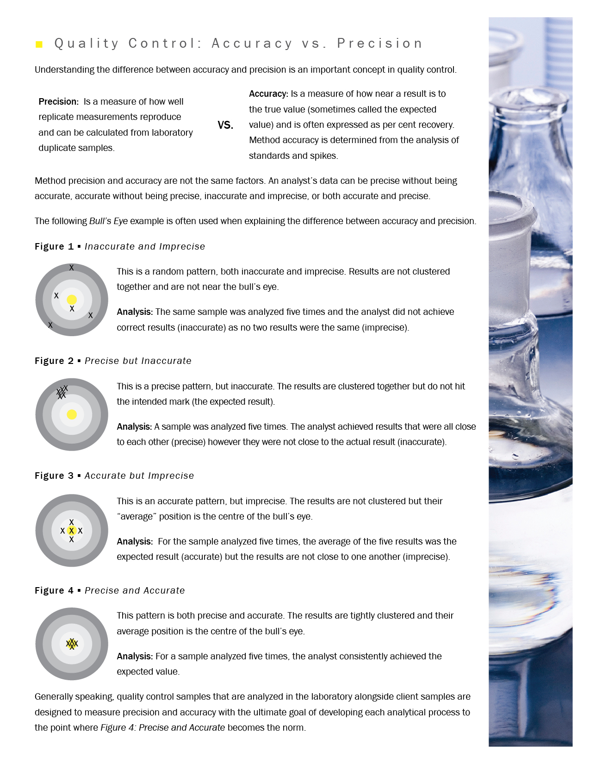
Defining Analytical Data Quality – Accuracy Versus Precision
    ACCURACY - A measure of how close a result is to the “true value”
    PRECISION - A measure of how well replicate measurements reproduce
Neither Accurate nor Precise
Accurate but not Precise
Precise but not Accurate
Accurate and Precise
    Quality Control measures are to ensure data is both accurate and precise every time
Notes:
Each analytical method must demonstrate acceptable degree of accuracy of analytical measurement, precision of the reading over time and selectivity to each matrix type and specificity to each analyte of interest.
The method specific quality assurance and quality control (QA/QC) requirements with respect to the sample processing, analysis and reporting of analytical data submitted for the purpose of O. Reg. 153/04 and O. Reg. 406/19
the method must be validated and must contain a statement that the method is fit for the intended use with respect to the sensitivity, selectivity, analytical range, and the method precision and bias
Laboratories must be accredited by an internationally recognized accreditation body (e.g., Standards Council of Canada (SCC), or Canadian Association for Laboratory Accreditation (CALA) in accordance with the International Standard ISO/IEC 17025:2017 – General Requirements for the Competence of Testing and Calibration Laboratories
All analytical methods providing data in support of O. Reg. 153/04 and O. Reg. 406/19 must be properly validated and proven fit for purpose. The validation data must be available for inspection on request.
Each method is split tested between 2 analyst and the precision and accuracy of the two analysts should be within a factor of 1.5 to demonstrate acceptable method ruggedness
Accreditation ensures that laboratories maintain a comprehensive documented quality system consistent with good analytical practice. Accreditation establishes a consistent basis for acceptable quality among analytical laboratories and ensures they adopt a satisfactory quality system to carry out sample analysis.
Method detection limits (MDLs) and uncertainty data must be current and fit for purpose. The MDLs must be less than or equal to (≤) the reporting limits (RLs)
At a minimum, initial validation must include demonstration of acceptable Precision, accuracy, selectivity and specificity.
As part of method validation, each method is tested for
GW – min 2 sets X 8 aliquots of real or synthetic ground water (not containing the analytes of interest) are spiked with the analytes of interest in the routinely used sample containers. One set is spiked at 5–10 times the RL, the other set at or above midrange. The samples are carried through the entire analytical process
Soil/Sediment – Min 2different soil types with 1 clay matrix & 1organic matrix containing > 3% TOC. Well homogenized composite samples are prepared and a minimum of five aliquots of each soil type is spiked with all the analytes of interest at 5–10 times the RL and at or above the midrange (20 samples total). If suitable reference materials are available, they may be used. The samples are carried through the entire analytical process
The relative percent difference (RPD) of the replicates, and matrix spike recovery should be within acceptable limit as defined by the protocol
Method Detection Limit (MDL): The minimum concentration of an analyte that can be identified, measured and reported with 99% confidence that the analyte concentration is greater than zero; it is determined from data produced by analysing a sample in a given matrix containing the analyte
Method detection limits (MDLs) must be determined for every regulated parameter analysed. The MDLs are redetermined at a minimum every two years or whenever major changes are made to the method or instrumentation.
The MDLs must be less than or equal to (≤) the required reporting limit (RL) for each parameter. MDL is determined at 99% confidence based on standard deviation assessments derived from long term method blanks (minimum 8 method blanks from multiple calendar dates) and/or long-term low-level spikes (Laboratory Control Samples) rather than using single-batch MDL spike studies

Slide 5

Field Quality Assurance - Data Quality Starts in the Field
Site-specific QA/QC is essential for establishing a degree of confidence in all data collected
Monitors all aspects of the field program including competency of field technicians, adherence to Standard Operating Procedures(SOPs) & best practices, early flagging of any data issues or bias and tracking sample chain of custody through every stage of sampling
Data Quality Objectives(DQO) set specifically to evaluate acceptable level of data accuracy, precision, representativeness, comparability and completeness reflective of sample handling & collection
A minimum requirement set on number, type & frequency of field QC performance including blanks, spikes, rinsates, sample duplicates as well as equipment calibration checks and screening measurements
Proper handling & labeling of sampling containers to preserve sample integrity (decontamination of sampling equipment)
Completing the Chain Of Custody (COC) form – ensure information is legible, accurate & provides all necessary information
5
Notes:
Laboratory QC may be supplemented by various field QC samples such as blind field duplicates, travel blanks, equipment rinse blanks and travel spikes. In general, acceptance limits for field QC are broader than laboratory QC.
Blanks are defined as matrices that have negligible or unmeasurable amounts of the analytes of interest.
Travel Blank: is a sample of methanol preservative, reagent water or blank soil transported unopened to and from the sampling location carried through the entire sampling and analytical process including all sample preparation steps. It is recommended that a travel blank be submitted with each batch of pre-weighed methanol or bisulphate vials to verify that no VOCs were introduced during the vial preparation process. Field contamination evaluation and methanol vial integrity. Target analytes should be less than the reporting limit (RL). Note: acetone, methylene chloride, toluene and hexane are common laboratory artefacts. If any are > RL the laboratory must comment on the impact on data quality.
Travel Blank: A clean sample of a matrix that is transported to and from the sampling site unopened and submitted to the laboratory for analysis without having been exposed to sampling procedures. A travel blank is used to document contamination attributable to preparation, shipping and field handling procedures. This type of blank is useful in documenting contamination of volatile organic compound (VOC) samples
Field Duplicates: Independent samples that are collected as close as possible to the same point in space and time. They are two separate samples taken from the same source, stored in separate containers, and analyzed independently. These duplicates are useful in documenting the precision of the sampling process. (US EPA SW-846, Chapter 1).

Slide 6
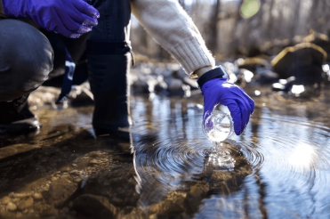
Field Quality Assurance- Keeping with Data Quality Objectives(DQOs)
TRIP/ TRAVEL BLANK (VOCs)
  Blank water shipped to and from the field and remains closed
  Indication of container/preservative/reagent water purity
FIELD BLANK (VOCs)
  Blank water left open or poured into an empty container at the field
  Indication of field conditions during sampling
TRAVEL SPIKE (VOCs)
  Spiked water of known analyte concentration shipped to & from the field and remains closed
  Indication of analyte loss during transit
EQUIPMENT RINSE BLANK/ FILTER BLANK
  Blank water used to rinse field equipment/ filter pre-sampling
  Indication of equipment cleanliness between sampling points
BLIND FIELD DUPLICATE
  Second sample aliquot collected in a separate container from the same sampling location at the same time
  Indication of sample heterogeneity
Field QC is typically 1.5X to 2X of laboratory QC limits
CCME Guidance Manual for Environmental Site Characterization in Support of Environmental and Human Health Risk Assessment- VOL4. Analytical methods document
6
Notes:
Laboratory QC may be supplemented by various field QC samples such as blind field duplicates, travel blanks, equipment rinse blanks and travel spikes. In general, acceptance limits for field QC are broader than laboratory QC.
Blanks are defined as matrices that have negligible or unmeasurable amounts of the analytes of interest.
Travel Blank: is a sample of methanol preservative, reagent water or blank soil transported unopened to and from the sampling location carried through the entire sampling and analytical process including all sample preparation steps. It is recommended that a travel blank be submitted with each batch of pre-weighed methanol or bisulphate vials to verify that no VOCs were introduced during the vial preparation process. Field contamination evaluation and methanol vial integrity. Target analytes should be less than the reporting limit (RL). Note: acetone, methylene chloride, toluene and hexane are common laboratory artefacts. If any are > RL the laboratory must comment on the impact on data quality.
Travel Blank: A clean sample of a matrix that is transported to and from the sampling site unopened and submitted to the laboratory for analysis without having been exposed to sampling procedures. A travel blank is used to document contamination attributable to preparation, shipping and field handling procedures. This type of blank is useful in documenting contamination of volatile organic compound (VOC) samples
Field Duplicates: Independent samples that are collected as close as possible to the same point in space and time. They are two separate samples taken from the same source, stored in separate containers, and analyzed independently. These duplicates are useful in documenting the precision of the sampling process. (US EPA SW-846, Chapter 1).

Slide 7
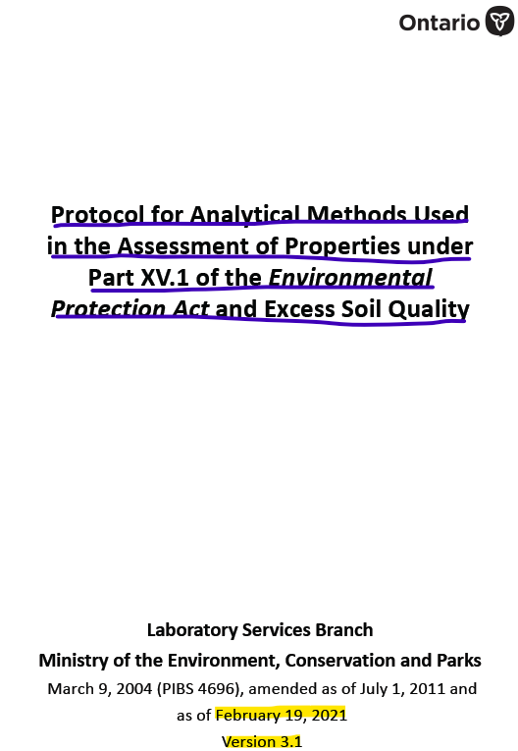
Laboratory Quality Assurance – How do Labs Demonstrate Quality?
ISO/IEC 17025:2017 general requirements for the Competence of Testing as part of laboratory accreditation program. This includes validation of each method on the scope to demonstrate it is selective to matrix type, specific for each analyte of interest and Fit for Purpose
Must meet QC performance criteria as set out in the Protocol for Analytical Methods. The acceptance limit is specific to each matrix type and contaminant group
Includes both Field & Lab QC samples
Must demonstrate Accuracy of data to actual contaminant concentrations, measurement Precision between readings, data Representativeness to field measurements, Comparability based on sample integrity during analysis and Completeness of the analytical testing in agreement with the chain of custody
Notes:
Accreditation: Laboratories must be accredited by an internationally recognized accreditation body (e.g., Standards Council of Canada (SCC), or Canadian Association for Laboratory Accreditation (CALA) in accordance with the International Standard ISO/IEC 17025:2017 – General Requirements for the Competence of Testing and Calibration Laboratories (as amended from time to time)
Method Validation: All analytical methods providing data in support of O. Reg. 153/04 and O. Reg. 406/19 must be properly validated and proven fit for purpose. The validation data must be available for inspection on request. Ongoing method performance data may be used to demonstrate the method is valid and fit for purpose. Method detection limits (MDLs) and uncertainty data must be current and fit for purpose. The MDLs must be less than or equal to (≤) the reporting limits (RLs)
Single blind proficiency testing (PT) samples (if available) must demonstrate ongoing acceptable performance.
In order for QP to be able to properly assess the quality of the analytical data, all associated QC must be reported – Travel Blk, Method Blk, Lab control sample, Reference material, Lab dup, Matrix spike, Surrogate/ Internal std recoveries must meet performance criteria
the method specific quality assurance and quality control (QA/QC) requirements with respect to the sample processing, analysis and reporting of analytical data submitted for the purpose of O. Reg. 153/04 and O. Reg. 406/19
The acceptance limits for these QC samples are the metrics by which the quality of the associated laboratory data is demonstrated.

Slide 8

Laboratory Quality Assurance – Measurement of Data Accuracy (Fit for Purpose)
CERTIFIED REFERENCE MATERIALS(CRMs): Purchased material certified to contain an “analyte of predetermined concentration” in the same medium as the sample matrix
Calibration Standards: A series of diluted standards prepared from a stock solution made from certified reference material. This is a measure of instrument accuracy for a linear response
Reference Standard: A standard of known concentration similar to a calibration standard that is purchased from a different supplier OR different lot #. This is performed as a check of instrument calibration
Continuing Calibration Verification (CCV): Reference standard run at the end of an instrument sequence to confirm that the calibration is still within acceptance limit
Acceptance limits
Organics <60% <140%
Metals: <80% <120% (more stringent)
Failure of any of the above standards require the entire batch to be repeated
8
Notes:
QC for GW will only be possible if there is duplicate sample containers provided as sub-sampling provision is not permitted for organic analysis. In the event, there is no sufficient sample provided, the lab can choose to run Blank Spike Dup in place of Dup/matrix spike.
Laboratory Control Sample (LCS): is a sample of reagent water or blank soil spiked with the analytes of interest and carried through the entire analytical process including all sample preparation steps. In general, the LCS will be a second source standard and have a concentration near the midpoint of the calibration range.
Method specific quality assurance and quality control (QA/QC) requirements with respect to the sample processing, analysis and reporting of analytical
data submitted for the purpose of O. Reg. 153/04 and O. Reg. 406/19.
Certified Reference Material is matrix matched
Reference Material (RM): A material or substance one or more of whose property values are sufficiently homogeneous and well established to be used for calibration of an apparatus, the assessment of a measurement method, or for assigning values to the materials (ISO/IEC Guide 35:2017 or more recent version). The RM should be matrix matched to the samples and carried through the entire analytical process.
Certified Reference Material (CRM) is purchased material that contains predetermined concentrations of the analyte or analytes of interest. CRMs are manufactured by companies accredited to the current version of the ISO 17034 standard. They are typically samples of either water or soil where the “right answer” for analysis is known to demonstrate the accuracy of a specific method. CRMs can be used to calibrate instruments by preparing a series of dilutions from the standard. Reference standards (RM) are similar to CRMs, but are purchased from a different supplier, not accredited to ISO 17034, where certified reference materials are not available. A second source CRM is used to ensure that the calibration standard is correct and is measured before and after a batch of client samples. On our Quality Assurance Report, the “measured value” for the CRM is expressed as a percentage recovery of the certified value after the client samples have been measured.
Continuing Calibration Verifications: (CCVs) are evaluated to determine whether the instrument was within acceptable calibration throughout the period in which samples were analysed (i.e., to verify that the initial calibration was applicable during the sample analyses). In general, failure of the CCV indicates that the initial calibration is no longer valid and should trigger recalibration and the reanalysis of the associated samples in the analytical sequence.

Slide 9

Laboratory Quality Assurance – Measurement of Data Accuracy (Fit for Purpose)
SPIKES
Method Blank Spike(LCS): Reagent water or blank soil spiked with known concentration of target analyte(s) from a secondary source and carried through the analytical process. This is a measure of method performance in the absence of matrix effect
Failure of method blank spike requires the entire batch to be repeated
Matrix Spike/ Matrix Spike Duplicate*: A second aliquot of soil or water spiked with a known concentration of target analyte(s) from a secondary source carried through the entire analytical process. This is a measure of method’s fitness specific to matrix type(Matrix Match) and impact of matrix effect on analyte recovery
Acceptance limits
Organics <60% <140%
Metals: <(70)80% < 120(130)% (more stringent)
* Only possible if there is multiple sampling containers available
9
Notes:
QC for GW will only be possible if there is duplicate sample containers provided as sub-sampling provision is not permitted for organic analysis. In the event, there is no sufficient sample provided, the lab can choose to run Blank Spike Dup in place of Dup/matrix spike.
Also known as Lab Control Sample taken from the same source as the calibration standard
Laboratory Control Sample (LCS): is a sample of reagent water or blank soil spiked with the analytes of interest and carried through the entire analytical process including all sample preparation steps. In general, the LCS will be a second source standard and have a concentration near the midpoint of the calibration range.
LCS Recovery = [measured concentration] / [design concentration]
The method blank spike acts as a measure of the accuracy of the equipment and analyst technique, as well as a check on the preparation of the matrix spike
Matrix Spike is a second aliquot of a soil or water sample spiked, usually about mid-range, with all analytes determined in the analysis and carried through the entire analytical process including all sample preparation steps. Note that for soil tests where the extraction is not intended to recover all the native analyte (chloride, cyanide, HWS boron), the spike is added post extraction. In general, the matrix spike will be a second source standard and have a concentration near the midpoint of the calibration range. Reference materials (RMs) may be used in place of matrix spikes where appropriate, provided the matrix is similar to the samples and they contain all analytes in the test.
Matrix Spike Recovery = {([spiked sample] – [un-spiked sample]) / [spike]} x 100
Because matrix spikes are also impacted by sample heterogeneity, the issues discussed in sample duplicates above may apply.
Effect of a particular matrix on an analytical method in recovering the target analyte
Acceptable criteria comparable between organics & inorganics since the matrix effect can be felt by both analytical groups.
The percentage recovery of the matrix spike will indicate the accuracy of the analytical method and provide a measure of any potential matrix interferences or heterogeneity issues
What is the purpose?
Test of method accuracy specific to matrix type – “Matrix Match” between standard & sample
Analytical method “fit for purpose” – degree of accuracy
Allows for assessment of “Matrix effect” on a target analyte recovery
Acceptance limits
Organics – Typically 60% - 140%
Metals – More stringent 70% - 130%
Matrix Spike - Laboratory method accuracy with matrix effects from a separate-source standard. Percent recoveries should be between 50–140%. If recovery is outside of specified limits, repeat if necessary or if the repeat also fails, report recovery and qualify results.

Slide 10

Laboratory Quality Assurance – Measurement of Data Precision
DUPLICATES *
Laboratory Duplicate: A second aliquot of the sample taken from same or separate containers and carried through the entire analytical process
Instrument Duplicate: A second aliquot of the sample extract analyzed in duplicate as a measure of instrument precision
Matrix Spike Duplicate: A second aliquot of the sample taken from same or separate containers, spiked and carried through the entire analytical process
Duplicates are a measure of analytical precision and sample homogeneity
Acceptance limits
Soil: ≤40%
Water: ≤30% (more homogeneous)
RPD most effective at >10x MDL
* In case of GW, the laboratory duplicate is the same as Field duplicate
10
Notes:
QC for GW will only be possible if there is duplicate sample containers provided as sub-sampling provision is not permitted for organic analysis. In the event, there is no sufficient sample provided, the lab can choose to run Blank Spike Dup in place of Dup/matrix spike.
Sample Duplicate: is a second aliquot of a soil or water sample carried through the entire analytical process including all sample preparation steps. It is a measure of precision of the analysis or sample matrix homogeneity. Note that since most water sample tests for extractable organic analytes consume the entire sample, duplicates are actually field duplicates, and are only possible if sufficient additional sample bottles are provided to the laboratory.
Duplicate RPD = {([sample] – [sample duplicate]) / ([sample] + [sample duplicate])/2} x 100
Relative Percent Difference (RPD): The absolute difference between two results expressed as a percentage of the average result:
RPD = |_ (x1 − x2) (x1 + x2)⁄2| × 100
For organic analysis, soils are analysed as received. As such, duplicates are primarily a measure of sample homogeneity. Similarly, because water analyses are “whole bottle” tests, sample duplicates are field duplicates, subject to sampling variability. The duplicate acceptance limits contained in the following tables are based on homogeneous samples. If samples are visibly nonhomogeneous, repeat analysis is not required. Data are reported flagged as “exceedance due to sample heterogeneity”. For most inorganic tests, samples are taken from the original container and processed with the documented method that will be used for the real samples, so the above stipulations do not apply.

Slide 11
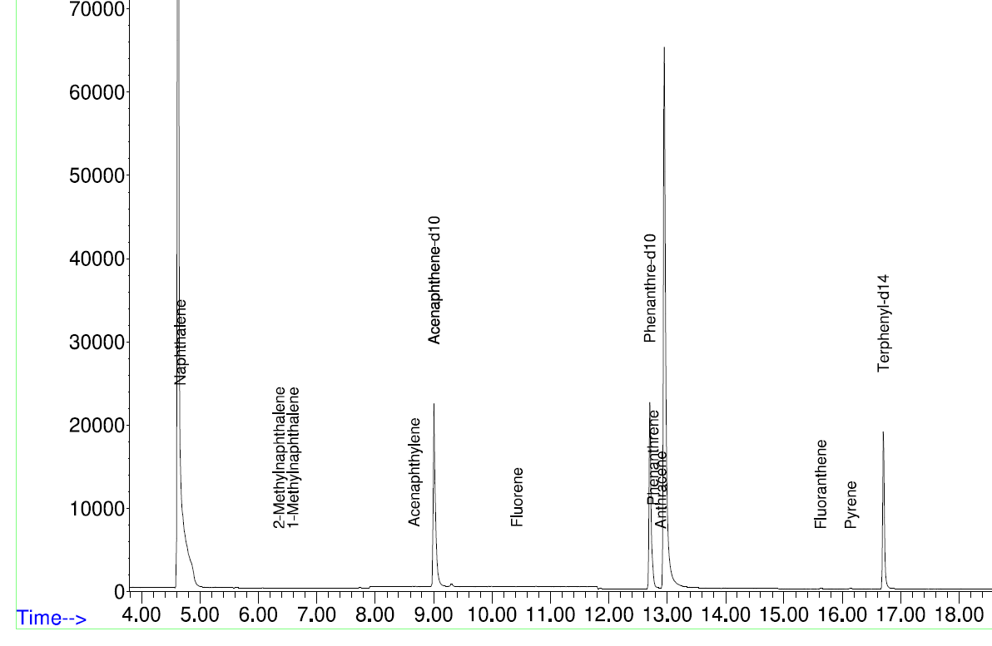
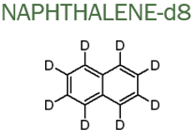
Laboratory Quality Assurance – Measurement of Data Specificity
ORGANIC SPIKES
Surrogate Standard(s):Deuterated compounds (+ 1 neutron) that are NOT found in nature. They behave chemically similarly to an analyte, but can be distinguished based on their mass difference. They are used in Organic analysis as an added measure of accuracy. Surrogate standards of known concentration is added to every sample and QC standards prior to extraction and carried through the entire analytical process
Internal Standard(s): A known concentration of organic compounds not present in the sample, but behave chemically similar to the target analytes, added to all samples including QC standards post extraction to correct for variations in sample matrix
Samples are not corrected for surrogate recoveries
Acceptance limits
Organics <50% <140%
11
Notes:
Surrogate: Has chemical characteristics similar to that of the analyte and provides an analytical response which is distinct from the analyte. The surrogate(s) is normally added to the sample prior to sample preparation and is used to assess the recovery of analyte(s) carried through the analytical process.
Surrogates are used for organic tests. All samples are spiked with compounds (usually deuterated analogs) representative of the analytes being determined but not found in environmental samples. The surrogates are spiked into the sample prior to any sample preparation steps and carried through the entire analytical process.
Surrogate Recovery = ([measured concentration] / [theoretical concentration]) x 100
Surrogate spikes are very important when analyzing organic environmental analytes. In particular, in determining how well the analyte of interest partition from the sample matrix (soil/water) completely. In case of extractables, it is the solvent phase and VOCs, it is the vapour phase.
In many cases, these compounds could be deuterated versions of the target compounds. These surrogates are identical to the parent compound; however, the hydrogen atoms on the original compound are replaced with deuterium atoms
Surrogate Recovery = ([measured concentration] / [theoretical concentration]) x 100
Internal Std for GC/MS
Surrogate spike coverage
F2-F4 -> 3
ABNs -> 4
PCBs/OC P -> 1
PAHs -> 3
Surrogates - Accuracy in sample matrix. Surrogates should represent analytes of interest and be representative of compound class of target analytes (deuterated analogs). Percent recoveries in soil and water should be between 50–140% for compounds. Surrogates are optional for isotope dilution methods. If recovery is outside of specified limits, laboratory must report recovery and qualify the result.
Internal Standards are used for some organic tests (i.e., ABNs, VOCs). A known amount of compound(s) (not present in the samples, but closely matching the chemical behavior of the compound(s) of interest) are added to every sample (including all QC samples) prior to analysis to quantitate by comparing the response of a major (quantitation) ion relative to an internal standard.
Internal Standards (IS) - Laboratory accuracy, method accuracy in sample matrix. Minimum of 3 at retention times across GC run • Area counts in samples must be between 50–200% of the area counts in associated continuing calibration standard (CCV). Retention times of internal standards should be within ±6 seconds of retention times in the associated CCV. If one or more internal standards are outside limits, reanalyze sample unless obvious interference present.
Internal Standard: A standard that has chemical characteristics similar to those of the analyte(s) and provides an analytical response that is distinct from the analyte and not subject to interference. Internal standards are usually added to the sample or sample extract just prior to sample analysis in order to correct for variations in sample matrix, injection volume. Internal standards are added after all preparation and cleanup steps are complete
Internal Standards are used for some organic tests (i.e., ABNs, VOCs). A known amount of compound(s) (not present in the samples, but closely matching the chemical behavior of the compound(s) of interest) are added to every sample (including all QC samples) prior to analysis to quantitate by comparing the response of a major (quantitation) ion relative to an internal standard.

Slide 12
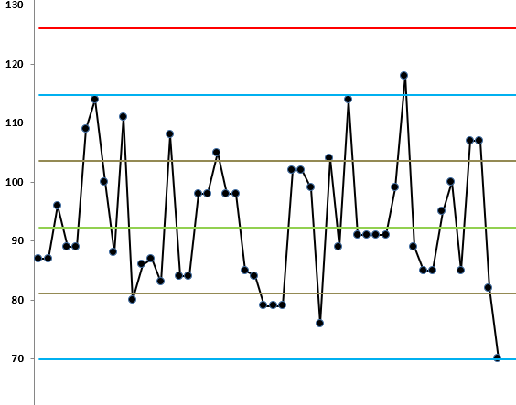
Laboratory Quality Assurance – Measurement of Data Bias
BLANKS
Container Proof Blank: Each container lot purchased is proofed at the lab by rinsing with reagent water and analyzed to show the target analyte(s) are non-detect or well below RDL
Instrument Blank: Reagent water run at the beginning of a sequence & after every spike standard as an indicator of instrument background and any carry over
Method Blank: Reagent water or blank soil carried through the entire analytical process to assess contamination from laboratory environment and reagents
If the Blank > RDL, the entire sample batch need to be repeated
REPORTING DETECTION LIMIT(RDL): Concentration level at which a target analyte if present is consistently detected. Data may be biased if the RDL is set closer to MDL as this increases data uncertainty
CONTROL CHART: Statistical monitoring of method performance on a real-time basis for an assessment of data quality specific to a method for each instrument used. This allows the lab to closely monitor trends in the analytical process and address any out-of-control situation prior to data reporting
Notes:
Reporting Limit (RL): The concentration at which a single analysis using the methods and matrices listed in this document will consistently detect target analytes when present. The RL must be equal to or greater than the MDL
Method Blank: is a sample of reagent water or blank soil carried through the entire analytical process including all sample preparation steps.
Method blank results are used to assess contamination from the laboratory environment and reagents
Control Chart: Provide the means of displaying the quality control data of a given analytical process. They are used to determine if a method is in-control or out of control. Purpose of control charting is to identify and correct method variation by looking for trends within the QC data. Expected distribution is either determined by SPC (statistical process control) or by using set upper and lower limits
Purpose of CC is to identify trends and that an out of control situation may not necessarily indicate poor results.
CC – A series of data points grouped on a line chart with calculated control limits. Designed to measure process variation over time and provide timely signals of instability or problems
CC is a mandatory process for lab accreditation. Ensure CC are established for critical and quantifiable parameters for each method.
Failed QC results must also be included to ensure accurate representation of the test method performance. Analyst must make note of any resolution for data that is out of control. If the out of control situation is not easily determined, the instrument is flagged as out of control and taken off production until the control can be restored.
Proper CC will have normal distribution of data points on each side of the mean with most points closer to the mean when the method is at its optimal performance.
The creation of CC limits should include typical variability in a test procedure that would come from different analyst, reagents, standards, env changes
Data points must be entered on real time basis. If more than 1 control sample ran per batch, each control point must be charted. If more than one batch a day, one point from each batch should be included.
Upper and lower 3SD should be within acceptance criteria specific for each method. When data falls outside of UCL or LCL, results need re-checking.
Trends & Failures
>3SD – Possibly wrong sample ran/ exported, check standard for expiry, check calibration for pass at 99% confidence. Out of control situation addressed prior to releasing data – variance from method or change in measurement system, incorrect measurement/calculation or plotting
Warning rules of potential issue. Must be documented, but they are not considered statistically out of control.
2/3 consecutive data points > +/- 2SD – significant process shift (new analyst, poor calibration, poor standard preparations)
4/5 consecutive points are > +/- 1SD – significant process shift (poor calibration)
8 or more on same side of mean – upward or downward means deterioration of reagents, standards, reference material, instrumentation, improved skill, change in lot #, instrument maintenance
causes include new reagent lot#, standard preparation, digestion buffer solution for metals, variability between analyst, changes in temperature and humidity

Slide 13
Exemption Rules* – When is QC Failure Acceptable?
Multi-element Scan Qualifier: As the number of analytes in a scan increases, so does the chance of a limit exceedance by random chance as opposed to a real method problem. Thus, in multi-element scans, for the LCS and matrix spike, up to 10% of the analytes may exceed the quoted limits by up to 10% absolute and the spike is considered acceptable
Duplicate Qualifier: For duplicates as the measured result approaches the RL, the uncertainty associated with the value increases dramatically, thus duplicate acceptance limits apply only where the average of the two duplicates is greater than five times the RL
Matrix Spike Qualifier: For matrix spikes, as the concentration of the native analyte increases, the uncertainty of the matrix spike recovery increases. (It is not possible to accurately quantitate a small difference between two large numbers). Thus, the matrix spike acceptance limits apply only when the concentration of the matrix spike is greater than or equal to the concentration of the native analyte
* Protocol (O. Reg 153/04, O. Reg. 406/19) Version 3.1 – February 19, 2021
Notes:
Multi-element Scan Qualifier: as the number of analytes in a scan increases, so does the chance of a limit exceedance by random chance as opposed to a real method problem. Thus, in multielement scans, for the LCS and matrix spike, up to 10% of the analytes may exceed the quoted limits by up to 10% absolute and the spike is considered acceptable.
Duplicate Qualifier: for duplicates as the measured result approaches the RL, the uncertainty associated with the value increases dramatically, thus duplicate acceptance limits apply only where the average of the two duplicates is greater than five times the RL.
Matrix Spike Qualifier: for matrix spikes, as the concentration of the native analyte increases, the uncertainty of the matrix spike recovery increases. (It is not possible to accurately quantitate a small difference between two large numbers). Thus, the matrix spike acceptance limits apply only when the concentration of the matrix spike is greater than or equal to the concentration of the native analyte.

Slide 14
Key Quality Control Standards
QA/QC STANDARD | FREQUENCY | INDICATOR TYPE | ACCEPTANCE LIMIT
Instrument Blank - NR | Beginning of the run and after every spike Standard | Indicator of instrument background (noise) & carry over | <RL
Method Blank - R | Every 20 Samples | Indicator of lab contamination specific to matrix type (Soil/ Water) | <RL
Calibration Standards - NR | Beginning of a run performed daily | Measure of instrument accuracy for a linear response | >0.990 correlation (or better) depending on the analysis.
Certified Reference Standard - R | Run following calibration and after 20 samples in each batch as a Reference Standard. Secondary source to Calibration Standards | Measure of accuracy | 60% - 140% recovery (or better) depending on analysis type
Method Blank Spike (LCS) - R | Every 20 samples | Measure of method accuracy without matrix effect | 60% - 140% Recovery (or better) depending on analysis type
Laboratory Duplicate - R | Every 20 samples | Measure of method precision & sample homogeneity | RPD ≤ 30% for Water RPD ≤ 40% for soil
R – Reported NR – Not Reported
Notes:
Method Blank - Laboratory contamination evaluation. Matrix-specific (e.g., water, soil). Target analytes should be less than the reporting limit (RL). If an analyte fails, the batch run is repeated. If not possible, data reported with a qualifier.
Laboratory Control Sample (LCS) - Laboratory method accuracy without matrix effects from a secondary -source standard. Re-extract/re-analyse all associated samples or report data flagged for all failing analytes.
Sample Duplicate - Sample homogeneity, laboratory method precision. RPD should be ≤30% for waters and ≤40% for solids

Slide 15
Key Quality Control Standards
QC STANDARD | FREQUENCY | INDICATOR TYPE | ACCEPTANCE LIMIT
Instrument Duplicate -NR | Every 20 samples for certain methods only | Measure of instrument precision | RPD ≤ 30% difference, depending on analysis type
Surrogate Standard - R | Add to method blank, blank spike, duplicate, matrix spike and all samples in a batch (organics only) | Measure of extraction & analysis accuracy specific to sample matrix | 50 - 140% Recovery
Internal Standard - NR | Organics - Every sample, blank, spike, matrix spike, CCV | Measure of instrument accuracy | 50 - 200% area count of CCV
Matrix Spike - R | Every 20 samples | Measure of method accuracy specific to matrix type | 60 - 140% Recovery (or better) depending on analysis type
Matrix Spike Duplicate - NR | Every 20 samples for certain methods only | Measure of method precision | RPD ≤ 30% difference depending on analysis type
Continuing Calibration Verification - NR | Beginning of every new batch of 20 samples | Measure of continued instrument accuracy | + 30% Recovery (or better) depending on the analysis
R – Reported NR – Not Reported
Notes:
Continuing Calibration Verifications: (CCVs) are evaluated to determine whether the instrument was within acceptable calibration throughout the period in which samples were analysed (i.e., to verify that the initial calibration was applicable during the sample analyses). In general, failure of the CCV indicates that the initial calibration is no longer valid and should trigger recalibration and the reanalysis of the associated samples in the analytical sequence.
Matrix Spike - Laboratory method accuracy with matrix effects from a separate-source standard. Percent recoveries should be between 50–140%. If recovery is outside of specified limits, repeat if necessary or if the repeat also fails, report recovery and qualify results.
Surrogates - Accuracy in sample matrix. Surrogates should represent analytes of interest and be representative of compound class of target analytes (deuterated analogs). Percent recoveries in soil and water should be between 50–140% for compounds. Surrogates are optional for isotope dilution methods. If recovery is outside of specified limits, laboratory must report recovery and qualify the result.
Internal Standards (IS) - Laboratory accuracy, method accuracy in sample matrix. Minimum of 3 at retention times across GC run • Area counts in samples must be between 50–200% of the area counts in associated continuing calibration standard (CCV). Retention times of internal standards should be within ±6 seconds of retention times in the associated CCV. If one or more internal standards are outside limits, reanalyze sample unless obvious interference present.

Slide 16
Putting the Pieces together
Order # | Sample Type
1 | Instrument Blank (Rinse)
2 | Calibration Standard 1
3 | Calibration Standard 2
4 | Calibration Standard 3
5 | Calibration Standard 4
6 | Calibration Standard 5
7 | Instrument Blank (Rinse)
8 | Method Blank
9 | Reference Material
10 | Method Blank Spike
11 | Client Sample 1
12 | Client Sample 1 Duplicate
13 | Client Sample 1 Matrix Spike
14 | Client Sample 2
15 | Client Sample 3
16 | Client Sample 4
17 | Client Sample 5
18 | Client Sample 6 - 9
19 | Client Sample 10 - 14
20 | Client Sample 15 - 19
21 | Client Sample 20
22 | Client Sample 20 Duplicate
23 | Client Sample 20 Matrix Spike
24 | Instrument Blank (Rinse)
25 | Continuing Calibration Verification
For every 20 client samples
    2 Instrument Blanks
    5 Calibration Standards
    1 Method Blank
    1 Method Blank Spike
    1 Reference Material
    2 sets of Duplicates
    2 sets of Matrix Spikes
    1 Continuing Calibration Verification (CCV)
    Minimum of 15 QC samples in total
*** Any QC failure within a batch requires the whole batch to be re-extracted & re-analyzed with the exception of matrix spike ***
16
Notes:
QC samples must be bracketed around client samples. A blank at the beginning of the batch to check for contamination, followed by CRM to confirm calibration, spk &dup to check matrix interferences and precision and CRM/reference std after the client sample to confirm the calibration is still acceptable and confirmation of accuracy of client samples.
Focus and importance are usually centred on individual components of quality control procedures that are followed in the laboratory. Of equal importance however, is reviewing how all of these procedures fit together
How many client samples are analyzed before, between and after quality assurance samples are utilized to verify the validity of the produced data?
If the first quality control samples adhere to the criteria, then the client samples undergo analysis. If the last quality control samples do not pass the specified criteria, client sample results are deemed “non-conforming” and the process starts again from the beginning, after the cause of the original failure has been determined. Before client sample results are released to the client, both sets of quality control samples must pass all relevant tests and adhere to the criteria. The quality control results that appear on your Quality Assurance Certificate are the results of the quality control samples analyzed after your samples. Any indication of irregularities will halt the laboratory analysis until such time that corrective measures can be taken and samples can be re-analyzed.

Slide 17
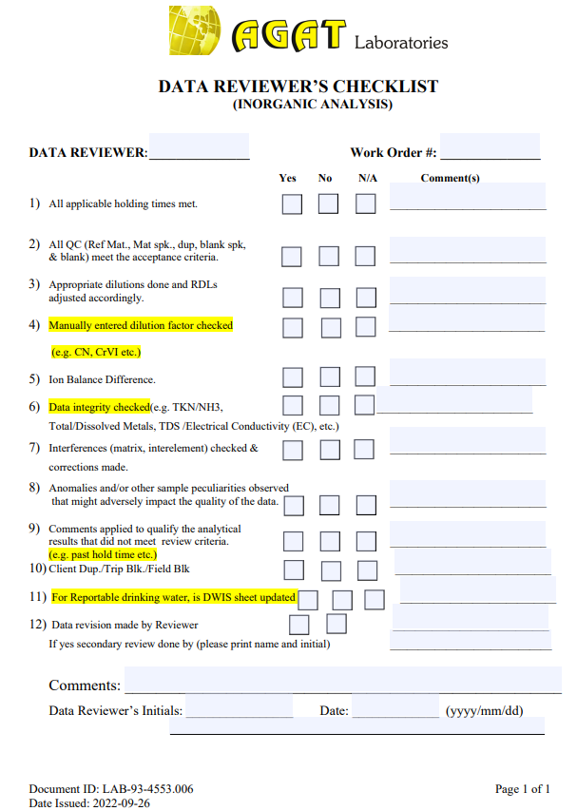
A Practitioner’s Check List – Quick Data Review
Verify and confirm if field QCs are reported and meet Data Quality Objective(DQO)
Review Trip/Field/ Rinse Blanks for any signs of contamination from field handling, storage or transportation and Method Blank to rule out lab contamination
Look for possible loss of analyte based on Travel Spike (if included) or matrix Spike
Confirm if the RPD between Blind Field Duplicate and it’s parent sample is within acceptable criteria. Have the sample re-analyzed if RPD fails for a decision to average data or re-sample. RPD > 50% may suggest sample heterogeneity
Double check if the Lab Reporting Limit(RDL) is below clean-up criteria based on generic or site-specific standards. Raised RDLs could be the result of dilution error or matrix interference. Sample may require re-analysis

Slide 18
A Practitioner’s Check List – Quick Data Review
Look for any data qualifiers that may indicate sample integrity issues which can directly impact data quality – temperature noncompliance, holding time, lab filtration/preservation, headspace(VOCs), sediment, dilution, matrix interference. Compare with field notes
Qualifier | Impact on Data Quality
Analyzed past holding time. Client was informed | Data not acceptable
Method Blank above RDL, but all results <RDL | No impact to client data
Sample received with head space for VOCs | Data may be biased low
Sample diluted to reduce matrix effect | No impact as long as RDLs < Regulatory Standard
Matrix Spike: Due to an elevated concentration of analyte in the native sample, matrix spike recovery is biased high | Spike data can be omitted as long as the sample data is properly quantified
Duplicate not within acceptance limits. Sample visibly non-homogeneous | Sample should be flagged as heterogeneous
Significant presence of sediment in GW | Data should be flagged as biased high
Target analytes above calibration range. Sample diluted and RDLs adjusted accordingly | Check to make sure the raised RDLs are not above standards. Have the sample repeated if needed
Notes:
Multi-element Scan Qualifier: as the number of analytes in a scan increases, so does the chance of a limit exceedance by random chance as opposed to a real method problem. Thus, in multielement scans, for the LCS and matrix spike, up to 10% of the analytes may exceed the quoted limits by up to 10% absolute and the spike is considered acceptable.
Duplicate Qualifier: for duplicates as the measured result approaches the RL, the uncertainty associated with the value increases dramatically, thus duplicate acceptance limits apply only where the average of the two duplicates is greater than five times the RL.
Matrix Spike Qualifier: for matrix spikes, as the concentration of the native analyte increases, the uncertainty of the matrix spike recovery increases. (It is not possible to accurately quantitate a small difference between two large numbers). Thus, the matrix spike acceptance limits apply only when the concentration of the matrix spike is greater than or equal to the concentration of the native analyte.

Slide 19
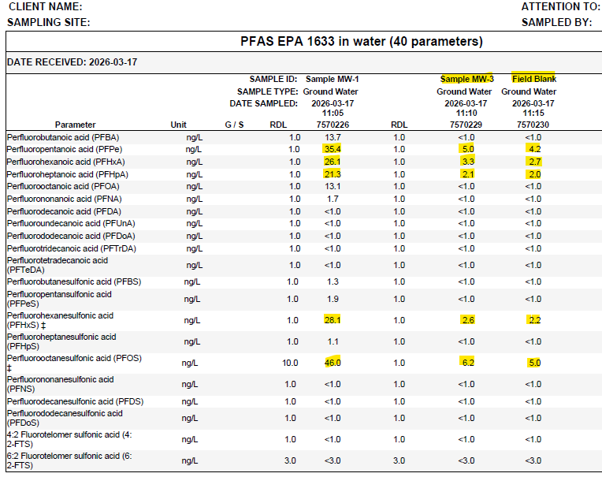
Scenario #1 – Field QC Failure (Cross-Contamination)
Field Blk > ½ RDL OR 10% sample
YES
Data Impacted?
NO
Re-sample
Flag & Proceed

Slide 20
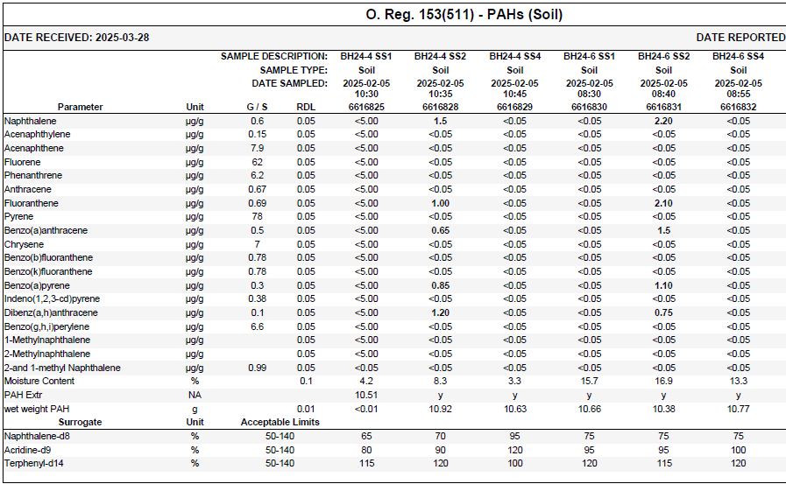
Scenario #2 – Lab Dilution Error (RDL > Clean-up Criteria)
100X Dilution RDL Raised
RDL > Criteria
YES
NO
Keep Data
Target COCs > Calibration
Matrix Effect Non-Target COCs
Re-analyze & Revise Report
Qualify Data OR Re-sample
Notes:
Elevated non-target analyte or matrix interferences resulting poor recovery

Slide 21
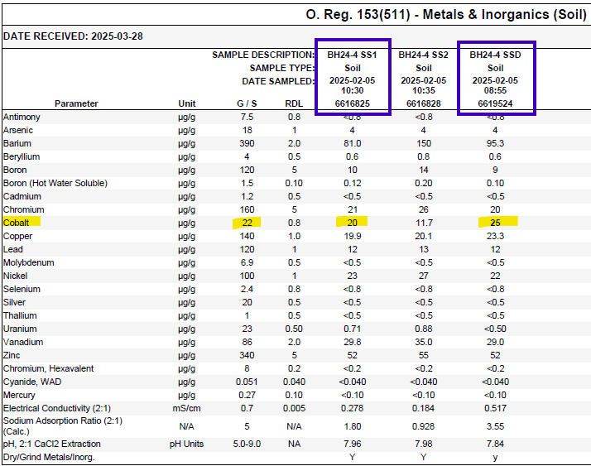
Scenario #3 – Blind Duplicates (Random Failure)
Field Dup > Criteria
NO
Dup RPD > 50% Limit
YES
Re-analyze
Is still > Criteria?
NO
YES
Heterogeneous Sample
Revise Report
Qualify Data OR Re-sample
Qualify Data OR Re-sample
Notes:
Duplicate Qualifier: for duplicates as the measured result approaches the RL, the uncertainty associated with the value increases dramatically, thus duplicate acceptance limits apply only where the average of the two duplicates is greater than five times the RL.
Duplicate Qualifier: For duplicates as the measured result approaches the RL, the uncertainty associated with the value increases dramatically, thus duplicate acceptance limits apply only where the average of the two duplicates is greater than five times the RL
Single-Point Compliance Method: If the following requirements are satisfied, the applicable excess soil quality standard is met.
If two or more in situ samples of soil are taken from sampling points at the same sampling location, as defined in subsection 48 (4) of O. Reg. 153/04, that are at the same depth, the excess soil quality standard is deemed to be met if the average of these sampling results are less than or equal to the applicable excess soil quality standard; and
The averaging provision set out immediately above does not allow for compositing of samples of soil that will be analyzed for volatile contaminants, including volatile organic compounds.

Slide 22
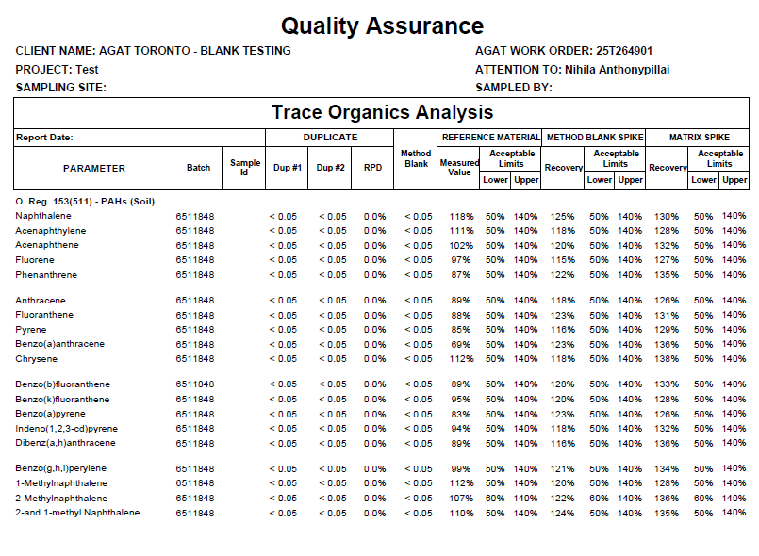
Scenario #4 – Lab QC Trend (Possible Data Bias)
SPK Recovery Trending >>
YES
Is Data > Criteria
NO
Re-calibrate & Re-analyze
Proceed with Data

Slide 23
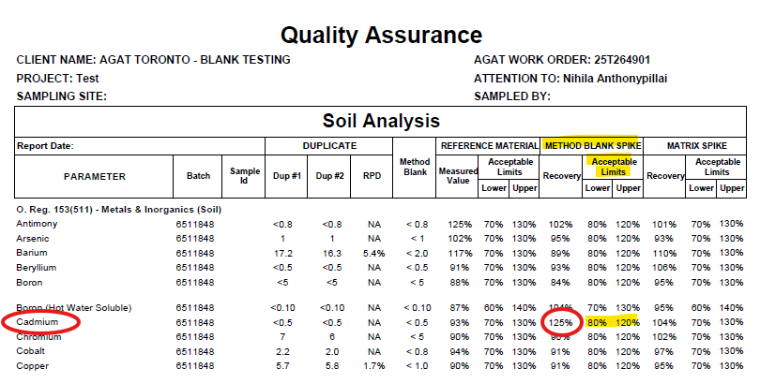

Scenario #5 – Acceptable QC Failure (Possible Data Bias)
BLK SPK > Limit
YES
Is Data > Criteria
NO
Re-calibrate & Re-analyze
Proceed with Data
Notes:
Multi-element Scan Qualifier: as the number of analytes in a scan increases, so does the chance of a limit exceedance by random chance as opposed to a real method problem. Thus, in multielement scans, for the LCS and matrix spike, up to 10% of the analytes may exceed the quoted limits by up to 10% absolute and the spike is considered acceptable. For example, in a metal scan of 18 analytes with matrix spike acceptance limits of 70–130%, 10% or one analyte may have a recovery outside of 70–130% by 10% absolute, i.e., a recovery of 60–140%.
Multi-element Scan Qualifier: As the number of analytes in a scan increases, so does the chance of a limit exceedance by random chance as opposed to a real method problem. Thus, in multi-element scans, for the LCS and matrix spike, up to 10% of the analytes may exceed the quoted limits by up to 10% absolute and the spike is considered acceptable

Slide 24


Future of Data Assessment Using AI – Enhancing Data Intelligence
“Environmental expertise meets purpose-built AI – Statvis”
On-line environmental data intelligence that
Source identification based on contaminant fingerprinting & database match to potential sources using graphical visualization of analytical data
Helps transform large sets of complex raw data into easy-to-read visual formats to map out spatial patterns of contaminant distribution on site
Currently developed for a number for COPCs including Hydrocarbons, PAHs (PAH Report Card), PCBs, PFAS
Speeds up remediation programs by differentiating source from background, identify between multiple sources of contamination, calculate actual versus estimated risk and develop a time friendly and cost-effective Remedial Action Plan that meets site-objectives
Notes:
Statvis — Environmental software company with proprietary hard coded software providing the tools to manage and remediate contaminated sites
AGAT partnership with Statvis in offering PAH Report card. Data visualization platform that transforms complex analytical data into clear insights
PAH fingerprinting identified new insights to provide researchers and environmental decision makers with the tools required to assess and mitigate potential sources of PAHs in the environment.
PAH Report Card from AGAT Labs contains histogram references, diagnostic ratios, and maps in easy-to-digest visual formats.
Data visualization is a graphical representation of information. It helps consultants build narratives and communicate their findings to stakeholders, clients, and governments.
PAH Fingerprinting: An Insight into Source and Spatial Patterns. Get most out of the data with the help of visualization.
compare samples to potential sources and background samples from sites:
Statvis’ newly online portal offers:
Guideline comparison. Compare results against established thresholds.
Graphical visualization. Export PAH fingerprints for databases or reports.
Diagnostic ratio analysis. Industry-standard ratios for source identification.
Database comparison. Match samples against potential sources.
Site-specific comparison. Compare with source and background samples.
The measured contaminants may not come from the initially suspected source. Don’t make assumptions—let the data tell you.
“chemical fingerprinting is a powerful tool for hydrocarbon source identification and differentiation, when it is applied properly.”
The data in combination with historic, geological, and environmental information, in many cases, helps settle legal liability.
Data visualization techniques transform complex numbers into clear visuals, empowering teams to make fast, confident decisions. Companies that use data visualization tools can boost decision-making, gaining an advantage from data that others struggle to interpret.
This article explores the benefits of data visualization, highlighting how it uncovers hidden patterns, strengthens collaboration, and transforms raw data into powerful insights that drive growth.
AGAT clients who wish to add a PAH Report Card can do so to any PAH analysis and do not need to be a Statvis user. However, current Statvis users can easily upload their results to the Statvis platform. Statvis users also gain access to a wealth of tools to support data visualization. Zoom in and out of areas of concern on an interactive map, select multiple samples to compare results in histograms, and see trends over time.

Slide 25
Key Takeaways
Data quality starts in the field. Any discrepancies add to data uncertainty
The lab quality control measures make results reliable and defensible
Quality control limits established for lab QC are not the same for field QC samples
Ensure sufficient sample volumes to ensure lab QA/QC requirements are met
By controlling the various factors contributing to the overall uncertainty, the lab has an increase level of confidence in the data reported
Timely review of results for any follow-ups required within holding times & sample shelf life
Utilizing AI based data visualization tools to accurately map contaminants to source type and their distribution to effectively manage remediation programs to keep within time and cost

Slide 26



Thank you !
Thank you !
Nihila Anthonypillai Manager of Technical Services anthonypillai@agatlabs.com

Slide 27
References
Protocol for Analytical Methods Used in the Assessment of Properties under Part XV.1 of the Environmental Protection Act and Excess Soil Quality, MECP, (O. Reg 153/04, O. Reg. 406/19) Version 3.1 – February 19, 2021
CCME Guidance Manual for Environmental Site Characterization in Support of Environmental and Human Health Risk Assessment, Volume 4 Analytical Methods, PN1557 ISBN 978-1-77202-032-8 PDF
RULES FOR SOIL MANAGEMENT AND EXCESS SOIL QUALITY STANDARDS, 23 DECEMBER 2022
AGAT SOP QC-1301 Estimation of Measurement Uncertainty, Revision # 009, May 11, 2023
AGAT SOP QC-3108 Implementation & Use of Control Charts, Revision # 003, April 18, 2023
AGAT SOP QA-3034 AGAT Corporate QC Limits – Environmental Division, June 13, 2024
STATVIS - https://www.statvis.com/company/

