Slide 1
Federal Contaminated Sites Action Plan
Update and Demand Forecast
Phase V 2026-2031
RemTech East 2026
Ottawa, Ontario
Darragh Kilroy, Manager Contaminated Sites
PSPC National Capital Region
April 9, 2026

Slide 2
Overview
Federal Contaminated Sites Action Plan (FCSAP)
Procurement Approaches
Procurement Assistance Canada
Phase V 2026-31 Demand Forecast
Demand Forecast Tools, including Interactive Map
Access to GCcollab
Contact Information

Slide 3
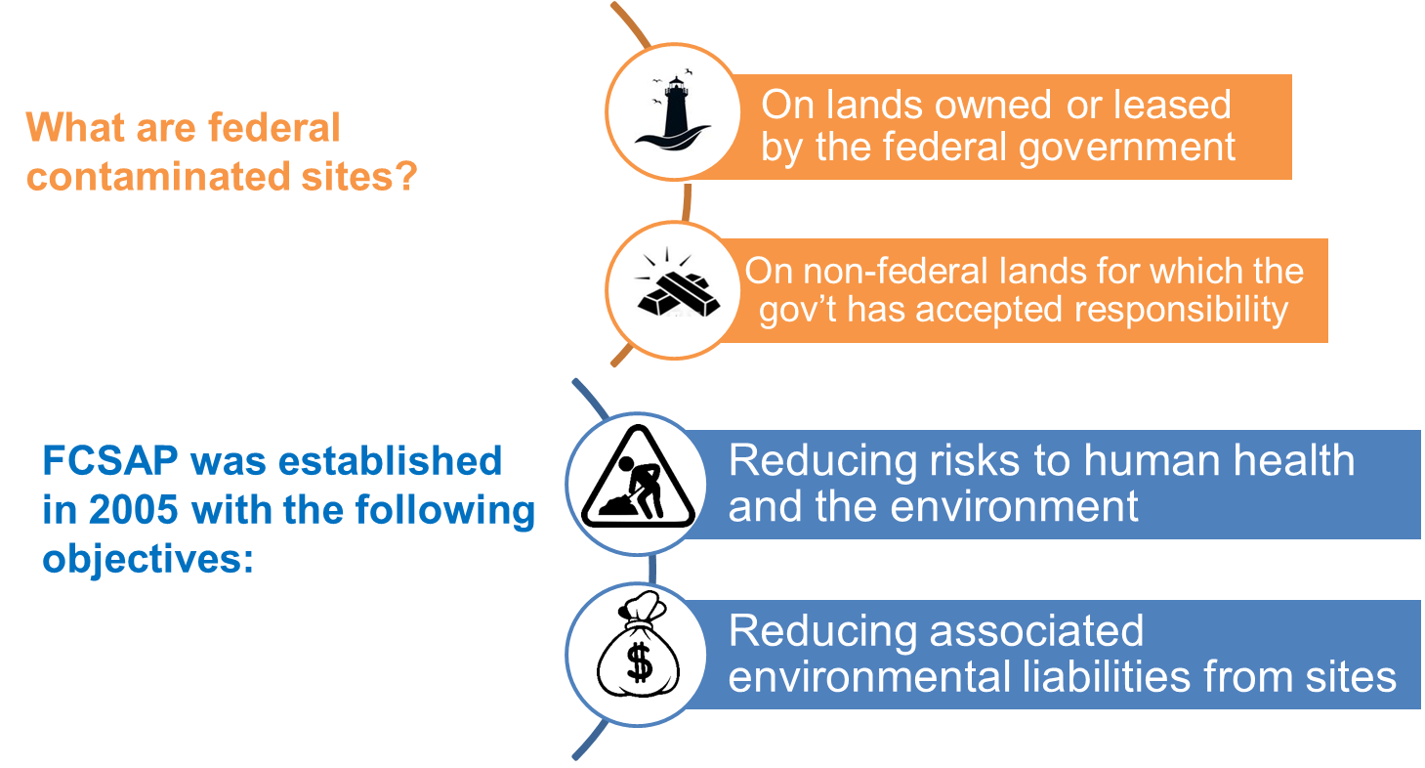
Federal Contaminated Sites Action Plan (FCSAP)

Slide 4
FCSAP Achievements after 19 Years (2005-2024)
3,000 sites with remediation
2,100 fully remediated
Skills development and job training
27,400 direct jobs; $2.4 billion spent in Canada’s North
Science development
120 environmental quality guidelines, technical guidance, tools
$5.7 billion investment
World-class contaminated sites management industry in Canada
Source: FCSAP Secretariat (June 2025)

Slide 5
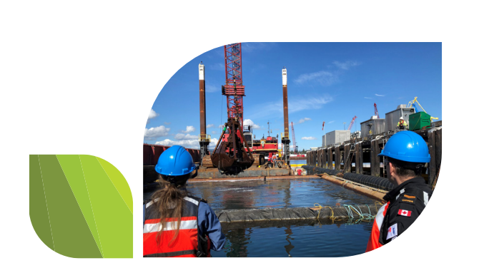
Program renewed until FY 2034-35, with funding renewed in 5 year increments.
Phase V (2025-2030) to begin April 1st, 2025
  $31 million in assessment funding
  $1.6 billion in remediation funding
14 custodians
4 Expert Support Departments: DFO, HC, ECCC and PSPC
Secretariat: ECCC and TBS
Six (6) Regional Integrated Planning Boards
FCSAP Renewal
Source: FCSAP Secretariat 2025

Slide 6
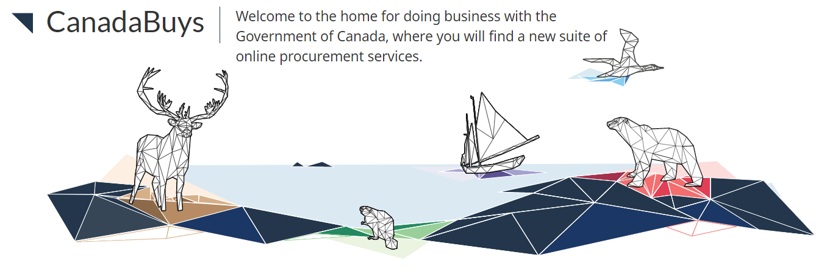
Procurement Approaches
Generally lower dollar value sites are procured by Standard Procurement Tools (e.g. Standing Offer Agreements, Task Authorizations, Supply Arrangements), which are advertised on CanadaBuys, the Government of Canada’s official tendering service, as well as MERX.
Generally higher dollar value and more complex sites are procured through the tendering process and are also advertised on CanadaBuys and MERX.
Individual First Nations and Tribal Councils put out requests for bidders for assessment and remediation work on their lands, using funds provided by Indigenous Services Canada (ISC) through grant and contribution agreements.
Notes:
PSPC is a Service Provider, which means that we provide the overall support for the planning, procurement and implementation of FCSAP contaminated sites assessment and remediation projects. As you will see later in the presentation, Defence Construction Canada (DCC) are the service provider for DND and then some departments do their own procurement internally, without using PSPC or DCC.
CanadaBuys is the authoritative source for government procurement information and will be one of the online resources that will be of great importance and help to you. You can use it to track tenders and sign up to be alerted to new ones. It is also a great resource for information to help understand the federal government contracting process. This platform has replaced the previously used Buyandsell. We recommend you check out the website to learn more.
Merx.com is what DCC uses largely, on behalf of DND.
Lower dollar value (assessment) <$1M
Higher dollar value/complex sites>$1M

Slide 7
Procurement Assistance Canada
Procurement Assistance Canada (PAC) supports small and medium enterprises (SME) through the federal procurement process
Engages, assists and informs SMEs on how to sell goods and services to the Government of Canada
Works to reduce barriers to ensure fairness in the process
Assist
Inform
Reduce Barriers
Engage
Notes:
PAC was created as part of PSPC to support small and medium enterprises (SME) in the federal procurement process. PAC's role is to engage with SMEs to assist and inform them on how to sell their goods and services to the Government of Canada, and to work to reduce procurement barriers in an effort to ensure fairness in the process.
They do this by listening to concerns, answering questions, helping them to understand the procurement process, and also helping them identify opportunities

Slide 8

Innovative Solutions Canada is an initiative designed to stimulate technology research, development, and commercialization of Canadian innovations.
Challenge Stream
Focuses on early-stage research and development (R&D)
Testing
Stream
Focuses on later-stage R&D prototype testing
Notes:
Innovative Solutions Canada is an initiative designed to stimulate technology research, development, and commercialization of Canadian innovations. The program's Challenge Stream and Testing Stream help startups and small/medium-sized businesses (SMEs) overcome technology testing and development hurdles so that they can produce globally-demanded products and services, while also improving government operations. You can visit their website to see their current open funding opportunities and subscribe to get notified of new ones.

Slide 9
FCSAP DEMAND FORECAST
PHASE V 2026-2031

Slide 10
Caveats
The information in the following slides is the best information currently available and provides a “big picture” perspective on FCSAP investments.
The data are extracted from the latest National Workplan and Federal Contaminated Site Inventory (FCSI) and are a snapshot of funding submissions and contaminated sites data and is subject to possible revisions.
Custodians sometimes experience project delays due to weather conditions or other unforeseen circumstances, which can affect their work plans. Although projects may be approved, they may not proceed for logistical reasons.
Annual updates will improve the accuracy of future year estimates, in both number of sites and estimated costs.
Complete list of caveats are available on Federal CS Demand Forecasts GCcollab group: FCSAP Phase V 2025-2030 Federal Contaminated Sites Demand Forecast Analysis Report : GCcollab
Notes:
Background: As part of its expert support mandate within the FCSAP program, PSPC is responsible for providing forecasted expenditure estimates to the environmental industry in order to create awareness of the demand for services and so that the industry can build adequate capacity to respond to this demand.
The data covers the forecasts for 2026 to 2031. Please note that these forecasts are provided for information only and may change.
It is not possible to provide details at a site-level to ensure the integrity of the bid process and to ensure adequate stakeholder engagement has been completed.

Slide 11
National Overview of FCSAP Phase V 2026-2031
$1.5 Billion
Total Forecast
$21 Million
Assessment
$1.5 Billion Remediation
Source: FCSAP Secretariat (February 2026)
Notes:
Source: FCSAP National Custodial Workplan of February 2026.
Assessment: $ 21M
Remediation/LTM: $1.5B - majority of funding for remediation.
Includes cost-share portion
% by region is based on the value of work. Sites throughout Canada; Value of sites mostly in Pacific & Ontario & North
Atlantic (NB, NS, PEI, NFLD)
Quebec
ON
Prairies (AB, SK, MB)
Northern (NU, NWT)
Pacific (BC, YK)

Slide 12
National Overview of FCSAP Phase V by Procurement Provider 2026-2031
Source: FCSAP Secretariat (February 2026)
Notes:
Source: FCSAP National Custodial Workplan of February 2026.
As mentioned previously, custodians use either PSPC or DCC as service providers or they do their own procurement internally.
As seen on the Procurement Approaches slides, for opportunities to bid on projects procured by DCC, consult MERX and for all others, consult CanadaBuys.
As the graph shows, for assessment projects, the bulk of procurement is through ISC, followed by smaller amounts for the others.
For Remediation funding, procurement is mainly through PSPC, followed by smaller amounts for DCC, ISC and Internal.
ISC does all of their procurement internally, through grants and contributions directly to First Nations.

Slide 13
Ontario - Overview of FCSAP Phase V 2026-2031
$234.5 Million
Total Forecast
$1.8 Million
Assessment
$232.7 Million Remediation
Source: FCSAP Secretariat (February 2026)
Notes:
Includes cost-share portion
Majority of funding for remediation and LTM.
DND, ISC and TC custodians with majority of funding.

Slide 14
Ontario - Overview of FCSAP Phase V by Procurement Provider 2026-2031
Source: FCSAP Secretariat (February 2026)
Notes:
For assessment, procurement is mainly internal or through ISC.
For remediation, procurement is mainly through PSPC, followed by ISC, DCC and Internal. Again, First Nations do all of their procurement internally, through grants and contributions directly from ISC.

Slide 15
Ontario – Distribution of Values of FCSAP Sites Phase V 2026-2031
Assessment
$1.8 Million
Remediation and Long Term Monitoring
$232 Million
Source: FCSAP Secretariat (February 2026)
Notes:
% based on number of sites.
Shows that majority of projects are lower dollar value, likely procured through tools.

Slide 16
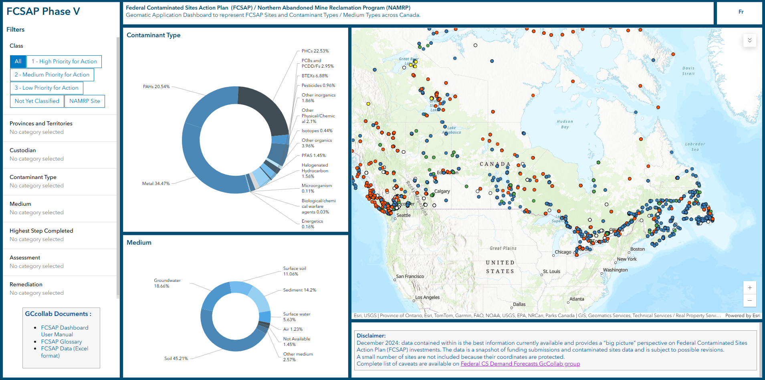
Demand Forecast
Tools
Live interactive tool: FCSAP Dashboard
Available on Federal Contaminated Sites Demand Forecasts GCcollab group:
  User Manual: FCSAP Phase V Web Dashboard
  Complete Federal CS Demand Forecast Analysis Report: FCSAP Phase V 2025-2030 Federal Contaminated Sites Demand Forecast Analysis Report : GCcollab

Slide 17
Access to GCcollab
Step 1: Create a GCcollab account GCcollab.
If you have a non-federal government email address, there are 2 options:
  Submit a ticket to the GCcollab Help Desk requesting an account Submit a ticket : GCTools
  Contact a GCcollab user for this person to invite you. e.g. Dianne Theriault (dianne.theriault@tpsgc-pwgsc.gc.ca)
Step 2: Request Membership to join this group: Federal Contaminated Sites Demand Forecasts / Prévisions de la demande reliée aux sites contaminés fédéraux using this link: Federal Contaminated Sites Demand Forecasts / Prévisions de la demande reliée aux sites contaminés fédéraux : Gccollab
Step 3: When your membership request has been processed, you will be to access the files using this link:Federal Contaminated Sites Demand Forecasts / Prévisions de la demande reliée aux sites contaminés fédéraux's files : GCcollab
If you have any questions/problems, please consult the FAQ GCcollab page: https://gccollab.ca/help/knowledgebase or contact Dianne Theriault (dianne.theriault@tpsgc-pwgsc.gc.ca).

Slide 18
Questions?

Slide 19
Contact Information
PSPC – National Capital Region
Darragh Kilroy
Manager, Contaminated Sites
Email: Darragh.Kilroy@tpsgc-pwgsc.gc.ca
ECCC – Ontario Region
Maria Petrou, FCSAP Regional Coordinator
Email: maria.petrou@canada.ca
Procurement Assistance Canada:
Telephone: 1-800-668-5378
Ontario: TPSGC.PASACOntario-APPACOntario.PWGSC@tpsgc-pwgsc.gc.ca
Federal Contaminated Sites Website: https://www.canada.ca/en/environment-climate-change/services/federal-contaminated-sites.html
Innovative Solutions Canada
Innovative Solutions Canada
Email: solutions@ised-isde.gc.ca

