Slide 1
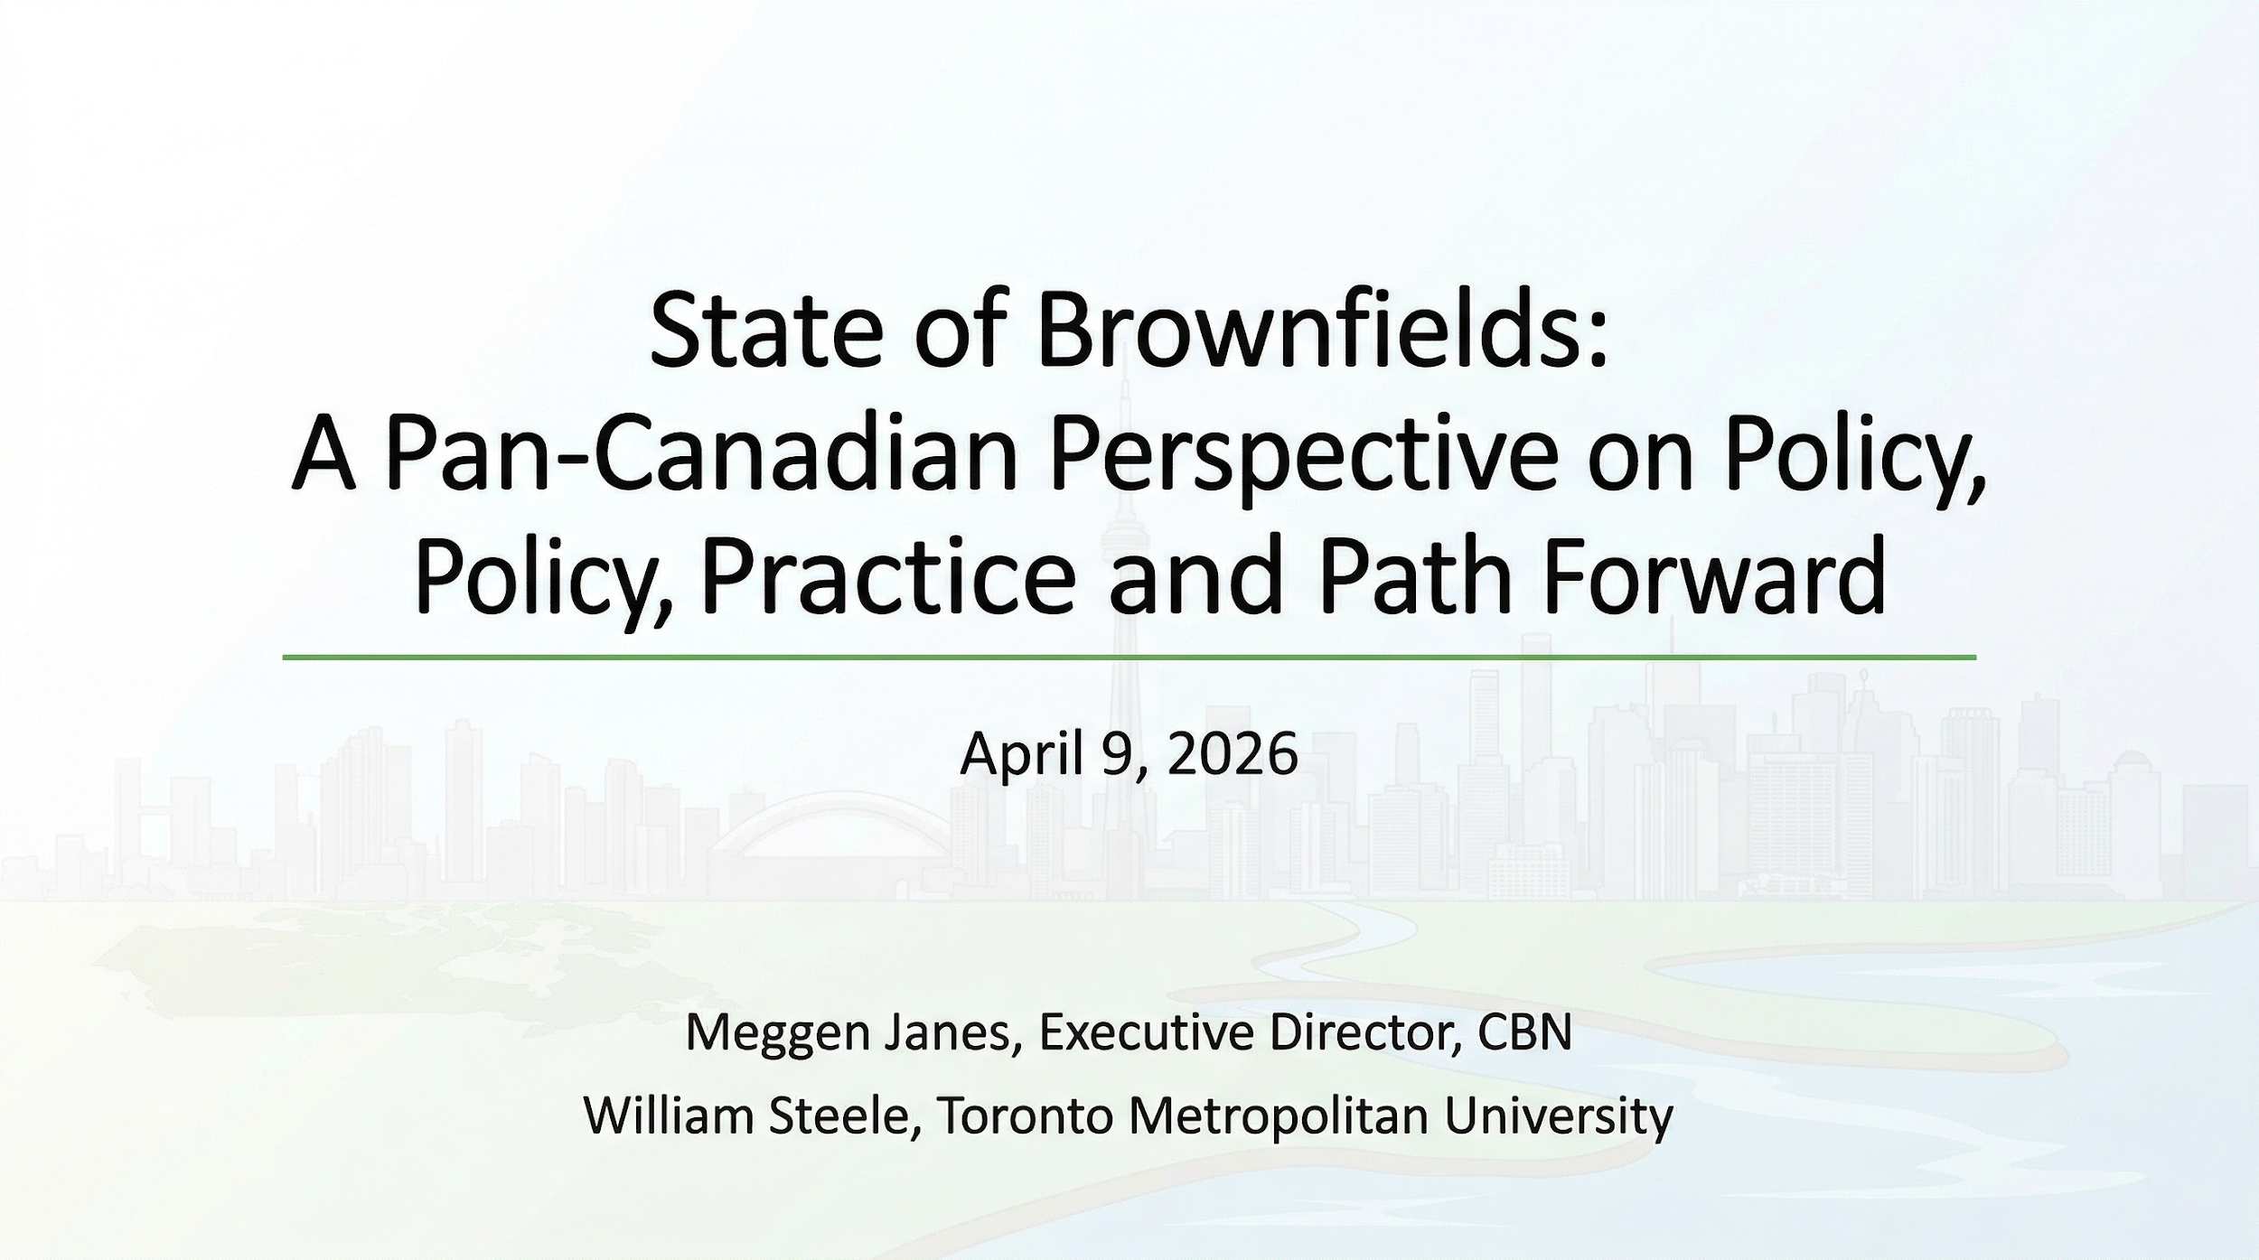


Slide 2

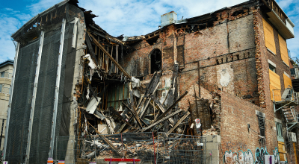
Who We Are
Not-for-profit, member-driven organization
Advocating for “Brownfields First” across Canada
National network bringing together public and private sector leaders
VISION
For brownfields to be Canada’s
preferred land development
solution.
Notes:
Good afternoon, everyone. My name is Meggen Janes, Executive Director of the Canadian Brownfields Network. Thank you to ONEIA and ESAA for the RemTech East. Canadian Brownfields Network, CBN, a not-for-profit organization that’s been promoting Brownfields First for over two decades.
Our vision is simple but powerful: to make brownfield redevelopment the first choice for sustainable community growth.
We bring together people who care about transforming underused and contaminated sites into vibrant, productive spaces look around the room you are leaders in advancing brownfield revitalization
CBN IS A NON-PROFIT ORGANIZATION THAT WAS CREATED IN RESPONSE TO RECOMMENDATIONS IN THE NATIONAL ROUNDTABLE ON THE ENVIRONMENT AND THE ECONOMY'S NATIONAL BROWNFIELD REDEVELOPMENT STRATEGY FOR CANADA.

Slide 3


City of Welland unlocked 220 hectares of brownfield land
for redevelopment
MECP Toronto District alone this year, the RSCs have the
potential to fulfill 100% of the Province’s annual housing
plans for Toronto. RSCs from 2004 to 2015 supplied over
84,000 housing units.
City of Hamilton ERASE program supported remediation of
83 hectares
Notes:
So what’s the scale of the opportunity?
Across Canada, we’re looking at over 25,000 brownfield sites.
And we don’t have to speculate on what’s possible—we can already see it in practice.
In Welland, over 220 hectares of brownfield land have been unlocked for redevelopment.
In Toronto, RSCs processed by the MECP district this year alone have the potential to support 100% of the Province’s annual housing target for the city.
And historically, between 2004 and 2015, RSCs contributed to over 84,000 housing units.
And in Hamilton, the ERASE program has supported remediation of over 80 hectares of land.
So the takeaway is this—
This isn’t a niche opportunity.
This is a scalable, proven pathway to deliver housing, growth, and revitalization—if we can get the system right.”**

Slide 4
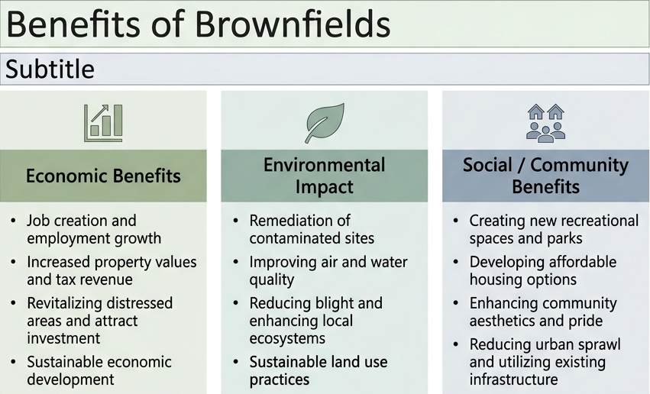
  A powerful tool to support sustainable growth, climate resilience, housing supply, and economic revitalization.
Notes:
So why do brownfields matter?
Because they deliver across every priority we’re talking about—economic growth, environmental performance, and stronger communities.
From an economic perspective, brownfield redevelopment drives jobs, investment, and increased tax base—while bringing underutilized land back into productive use.
Environmentally, it’s about cleaning up legacy contamination, improving air and water quality, and making better use of land we’ve already disturbed.
And from a community perspective, this is where it really comes together—
we’re creating housing, improving public spaces, and reducing pressure to expand outward by using existing infrastructure more efficiently.
So this isn’t just an environmental issue—
it’s a housing solution, a climate solution, and an economic development strategy all in one.”
Economic Benefits
+11% residential growth
+13% job growth
Increased tax base
Environmental Impact
32 to 57% reduced vehicle travel
Soil remediation benefits
Social Transformation
Possible means to meet Provincial Housing Targets
UTILIZE CONTAMINATED LAND FOR FUTURE DEVELOPMENT
INCREASE LAND VALUE
FINANCIAL SUPPORT
REDUCED EMISSIONS

Slide 5
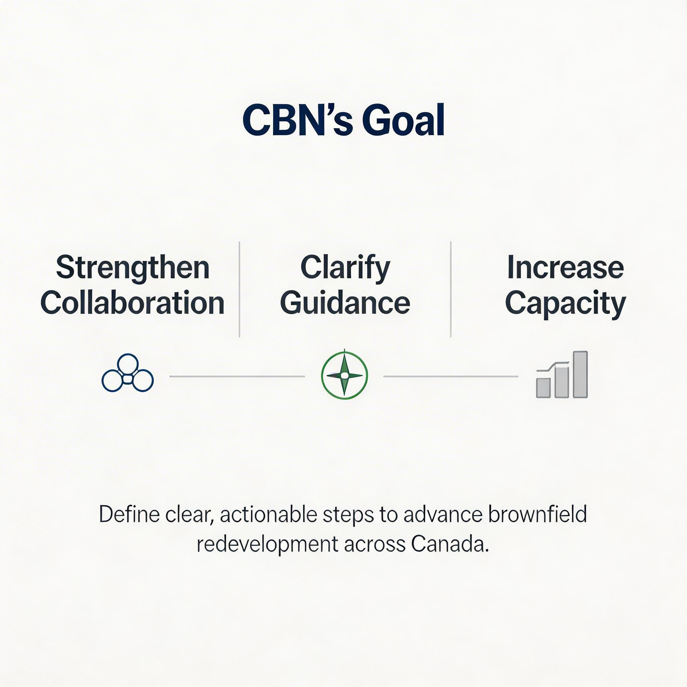
CBN’s Goal
WORK TOGETHER TO DEFINE CLEAR, ACTIONABLE STEPS THAT STRENGTHEN COLLABORATION BETWEEN MUNICIPALITIES AND PROVINCES/TERRITORIES, CLARIFY GUIDANCE, AND INCREASE CAPACITY TO ADVANCE BROWNFIELD REDEVELOPMENT.
Notes:
So what does success look like?
At its core, it comes down to three things.
First, we need to strengthen collaboration—bringing regulators, municipalities, industry, and partners together in a more coordinated way.
Second, we need to clarify guidance—so expectations are clear, consistent, and predictable across jurisdictions.
And third, we need to increase capacity—ensuring the system is properly resourced to deliver timely decisions.
Together, these form the foundation for defining clear, actionable steps to advance brownfield redevelopment across Canada.”**

Slide 6
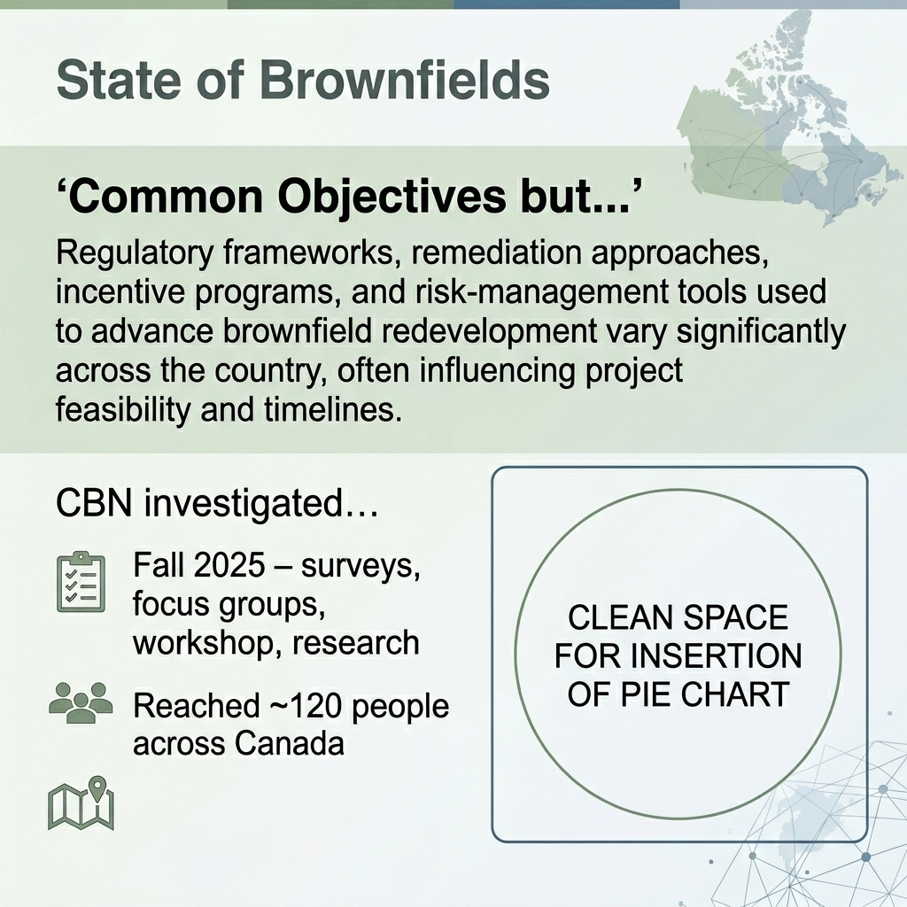
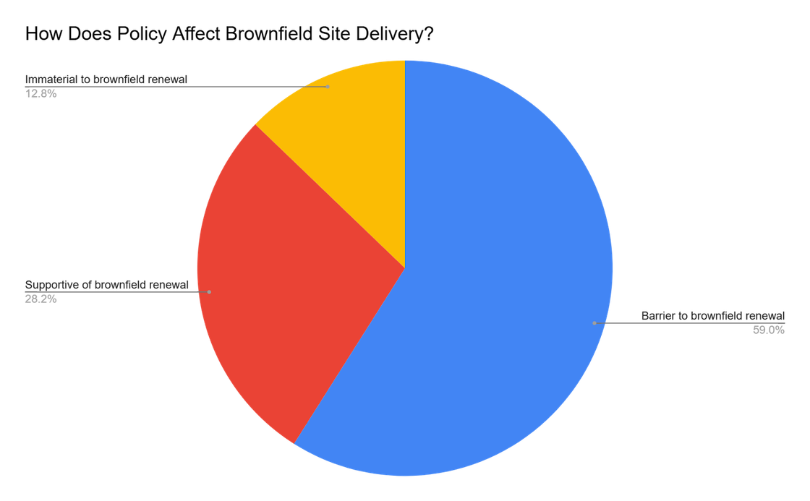
Notes:
So what did we hear across the country?
There’s actually a high degree of alignment on the objective—
we all want to see brownfield redevelopment move forward.
But the challenge is that the way we get there varies significantly.
Regulatory frameworks, remediation approaches, incentive programs, and risk-management tools differ across jurisdictions—and that variability directly impacts feasibility, timelines, and ultimately whether projects move ahead.
To better understand this, CBN undertook a national effort—through surveys, focus groups, workshops, and research—engaging about 120 stakeholders from across Canada.
And what we heard was consistent:
While the intent is aligned, the system itself is not—
and that inconsistency is a major factor influencing brownfield delivery.”

Slide 7
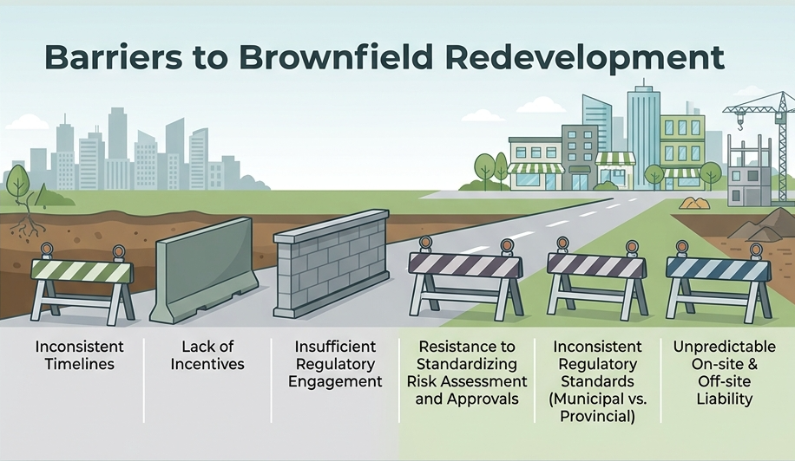
Notes:
So what’s getting in the way?
Across the country, we heard a consistent set of barriers—and they tend to show up at every stage of a project.
We see inconsistent timelines, where approvals can vary significantly depending on jurisdiction.
A lack of incentives in some areas, making projects harder to finance or less competitive.
Limited regulatory engagement, especially early in the process, which creates uncertainty for proponents.
And then more systemic challenges—
resistance to standardizing risk-based approaches,
differences between municipal and provincial standards,
and ongoing uncertainty around on-site and off-site liability.
Individually, these are challenges—but together, they create friction across the entire system.
And that friction is what slows down—or stops—brownfield redevelopment.”

Slide 8
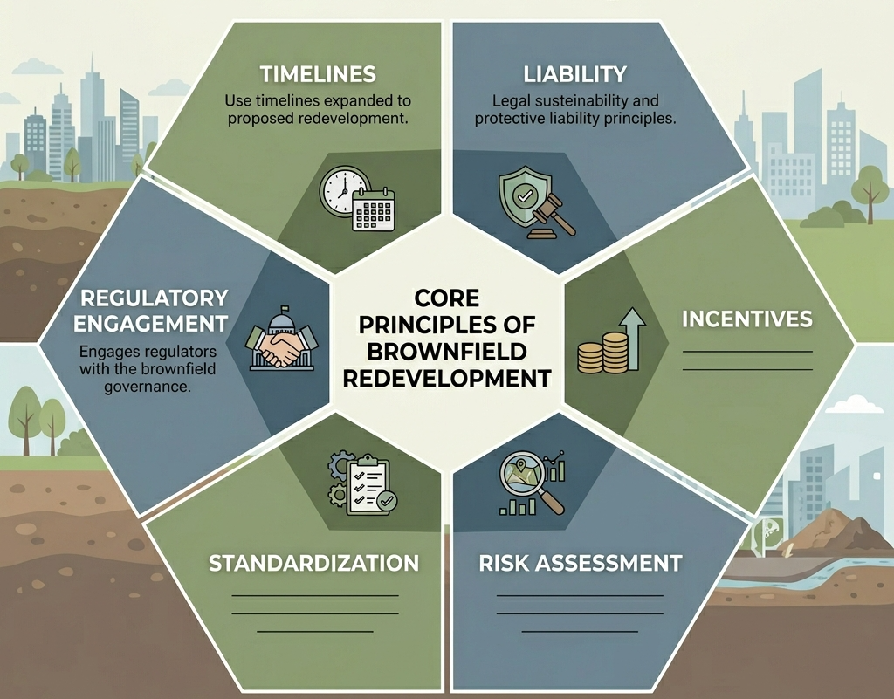
Foundational Principles Supporting Brownfield Redevelopment
Notes:
So if those are the barriers—what does a better system look like?
It’s not about solving one issue in isolation.
It’s about putting in place a set of core, coordinated principles that work together.
We need clear and predictable timelines…
effective incentives that support redevelopment…
early and consistent regulatory engagement…
risk-based approaches that are understood and accepted…
clear and consistent liability frameworks…
and standardization where it matters, with flexibility where it’s needed.
Individually, each of these helps—but it’s when they come together that the system really works.
That’s what enables projects to move forward with confidence—and ultimately allows brownfields to be delivered at scale.

Slide 9
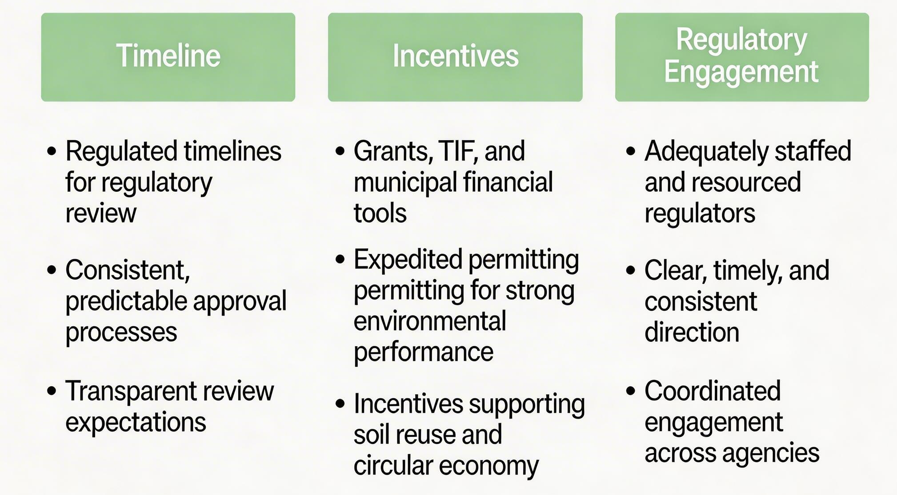
Brownfield “Utopia”
Notes:
So what does a ‘brownfield utopia’ look like in practice?
It starts with timelines—
where regulatory reviews are clear, consistent, and predictable, and proponents understand what’s expected from the outset.
It’s supported by incentives—
not just funding tools like grants or TIF, but also expedited pathways for projects that deliver strong environmental outcomes, and incentives that support soil reuse and circular economy approaches.
And critically, it depends on regulatory engagement—
with regulators that are adequately resourced, providing clear and timely direction, and working in a coordinated way across agencies.
These aren’t new ideas—
they’re things we’ve seen work.
The opportunity is to make them consistent and scalable across the system

Slide 10
Brownfield “Utopia”
Risk Assessment
Liability
Standardization
Clear, predictable frameworks and expectations
Enables redevelopment of lower-value sites
Normalize and support risk-based approaches
Tools for closure and long-term certainty
Transparent on-site and off-site liability framework
Mechanisms to support “innocent owner” status
Alignment of provincial and municipal policies
Standardized science behind numerical standards
Flexibility for site-specific conditions and context
Notes:
The other side of this—and just as critical—is creating certainty in the system.
That starts with risk assessment—
where frameworks are clear and predictable, enabling redevelopment of more challenging and lower-value sites, and where risk-based approaches are understood and accepted.
It extends to liability—
where proponents have tools for closure and long-term certainty, and where on-site and off-site responsibilities are clearly defined.
And it requires standardization—
alignment between provincial and municipal policies, consistency in the science behind standards, and the ability to apply flexibility where site-specific conditions demand it.
Together, these elements reduce uncertainty—
and that’s what ultimately allows projects to move forward with confidence

Slide 11

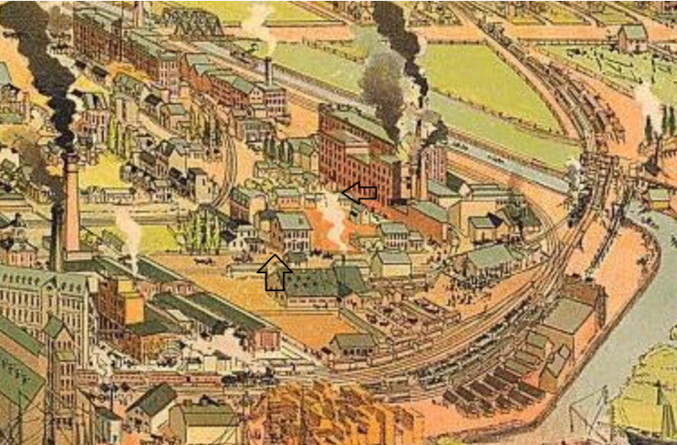
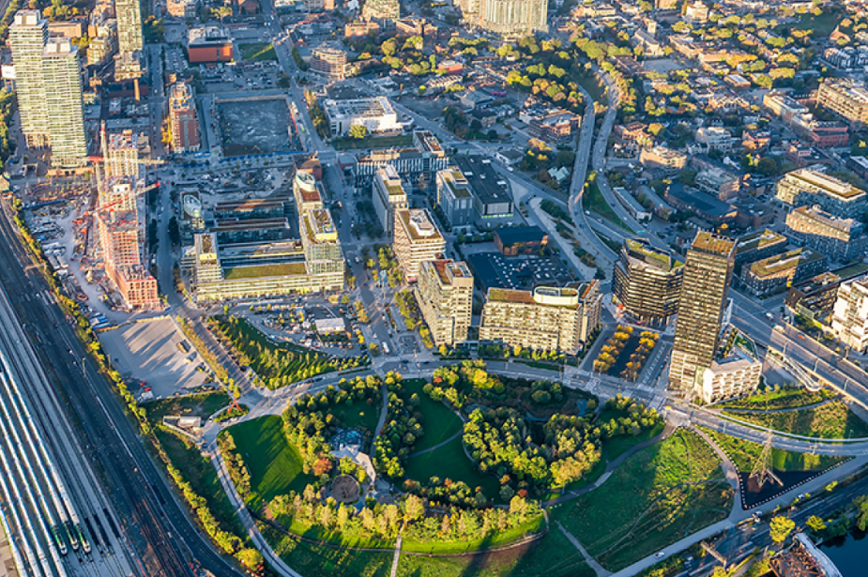
West Don Lands – Enabling Infrastructure and Regulatory Timelines
Accelerated timelines (RA completed within ~ 1 year)
Risk-based regulatory tools
Major public infrastructure investment (flood protection, park, streets)
Limited traditional financing tools
Key Takeaway: Regulatory flexibility + infrastructure investment can unlock stalled brownfield sites

Slide 12
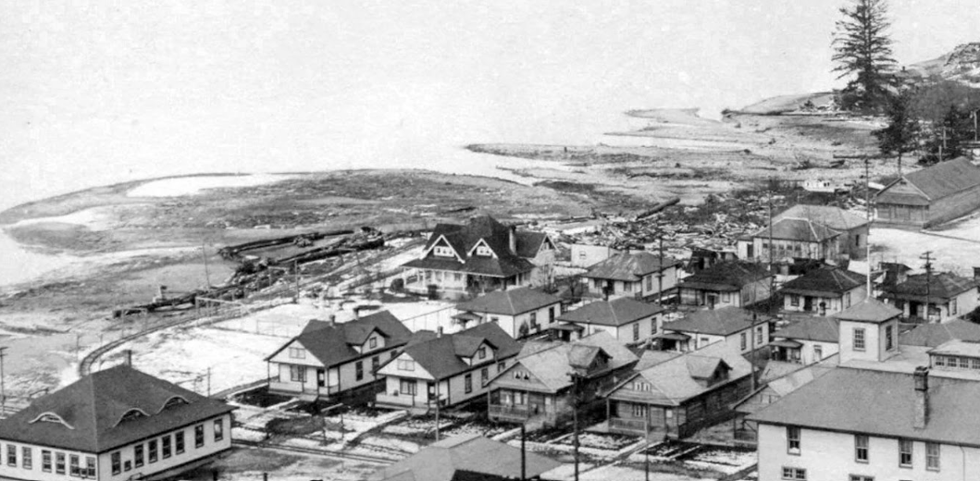
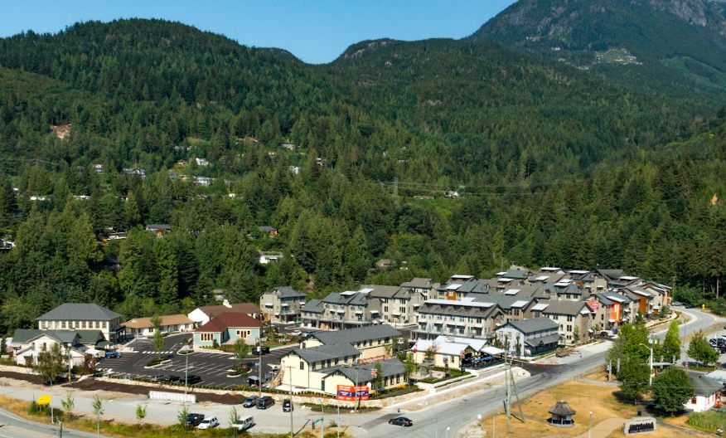
Vancouver Area – Incentives + Remediation Approval
Risk-based regulatory framework (BC CSAP model)
Collaboration and consultation with the regulator and local government on remediation approach
Obtained an Approval in Principle for remediation from the regulator
Land transfer to government to access a $30 million fund available from former polluters.
Key Takeaway: Incentives + remediation approvals + regulatory engagement can accelerate redevelopment and enhance outcomes.
Notes:
A Future Shaped by the Past.
Britannia Beach lies on a site that formerly hosted the Britannia Mine, a large copper mine that operated for over seven decades until it shut down in 1974.
Located in the heart of the Sea to Sky corridor between Vancouver and Whistler, Britannia Beach is a historic settlement originally built to support a copper mine. In 2004, the Macdonald Group subdivided and sold 197 lots and dedicated 9,500 acres of land back to the Province to enable remediation of the environmental legacy left behind by the former mine.
In 2025, the neighbourhood of Britannia Beach experienced a profound resurgence as work was completed on the final phase of the project – a new residential, commercial, and retail development incorporating many refinished historic buildings. The new community consists of 73 townhomes, walkable and bikeable trails, a community garden, a children’s playground; and a commercial village including a full-service grocer, family restaurant, local cafe, and dedicated rental units for employees.
An underutilized, 15-acre area with four parcels on the west bank of the Upper Harbour, part of which was once a landfill, was contaminated with heavy metals and petrochemical residue from mills and a paint factory. The City of Victoria purchased the parcels, which it named “Dockside Lands,” from the province in 1989 for $1. The sloping parcels sat one block off the water’s edge, separated from the Harbour by the relics of Point Hope Shipyard. The Harbour Plan, completed in 2001, had supported the continued industrial use of the working waterfront and the city intended to include some form of light high-tech industry. But efforts to market the property failed due to inadequate understanding of soil contamination.
The city commissioned a detailed environmental assessment as part of the preparation of a business case for the property. It concluded in 2002 that development was possible, with some public financial support, favorable land pricing, and rezoning to allow greater density (the existing zoning was light industrial with a floor-to-area ratio of 1:1, and the project is currently at a 2:1 ratio). Utilities already existed on the site, with capacity for new development. A new 6-story office project called Upper Harbour Place was constructed adjacent to the site in 2002, proving the marketability of the land.
Most of the capital (75 percent) was provided by Canada’s largest credit union, VanCity, which became a co-developer of the project in a partnership called Dockside Green Limited.
Under the September 2005 Master Development Agreement with the City of Victoria, Dockside Green Limited agreed to purchase the property for $8.5 million and develop it according to an approved site master plan and design guidelines with an extensive list of amenities such as public spaces and public art, interpretive signage, shoreline enhancement, and trail improvements. Dockside Green Limited also agreed to contribute money towards a dedicated City of Victoria staff member to shepherd development review and contributed $400,000 toward a new Sustainability Centre at Dockside. A key early contributor to the project’s success was the city’s willingness to allow the developers to defer payment for the land, which freed up enough cash for quick construction of the project’s infrastructure without significant bridge financing.
The city agreed to initiate zone changes and amend the Community Plan and land use designations. The city also created an interdisciplinary project team, bringing together city planners, engineers, and finance specialists and including representatives of the local Victoria West Community Association and local First Nations indigenous peoples.

Slide 13
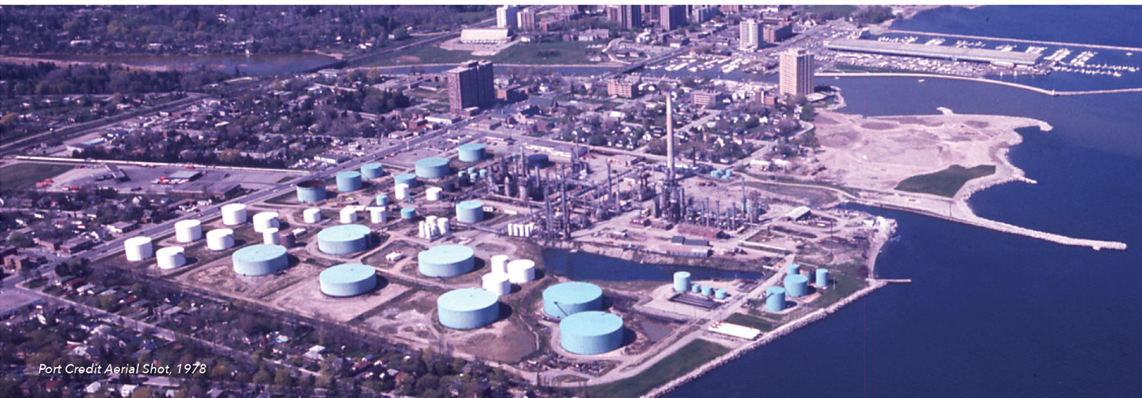
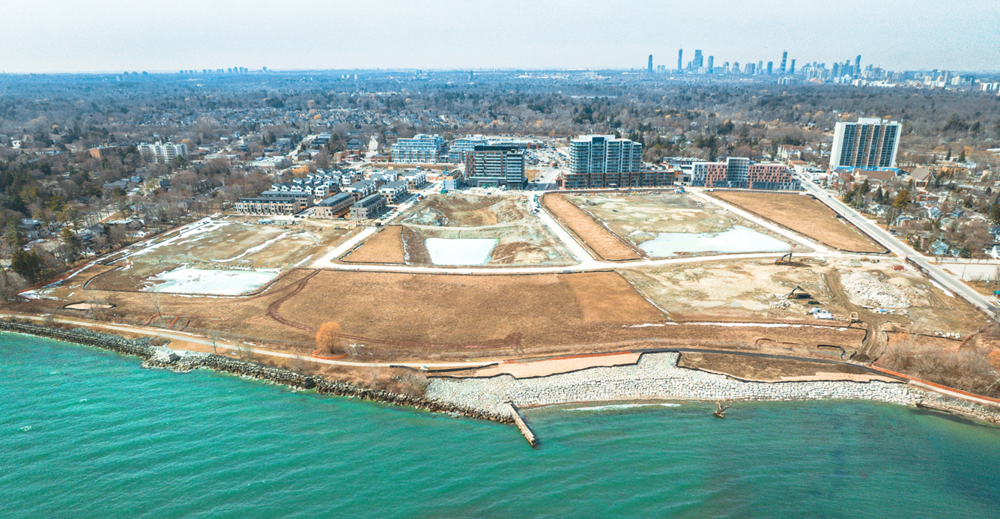
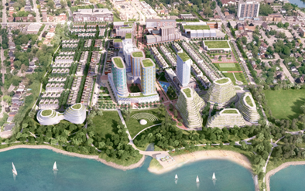
Brightwater – Private development supported by process clarity
RA and integrated project design minimized excess soil
Use of expedited MGRA supported early delivery of first phase
Municipal processes enabled envirnmental approvals and early construction to occur concurrently.
Strong developer track record and regulatory closure enabled traditional financing
Key Takeaway: Integration of environmental, project design, and municipal planning processes creates value in private development through efficiencies in project delivery.
Notes:
Brightwater:
72 acres waterfront, almost 100 years of historical oil refining uses and former brick quarry.
Will deliver more than 3800 homes and 240,000sqft mixed use, 14+ acres of new parkland, affordable housing and a new school.
Transit oriented, low impact stormwater design, LEED ND certification.
Fully privately-funded, no public funds or grants in the phases of development to-date.
Environmental remediation was optimized through risk assessment and built form design and grading to minimize offsite disposal of soils
Early delivery of revenues was critical in a project that required significant upfront equity to fund remediation and infrastructure. An first development phase was planned that was able to be managed through the expedited Tier 2 RA (MGRA) process.
Municipality was able to build processes that protected their interests while enabling efficient process for project delivery:
Delay of RSCs to later in the planning process was enabled by clear communication and transparency between developer and municipality, and use of peer review process
Municipality was willing to accept lands with risk-based closure.
Conditional building permits enabled early construction to occur while environmental approvals were in final stage
Traditional financing was enabled by strong developer track record in delivering complex projects, and presentation of clear implementable development plan that integrated environmental concerns and laid out achievable regulatory approval structure. Clarity in the Ontario RSC process

Slide 14
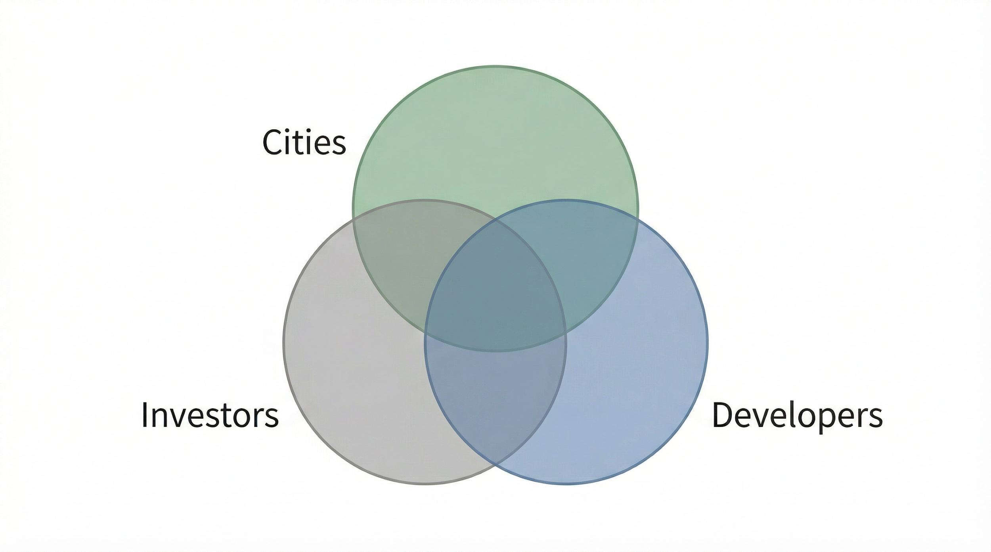
Action Plan
👉 We know the barriers. We know what works. Now we act.
CBN Action Plan Focus:
Raise awareness across Canada
Advocate for systemic change
Streamline redevelopment processes
Stakeholder alignment
Regulators &
Notes:
“So where does this leave us?
We’ve spent time understanding the barriers—and we’ve seen what works in practice.
Now, the focus shifts to action.
CBN is actively developing an action plan to help move this forward at a national level.
That plan is centered on four areas:
raising awareness across Canada,
advocating for systemic change,
streamlining redevelopment processes,
and—critically—aligning stakeholders across the system.
Because ultimately, progress doesn’t come from any one initiative—it comes from coordinated effort with consideration of the stakeholds: regulators & cities, investors and developers.
And this action plan is about turning insight into something that is practical, scalable, and deliverable.”**

Slide 15
Next Steps – short term
Timeline | Incentives | Regulatory Engagement | Risk/Liability/ Standardization
Cross-country check-up webinar Highlight benefits of transparency in service standards | Share incentive tools and case studies | Determine need for consultation framework between regulators and applicants | Review self-directed risk-based approaches Initiate discussions on liability gaps Conversations across jurisdictions
Notes:
“So what are we doing in the short term?
We’re focused on building momentum and creating visibility across the system.
On timelines, we’re launching a cross-country check-up to better understand current service levels—and to highlight the value of transparency and predictability.
On incentives, it starts with sharing—bringing together tools, case studies, and practical examples that can be used across jurisdictions.
For regulatory engagement, we’re taking a step back and asking: what does effective consultation actually look like?—and working toward a clearer framework between regulators and applicants.
And across risk, liability, and standardization, the focus is on starting the right conversations—reviewing risk-based approaches, identifying liability gaps, and connecting jurisdictions that are tackling similar challenges.
These are practical, near-term actions—but they’re all designed to move us toward a more coordinated and predictable system.”

Slide 16
System Change – Coordinated, Predictable System
Timelines | Incentives | Regulatory Engagement | Risk | Liability | Standardization
Share knowledge on transparent service standards and performance tracking | Develop primer on incentive tools, case studies and insurance tools Engage governments on incentive stacking | Advocate for well-staffed regulatory offices Research fee-for-service model | Publish examples of low-risk approval mechanisms Consider alignment of environmental and planning processes | Identify regulatory gaps limiting closure and long-term certainty Document tools and policies | Evaluate alignment principles with municipal processes
Notes:
In the near term, our focus is on direct engagement and practical change.
Reaching out to regulators across the country—because this only works if regulatory offices are well-staffed, supported, and resourced to deliver timely decisions.
At the same time, we’re exploring tools like a fee-for-service model, which could help improve responsiveness, provide greater predictability, and create a more consistent experience for proponents.
But stepping back—this isn’t about one tool or one initiative.
This is about moving toward a coordinated, predictable system.
A system where timelines are clear, expectations are aligned, and projects can move forward with confidence.
And that’s how we begin to shift from isolated successes… to delivering brownfield redevelopment at scale.”

Slide 17
Regulator & Cities
The tools exist. The path is clear.
Now we align.
Developers
Investors
Notes:
When regulators and cities, developers, and investors move from working in parallel to working together, brownfield redevelopment becomes predictable, viable, and scalable.
The tools exist. The path is clear. Now we align to unlock brownfield redevelopment across Canada.

Slide 18
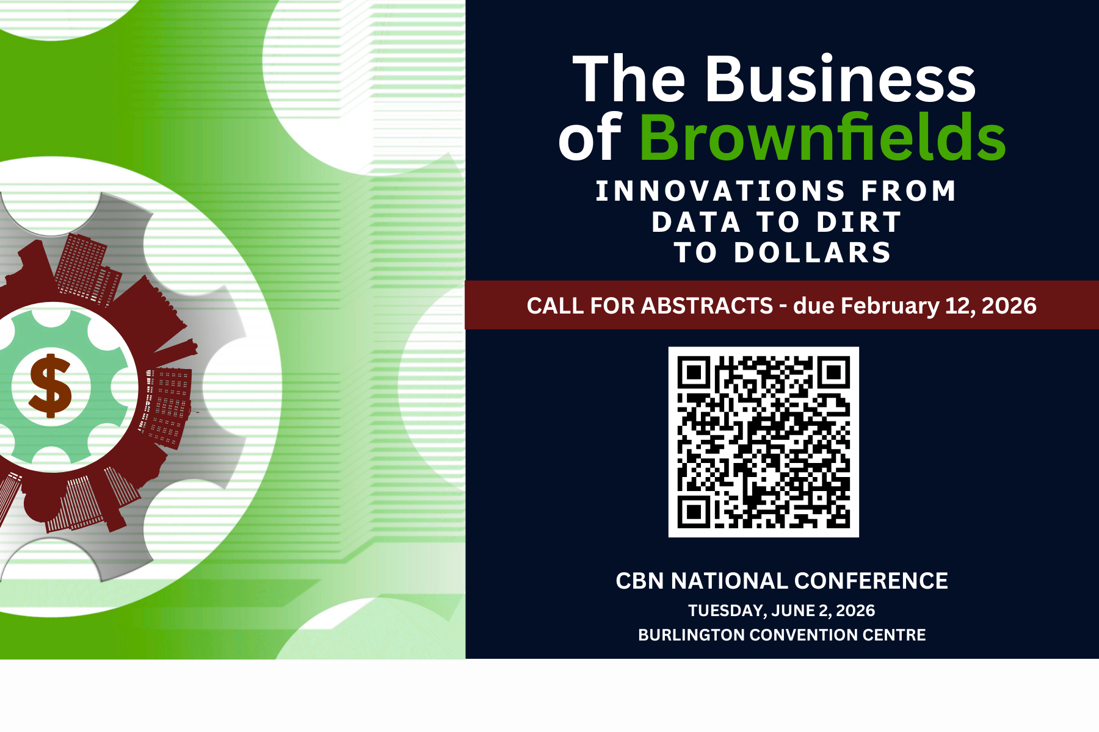
Notes:
Add to your calendars now. Our annual conference is on June 2 in Burlington. We are thrilled to announce here first our Conference Keynote - Derek Goring, CEO of Northcrest!

Slide 19

Notes:
We’ll end with this - to the public and private developers, the government staff, researchers and journalists, and the consultants in this room: You are a team.
The best brownfield projects, like the ones we’ll celebrate tonight, come from partnership, shared vision, and collaboration.
So, let’s keep building that network. Be part of change. Join the Community of CBN.

