Slide 1

SALT ORIGIN FORENSIC TESTING
2026
BUREAU VERITAS
A GLOBAL LEADER IN TESTING, INSPECTION & CERTIFICATION SERVICES

Slide 2


Brody ANDERSEN, B.Sc., B.Sc.
Technical Account Manager
E: brody.andersen@bureauveritas.com
P: (780) 742-1616
Notes:
Name is Brody Andersen
Account manager with BV in Edmonton lab + technical advisor for Western Canada
Information and QR code here, will include at the end

Slide 3
Sources of salts
NATURAL
Geological deposits such as halite and evaporite
Weathering of rocks
Oceanwater contamination
ANTHROPOGENIC
Agriculture and soil salinity
Road or de-icing salts
Produced waters and brines
Notes:
Salts are common problem across the country
Dominant issue becomes chloride impact due to its toxicity
Inorganic chloride is
highly water soluble until saturation
binds poorly with most sediments
moves easily through groundwater
concentrates through evaporation
Natural sources include
geological deposits
weathering of rocks
ocean water contamination
Anthropogenic sources include
Agricultural
Road or de-icing salts
Produced waters and brines

Slide 4
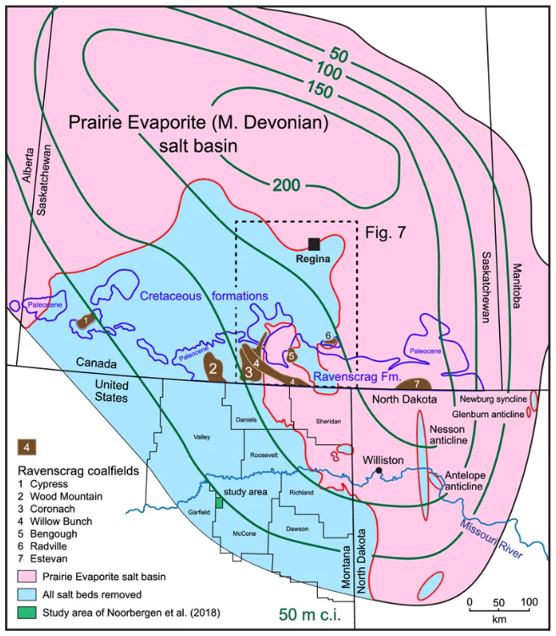
Broughton, Paul. (2021). Coals peripheral to opening and closure of the northern Western Interior Seaway: depositional signatures recording interplay between Milankovitch orbital forcing and salt dissolution collapse-subsidence structures with responsiveness to craton deformation and eustatic sea-level. Carbonates and Evaporites. 36. 10.1007/s13146-021-00679-9.
Notes:
Geological formations throughout Canada contribute to chloride
Prairies has the Devonian Prairie Evaporite Basin
Very thick layer (up to 300 m) of potash, halite and anhydrite
Spans through Alberta, Saskatchewan, Manitoba, North Dakota and Montana

Slide 5
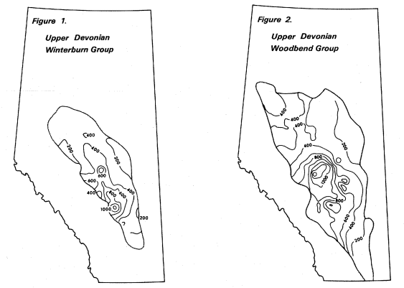
Levinson, A. A., et al. "Bromide, Iodide, and Boron in Alberta Formation Waters." Economic Geology Report 5, Association of Professional Engineers and Geoscientists of Alberta, https://static.ags.aer.ca/files/document/ECO/ECO_5.pdf.
Notes:
With evaporite also comes bromide levels in the groundwater
Concentrations have been studied for decades
Alberta Research Council released data in 1977
Monitored every year to observe changes

Slide 6
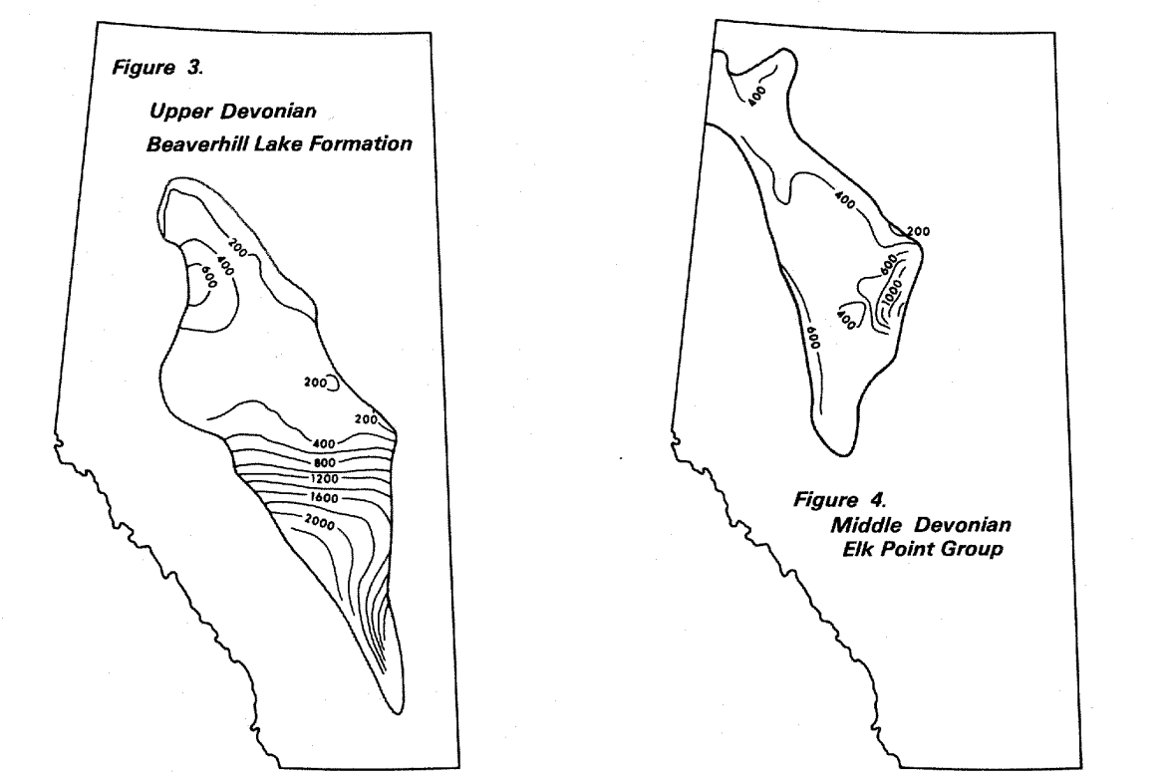
Levinson, A. A., et al. "Bromide, Iodide, and Boron in Alberta Formation Waters." Economic Geology Report 5, Association of Professional Engineers and Geoscientists of Alberta, https://static.ags.aer.ca/files/document/ECO/ECO_5.pdf.
Notes:
With evaporite also comes bromide levels in the groundwater
Concentrations have been studied for decades
Alberta Research Council released data in 1977
Monitored every year to observe changes

Slide 7
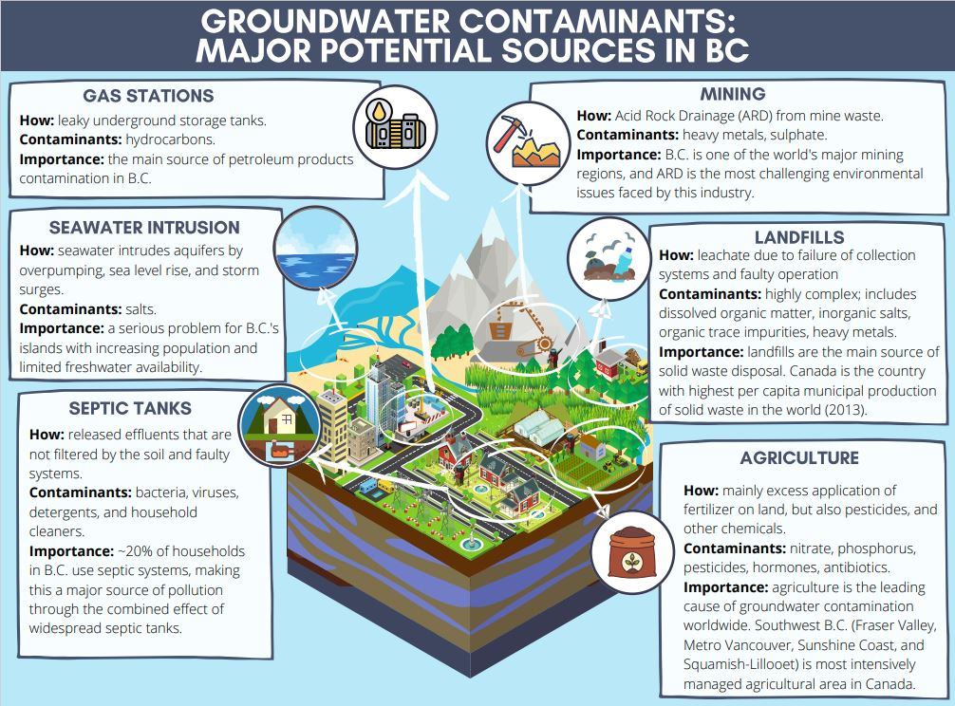
Notes:
Ocean water can also contribute to salt content in groundwater
Listed as a major potential source from the BC government
Saltwater intrusion can be caused by many reasons
All bring these halogens into fresh groundwater

Slide 8
Notes:
Ocean water can also contribute to salt content in groundwater
Listed as a major potential source from the BC government
Saltwater intrusion can be caused by many reasons
All bring these halogens into fresh groundwater

Slide 9
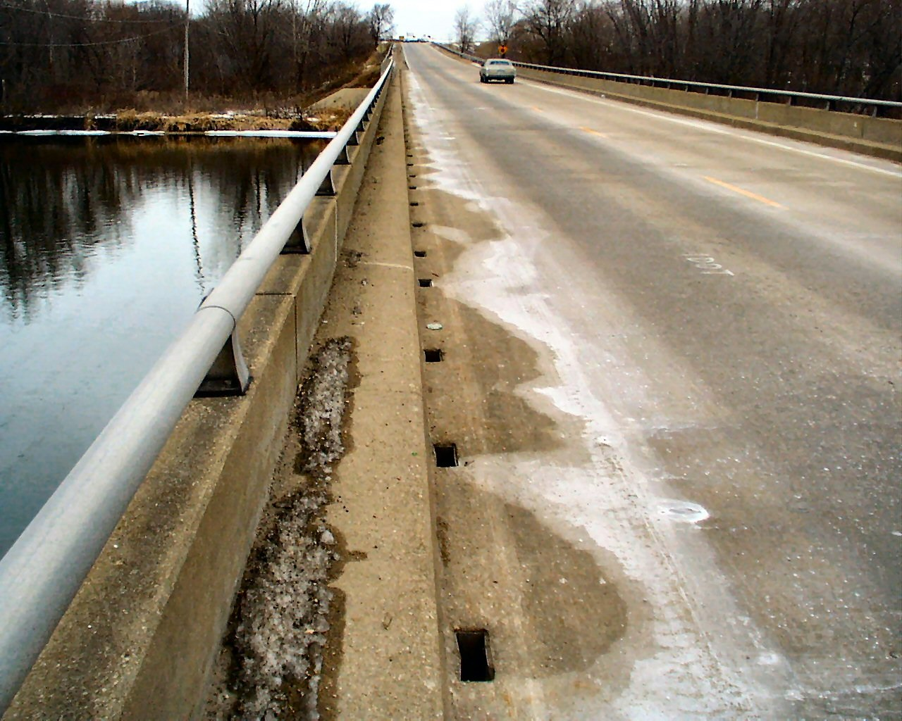
ROAD SALTS
Many municipalities in Canada use a sodium chloride based salt like rock salt or halite to de-ice roads
In Canada, more than 5m – 7m tonnes of rock salt are placed onto roads per year
Sodium and chloride regulated as a result
Notes:
Fully anthropogenic side
Salting roads obviously contributes chloride
Practice became widespread in 1940s
By 1950s, became primary method for winter maintenance throughout country
Canada is one of largest users of road salt in world, 5-7m tonnes used per year
Most is sodium chloride

Slide 10
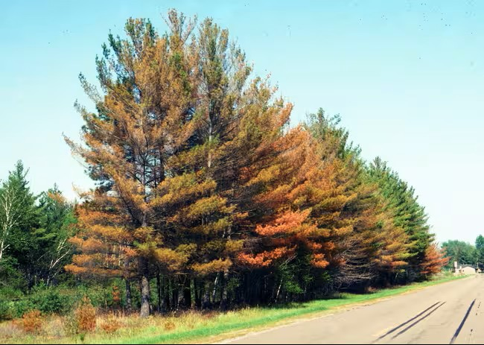
ROAD SALTS
Many municipalities in Canada use a sodium chloride based salt like rock salt or halite to de-ice roads
In Canada, more than 5m – 7m tonnes of rock salt are placed onto roads per year
Sodium and chloride regulated as a result
Notes:
Typical evidence of toxic effects from chloride
Osmotic stress
High chloride acts like a drought and pulls water away from plant roots
Difficult for plants to absorb water
Translates to burning and drying of leaves
Leads to reduced photosynthesis and eventually plant death

Slide 11
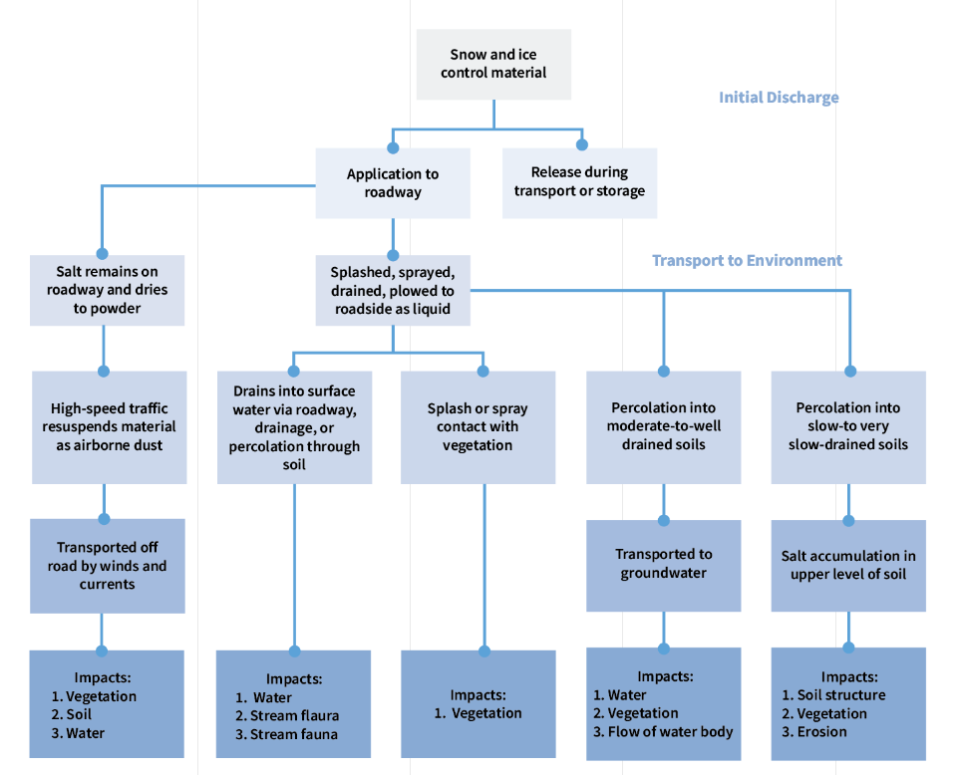
Notes:
Several impact effects from the release of road salt onto the surrounding environment
Whether increase of salt dust, draining into waterways, transport into groundwater
Toxicological impacts possible in multiple avenues

Slide 12
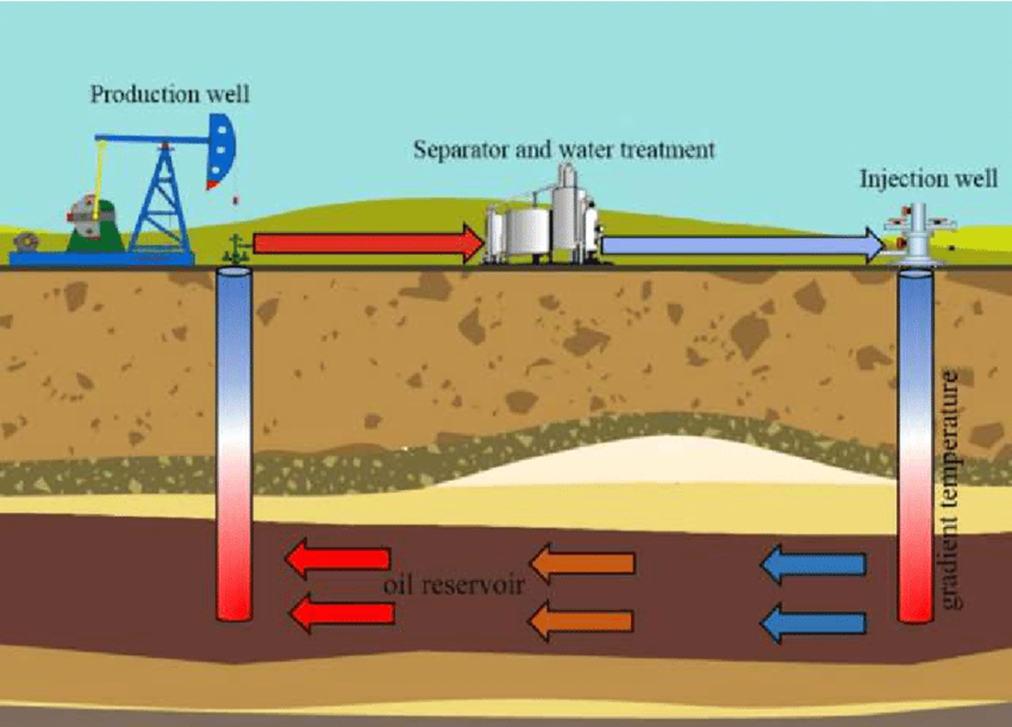
Water injection
Injection of water into an oil reservoir allows for oil to be displaced and moved to the production well
Can increase oil recovery by 30-60%
Water treated and reused
Accumulates salts from repeated use
Scaling common causing corrosion and integrity issues
Notes:
Western Canada uses regularly
To allow an oil well to produce, water is injected into reservoir
Water displaces the oil and pushes to production well (pumpjack)
Separator and water treatment
Chloride accumulates from soil salinity, particularly when evaporite present
Further risk due to corrosion scaling, potential structural integrity problems

Slide 13
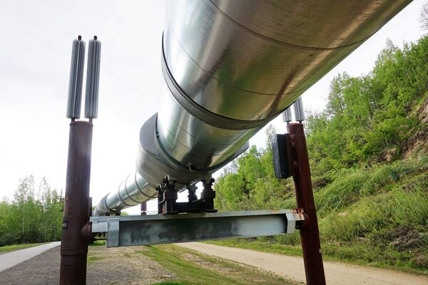
Water injection
Injection of water into an oil reservoir allows for oil to be displaced and moved to the production well
Can increase oil recovery by 30-60%
Water treated and reused
Accumulates salts from repeated use
Scaling common causing corrosion and integrity issues
Notes:
Much of the processing above ground
Integrity problems lead to release of high TDS water

Slide 14
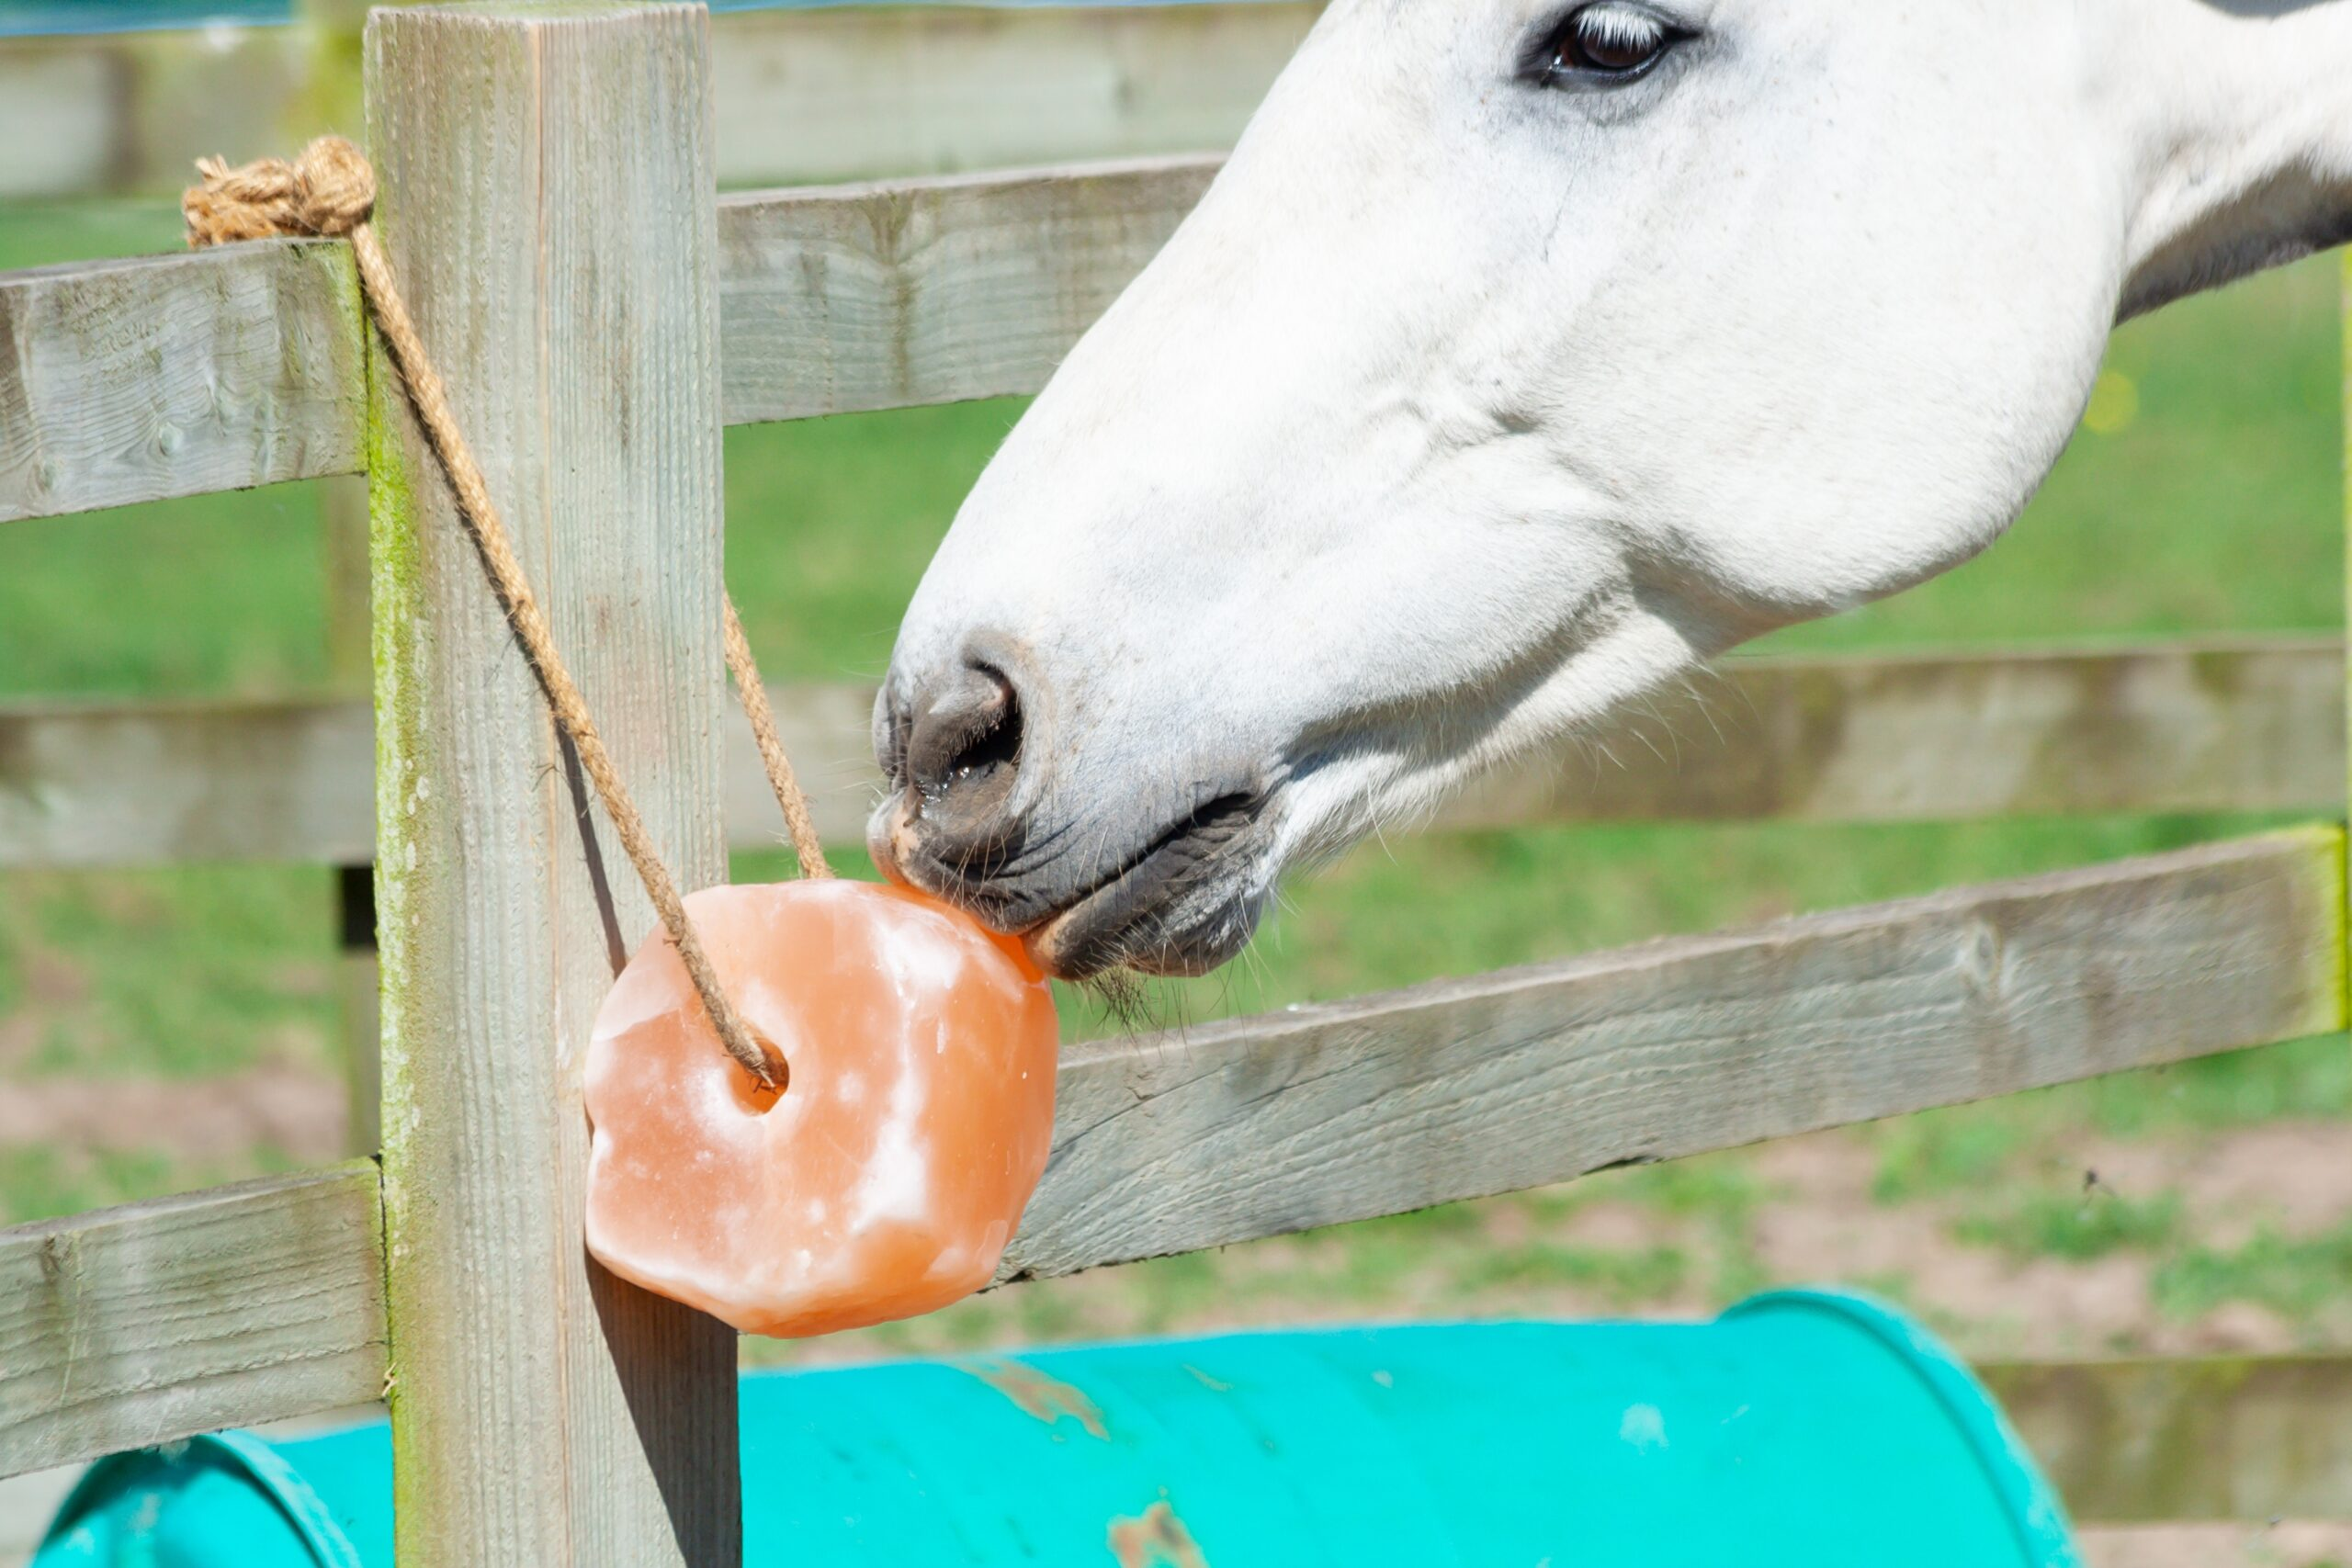

AGRICULTURAL SALTS
Potential sources of salt-related compounds in vicinity of testing locations
Most will have only close-proximity effects due to limited quantities
Many powdered pesticides have salt component to allow products to be water soluble
Notes:
Multiple sources, most of them small
Check immediate area for sources
Pesticide spraying can be common source
Powders often have salt to make them water soluble as wettable powder
Pesticide application can increase salinity

Slide 15

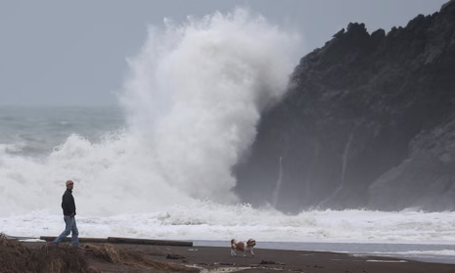
Cl ⁻
Notes:
When there are so many sources, what can give direction
Chloride is chloride
Hydrocarbon fingerprinting for source, not chloride

Slide 16
Differentiating factor
Bromide and Iodide
Chloride is generally 40-8,000 times more abundant in nature than bromide
Iodide difference is not well studied but presence of any iodide suggests rock salt impact
Chloride:bromide ratio and, if necessary, chloride:iodide ratio can be used to separate graphically the sources of chloride
Notes:
Other halogens can help differentiate
Well established practice in many industries

Slide 17
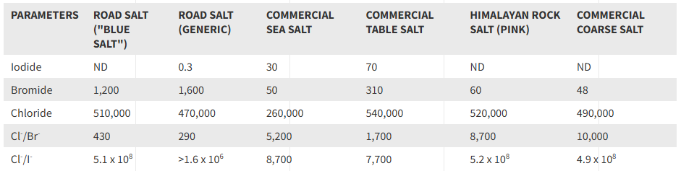
Notes:
Each mixture of salts has a unique ratio of chloride to bromide, or chloride to iodide
Literature shows potential sources of each of the ratio ranges
By plotting ratios, can point to source

Slide 18
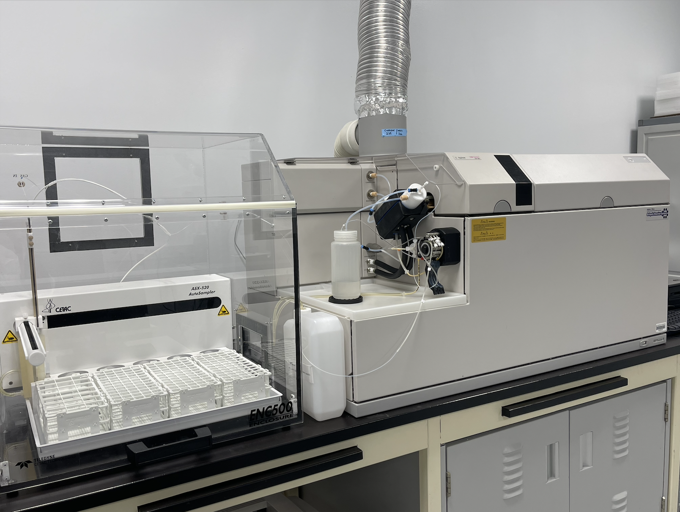
Simultaneous measurements
of parameters
Method associated with
literature
Equal dilution factors
Ideal for diagnostic ratios
Comparable detection limits
to traditional methods
Limited matrix
interferences
Inductively-Coupled Plasma with
Mass Spectrometry
Instrument resolution in
complex mixtures
Notes:
Question became how to do this
Answer became ICP-MS
Instrument used for trace metal analysis
Metals uses acid digestion, halogens uses alkaline digestion
Key benefits to using this method

Slide 19
Notes:
Common detection limits hit with typical methods
Ion chromatography is regularly used for anions
Columns becoming harder to source
Run time for these parameters becomes long
Coelution is common
Becoming our standard method for measuring bromide

Slide 20
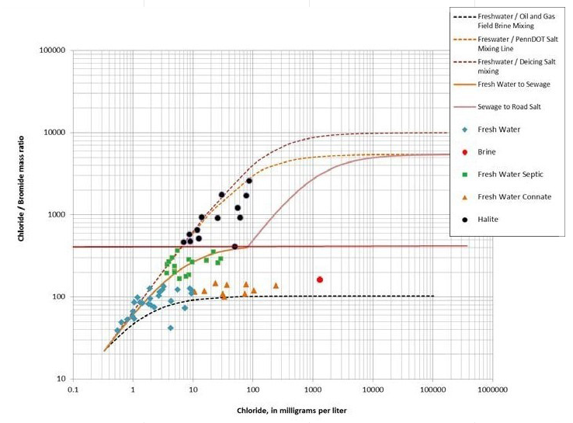
Naily and Sudaryento 2018 IOP Conf. Ser.:Earth Environ. Sci. 118 01202
Notes:
Literature supports diagnostic ratios
Depending on source, the Cl:Br lands on different region of the trendline

Slide 21
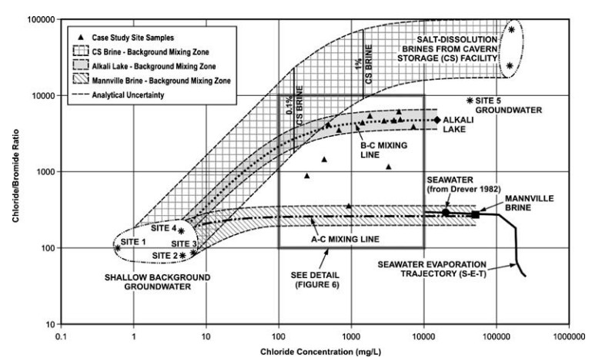
Freeman, J. T. (2007). The use of bromide and chloride mass ratios to differentiate salt-dissolution and formation brines in shallow groundwaters of the Western Canadian Sedimentary Basin. Hydrogeology Journal, 15, 1377–1385.
Notes:
Not just one paper
Historical assessments become much more robust
Brought online earlier this year
More research will be conducted
All indicators suggest that clear correlation can be made
Ready to partner on projects

Slide 22


Brody Andersen, B.Sc, B.Sc.
Technical Account Manager
P: (780) 742-1616
E: brody.andersen@bureauveritas.com
WWW.BUREAUVERITAS.COM

