Slide 1



Unlocking Insights through Artificial Intelligence:
A Case Study of Regulatory Assessment & Remediation in Ontario
Scott Ambridge, M.A.Sc., P.Eng, CPEng.
April 9th, 2026

Slide 2

Agenda
Artificial Intelligence Overview
Unlocking Records of Site Condition with AI
RSC Insights
Conclusions

Slide 3
Artificial Intelligence Overview
1

Slide 4
What is Artificial Intelligence?
The term “AI” is broadly used by the tech industry and is an umbrella term that can have multiple meanings.
Artificial Intelligence (AI) refers to the simulation of “human-like” intelligence in machines.
Historically, AI was achieved using hard coding and rule-based decisions in applications.
The release of ChatGPT in November 2022 brought Large Language Models (LLMs) into the mainstream.

Slide 5
Machine Learning (ML) and Generative AI (GenAI)
ML is a subset of AI where systems learn patterns from data and improve over time without explicit programming.
GenAI is a subset of AI focused on creating new content (text, images, audio, etc) from input prompts.
LLMs used in GenAI are built using machine learning techniques (e.g. deep learning with neural networks).
However, the output of an LLM (like text generating) is not the same as traditional ML tasks.

Slide 6
Deterministic vs Probabilistic Outputs
LLMs used in GenAI are stochastic, probability-based systems – usually produce the statistically most likely answer (i.e. probabilistic), however they may reproduce the answer in a different format each time (stochastic)
As LLMs are probability based, there is a chance they may produce an incorrect answer (i.e hallucinations).
GenAI has improved dramatically with the addition of tools to ‘ground answers’
Gen AI can be used to produce deterministic outputs by creating scripts or code where the output is verified and reproducible.

Slide 7
AI Coding
Also known as ‘vibe coding’, LLMs generated code based on user prompts
A number of platforms exist – Cursor, Claude Code, OpenAI Codex, Augment Code, etc
What is the most popular programming language?

Slide 8
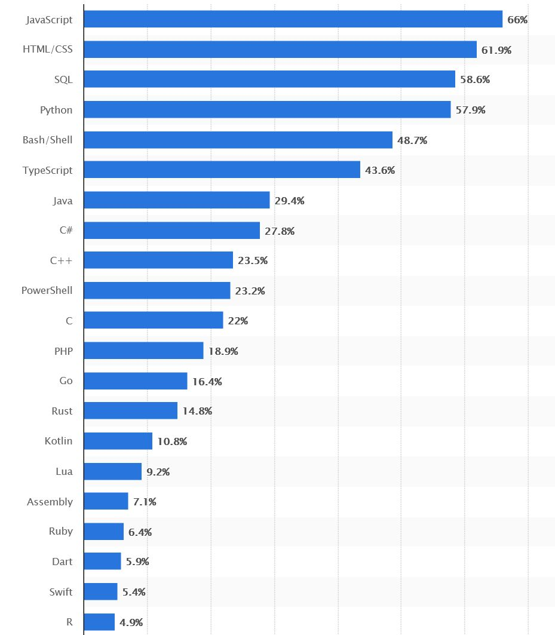
AI Coding
Also known as ‘vibe coding’, LLMs generated code based on user prompts
A number of platforms exist – Cursor, Claude Code, OpenAI Codex, Augment Code, etc

Slide 9
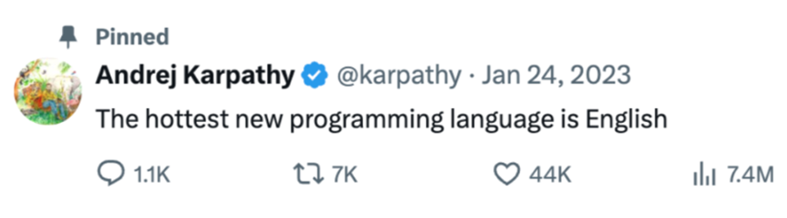
AI Coding
Also known as ‘vibe coding’, LLMs generated code based on user prompts
A number of platforms exist – Cursor, Claude Code, OpenAI Codex, Augment Code, etc

Slide 10
AI Coding – “the big leap” in December 2025
“Today probably 95% of the code that I produce, I didn’t type myself” – Simon Willison, co-create of Django
“I haven’t typed a line of code since basically December [2025]” – Andrej Karpathy, Open AI founder
The best developers at Spotify “have not written a single line of code since December.” – Gustav Söderström, Spotify CEO

Slide 11
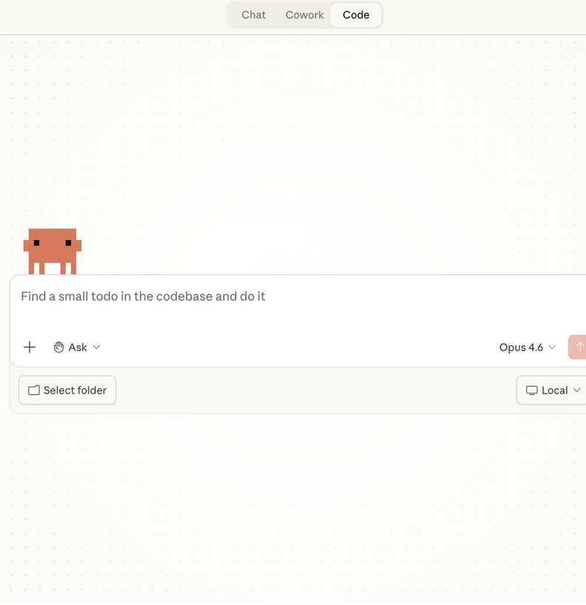
Anthropic’s Claude pulls ahead
(for now)
Claude Code is now the most widely used coding tool.
Claude Cowork can undertake tasks autonomously on your computer
Cowork can be controlled from your phone using Dispatch – assign tasks anywhere
Claude integrates with PowerPoint and Excel

Slide 12
Unlocking Records of Site Condition with AI
2

Slide 13
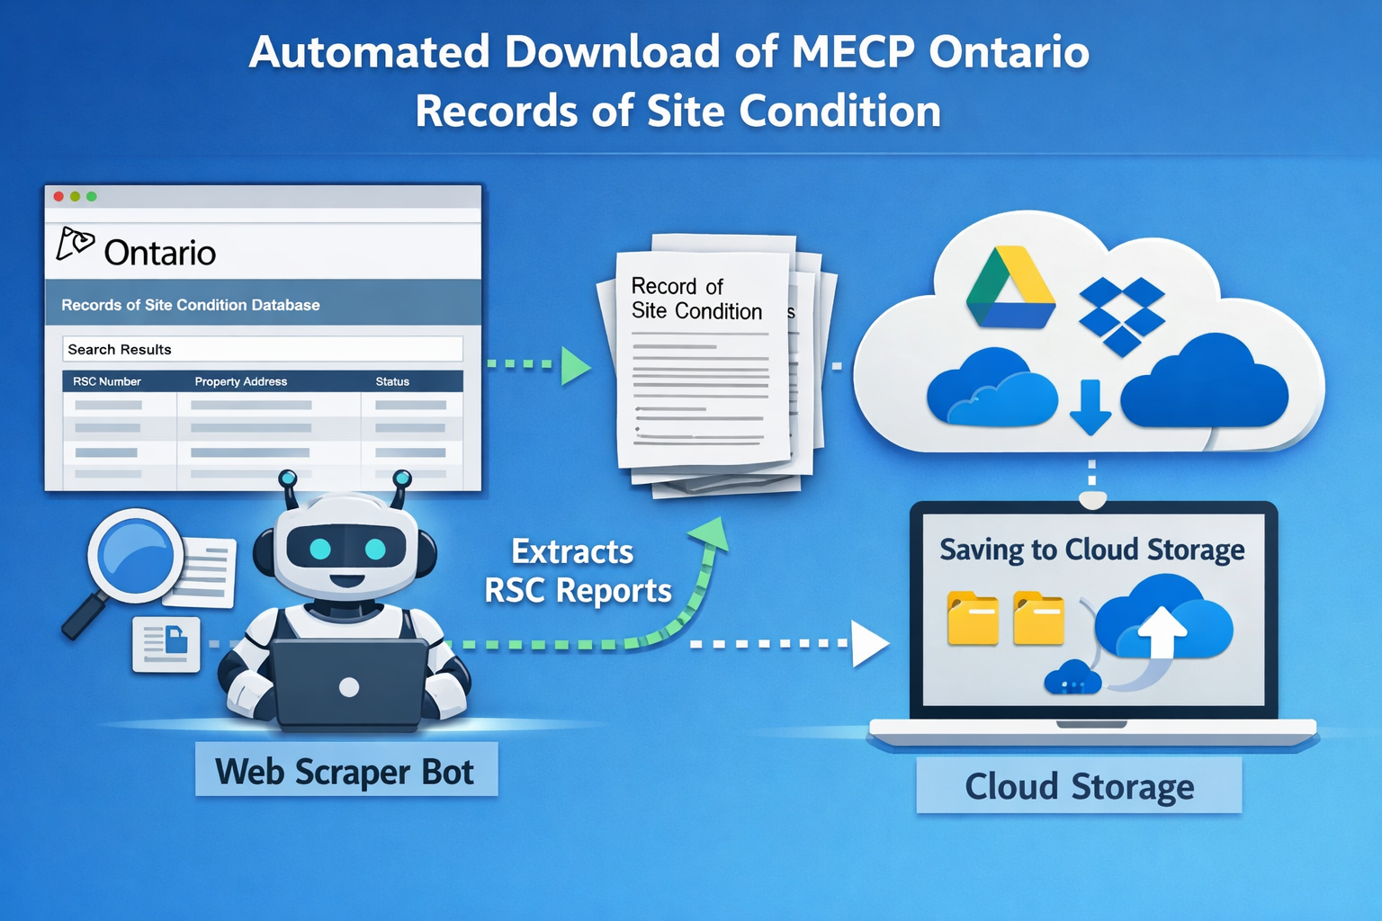
Step 1 – Capture RSCs
Create an automated AI bot (web crawler / scraper) to access the MECP website
Bot pulls a list of RSCs from MECP API
Bot downloads + catalogues pdfs
Bot saves RSCs to cloud storage
RSC zip files extracted

Slide 14

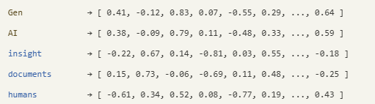
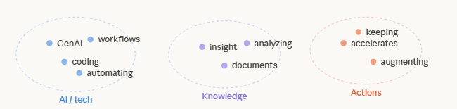
Step 2 – Summarizing text with GenAI
Sentence represented as tokens:
Sentence as token IDs:
[11757, 17527, 21798, 1381, 24058, 656, 57465, 10358, 13427, 11, 5099, 1365, 113770, 11, 326, 44474, 289, 22458, 533, 2049, 13958, 23011, 306, 290, 11453, 13]
Documents are processed and summarized using an AI language model (LLM).
The content is split into smaller chunks + summarized
Each summary is converted into a vector embedding and stored in the database.
Words as vectors (context):
Similar words cluster in vector space:

Slide 15
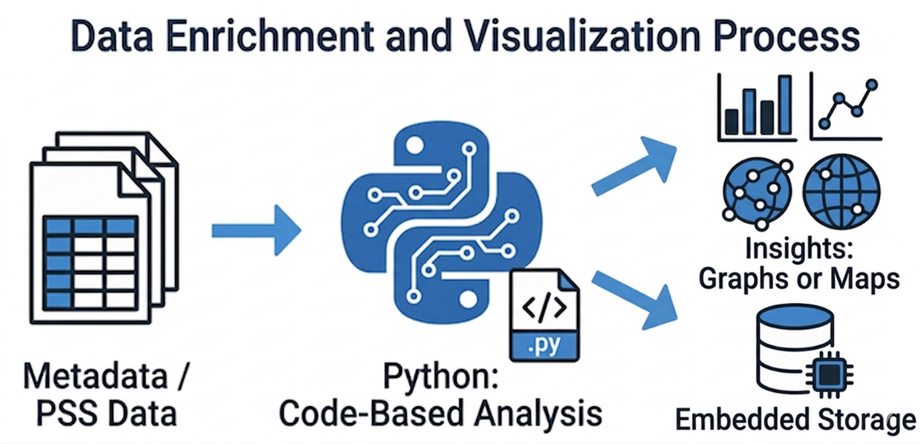
Step 3 – Summarizing data with AI Coding
Extracted metadata (RSC number, MECP Region, etc) and PSS spreadsheets are centrally stored
Code based scripts are generated to categorize the data.
Selected data is attached to the vector store as metadata.
Outputs are generated – summary excel files, graphs, maps etc.

Slide 16
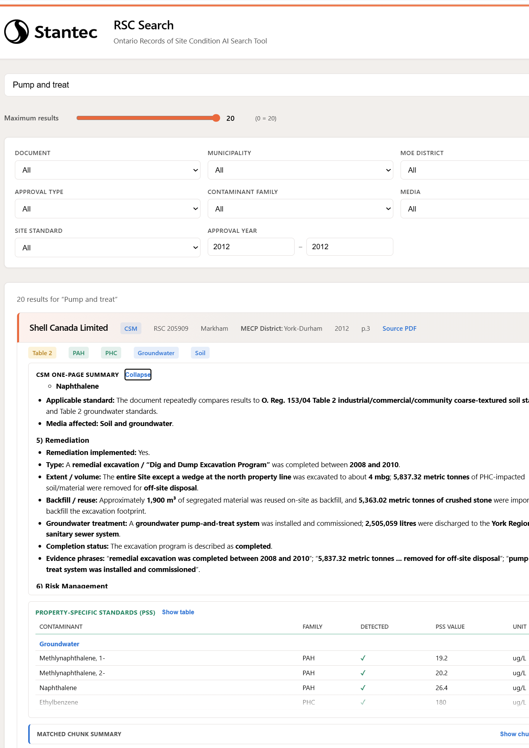
Step 4 – Search Application
There are a number of ways to retrieve data once stored – querying using code, creating an AI agent or a search engine.
In this case a web search application was created to allow various users to search the data as needed.
System uses Retrieval Augmented Generation (RAG).

Slide 17
RSC Insights –
the numbers
3

Slide 18
Insights – the numbers
RSCs with Risk Assessments after 2011 were considered (2012 – early 2026)
684 RSCs with RA have been undertaken
677 APEC tables and 675 Phase Two CSMs were identified
Only 546 CPU documents were identified
105 were filed by public or government agencies and 579 by private owners
City of Toronto has filed the most RSC with RA – 47

Slide 19
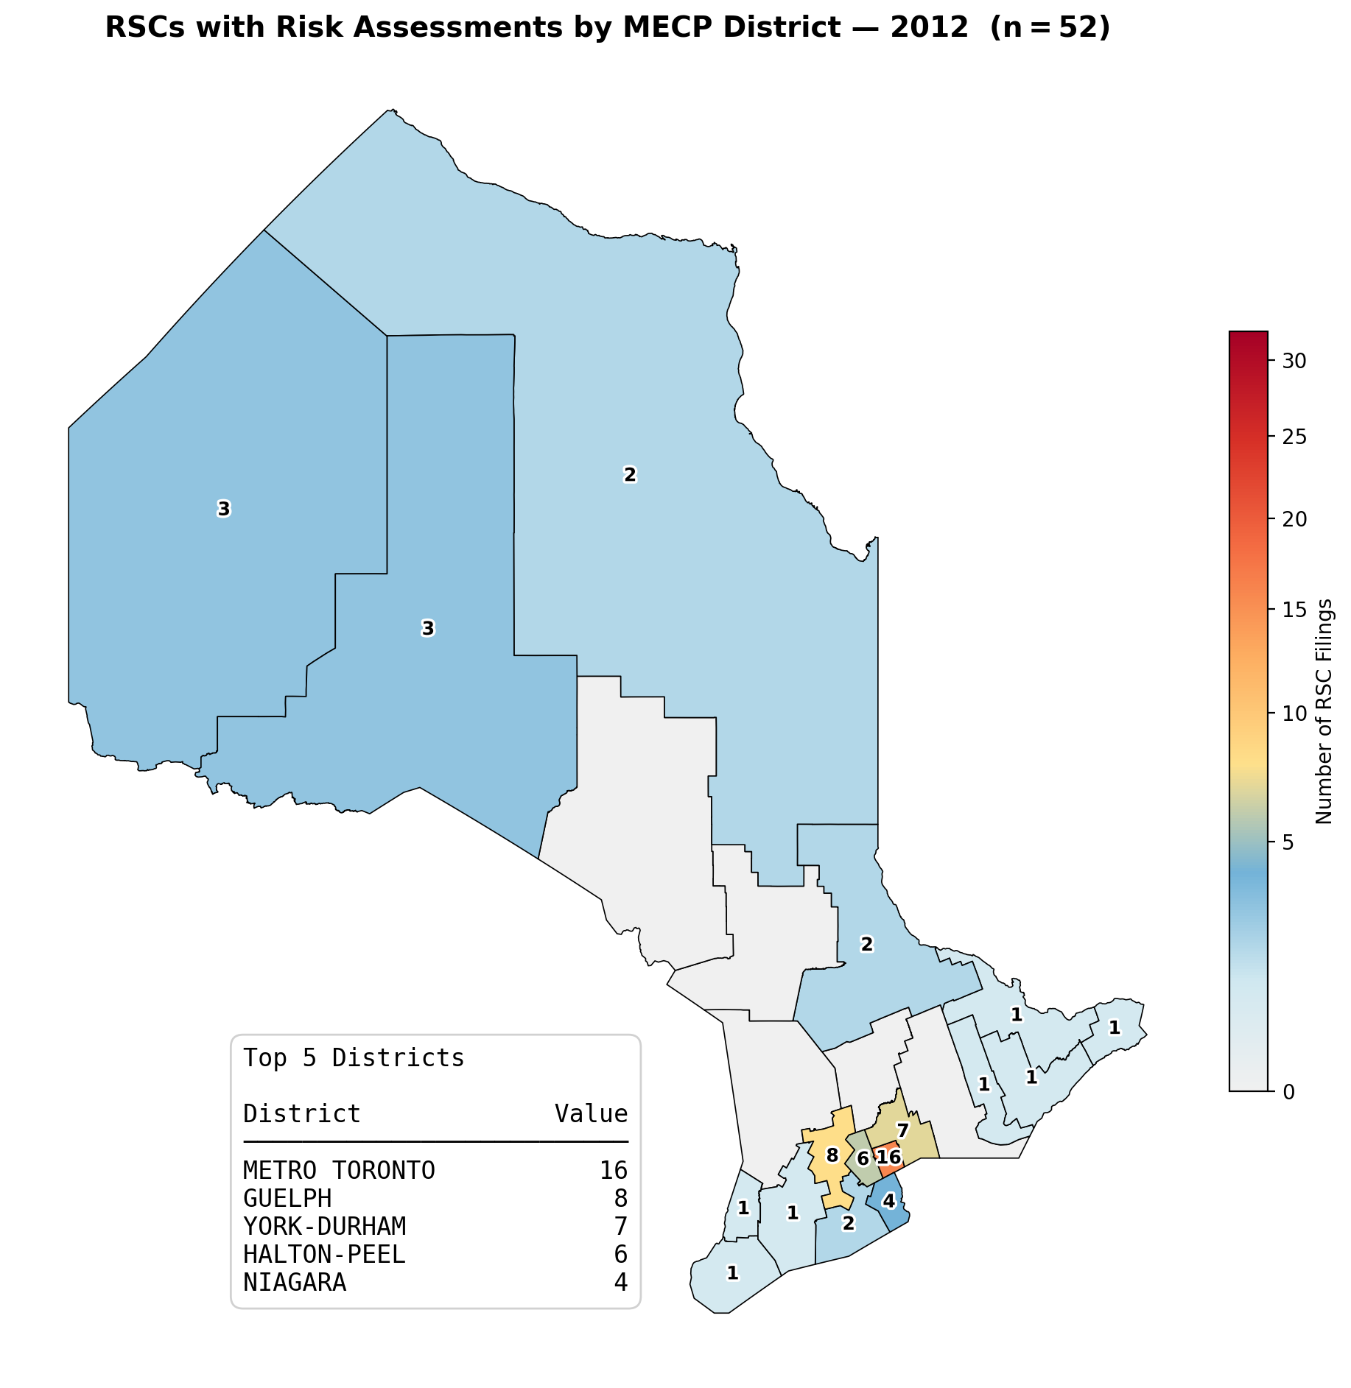

Slide 20
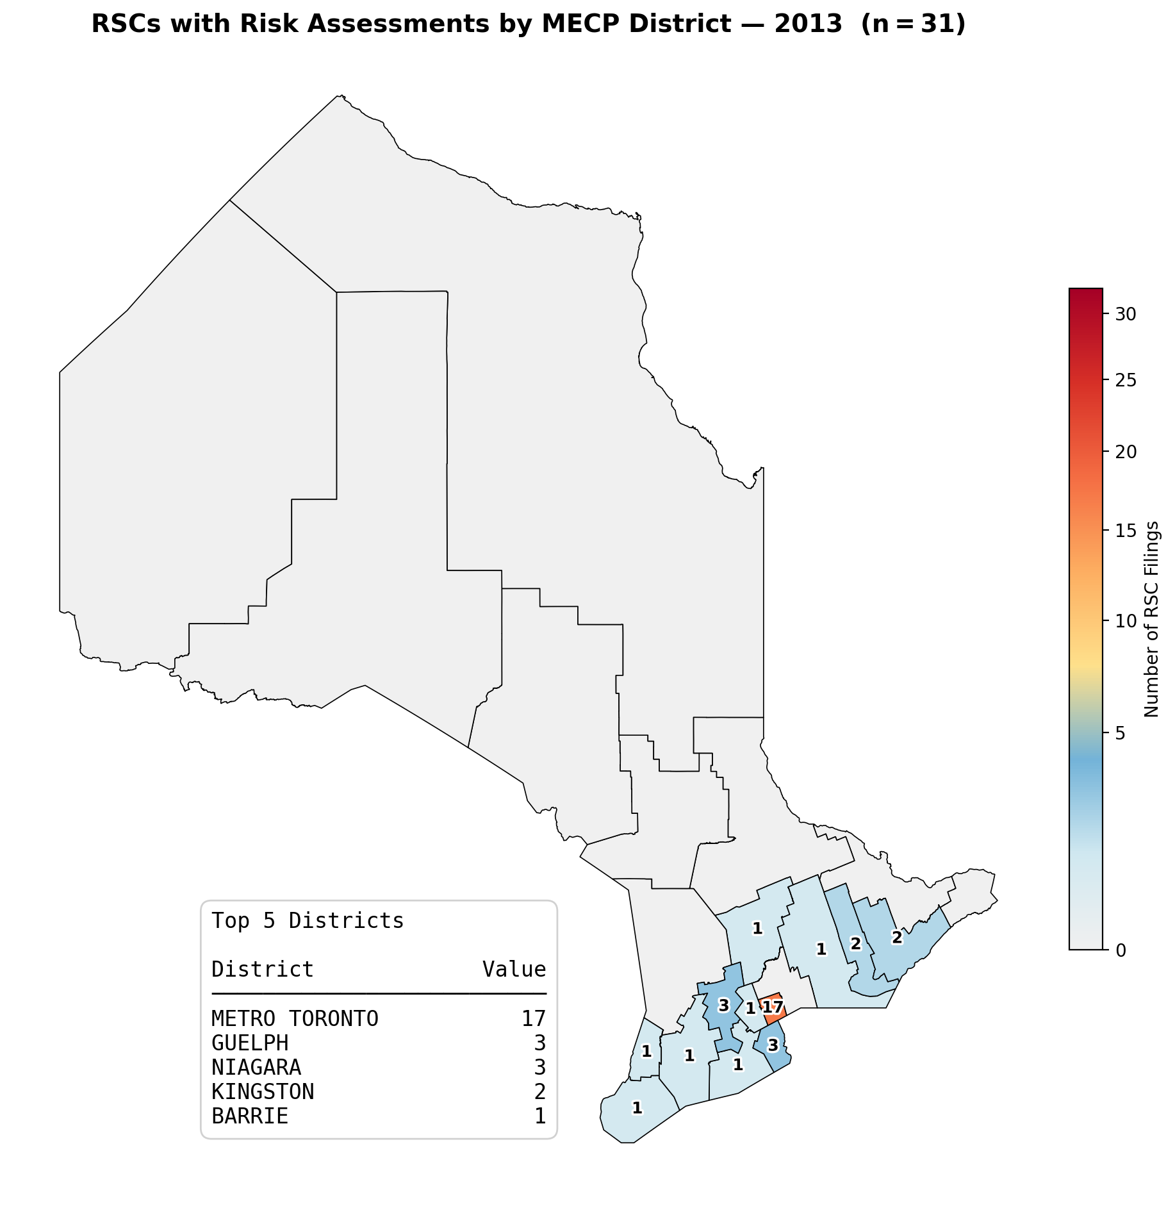

Slide 21
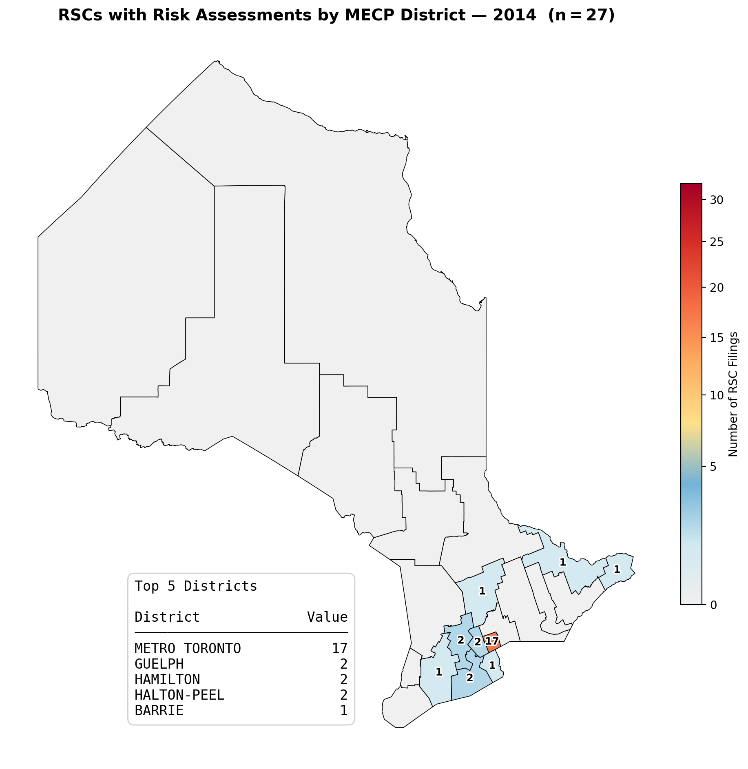

Slide 22
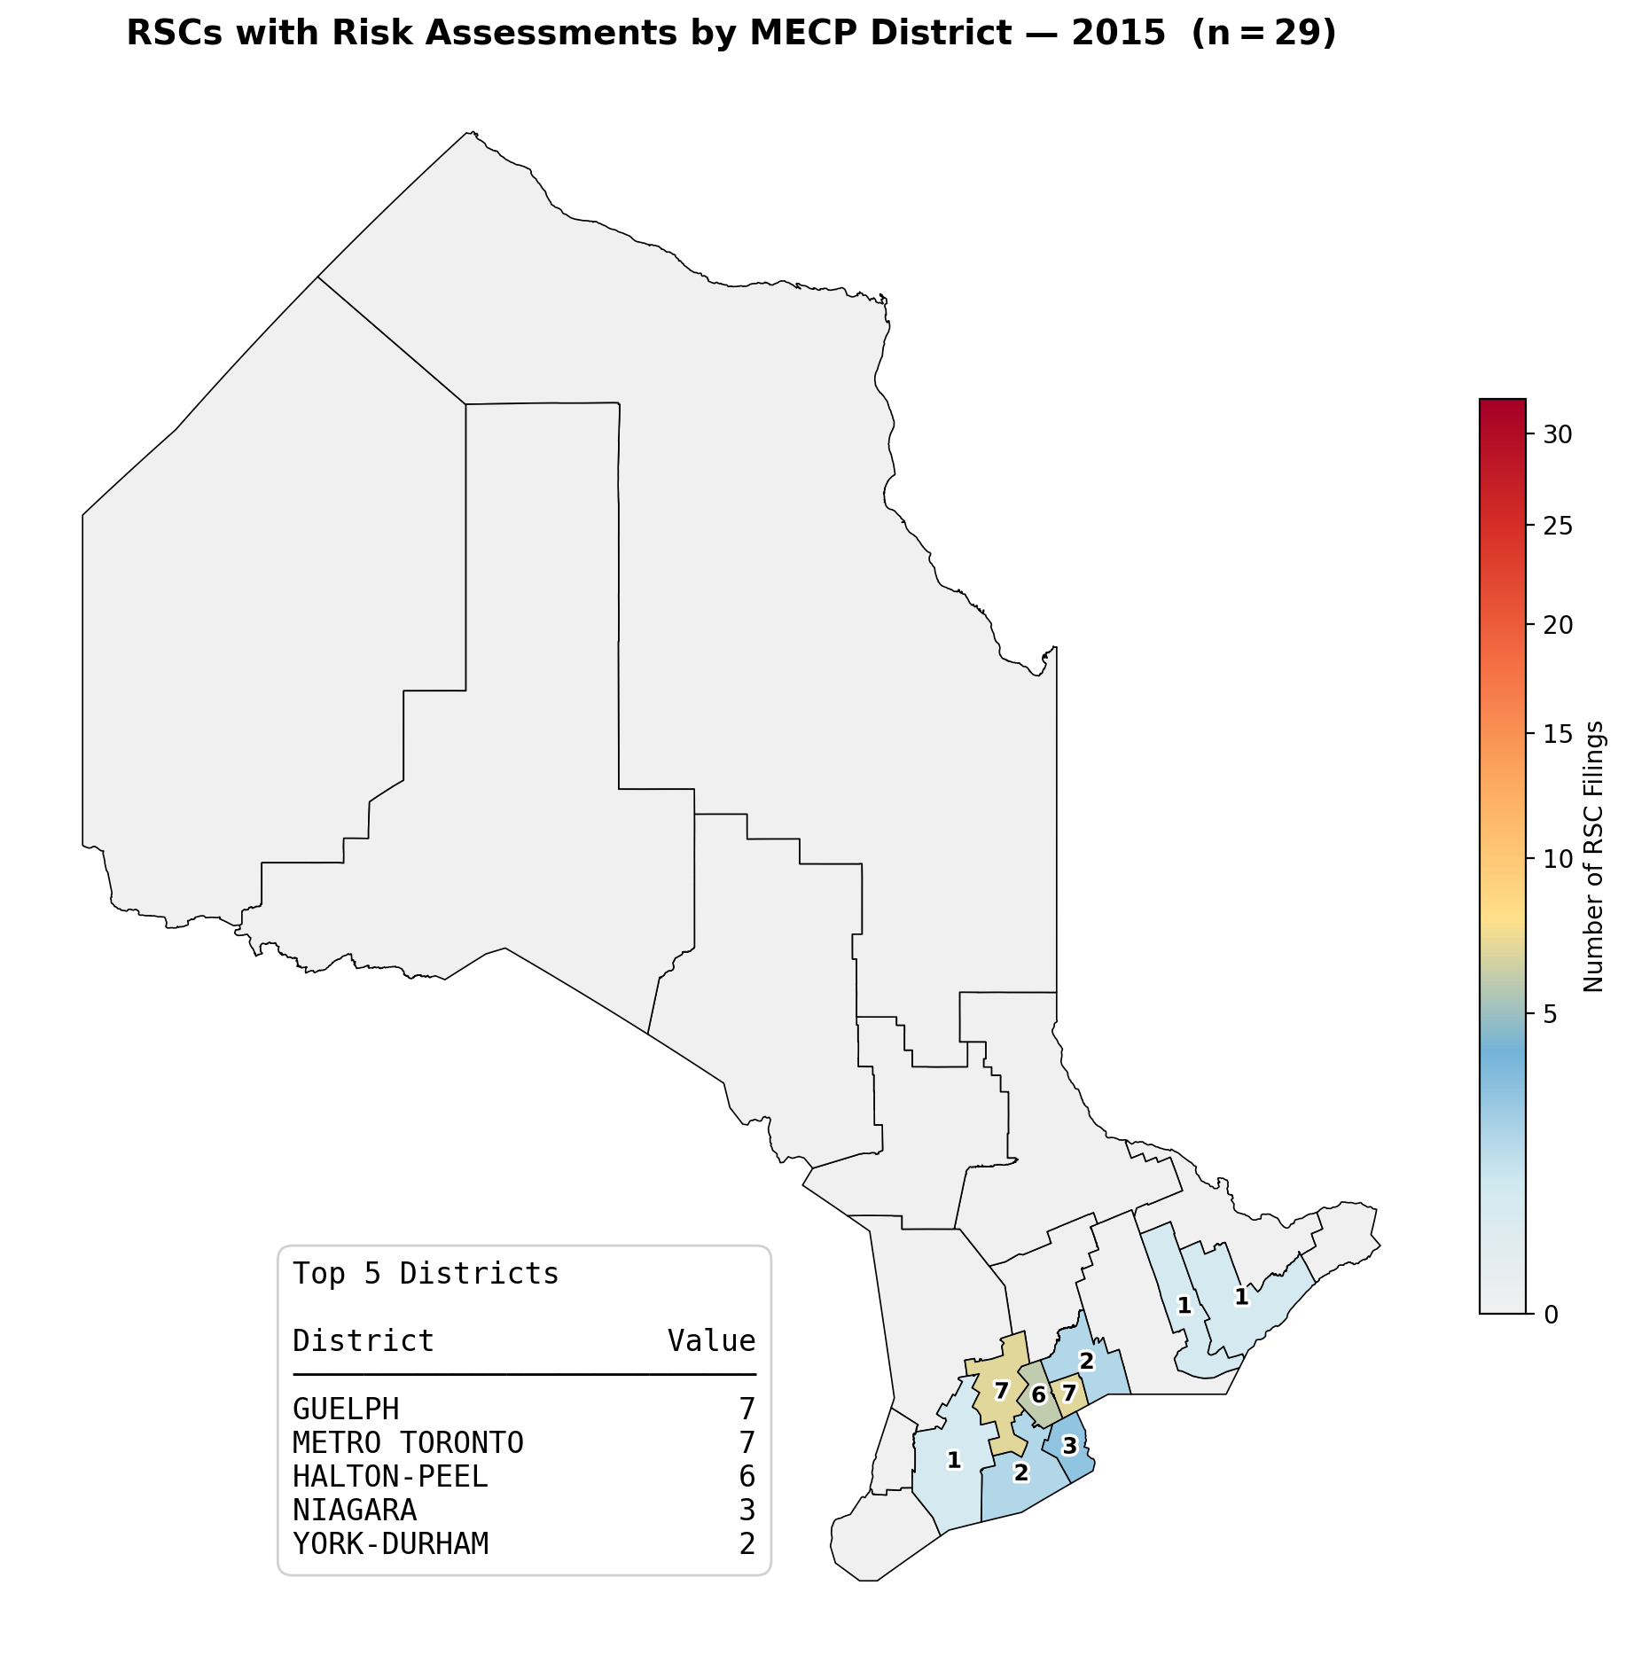

Slide 23
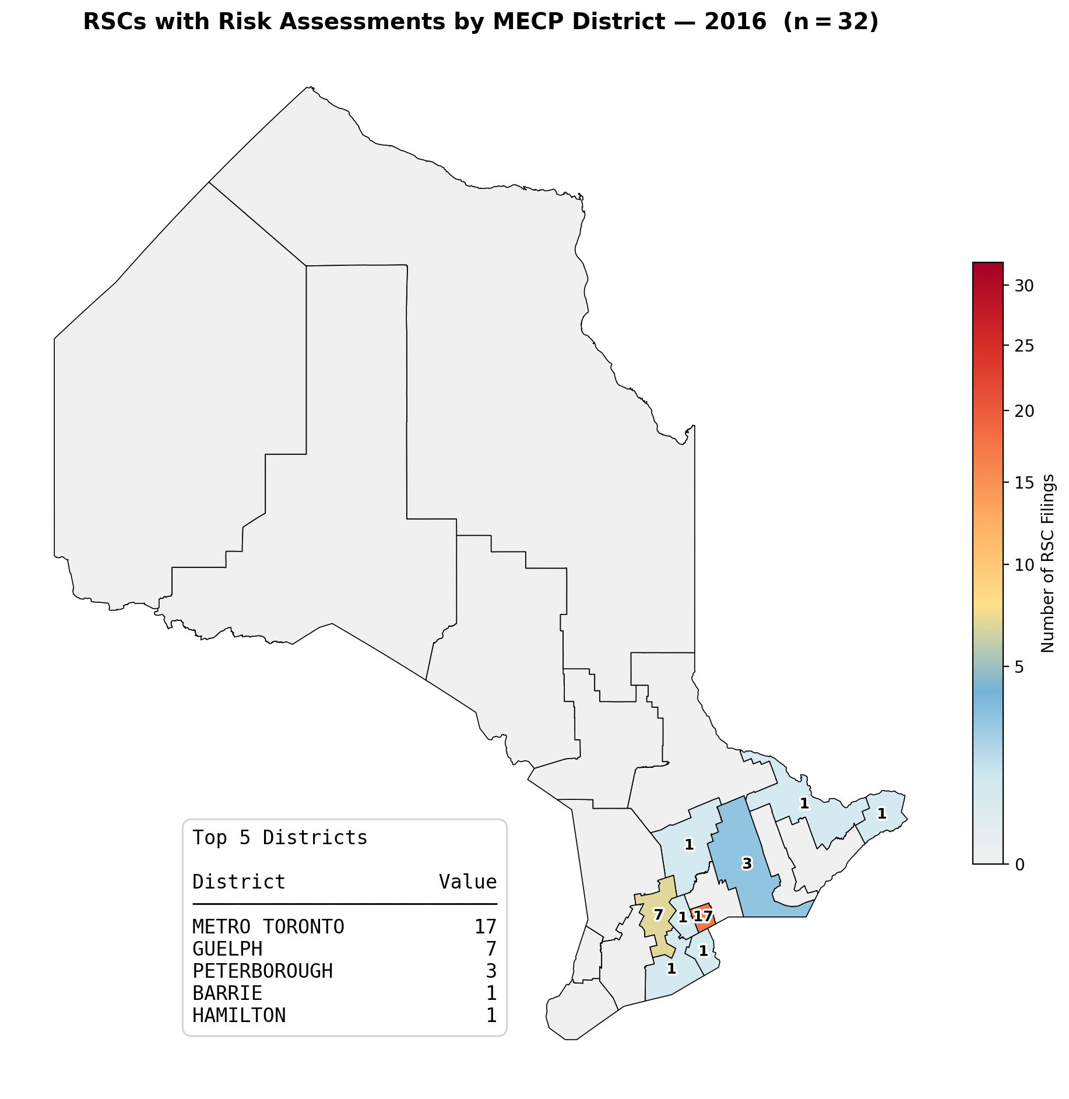

Slide 24
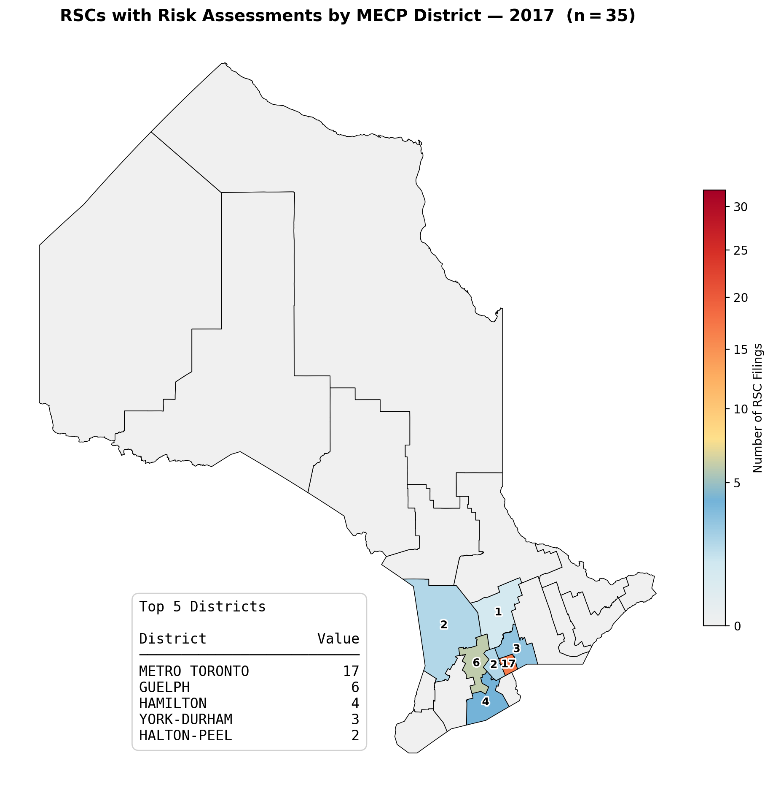

Slide 25
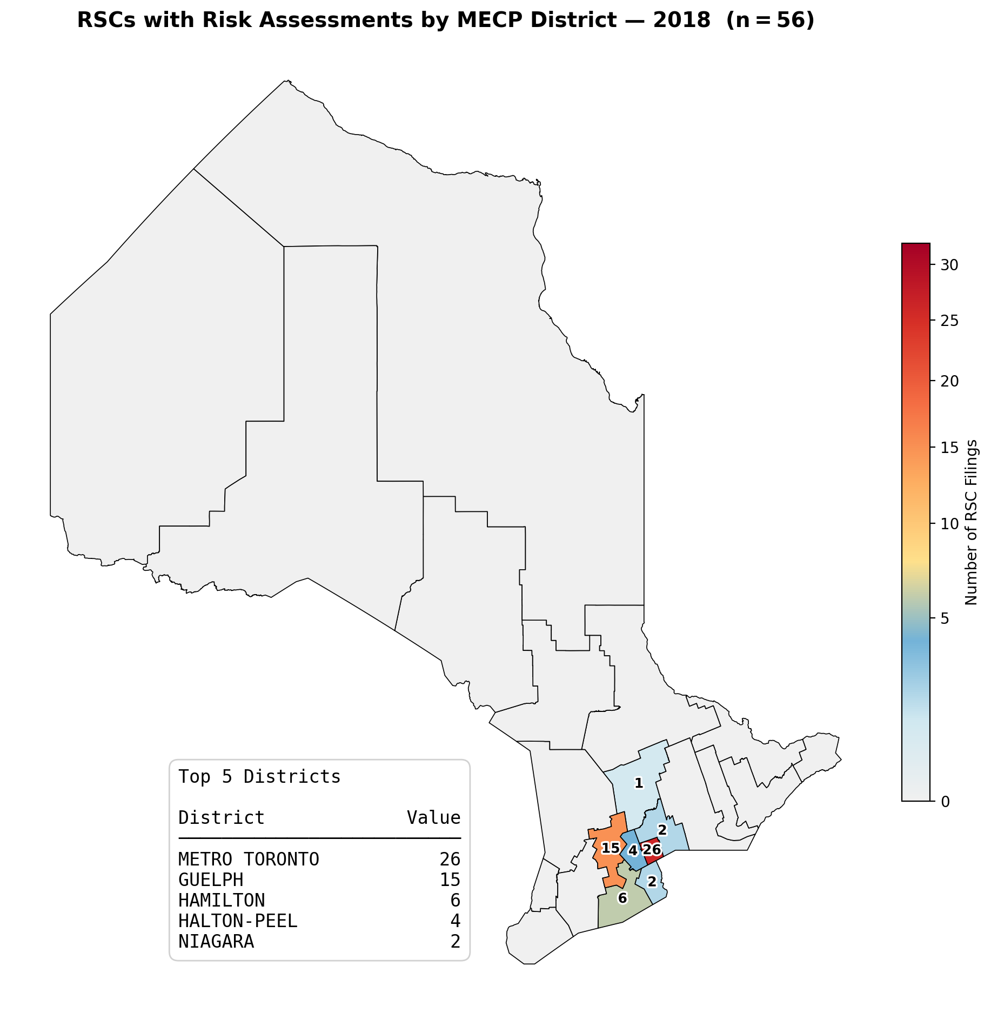

Slide 26
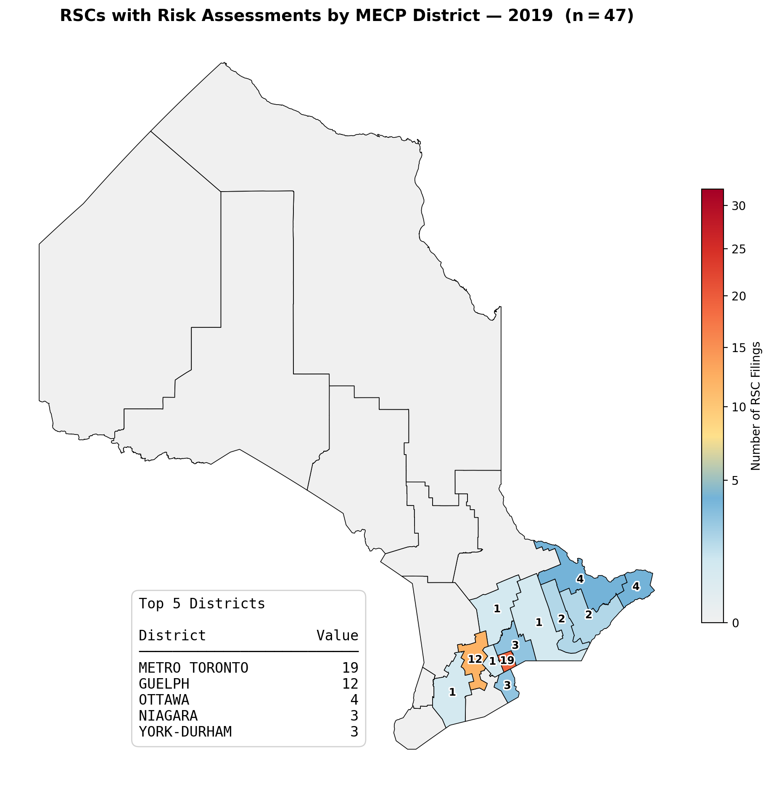

Slide 27
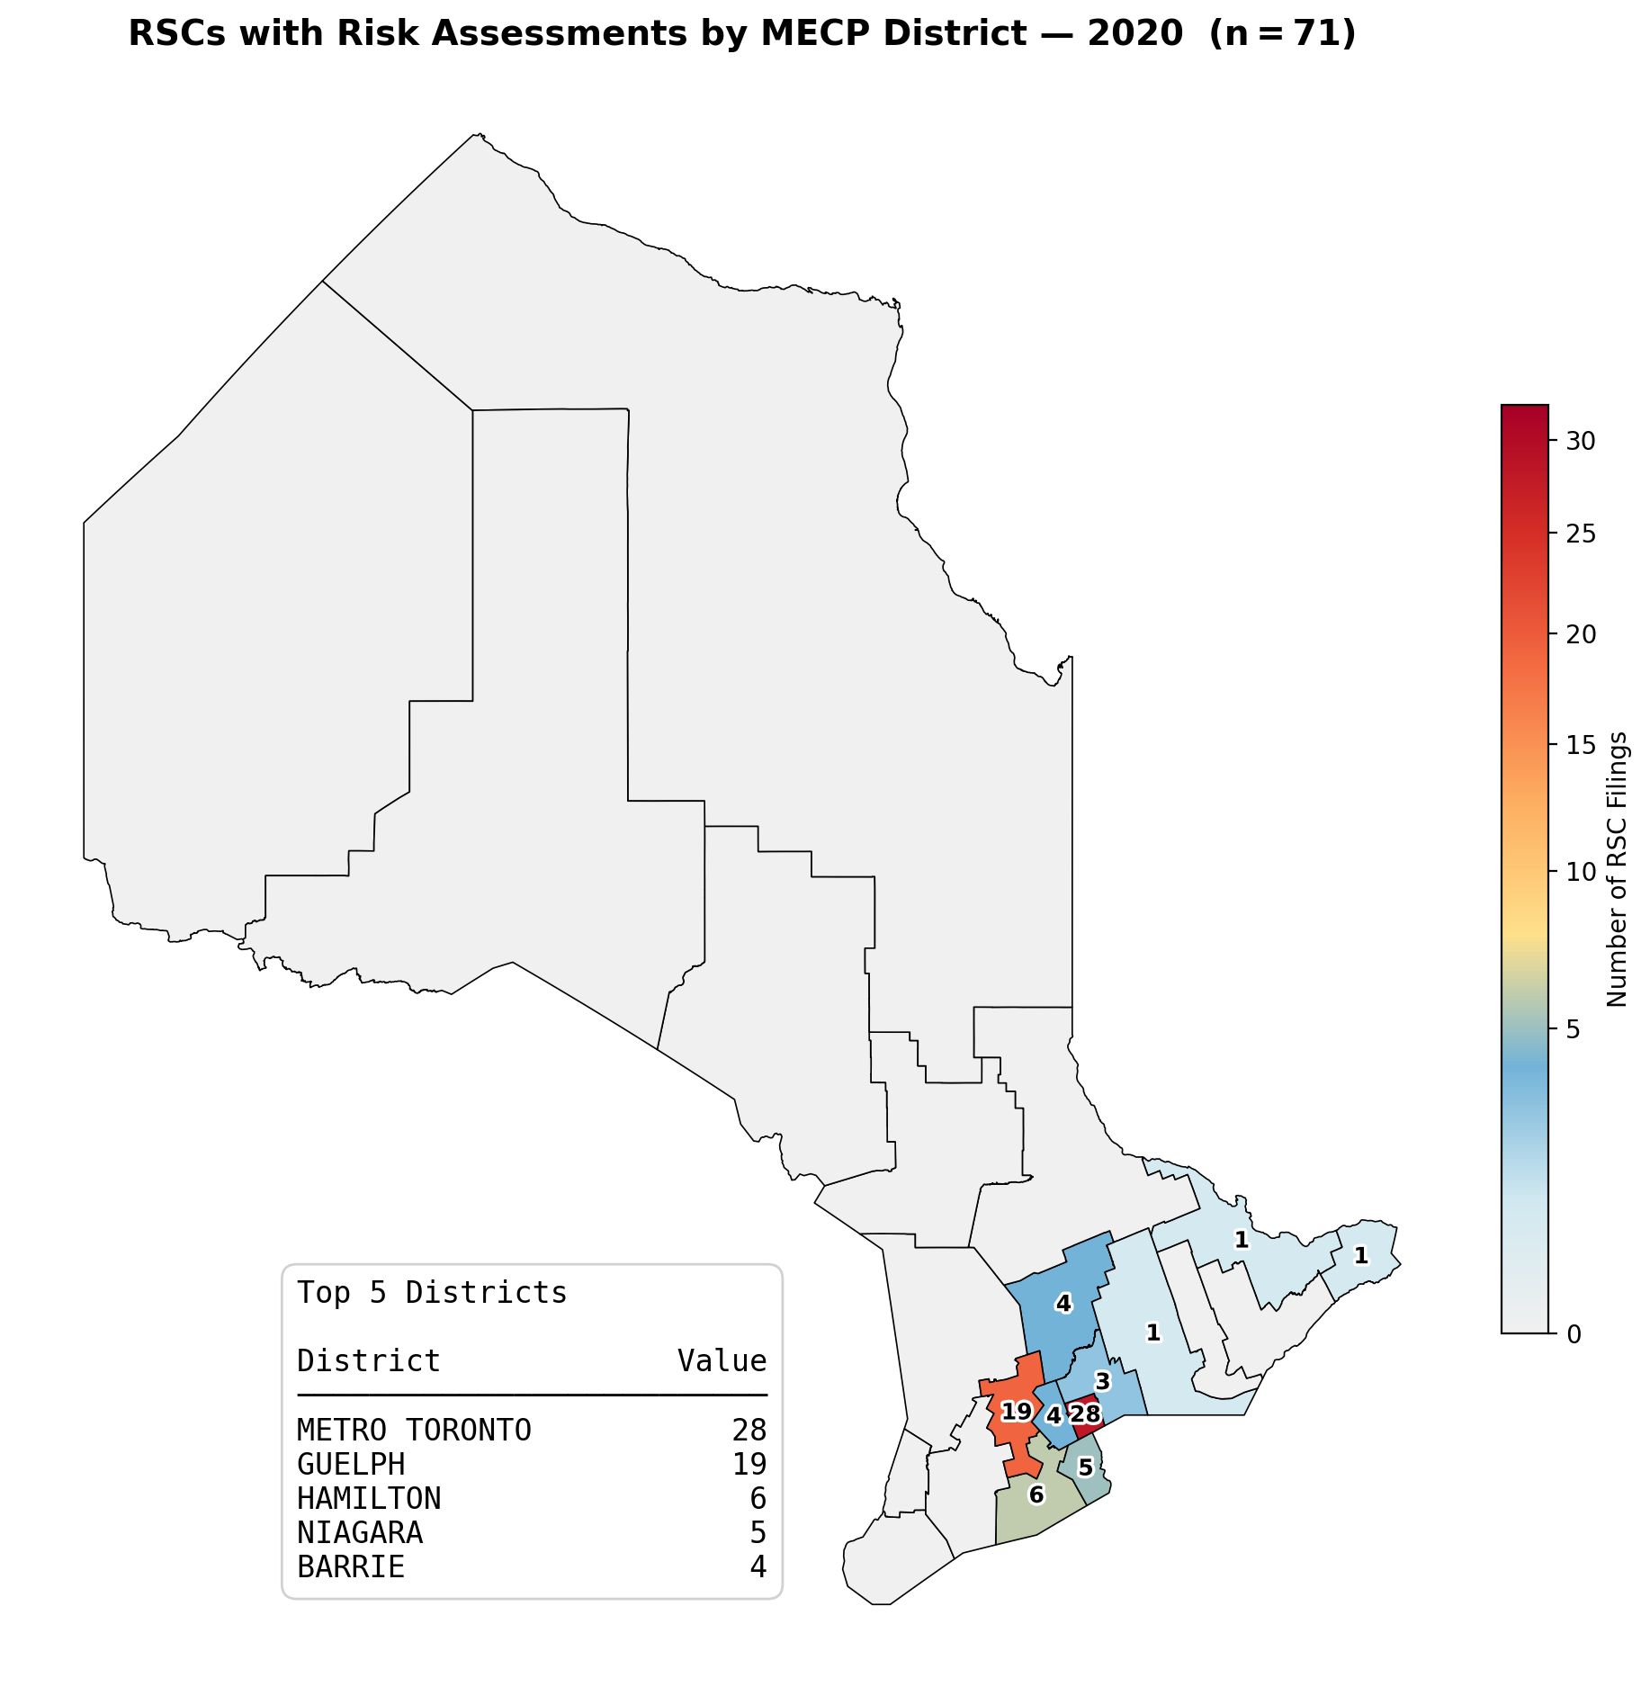

Slide 28
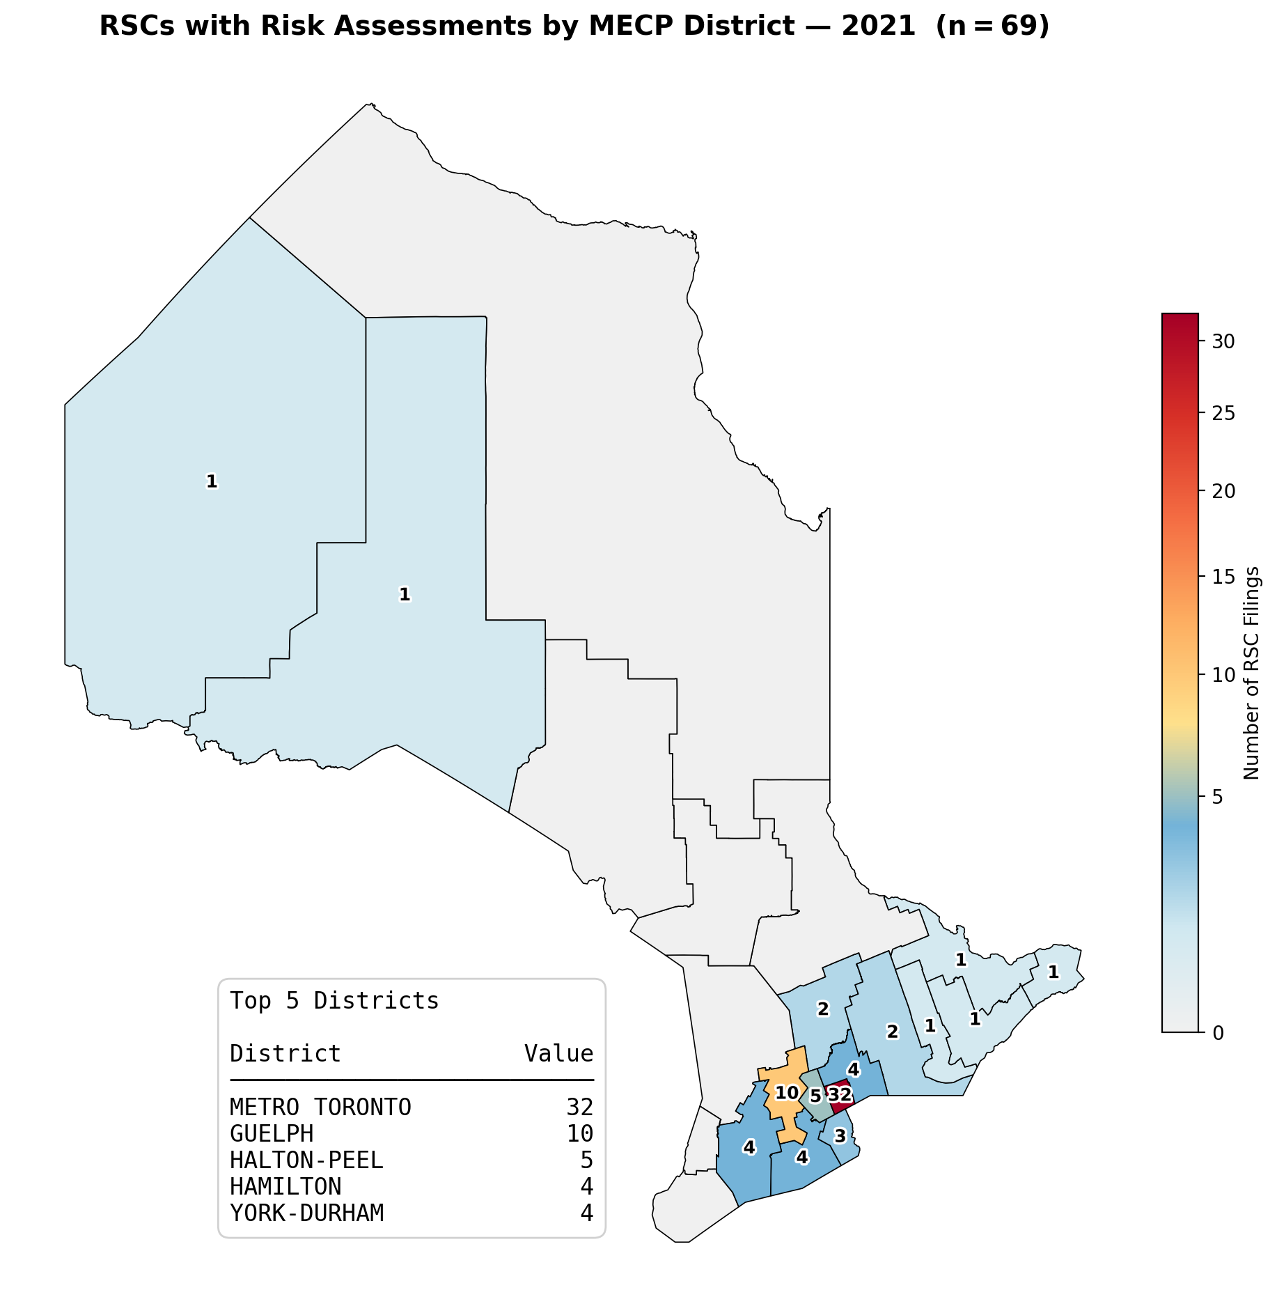

Slide 29
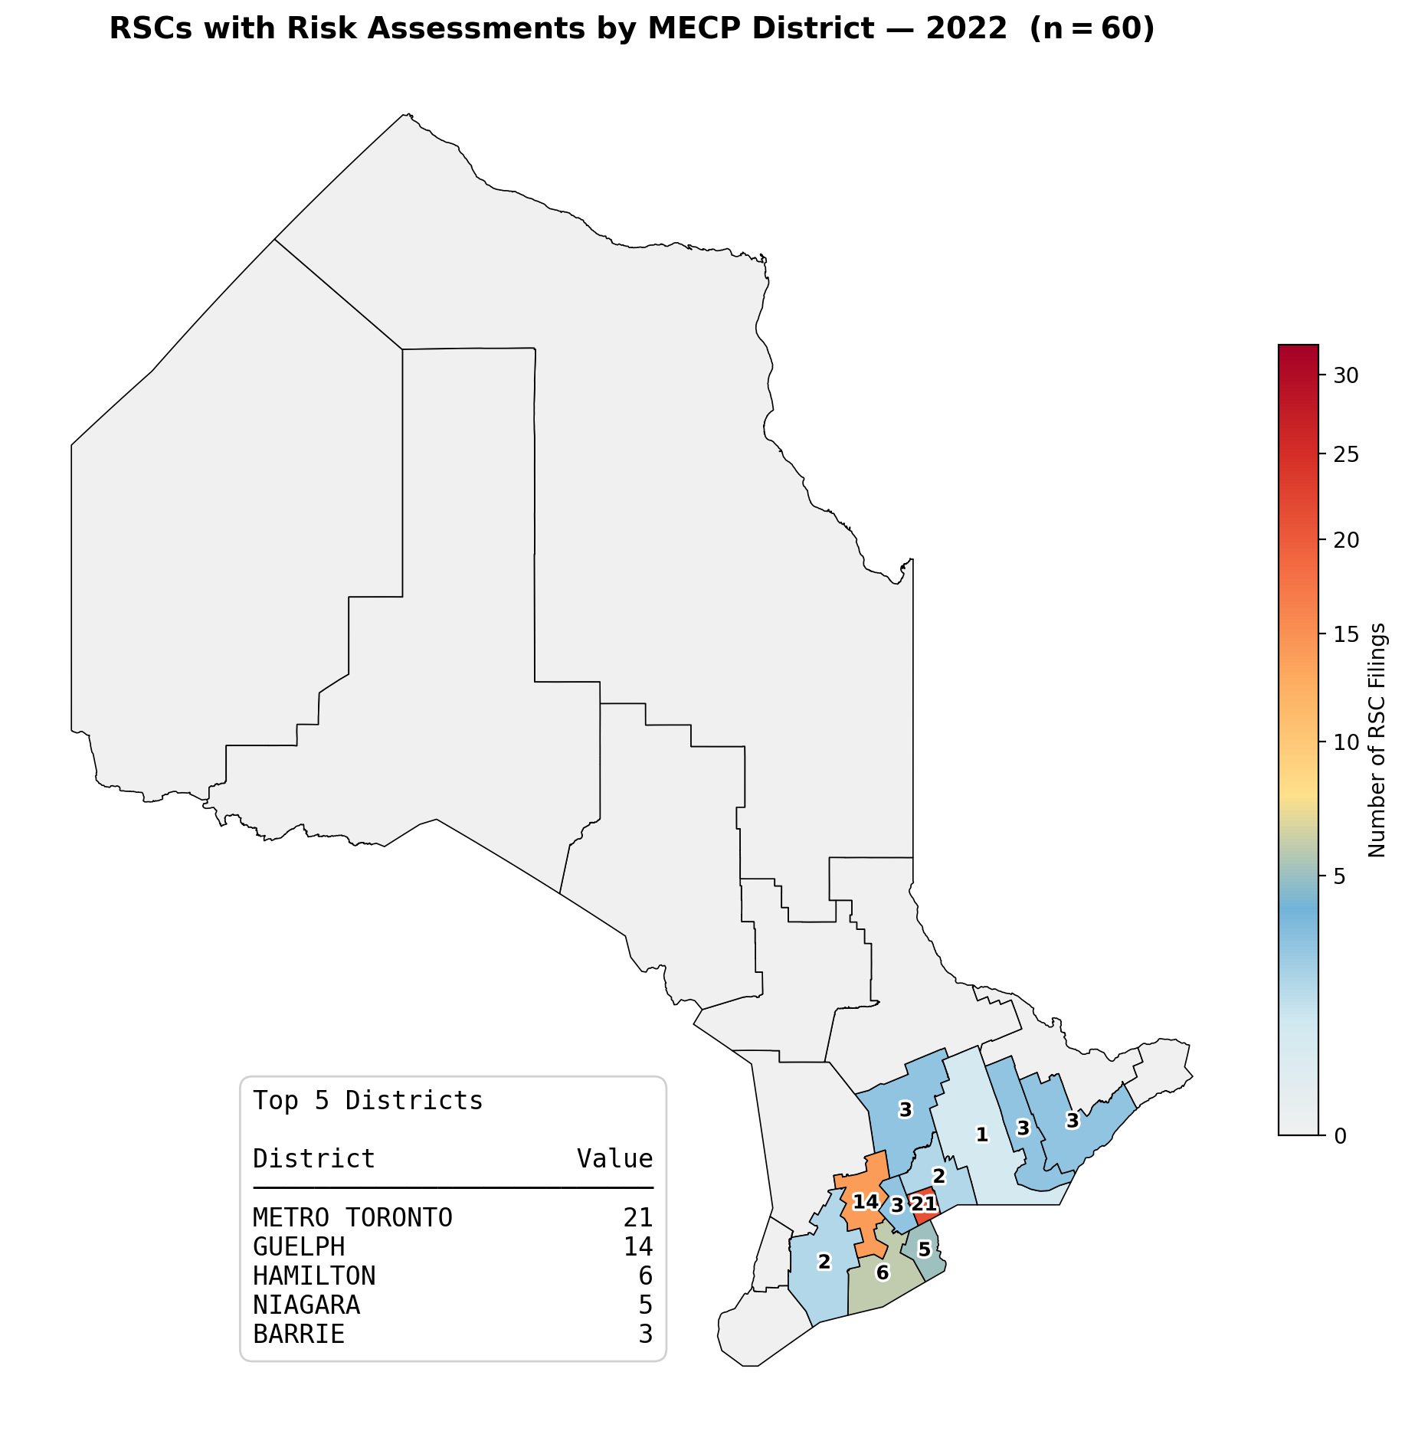

Slide 30
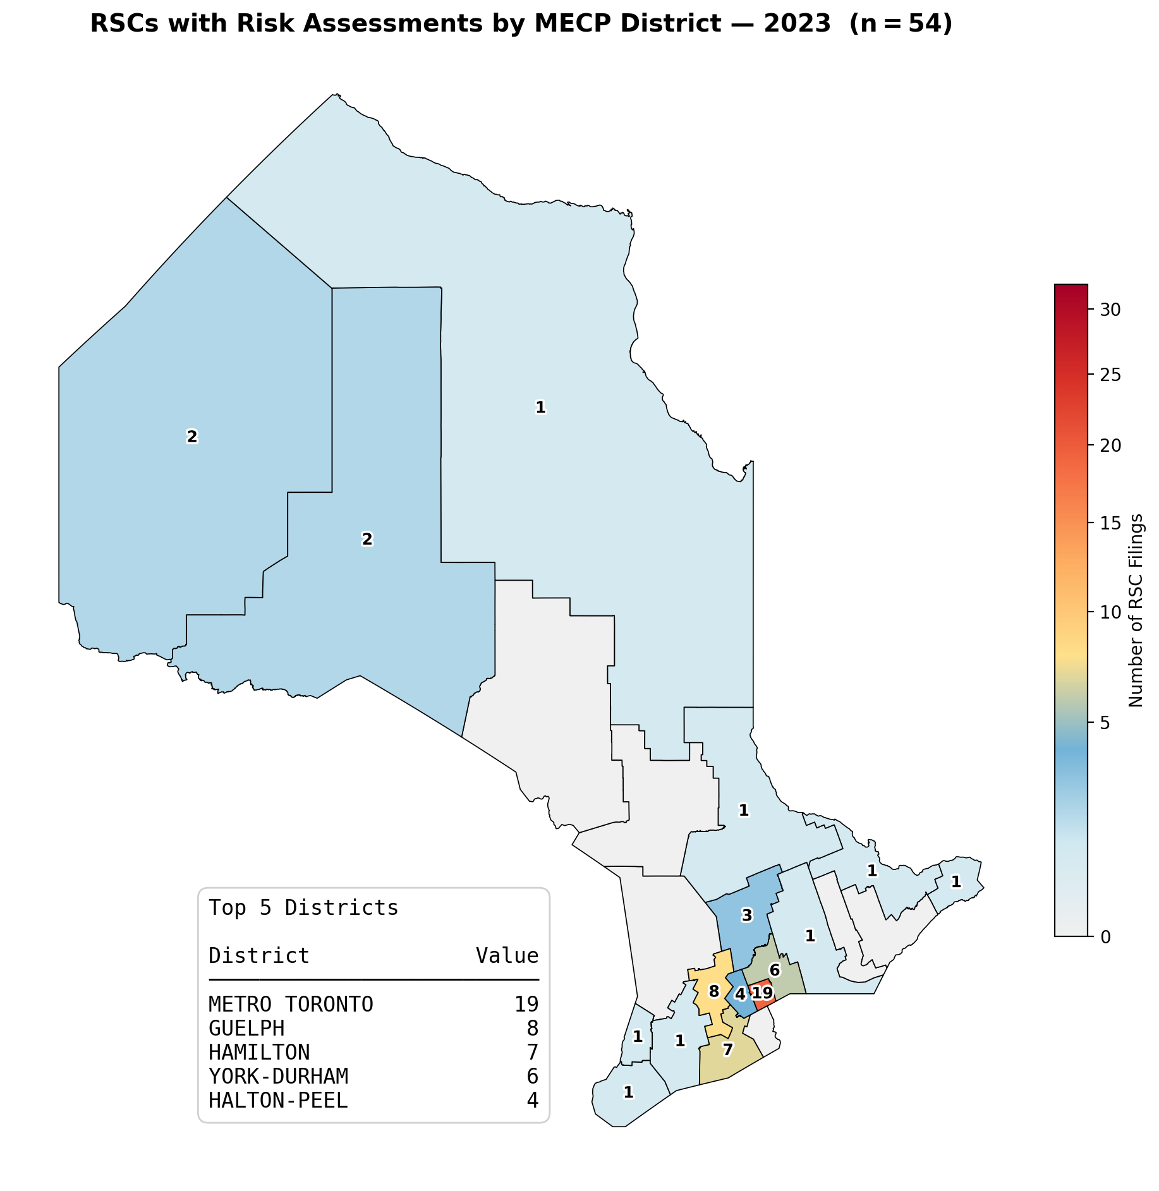

Slide 31
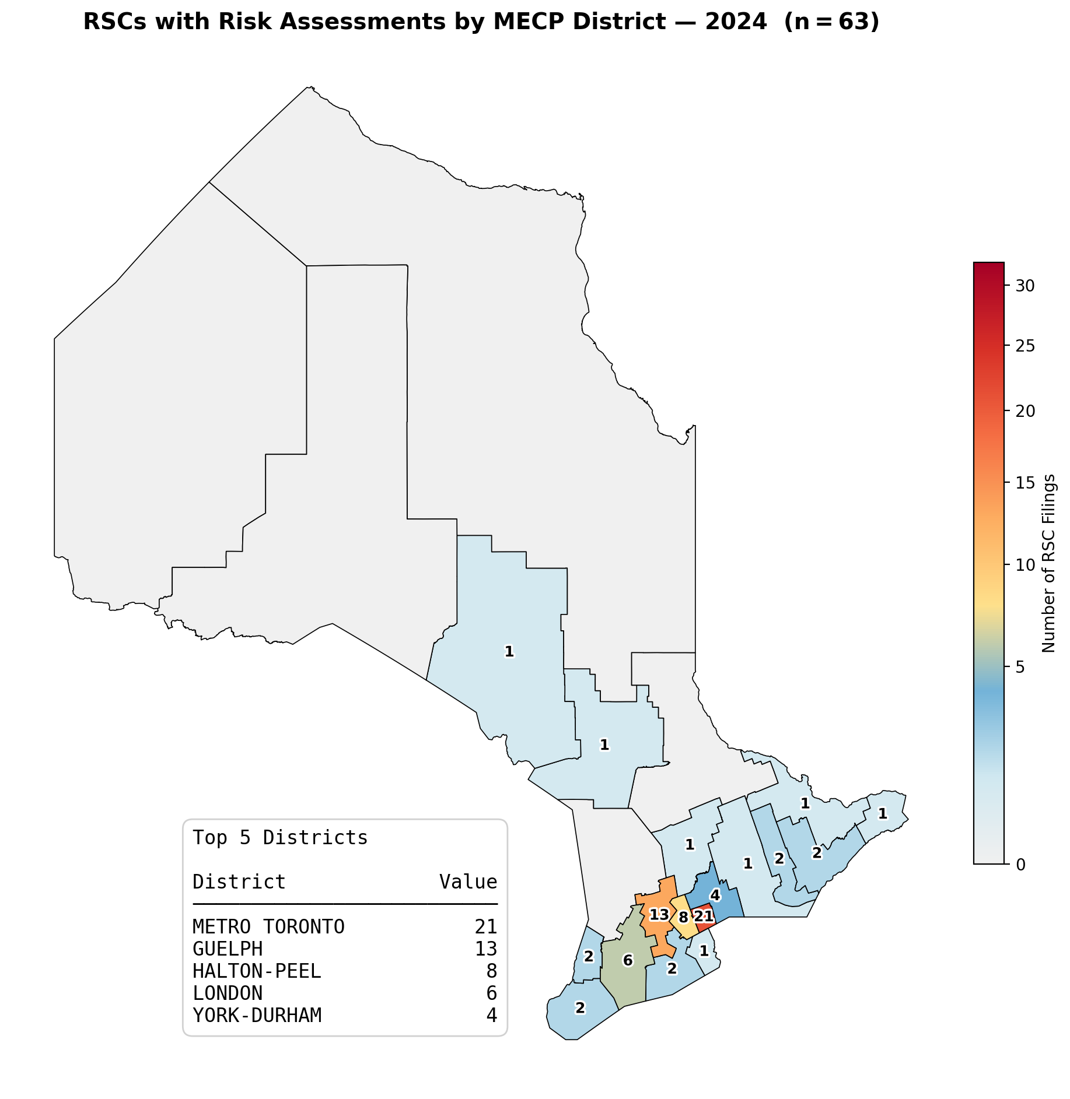

Slide 32
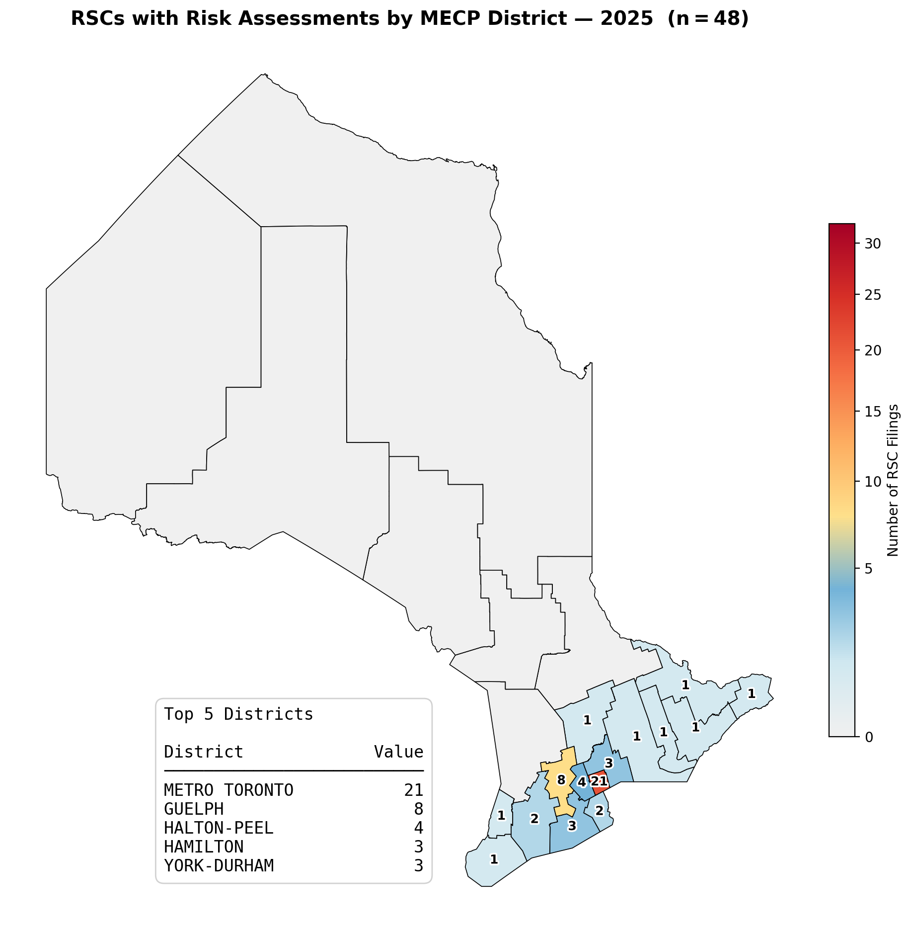

Slide 33
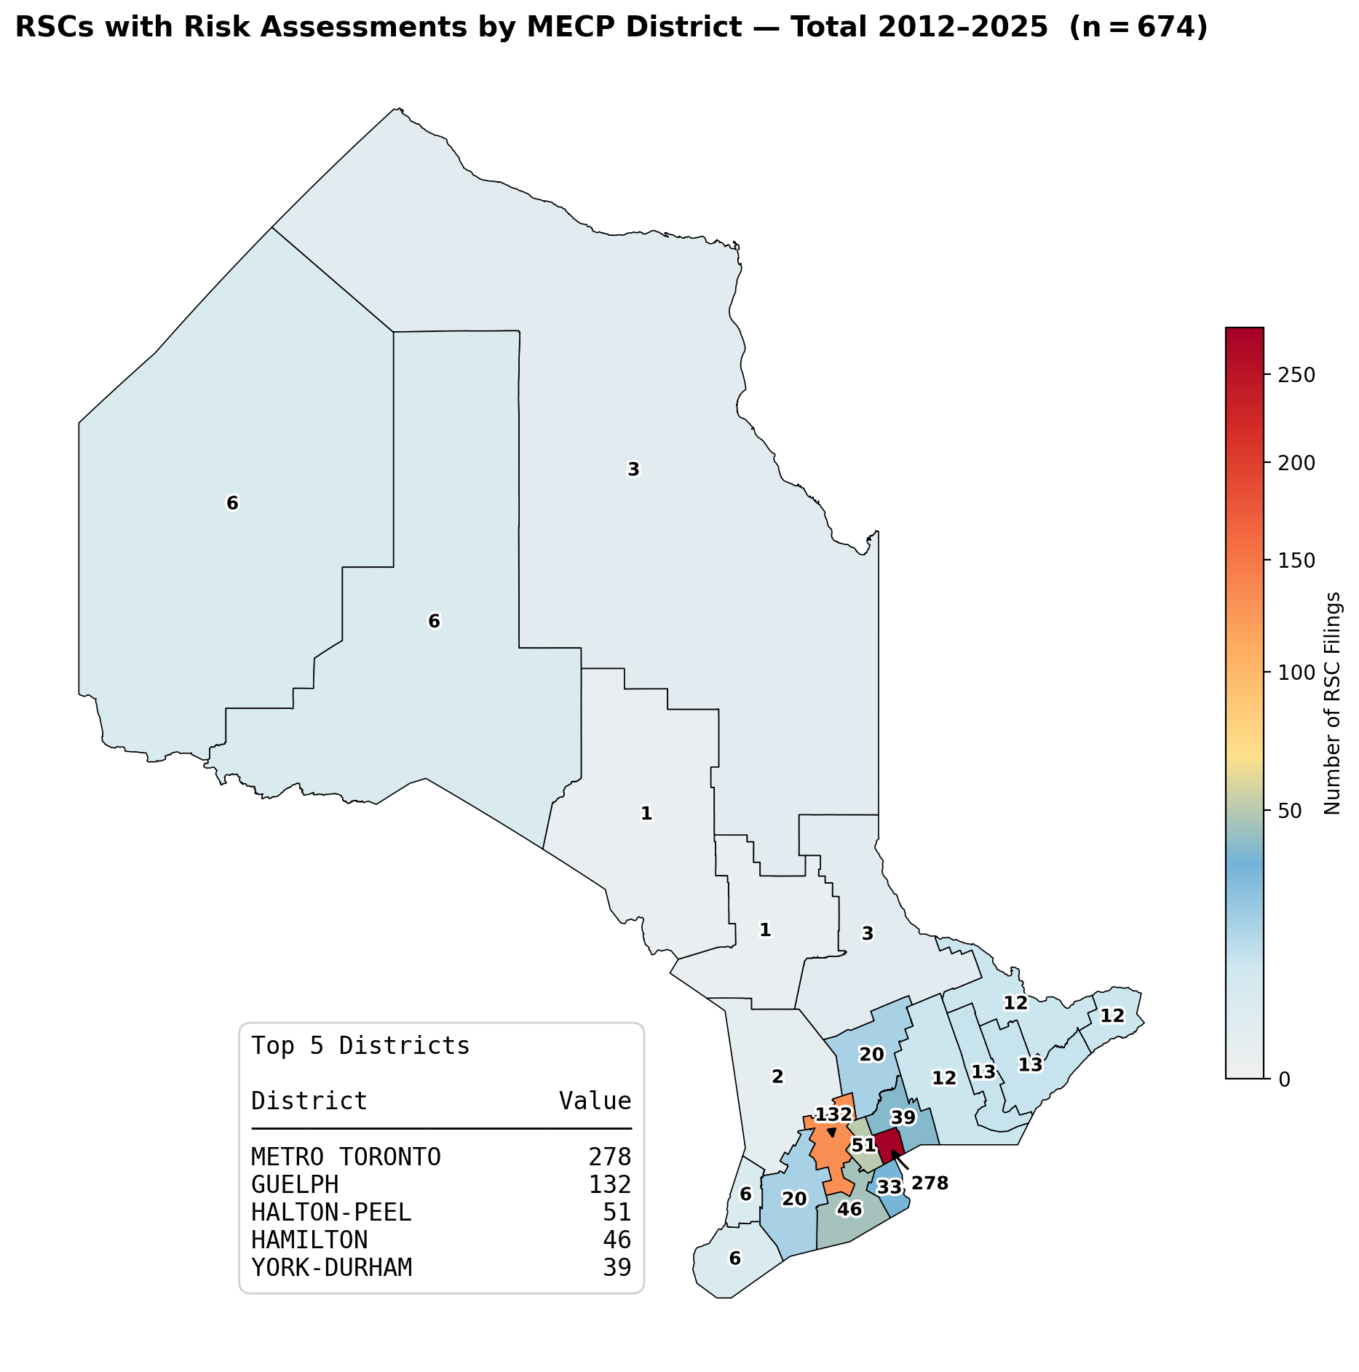

Slide 34
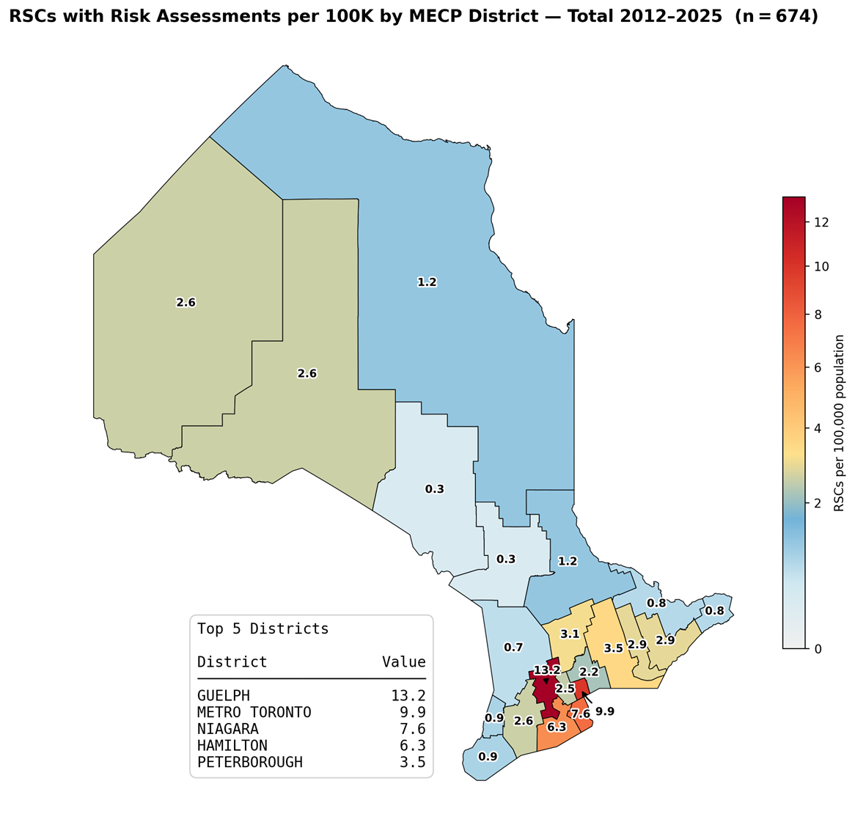

Slide 35
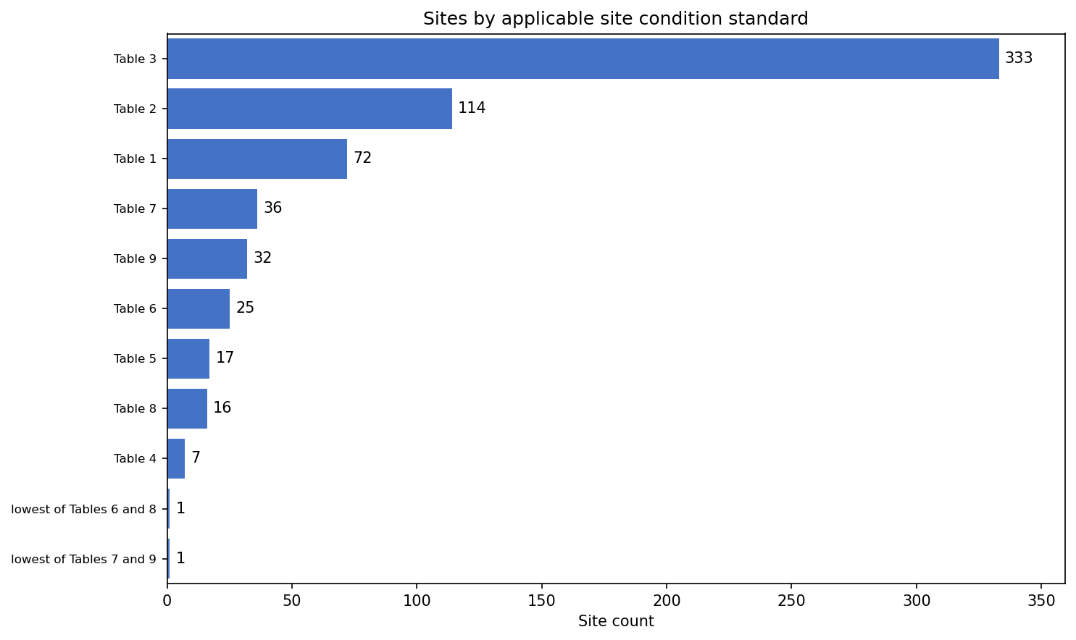

Slide 36
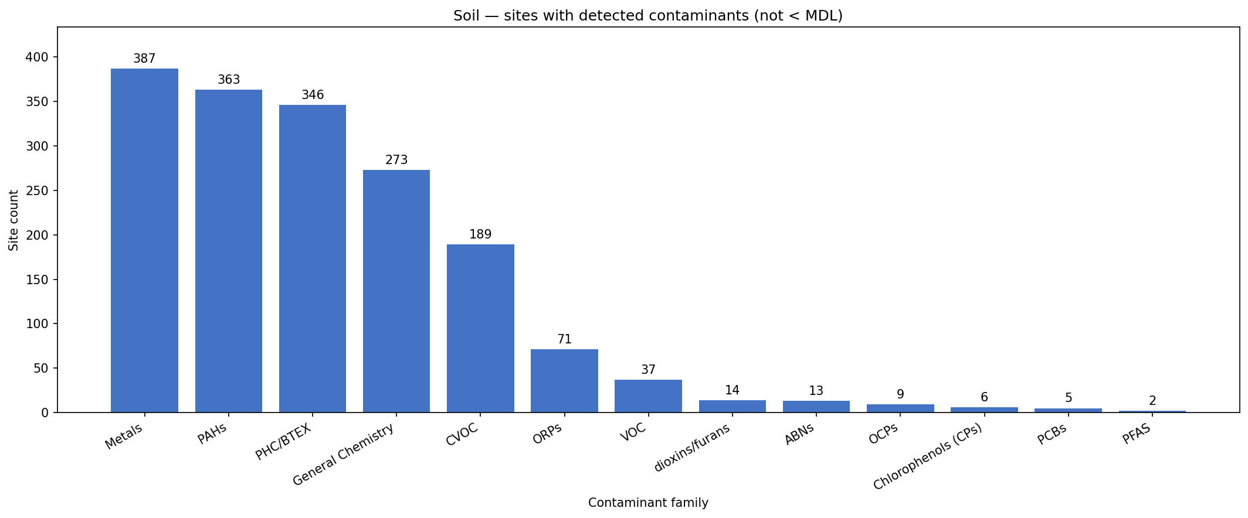
Soil – detected compounds going to RA

Slide 37
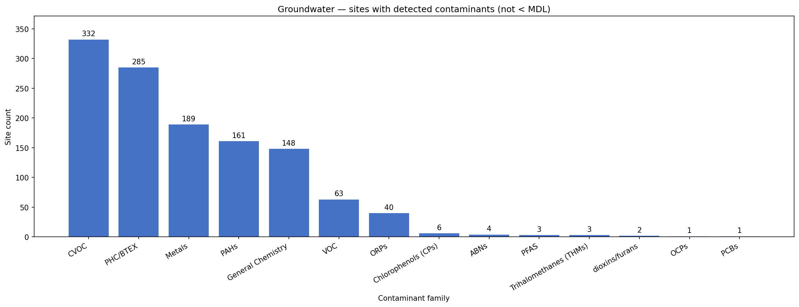
Groundwater – detected compounds going to RA

Slide 38
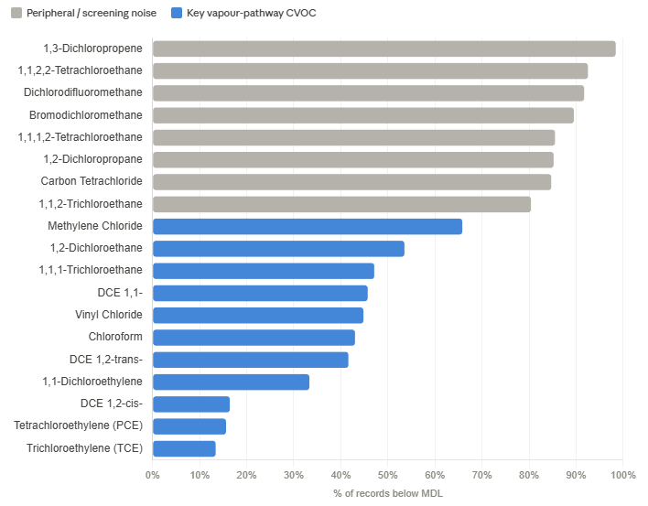
CVOCs below the Detection Limit

Slide 39
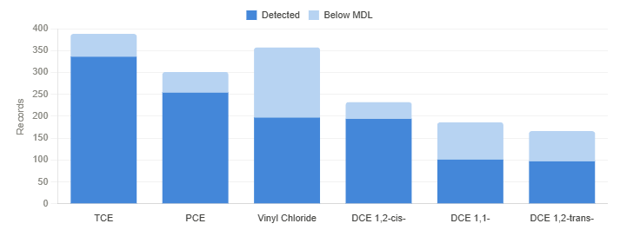
Key CVOCs below the Dectected vs Non-Detect

Slide 40
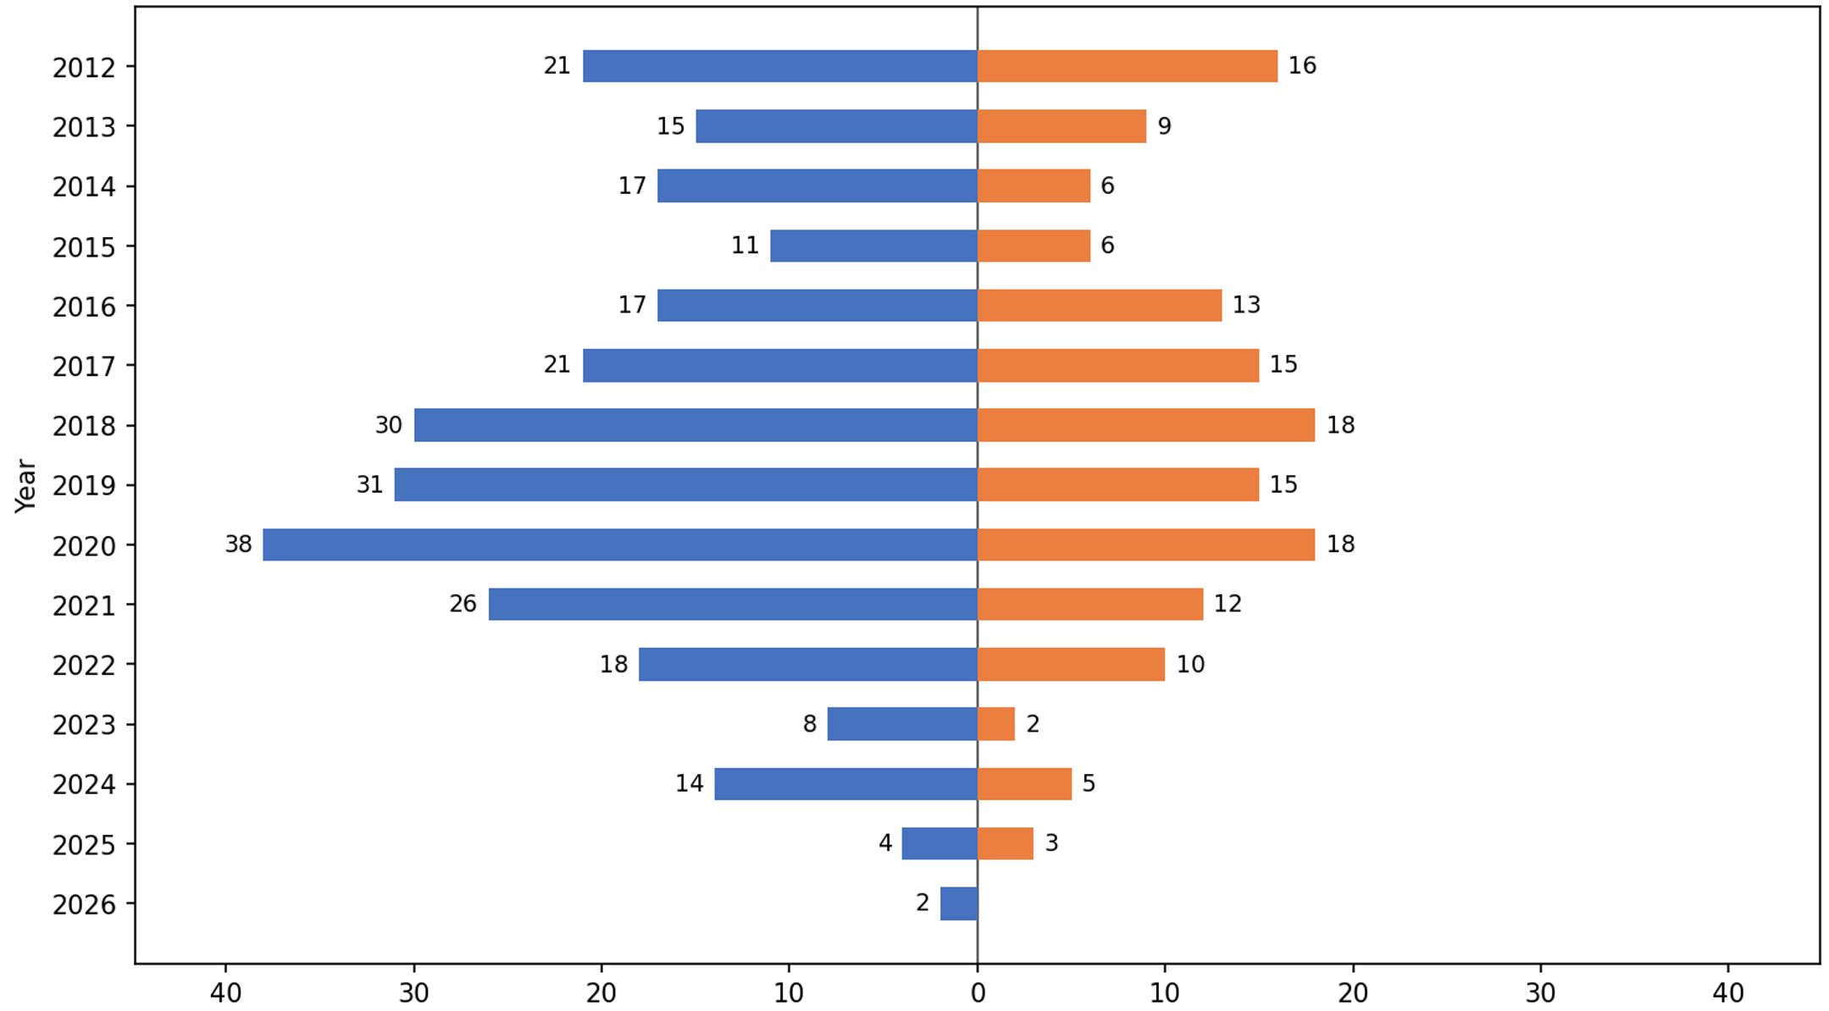
Impact of Section 49.1 on RAs

Slide 41
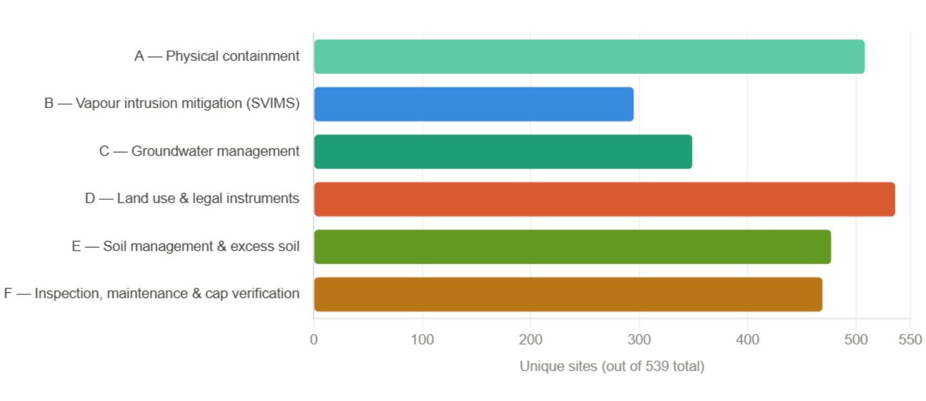
What RMMs are being implemented?

Slide 42
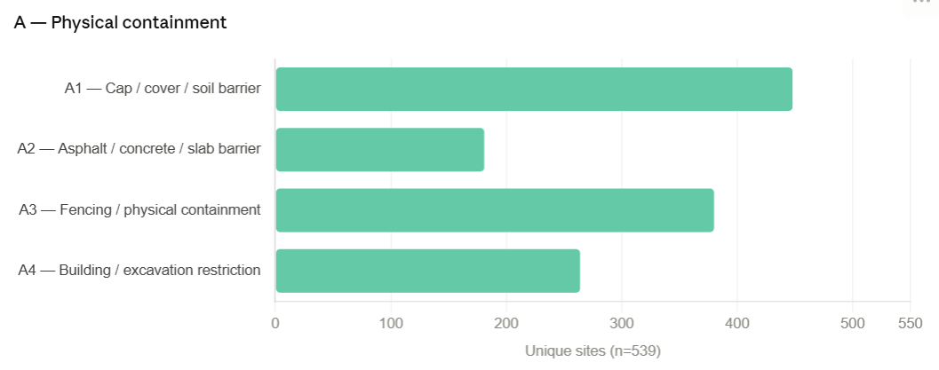
What RMMs are being implemented?

Slide 43
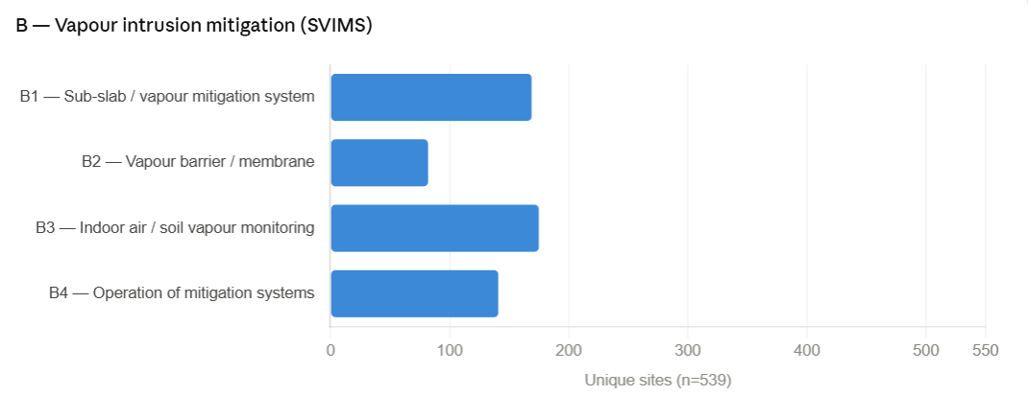
What RMMs are being implemented?

Slide 44
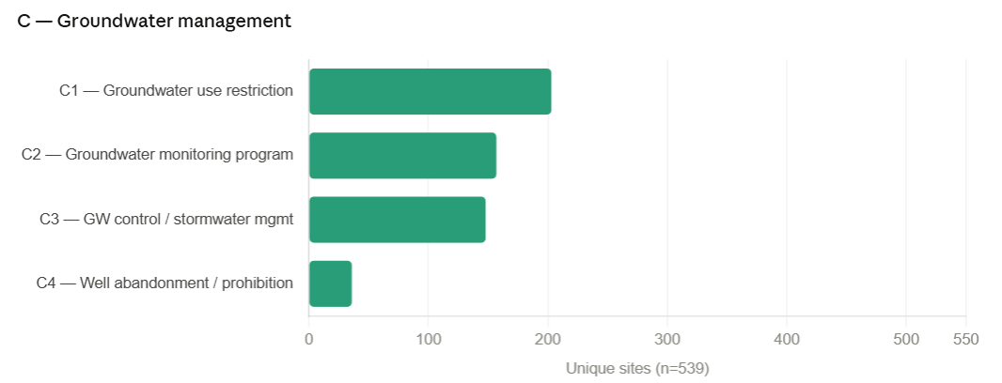
What RMMs are being implemented?

Slide 45
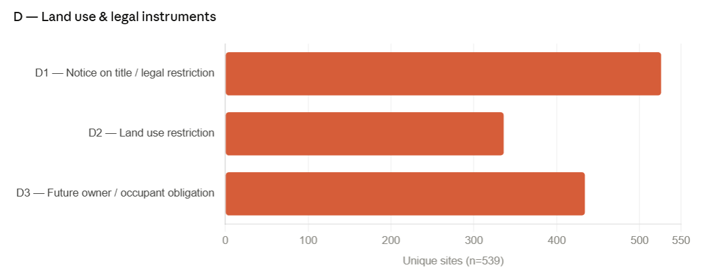
What RMMs are being implemented?

Slide 46
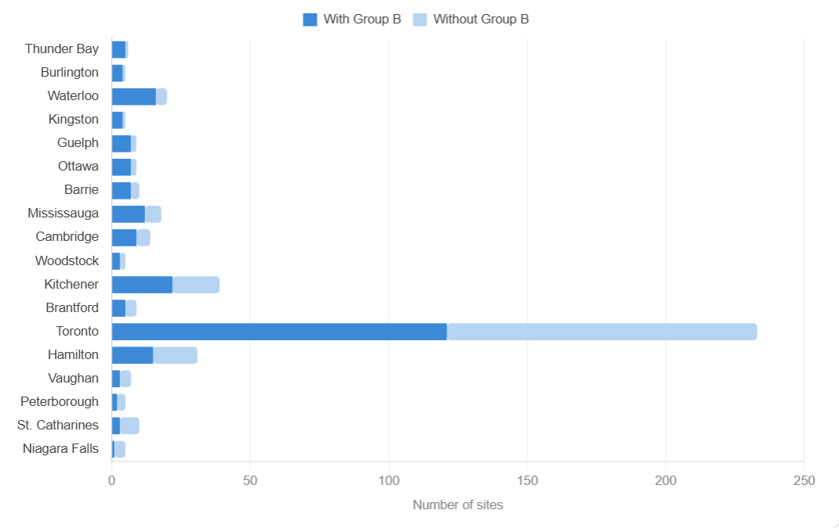
Where is vapour mitigation being used?

Slide 47
4
Conclusions

Slide 48
Conclusions - AI
GenAI continues to improve at an astounding rate and will extend the reach and capability of individual practitioners.
Routine tasks will continue to be automated, freeing practitioners to focus on interpretation, strategy, and client-facing value.
Applications like Claude are unlocking more complex tasks, including analysis of data and analytics for all practitioners.
Human-in-the-loop is still critically important for non-deterministic AI systems.

Slide 49
Conclusions – RSC Insights
CVOCs drive groundwater RAs at 67% of sites. Vinyl chloride and TCE are the top two groundwater contaminants.
38% of groundwater cVOCs and 54% of soil cVOCs are non-detect, but carried through the RA process.
296 sites (52%) cluster around a PHC/BTEX-leaning profile, consistent with the large number of former fuel retail cleanups and other uses such as heating fuel.
Updates to the O.Reg153/04 for road salt application are working, with a reduction in RAs for EC, SAR, sodium of chloride over the past few years.
PAHs and metals dominate soil, PHC/BTEX is nearly as common. Benzo[a]pyrene leads individual soil contaminants followed by lead and fluoranthene, suggesting most brownfield sites carry a legacy industrial signature.

Slide 50

Conclusions – RSC Insights
PFAS – only three site (two are linked) have been accepted for PFAS RAs, yet there are a significant number of Table 1 and Table 2 sites.

Slide 51

Questions?
Presented By
Scott Ambridge, M.A.Sc., P.Eng, CPEng
scott.ambridge@stantec.com

