Slide 1
Risk-based Solutions for Salinity and Nitrate Impact at a Remote Drilling Waste Sump Site in Southern Alberta
Presented by: Sylvain Bordenave, Ph.D., P.Biol.
April 9, 2026
0300-011 RemTech East 2026 Tier 2 Salinity and Nitrate at a Remote Sump

Slide 2
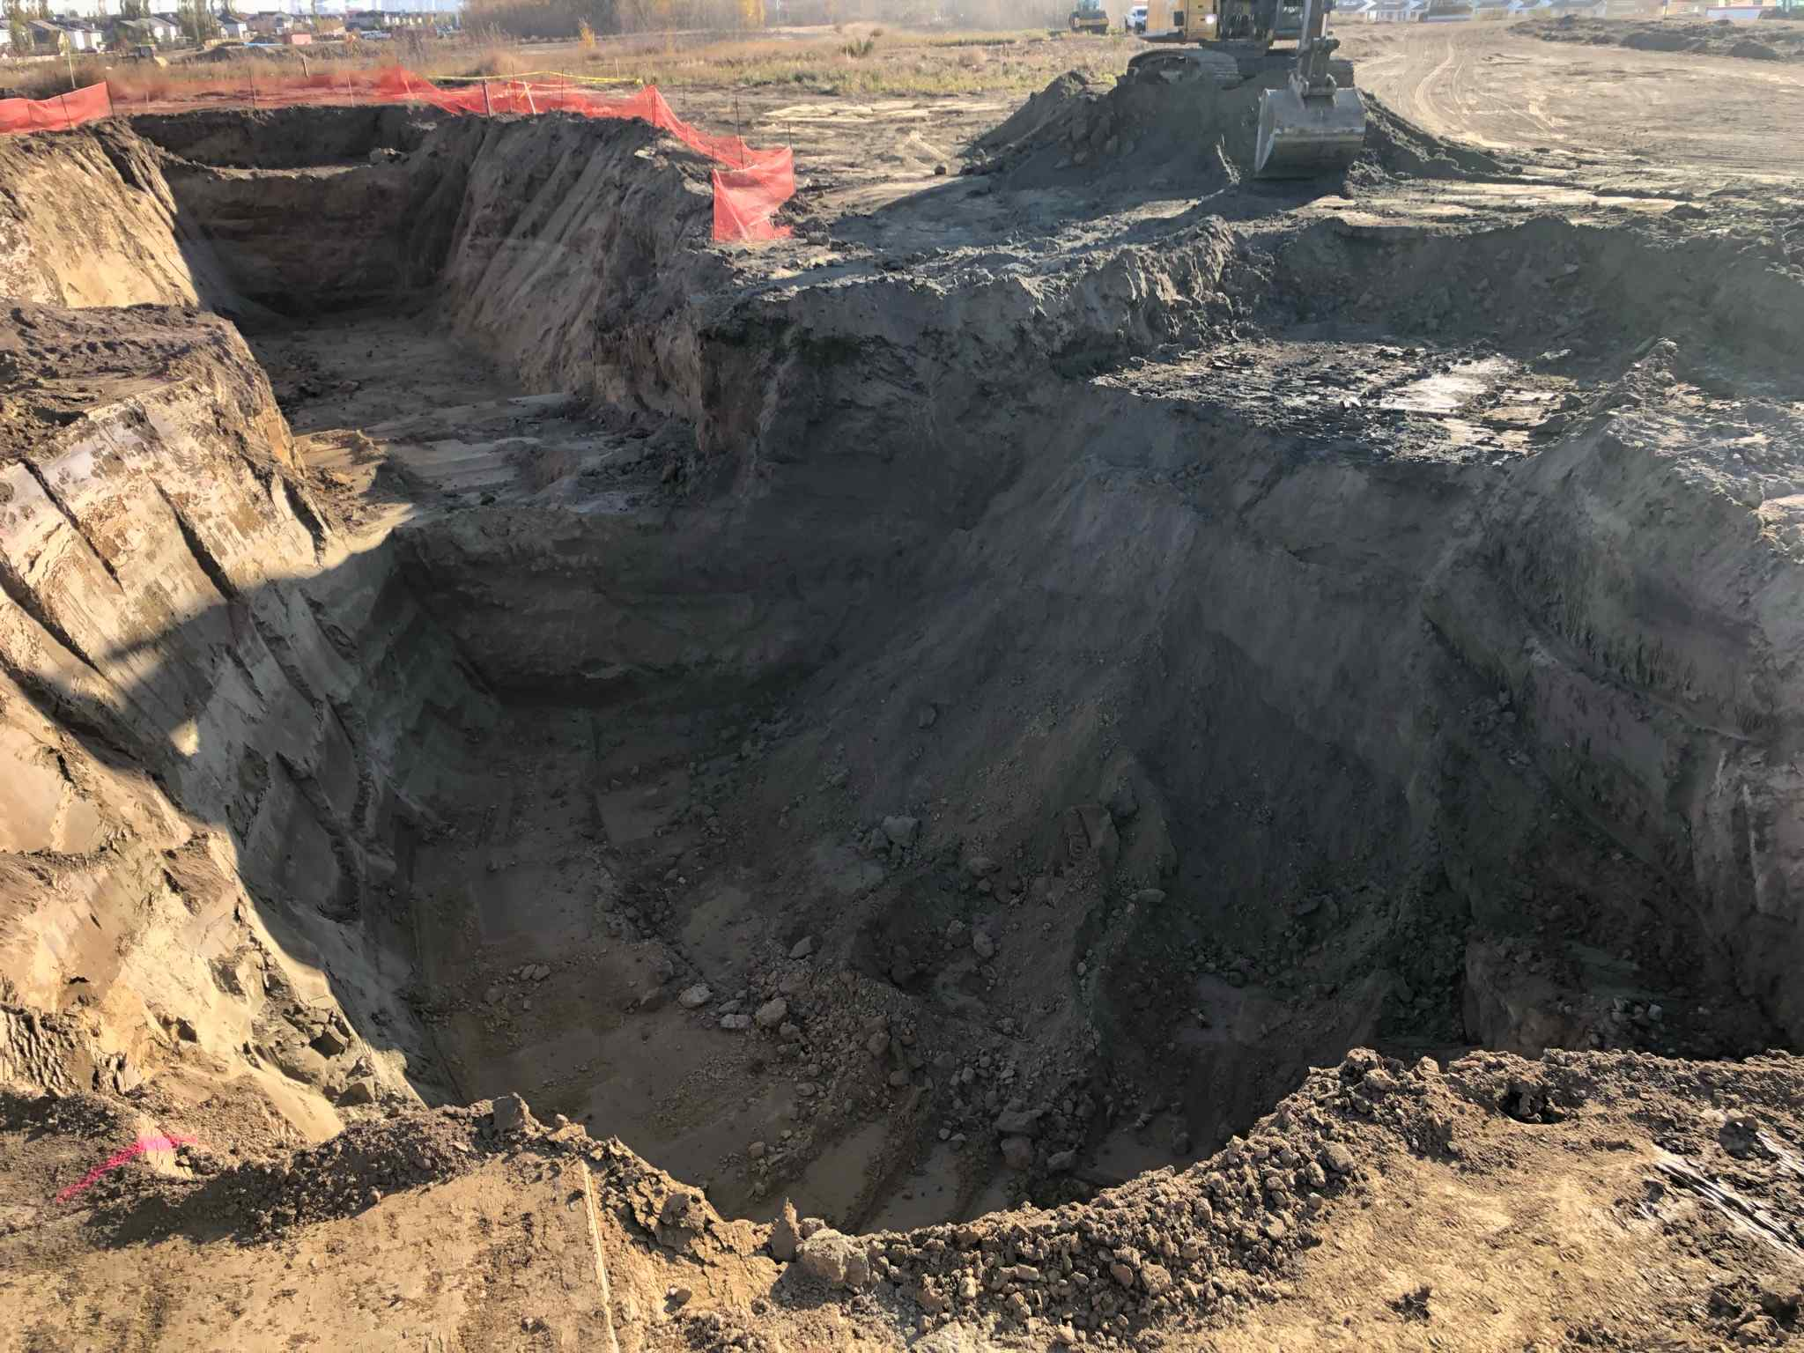
Introduction
Remediation of "low risk" sites to Tier 1 is associated with unnecessary costs (environmental, resources, and financial costs)
Non-generic guidelines available to determine risk while maintaining same level of protection with more sustainable approach
Image captured by Trace personnel

Slide 3
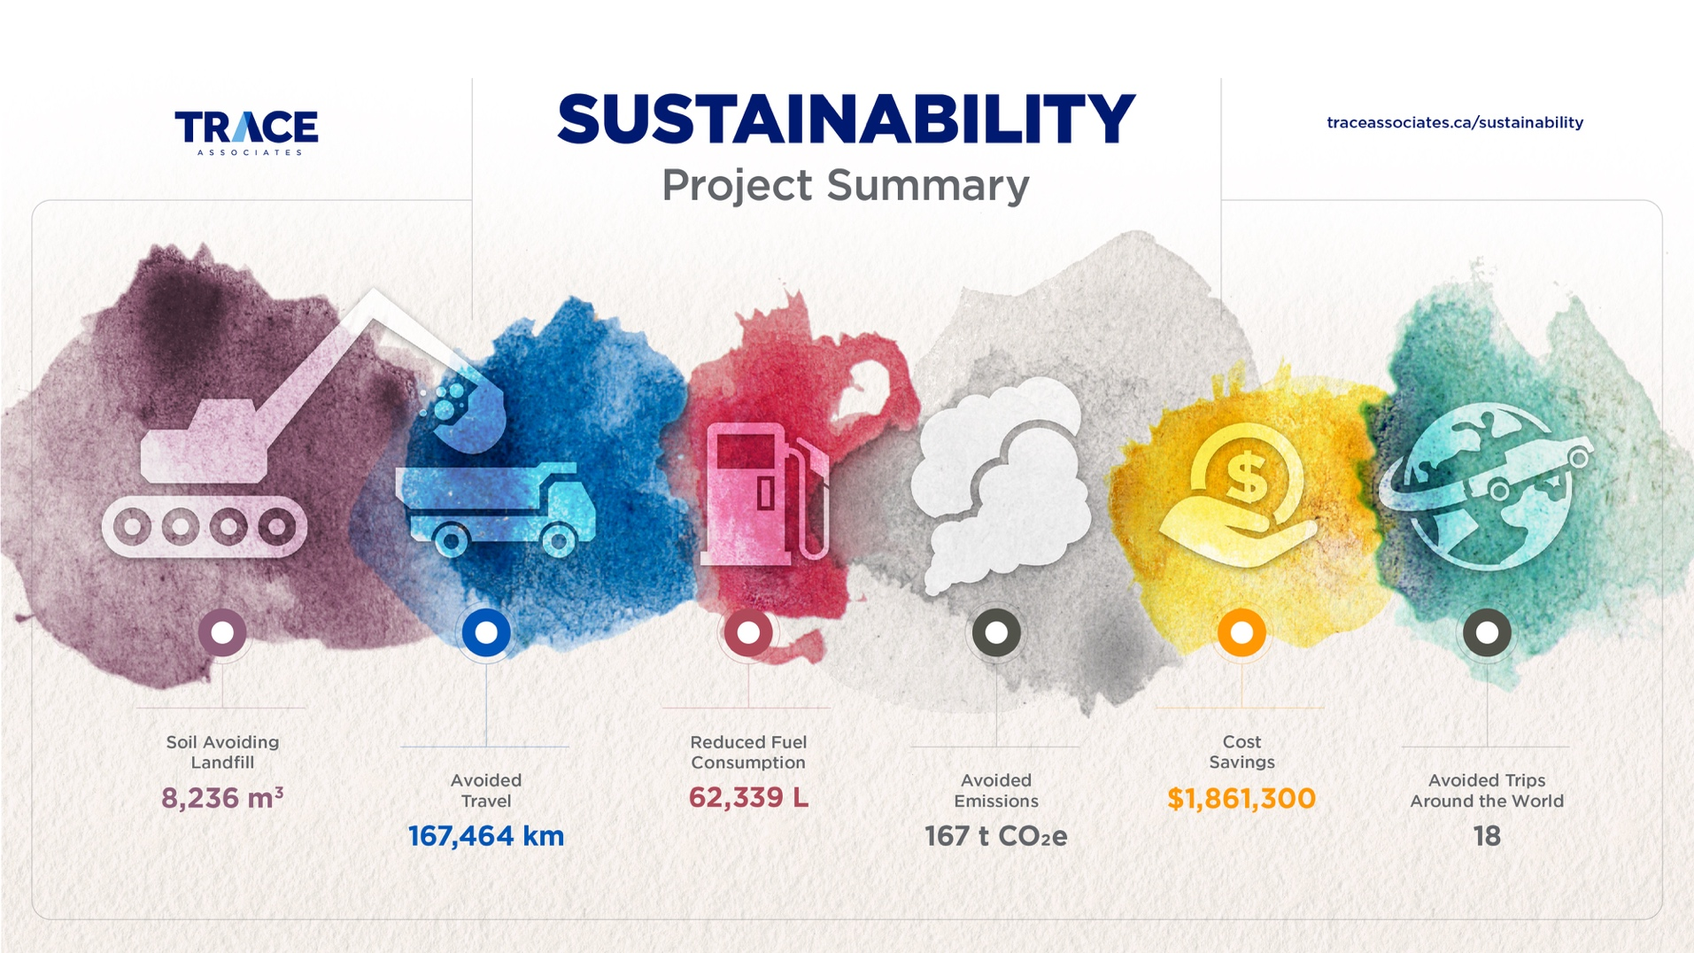
Sustainability Benefits

Slide 4
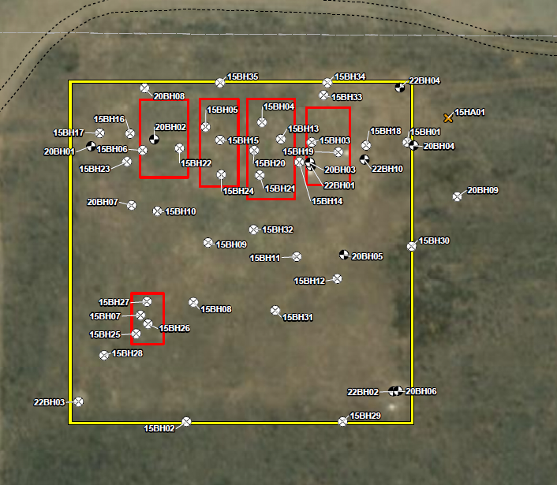
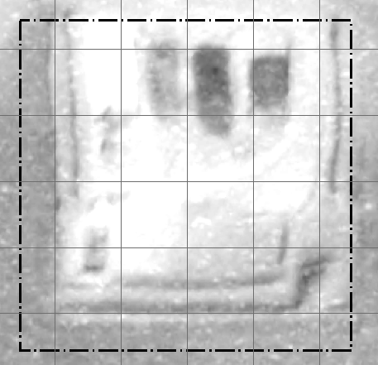
Site Background
Agricultural land use
Remote sump: ~39 wells
(3:1 mix-bury-cover disposal)
Multiple pits, configuration changes
Salinity-based additives (e.g., NaOH, CaNO₃, MgO, CaOH, etc.)
Phase 2 environmental site assessments in 2015 and 2020
Groundwater assessment
from 2021 to 2025
Image from Trace Phase 1

Slide 5
Source/Contamination Characteristics
Total of 31 boreholes and
14 monitoring wells (3 nested pairs)
Exceedances in soil: pH, electrical conductivity (EC), and sodium adsorption ratio (SAR)
EC influenced by nitrate in soil
Exceedances in groundwater: EC, SAR, chloride, nitrogen compounds, sodium, sulphate, and total dissolved solids
Image from Trace Phase 2
Notes:
EC influenced by soil nitrate (not included on standard salinity test) – nitrate is a salinity parameter but less commonly needed during O&G ESA

Slide 6
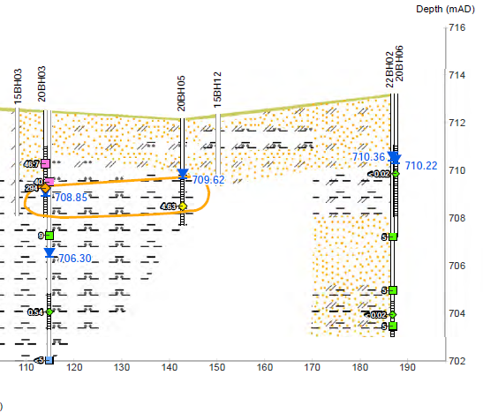
Hydrogeological Conditions
Mean water table ~4.0 m below ground surface (mbgs)
Fine- and coarse-grained material:
  Coarse/fine mix in unsaturated and shallow saturated zone in plume area
  Fine-grained soils at depth in plume area
  Coarser grained off site
Groundwater conductivity from 6E-8 (shallow) to 3E-7 m/s (deep) with lateral velocity estimated at 0.3 to 3 m/year
Northeast groundwater flow
Image from Trace Phase 2

Slide 7
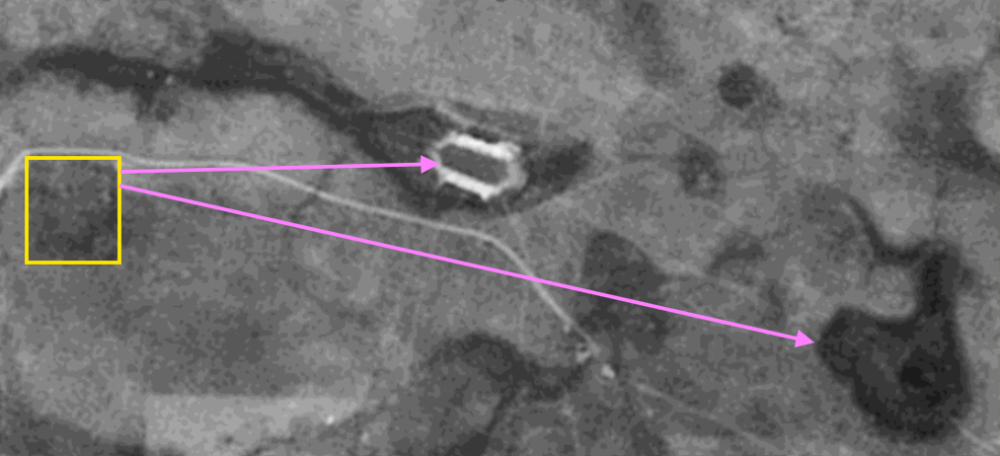
Receptors of Potential Concern
Vegetation (native prairie)
Potential Underlying Domestic Use Aquifer (DUA) >10.5 mbgs
Dugout ~360 m east
Potential Class 2 waterbody ~770 m east of the site (visible on 3 out of 17 years imagery)
Image from AbaData
Notes:
could have extended further out because water was only present in 3 of 17 years for available images but this wasn’t required because wasn’t as limiting as other pathways.

Slide 8
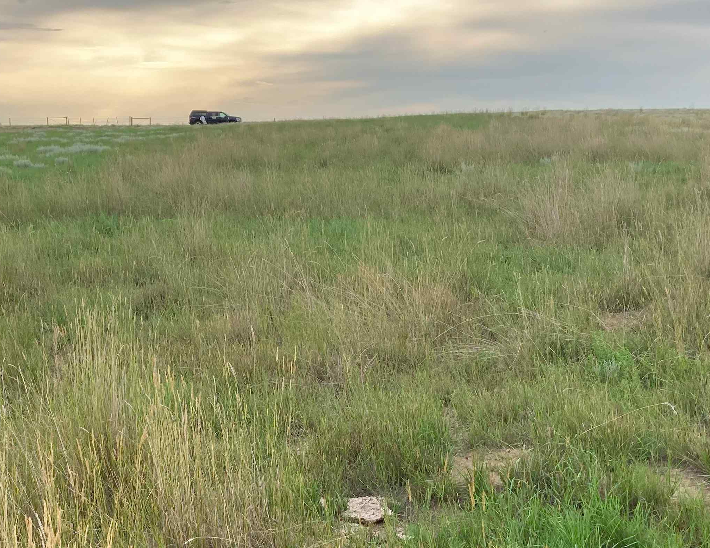
Challenges
Sensitive ecosystem (native prairie)
Several salinity contaminants of potential concern in soil
and groundwater
No Tier 1 nitrate-compound guidelines in soil and
Tier 2 guidelines not
commonly implemented
Image captured by Trace personnel

Slide 9

Risk Assessment Approach
Native Prairie Protocol (NPP) – salinity in surface soil
Subsoil Salinity Tool (SST) – chloride in subsoil and groundwater, sodium in subsoil
Tier 2 Dilution Factors (DF) Assessment – Nitrate as nitrogen
in groundwater
SST Proxy – Nitrogen compounds, sodium, and SAR in groundwater
Image from https://pngtree.com/

Slide 10
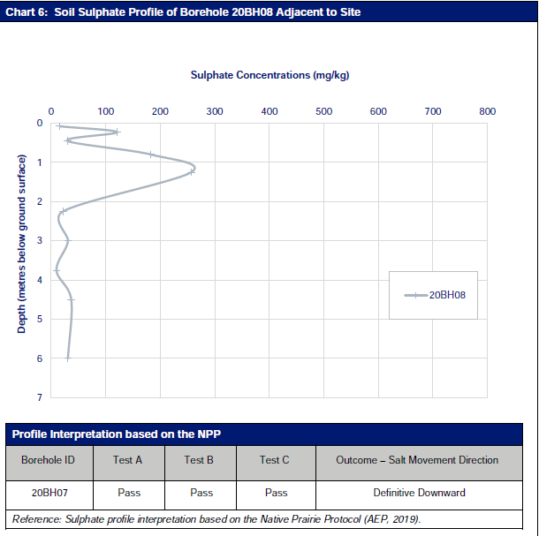
Native Prairie Protocol – Salinity in Surface Soil
Alternative approach to “disturbing” remediation for salt-contaminated sites on native grasslands
Prevent the destruction of sensitive native prairie ecosystems
No current adverse effects on grassland vegetation
No likely future adverse effects based on net downward migration of ions in the soils
Sulphate profiles indicated a net downward migration of ions at the site
Notes:
>30% Native Prairie
Demonstrate no current adverse effect(s) on the grassland plant community.
Demonstrate not likely to have an adverse effect on the grassland plant community in the future (net downward gradient)
Demonstrate site conditions are not likely to have an adverse effect on any other receptors via relevant exposure pathways.

Slide 11
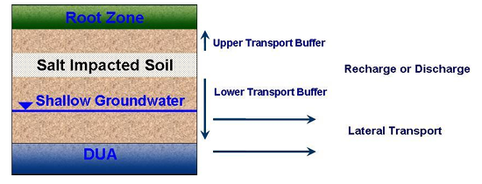
Subsoil Salinity Tool
Tier 2 science‑based tool
Used to manage chloride‑based salinity impacts below the
root zone
Based on numerical models to simulate salinity movement
over time
Root zone soil and vegetation, DUAs, Freshwater Aquatic Life (FAL), agricultural water uses (dugout), and soil structure (SAR/sodium)
Recharge or Discharge
Lateral Transport
Modified from SST User Manual (Equilibrium Environmental Inc, 2020)

Slide 12
Subsoil Salinity Tool – Salinity in Subsoil
SST-calculated chloride, SAR, and sodium subsoil guidelines:
Chloride = 7,000 mg/kg and Sodium = 4,500 mg/kg (Management Limits) (root zone pathway not applicable [N/A], as determined from the NPP evaluation).
SAR = N/A (SAR module was calculated using a mock
SST input value. The NPP overrides this guideline relevant to the root zone pathway).
All subsoil concentrations met these applied guidelines for the site.
Notes:
Cl and Na guidelines protective of GW pathways. Soil pathways (i.e., risk of salinity migrating upward managed using NPP)
Max chloride at 2,010 mg/kg and max. sodium at 2,330 mg/kg

Slide 13
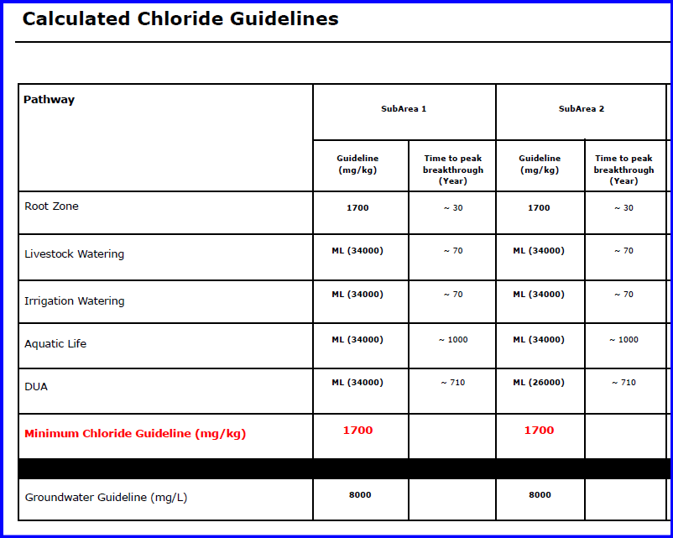
Subsoil Salinity Tool – Salinity in Groundwater
SST chloride groundwater guidelines:
Chloride = N/A-Vadose (chloride impact limited to vadose zone)
A mock scenario with the bottom of the chloride extents 1 m deeper than the water table would yield 8,000 mg/L
Maximum chloride concentration in groundwater at 213 mg/L
Notes:
Max chloride concentration in groundwater at 213 mg/L

Slide 14
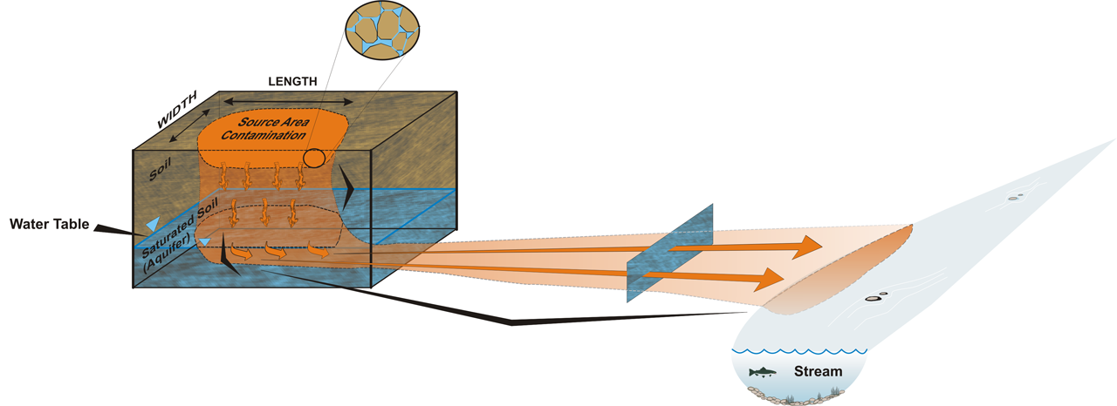
Nitrate Dilution Factor Calculations
DF1 – Soil to Pore Water Partitioning
(three phase partitioning air-soil-water)
DF1 – Soil to Pore Water Partitioning
(three phase partitioning air-soil-water)
DF2 – Downward Migration Through Unsaturated Soil
(adsorption, biodegradation, and dispersion)
DF2 – Downward Migration Through Unsaturated Soil
(adsorption, biodegradation, and dispersion)
DF4 – Lateral Groundwater Transport (dispersion, biodegradation, and adsorption)
DF3 – Mixing of Pore Water into Groundwater (dilution)
DF4 – Lateral Groundwater Transport (dispersion, biodegradation, and adsorption)
DF3 – Mixing of Pore Water into Groundwater (dilution)

Slide 15
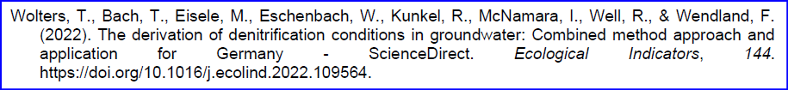
Nitrate Dilution Factor Calculations – Method
DF for lateral groundwater transport (DF4) used to calculate
N-compounds guideline in groundwater for protection of FAL
N-compounds groundwater guideline for protection of the DUA based on:
  DF for vertical groundwater transport (DF4v) within the saturated zone to the deeper DUA.
  DF for mixing of the impacted shallow groundwater with a potential deeper DUA (DF3)
Modeling accounted for biodegradation during groundwater transport using half-life values from literature

Slide 16
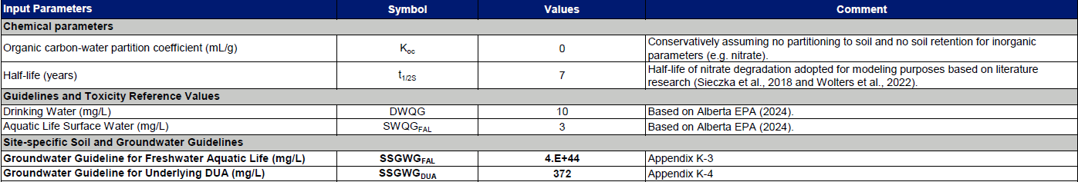
Nitrate Dilution Factor Calculations – Results
The results of the calculations were:
4.0 x 10⁴⁴ mg/L for the site-specific nitrate groundwater guideline for FAL
372 mg/L for the site-specific nitrate groundwater guideline for DUA
Notes:
Max nitrate in GW at 330 mg/L for Tier 1 guidelines at 3 and 10 mg/L for FAL and DUA
Max nitrite in GW at 11.2 mg/L for Tier 1 guidelines at 0.2 (FAL) to 10 mg/L (livestock)

Slide 17
Nitrate SST-Proxy Calculations – Method
 |  | NO3-N, NO2-N | Cl-
Similarities | GW Pathways/Receptors: | DUA//LW | DUA//IW/LW
 | Solubility: | High ->10 g/100 g water >0ºC | High ->10 g/100 g water >0ºC
 | Charge / sorption: | Negative / low sorption to clayparticles and OM | Negative / low sorption to clayparticles and OM
 | Main Transport Driver: | Water movement (some biological uptake) | Primarly water movement
Differences | Biodegradation: | Reactive (subject to biodegradation) | Conservative (inert)
 | Biological: | Denitrification - to NO2 and N2 | Minimal
 | Seasonal variation: | Lower in summer (increased microbial activity) | Stable
Concept: SST Cl-dilution (multiplier) indicative of N dilution - SST multiplier will be conservative because SST does not factor in biodegradation
Relative to DF, the SST may have more elaborate vadose partitioning (Hydrus model) and more elaborate three-dimensional saturated zone dilution (3DADE)
SST only provides one groundwater pathway guideline (worst-case pathway)
Notes:
Chloride is considered a conservative tracer
assumes similar dilution effects for nitrate and nitrite as for chloride

Slide 18
Methods – Nitrate Compound SST-Proxy Calculations
Step 1: Updated the inputs in the SST to model for N-compounds
Step 2: Two SST scenarios for livestock watering (LW):
1) Potential future dugout on site
2) Existing dugout 360 m east of the site
Step 3: Calculated the guideline multipliers using SST model output provided divided by the applicable Tier 1 pathway guideline (most conservative
pathway used)
Step 4: Multipliers applied to the Tier 1 groundwater guidelines for
N-compounds, sodium, and SAR

Slide 19
Nitrate Calculations Summary
SST and SST-Proxy calculated thresholds:
NO3-N = 201 mg/L (FAL) and 320 mg/L (DUA)
NO2-N= 13.4 mg/L (FAL), 32 mg/L (DUA), and 320 mg/L (LW)
NO3+NO2-N = 3,200 mg/L (LW)
Sodium = 6,400 mg/L (DUA)
SAR = 60 irrigation watering (IW)
All maximum measured concentrations
in groundwater below Tier 2
site-specific guidelines
 |  | Groundwater Guidelines, mg/L |  |  | 2023 Site concentration
Parameter | Pathway | Tier 1 (Ag) | DF | SST or SST-proxy* | mg/L
Cl | RZ | - | - | 8000 | 133
 | LW | - | - | 8000 | 133
 | LW 360 m | - | - | 16000 | 133
 | IW | 100 | - | 8000 | 133
 |  | 120 | 6E+28 | 8000 | 133
 | DUA | 250 | 2117 | 8000 | 133
NO3-N |  | 3 | 4E+44 | 201 | 293
 | DUA | 10 | 372 | 320 | 293
NO2-N |  | 0.2 | 3E+43 | 13.4 | 0.07
 | DUA | 1 | 37 | 32 | 0.07
 | LW | 10 | - | 320 | 0.07
 | LW 360 m | 10 | - | 600 | 0.07
NO3-N+NO2-N | LW | 100 | - | 3200 | 294
 | LW 360 m | 100 | - | 6000 | 294
Na | DUA | 200 | 1693 | 6400 | 593
SAR | IW | 5 | - | 400 | 5.89
Notes:
Max nitrate in GW at 330 mg/L for Tier 1 guidelines at 3 and 10 mg/L for FAL and DUA
Max nitrite in GW at 11.2 mg/L for Tier 1 guidelines at 0.2 (FAL) to 10 mg/L (livestock)
Max nitrate + nitrite at 330 mg/L for Tier 1 guidelines at 100 mg/L for livestock
Max sodium and SAR at 727 mg/L and 7.51 for guidelines at 200 mg/L (DUA) and 3 (irrigation)

Slide 20
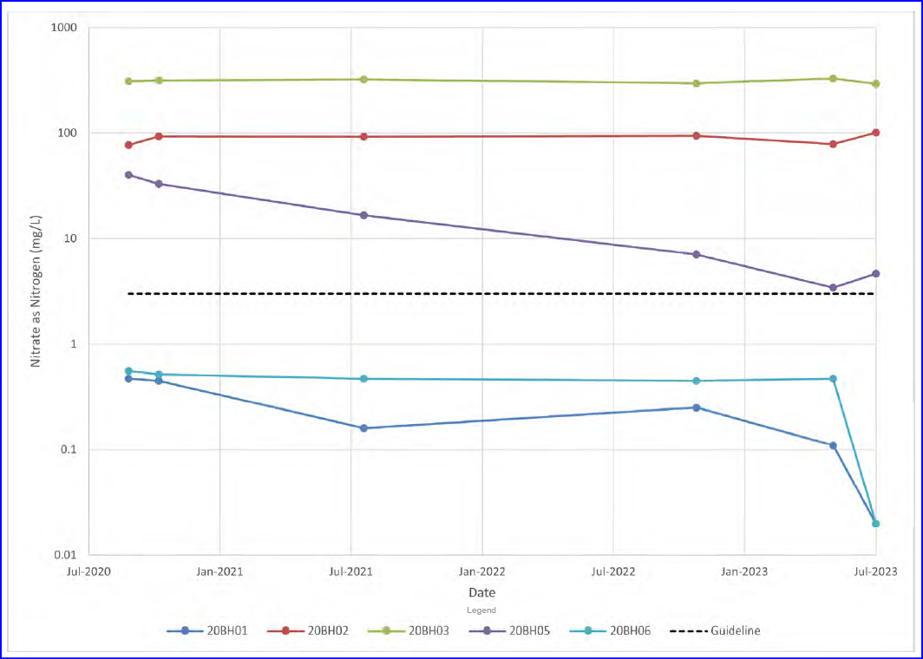
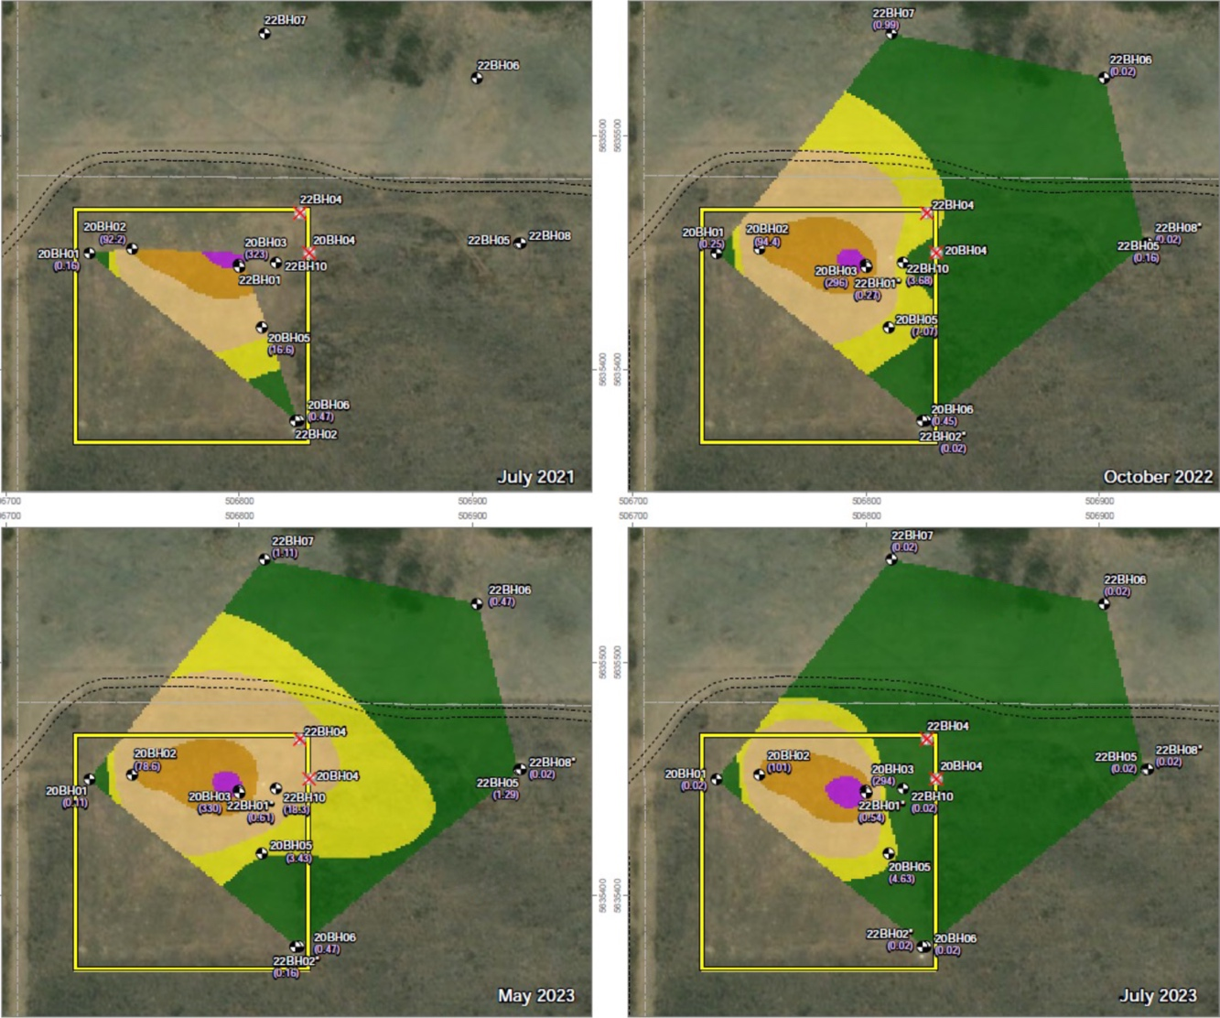
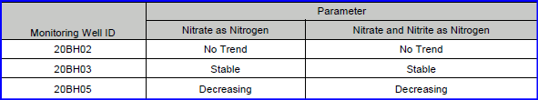
Empirical (Field Results) Validation
Mann-Kendall trend analysis: No trend, stable, or decreasing concentrations of nitrate as nitrogen and
nitrate + nitrite as nitrogen
Plume temporal analysis: Plume lateral extent is stable and not extending to deeper wells

Slide 21
Conclusions
SST and NPP application illustrated that soil salinity concentrations on site posed low risk to receptors (to be confirmed with vegetation assessment).
DF-based Modeling and SST-proxy approach demonstrated that
N-compounds in groundwater posed low risk to receptors.
Findings were supported by empirical (field) observations and trend analysis.
Successful approach applied in a site-specific situation with multiple lines of evidence and tools to prove receptors were adequately protected.
No remediation was required for this site.

Slide 22
Conclusions – Sustainability Benefits

Slide 23

Questions?
We’re Here to Help.
SYLVAIN BORDENAVE, Ph.D., P.Biol.
Principal Risk Assessor, Practice Area Lead Remediation and Risk
sbordenave@traceassociates.ca
Environmental Science, Engineering, and Management Consulting

