Slide 1


Modern LNAPL Management in Canada: Policy Shifts, High-Resolution Characterization, and Execution Focused Pathways to Closure
RemTech East
April 10, 2026
Pete Craig, M.Sc., PChem

Slide 2

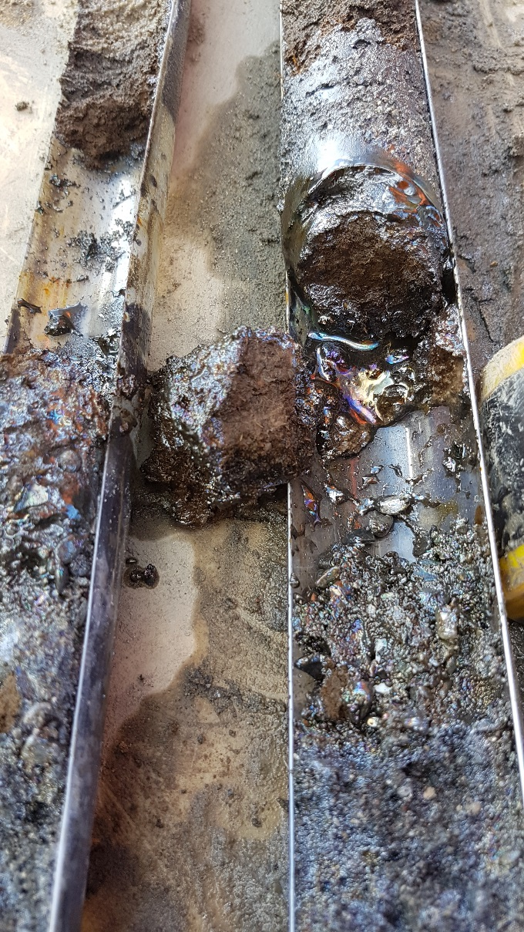
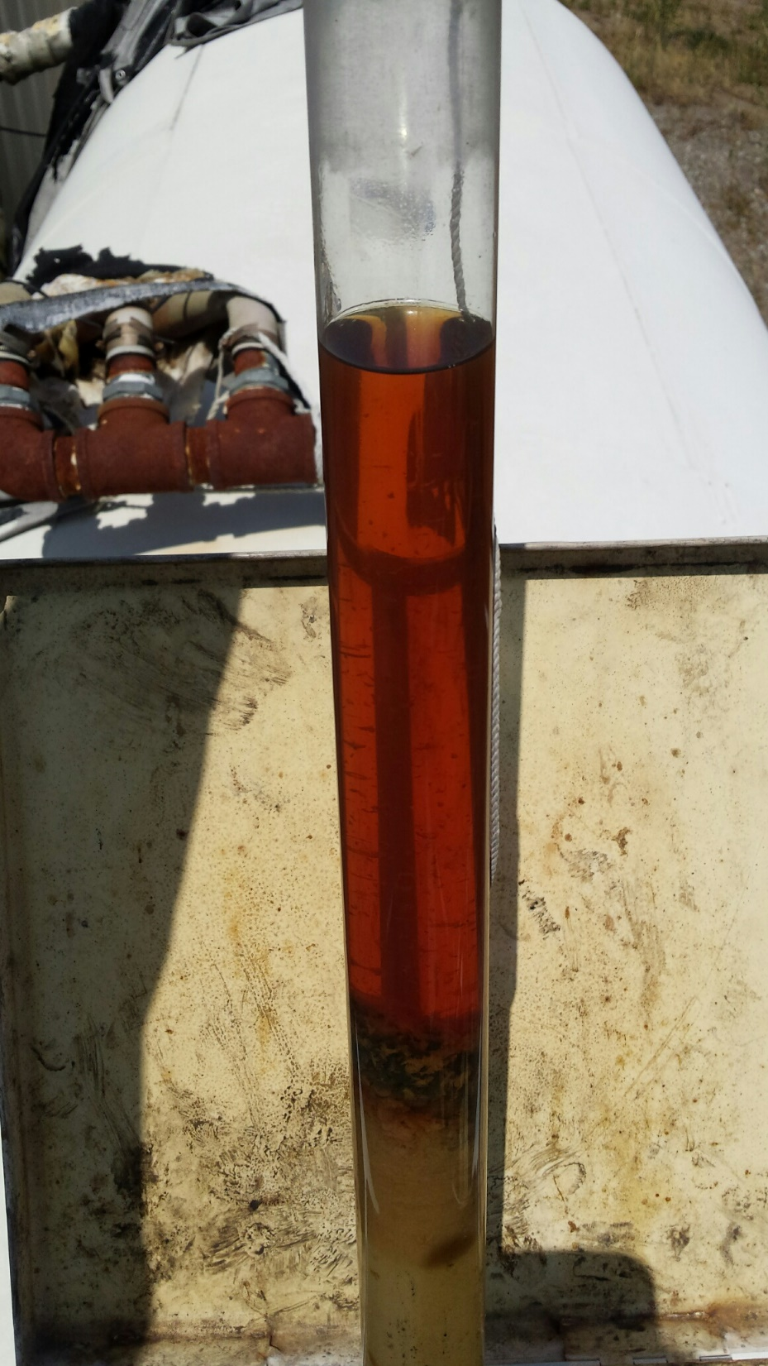
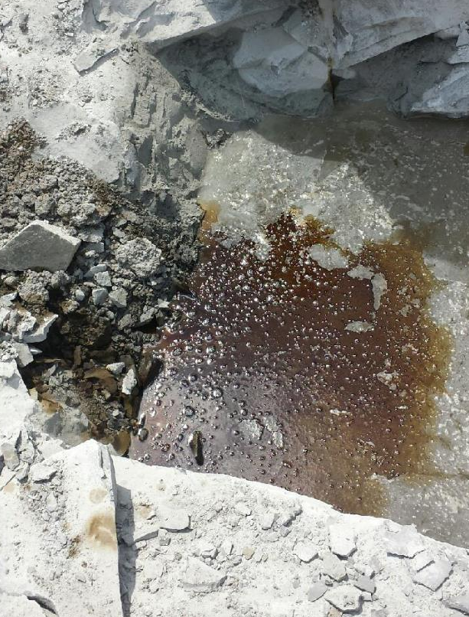
Agenda:
Introduction & VEI Overview
Evolution of Practice – From “Just Dig” to “First, Risk”
Why is LNAPL is a Special Problem for Risk Assessments?
Core Technologies
  Characterization
  Immobilization
  Destruction
Case Study
Closing Thoughts
Questions

Slide 3
Agenda:
Introduction & VEI Overview
Evolution of Practice – From “Just Dig” to “First, Risk”
Why is LNAPL is a Special Problem for Risk Assessments?
Core Technologies
  Characterization
  Immobilization
  Destruction
Case Study
Closing Thoughts
Questions
Introduction & VEI Overview

Slide 4
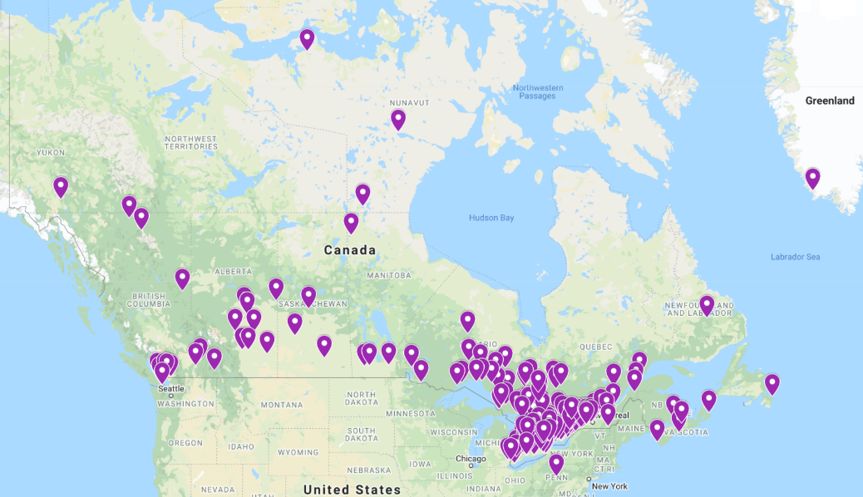
Introduction
VEI Contracting Inc.
Founded in 2003 as Vertex Environmental
>1400 Projects Completed
Specialty contractor/subcontractor
Specializes in Environmental Remediation, Treatment Systems & Construction Dewatering
Provides services, incl. design support, across Canada and Internationally
Notes:
Dewatering

Slide 5
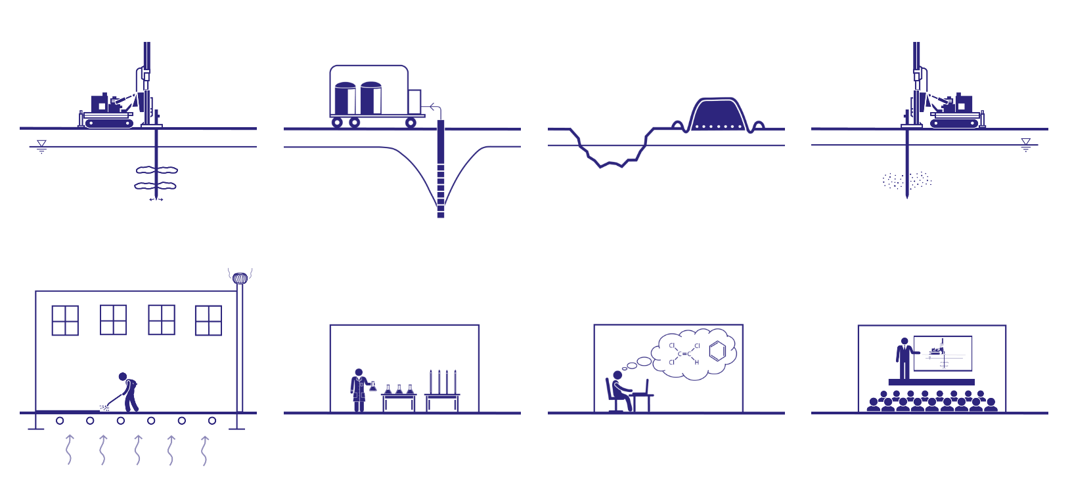
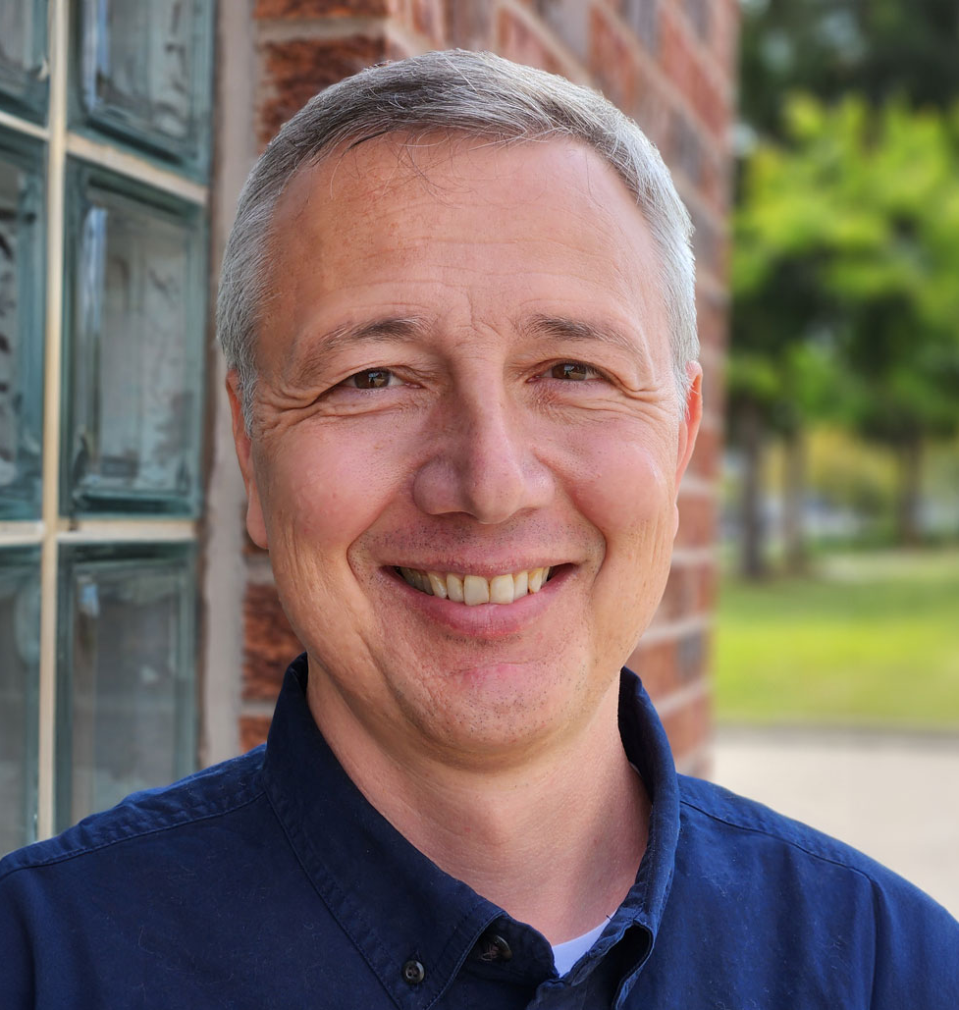
In-Situ Remediation
WTS & Dewatering
Ex-Situ Remediation
HRSC & RDC
Presenter Overview:
Pete Craig, PChem (BC)
Corporate Development Manager
M.Sc., Environmental Engineering, Stanford
B.Sc., Chemistry, UC Berkeley
Vapour Intrusion
Bench-Scale Testing
Remedial Design
Outreach

Slide 6
Agenda:
Introduction & VEI Overview
Evolution of Practice – From “Just Dig” to “First, Risk”
Why is LNAPL is a Special Problem for Risk Assessments?
Core Technologies
  Characterization
  Immobilization
  Destruction
Case Study
Closing Thoughts
Questions
Evolution of Remediation Practice

Slide 7
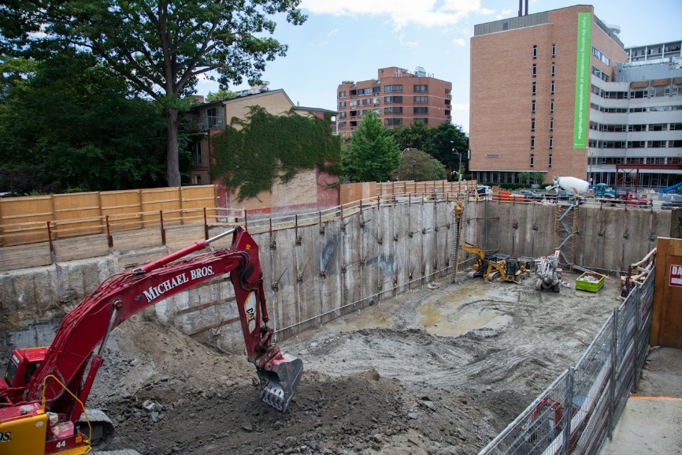
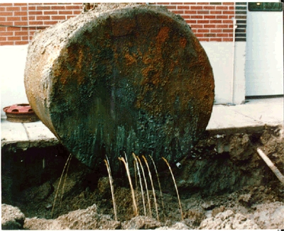
1970s & 1980s – D&D & P&T
Excavation & Off-Site Disposal (a.k.a. “Dig & Dump”):
Only solution for dealing with soil contamination regardless of contaminant – dig until “clean” line reached
Often times also used to address groundwater only contamination due to lack of remediation solutions
Was effective at soil remediation but revealed the idea of “rebound” or “back diffusion” in groundwater
Soil could pass but could still contain enough residual sorbed mass of organics to fail groundwater standards
Still has its place today for mass removal when accessible (e.g., source area extraction)
Notes:
Dewatering

Slide 8
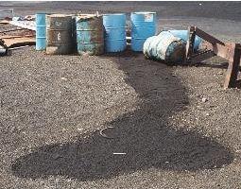
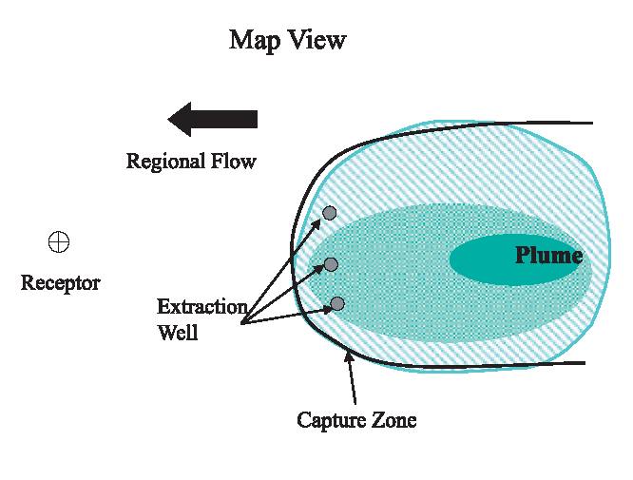
1970s & 1980s – D&D & P&T
Pump & Treat Systems:
Originally believed to be able to remediate to permanent low concentrations
Good for removing initial high concentrations, mass and *mobile* LNAPL
Diminishing returns realized after years; sometimes plans changed to operate “into perpetuity”
Still has its place for mass removal and hydraulic control
Notes:
Dewatering

Slide 9
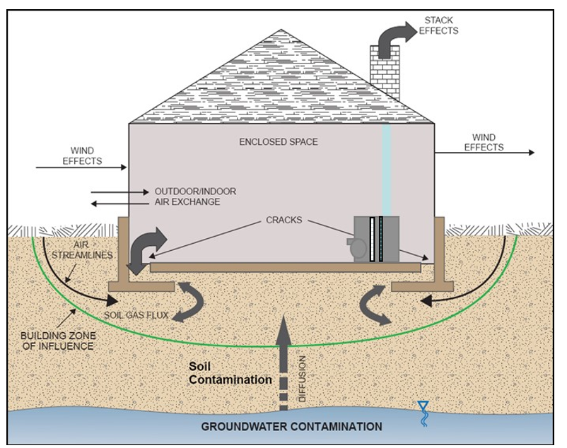
1990s – (Biopiles, PRBs) & RAs
Risk Assessments (RAs):
A means to derive site-specific soil and groundwater standards based on exposure routes, toxicity and receptors
RAs established and accepted earliest in BC ~late 1980s/early 1990s
First “unofficial” RA in Ontario approved ~1994 at the former Gooderham & Worts site with coal tar in bedrock (Distillery District site in Toronto)
Concept written into Guidelines in ON in 1996 and in AB in 2001
RAs accepted in most jurisdictions, including Quebec (with the notable exception of PHCs)
Notes:
Dewatering

Slide 10
Agenda:
Introduction & VEI Overview
Evolution of Practice – From “Just Dig” to “First, Risk”
Why is LNAPL is a Special Problem for Risk Assessments?
Core Technologies
  Characterization
  Immobilization
  Destruction
Case Study
Closing Thoughts
Questions
Why LNAPL is a Problem for Risk Assessments?

Slide 11
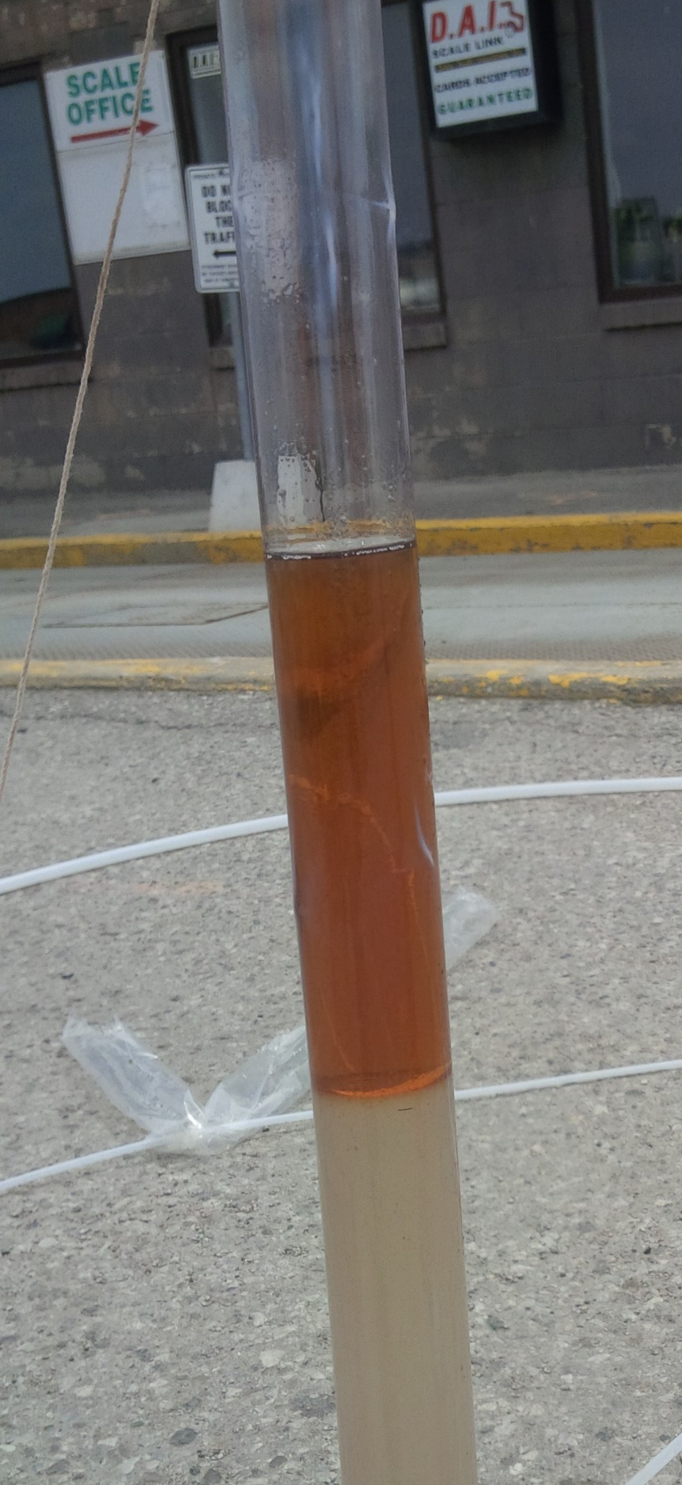
Several Canadian jurisdictions allow RAs on PHCs:
  Alberta:
    Control non-mobile LNAPL or actively remediate (remove) mobile LNAPL to the “extent practicable”
    Demonstrate LNAPL source control = “stable” and “decreasing”
    Exposure controls and risk management measures may be needed
  British Columbia:
    Must assess whether LNAPL is mobile or stable (1 year of monitoring needed)
    LNAPL (>2 mm) and mobile LNAPL can trigger “high-risk” classification for the site
    Must assess vapour intrusion concerns
  Ontario:
    Permitted (bedrock) but not preferred (overburden)
    Remove LNAPL to the “extent technologically practicable” (includes films, sheen, and >50% solubility)
    Must assess vapour intrusion concerns
Notes:
-Technologically feasible, regardless of cost

Slide 12
Agenda:
Introduction & VEI Overview
Evolution of Practice – From “Just Dig” to “First, Risk”
Why is LNAPL is a Special Problem for Risk Assessments?
Core Technologies
  Characterization
  Immobilization
  Destruction
Case Study
Closing Thoughts
Questions
Core Technologies
Characterization using Laser Induced Fluorescence (LIF)
Immobilization using Block & Absorb©
Destruction using Trap & Treat® BOS 200+®

Slide 13
LNAPL Characterization

Slide 14
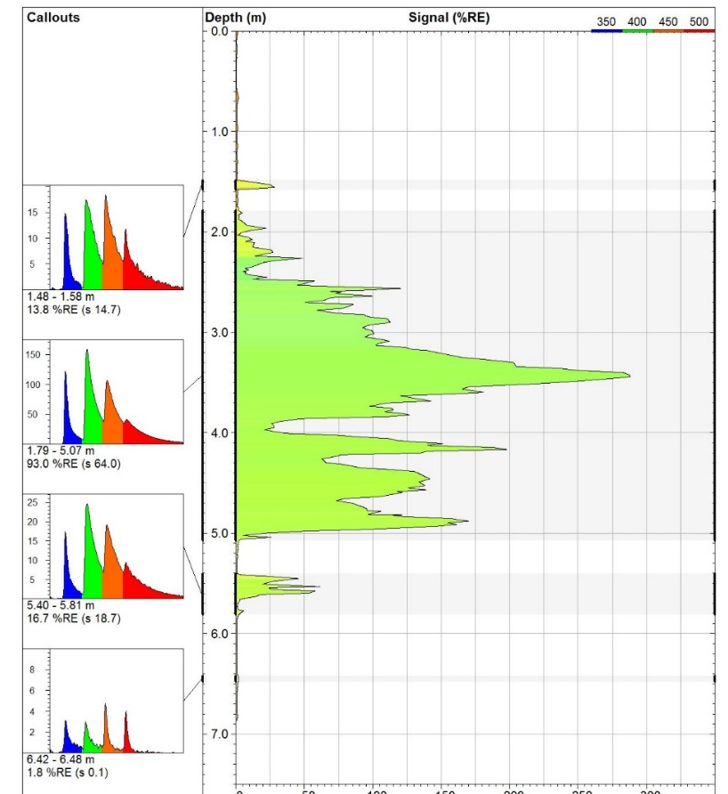
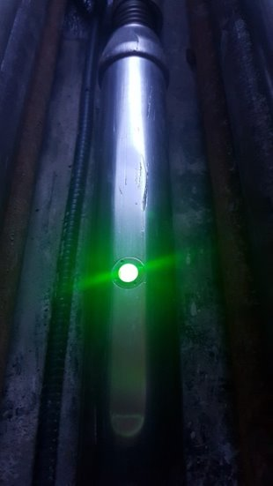
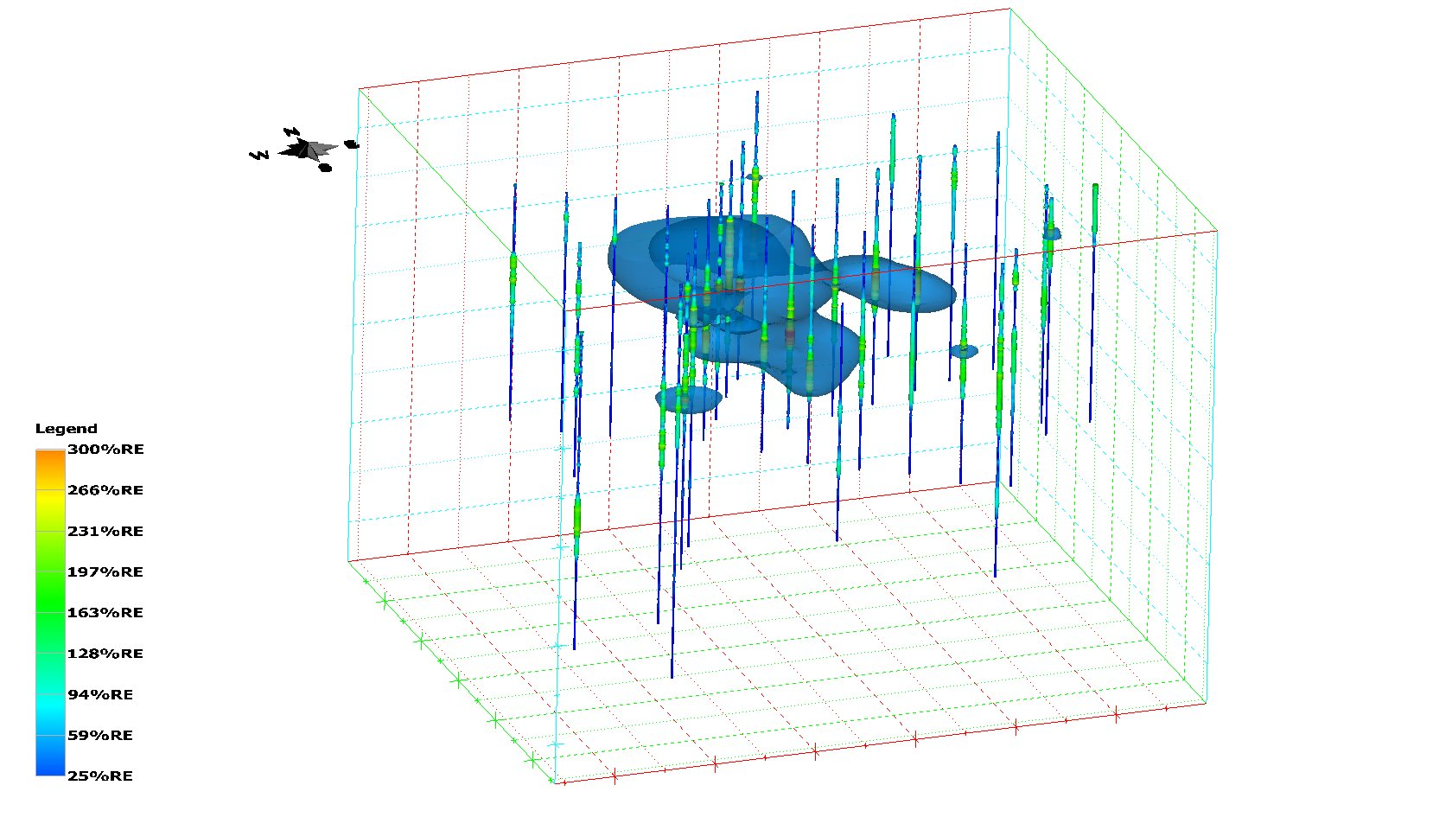
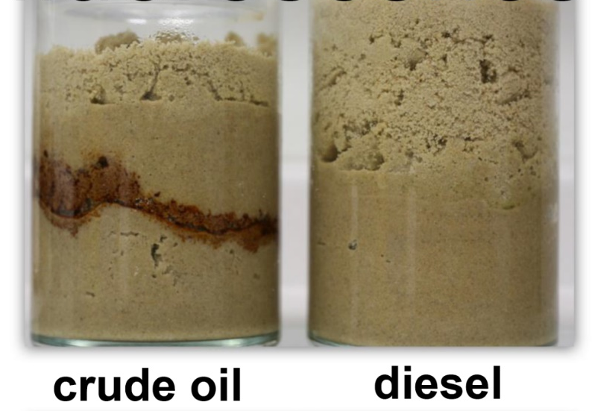

LNAPL Characterization - LIF
Diesel/Heating Oil “Finger Print”
Laser Induced Fluorescence (LIF)
Ultraviolet Optical Screening Tool (UVOST)
UV Wavelengths of Laser:​
  Excites PAHs to fluoresce​
  Fluorescence is detected​
  Semi-quantitative concentration (“response”)​
Detection of Free-Phased PHCs:​
  Mobile (flowing) or non-mobile (sorbed)​
  Above or below the water table​
  “Fingerprint” of PHC type and age
LNAPL
Hidden LNAPL

Slide 15
LNAPL Immobilization

Slide 16
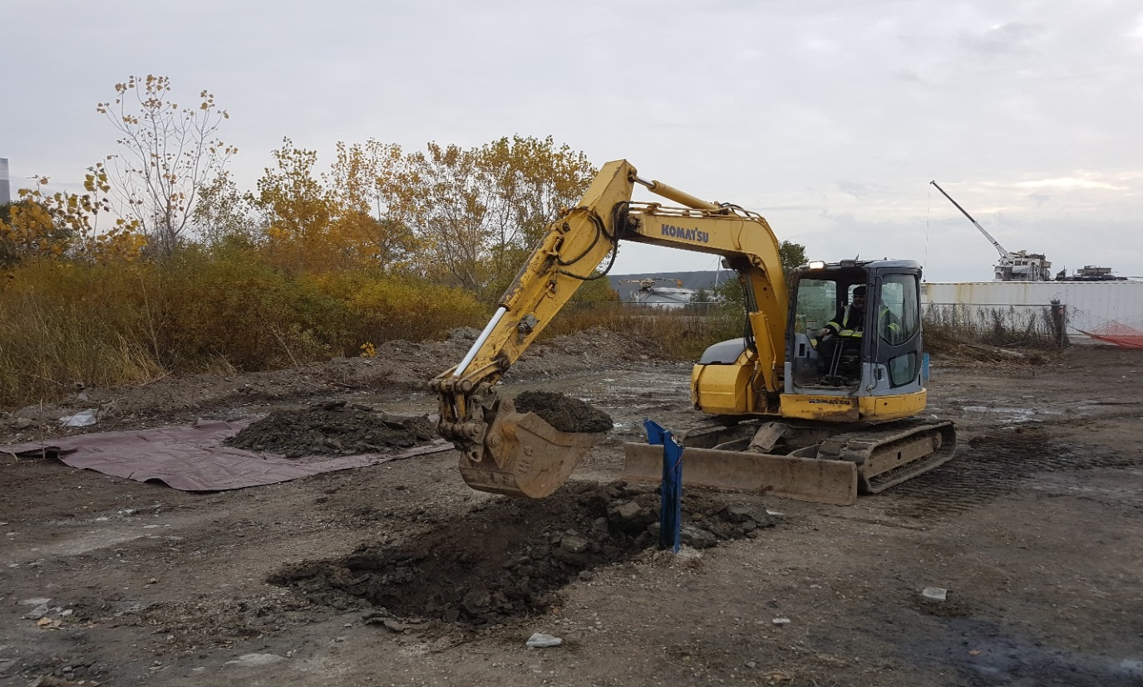
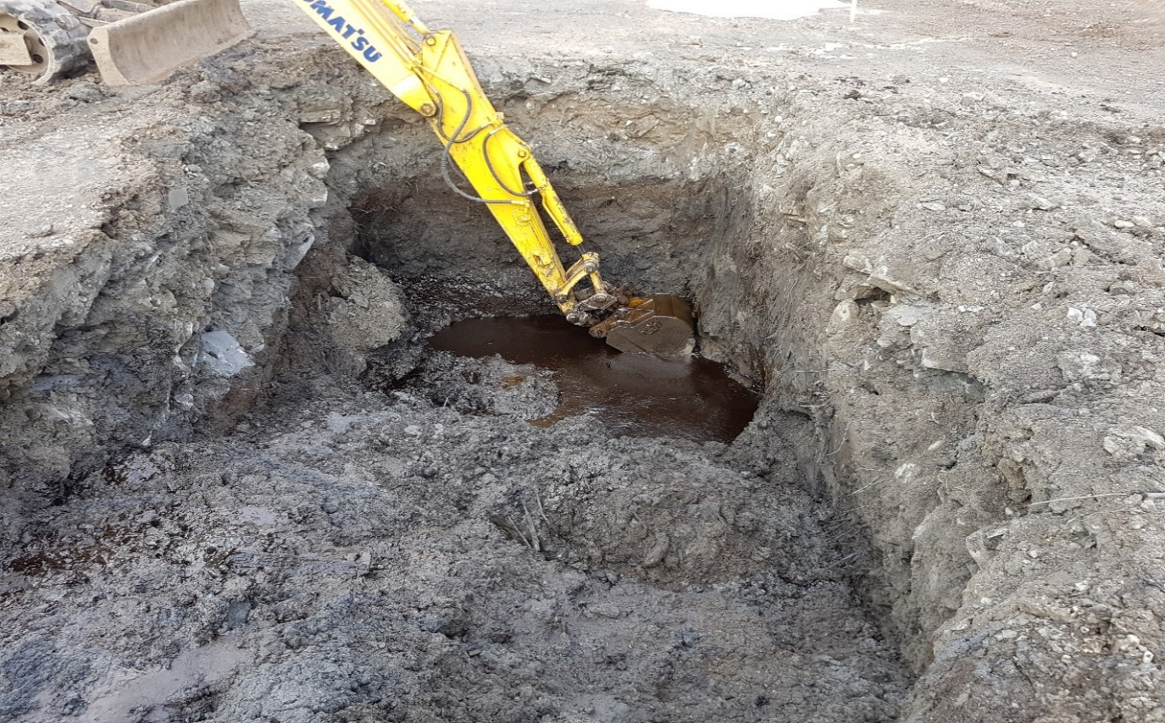
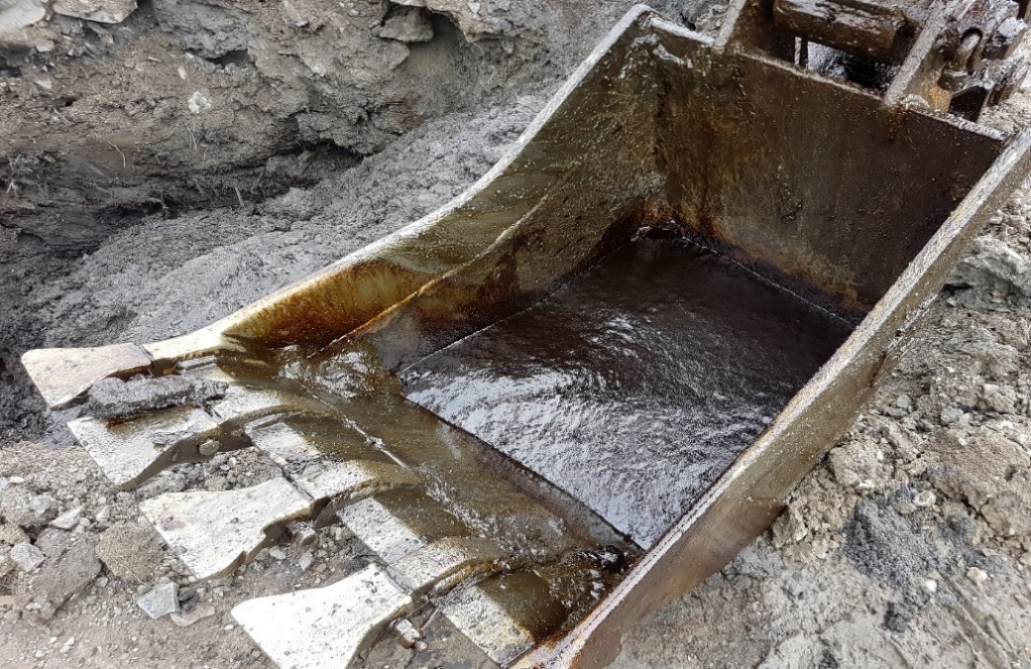
LNAPL Immobilization – Block & Adsorb©
Notes:
Dewatering

Slide 17
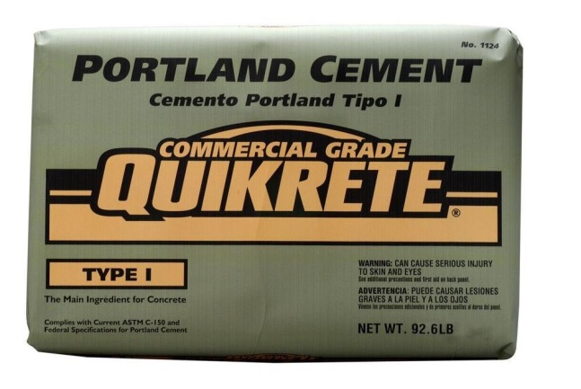
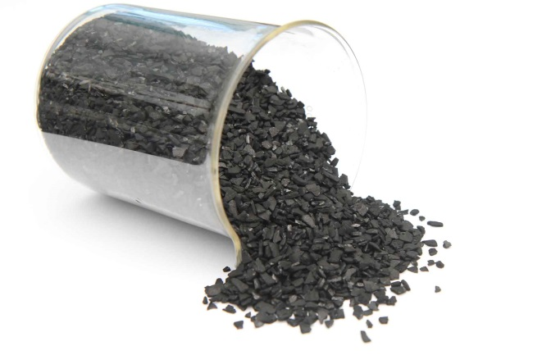

LNAPL Immobilization – Block & Adsorb©
Concept:
Bind mobile LNAPL & high concentrations of PHCs in soil and groundwater
Lower formation permeability
Block = Portland Cement (PC)
& Adsorb = Activated Carbon (GAC / PAC)
Notes:
Dewatering

Slide 18
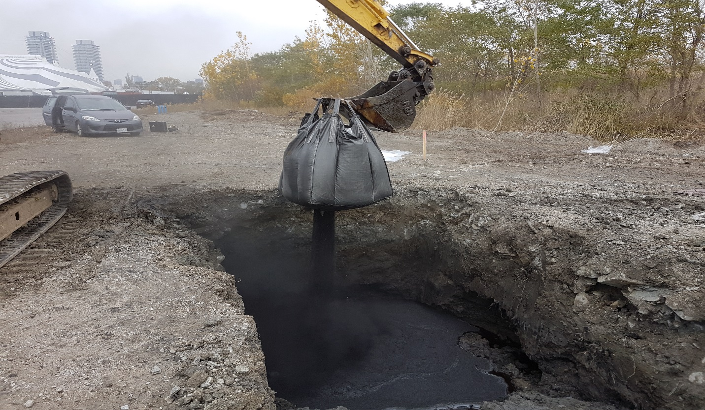
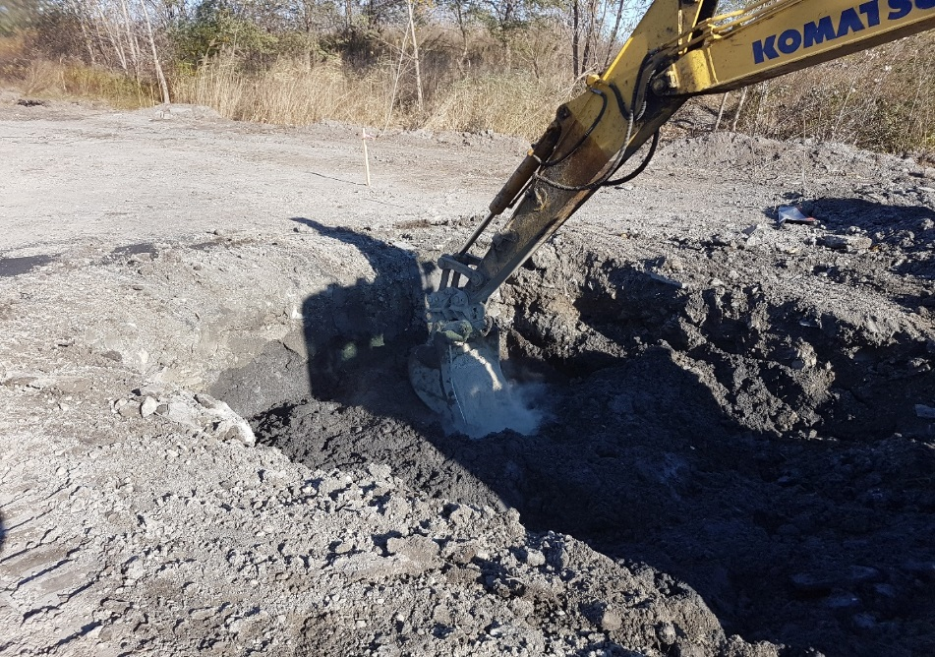
LNAPL Immobilization – Block & Adsorb©
Concept:
Bind mobile LNAPL & high concentration PHCs in soil and groundwater
Lower formation permeability
Block = Portland Cement (PC) & Adsorb = Activated Carbon (GAC / PAC)
Notes:
-In-situ stabilization process = address the mobility and solubility triggers

Slide 19
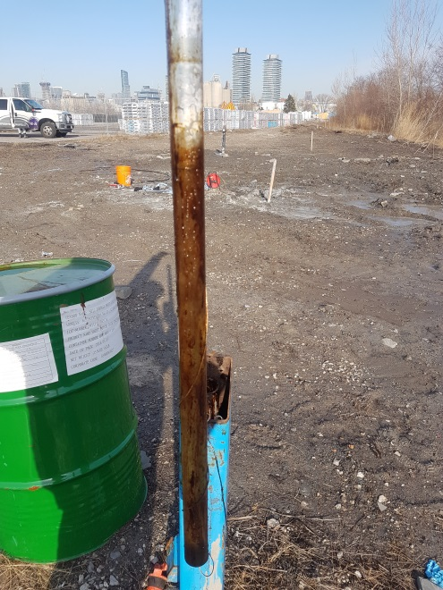
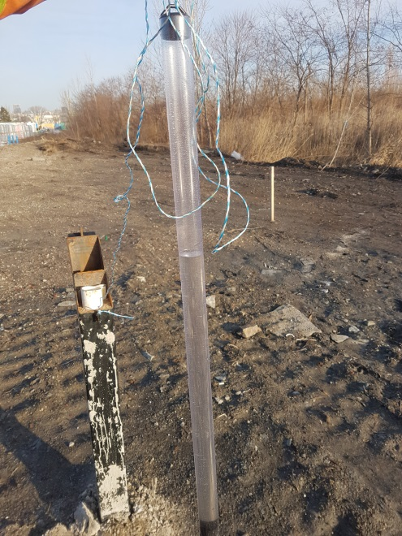
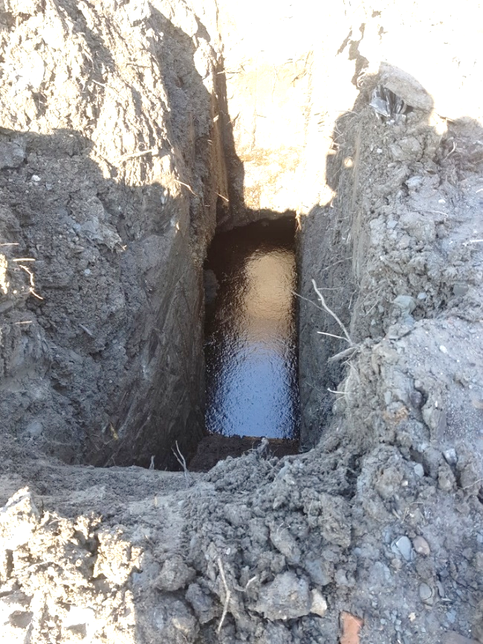
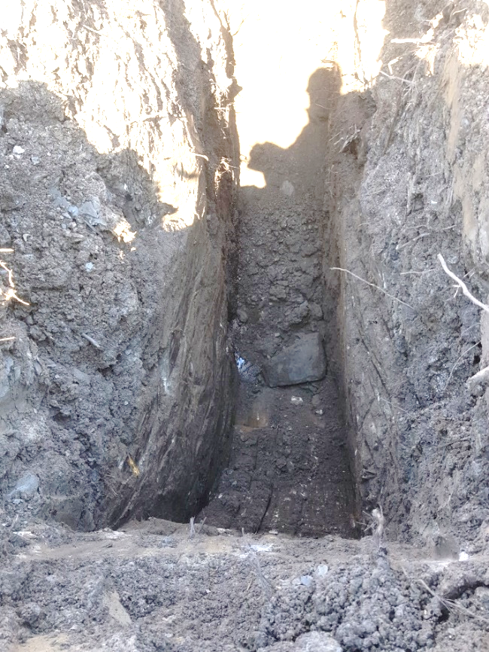
LNAPL Immobilization – Block & Adsorb©
Groundwater Samples Collected:
Control Plot vs Test Plot
Test Pit Excavated:
Adjacent vs Within Treated Soil Mass
=
Notes:
-Proven effective at immobilizing LNAPL and sheens in soils in-situ
-Combined PC and GAC is more effective than individually
-Still “soil-like” with up to moderate concentrations of PC
-Injection suitable for deep soils and/or bedrock and areas not amenable to physical disturbance via direct soil mixing (e.g., under buildings)
-Reduces formation permeability and dissolved-phase PHC concentrations in groundwater
-Sustainable = no excavation / extraction / wastes generated

Slide 20
LNAPL Immobilization – Block & Adsorb©
Proven effective at immobilizing LNAPL and sheens in soils in-situ
Combined PC and GAC is more effective than individually
Still “soil-like” with up to moderate concentrations of PC
Injection suitable for deep soils and/or bedrock and areas not amenable to physical disturbance via direct soil mixing (e.g. under buildings)
Also drastically reduces formation permeability and dissolved-phase PHC concentrations in groundwater
No excavation / extraction / wastes generated
Sustainable
Notes:
Dewatering

Slide 21
LNAPL Destruction

Slide 22
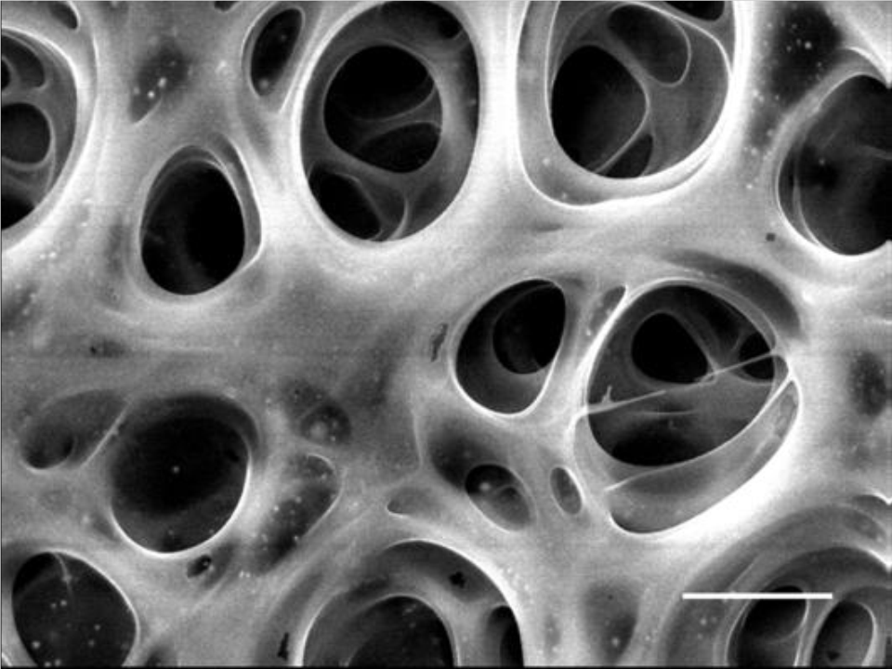
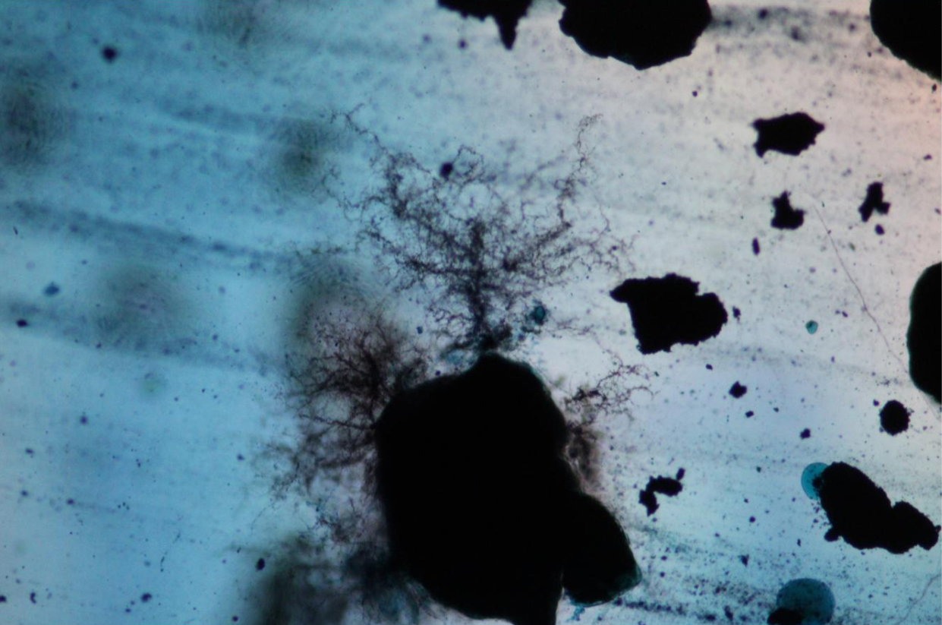
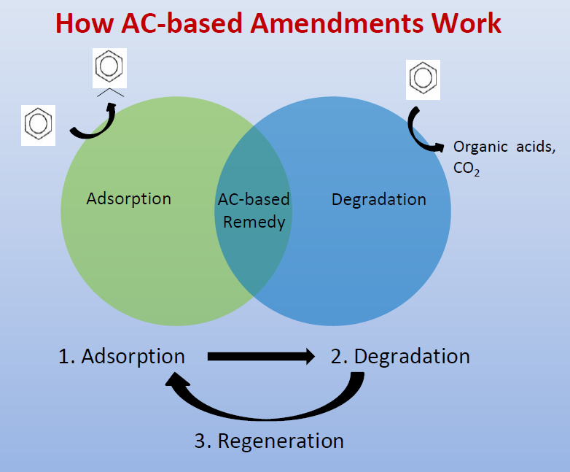
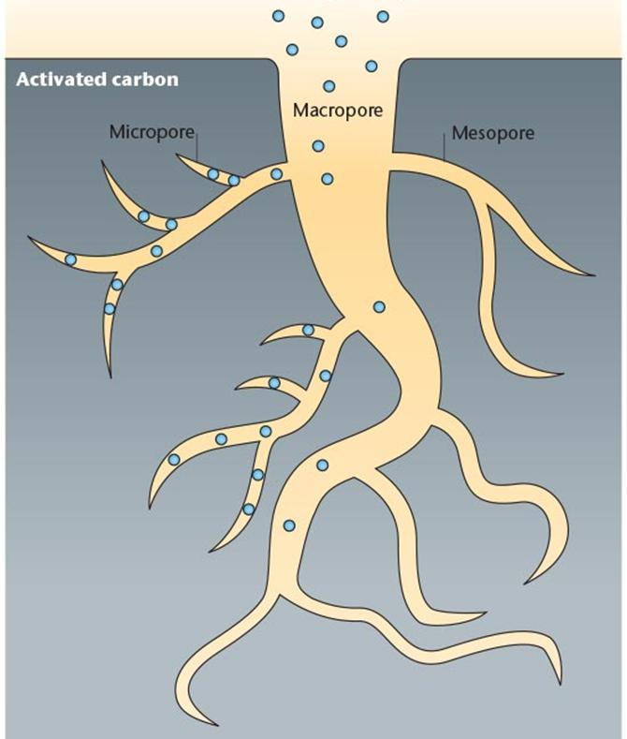
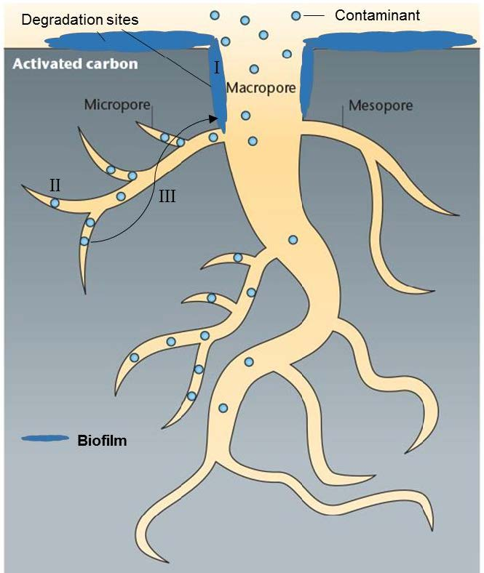
LNAPL Destruction – Trap & Treat® BOS 200+®
Trap
Treat
Trap
Treat
Notes:
-BOS 200+® for PHCs = AC & Nutrients (TEAs, carbohydrates, amino acids & microbes) = carbon adsorption & enhanced anaerobic biodegradation
-BOS 200+® used in the US since 2017; used in Canada since 2023
-Bacteria is growing on and around an activated carbon particle creating a bush-like structure
-Single application and long-term solution (back diffusion control = prevents rebound)

Slide 23
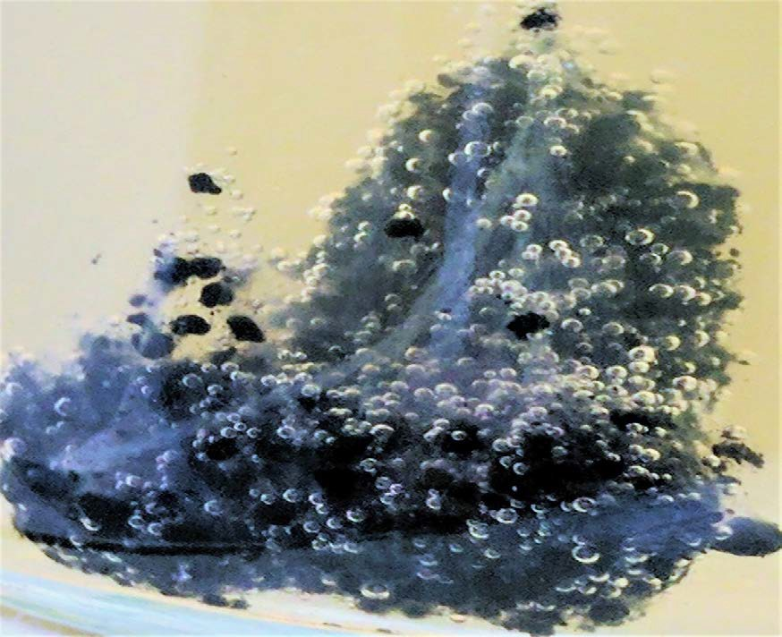
Trap & Treat® BOS 200+®
Do sorption limitations of AC prevent its application to LNAPL?
  The saturation adsorption capacity for PHCs on AC is widely considered to be 20 to 25% by wt.
  For BOS 200+® coal-based AC it has been measured at 58% by wt.
  Adsorbed PHCs, including gasoline and diesel range, are bioavailable even when located in the microporous structure of the AC.
  Biological regeneration of AC recovers substantial amounts (i.e., over 90%) of the original sorption capacity.
Notes:
Dewatering

Slide 24
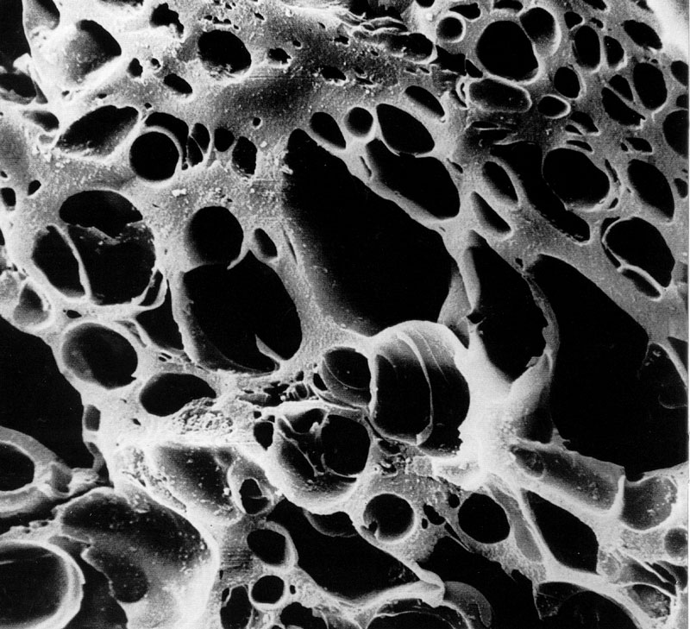
Trap & Treat® BOS 200+®
Do sorption limitations of AC prevent its application to LNAPL?
  Kinetic data for BOS 200+® suggests that between 0.5 to 1 kg of PHC mass can be degraded per kg of AC per year
  There is no need to have enough AC in the ground to account for every kg of PHCs.
  Biological regeneration of AC saturated with PHCs is a viable process.
  BOS 200® coal-based AC amendment has the necessary properties coupled with a viable degradation mechanism to realistically address LNAPL impacted sites.
Notes:
Dewatering

Slide 25
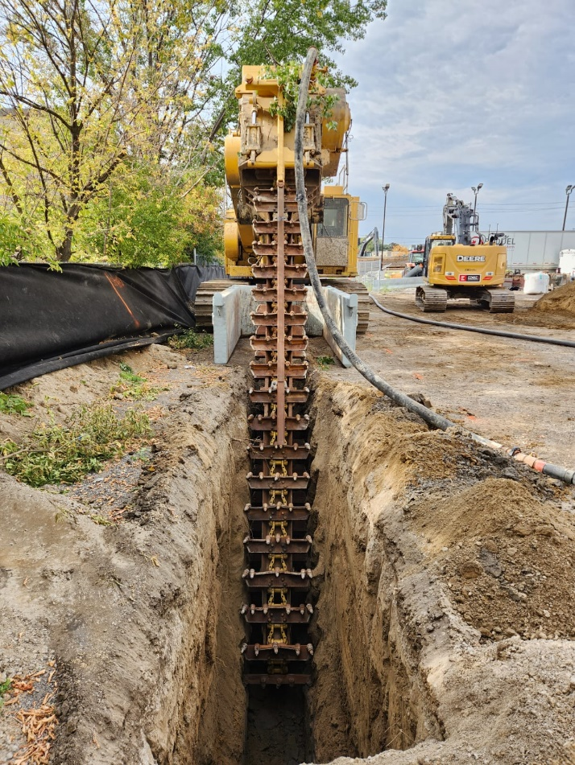
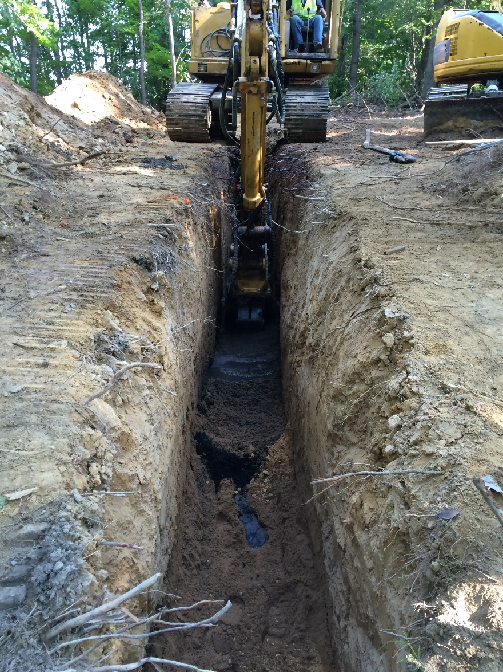
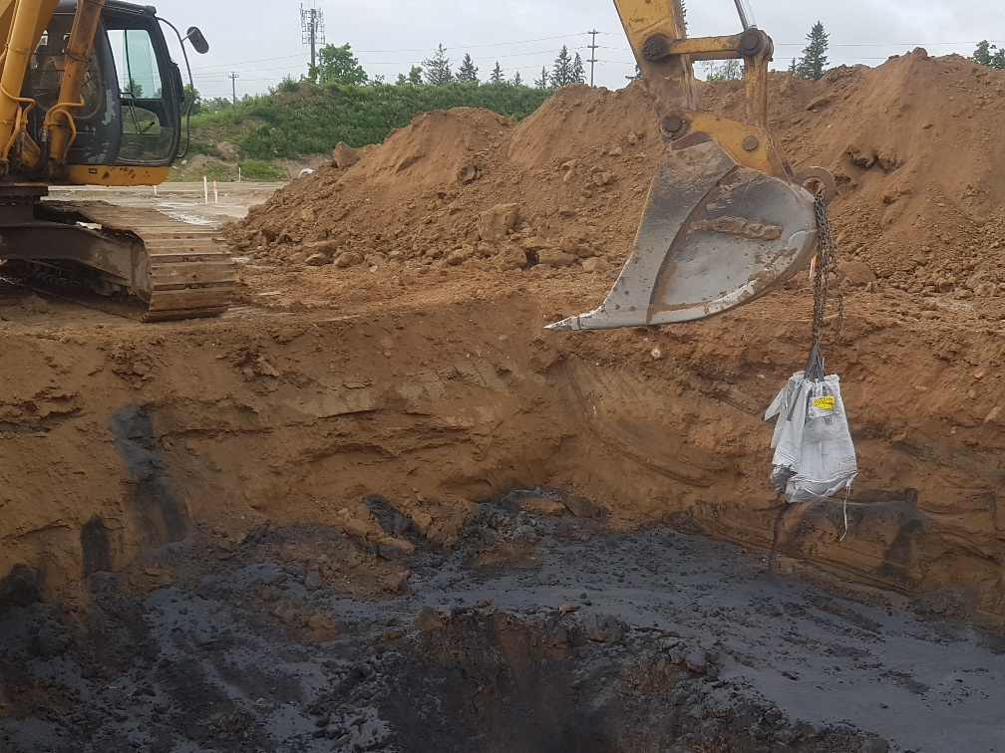
LNAPL Destruction – Soil Mixing & Direct Placement

Slide 26
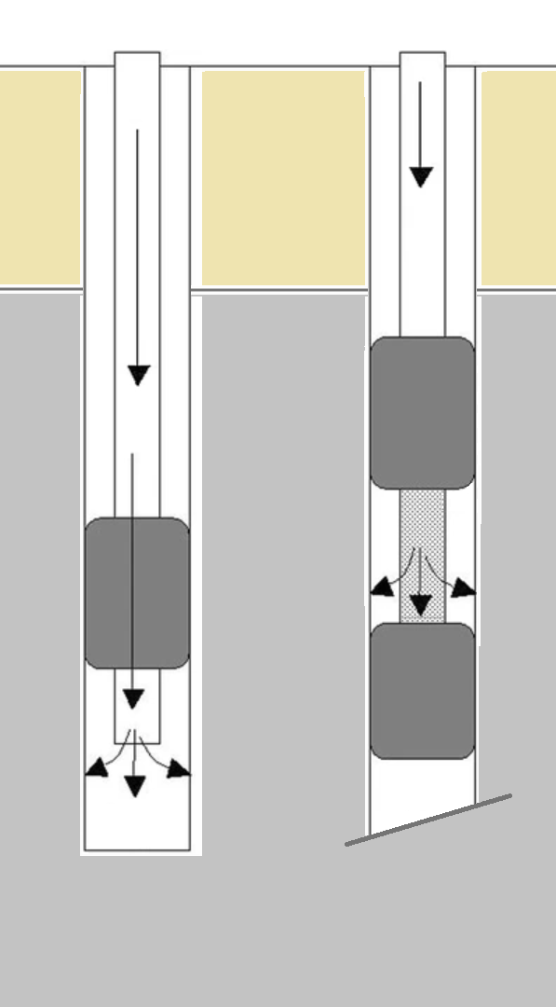
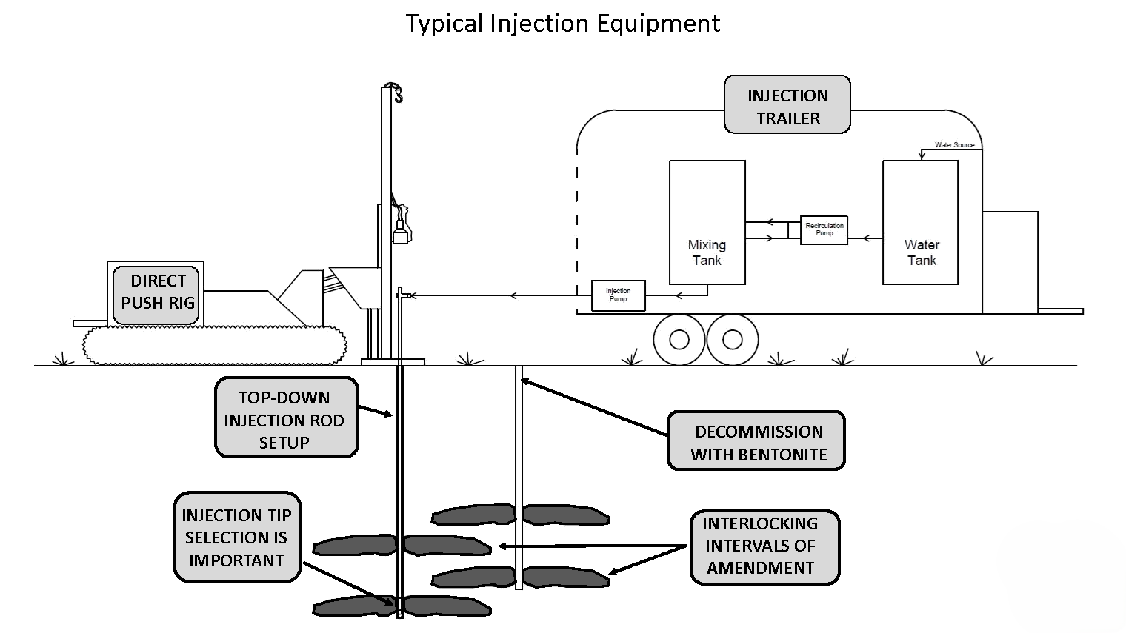
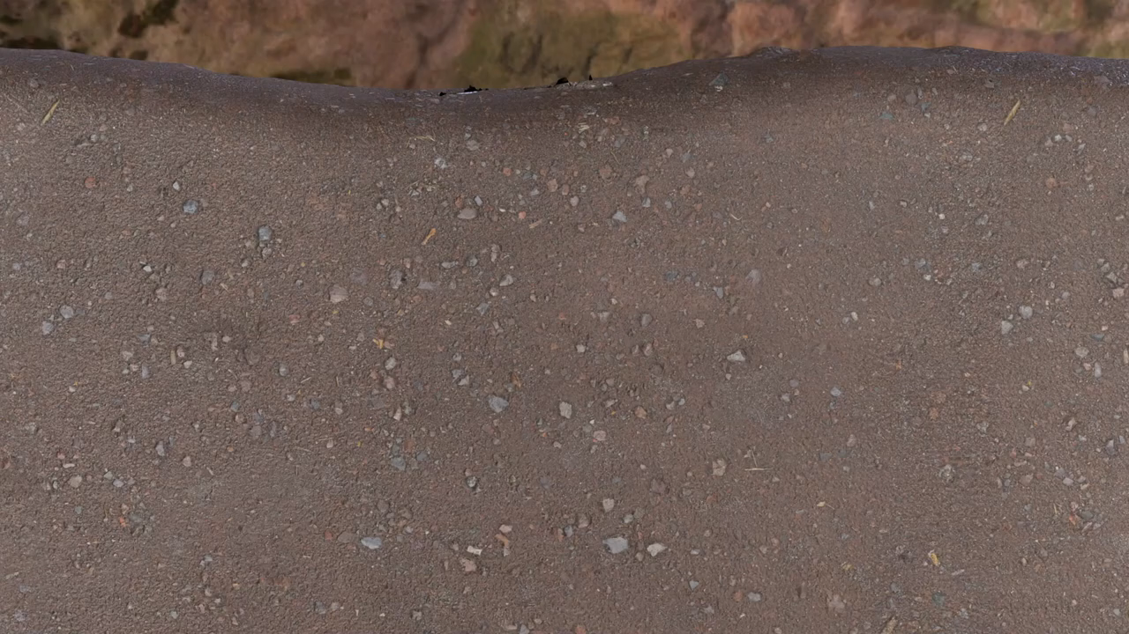
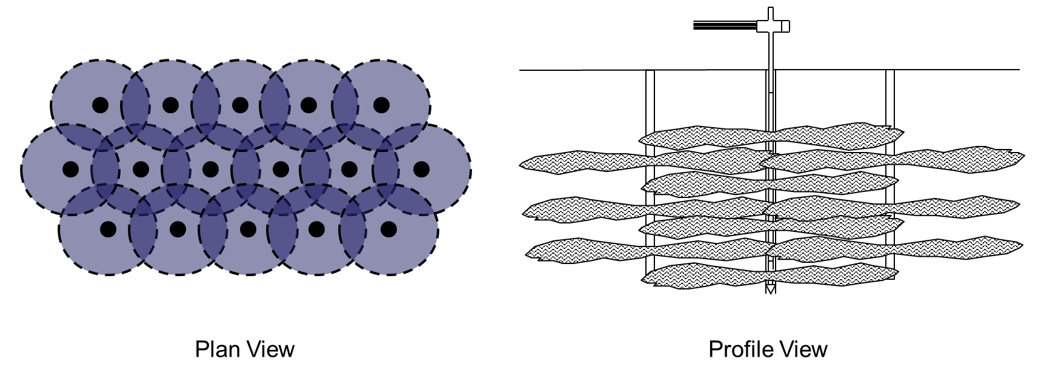
LNAPL Destruction – Injection Methods
Soil
Bedrock

Slide 27
Agenda:
Introduction & VEI Overview
Evolution of Practice – From “Just Dig” to “First, Risk”
Why is LNAPL is a Special Problem for Risk Assessments?
Core Technologies
  Characterization
  Immobilization
  Destruction
Case Study
Closing Thoughts
Questions
Case Study

Slide 28
Background – The Situation
Historical industrial operations:
  Leaky fuel tank
  PHCs and LNAPL primarily in bedrock groundwater
Future redevelopment planned:
  Residential redevelopment
  RA and RSC process underway
  Remediation required to address free product (LNAPL)
Staged remedial approach:
  Source Removal = Decommission fuel tank & removal of impacted soil
  MPE System = Direct LNAPL removal
  In-Situ Injection = Polishing step to address residual/remaining PHCs & LNAPL

Slide 29
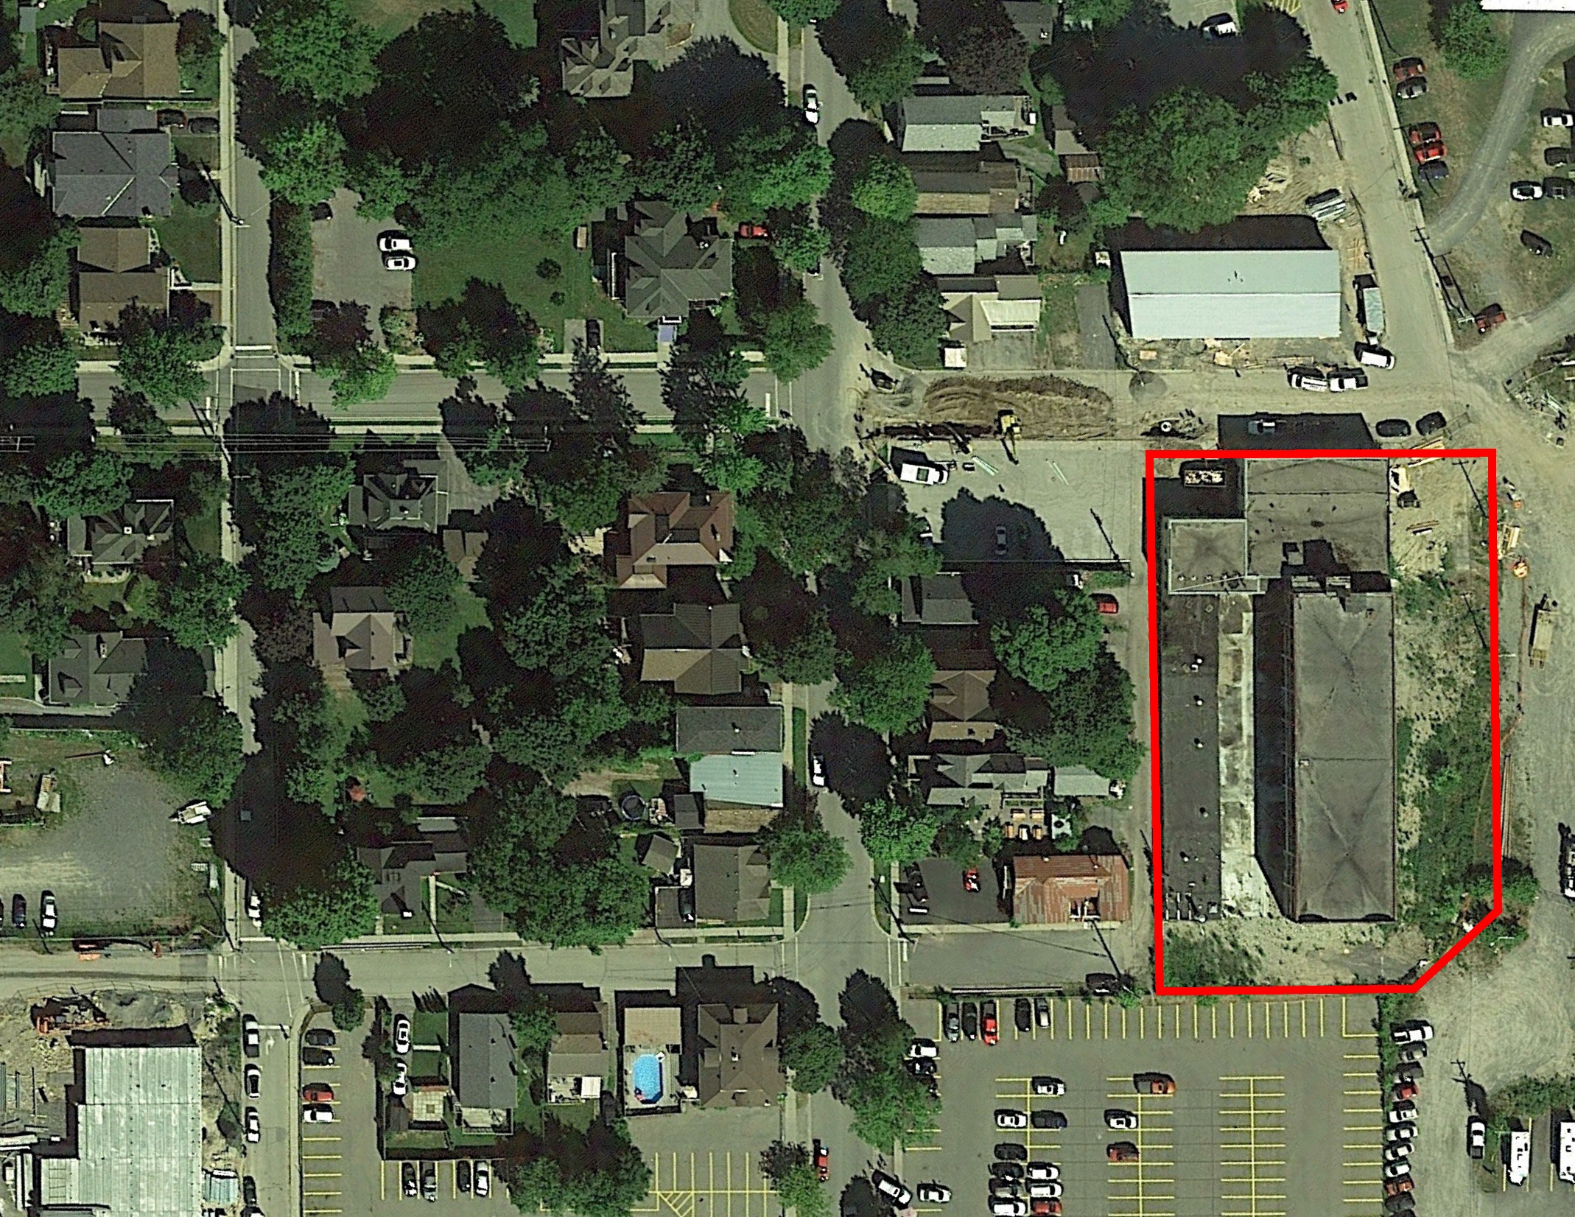
Site Location
Remedial Area
Notes:
Dewatering

Slide 30
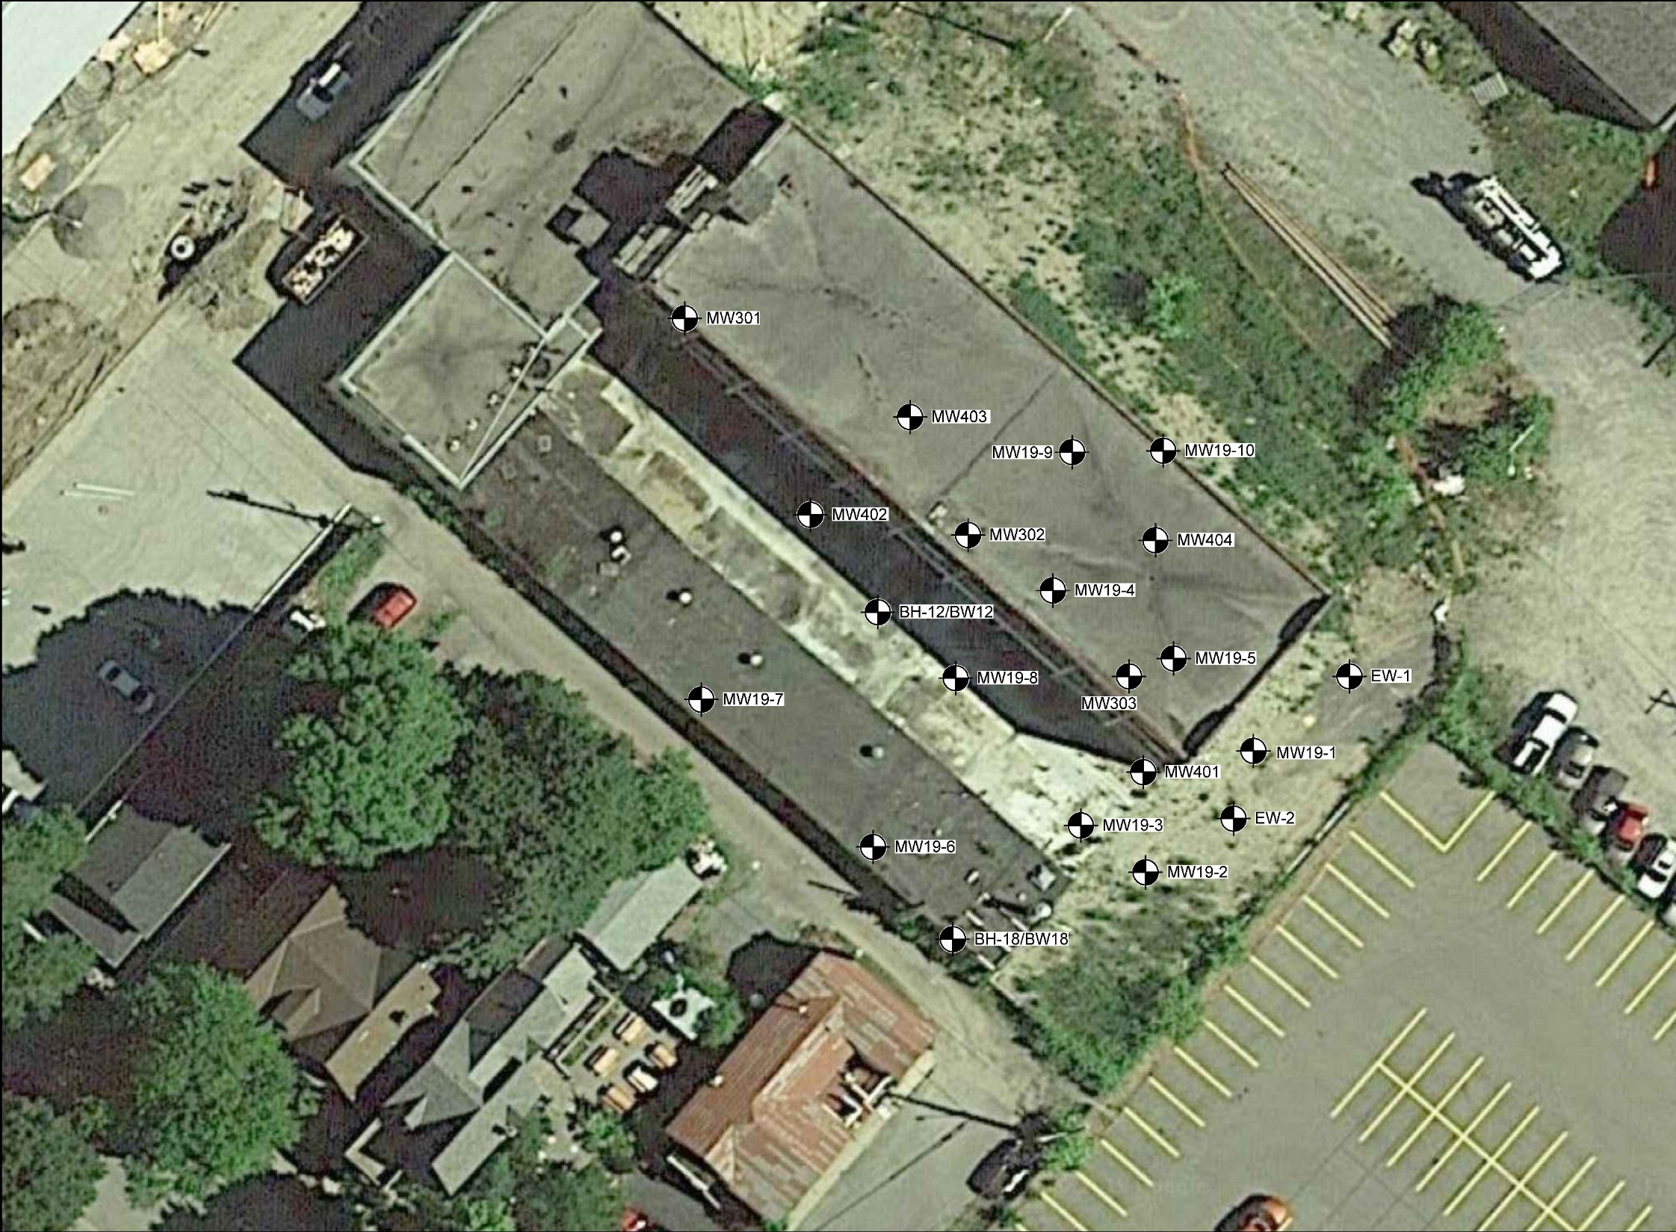
PHCs & LNAPL in Groundwater
No LNAPL, GW<SCS
No LNAPL, GW>SCS
No LNAPL, Odours, GW>SCS
LNAPL, GW>SCS
GW Flow
TANK
Notes:
Dewatering

Slide 31
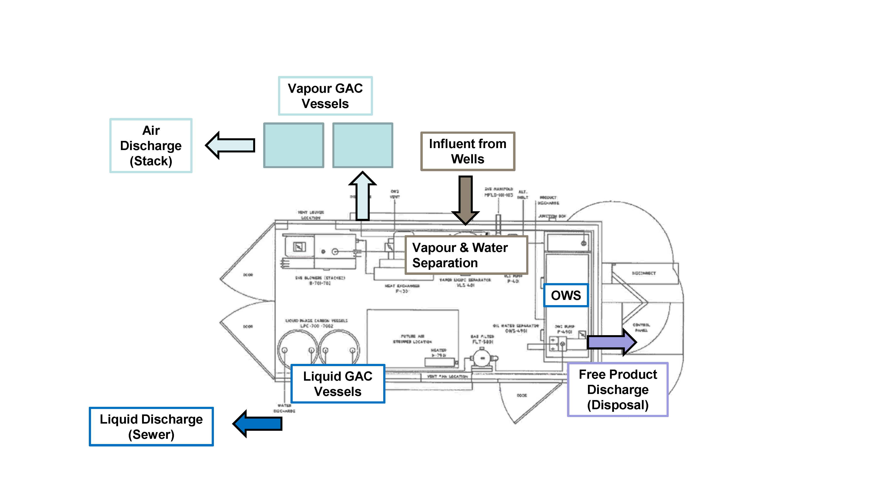
Multi-Phase Extraction (MPE) System
Notes:
Dewatering

Slide 32
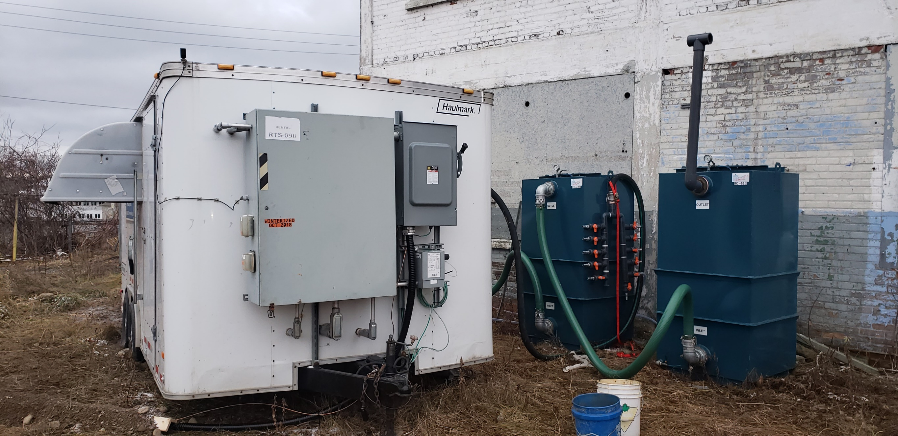
Multi-Phase Extraction (MPE) System
Notes:
Dewatering

Slide 33
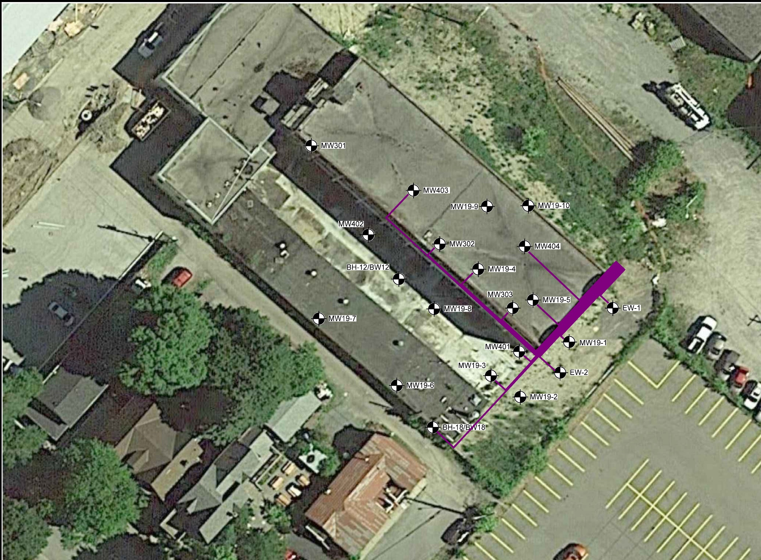
MPE System
No LNAPL, GW<SCS
No LNAPL, GW>SCS
No LNAPL, Odours, GW>SCS
LNAPL, GW>SCS
MPE System Details:
6 wells with recent LNAPL presence
Good containment of LNAPL body
Overland extraction lines
  Save on cost (no trenching)
  Quicker set up
Notes:
Dewatering

Slide 34
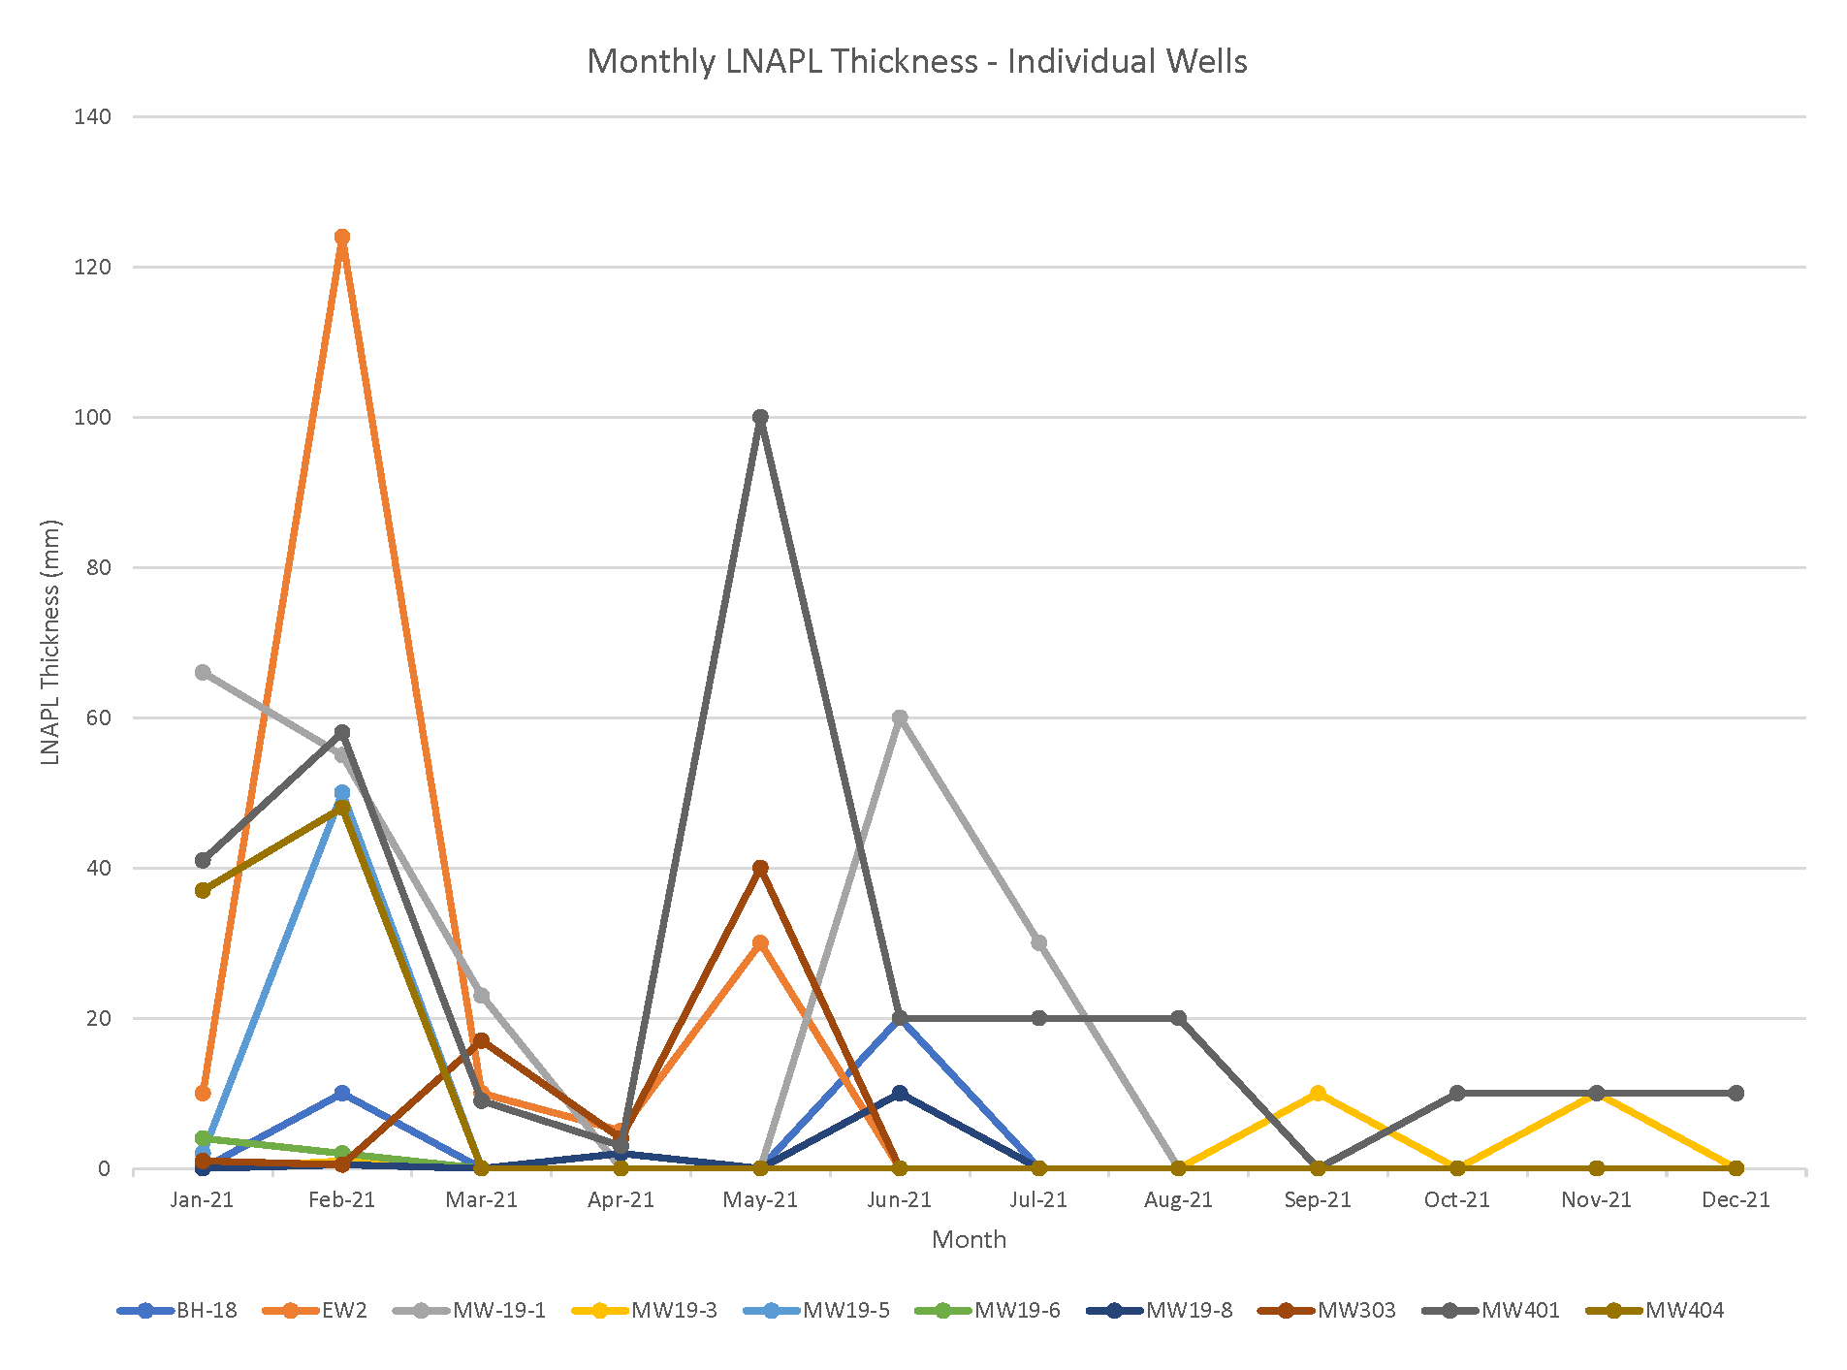
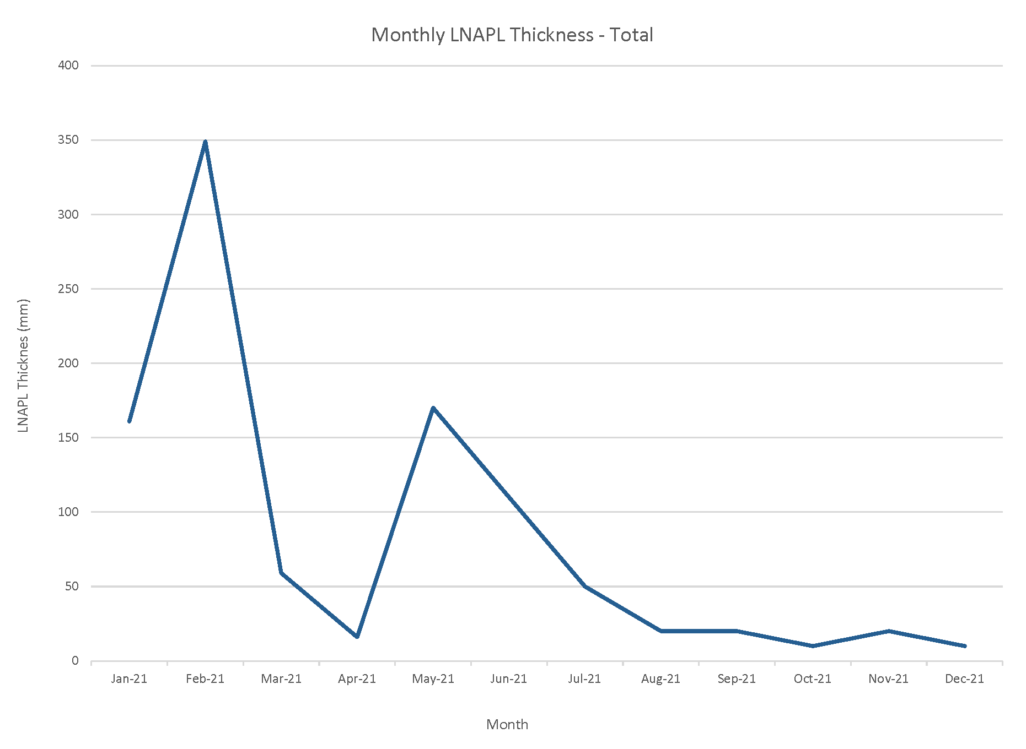
MPE System Results
LNAPL Area reduced by >75%
Diminishing Returns
Notes:
Dewatering

Slide 35
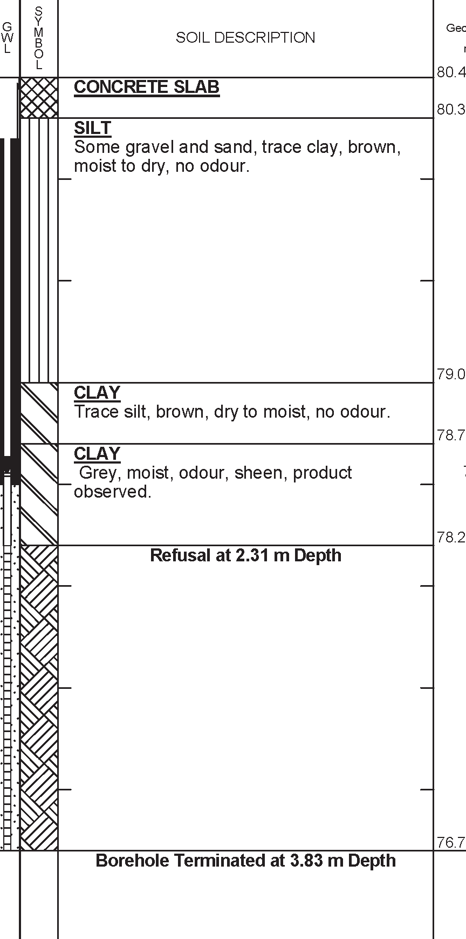
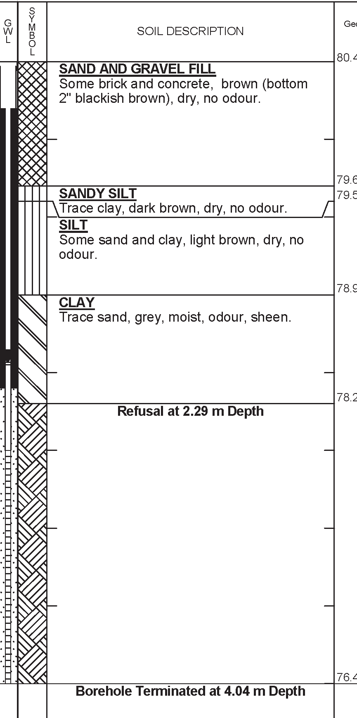
Injection Program
BH19-3
BH19-1
Notes:
Dewatering

Slide 36


Injection Summary
Completed over 2 days in Fall 2022
5 bedrock GeoTAPTM injection points (IPs)
10 overburden direct-push IPs
15 IPs in total to target “Hot Spot” area
Injected 2,200 kg BOS 200+® in 4,000 L
GeoTAPTM
Notes:
Dewatering

Slide 37




Injection Results
Post Injection Analytical
MW19-5
MW401
EW-2
Success!
8 months
after Injection
Notes:
Dewatering

Slide 38
Case Study Wrap-Up
Remediation of Bedrock with LNAPL:
UST Removal:
  Source removal of leaky UST
MPE System:
  Implemented for a period of 12 months
  Removal of majority (~75%) of the LNAPL volume
Trap & Treat® BOS 200+® Injection:
  Implemented GeoTAPTM method to allow in-situ injection into fractured bedrock and overburden bedrock interface
  Amendment selected to destroy LNAPL, control migration and prevent back diffusion of PHCs
  Sustained treatment in LNAPL
Notes:
Dewatering

Slide 39
Closing Thoughts
LNAPL Characterization:
  Success remedial programs start with a comprehensive CSM
  LIF can assist in delineation of LNAPL
LNAPL Immobilization:
  Block & Adsorb©: combined PC and GAC more effective than either individually
  Proven effective at immobilizing LNAPL and sheens in soils in-situ
LNAPL Destruction:
  Trap & Treat® BOS 200+®: robust particulate based remedial amendment which overcomes mass limitations of AC sorption alone
  Application through soil mixing, direct placement, and injection technologies (overburden, bedrock, and complex geologies)
Agenda:
Introduction & VEI Overview
Evolution of Practice – From “Just Dig” to “First, Risk”
Why is LNAPL is a Special Problem for Risk Assessments?
Core Technologies
  Characterization
  Immobilization
  Destruction
Case Study
Closing Thoughts
Questions

Slide 40

Questions
Pete Craig
VEI Contracting Inc.
(226) 338-3248
petec@vei.ca
www.vei.ca
Agenda:
Introduction & VEI Overview
Evolution of Practice – From “Just Dig” to “First, Risk”
Why is LNAPL is a Special Problem for Risk Assessments?
Core Technologies
  Characterization
  Immobilization
  Destruction
Case Study
Closing Thoughts
Questions

