Slide 1


Unseen Risks
Gaps in the Identification of Potential Habitant
of Threatened or Endangered Species during
Environmental Site Assessment
RemTech East
April 9, 2026

Slide 2
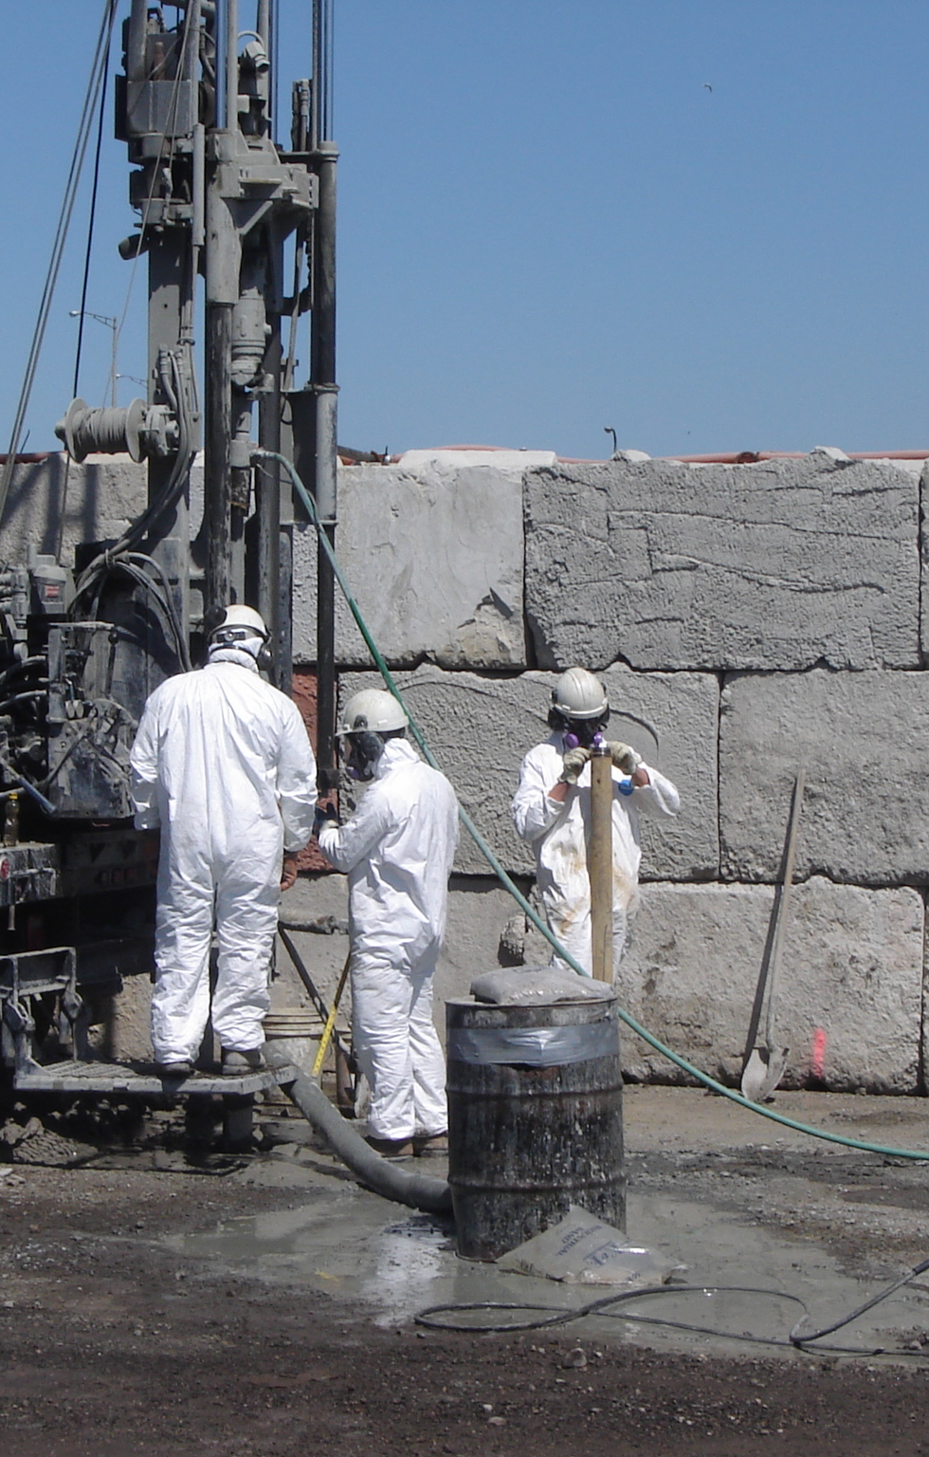
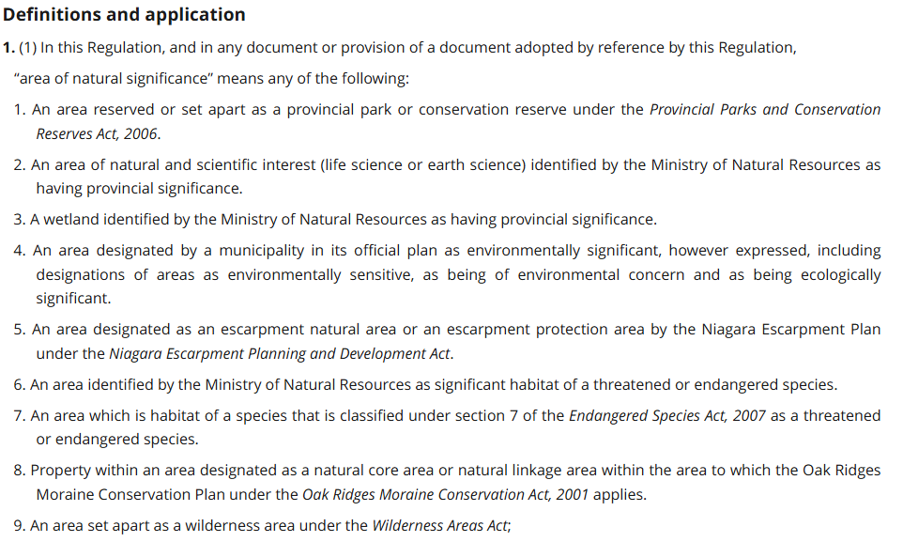
Site Condition Standards
and
Excess Soil Quality Standards
O. Reg. 153/04
Records of Site Condition – Part XV.1 of the Act
Big implications when “Species at Risk” are present!
N.B on March 30, 2026, the Endangered Species Act, 2007 was replaced by the Species Conservation Act, 2025
2
Notes:
#6: vestigial reference to MNR

Slide 3
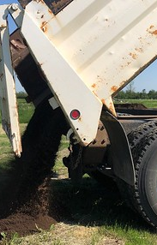
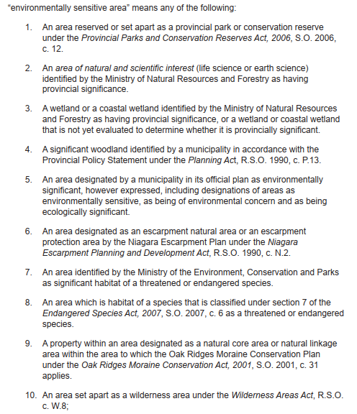
Site Condition Standards
and
Excess Soil Quality Standards
O. Reg. 406/19
On-Site and Excess
Soil Management
Rules for Soil
Management and
Excess Soil
Quality Standards
Big implications when “Species at Risk” are present!
*
*As of March 30, 2026, the Species Conservation Act, 2025
3
Notes:
#6: corrected vestigial reference in O. Reg. 153/04;

Slide 4
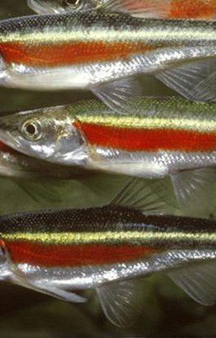
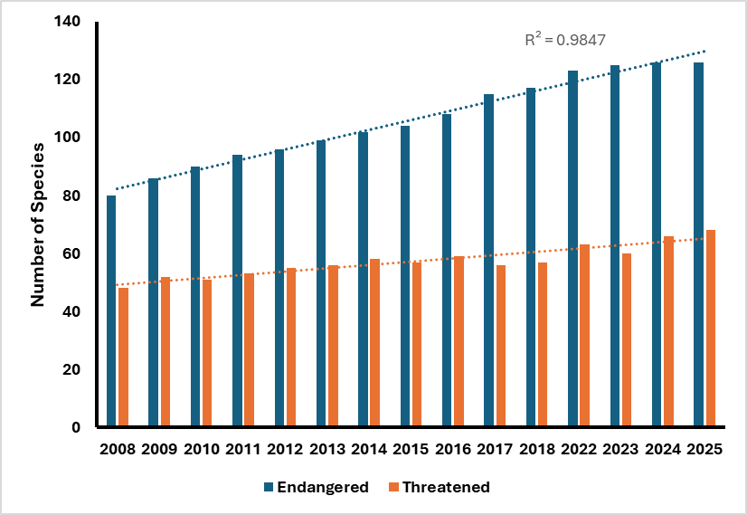
52% growth over 17 years
Section 7 of the
Endangered Species Act, 2007
*
Currently,
126 Endangered and 68 Threatened species are listed
52% increase in the number of Species at Risk since 2008!
*On March 30, 2026, the Endangered Species Act, 2007 was replaced by the Species Conservation Act, 2025
4
Notes:
SAR list is not static; it is updated regularly (though not every year)

Slide 5
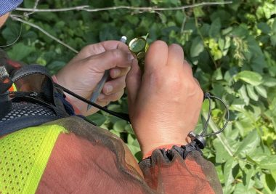

Interdisciplinary Collaboration
in selecting SCS and ESQS
126 Endangered and 68 Threatened species are currently listed
The Screening Process requires relatively little time or effort and allow QPs an opportunity to scope more detailed ecological studies into their work programs.
SAR is potentially present within the study area
Communicate with the client
Plan for the next steps
Background Review for species at risk
SAR is not potentially present within the study area
Report and document

Slide 6
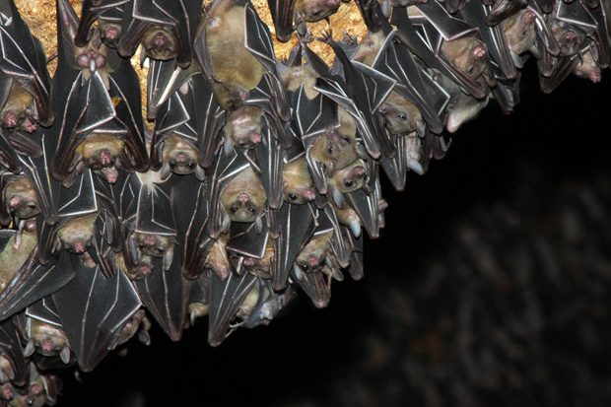
The
Bat Study

Slide 7
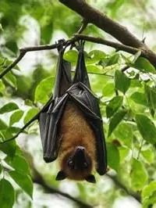
January 2025 update to the list of Threatened and Endangered species
Listed as “Endangered”
Hoary Bat (Lasiurus cinereus)
Eastern Red Bat (Lasiurus borealis)
Silver-Haired Bat (Lasionycteris noctivagans)
Tri-colored Bat (Perimyotis subflavus)
Little Brown Myotis (Myotis lucifugus)
Northern Long-eared Myotis (Myotis septentrionalis)
Eastern Small-footed Myotis (Myotis leibii)
Listed as “Threatened”
none
Species not listed:
Big Brown Bat (Eptesicus fuscus)
7
Notes:
As part of these updates, three more bat species in Ontario were designated as “endangered”, bringing the total number of so-designated species to 7

Slide 8
Involvement of Ecologists in Environmental Site Assessment
Concern:
As of January 2025, with one exception, all of the native bat species in Ontario are considered Endangered per the Endangered Species Act, 2007
Identifying (and speciating) bats and their habitat is a complex, multi-step process
The echolocation calls of the Silver-Haired Bat (endangered) overlap with those of the Big Brown Bat (not threatened or endangered)
Competing Concern
While SAR assessments by Terrapex ecologists do not require significant time, there is a cost nonetheless
A perception amongst QPs that SAR are not really a concern in urban environments unless there are significant natural heritage features or rural areas nearby
Calls for increased collaboration…
and pushback
8

Slide 9
Objectives of the Bat Study
Evaluate the impact of bats on the identification of potential habitat of Threatened and Endangered species
Evaluate the utility of completing Species at Risk assessments for urban project locations

Slide 10
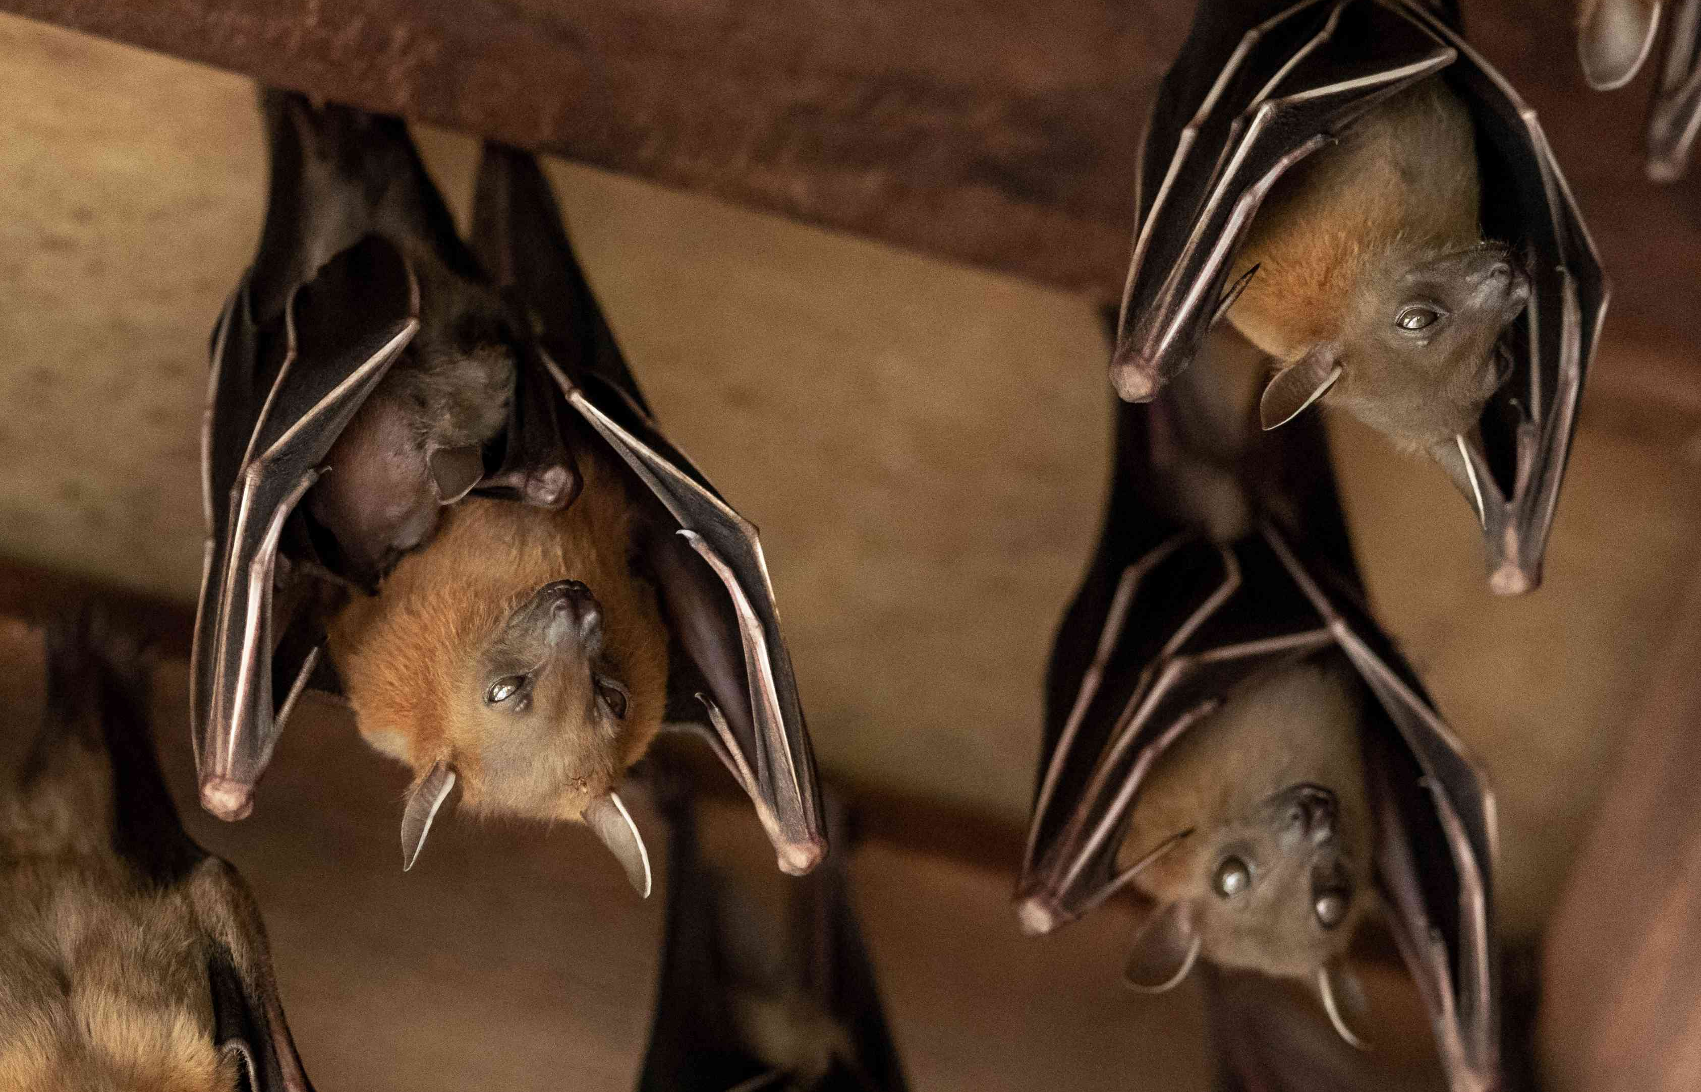
Sinking
our fangs
into the data…

Slide 11
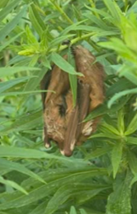
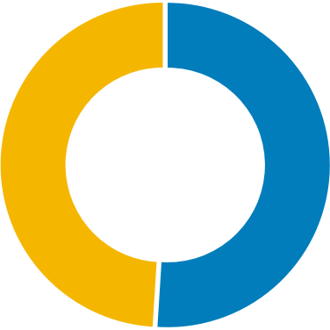
All Locations
51% of screening locations identified potential habitat for Species at Risk
Sinking our fangs into the data
No Potential SAR Habitat
Identified
Potential SAR Habitat
Identified
49%
51%
Overall, screening efforts are sufficient to discount potential SAR habitat only half the time!
11

Slide 12
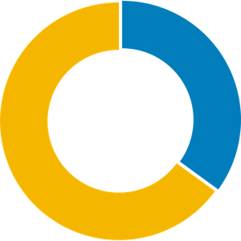
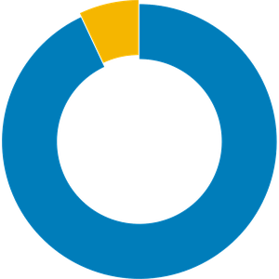
Sinking our fangs into the data
Urban vs. Rural Locations
Potential SAR Habitat
Potential SAR Habitat
7%
35%
93%
65%
Big differences between screening outcomes for Urban and Rural locations
Urban Locations
35% of screening locations
identified potential habitat
for Species at Risk
Rural Locations
93% of screening locations
identified potential habitat
for Species at Risk
12
Notes:
Purposes of this study

Slide 13
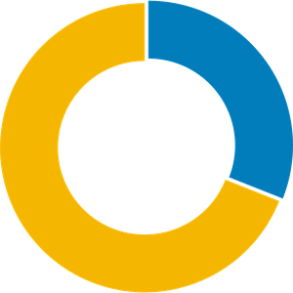
Sinking our fangs into the data
Impact of Bat Habitat | Urban
Potential SAR Habitat
Potential SAR Habitat
35%
31%
65%
69%
Screening has identified potential Species at Risk concerns at only 4% of all urban locations solely because of bats
Bats
Including bat habitat in Species at Risk screening
No Bats
Excluding bat habitat from Species at Risk screening
13
Notes:
Purposes of this study

Slide 14
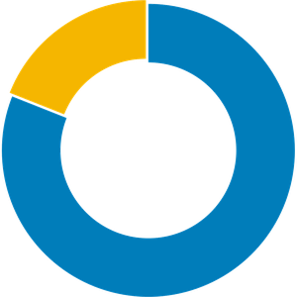
Sinking our fangs into the data
Impact of Bat Habitat | Rural
Potential SAR Habitat
Potential SAR Habitat
7%
93%
19%
81%
Screening has identified potential Species at Risk concerns at 12% of all rural locations solely because of bats
Bats
Including bat habitat in Species at Risk screening
No Bats
Excluding bat habitat from Species at Risk screening
14
Notes:
Purposes of this study

Slide 15

Sinking our fangs into the data
Detailed SAR Studies
No
Data
No
Data
But all of this data relates to screening assessments!
Urban Locations
Limited data, potentially biased dataset
Rural Locations
Limited data, potentially biased dataset
15
Notes:
Lots of reasons why detailed SAR studies aren’t completed

Slide 16
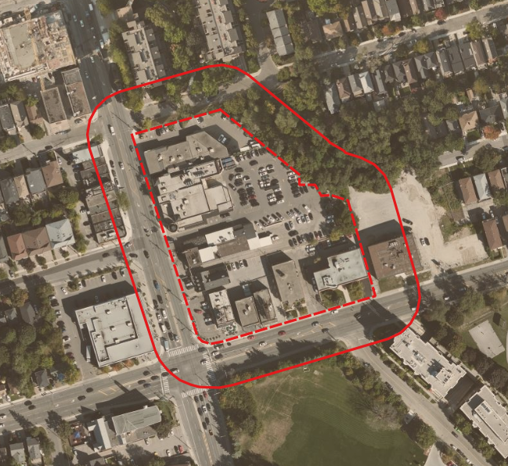
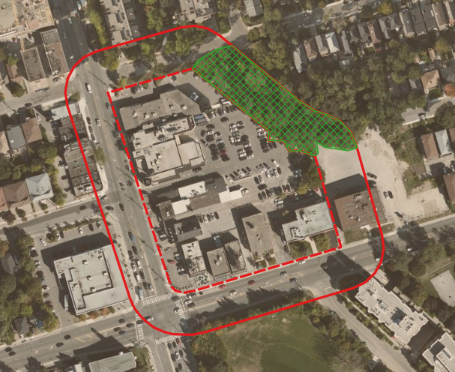

Anecdotal Evidence
(Case Study 1)
Midtown Toronto

Slide 17
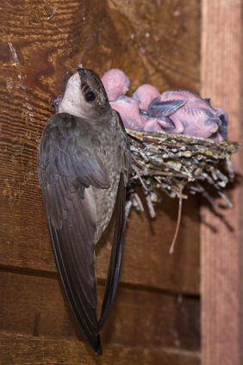
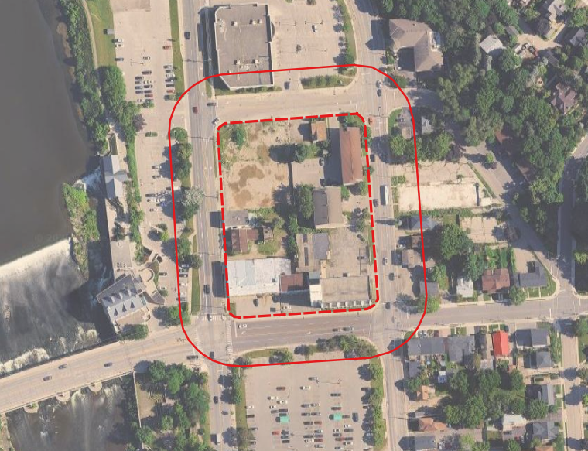
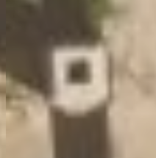
Anecdotal Evidence
(Case Study 2)
Southwest Ontario (urbanized area)

Slide 18
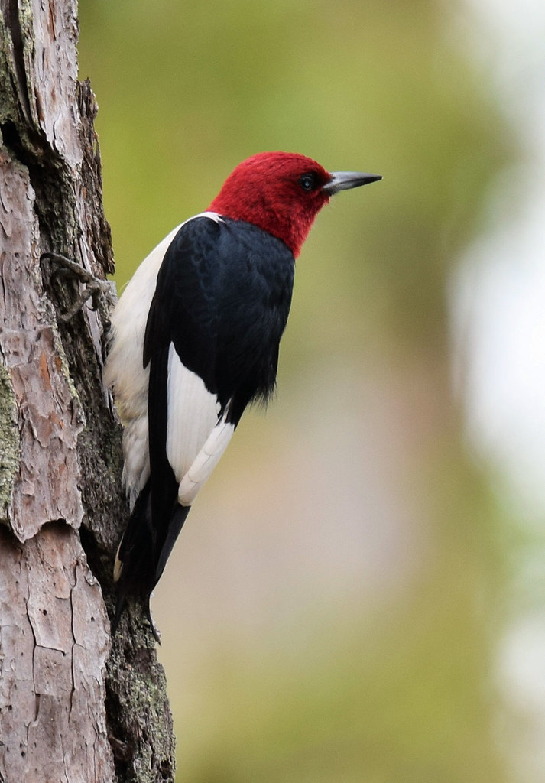
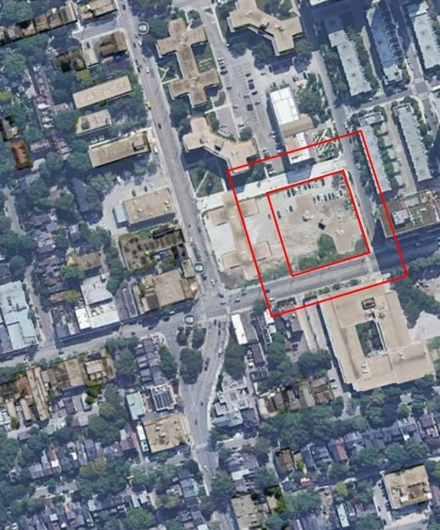
Anecdotal Evidence
(Case Study 3)
Downtown Urban Area
SAR screening identified possible habitat of Red-headed Woodpecker
Site visit by an ecologist did not identify any evidence that the trees on or within 30 m of the property were suitable woodpecker habitat

Slide 19
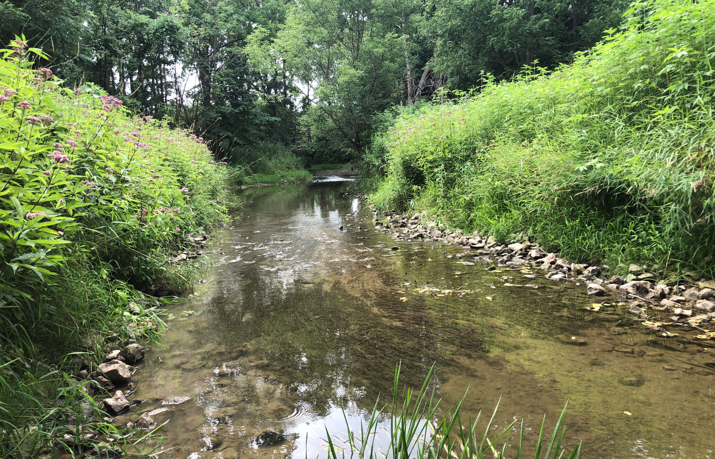
Conclusions
Species at Risk screening by individuals with the appropriate skills, knowledge, and competencies is necessary, even in urban locations.
The potential presence of bat habitat is probably having a noticeable increase in the identification of potential habitat of threatened or endangered species, at least in rural locations.
Current difficulties in differentiating between bat species is likely to pose a significant challenge in the selection of SCS and ESQS, particularly in rural areas.

Slide 20
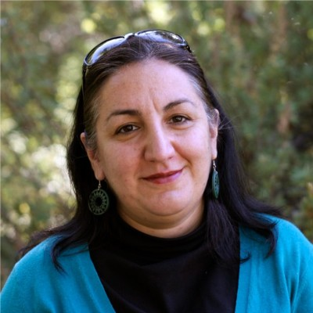


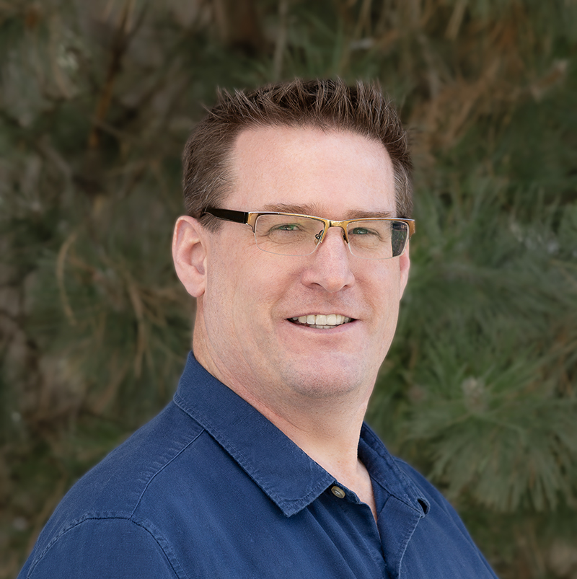
Roxana Khoshravesh, Ph.D.
Ecologist
Environmental Services, Terrapex
Michelle Letourneau, M.Sc.
Manager, Ecological Services
Environmental Services, Terrapex
Acknowledgements and thanks
Elizabeth Madden, P.Eng., QP_{ESA}, QP_{RA}
Manager, Risk Assessment
Environmental Services, Terrapex
Oliver “Ollie” Owens, P.Geo., QP_{ESA}
Manager, Site Assessment and Remediation
Environmental Services, Terrapex
20

Slide 21
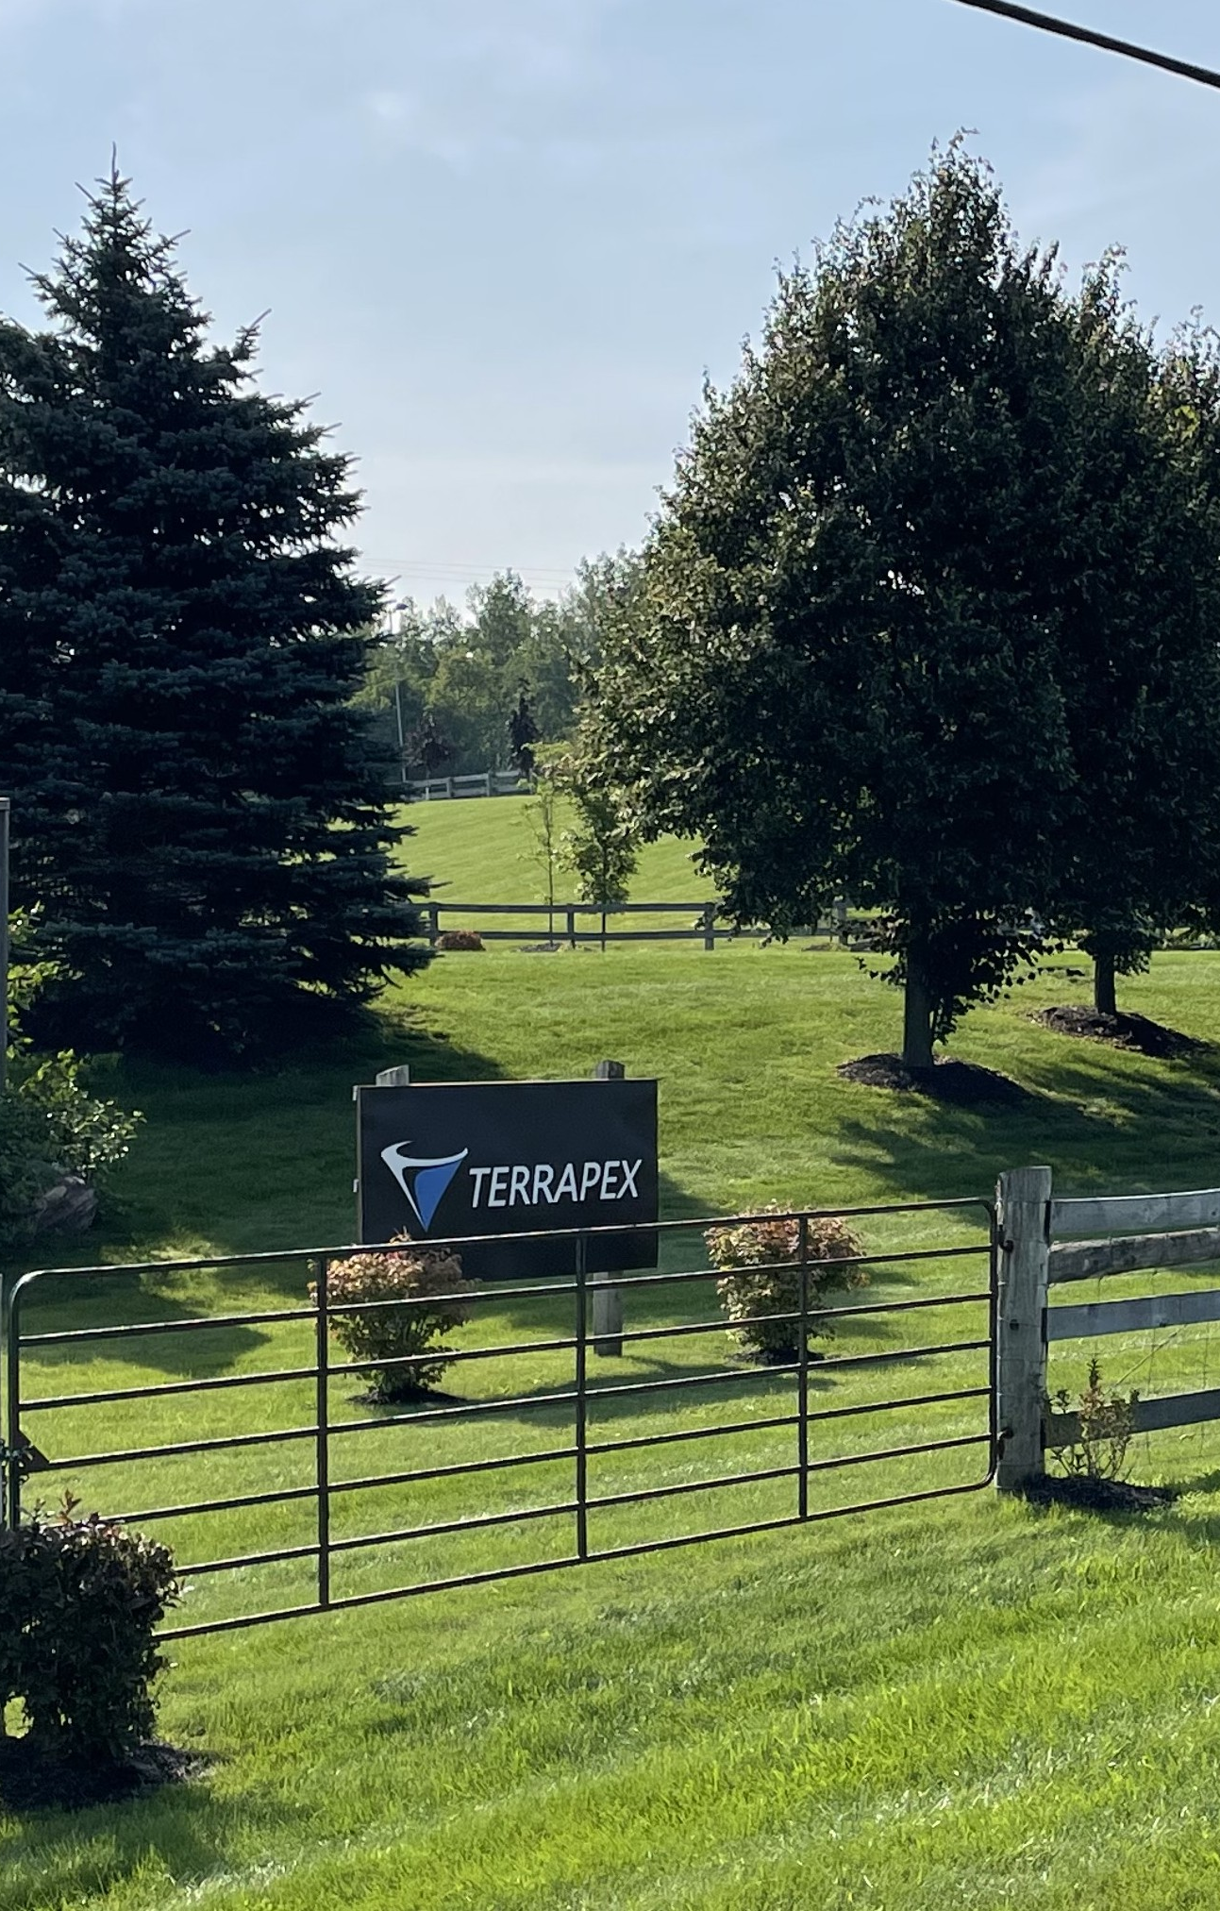


Thank you!
Peter Sutton, P.Eng.
Vice President, Environmental Services
(416) 245-0011
P.Sutton@terrapex.com
https://www.linkedin.com/in/petersutton/
21

