Slide 1

Converting PFAS-Impacted Landfill Leachate Waste from a Liquid to a Solid: Using Full-Scale Foam Fractionation and Media SuperLoading to Minimize Waste and Reduce Risk

Slide 2

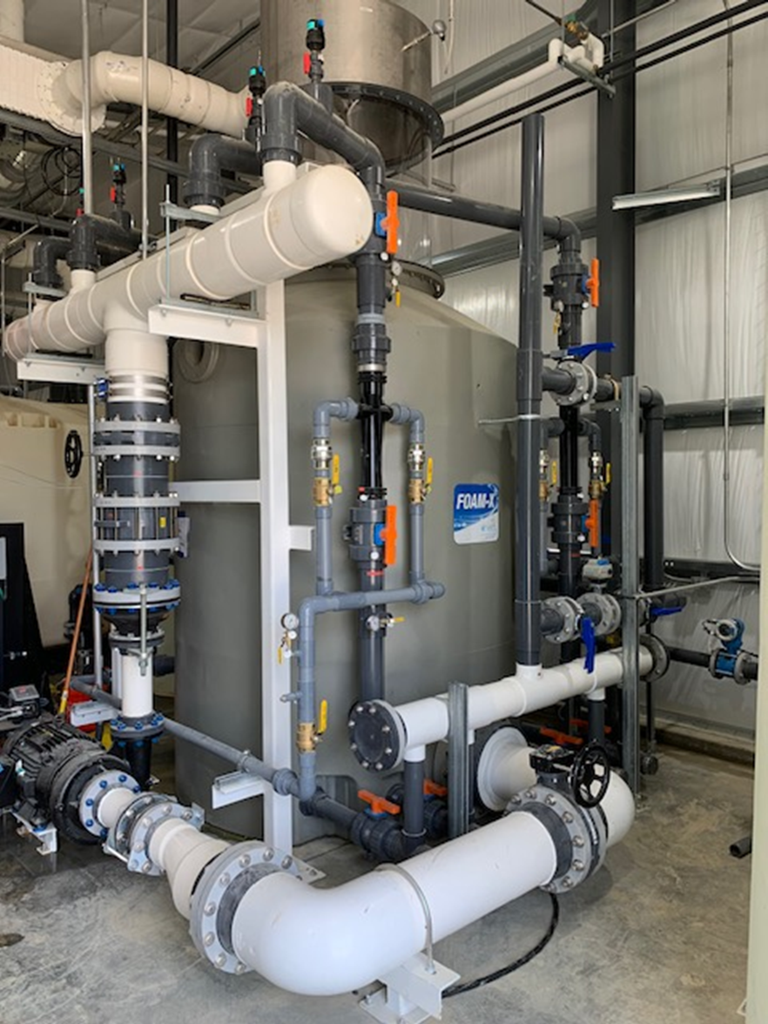
Presentation Overview
Foam fractionation 101
Case study: full-scale treatment of landfill leachate over two-year period
Effectiveness
PFAS waste produced
Superloading media treatment to convert liquid waste to a solid waste
Options for PFAS waste
PFAS retention in solid waste
Breaking the PFAS cycle = reduce risk

Slide 3
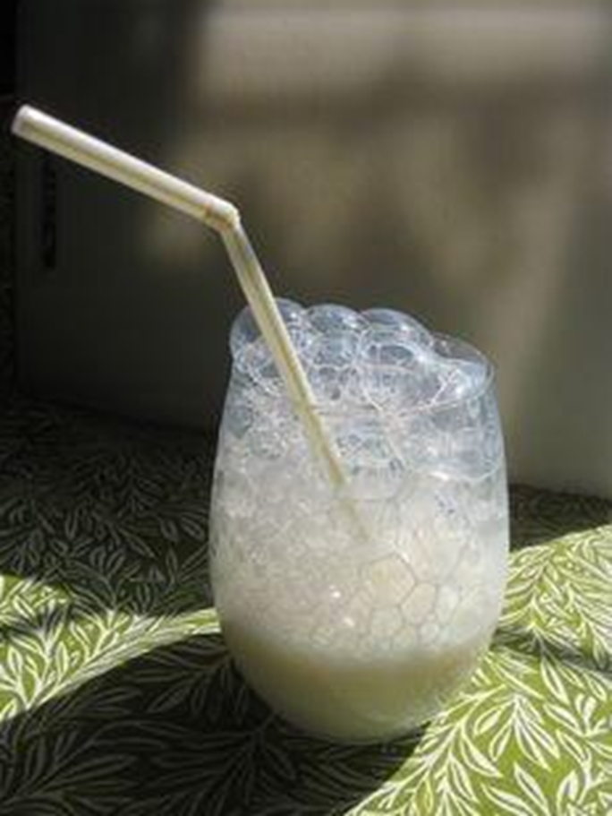
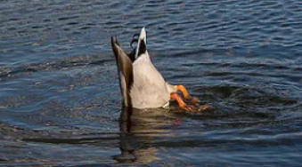
Foam Fractionation 101
Leverages hydrophobic properties of PFAS compounds to remove from water using air
Bubbles are introduced at base of water column flow countercurrent
PFAS binds to the bubbles (head in the water, tail in the air – like a duck)

Slide 4
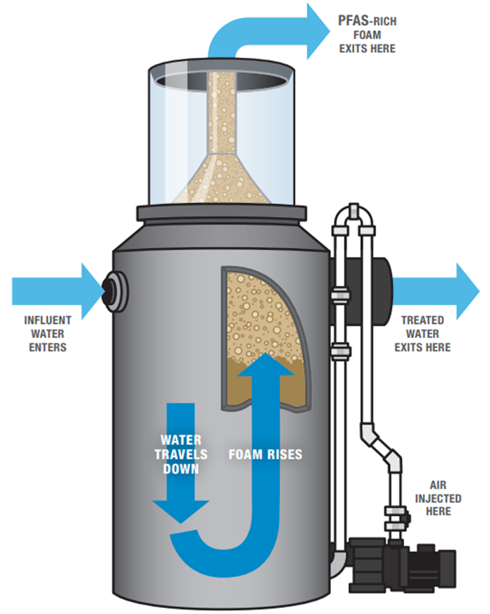
Foam Fractionation 101
Foam contains highly-concentrated PFAS
Foam can be further concentrated, loaded onto a solid media, or destroyed as a liquid
Works very well on "long-chain" PFAS
Unlikely to get fouled, easy to maintain
Great technology for landfill leachate, complex industrial wastewater

Slide 5
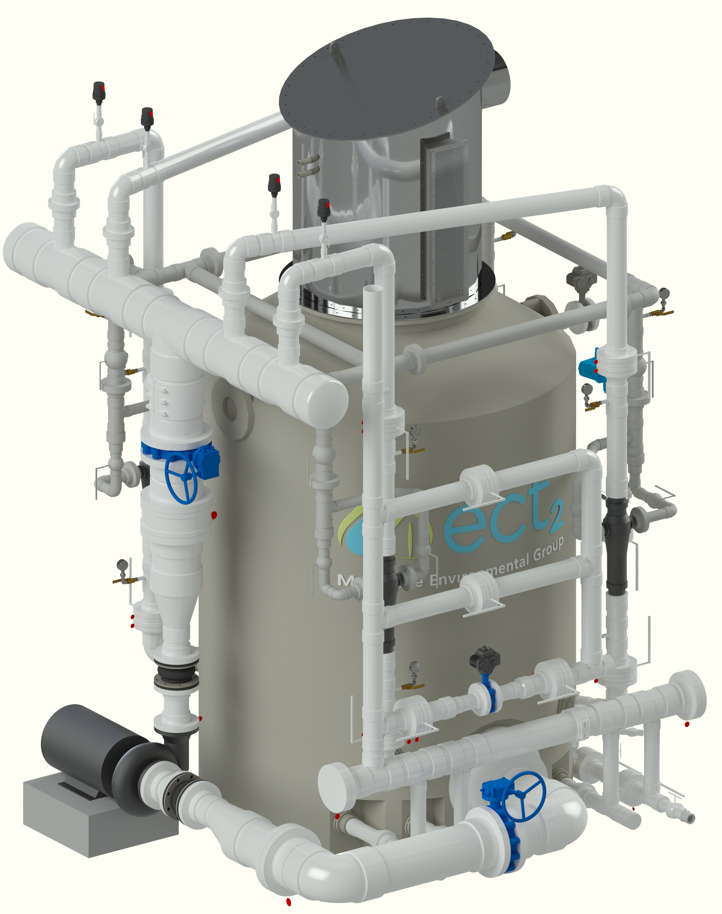
Equipment: FOAM-X™ 3000
Compact design for high throughput in small footprint
Continuous flow-through process (not batch)
Can be installed in existing buildings, along with ancillary equipment (e.g. blowers, chemicals, etc.)
Modular – can be installed in parallel/lead-lag to meet flows/treatment targets
Outpacing all other foam fractionation technologies for PFAS removal in terms of flow treated and online operational experience
Hydraulic Capacity Flow Range (L/s)
Standard | XL
3-10 | 5-15

Slide 6
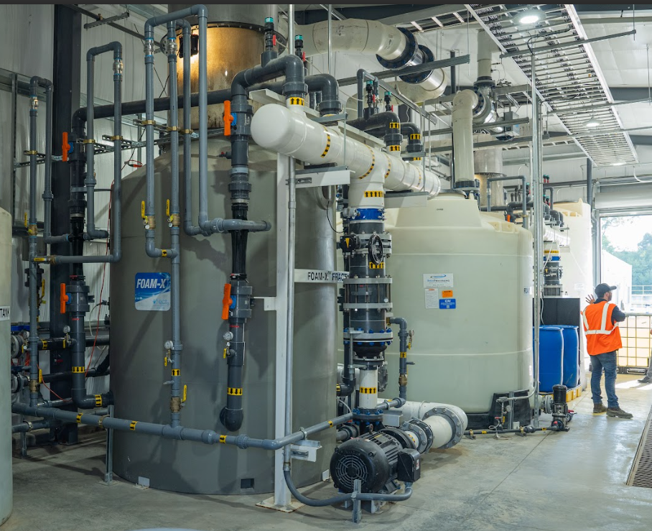
Case Study: Full-Scale Treatment of Landfill Leachate
Treatment at 0.4 ML/day
24/7 operation since 2024
155 ML of leachate treated to date
Dual-stage FOAM-X 3000 with SuperLoader solution concentrating liquid residuals on to solid media
Online since Summer 2024
Customer's goal:
Remove 50% Total PFAS mass
Abate accumulation of PFAS in landfill

Slide 7

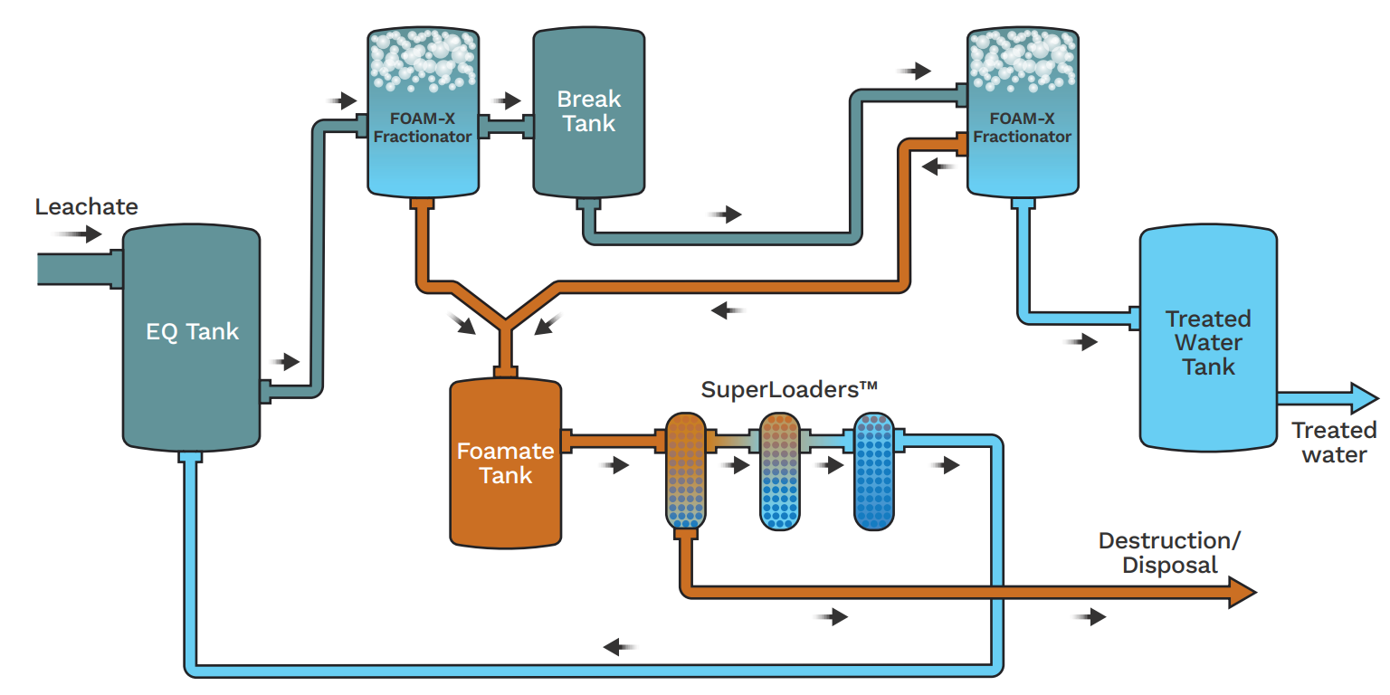


System Process Flow Diagram

Slide 8
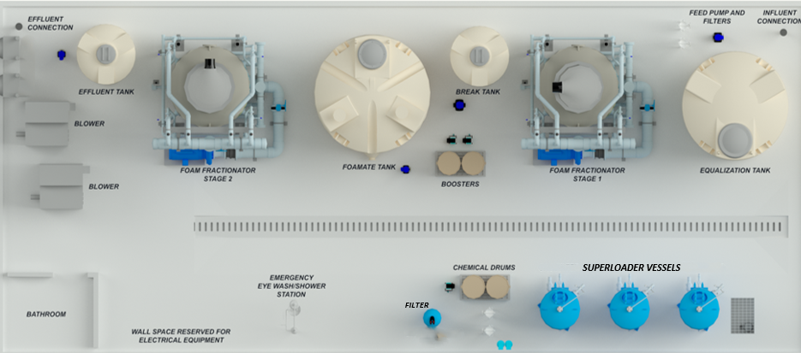
Full Scale Two-Stage FOAM-X System Layout
20 m x 8 m footprint

Slide 9
Successful System Startup and Optimization

Slide 10
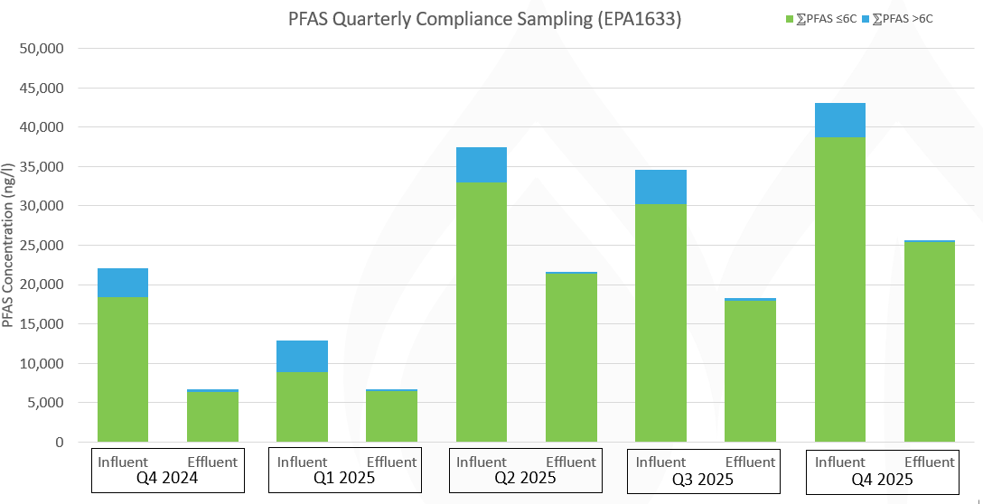

Quarterly Compliance Results: Meeting Treatment Objectives Total PFAS Influent vs. Effluent
PFAS Quarterly Compliance Sampling Results (EPA1633)
ƩPFAS ≤6C
ƩPFAS >6C

Slide 11
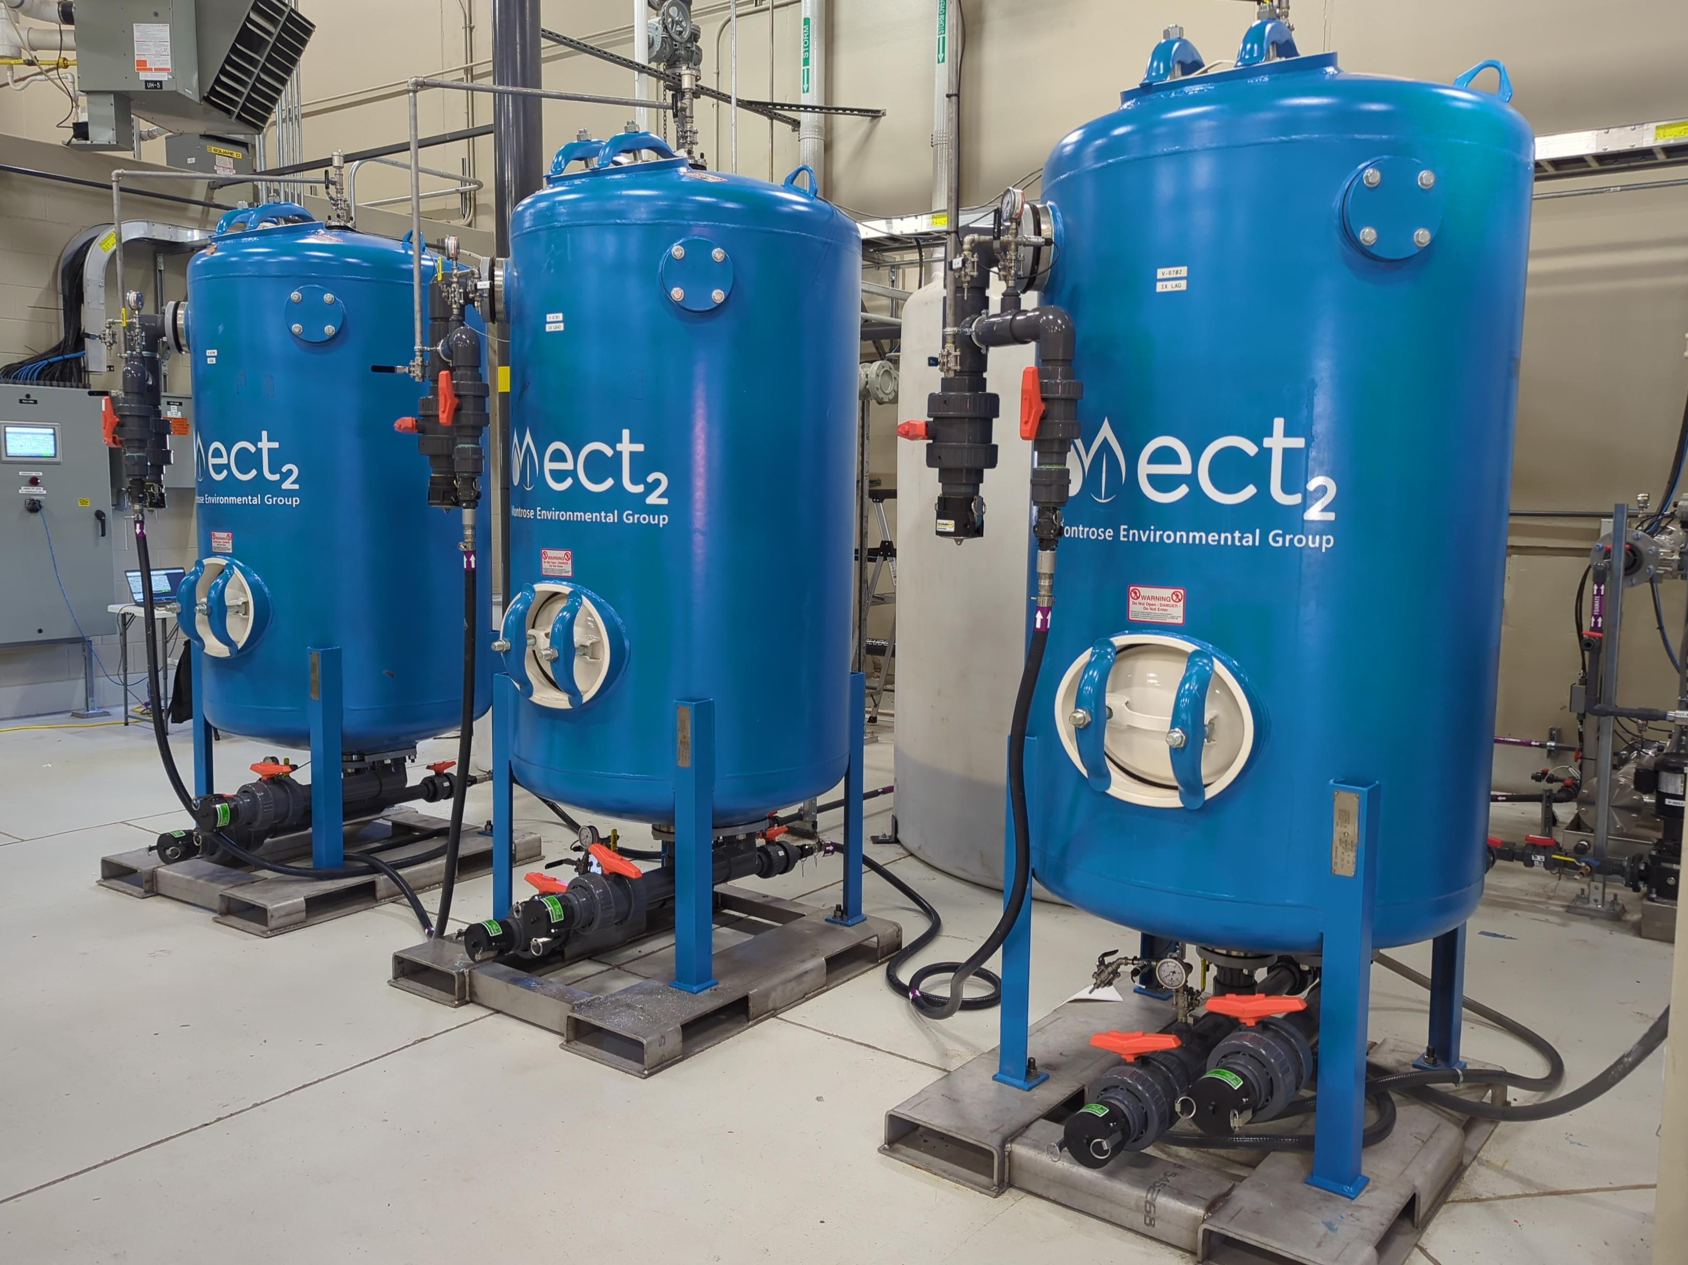
What Happens to the PFAS?
Liquid concentrated foamate from the FOAM-X fractionator is loaded onto our selective media
SuperloadingTM generates a solid waste vs liquid concentrate
Cost-effective and rapidly-mobilized residuals treatment method
Can be replaced with destruction technology in the future if desired
Treating up to 0.3 L/s of primary foamate
Fully automated, continuous flow-through

Slide 12

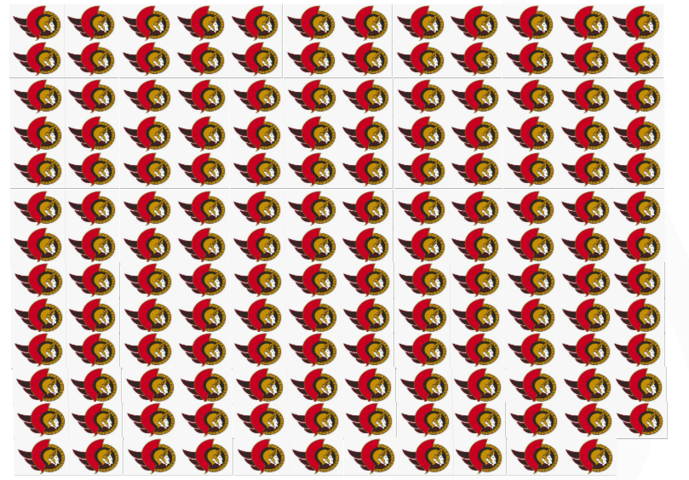
Concentration Factor: Volume of Leachate Treated to Residuals Created
One Ottawa Senator = 1 Million Liters
155 million liters leachate treated
0.03 million liters residuals created
5,000:1 concentration factor

Slide 13
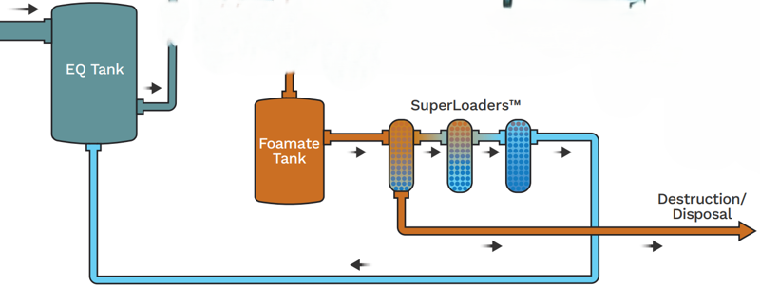
SuperLoader Case Study Results at 400 Bed Volumes (~3 mo.)
Leachate + SL Recycle to Fractionators
100% of Total PFAS Influent Mass
Primary Foamate from Fractionators
5% of Total PFAS Influent Mass
To Landfill

Slide 14
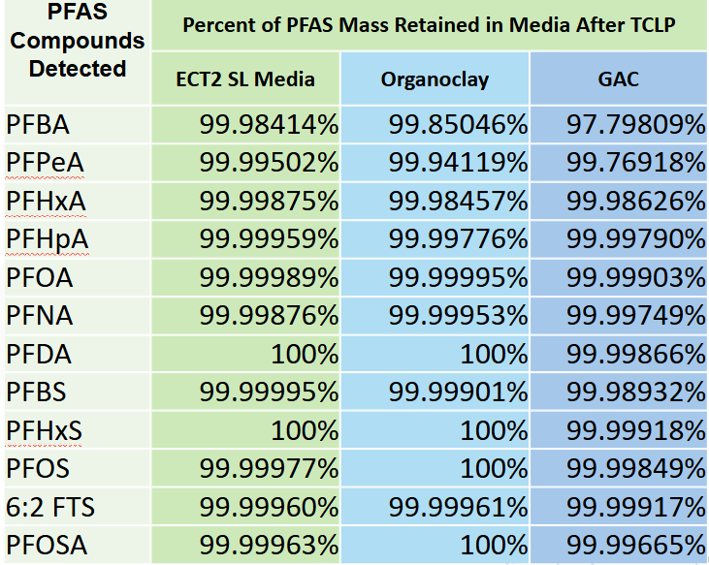
Does PFAS Desorb from SuperLoaded Media?
Methodology:
Standard EPA TCLP
Loaded PFAS mass consistent (1.83 – 1.86 mg/g) across three media
PFAS analysis using EPA 8327M
All three media types tested exhibited very low desorption of long-chain PFAS

Slide 15
SuperLoaded Media Leaching Test Results Summary
Desorption Testing Results:
ECT2 SL Media desorption rate was lowest of the media tested
Organoclay desorption mass 8x the ECT2 media
GAC desorption rate was the highest of the media tested (72x the ECT2 SL Media)
Total PFAS Mass Desorbed in TCLP Test
ECT2 SL Media | Organoclay | GAC
0.002% | 0.016% | 0.144%
8x
72x
Using ECT2 SuperLoader technology PFAS is solidified and captured on-site

Slide 16


Conclusions
Removal: foam fractionation is effective
Concentration: creates a PFAS-rich liquid waste
Superloading: media treatment turns a liquid waste into a solid waste suitable for destruction or disposal
PFAS Retention: leaching data from SuperLoaded media to confirm we are breaking the PFAS cycle
BREAK THE
PFAS CYCLE!

Slide 17
Thank You!

